Slide 1

Just a thing I remembered exists...
https://www.nso.upenn.edu/take-your-professormentor-program-students

Slide 2
CIS 700-004: Lecture 15W
Sarcasm Presentation
4/24/19
Notes:
Done

Slide 3
The dataset

Slide 4
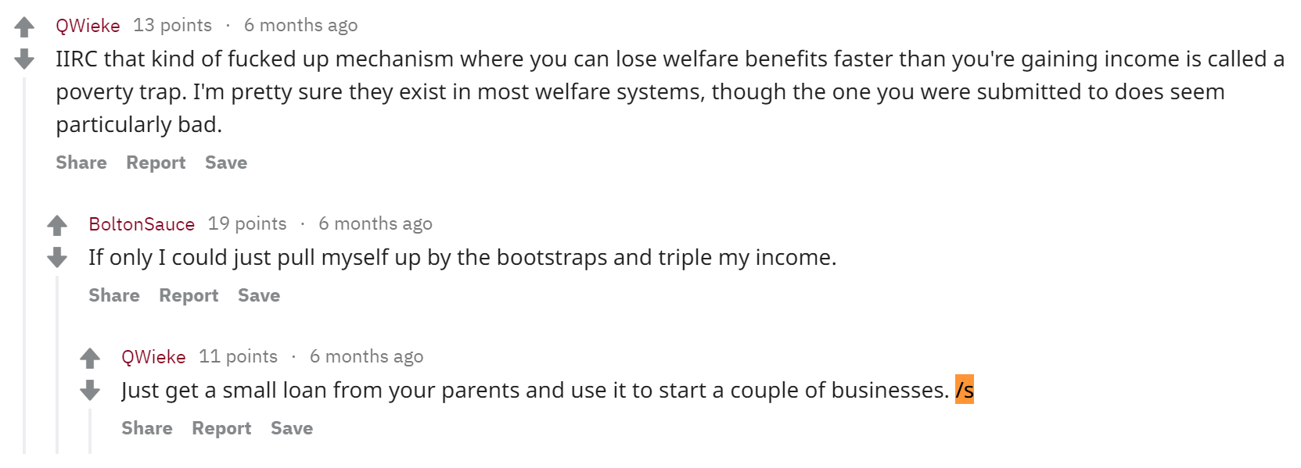

Slide 5
Parent
Child

Slide 6
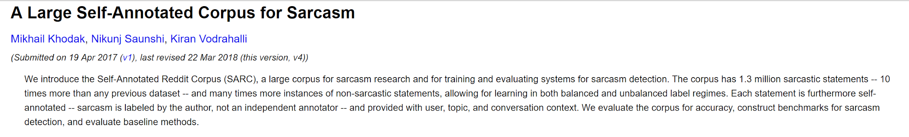
Dataset source

Slide 7
Summary stats of the dataset
707579 training examples
303248 test examples
Artificially balanced: 50% labeled true; 50% labeled false

Slide 8
Thinking about the dataset

Slide 9

Sarcasm is hard and confuses Reddit.
Parent
Child

Slide 10
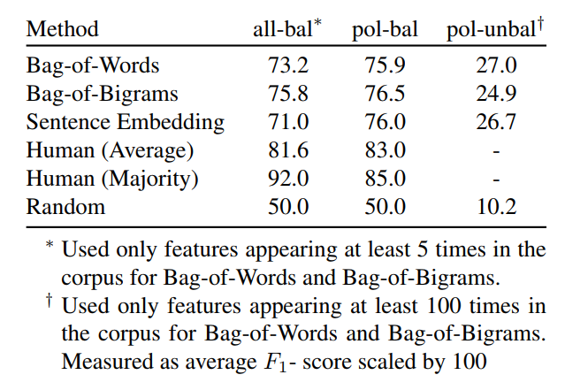
No, really, sarcasm is hard.

Slide 11
Why is SARC so hard?
Context is difficult to understand (AI-hard).
Not all of the context is even present in the dataset.
Not every example is labeled correctly.

Slide 12
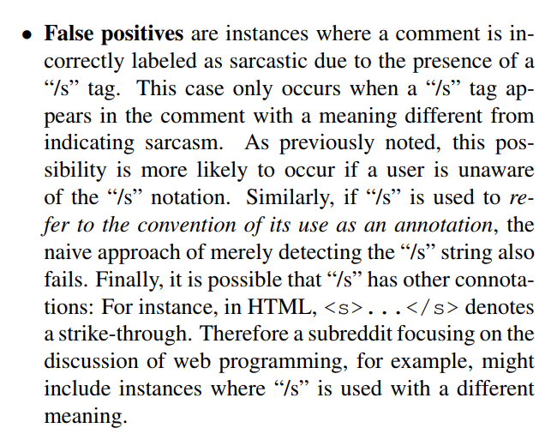
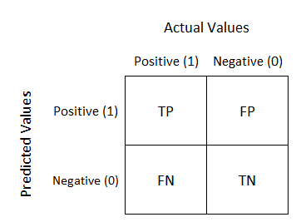
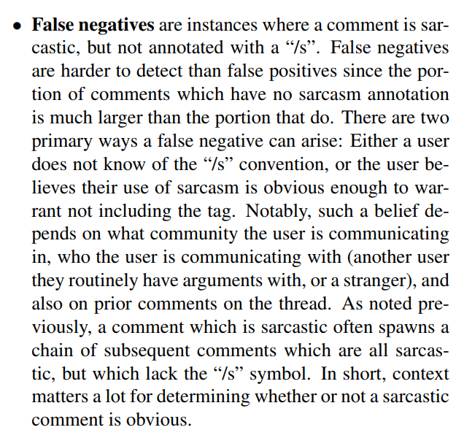
Consider the confusion matrix for the "/s" proxy.

Slide 13
Consider the confusion matrix for the "/s" proxy.
We can't use accuracy. We should use F1.

Slide 14
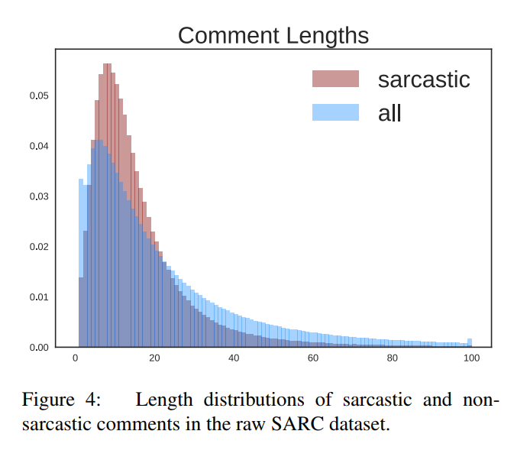
Hypothesis: sarcastic comments tend to be short.

Slide 15
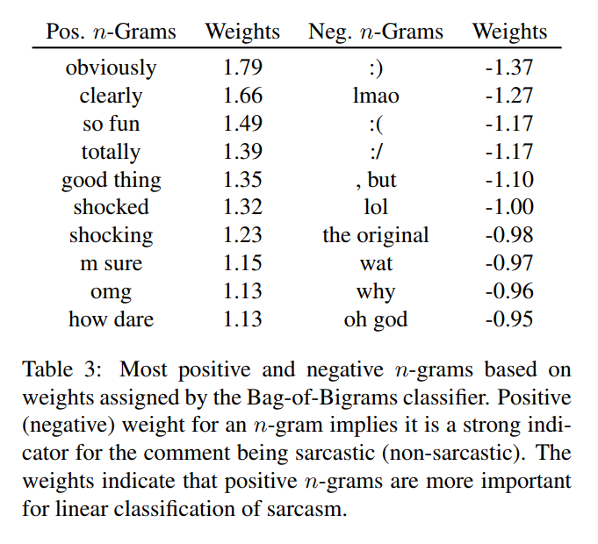
Hypothesis: certain words are signals for sarcasm.
A lot of question marks and exclamation marks might indicate that the comment is sarcastic.
-- Aditya Kashyap

Slide 16
Hypothesis: capitalization is a signal for sarcasm.
Comments whose words are all capitalized (like "OMG, WHAT’S NEXT, KISSES?", "ZOMG!") are more likely to be sarcastic.
-- Yinchuan Xu, Keyu He

Slide 17
Hypothesis: sentiment is somehow related.
A mismatch in expected sentiment may be an indicator of sarcasm.
-- Pedro Ribeiro, Ilenna Jones
We also believe that mixed uses of positive and negative emotions can also be an indicator.Examples can be ”how I like to be ignored” and ”thanks for nothing.”
-- Harsha Uppili, Mingyung Kim
In comedy, it is theorized that humor is found in setting up an expectation and then subverting it. We would surmise that sarcasm is similar, in that it sets up a sentiment and then subverts it.
-- Sam Oshay

Slide 18

Hypothesis: sarcastic comments quote their parents.
Sarcastic comments will have contextual information from the parent com-ment and often it would have repeated words from the parent comment. A phrase would often be repeated from the parent comment.
-- Dhruv Desai, Rahul Shekhar

Slide 19
How do we encode the parent->child structure?

Slide 20
Option 1: just pass the child into the model.
Parent
If only I could just pull myself up by the bootstraps and triple my income.
Model
Child
Just get a small loan from your parents and use it to start a couple of businesses. /s
Label

Slide 21
Option 2: concatenate the parent and the child.
Model
Parent
If only I could just pull myself up by the bootstraps and triple my income.
Input
If only I could just pull myself up by the bootstraps and triple my income.
*****
Just get a small loan from your parents and use it to start a couple of businesses. /s
Child
Just get a small loan from your parents and use it to start a couple of businesses. /s
Label

Slide 22
Option 3: model the parent and child separately.
Reduce the parent and the child to fixed length with separate models. Concatenate the fixed-length embeddings.
Parent model
Parent
If only I could just pull myself up by the bootstraps and triple my income.
Parent embedding
Model
Child
Just get a small loan from your parents and use it to start a couple of businesses. /s
Child model
Child embedding
Label

Slide 23
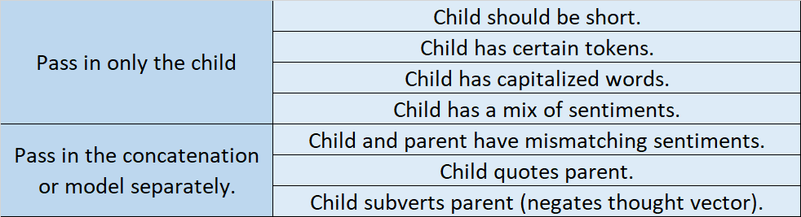
Data hypotheses and encodings.

Slide 24
How do we model the natural language data?

Slide 25
Option 1: use a logistic regression.
GloVE 100d
Mean Pool
Input Sequence
Featurized Input Sequence
Sequence "Embedding"
Logistic Regression
Label

Slide 26
Option 1: use a logistic regression.
GloVE 100d
Mean Pool
Input Sequence
Featurized Input Sequence
Sequence "Embedding"
100
n
nx100
Logistic Regression
1
Label

Slide 27
Option 2: use a CNN.
GloVE 100d
Input Sequence
Featurized Input Sequence
Conv filter
Kernel=3, features=20
Conv filter
Kernel=4, features=20
Conv filter
Kernel=5, features=20
Max Pool
Feedforward Net
Convolution Features
Pooled
Features
Label

Slide 28
Option 2: use a CNN.
GloVE 100d
Input Sequence
Featurized Input Sequence
nx100
n
Conv filter
Kernel=3, features=20
Conv filter
Kernel=4, features=20
Conv filter
Kernel=5, features=20
Max Pool
Feedforward Net
Convolution Features
Pooled
Features
Label
nx60
60
1

Slide 29
Option 3: use an LSTM.
GloVE 100d
LSTM
Input Sequence
Featurized Input Sequence
Label
n
nx100
1

Slide 30
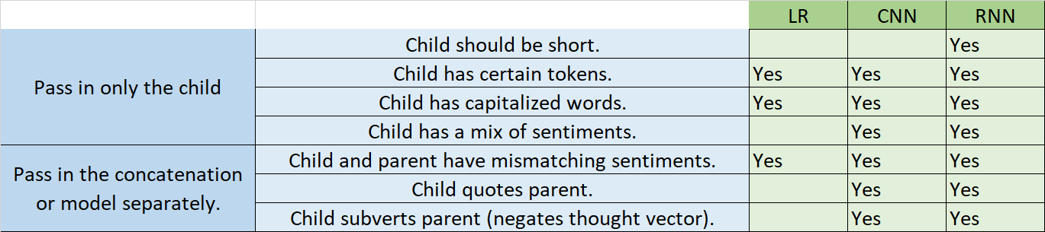
Data hypotheses, encodings, and models.

Slide 31
Model performance

Slide 32
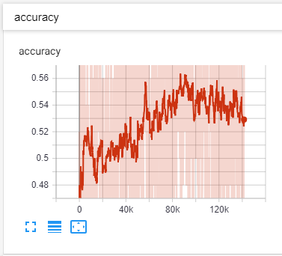
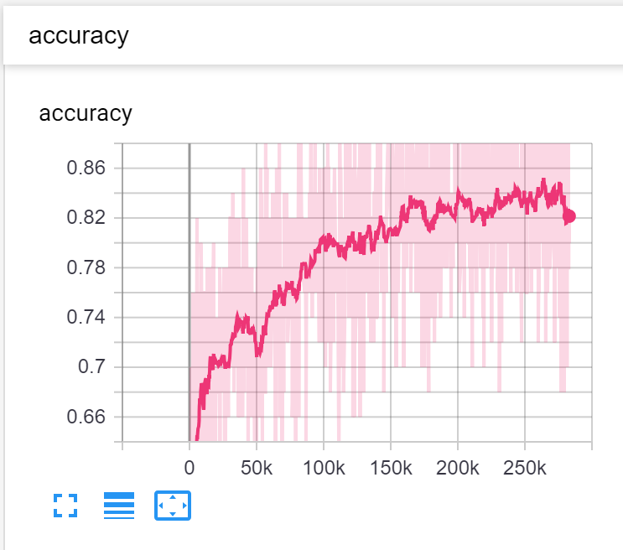
Example learning curves (smoothing = 0.95)

Slide 33
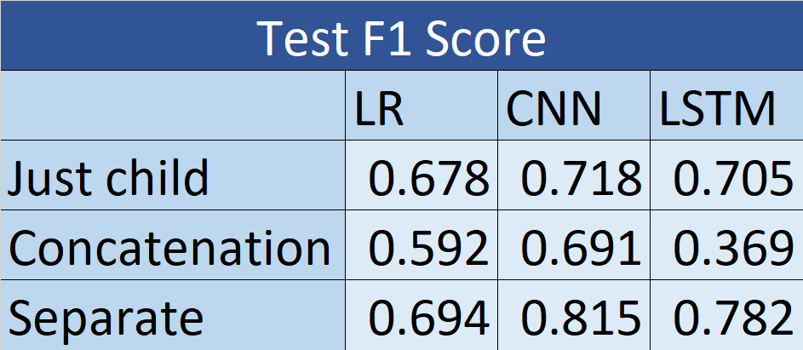
Overall performance

Slide 34
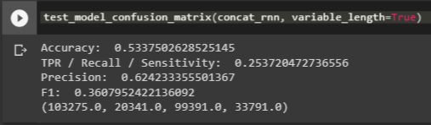
Overall performance
Best performance is CNN-separate.
Concatenation is strictly worse than just the child.
Concatenated LSTM is truly awful.

Slide 35
Sanity-checking the models

Slide 36
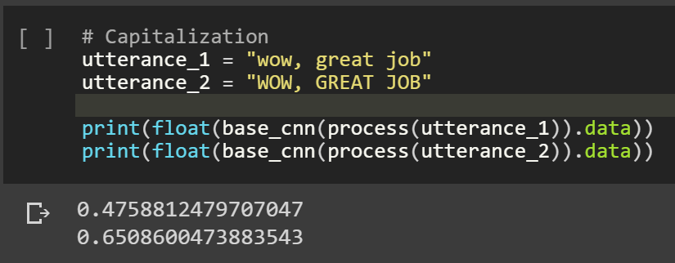
Capitalization slightly increases Pr[sarcasm].

Slide 37
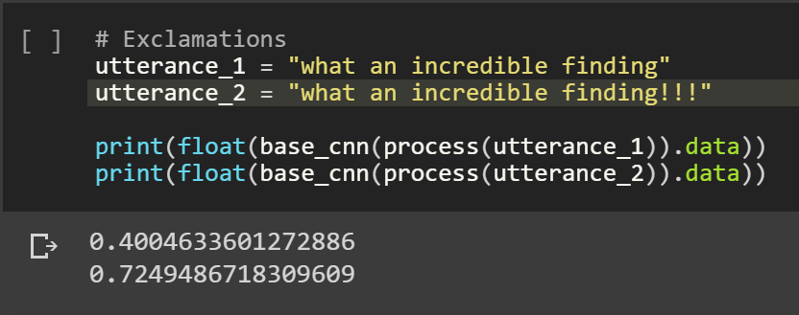
Repeated punctuation really increases Pr[sarcasm].

Slide 38
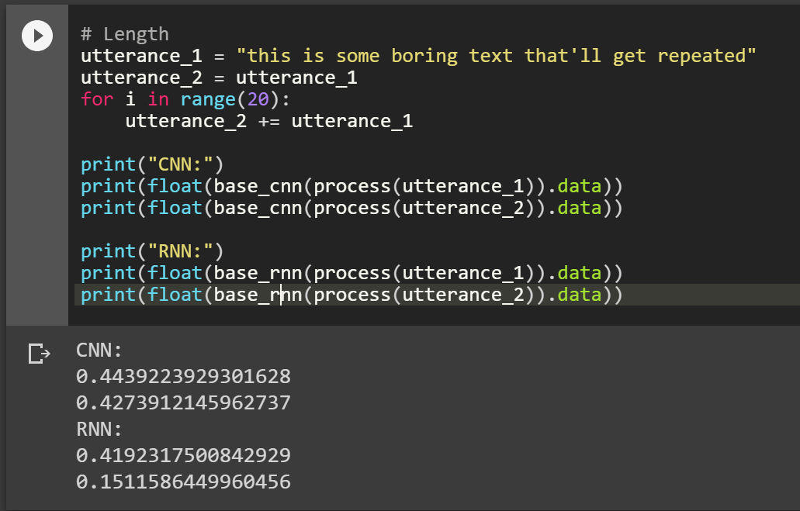
Length really decreases increases Pr[sarcasm].

Slide 39
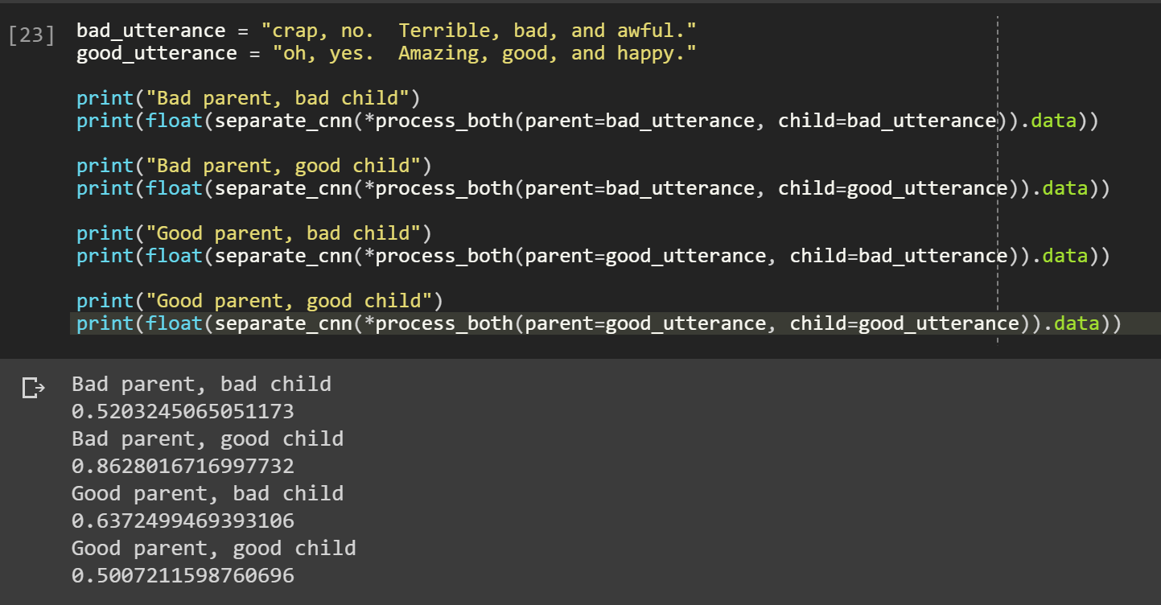
The lone sentiment of the child is not a signal. But the difference of the sentiments is a strong signal.

Slide 40
Major takeaways
NLP is hard.
Carefully pick an evaluation metric that won't bias your results poorly.
In structured problems, data encoding is as important as choice of models.
Use data hypotheses to inform a choice of inductive bias.
It may not be what you expect.
Don't jump to conclusions that simple models will suck.
The mean-pool logistic regression performed pretty much as well as the other models on the solo-child setup. It outperformed the LSTM on the concatenated setup.
Testing data hypotheses is really convincing.

