Slide 1
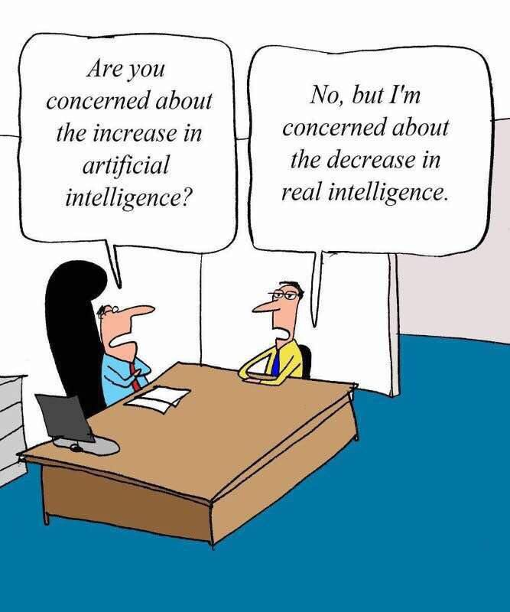

Slide 2
CIS 700-004: Lecture 13W
Neuroscience, Part II
4/10/19
Notes:
Done

Slide 3
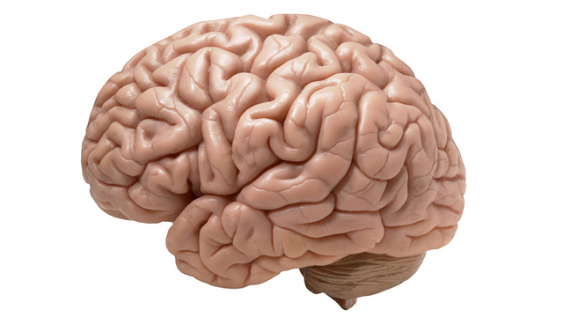
Could the brain do something like backpropagation of error?

Slide 4

What is a learning algorithm?

Slide 5
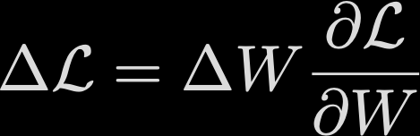
What is a learning algorithm?

Slide 6
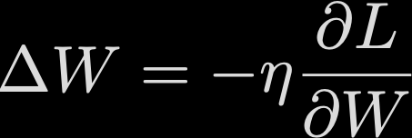
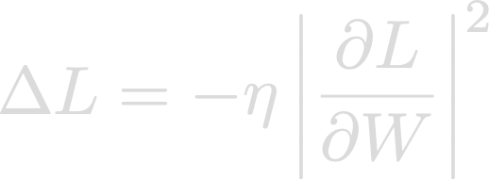

Why backpropagation works

Slide 7
What makes backpropagation a good idea?

Slide 8
What makes backpropagation a good idea?
Greedy for small updates.
Cheap to compute.
Unlikely to find poor local minimum in high dim.

Slide 9
Why is backpropagation bad?

Slide 10
Why is backpropagation bad?
Myopic
Slow
Can get stuck in flat places
In practice, needs modifications like Adam
Lack of meaning/ modularity

Slide 11
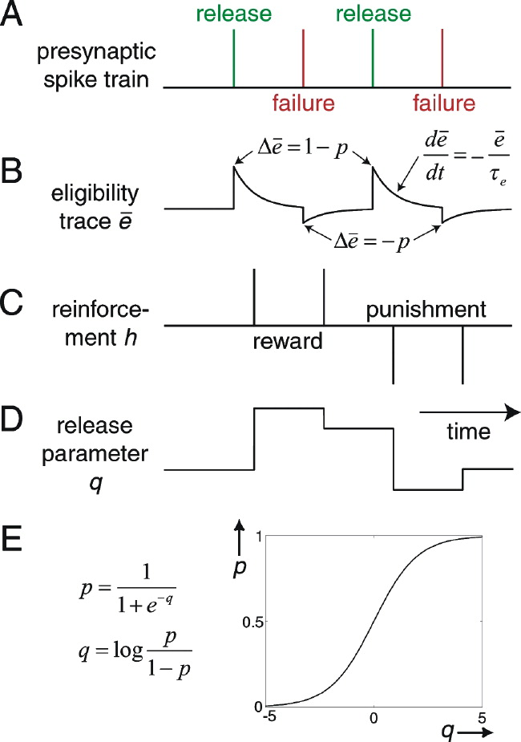
Weight perturbation

Slide 12




A scaling problem

Slide 13
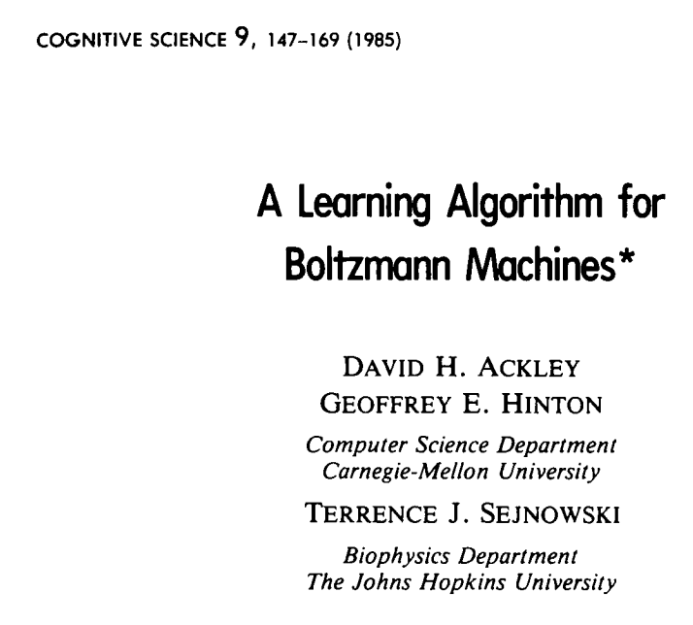
Realistic BP is about as old as BP
Boltzmann machines

Slide 14
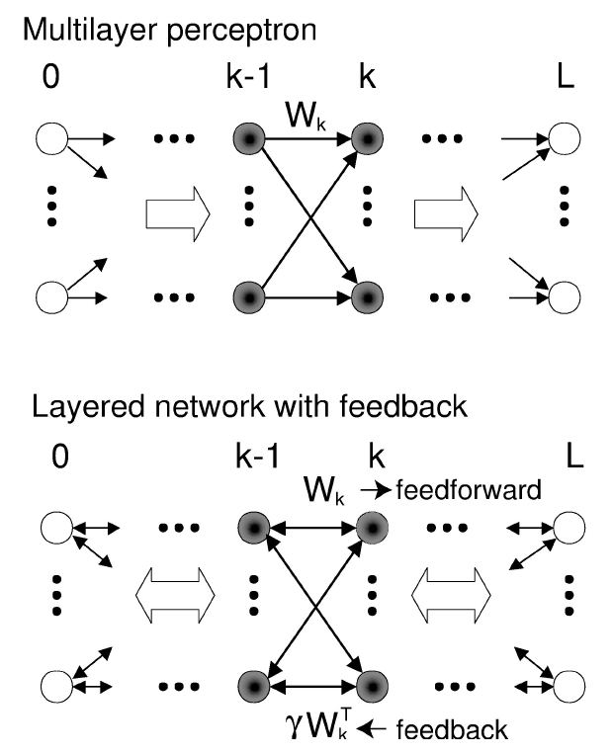
Xie and Seung
Continuous variables

Slide 15
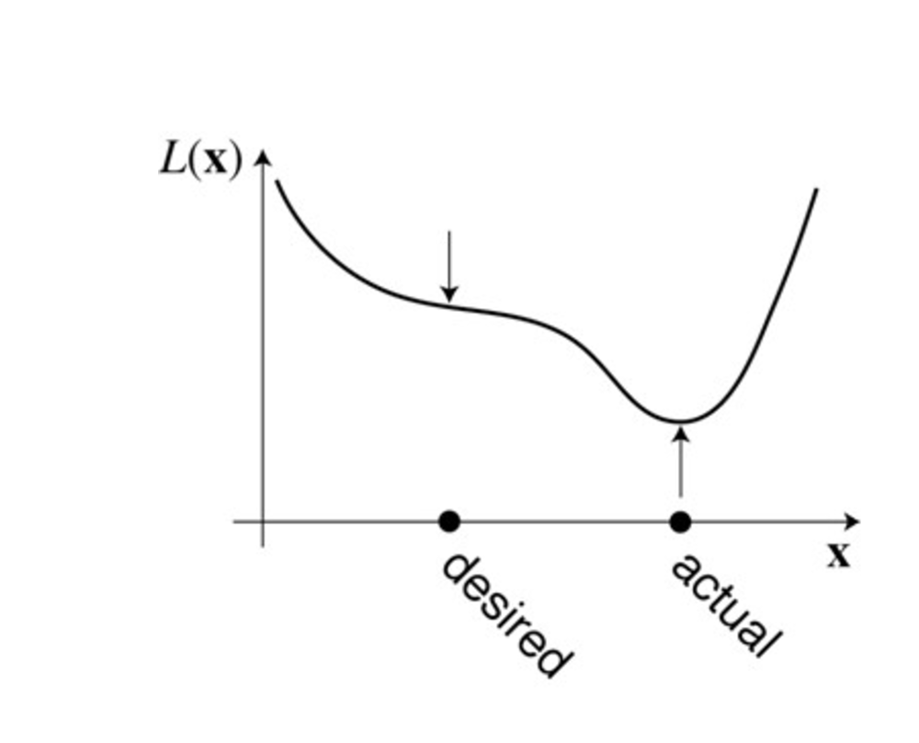
Intuition

Slide 16

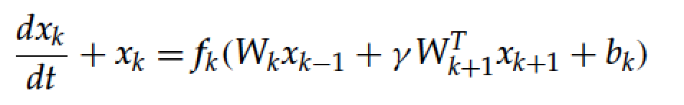


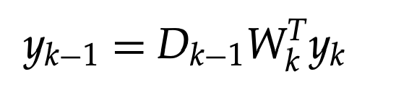
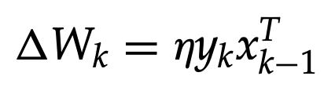

Backpropagation Contrastive Hebbian
But we need two variables, weight symmetry, weak feedback weights, exponentially growing learning rates

Slide 17
Now, let’s get to Equilibrium propagation

Slide 18
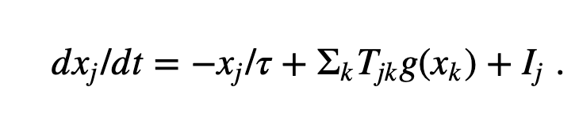
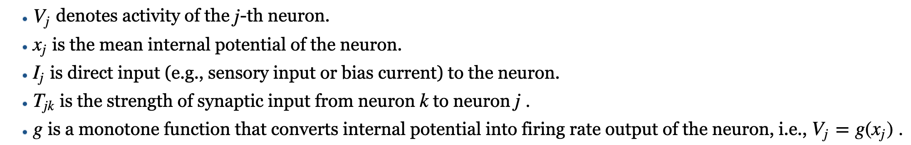
Continuous Hopfield network

Slide 19



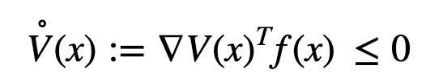
Lyapunov function

Slide 20
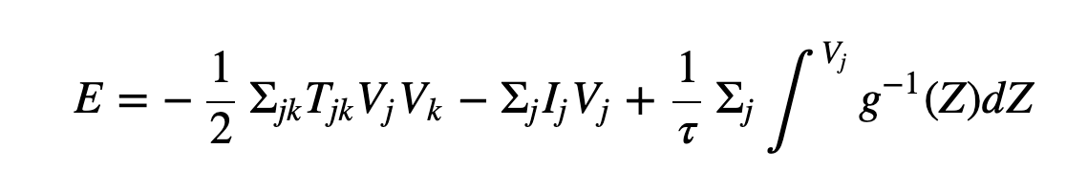
A Lyapunov function for the continuous Hopfield network

Slide 21
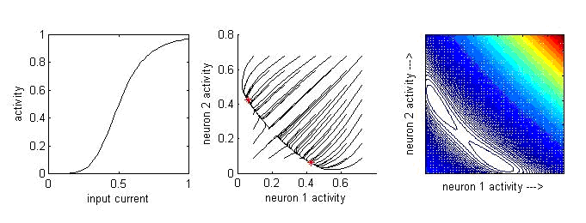
Example
Scholarpedia

Slide 22
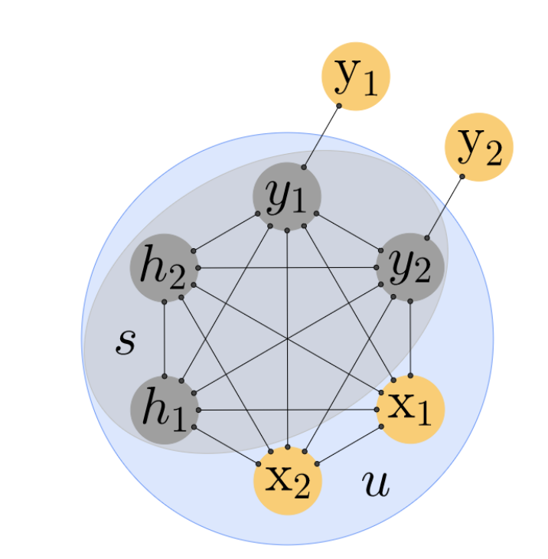
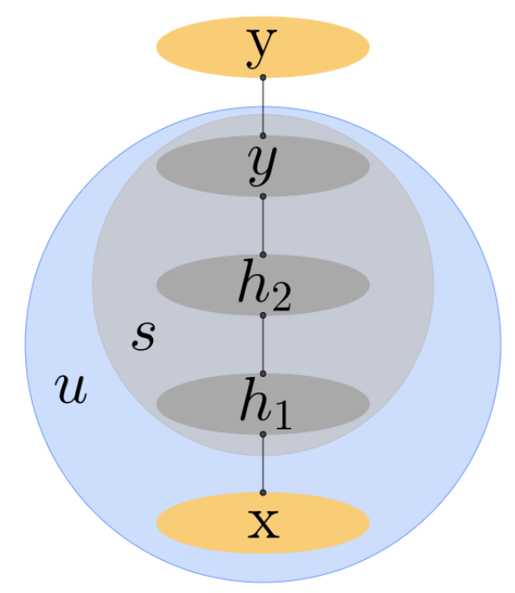
Setup of equilibrium propagation

Slide 23
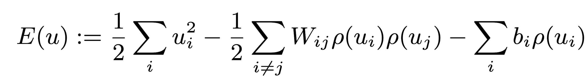
Towards EP

Slide 24
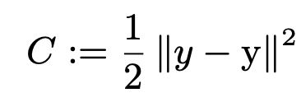
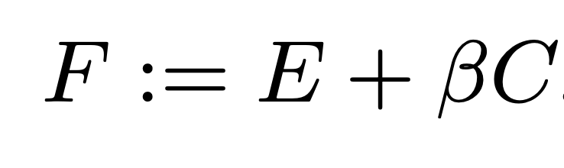
Nudging

Slide 25
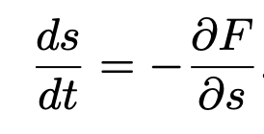
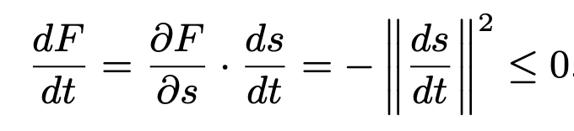
Overall dynamics

Slide 26
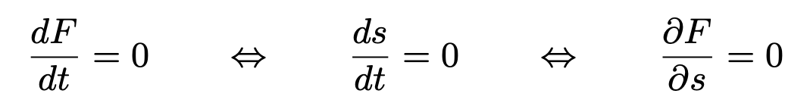
Convergence

Slide 27
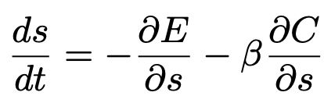
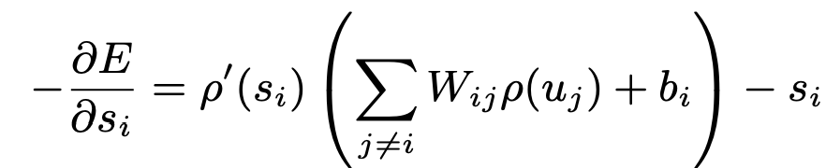
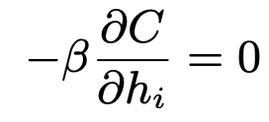
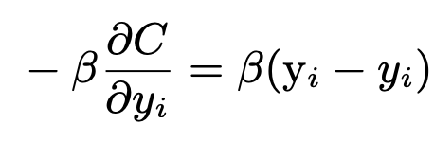
The components

Slide 28
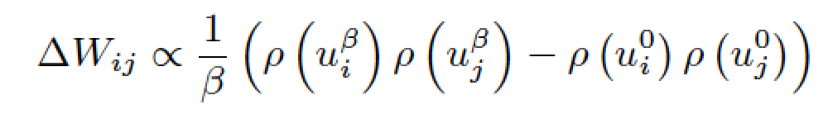
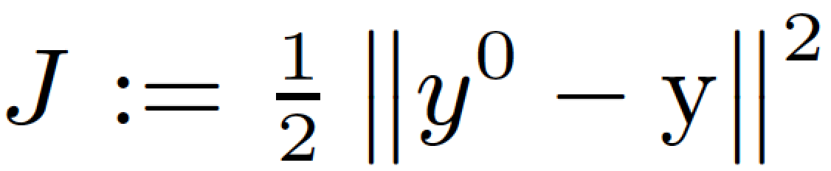
Simple update rule gives rise to SGD
Relation to Xie: strong back-weights, weak clamping

Slide 29
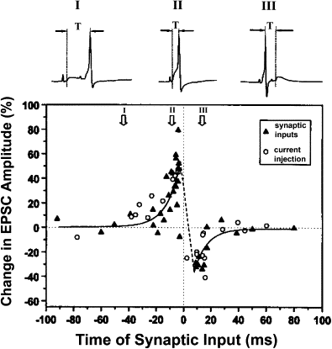
Spike timing dependent plasticity
Yang Dan and Mu-Ming Poo

Slide 30
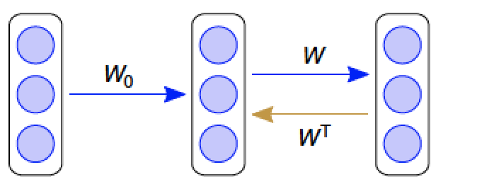
Feedback alignment
Lillicrap Tweed ...

Slide 31
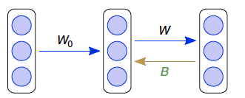
Feedback alignment

Slide 32
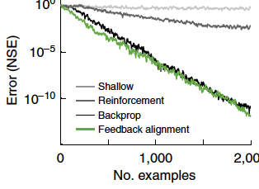
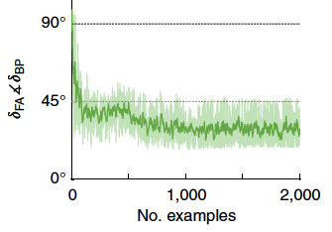
Works on linear problems

Slide 33
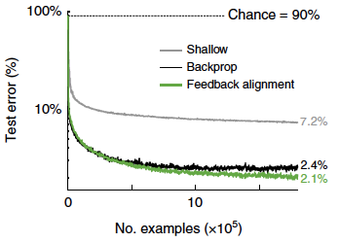
MNIST

Slide 34
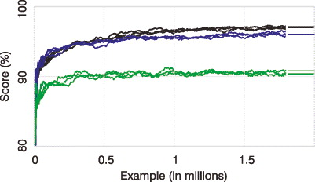
Spiking MNIST
Samadi, Lillicrap, Tweed

Slide 35
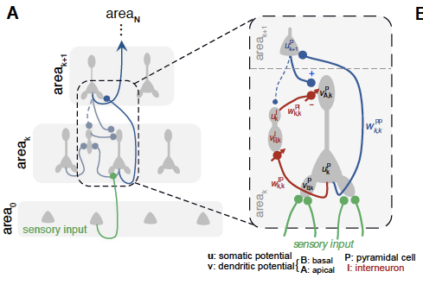
Predictive coding
Senn and Bengio

Slide 36
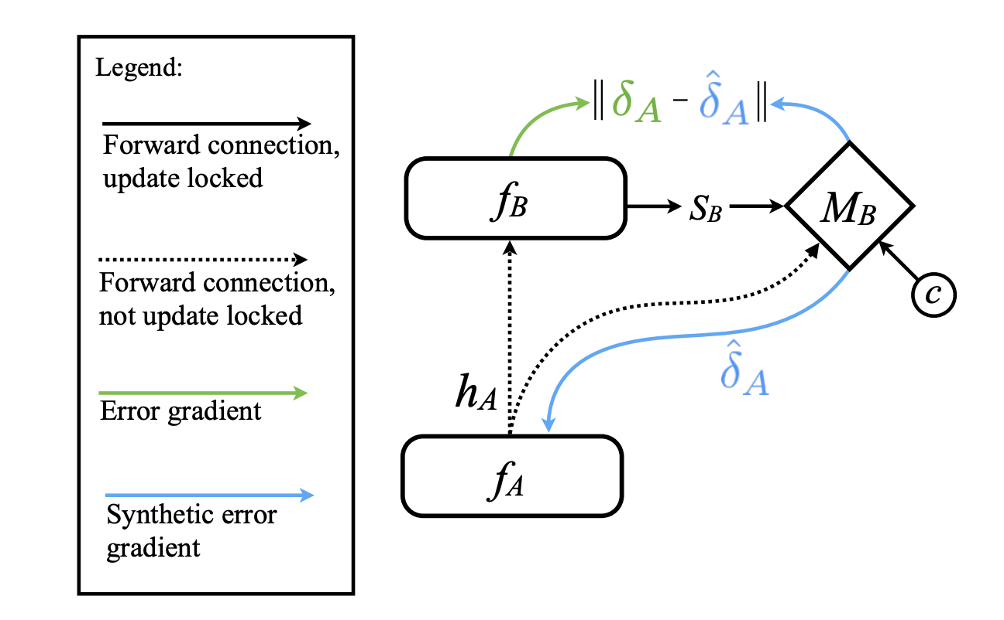
Learning to learn
Simply broadcast the error
Synthetic gradients
Jaderberg et al

Slide 37
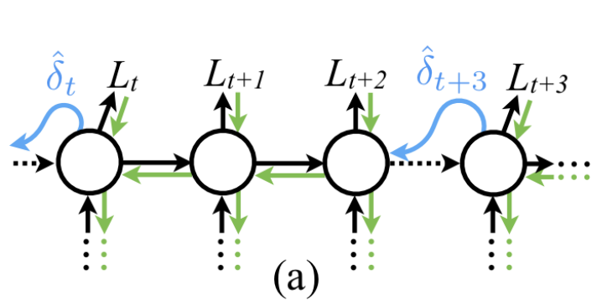
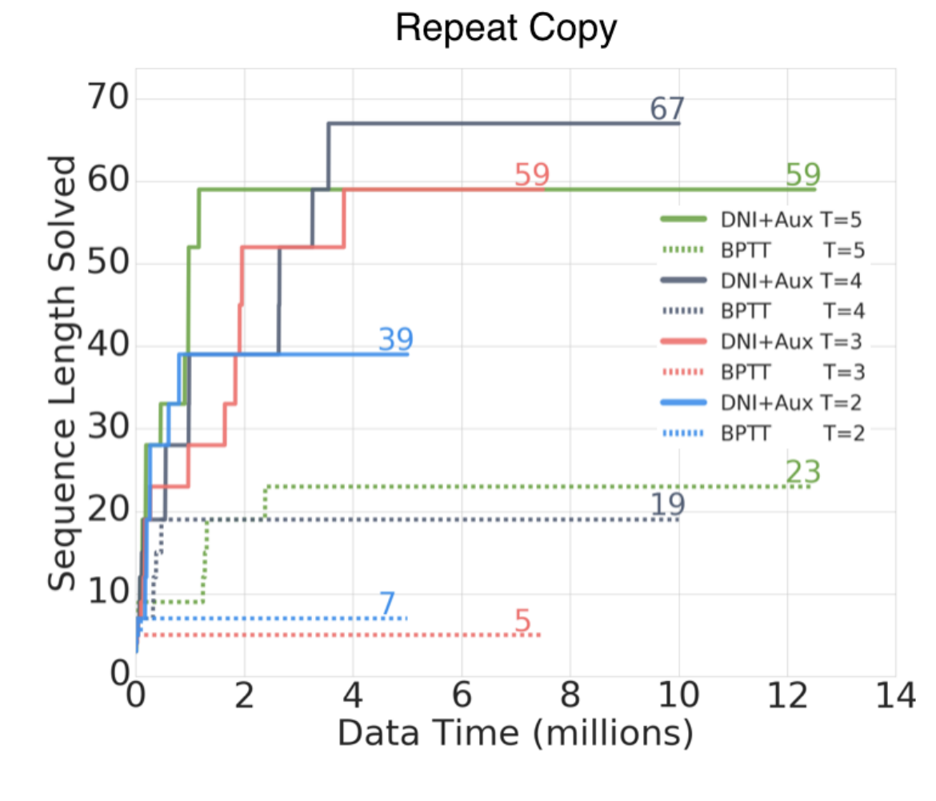
Synthetic gradients

Slide 38
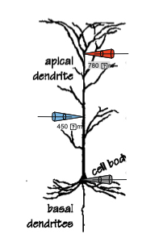
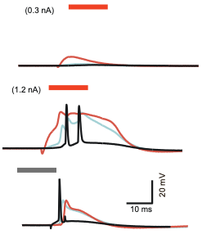
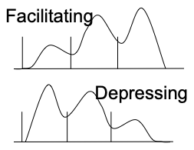
My PhD thesis: multiplexing spikes vs bursts
Larkum ME, Kaiser KM, Sakmann B 1999, Tsodyks & Markram 1997

Slide 39
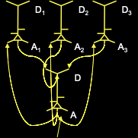
Division of labor
Kording and Konig 2001: supervised and unsupervised learning ...

Slide 40
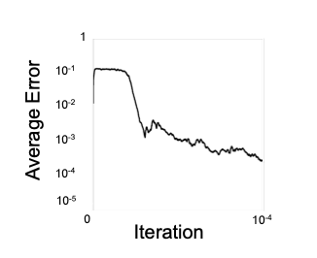
Learning the Xor function (MNISTy back then)

Slide 41
All proposals boil down to the multiplexing problem
Contrastive Hebbian: Early vs late
Predictive Coding/ Senn: Up vs down
My PhD thesis: Spikes vs Bursts
Learning to learn: however it got there last time

Slide 42

Common to all but feedback alignment: weight symmetry problem

Slide 43
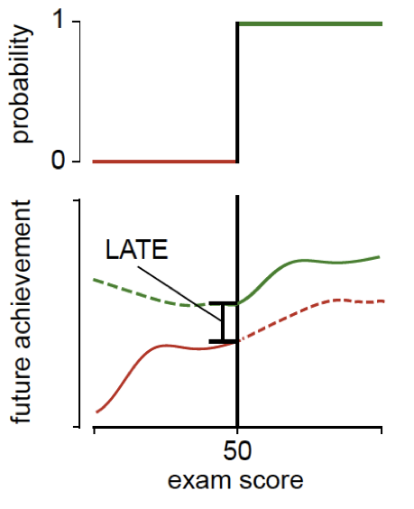
Regression discontinuity
Lawlor, Marinescu and Kording

Slide 44
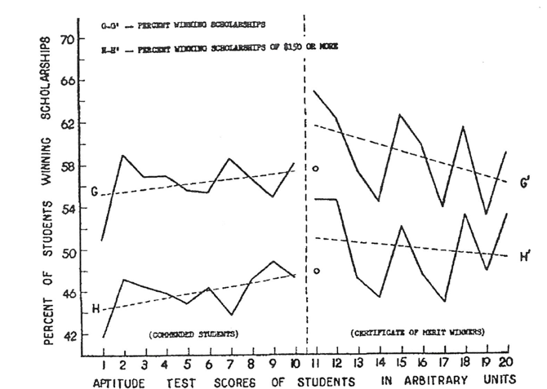
Thistlewaite and Campbell

Slide 45
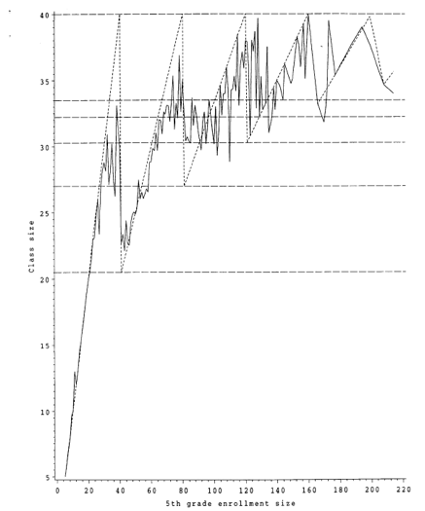
Maimonides rule

Slide 46

Making weights symmetrical
Downstream activity

Slide 47

A causal estimator

Slide 48

Realistic learning rule

Slide 49

And optimization/ RL

Slide 50
Deep learning-inspired neuroscience
Neuromodulators
Dopamine
Acetylcholine
Serotonin
Slice physiology

Slide 51
Next week: full session on causality
Don’t predict
Find out what works

