Slide 1
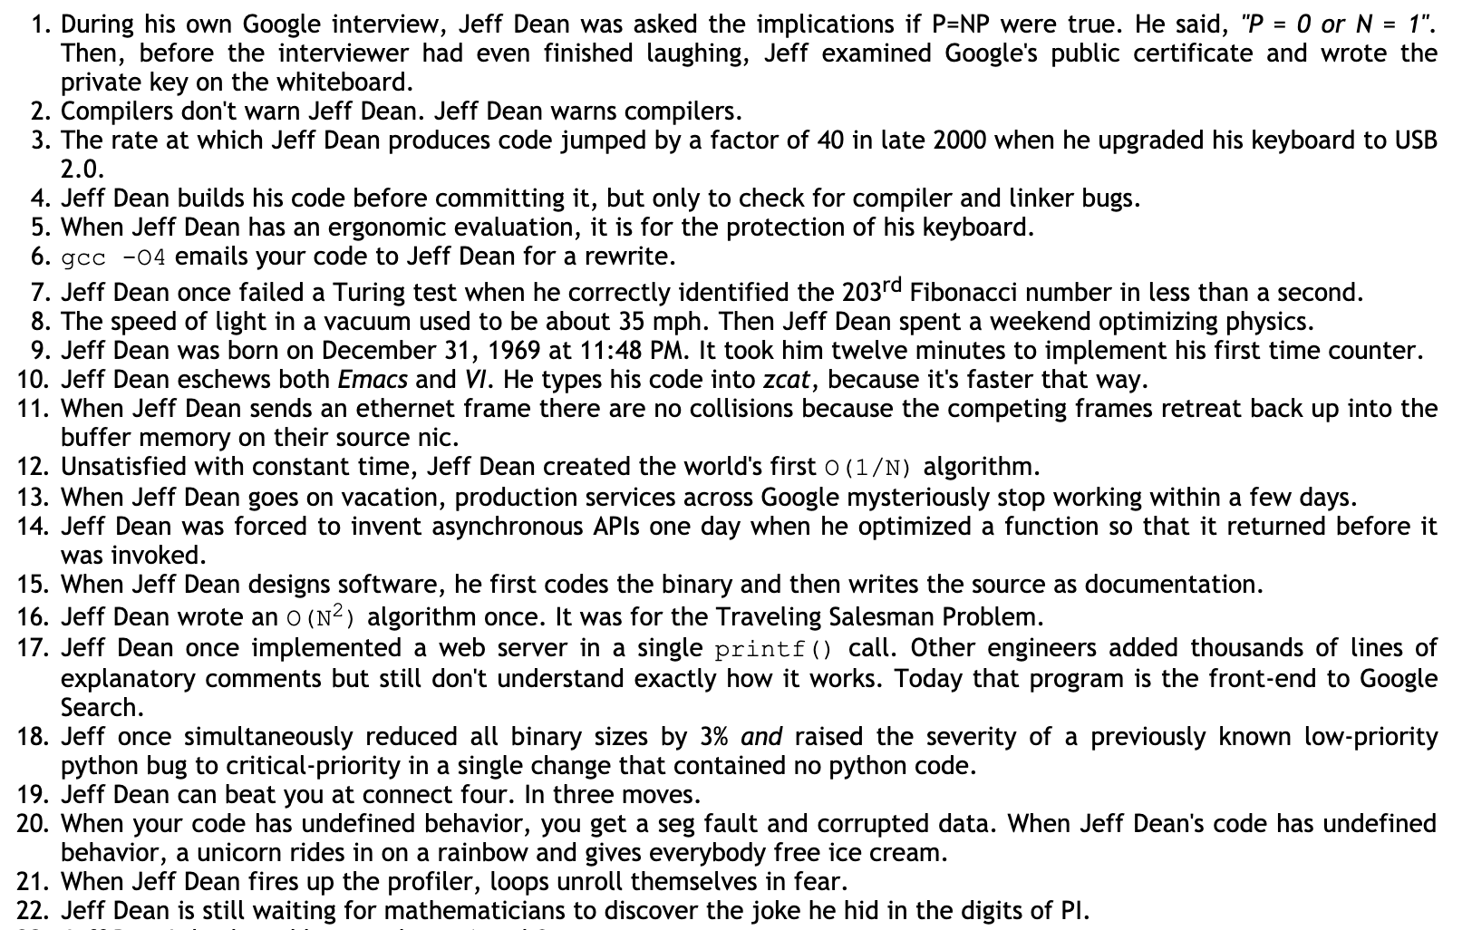

Slide 2
CIS 700-004: Lecture 14M
Deep Learning and Society
4/15/19
Notes:
Done

Slide 3
Homework 3, part 1 is out
How do people express sarcasm?

Slide 4
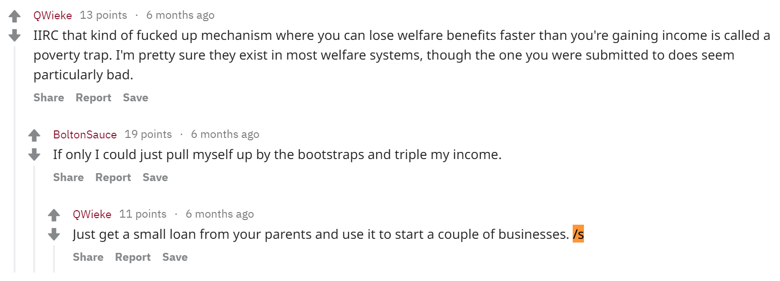
Homework 3, part 1 is out
How do people express sarcasm?

Slide 5
Homework 3, part 1 is out
How do people express sarcasm?
https://www.seas.upenn.edu/~cis700dl/homeworks/HW3_Part1.pdf

Slide 6
Where does deep learning innovation happen?
Major players in DL

Slide 7
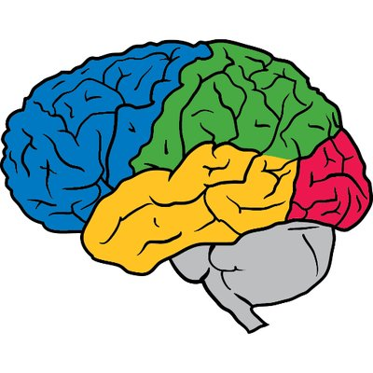
Google Brain
Large, broad interests
Led by: Jeff Dean
Mostly Mountain View, CA, but also NYC, other Google offices
Publication-heavy, lots of parallel projects and collaborations

Slide 8

DeepMind
Mostly RL
Led by: Demis Hassabis
Mostly London, also small offices in Montreal, Paris
Mission-driven: “solve AGI” (artificial general intelligence)
High-impact, coordinated projects with large teams
Many neuro folks

Slide 9

FAIR (Facebook AI Research)
Focus on NLP and CV
Led by: Yann LeCun
Mostly New York, but also Menlo Park, other FB offices
Smaller group, high caliber researchers
Lots of freedom in research

Slide 10

OpenAI
Focus on RL, safe AI
Led by: Ilya Sutskever
San Francisco
Goal: open-source AGI

Slide 11

MILA: Montreal Institute for Learning Algorithms
Very broad focus, some neuro inspiration
Led by: Yoshua Bengio
Montreal

Slide 12
Stanford
Andrew Ng
Fei-Fei Li
Daphne Koller
Chris Manning
Percy Liang
Surya Ganguli
Chelsea Finn
etc.

Slide 13
UC Berkeley (=BAIR)
Michael Jordan
Jitendra Malik
Ben Recht
Pieter Abbeel
Dawn Song
Sergey Levine
Dan Klein
etc.

Slide 14
Other players
Microsoft Research - lots of different research, including some ML
Element AI (associated with MILA) - essentially AI consultants
Baidu
Amazon
Nvidia

Slide 15
Where does deep learning innovation happen?
2. Conferences and journals

Slide 16
Major publication venues
General ML: NeurIPS, ICML, ICLR, JMLR (journal), COLT, AISTATS, UAI, AAAI
Computer vision: CVPR, ICCV, ECCV
NLP: ACL, EMNLP
Sometimes, big breakthroughs in Science, Nature, PNAS

Slide 17
Succeeding at conferences
Know who you want to talk with
The lobby game
Have a proof of competency before approaching
The small conferences is where the action happens

Slide 18
Issues with DL culture

Slide 19
Homogeneity & cliquiness

Slide 20
Issues with DL research
From Lipton & Steinhardt (2018):
Explanations vs. speculations
Misattribution of empirical gains
Mathiness
Misuse of language

Slide 21
A survey of deep learning applications

Slide 22
Suppose we have a data pipeline.
If deep learning is part of this applied pipeline, it gets used at some point.

Slide 23
In general, data science is used in 3 places.
The model provides some business intelligence.
A marketing scientist uses a model to optimize advertising mix.
A data scientist helps a manager forecast sales to decide on inventory levels.

Slide 24
In general, data science is used in 3 places.
The model provides some business intelligence.
A marketing scientist uses a model to optimize advertising mix.
A data scientist helps a manager forecast sales to decide on inventory levels.
The model helps you design the product / end.
A data scientist sends a heatmap of all video game deaths to a designer.
A software engineer uses a Mann-Whitney U test for A/B testing two UIs.

Slide 25
In general, data science is used in 3 places.
The model provides some business intelligence.
A marketing scientist uses a model to optimize advertising mix.
A data scientist helps a manager forecast sales to decide on inventory levels.
The model helps you design the product / end.
A data scientist sends a heatmap of all video game deaths to a designer.
A software engineer uses a Mann-Whitney U test for A/B testing two UIs.
The model is the product / end.
A Snapchat filter uses a convnet.
A videogame uses an AI agent as an enemy.

Slide 26
Deep learning for business intelligence

Slide 27
Deep learning for finance
Extracting alternative signals
Counting cars in parking lots
Evaluating sentiment of news headlines
Automating analysis of financial documents
Generalizing linear models
Smart indexing
Nonlinear factor models
Anomaly detection
Notes:
https://arxiv.org/pdf/1602.06561v2.pdf

Slide 28
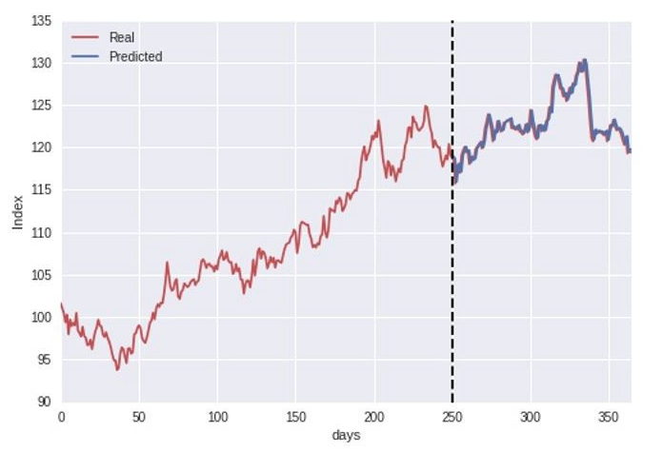
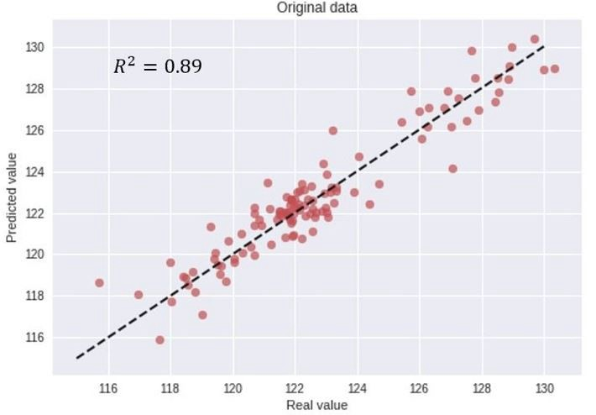
How not to use deep learning in finance
Notes:
https://arxiv.org/pdf/1602.06561v2.pdf

Slide 29
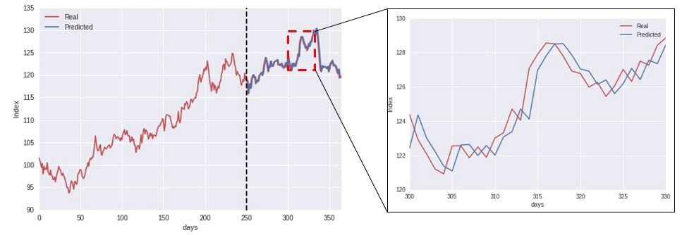
How not to use deep learning in finance
Notes:
https://arxiv.org/pdf/1602.06561v2.pdf

Slide 30
Deep learning for customer engagement
Sentiment analysis on satisfaction surveys
Predictive models on push advertisements
Chatbots

Slide 31
Deep learning as a design tool
and as an end goal

Slide 32
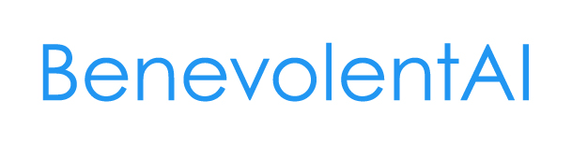



AI for drug discovery

Slide 33
DL for healthcare
Image analytics - detect cancers, stroke, brain hemorrhage, eye disease , etc
GANs to train with privacy
NLP to get at stuff that matters in EHRs
Predict readmissions
Precision medicine

Slide 34
DL for genomics
Predict what binds what
Enhancers
Expression
Splicing
3D organization
Methylation
Phenotype
Pathogens

Slide 35
DL for physics
Detect galaxies and stars
Particles in high energy physics
Trigger initiation in LHC
Predict solar flares
RL for reactors
Detect gravitational waves
Predicting extreme weather events

Slide 36
DL for chemistry
Make spectrum calculation fast
Inverting spectrums
Optimal experiment design
Reactor control
Graph CNNs with molecules

Slide 37
DL for climate change
Power generation and grids
Transportation
Smart buildings and cities
Industrial optimization
Carbon capture and sequestration
Agriculture, forestry and other land use
Climate modeling
Extreme weather events
Disaster management and relief
Societal adaptation
Ecosystems and natural resources
Data presentation and management
Climate finance

Slide 38
AI for Social Good
Movement within the field
There are a LOT of applications of AI
https://aiforsocialgood.github.io/2018/acceptedpapers.htm

Slide 39
This class, within the context of DL

Slide 40
Discussion

