Slide 1
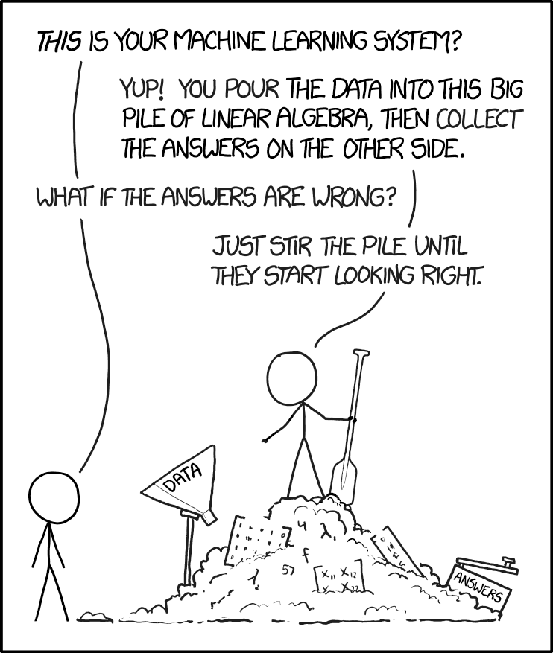
Source:
https://xkcd.com/1838/
Notes:
Done

Slide 2
CIS 700-004: Lecture 3M
Introduction to neural nets
01/28/19
Notes:
Done

Slide 3
Course Announcements
HW0 is due on Wednesday at 11:59pm.
Final OH schedule is posted.
Reminder to make a private Piazza post if you'd like Canvas access to submit the homework as an auditor.

Slide 4
Neuroscience of simple computations

Slide 5
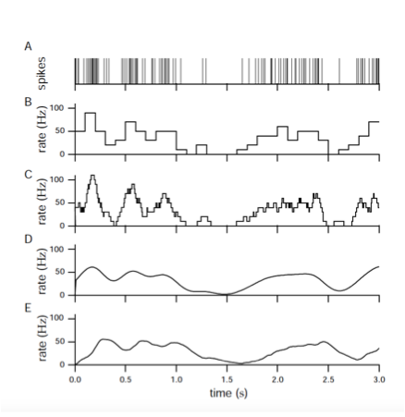
Neural codes

Slide 6
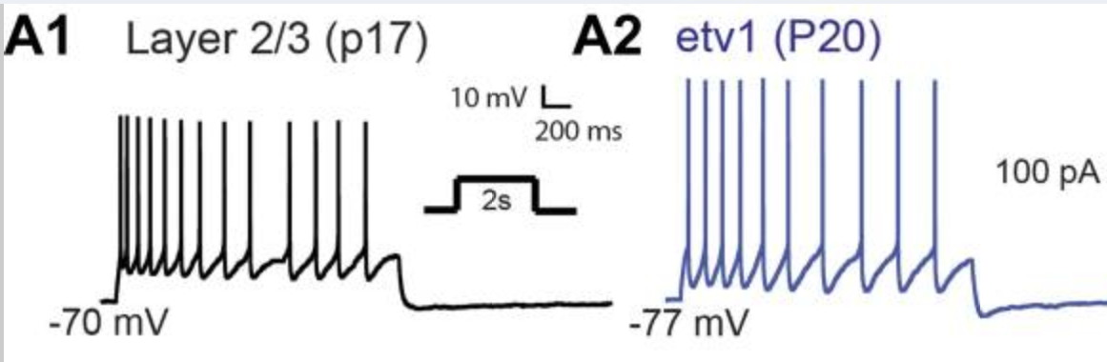
Neural responses to inputs
Guang, Armstrong, Foehring, 2015

Slide 7
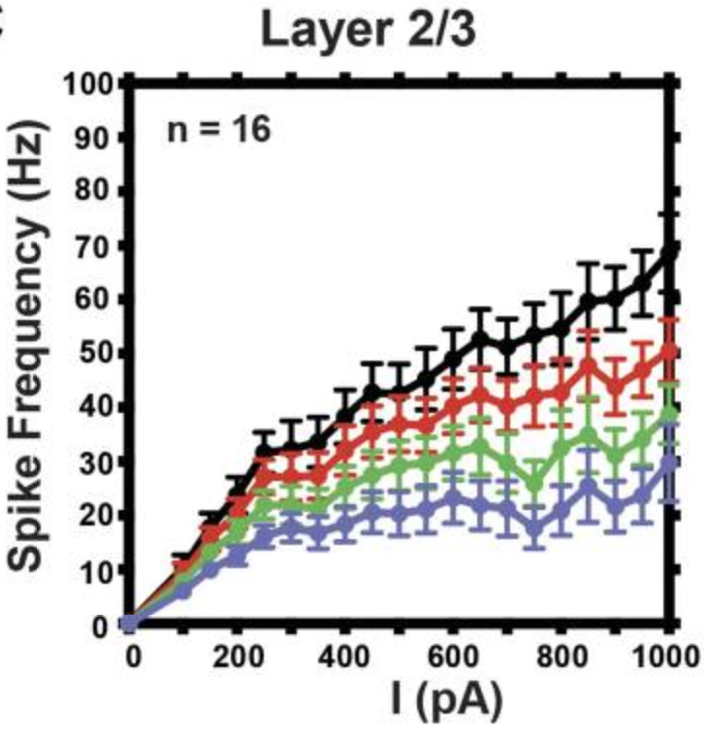
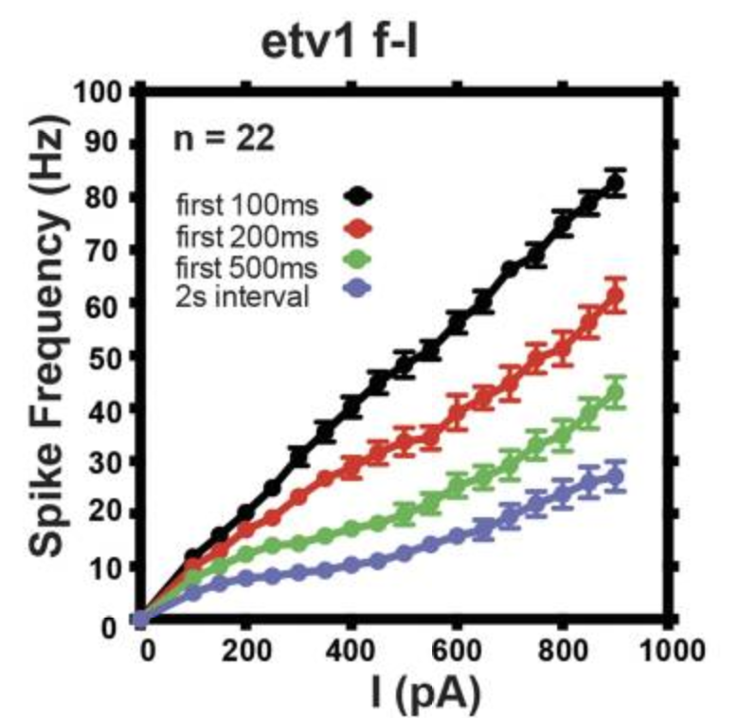
Nonlinear (a bit)

Slide 8
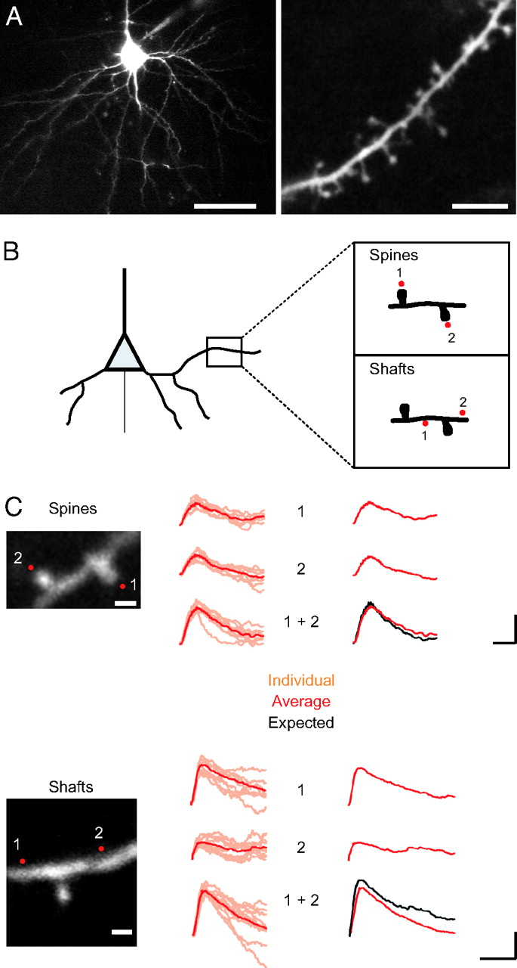
Linear integration within dendritic trees
50 um
5 um
Araya, Eisenthal, Yuste, 2006

Slide 9
Linear integration within dendritic trees

Slide 11
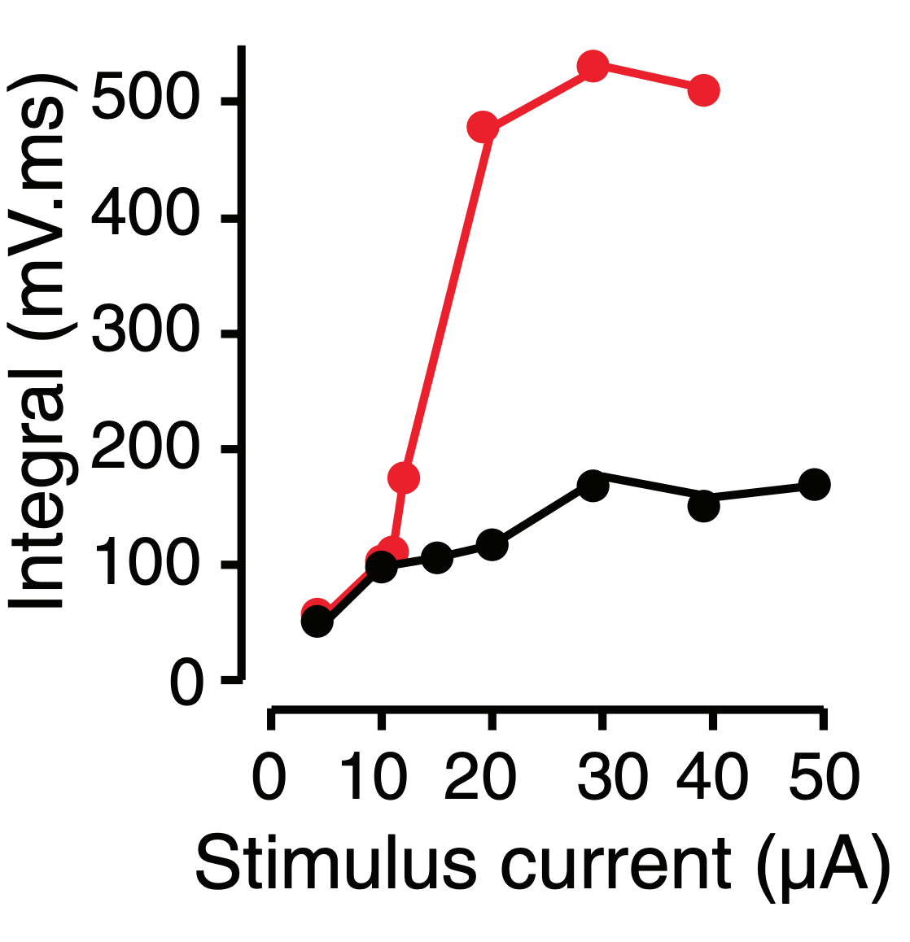
Or maybe not - NMDA spikes
Larkum et al 2009

Slide 12
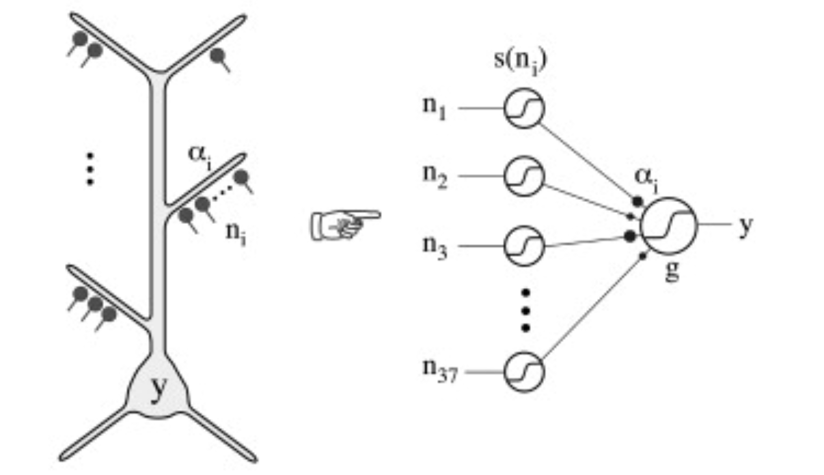
So then what does a neuron do?
Poirazi Brennon Mel, 2003

Slide 13
Perceptrons
Notes:
Done

Slide 14
What is (supervised) learning?
Suppose we have data points (x₁ , y₁ ), (x₂ , y₂ ), …, (x_{s} , y_{s} )
(both x_{i} , y_{i} may be multivariate)
If we see a new x, we want to predict the y.
Implicitly, we are assuming there is an unknown function y(x) = y.
Examples of useful functions y:
y(image) = cat or dog, y(audio signal) = sentence, y(chess position) = good move to make
We can approximate the intractable function y(x) by fitting it with a family of easier-to-express functions.
Notes:
Done

Slide 15


A first cut at learning - linear functions
The easiest way to fit data:
Mean squared error (MSE) - a natural loss function:
Notes:
Done

Slide 16

A first cut at learning - linear functions
The easiest way to fit data:
Mean squared error (MSE) - a natural loss function:
This is just linear regression, and it can be solved exactly:
Notes:
Done

Slide 17

Perceptrons
What about binary classification? I.e., if y(x) = ±1.
We can fit a function of the form:
Perceptron Learning Algorithm (details presented on blackboard).
Always works if the data is actually linearly separable.
Otherwise may not work at all.
Best solution depends on a loss function.
Notes:
Done

Slide 18
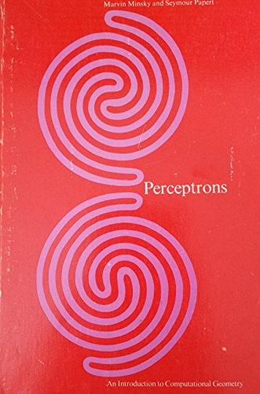
Do perceptrons actually work?
Not really, but sometimes surprisingly well.
It’s a good first cut.
Very rarely are data actually linearly separable.
Notes:
Done

Slide 19
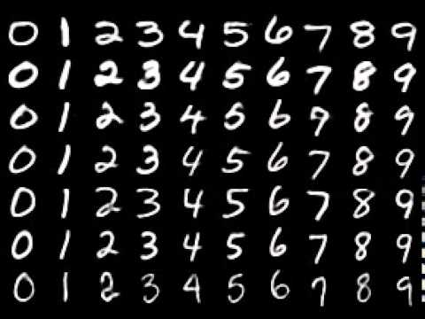
Do perceptrons actually work?
MNIST image dataset for classification of digits
Essentially the simplest deep learning test dataset.
Random performance (10 classes) is 10%
Perceptrons (trained by backpropagation) get ~93%.
How is that possible? High-dimensional input (d=784 here) makes it a bit easier.
Notes:
Done. Discuss how it works for ten-fold image-classification.

Slide 20
Multilayer perceptrons
Notes:
Done

Slide 21

What is the simplest thing that isn’t linear?
We have tried fitting linear functions.
What about iterating linear functions?
Notes:
Done

Slide 22
What is the simplest thing that isn’t linear?
We have tried fitting linear functions.
What about iterating linear functions?
Unfortunately, that’s still a linear function.
If we want to iterate, we can alternate a simple nonlinear function :
(the nonlinear function is usually univariate and applied component-wise to vectors)
Notes:
Done

Slide 23

What is the simplest thing that isn’t linear?
More generally, we can add bias terms:
The function is called a multilayer perceptron (MLP) or fully-connected network.
These are the most basic general-purpose “deep learning”-style neural networks.
Notes:
Done

Slide 24
A bit like a biological neuron
Neurons have one output
They linearly integrate on their dendrites
They have a ReLU-like nonlinearity
And they are hierarchically organized

Slide 25
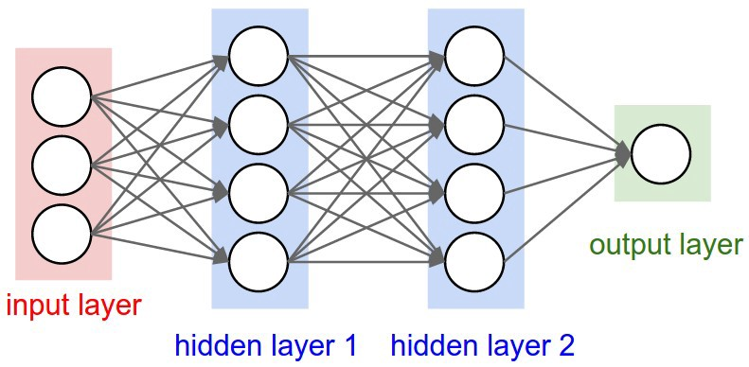
Architecture of a neural network
A layer is one of the intermediate vectors.
A neuron is one of the entries of a layer vector.
The depth is the number of layers.
The width of a layer is the layer’s dimension.
The weights are the coefficients of the matrices W_{k} .
The biases are the terms b_{k} .
The activation function or non-linearity is the function .
Notes:
Done

Slide 26


How to deal with discrete output?
Often (e.g. in classification problems), the output will take on discrete values
Does an image show the digit 0, 1, etc? (10 possibilities)
Which word comes next in a sentence? (finite number of possible words)
The simplest way to deal with this is one-hot encoding.
Then, the output of the network is a length-C vector if there are C possible classes.
This has the added advantage of essentially encoding confidence (or, alternatively, a probability distribution):
Notes:
Done

Slide 27
How to deal with discrete output?
A disadvantage of one-hot encoding is if there are a lot of possibilities.
It also doesn’t capture information about structure in the outputs.
In natural language processing (NLP), often Word2Vec representations are used instead (will be covered more later).
Notes:
Done

Slide 28
Training a neural network
Training a network means changing the weights and biases to match the data.
It’s generally done by some form of backpropagation - calculating the gradient of the loss with respect to the weights and biases.
The weights and biases change along the gradient to decrease the loss.
Ingredients (more on these later):
Network architecture
Initialization of weights and biases
Loss function (e.g. mean squared error)
Optimizer (e.g. SGD)
Notes:
Done

Slide 29
Choices for the non-linearity
Notes:
Done

Slide 30
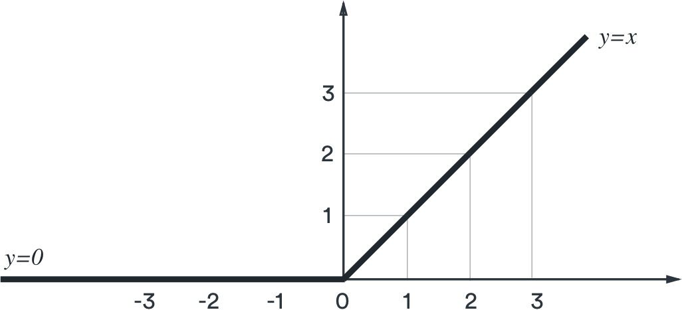

ReLU
Very fast computation.
Most common activation function.
The resulting functions N(x) are piecewise linear.
Not actually differentiable everywhere, but this is okay.
More of a problem is when the derivative is zero, “dead ReLU” problem
But very unlikely for a ReLU to be “dead” for all inputs.
Notes:
Done

Slide 31
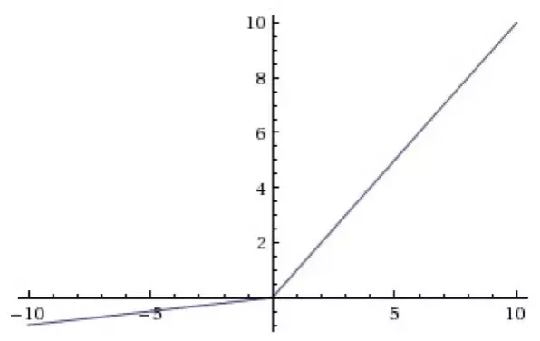
Leaky ReLU
Fixes the problem of “dead ReLUs.”
Not used very much in practice compared to ReLU.
Notes:
Done

Slide 32

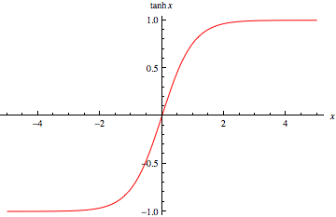
tanh
“hyperbolic tangent”, often pronounced like “tanch”.
Smoothes out discontinuities.
Used to be more popular, replaced by ReLU.
Notes:
Done

Slide 33

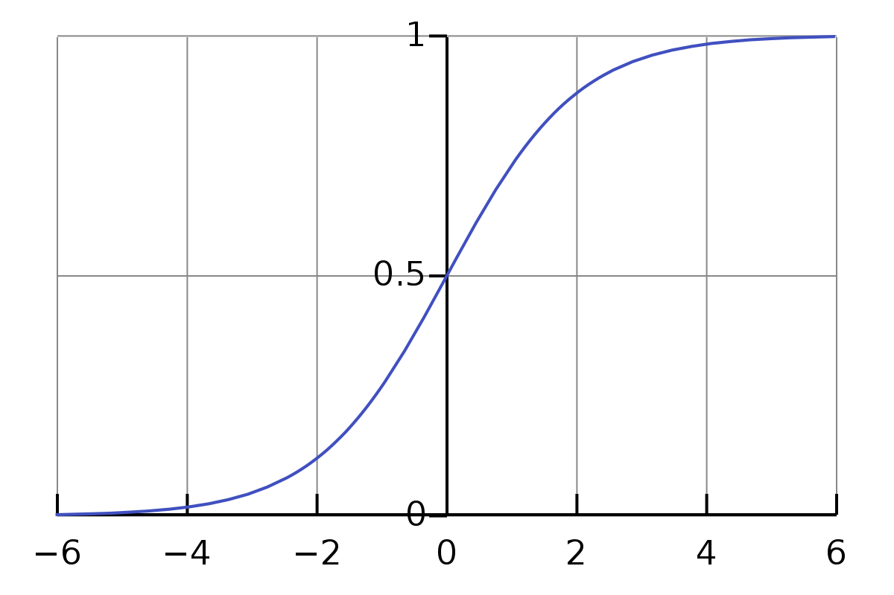
logistic sigmoid
Similar to tanh, but asymptotes to 0 and 1, instead of -1 and 1.
Like tanh, used rarely nowadays.
Notes:
Done

Slide 34

softmax
Applied to an entire vector, not component-wise.
Entries of the output sum to 1.
The most common way to predict a probability distribution.
Typically used in the final layer of networks for classification tasks.
Notes:
Done

Slide 35
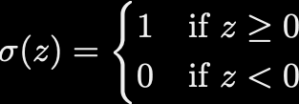
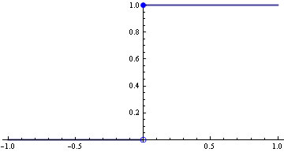
Step function?
What is the problem here? (if using backpropagation)
The gradient is zero everywhere - gradient updates don’t do anything.
Notes:
Done

Slide 36
What if a deep network were actually linear?
What if the activation function is linear?
The overall network would be a linear transformation.
But any learning algorithms might give different results.
Also, the resulting weight matrices would be factored into different layers.
Used sometimes as a simple case to prove results, and in some neuro models.
Various authors, esp. Andrew Saxe, have considered these networks, but not really used in practice.
Notes:
Done

Slide 37
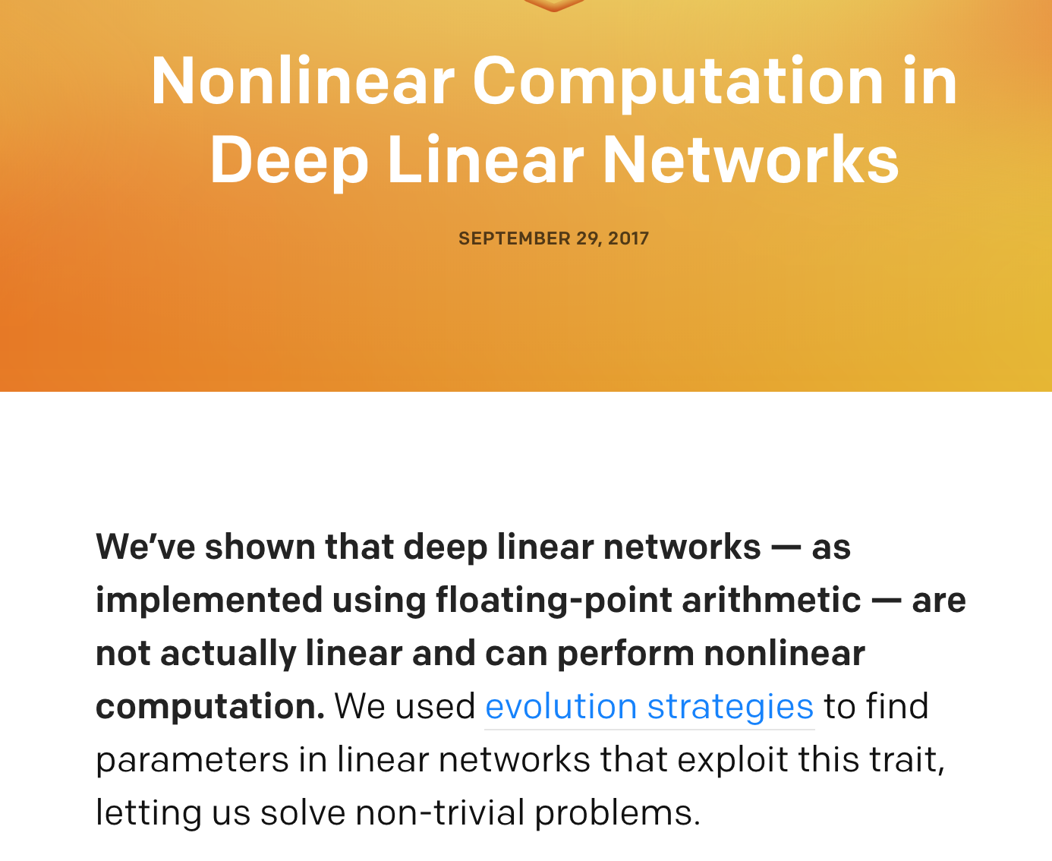
What if a deep network were actually linear?
Notes:
Done

Slide 38
Loss functions
Notes:
Done

Slide 39

Mean squared error
Often used if the network is predicting a scalar.
Notes:
Done

Slide 40
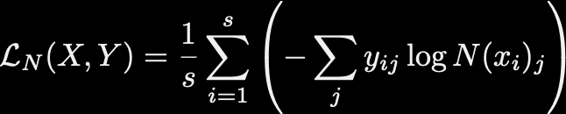
Cross-entropy
Most common loss function for classification tasks.
It is a measure of distance between two probability distributions.
For classification, generally the target vector is one-hot encoded, which means that is 1 where belongs to class j, and is otherwise 0.
Be careful to apply cross-entropy loss only to probabilities! (e.g. after softmax)
In PyTorch, softmax and cross-entropy can be applied in a single step.
Be careful in that case not to apply it twice :)

Slide 41

Cosine similarity
Computes similarity between directions of two vectors.
Often used in NLP contexts. For example, the two vectors might be the frequencies of different words.
Notes:
Done

