Slide 1
Some recent news
In a shocking finding, scientist discovered a herd of unicorns living in a remote, previously unexplored valley, in the Andes Mountains. Even more surprising to the researchers was the fact that the unicorns spoke perfect English.
The scientist named the population, after their distinctive horn, Ovid’s Unicorn. These four-horned, silver-white unicorns were previously unknown to science. Now, after almost two centuries, the mystery of what sparked this odd phenomenon is finally solved. Dr. Jorge Pérez, an evolutionary biologist from the University of La Paz, and several companions, were exploring the Andes Mountains when they found a small valley, with no other animals or humans. Pérez noticed that the valley had what appeared to be a natural fountain, surrounded by two peaks of rock and silver snow. Pérez and the others then ventured further into the valley. “By the time we reached the top of one peak, the water looked blue, with some crystals on top,” said Pérez. Pérez and his friends were astonished to see the unicorn herd. These creatures could be seen from the air without having to move too much to see them – they were so close they could touch their horns. While examining these bizarre creatures the scientists discovered that the creatures also spoke some fairly regular English. Pérez stated, “We can see, for example, that they have a common ‘language,’ something like a dialect or dialectic.”
Dr. Pérez believes that the unicorns may have originated in Argentina, where the animals were believed to be descendants of a lost race of people who lived there before the arrival of humans in those parts of South America.
While their origins are still unclear, some believe that perhaps the creatures were created when a human and a unicorn met each other in a time before human civilization. According to Pérez, “In South America, such incidents seem to be quite common.”
However, Pérez also pointed out that it is likely that the only way of knowing for sure if unicorns are indeed the descendants of a lost alien race is through DNA. “But they seem to be able to communicate in English quite well, which I believe is a sign of evolution, or at least a change in social organization,” said the scientist.

Slide 2
OpenAI's GPT-2
https://blog.openai.com/better-language-models/
https://www.wired.com/story/ai-text-generator-too-dangerous-to-make-public/

Slide 3
CIS 700-004: Lecture 6M
Vector semantics and CNNs for NLP
2/18/19
Notes:
Done

Slide 4
Today's Agenda
ResNet implementation
Intro to NLP
In the news: GPT-2
Question 1: how can we featurize language?
Lexical semantics
td-idf, word2vec, Elmo
Question 2: how can we deal with variable-length data?
Question 3: what NLP problems can we solve?
Some convolutional (non-recurrent) solutions

Slide 5
ResNets

Slide 6
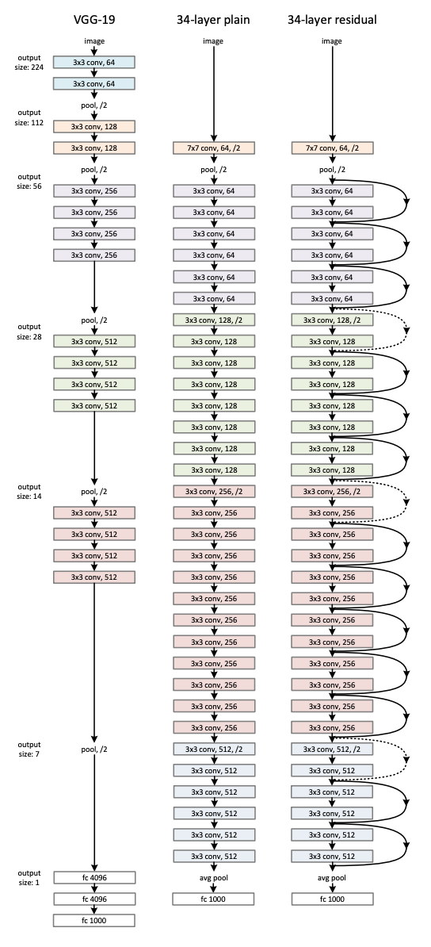
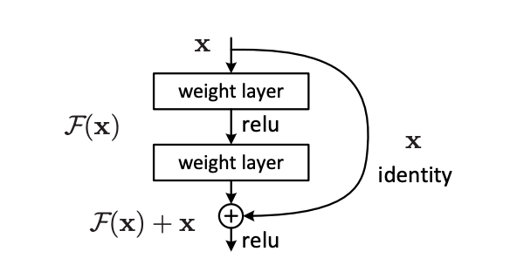
ResNets
Residual networks (ResNets): skip connections between non-consecutive layers

Slide 7
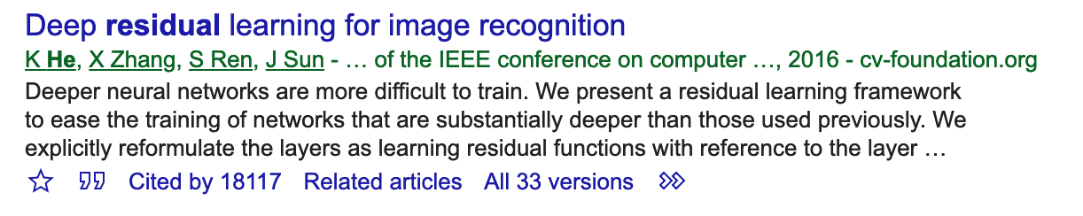
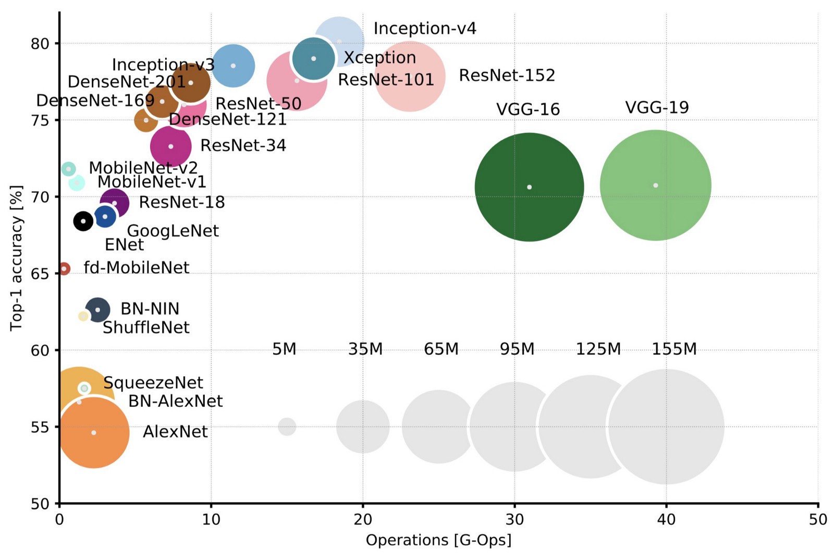
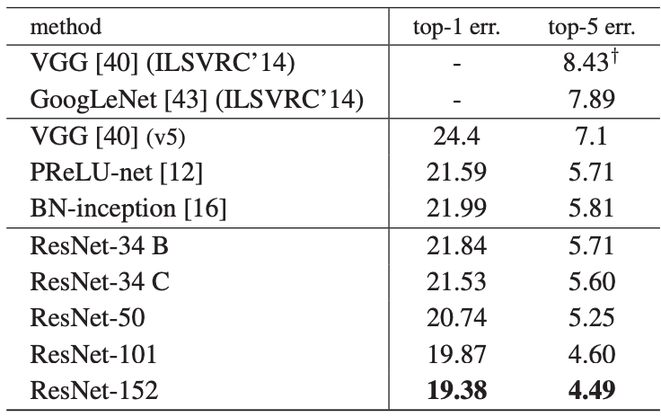
Results

Slide 8
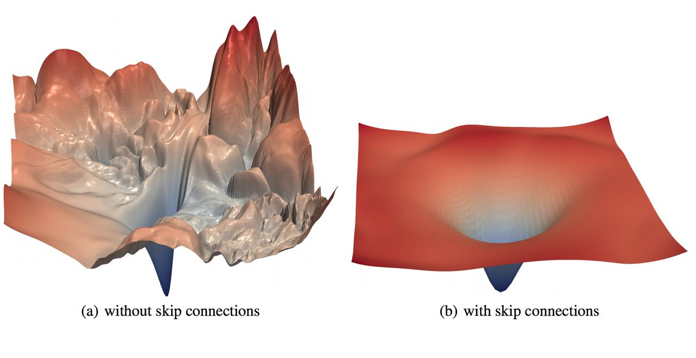
Loss landscapes
Li et al. (2018)

Slide 9
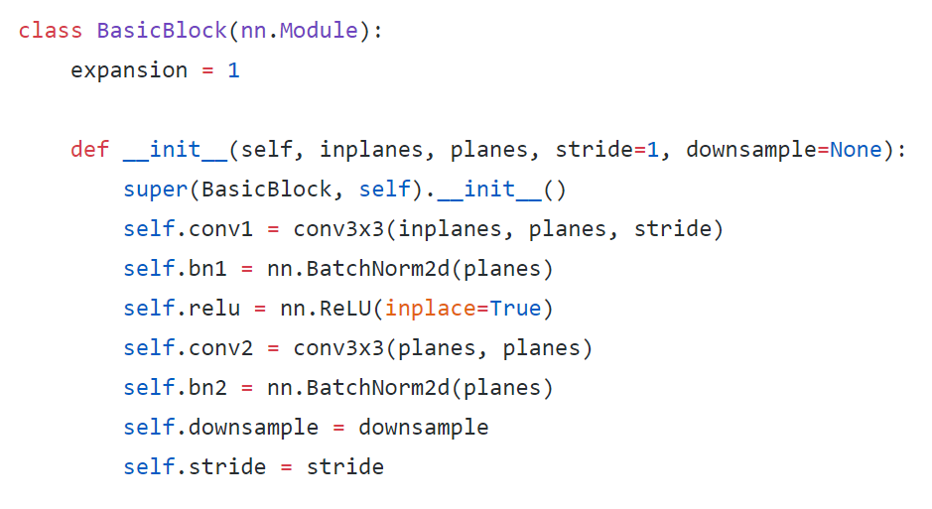
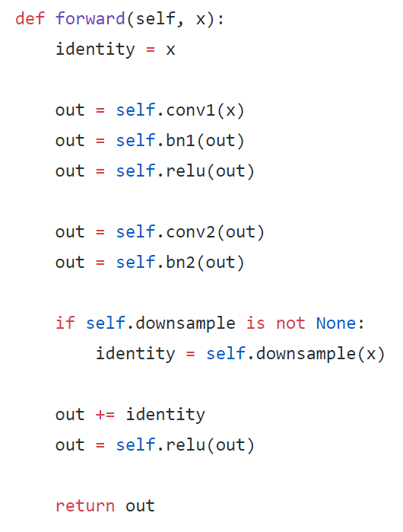
ResNets in PyTorch: a block
Notes:
https://github.com/pytorch/vision/blob/master/torchvision/models/resnet.py

Slide 10
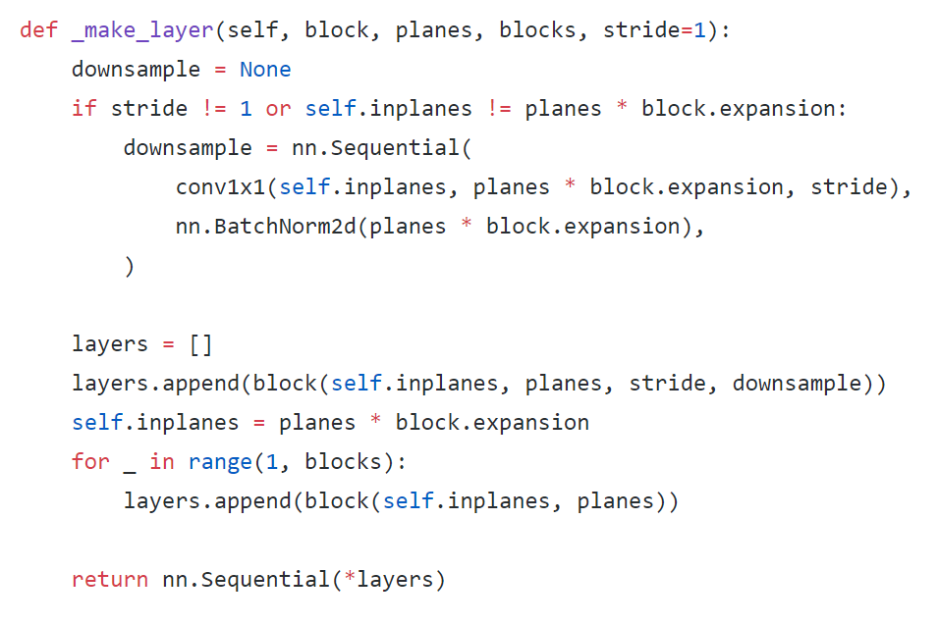
ResNets in PyTorch: a layer
Notes:
https://github.com/pytorch/vision/blob/master/torchvision/models/resnet.py

Slide 11
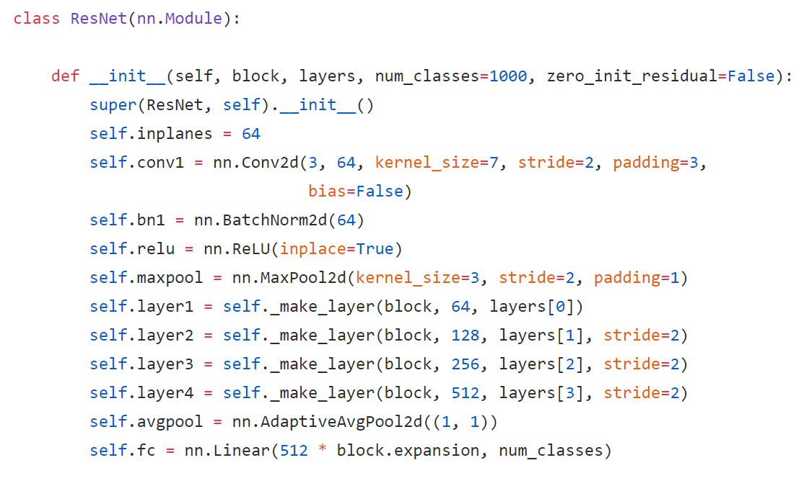
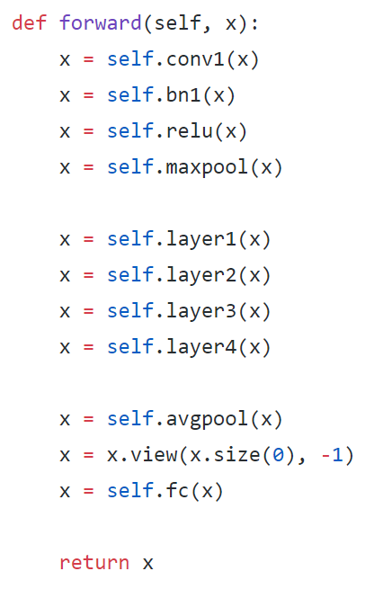
ResNets in PyTorch: the network
Notes:
https://github.com/pytorch/vision/blob/master/torchvision/models/resnet.py

Slide 12
Natural language processing

Slide 13
Vector semantics:
how can we encode words as vectors?

Slide 14
Attempt #1: do what we normally do with categorical data.
Encode each word as a one-hot vector.
How good is this embedding?

Slide 15
Attempt #1: do what we normally do with categorical data.
Encode each word as a one-hot vector.
How good is this embedding? Terrible!
Extremely high dimensional (there are over 200K words in the English language)
Extremely sparse
No semantic meaning

Slide 16
Wishlist: what can we hope for in a vector representation?
Discuss.

Slide 17
Wishlist: what can we hope for in a vector representation?
Words with same lemma (also known as citation form) have similar representations.
e.g. "sing", "sang", "sung" are all wordforms of the lemma "sing"

Slide 18
Wishlist: what can we hope for in a vector representation?
Words with same lemma (also known as citation form) have similar representations.
e.g. "sing", "sang", "sung" are all wordforms of the lemma "sing"
Homonyms (e.g. mouse the creature and mouse the cursor control device have different representations.

Slide 19
Wishlist: what can we hope for in a vector representation?
Words with same lemma (also known as citation form) have similar representations.
e.g. "sing", "sang", "sung" are all wordforms of the lemma "sing"
Homonyms (e.g. mouse the creature and mouse the cursor control device have different representations.
Synonyms (e.g. lucky, auspicious) have the same representations.

Slide 20
Wishlist: what can we hope for in a vector representation?
Words with same lemma (also known as citation form) have similar representations.
e.g. "sing", "sang", "sung" are all wordforms of the lemma "sing"
Homonyms (e.g. mouse the creature and mouse the cursor control device have different representations.
Synonyms (e.g. lucky, auspicious) have the same representations.
Antonyms (e.g. good, bad) have different representations.

Slide 21
Wishlist: what can we hope for in a vector representation?
Words with same lemma (also known as citation form) have similar representations.
e.g. "sing", "sang", "sung" are all wordforms of the lemma "sing"
Homonyms (e.g. mouse the creature and mouse the cursor control device have different representations.
Synonyms (e.g. lucky, auspicious) have the same representations.
Antonyms (e.g. good, bad) have different representations.
Related words (e.g. coffee and cup) have similar representations.

Slide 22
Wishlist: what can we hope for in a vector representation?
Words with same lemma (also known as citation form) have similar representations.
e.g. "sing", "sang", "sung" are all wordforms of the lemma "sing"
Homonyms (e.g. mouse the creature and mouse the cursor control device have different representations.
Synonyms (e.g. lucky, auspicious) have the same representations.
Antonyms (e.g. good, bad) have different representations.
Related words (e.g. coffee and cup) have similar representations.
Hyponyms / hypernyms (e.g. animal and dog) have similar representations.

Slide 23
This is a field of study called lexical semantics.
We adopt a prior from lexical semantics for NLP:
The language-game prior
The meaning of a word is its usage. (Wittgenstein, 1953)
Distributional hypothesis
"a word is characterized by the company it keeps." (Firth, 1957)
The principle of contrast
A difference in usage denotes a difference in meaning (Clark, 1987)

Slide 24
We'd like to use word usage (context) in order to inform a good featurization.

Slide 25
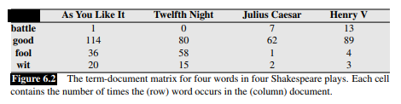
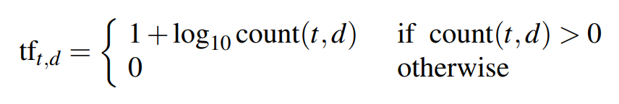
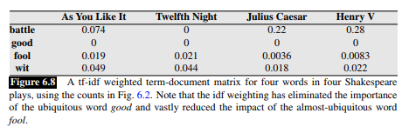
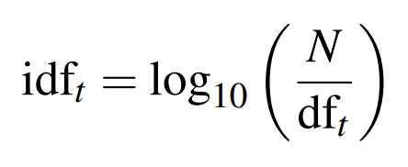

Attempt #2: td-idf
Construct a term-document matrix.
Convert word counts to td-idf scores.
Take rows as word feature vectors.
A term-document matrix.
A tf-idf matrix.

Slide 26
How does td-idf perform?
Terrible!
Even more high-dimensional (there are 29 million Wikipedia pages).
Assumes that documents are homogeneous throughout.
Ignores syntax.

Slide 27




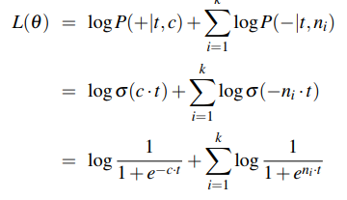
Attempt #3: word2vec
Problem setting:
Prior: if two words (t, c) are similar, then they are likely to appear near each other.
Similarity is the dot product:
Likelihoods are denoted by:
The objective function:

Slide 28
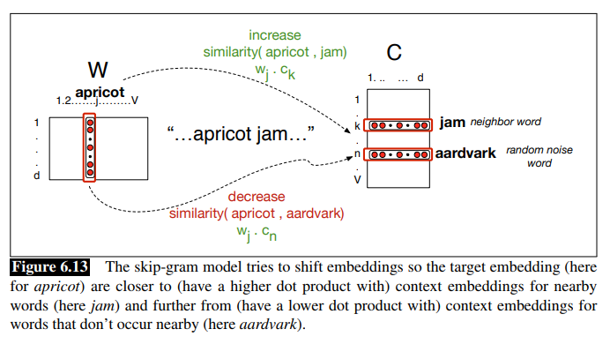

Slide 29
Other word embeddings
GloVe (Global Vectors)
Pennington et al., 2014
fasttext
Bojanowski et al., 2017
Elmo
Peters, 2018
BERT
Devlin et al., 2018

Slide 30
Natural language is variable-length. How do we encode natural language data for models?

Slide 31
There are 4 canonical ways to deal with variable length.
Truncation: chop off the tail.
Bagging: turn the vector into a count-dict.
Convolution: convolute over a fixed-length filter and aggregate the results.
Recurrence: make your forward pass variable-length.

Slide 32
Each of the 4 methods has its own prior.
Truncation: chop off the tail.
Use when you have a ranking of the most important features (similar to PCA).
Ex: for each person in a group, we have a variable-length ranked list of their favorite books.

Slide 33
Each of the 4 methods has its own prior.
Truncation: chop off the tail.
Use when you have a ranking of the most important features (similar to PCA).
Ex: for each person in a group, we have a variable-length ranked list of their favorite books.
Bagging: turn the vector into a count-dict.
Use when your prior is that syntax (i.e. ordering) does not matter.
Ex: for each baseball player in a game, we have a sequence of strikes / hits.

Slide 34
Each of the 4 methods has its own prior.
Truncation: chop off the tail.
Use when you have a ranking of the most important features (similar to PCA).
Ex: for each person in a group, we have a variable-length ranked list of their favorite books.
Bagging: turn the vector into a count-dict.
Use when your prior is that syntax (i.e. ordering) does not matter.
Ex: for each baseball player in a game, we have a sequence of strikes / hits.
Convolution: convolute over a fixed-length filter and aggregate the results.
Use when your prior is that only short-term syntax matters.
Ex: n-gram models

Slide 35
Each of the 4 methods has its own prior.
Truncation: chop off the tail.
Use when you have a ranking of the most important features (similar to PCA).
Ex: for each person in a group, we have a variable-length ranked list of their favorite books.
Bagging: turn the vector into a count-dict.
Use when your prior is that syntax (i.e. ordering) does not matter.
Ex: for each baseball player in a game, we have a sequence of strikes / hits.
Convolution: convolute over a fixed-length filter and aggregate the results.
Use when your prior is that only short-term syntax matters.
Ex: n-gram models
Recurrence: make your forward pass variable-length.
Use when your prior is that both short-term and long-term ordering matters.
Ex: most general-purpose NLP architectures

Slide 36
Syntactical NLP problems

Slide 37
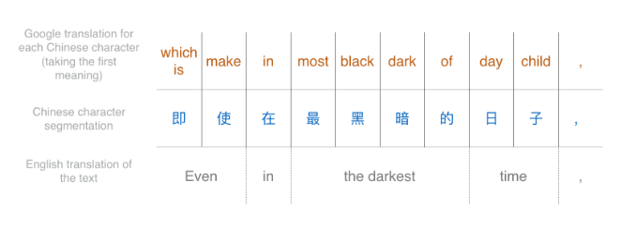
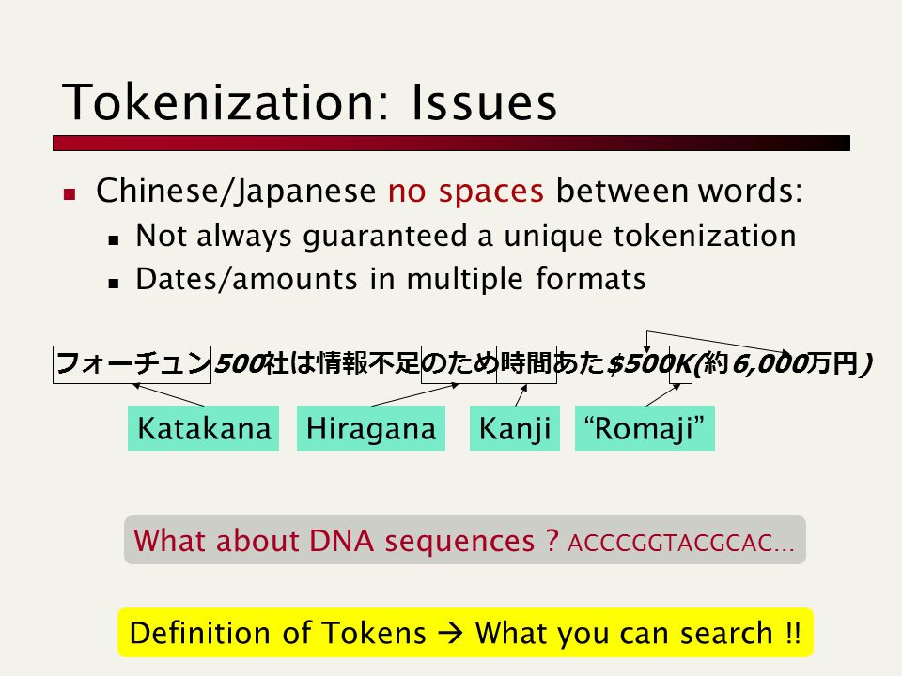
Tokenization
https://spacy.io/usage/linguistic-features https://www.nltk.org/api/nltk.tokenize.html https://nlp.stanford.edu/software/tokenizer.shtml
Notes:
In Chinese, solved by 4-gram

Slide 38
Tokenization (solved by convolution)
https://spacy.io/usage/linguistic-features https://www.nltk.org/api/nltk.tokenize.html https://nlp.stanford.edu/software/tokenizer.shtml
Notes:
In Chinese, solved by 4-gram

Slide 39
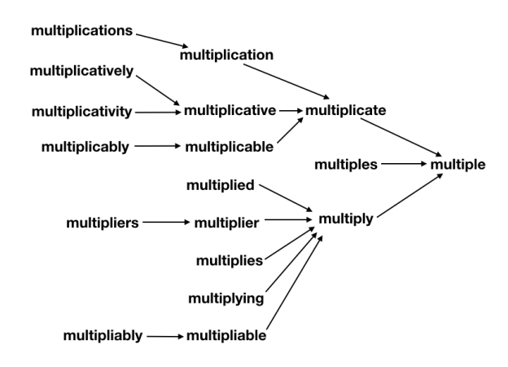
Lemmatization
https://spacy.io/usage/linguistic-features https://www.nltk.org/api/nltk.tokenize.html https://nlp.stanford.edu/software/tokenizer.shtml

Slide 40
Lemmatization (solved by rules, not ML)
https://spacy.io/usage/linguistic-features https://www.nltk.org/api/nltk.tokenize.html https://nlp.stanford.edu/software/tokenizer.shtml

Slide 41
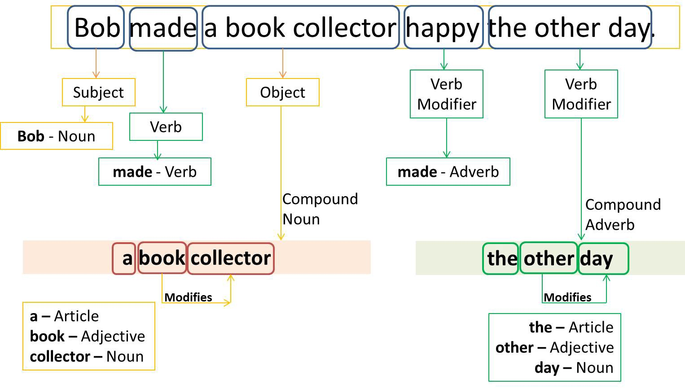
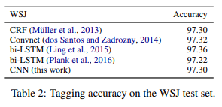
POS tagging
https://nlp.stanford.edu/software/tagger.shtml https://www.nltk.org/book/ch05.html

Slide 42
POS tagging (solved by convolution or recurrence)
https://nlp.stanford.edu/software/tagger.shtml https://www.nltk.org/book/ch05.html

Slide 43
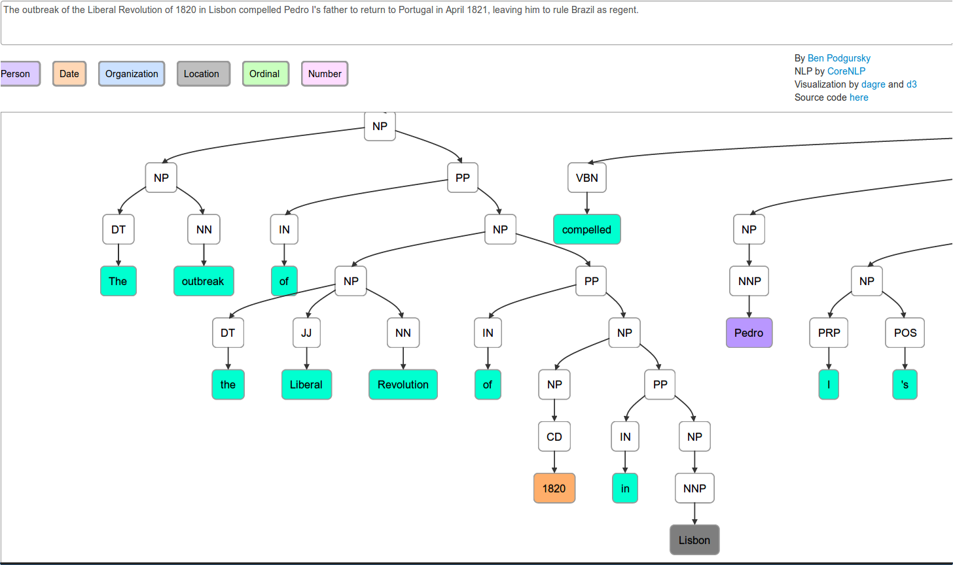
Parsing
https://spacy.io/

Slide 44
Parsing (solved by recurrence)
https://spacy.io/

Slide 45
Semantic NLP problems

Slide 46
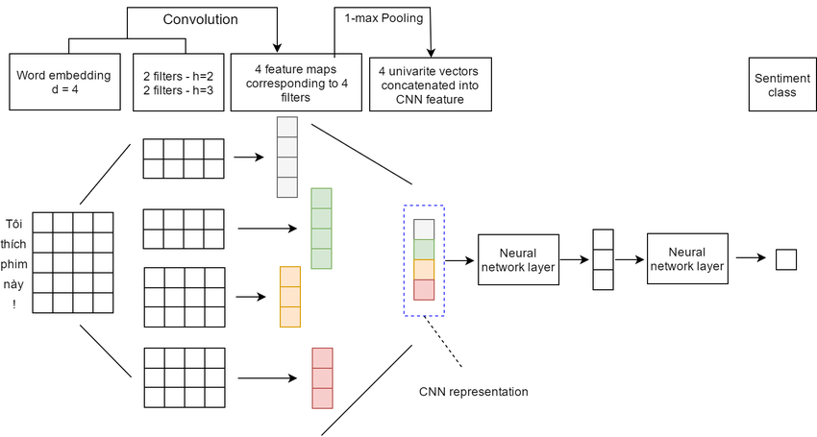
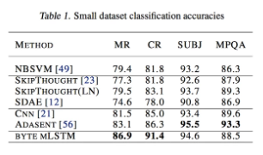
Sentiment analysis (solved by convolution or recurrence)
https://cloud.google.com/natural-language/docs/sentiment-tutorial http://www.nltk.org/howto/sentiment.html
Notes:
http://www.wildml.com/2015/12/implementing-a-cnn-for-text-classification-in-tensorflow/

Slide 47
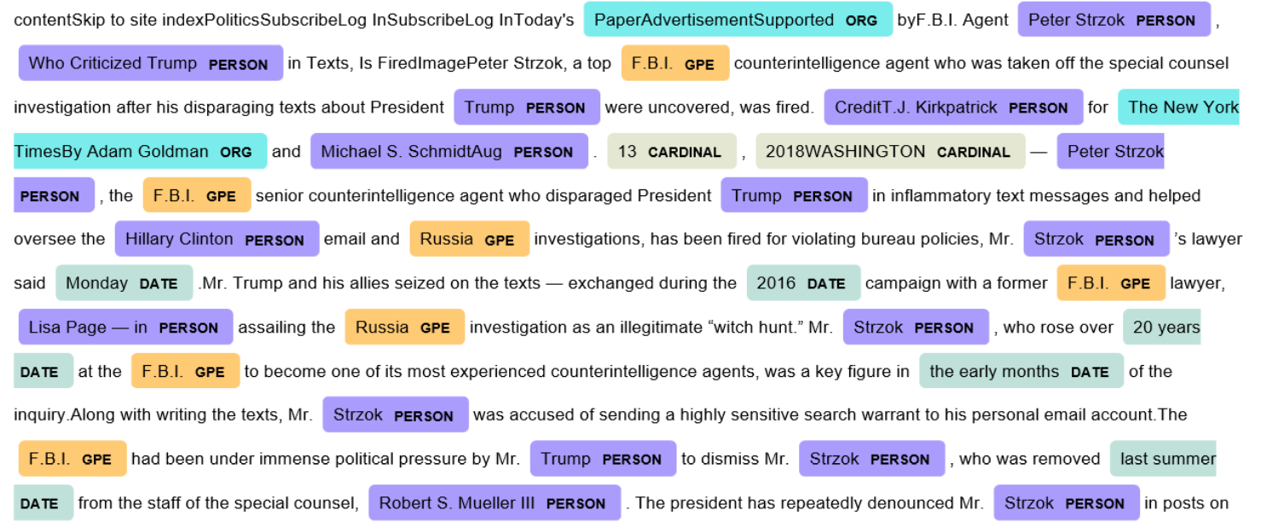
Named entity recognition (solved by convolution and recurrence)
https://arxiv.org/abs/1511.08308

Slide 48
There are entire classes of variable-length problems that can only be solved by recurrence.
Anything requiring long-range patterns
Question detection
Natural language context understanding
Entity disambiguation
Sentence embedding
Anything generative
Machine translation
Natural language generation
Question answering
Skip-thoughts

Slide 49
Looking forward
Computer vision is wrapping up in 2 lectures.
Autoencoders on Wednesday, February 20th
GANs on Monday, February 25th (guest lecture by Sadat Shaik)
HW1 due on Friday
NLP continuing next Wednesday, February 27th.
LSTMs
Discriminative
Generative
Both (seq2seq)
Attention
Transformers
Elmo
Bert

