Slide 1
CIS 700-004: Lecture 9M
RNNs and LSTMs
03/11/19
Notes:
Done

Slide 2
Today's Agenda
Review of NLP and variable-length problems
RNNs
Architecture
Backpropagation through time (BPTT)
LSTMs
Motivation
Forget gates
BiLSTMs
Motivation
Architecture

Slide 3
Project overview

Slide 4
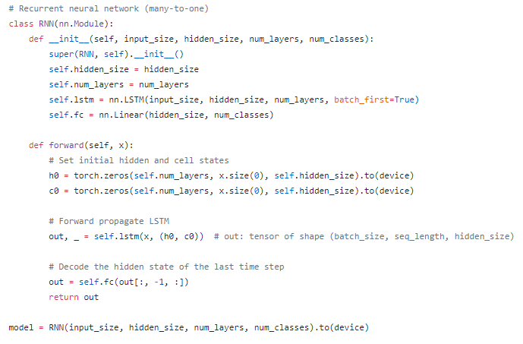

Slide 5
NLP review

Slide 6
Text is bad. What is an ideal representation of words?
Words with same lemma (also known as citation form) have similar representations.
e.g. "sing", "sang", "sung" are all wordforms of the lemma "sing"
Homonyms (e.g. mouse the creature and mouse the cursor control device have different representations.
Synonyms (e.g. lucky, auspicious) have the same representations.
Antonyms (e.g. good, bad) have different representations.
Related words (e.g. coffee and cup) have similar representations.
Hyponyms / hypernyms (e.g. animal and dog) have similar representations.

Slide 7
This is a field of study called lexical semantics.
We adopt a prior from lexical semantics for NLP:
The language-game prior
The meaning of a word is its usage. (Wittgenstein, 1953)
Distributional hypothesis
"a word is characterized by the company it keeps." (Firth, 1957)
The principle of contrast
A difference in usage denotes a difference in meaning (Clark, 1987)

Slide 8
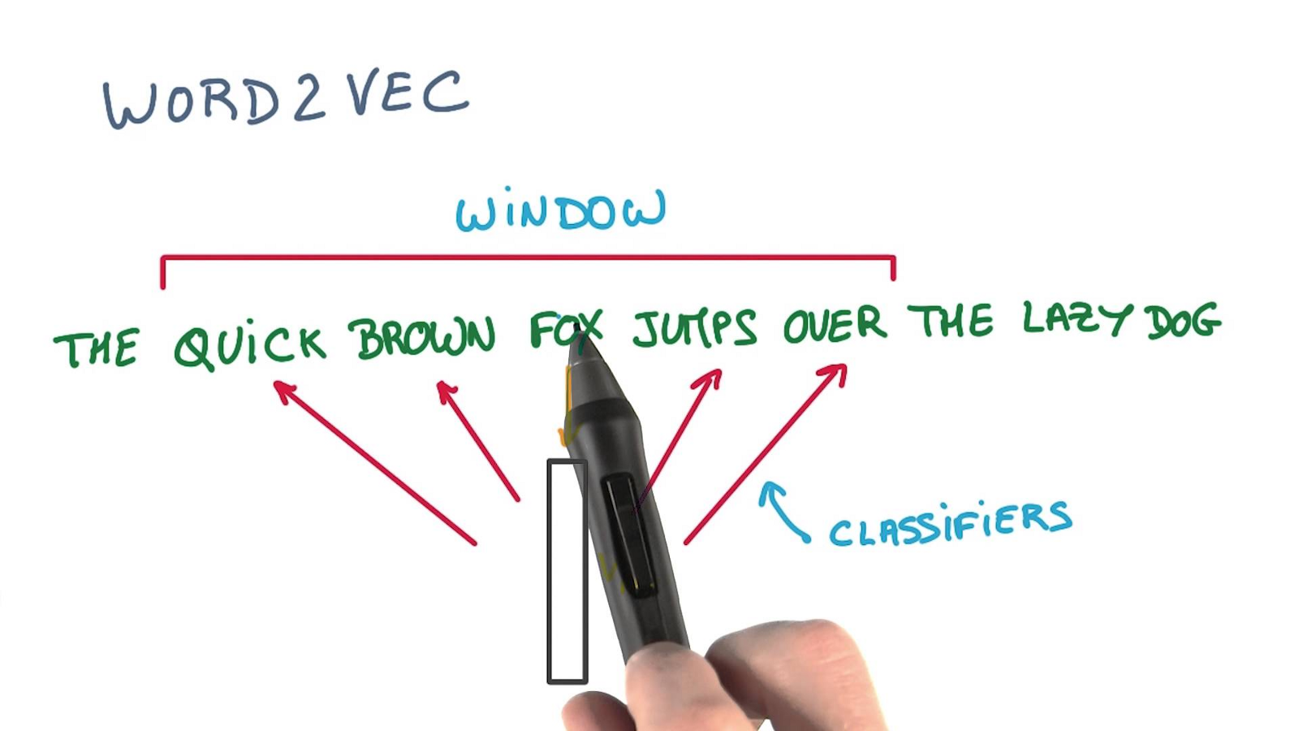
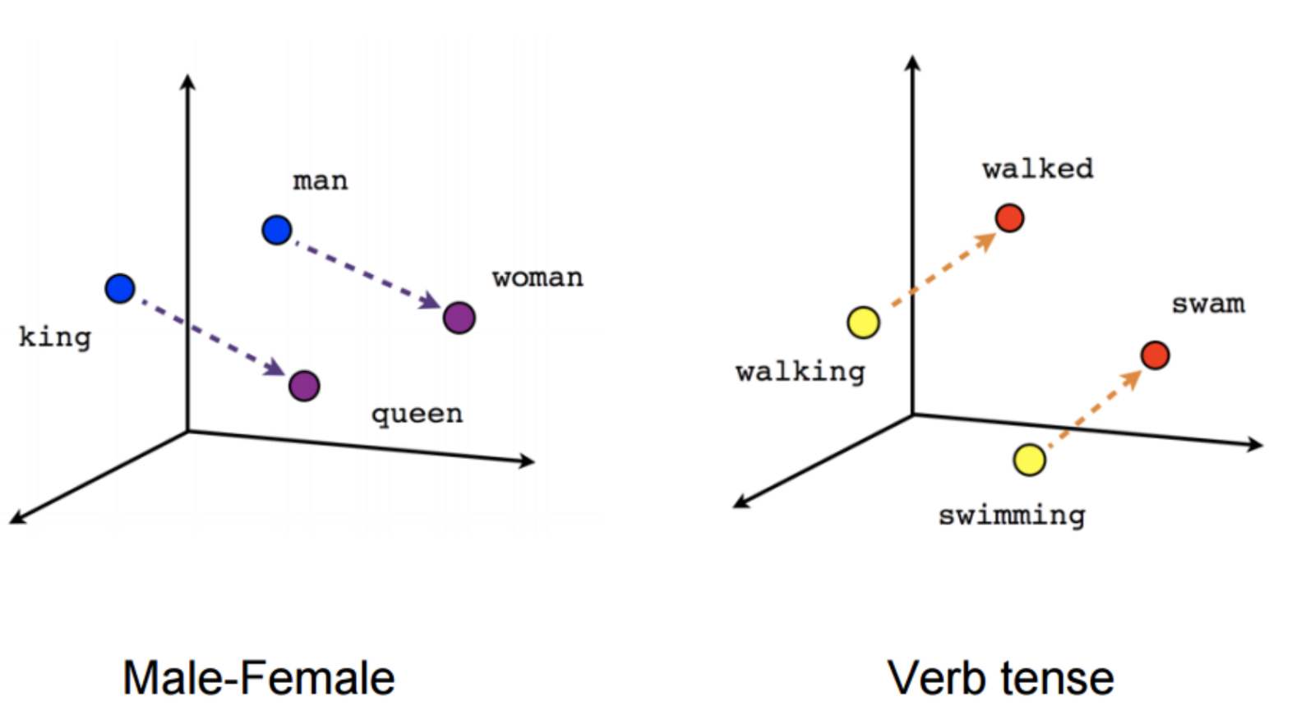
We featurize words into vectors with word2vec.

Slide 9
There are 4 canonical ways to deal with variable length.
Truncation: chop off the tail.
Bagging: turn the vector into a count-dict.
Convolution: convolute over a fixed-length filter and aggregate the results.
Recurrence: make your forward pass variable-length.

Slide 10
Each of the 4 methods has its own prior.
Truncation: chop off the tail.
Use when you have a ranking of the most important features (similar to PCA).
Ex: for each person in a group, we have a variable-length ranked list of their favorite books.

Slide 11
Each of the 4 methods has its own prior.
Truncation: chop off the tail.
Use when you have a ranking of the most important features (similar to PCA).
Ex: for each person in a group, we have a variable-length ranked list of their favorite books.
Bagging: turn the vector into a count-dict.
Use when your prior is that syntax (i.e. ordering) does not matter.
Ex: for each baseball player in a game, we have a sequence of strikes / hits.

Slide 12
Each of the 4 methods has its own prior.
Truncation: chop off the tail.
Use when you have a ranking of the most important features (similar to PCA).
Ex: for each person in a group, we have a variable-length ranked list of their favorite books.
Bagging: turn the vector into a count-dict.
Use when your prior is that syntax (i.e. ordering) does not matter.
Ex: for each baseball player in a game, we have a sequence of strikes / hits.
Convolution: convolute over a fixed-length filter and aggregate the results.
Use when your prior is that only short-term syntax matters.
Ex: n-gram models

Slide 13
Each of the 4 methods has its own prior.
Truncation: chop off the tail.
Use when you have a ranking of the most important features (similar to PCA).
Ex: for each person in a group, we have a variable-length ranked list of their favorite books.
Bagging: turn the vector into a count-dict.
Use when your prior is that syntax (i.e. ordering) does not matter.
Ex: for each baseball player in a game, we have a sequence of strikes / hits.
Convolution: convolute over a fixed-length filter and aggregate the results.
Use when your prior is that only short-term syntax matters.
Ex: n-gram models
Recurrence: make your forward pass variable-length.
Use when your prior is that both short-term and long-term ordering matters.
Ex: most general-purpose NLP architectures

Slide 14
RNNs

Slide 15
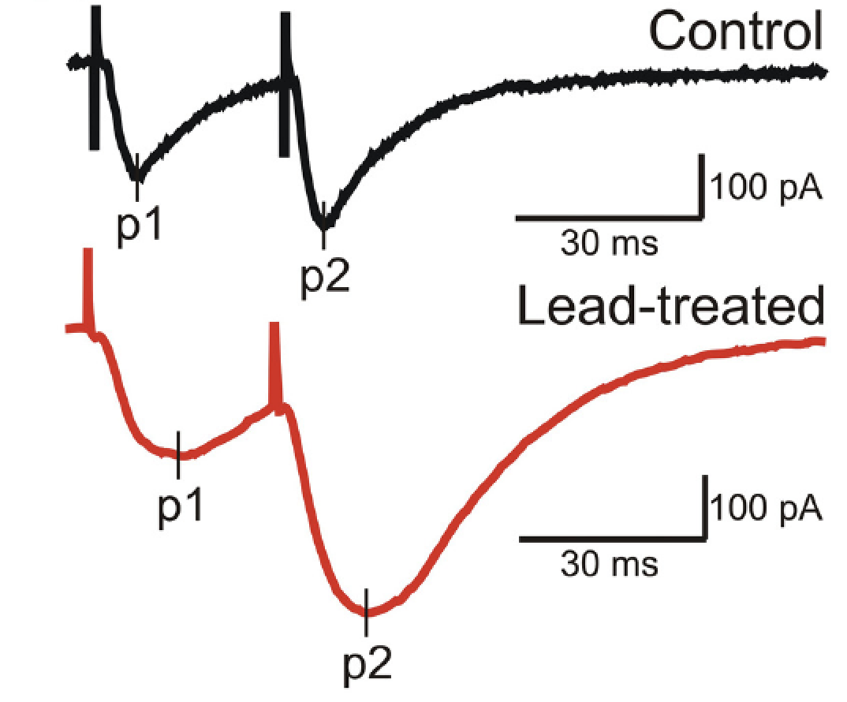
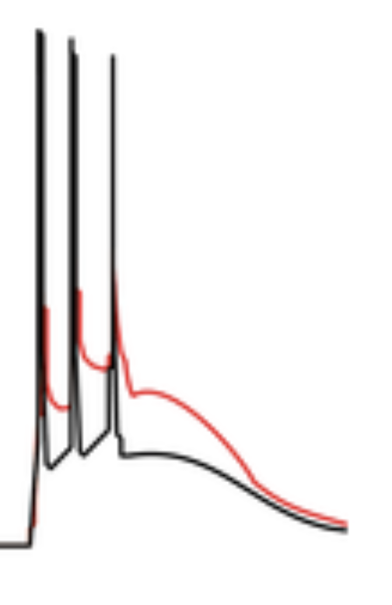
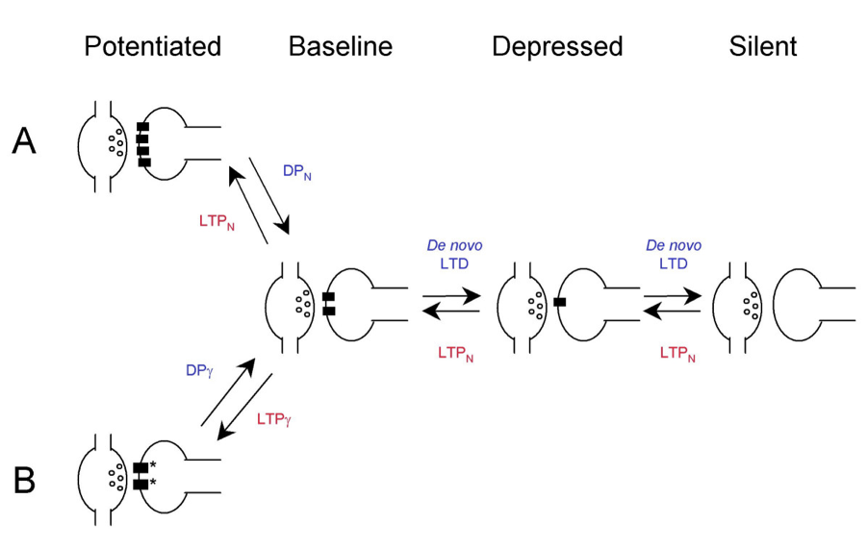
Neuroscience: The ubiquity of memory across timescales
PPF: Zhang et al 2015
Ca2+ spikes:
Larkum
Recurrent activity
Plasticity

Slide 16
Working memory
Pencil
Automobile
Evil

Slide 17
Working memory
Graphic
Element
Mediocre
Steel
Plate
Nociception
Memory

Slide 18
Working memory
Random
Bottle
Phone
Overeager
Card
Plant
Chimney
Tree
House
Roof

Slide 19
A multitude of memory elements
Working memory
Episodic memory
Procedural memory
Declarative memory

Slide 20
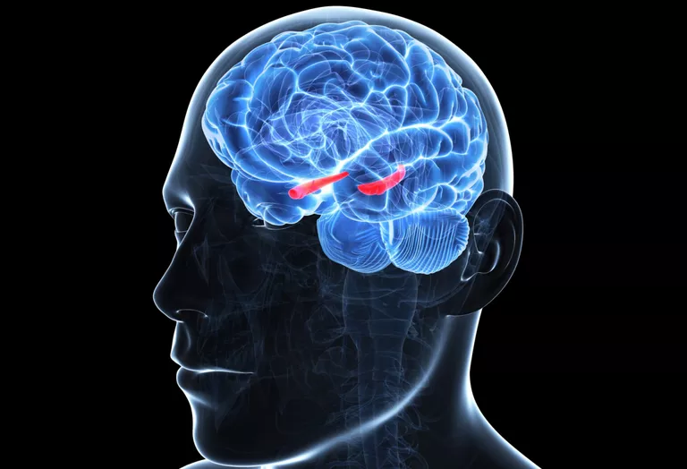
Hippocampus

Slide 21
Thoughts have persistence over time. How can we capture this with an architecture?

Slide 22


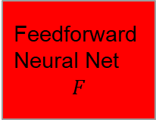


The API for feedforward nets is too restrictive.
$$x_{1}$$
$$x_{2}$$
Feedforward
Neural Net
$$F$$
$$y$$
…
$$x_{m}$$
Notes:
https://medium.com/explore-artificial-intelligence/an-introduction-to-recurrent-neural-networks-72c97bf0912

Slide 23
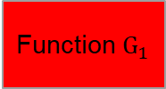
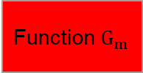


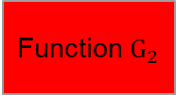

We'd like to have a notion of time and maintain state.
$$x_{1}$$
$$x_{1}$$
Function$G_{1}$
$$h_{1}$$
$$x_{2}$$
Feedforward
Neural Net
$$F$$
Function$G_{2}$
$$x_{2}$$
$$h_{2}$$
$$y$$
…
…
$$x_{m}$$
Function$G_{m}$
$$x_{m}$$
$$y$$
Notes:
https://medium.com/explore-artificial-intelligence/an-introduction-to-recurrent-neural-networks-72c97bf0912

Slide 24
We can't learn a new function for each timestep! How do we simplify our architecture?
Notes:
Space-time comparison with CNNs. Weight sharing.

Slide 25
We can't learn a new function for each timestep! How do we simplify our architecture?
The way we think doesn't change from moment to moment.
Notes:
Space-time comparison with CNNs. Weight sharing.

Slide 26
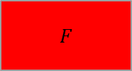
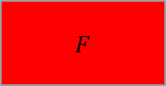
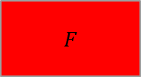
We share weights across time.
$$x_{1}$$
$$x_{1}$$
$$F$$
$$h_{1}$$
$$x_{2}$$
Feedforward
Neural Net
$$F$$
$$F$$
$$x_{2}$$
$$h_{2}$$
$$y$$
…
…
$$x_{m}$$
$$F$$
$$x_{m}$$
$$y$$
Notes:
https://medium.com/explore-artificial-intelligence/an-introduction-to-recurrent-neural-networks-72c97bf0912

Slide 27

Recurrent neural networks (RNNs)
Prior: the function modifying the state of a thought is invariant to temporal shifts.

Slide 28
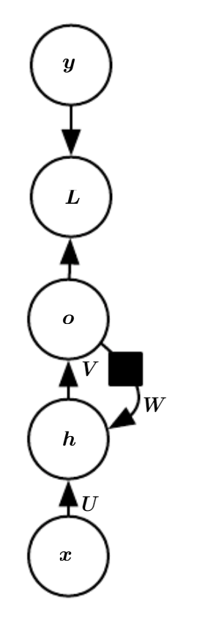
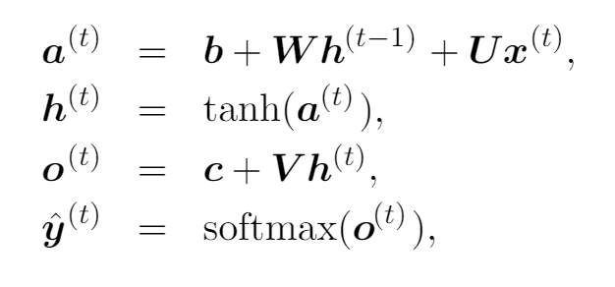
RNNs typically have 3 weight tensors (U, W, V) and 2 biases.
Notes:
board

Slide 29
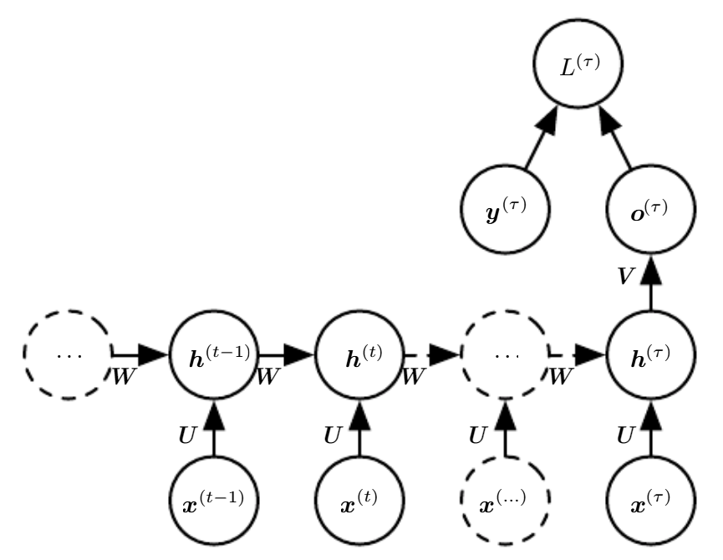
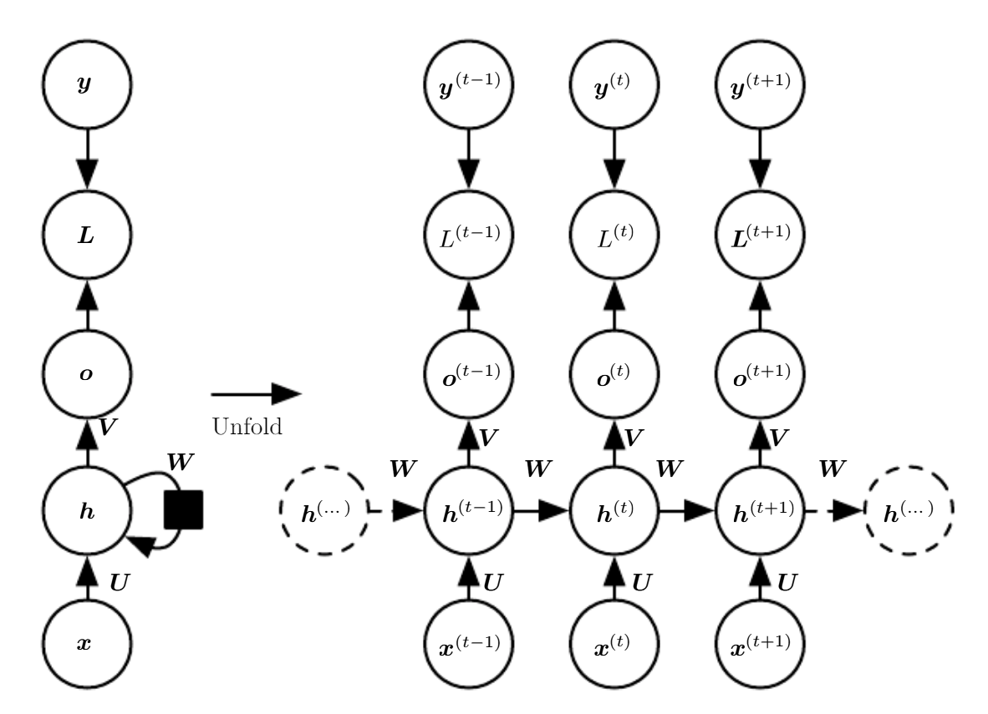
The exact unrolled architecture depends on the learning problem.
Variable-length input, single output at the end.
Variable-length input, simultaneous outputs.
Notes:
board

Slide 30
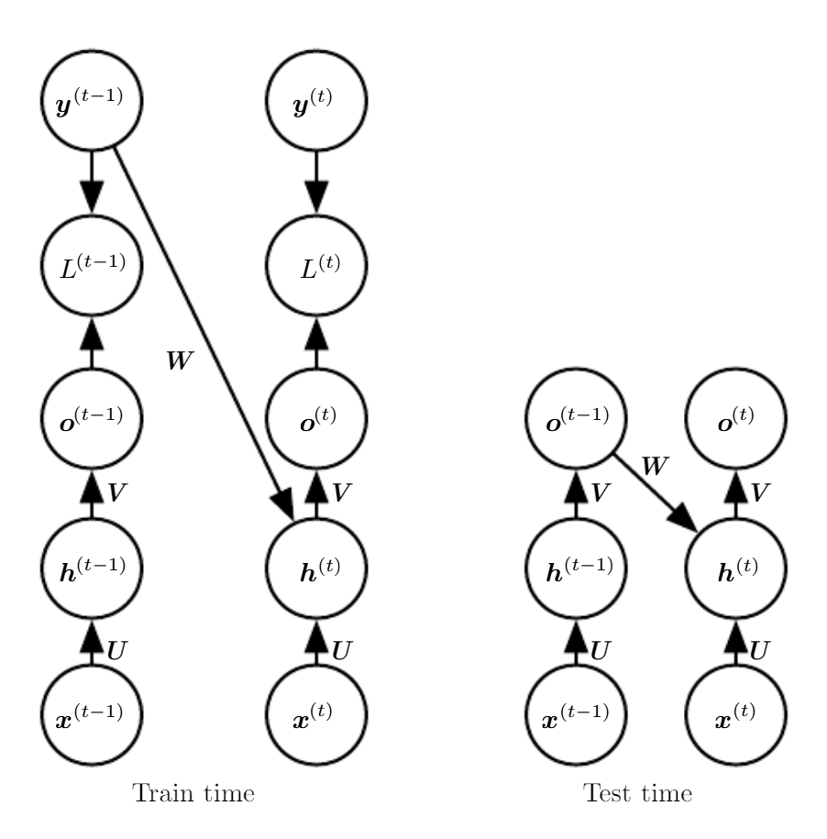
Teacher forcing helps learn complex patterns concurrently.

Slide 31
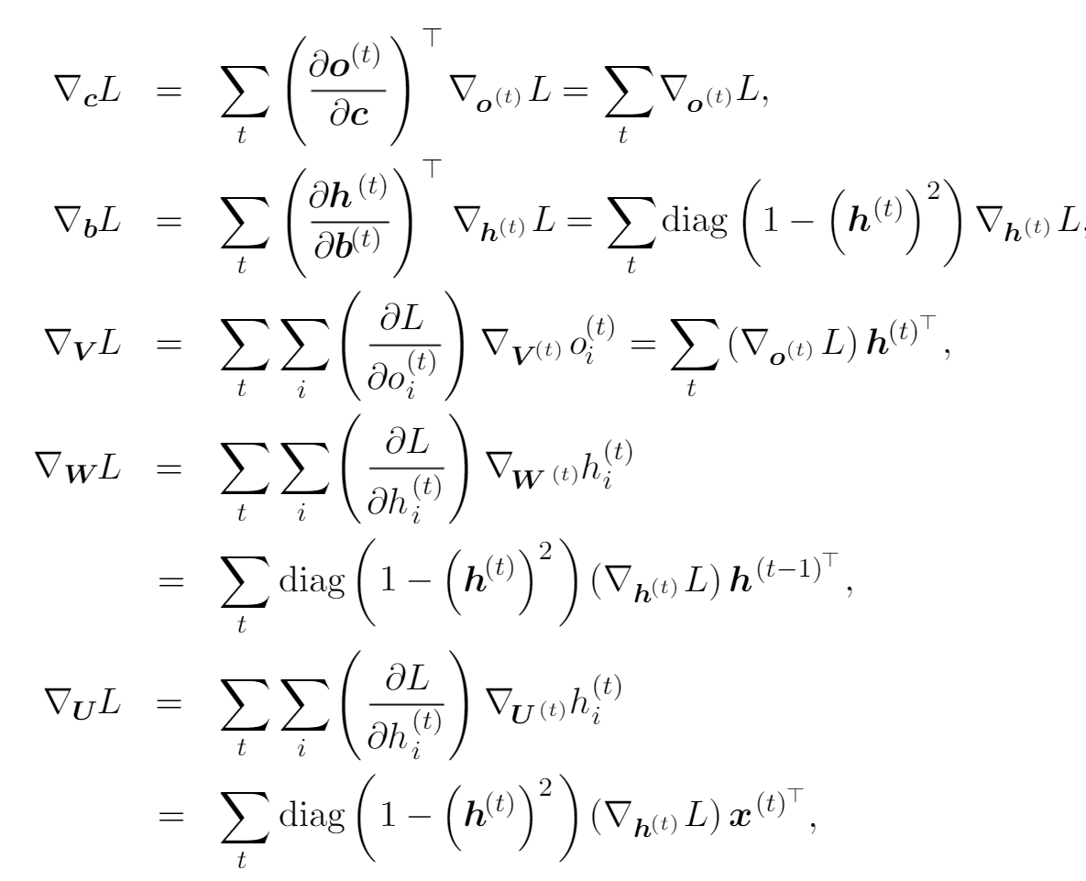
Backpropagation through time (BPTT)
Notes:
http://ir.hit.edu.cn/~jguo/docs/notes/bptt.pdf, see Goodfellow

Slide 32
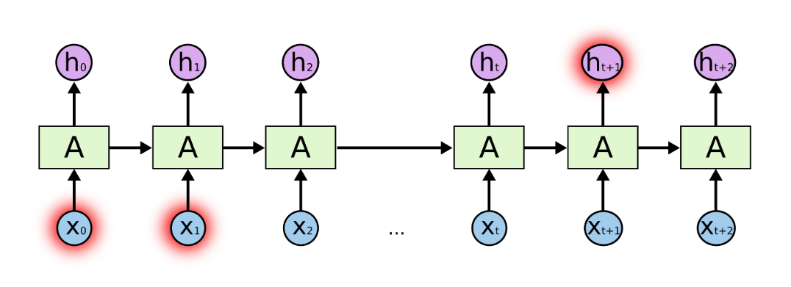
RNNs are awful at learning long-term patterns.
Notes:
http://ai.dinfo.unifi.it/paolo//ps/tnn-94-gradient.pdf

Slide 33
RNNs are awful at learning long-term patterns.
Your gradients will do unkind things.
Notes:
http://ai.dinfo.unifi.it/paolo//ps/tnn-94-gradient.pdf

Slide 34
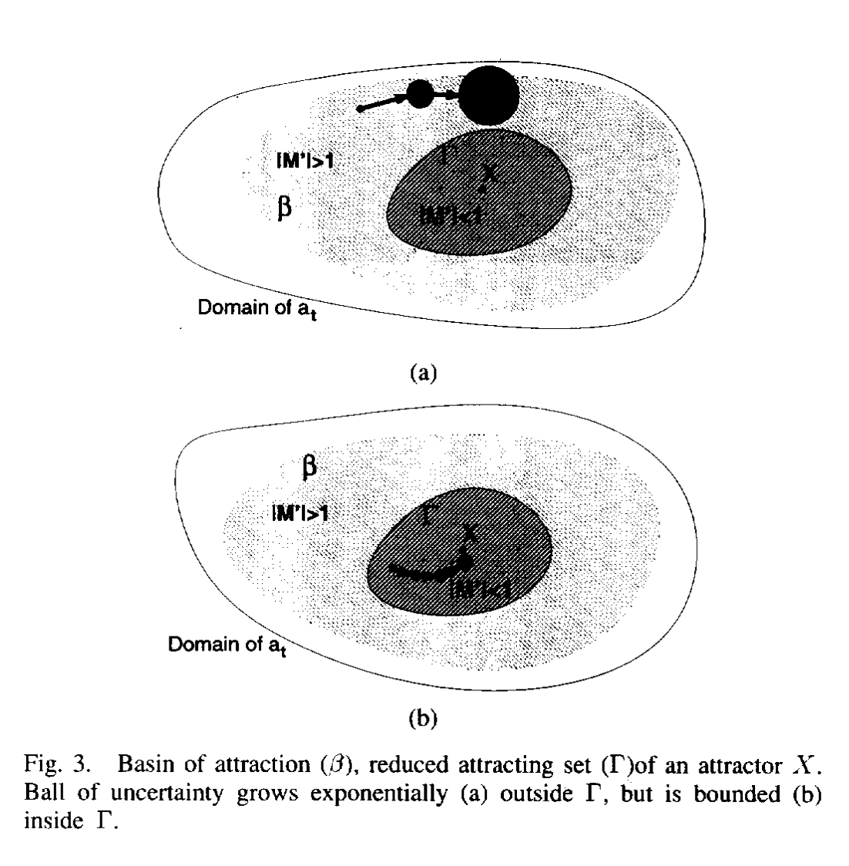
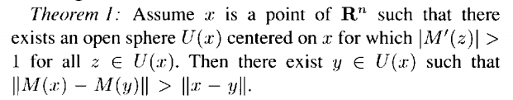
RNNs are awful at learning long-term patterns.
Notes:
http://ai.dinfo.unifi.it/paolo//ps/tnn-94-gradient.pdf

Slide 35
LSTMs

Slide 36

Anatomy of a forget gate

Slide 37
Example of an LSTM
Design an LSTM that remembers the last nonzero element in a stream of numbers.

Slide 38
biLSTMs

Slide 39
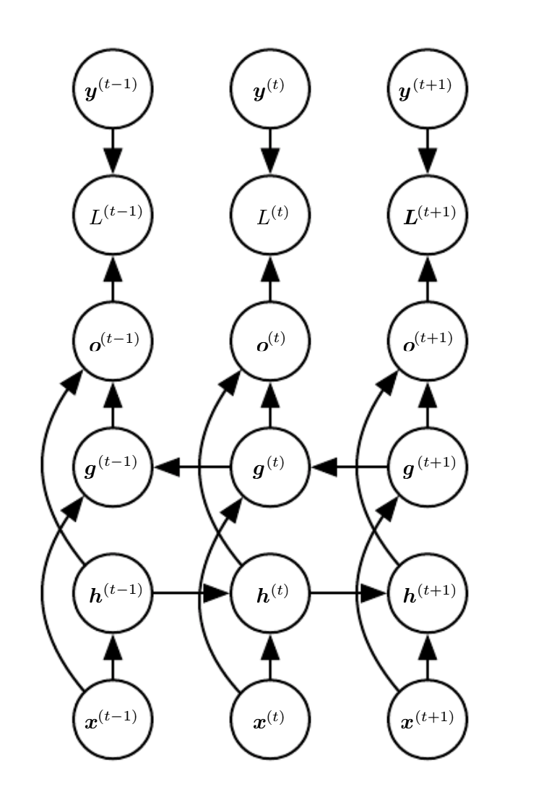
Architecture of a biLSTM

Slide 40
PyTorch implementation

Slide 41
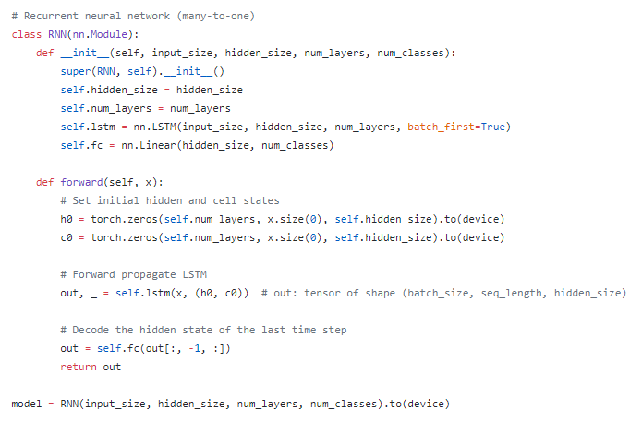
LSTM

Slide 42
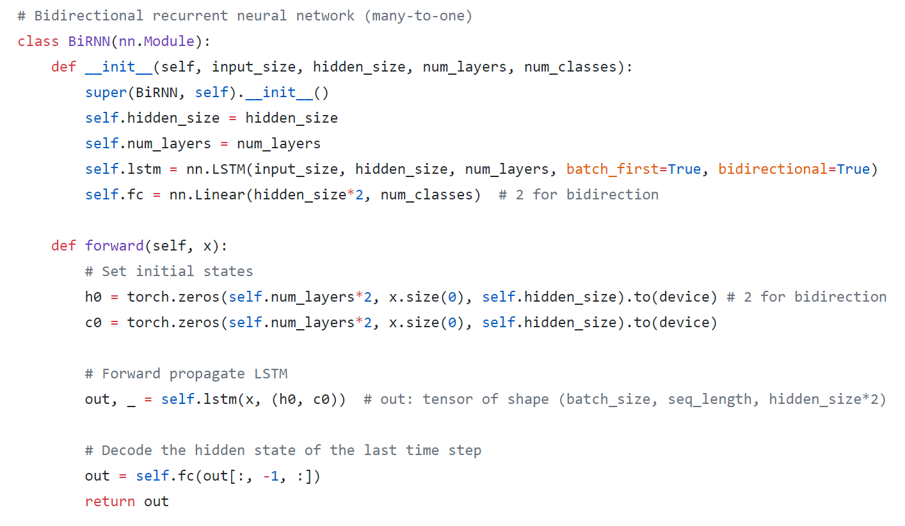
biLSTM

