Slide 1

Introduction to CUDA 1 of 2
Patrick Cozzi
University of Pennsylvania
CIS 565 - Fall 2012

Slide 2
Announcements
Project 0 due Tues 09/18
Project 1 released today. Due Friday 09/28
Starts student blogs
Get approval for all third-party code

Slide 3
Acknowledgements
Many slides are from David Kirk and Wen-mei Hwu’s UIUC course:
http://courses.engr.illinois.edu/ece498/al/

Slide 4
GPU Architecture Review
GPUs are specialized for
Compute-intensive, highly parallel computation
Graphics!
Transistors are devoted to:
Processing
Not:
Data caching
Flow control

Slide 5
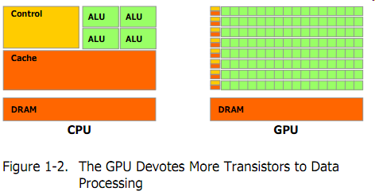
GPU Architecture Review
Transistor Usage
Image from: http://developer.download.nvidia.com/compute/cuda/3_2_prod/toolkit/docs/CUDA_C_Programming_Guide.pdf

Slide 6
Let’s program this thing!

Slide 7
GPU Computing History
2001/2002 – researchers see GPU as data-parallel coprocessor
The GPGPU field is born
2007 – NVIDIA releases CUDA
CUDA – Compute Uniform Device Architecture
GPGPU shifts to GPU Computing
2008 – Khronos releases OpenCL specification
Notes:
More recent – WebCL and compute shaders in OpenGL 4.3. Compute shaders have been in Direct3D for a while.

Slide 8
CUDA Abstractions
A hierarchy of thread groups
Shared memories
Barrier synchronization

Slide 9
CUDA Terminology
Host – typically the CPU
Code written in ANSI C
Device – typically the GPU (data-parallel)
Code written in extended ANSI C
Host and device have separate memories
CUDA Program
Contains both host and device code

Slide 10
CUDA Terminology
Kernel – data-parallel function
Invoking a kernel creates lightweight threads on the device
Threads are generated and scheduled with hardware
Similar to a shader in OpenGL?

Slide 11
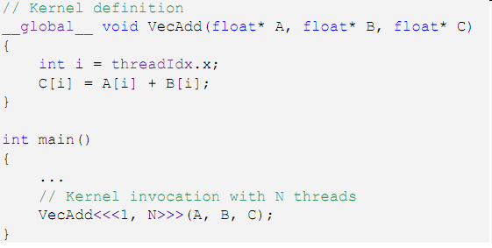
CUDA Kernels
Executed N times in parallel by N different CUDA threads
Thread ID
Declaration
Specifier
Execution
Configuration
Notes:
threadIdx is a 3-component vector

Slide 12
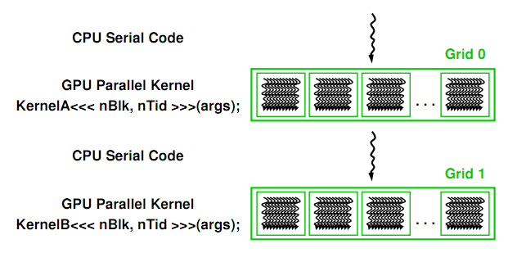
CUDA Program Execution
Image from: http://courses.engr.illinois.edu/ece498/al/textbook/Chapter2-CudaProgrammingModel.pdf

Slide 13
Thread Hierarchies
Grid – one or more thread blocks
1D or 2D
Block – array of threads
1D, 2D, or 3D
Each block in a grid has the same number of threads
Each thread in a block can
Synchronize
Access shared memory

Slide 14
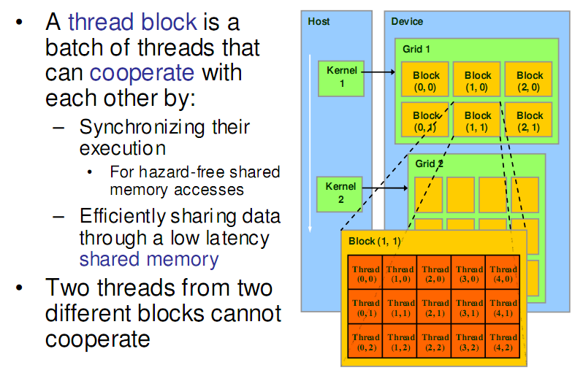
Thread Hierarchies
Image from: http://courses.engr.illinois.edu/ece498/al/textbook/Chapter2-CudaProgrammingModel.pdf

Slide 15
Thread Hierarchies
Block – 1D, 2D, or 3D
Example: Index into vector, matrix, volume

Slide 16
Thread Hierarchies
Thread ID: Scalar thread identifier
Thread Index: threadIdx
1D: Thread ID == Thread Index
2D with size (D_{x}, D_{y})
Thread ID of index (x, y) == x + y D_{y}
3D with size (D_{x}, D_{y,} D_{z})
Thread ID of index (x, y, z) == x + y D_{y} + z D_{x} D_{y}

Slide 17
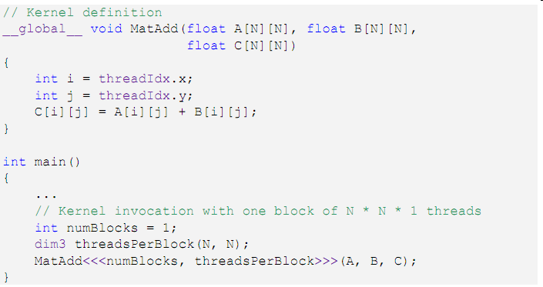
Thread Hierarchies
2D Index
1 Thread Block
2D Block

Slide 18
Thread Hierarchies
Thread Block
Group of threads
G80 and GT200: Up to 512 threads
Fermi: Up to 1024 threads
Reside on same processor core
Share memory of that core

Slide 19
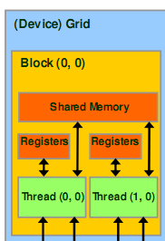
Thread Hierarchies
Thread Block
Group of threads
G80 and GT200: Up to 512 threads
Fermi: Up to 1024 threads
Reside on same processor core
Share memory of that core
Image from: http://courses.engr.illinois.edu/ece498/al/textbook/Chapter2-CudaProgrammingModel.pdf

Slide 20
Thread Hierarchies
Block Index: blockIdx
Dimension: blockDim
1D or 2D

Slide 21
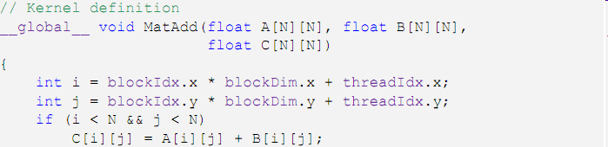
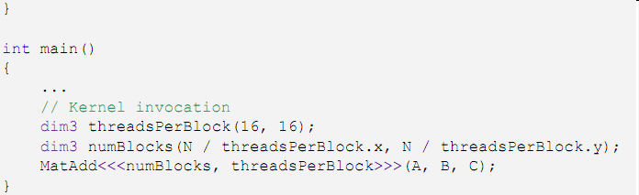
Thread Hierarchies
16x16
Threads per block
2D Thread Block

Slide 22
Thread Hierarchies
Example: N = 32
16x16 threads per block (independent of N)
threadIdx ([0, 15], [0, 15])
2x2 thread blocks in grid
blockIdx ([0, 1], [0, 1])
blockDim = 16
i = [0, 1] * 16 + [0, 15]

Slide 23
Thread Hierarchies
Thread blocks execute independently
In any order: parallel or series
Scheduled in any order by any number of cores
Allows code to scale with core count

Slide 24
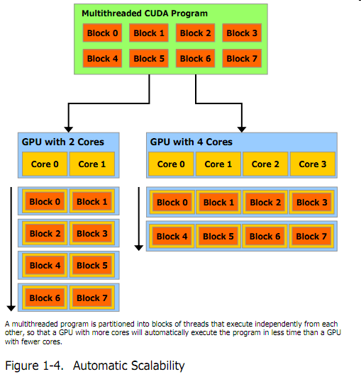
Thread Hierarchies
Image from: http://developer.download.nvidia.com/compute/cuda/3_2_prod/toolkit/docs/CUDA_C_Programming_Guide.pdf
Notes:
Scheduled by the CUDA runtime

Slide 25
Thread Hierarchies
Threads in a block
Share (limited) low-latency memory
Synchronize execution
To coordinate memory accesses
__syncThreads()
Barrier – threads in block wait until all threads reach this
Lightweight
Image from: http://courses.engr.illinois.edu/ece498/al/textbook/Chapter2-CudaProgrammingModel.pdf

Slide 26
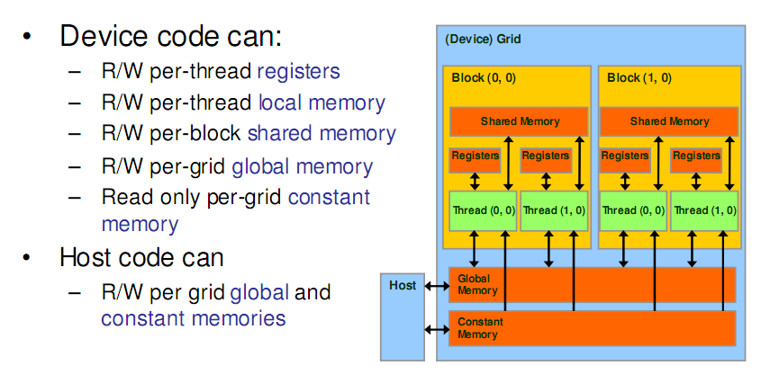
CUDA Memory Transfers
Image from: http://courses.engr.illinois.edu/ece498/al/textbook/Chapter2-CudaProgrammingModel.pdf

Slide 27
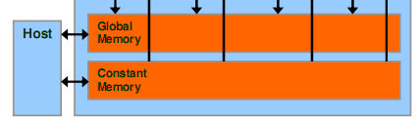
CUDA Memory Transfers
Host can transfer to/from device
Global memory
Constant memory
Image from: http://courses.engr.illinois.edu/ece498/al/textbook/Chapter2-CudaProgrammingModel.pdf

Slide 28
CUDA Memory Transfers
cudaMalloc()
Allocate global memory on device
cudaFree()
Frees memory
Image from: http://courses.engr.illinois.edu/ece498/al/textbook/Chapter2-CudaProgrammingModel.pdf

Slide 29
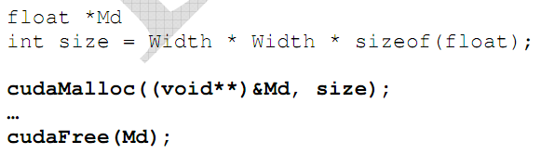
CUDA Memory Transfers
Code from: http://courses.engr.illinois.edu/ece498/al/textbook/Chapter2-CudaProgrammingModel.pdf

Slide 30
CUDA Memory Transfers
Pointer to device memory
Code from: http://courses.engr.illinois.edu/ece498/al/textbook/Chapter2-CudaProgrammingModel.pdf

Slide 31
CUDA Memory Transfers
Size in bytes
Code from: http://courses.engr.illinois.edu/ece498/al/textbook/Chapter2-CudaProgrammingModel.pdf

Slide 32
CUDA Memory Transfers
cudaMemcpy()
Memory transfer
Host to host
Host to device
Device to host
Device to device
Host
Device
Global Memory
Similar to buffer objects in OpenGL

Slide 33
CUDA Memory Transfers
cudaMemcpy()
Memory transfer
Host to host
Host to device
Device to host
Device to device
Host
Device
Global Memory

Slide 34
CUDA Memory Transfers
cudaMemcpy()
Memory transfer
Host to host
Host to device
Device to host
Device to device
Host
Device
Global Memory

Slide 35
CUDA Memory Transfers
cudaMemcpy()
Memory transfer
Host to host
Host to device
Device to host
Device to device
Host
Device
Global Memory

Slide 36
CUDA Memory Transfers
cudaMemcpy()
Memory transfer
Host to host
Host to device
Device to host
Device to device
Host
Device
Global Memory

Slide 37
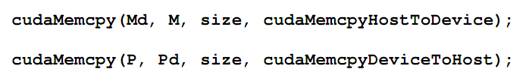
CUDA Memory Transfers
Host to device
Host
Device
Global Memory
Code from: http://courses.engr.illinois.edu/ece498/al/textbook/Chapter2-CudaProgrammingModel.pdf

Slide 38
CUDA Memory Transfers
Destination (device)
Source (host)
Host
Device
Global Memory
Code from: http://courses.engr.illinois.edu/ece498/al/textbook/Chapter2-CudaProgrammingModel.pdf

Slide 39
CUDA Memory Transfers
Host
Device
Global Memory
Code from: http://courses.engr.illinois.edu/ece498/al/textbook/Chapter2-CudaProgrammingModel.pdf

Slide 40
Matrix Multiply Reminder
Vectors
Dot products
Row major or column major?
Dot product per output element

Slide 41
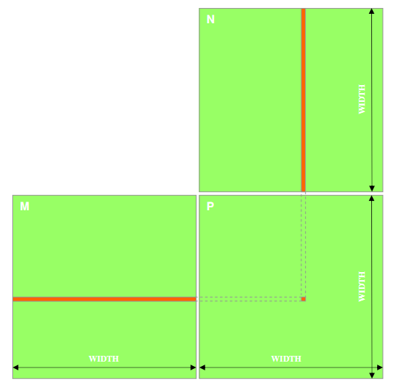
Matrix Multiply
P = M * N
Assume M and N are square for simplicity
Image from: http://courses.engr.illinois.edu/ece498/al/textbook/Chapter2-CudaProgrammingModel.pdf

Slide 42
Matrix Multiply
1,000 x 1,000 matrix
1,000,000 dot products
Each 1,000 multiples and 1,000 adds

Slide 43
Matrix Multiply: CPU Implementation
void MatrixMulOnHost(float* M, float* N, float* P, int width)‏
{
for (int i = 0; i < width; ++i)‏
for (int j = 0; j < width; ++j)
{
float sum = 0;
for (int k = 0; k < width; ++k)
{
float a = M[i * width + k];
float b = N[k * width + j];
sum += a * b;
}
P[i * width + j] = sum;
}
}
Code from: http://courses.engr.illinois.edu/ece498/al/lectures/lecture3%20cuda%20threads%20spring%202010.ppt

Slide 44
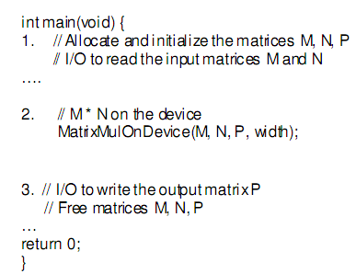
Matrix Multiply: CUDA Skeleton
Code from: http://courses.engr.illinois.edu/ece498/al/textbook/Chapter2-CudaProgrammingModel.pdf

Slide 45
Matrix Multiply: CUDA Skeleton
Code from: http://courses.engr.illinois.edu/ece498/al/textbook/Chapter2-CudaProgrammingModel.pdf

Slide 46
Matrix Multiply: CUDA Skeleton
Code from: http://courses.engr.illinois.edu/ece498/al/textbook/Chapter2-CudaProgrammingModel.pdf

Slide 47
Matrix Multiply
Step 1
Add CUDA memory transfers to the skeleton

Slide 48
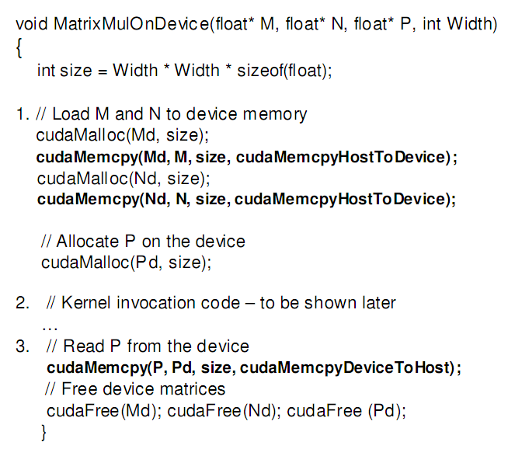
Matrix Multiply: Data Transfer
Allocate input
Code from: http://courses.engr.illinois.edu/ece498/al/textbook/Chapter2-CudaProgrammingModel.pdf

Slide 49
Matrix Multiply: Data Transfer
Allocate output
Code from: http://courses.engr.illinois.edu/ece498/al/textbook/Chapter2-CudaProgrammingModel.pdf

Slide 50
Matrix Multiply: Data Transfer
Code from: http://courses.engr.illinois.edu/ece498/al/textbook/Chapter2-CudaProgrammingModel.pdf

Slide 51
Matrix Multiply: Data Transfer
Read back from device
Code from: http://courses.engr.illinois.edu/ece498/al/textbook/Chapter2-CudaProgrammingModel.pdf

Slide 52
Matrix Multiply: Data Transfer
Similar to GPGPU with GLSL.
Code from: http://courses.engr.illinois.edu/ece498/al/textbook/Chapter2-CudaProgrammingModel.pdf

Slide 53
Matrix Multiply
Step 2
Implement the kernel in CUDA C

Slide 54
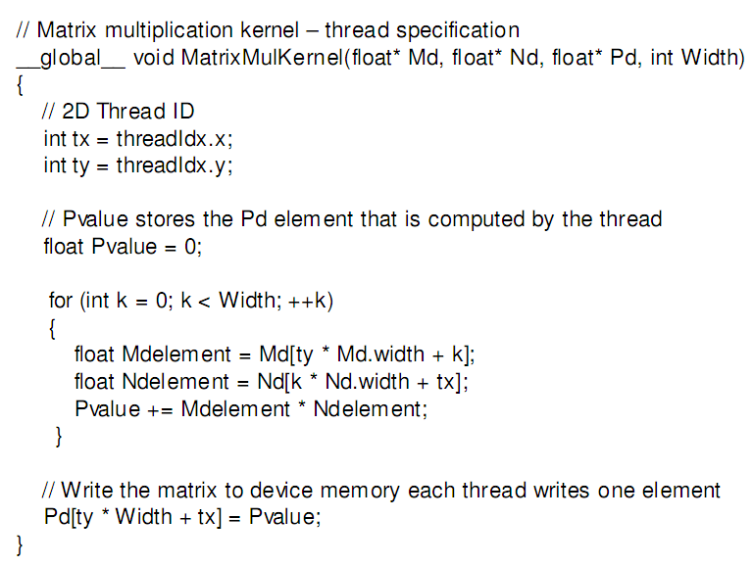
Matrix Multiply: CUDA Kernel
Accessing a matrix, so using a 2D block
Code from: http://courses.engr.illinois.edu/ece498/al/textbook/Chapter2-CudaProgrammingModel.pdf

Slide 55
Matrix Multiply: CUDA Kernel
Each kernel computes one output
Code from: http://courses.engr.illinois.edu/ece498/al/textbook/Chapter2-CudaProgrammingModel.pdf

Slide 56
Matrix Multiply: CUDA Kernel
Where did the two outer for loops in the CPU implementation go?
Code from: http://courses.engr.illinois.edu/ece498/al/textbook/Chapter2-CudaProgrammingModel.pdf

Slide 57
Matrix Multiply: CUDA Kernel
No locks or synchronization, why?
Code from: http://courses.engr.illinois.edu/ece498/al/textbook/Chapter2-CudaProgrammingModel.pdf

Slide 58
Matrix Multiply
Step 3
Invoke the kernel in CUDA C

Slide 59
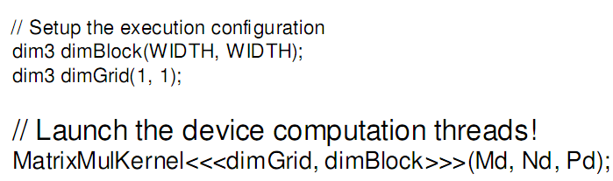
Matrix Multiply: Invoke Kernel
One block with width by width threads
Code from: http://courses.engr.illinois.edu/ece498/al/textbook/Chapter2-CudaProgrammingModel.pdf

Slide 60
Matrix Multiply
Nd
Grid 1
One Block of threads compute matrix Pd
Each thread computes one element of Pd
Each thread
Loads a row of matrix Md
Loads a column of matrix Nd
Perform one multiply and addition for each pair of Md and Nd elements
Compute to off-chip memory access ratio close to 1:1 (not very high)‏
Size of matrix limited by the number of threads allowed in a thread block
Block 1
Thread
(2, 2)‏
48
WIDTH
Md
Pd
Slide from: http://courses.engr.illinois.edu/ece498/al/lectures/lecture2%20cuda%20spring%2009.ppt

Slide 61
Matrix Multiply
What is the major performance problem with our implementation?
What is the major limitation?

