Slide 1






WebGL
Patrick Cozzi
University of Pennsylvania
CIS 565 - Fall 2012

Slide 2





WebGL
The web has text, images, and video
What is the next media-type?
We want to support
Windows, Linux, Mac
Desktop and mobile

Slide 3
Bring 3D to the Masses
Put it in on a webpage
Does not require a plugin or install
Does not require administrator rights
Make it run on most GPUs

Slide 4
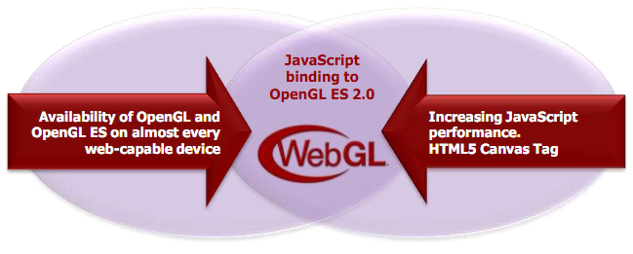
WebGL
OpenGL ES 2.0 for JavaScript
Seriously, JavaScript
Image from http://www.khronos.org/assets/uploads/developers/library/2011-siggraph-mobile/Khronos-and-the-Mobile-Ecosystem_Aug-11.pdf

Slide 5
WebGL
Includes
Vertex shaders
Fragment shaders
Vertex buffers
Textures
Framebuffers
Render states
…
Does not include
Geometry shaders
Tessellation shaders
Vertex Array Objects
Multiple render targets
Floating-point textures
Compressed textures
FS depth writes
…
See http://www.khronos.org/registry/webgl/specs/latest/

Slide 6
WebGL
If you know OpenGL, you already know WebGL
If you know C++, the real learning curve is JavaScript

Slide 7
WebGL Alternatives?
Flash
Silverlight
Java Applets
Unity

Slide 8
WebGL
Creating a context is easy:
// HTML:
<canvas id="glCanvas" width="1024" height="768"></canvas>
// JavaScript:
var gl = document.getElementById("glCanvas").getContext("experimental-webgl");
Notes:
Try “webgl”, then “experimental-webgl”

Slide 9
WebGL
The rest is similar to desktop OpenGL:
// ...
gl.bindBuffer(/* ... */);
gl.vertexAttribPointer(/* ... */);
gl.useProgram(/* ... */);
gl.drawArrays(/* ... */);
Checkout http://learningwebgl.com/

Slide 10
WebGL
Create an animation loop:
(function tick(){
// ... GL calls to draw scene
window.requestAnimationFrame(tick);
})();
You want this to work cross-browser. See http://paulirish.com/2011/requestanimationframe-for-smart-animating/

Slide 11
WebGL Performance
Performance can be very good. Why?

Slide 12
WebGL Performance
Performance can be very good. Why?
The GPU is still doing the rendering
Batch!
Draw multiple objects with one draw call
Sort by texture
Push work into shaders
Push work into web workers
See http://www.youtube.com/watch?v=rfQ8rKGTVlg

Slide 13
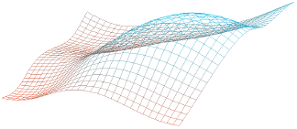
WebGL Performance
 | 32x32 | 64x64 | 128x128
C++ | 1.9 ms | 6.25 ms | 58.82 ms
Chrome 18 | 27.77 ms | 111.11 ms | 454.54 ms
x slowdown | 14.62 | 17.78 | 7.73
CPU-intensive
 | 32x32 | 64x64 | 128x128
C++ | 3.33 ms | 9.43 ms | 37.03 ms
Chrome 18 | 12.82 ms | 22.72 ms | 41.66 ms
x slowdown | 3.85 | 2.41 | 1.13
GPU-intensive (256 draws per frame)
Image from http://openglinsights.com/
Notes:
A 32x32 grid evenly spaced in the xy plane; each point's z component is determined by a 3D noise function given the xy position and the current time.

Slide 14
WebGL and other APIs
Take advantage of other web APIs:
HTML5 <video>
2D <canvas>
CSS transforms
Composite UI elements
Web workers
Typed Arrays

Slide 15
HTML5 on Mobile
Touch events
Test with http://www.snappymaria.com/misc/TouchEventTest_v2.html
Geolocation
Device orientation and motion
The future of HTML5 and WebGL on mobile is very promising
Notes:
Touch events: http://www.html5rocks.com/en/mobile/touch.html
Geolocation: http://diveintohtml5.org/geolocation.html
Orientation and motion: http://www.html5rocks.com/en/tutorials/device/orientation/

Slide 16
WebGL support is good, and it is getting better…

Slide 17
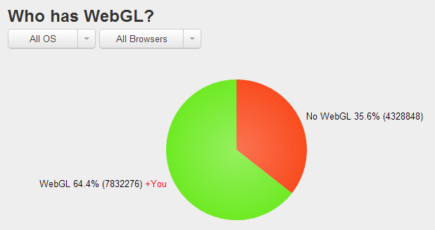
WebGL Stats
In October, 2012
http://webglstats.com/
Notes:
Drivers can be a problem.

Slide 18



Desktop WebGL Support
In October, 2012
- 3rd Party Plugins available
See http://www.khronos.org/webgl/wiki/Getting_a_WebGL_Implementation
Notes:
Safari – Mac OSX only and needs a switch to turn it on.

Slide 19
Android WebGL Support
In October, 2012
Stock Browser
Demo at SIGGRAPH 2011
For Cesium, see our mobile page
Notes:
Chrome to get WebGL support soon
Firefox (Beta) rapidly getting better

Slide 20

Mobile WebGL Support
In October, 2012
In iOS 5 for iAd developers
See http://news.cnet.com/8301-30685_3-20071902-264/apple-signs-up-for-webgl-graphics-in-iads/

Slide 21
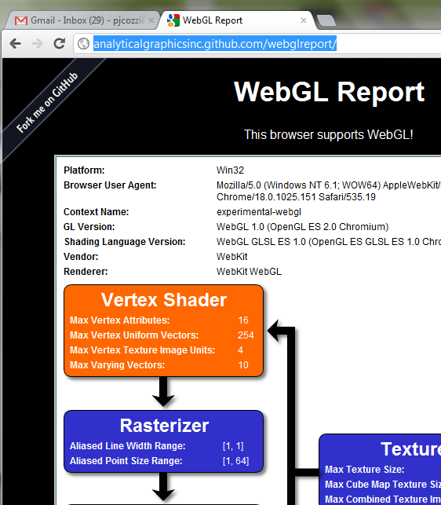
WebGL on Your System
http://www.webglreport.com

Slide 22
Desktop WebGL Support
Windows
No OpenGL driver installed? Old driver?
Only 35% of Windows XP machines have GL 2 drivers
Buggy driver?
No problem:
ANGLE – Almost Native Graphics Layer Engine
OpenGL ES 2.0
Direct3D 9
See http://code.google.com/p/angleproject/
Notes:
ANGLE
Implements GL ES API over D3D 9
Translates GLSL ES to HLSL

Slide 23
WebCL
OpenCL bindings for JavaScript are coming.
N-Body Simulation
http://www.youtube.com/watch?v=F7YSQxz3j7o
http://www.khronos.org/webcl/
Prototypes for Firefox and WebKit are available
Notes:
Calculates the positions and velocities of N particles and animates them
For 1024 particles, WebCL gets 20~40x faster simulation time on Mac

Slide 24
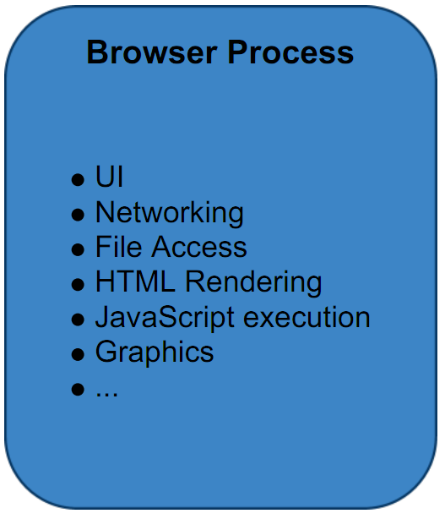
Browser Architecture
Single Process
See http://www.khronos.org/assets/uploads/developers/library/2010_siggraph_bof_webgl/WebGL-BOF-2-WebGL-in-Chrome_SIGGRAPH-Jul29.pdf

Slide 25
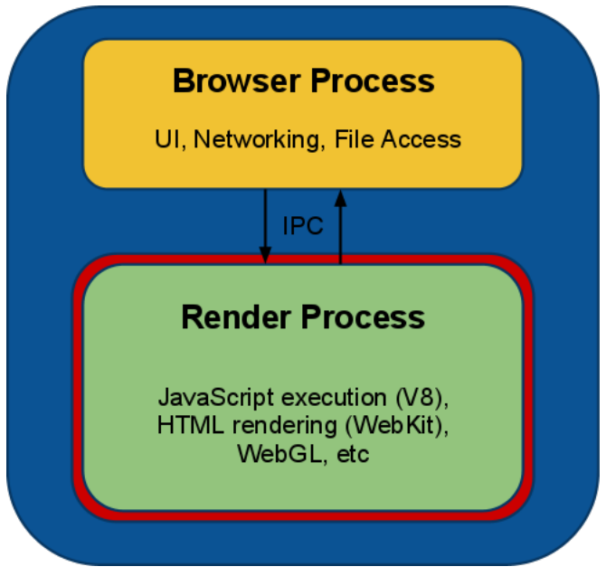
Browser Architecture
Chrome’s Multi-process
See http://www.khronos.org/assets/uploads/developers/library/2010_siggraph_bof_webgl/WebGL-BOF-2-WebGL-in-Chrome_SIGGRAPH-Jul29.pdf

Slide 26
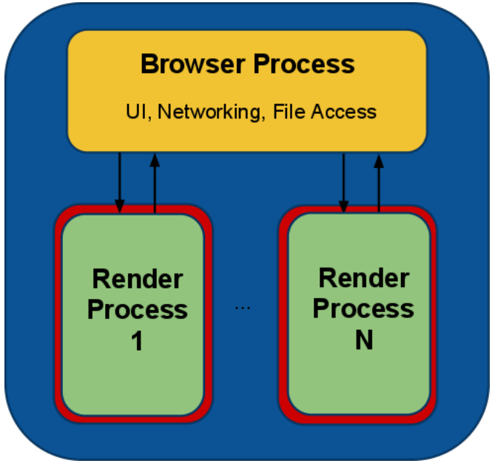
Browser Architecture
Chrome’s Multi-process
See http://www.khronos.org/assets/uploads/developers/library/2010_siggraph_bof_webgl/WebGL-BOF-2-WebGL-in-Chrome_SIGGRAPH-Jul29.pdf
Notes:
Each tab is in a separate process – security – one tab can’t crash other tabs.

Slide 27
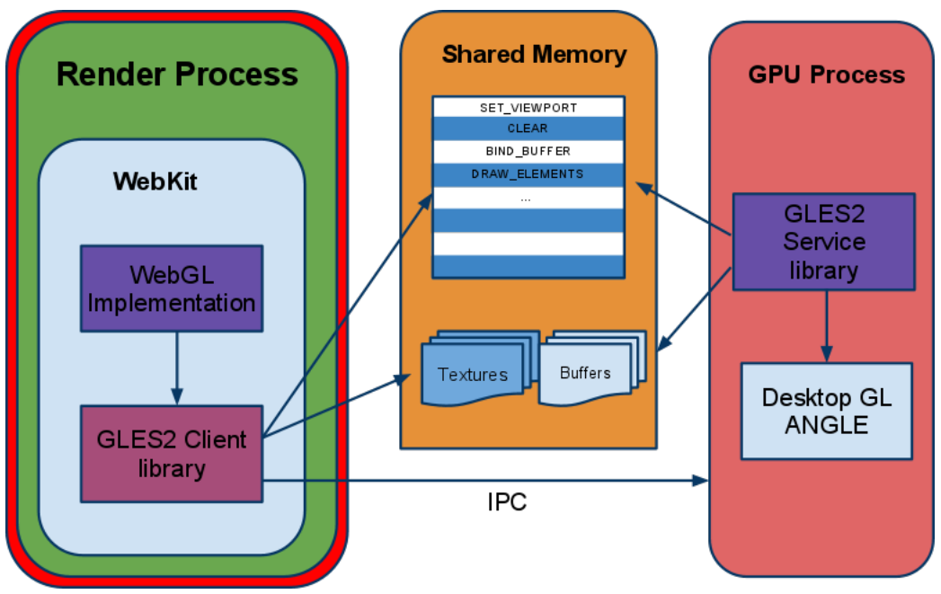
Browser Architecture
Chrome’s Multi-process
See http://www.khronos.org/assets/uploads/developers/library/2010_siggraph_bof_webgl/WebGL-BOF-2-WebGL-in-Chrome_SIGGRAPH-Jul29.pdf
Notes:
Other browsers also use a multi-process architecture in one form or another

Slide 28
Questions
In a multi-process is gl.Get* slow? Why?
What about security?
Notes:
Has to synchronize processes.

Slide 29
Cross-Origin Resource Sharing
Images can’t always be used as texture sources. Why?

Slide 30
Cross-Origin Resource Sharing
Same domain is OK:
var img = new Image();
img.onload = function() {
gl.texImage2D(/* ... */, img);
};
img.src = "image.png";

Slide 31
Cross-Origin Resource Sharing
Another domain requires CORS if supported:
var img = new Image();
img.onload = function() {
gl.texImage2D(/* ... */, img);
};
img.crossOrigin = "anonymous";
img.src =
"http://another-domain.com/image.png";

Slide 32
Cross-Origin Resource Sharing
Not all servers support CORS:
www.your-domain.com
www.another-domain.com
html/js/css
files
Images files
used for textures
Browser

Slide 33
Cross-Origin Resource Sharing
Use a proxy server:
www.another-domain.com
Images files
used for textures
www.your-domain.com
“proxy.php?http://another-domain.com/image.png"
html/js/css
files
Images files
used for textures
Browser
See http://resources.esri.com/help/9.3/arcgisserver/apis/javascript/arcgis/help/jshelp/ags_proxy.htm

Slide 34
Denial of Service Attacks
Long draw calls
Complicated shaders
Big vertex buffers
Solutions
Kill long draw calls
Forbid further rendering
Lots of WebGL security info: http://learningwebgl.com/blog/?p=3890
Notes:
Long draw calls were also used in early GPGPU days. These calls were killed by some operating systems (I think Windows Vista killed draw calls longer than two seconds).

Slide 35
WebGL Libraries
Three.js: https://github.com/mrdoob/three.js/
Cesium: http://cesium.agi.com/
Many more: http://www.khronos.org/webgl/wiki/User_Contributions

Slide 36
WebGL Resources
WebGL Camps: http://www.webglcamp.com
Learning WebGL: http://learningwebgl.com

Slide 37
The Joys of JavaScript
Skip the next 30 slides if you already know JavaScript

Slide 38
JavaScript is weakly typed…

Slide 39
JavaScript Type System
short, int, float, double. Who needs them?
var n = 1;
Notes:
All numbers are 64-bit IEEE floating-point.

Slide 40
JavaScript Type System
JavaScript has numbers, strings, and booleans:
var n = 1;
var s = “WebGL”;
var b = true;
Notes:
All numbers are 64-bit IEEE floating-point.

Slide 41
JavaScript Type System
This compiles:
var n = 1;
var s = “WebGL”;
var b = true;
var sum = n + s + b;
Notes:
Output is “1WebGLtrue”

Slide 42
JavaScript is a functional language…

Slide 43
JavaScript Functions
Looks familiar:
Functions are first-class objects, so…
function add(x, y) {
return x + y;
}
var sum = add(1, 2);

Slide 44
JavaScript Functions
Functions are objects:
var add = function(x, y) {
return x + y;
};
var sum = add(1, 2);

Slide 45
JavaScript Functions
Pass functions to functions:
var add = function // ...
function execute(op, x, y) {
return op(x, y);
}
var sum = execute(add, 1, 2);

Slide 46
JavaScript Anonymous Functions
Why name functions?
function execute(op, x, y) // ...
var sum = execute(function(x, y) {
return x + y;
}, 1, 2);
Notes:
Anonymous functions are also in C#, etc.

Slide 47
JavaScript Closures
Why limit scope?
var z = 3;
var sum = execute(function(x, y) {
return x + y + z;
}, 1, 2);
Notes:
Anonymous functions are also in C#, etc.

Slide 48
JavaScript is a dynamic language…

Slide 49
JavaScript Object Literals
Who needs struct? Create objects on the fly:
var position = {
x : 1.0,
y : 2.0
};

Slide 50
JavaScript Object Literals
Why not add fields on the fly too?
var position = {
x : 1.0,
y : 2.0
};
position.z = 3.0;

Slide 51
JavaScript Object Literals
Who needs class?

Slide 52
JavaScript Object Literals
Who needs class? Create functions too:
var position = {
x : 1.0,
y : 2.0,
min : function() {
return Math.min(this.x, this.y);
}
};

Slide 53
JavaScript Object Literals
Why not change min()?
position.z = 3.0;
position.min = function() {
return Math.min(this.x, this.y,
this.z);
};

Slide 54
JavaScript Object Literals
Useful for passing to functions. Why?

Slide 55
JavaScript Object Literals
Useful for passing to functions. Why?
What do these arguments mean?
pick(322, 40, 5, 4);

Slide 56
JavaScript Object Literals
Useful for passing to functions. Why?
What do these arguments mean?
pick({
x : 322,
y : 40,
width : 5,
height : 4
});
Notes:
Self-documenting code.
Also, you can pass arguments in any order.

Slide 57
JavaScript does object-oriented…
Notes:
But there are no classes

Slide 58
JavaScript Constructor Functions
function Vector(x, y) {
this.x = x;
this.y = y;
}
var v = new Vector(1, 2);
Notes:
Constructor functions start with a capital letter by convention.

Slide 59
JavaScript Constructor Functions
Objects can have functions:
function Vector(x, y) {
this.x = x;
this.y = y;
this.min = function() {
return Math.min(this.x, this.y);
};
}
Notes:
Constructor functions start with a capital letter by convention.

Slide 60
JavaScript Constructor Functions
Objects have prototypes:
function Vector(x, y) {
this.x = x;
this.y = y;
}
Vector.prototype.min = function() {
return Math.min(this.x, this.y);
};
Notes:
Prototype functions can’t access closures in the constructor function.

Slide 61
JavaScript Polymorphism
No need for virtual functions
function draw(model) {
model.setRenderState();
model.render();
}
Notes:
“Duck typing”
Kind of like C# templates.

Slide 62
JavaScript Polymorphism
No need for virtual functions
var level = {
setRenderState : function() // ...
render : function() // ...
};
draw(level); // Just works
Notes:
“Duck typing”
Kind of like C# templates.

Slide 63
JavaScript Build Pipeline
Different than C++
Goal: fast downloads
Common:
Alternative: fine-grain modules
How do you deploy shaders?
.js
files
Concatenate
One
.js file
Minify
“Compressed”
.js file
See http://www.julienlecomte.net/blog/2007/09/16/
Notes:
Example minified javascript, and then beautifying it with http://jsbeautifier.org/
Shader source can be put into HTML script tags, into separate glsl files downloaded with XMLHttpRequest, or put into JavaScript literals as part of the build process.

Slide 64
JavaScript Advice
Use JSHint
Have excellent test coverage
Use the Chrome and Firefox debuggers

Slide 65



JavaScript Resources
I promise I do not work for O'Reilly or Yahoo

