Slide 1
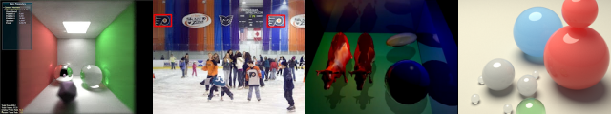
Ambient Occlusion
Patrick Cozzi
University of Pennsylvania
CIS 565 - Fall 2012

Slide 2
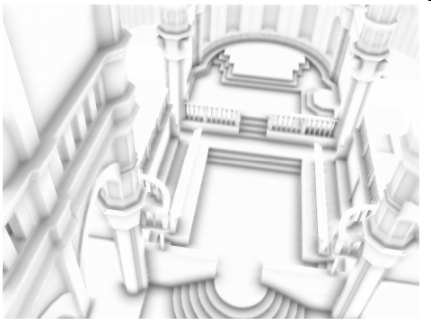
Ambient Occlusion
Ambient Occlusion (AO)
"shadowing of ambient light“
"darkening of the ambient shading contribution“
Image from Bavoil and Sainz. http://developer.download.nvidia.com/SDK/10.5/direct3d/Source/ScreenSpaceAO/doc/ScreenSpaceAO.pdf
Notes:
Ambient light - casts softest shadows
Does not depend on light direction so it can be pre-computed for static objects

Slide 3
Ambient Occlusion
Ambient Occlusion
"the crevices of the model are realistically darkened, and the exposed parts of the model realistically receive more light and are thus brighter“
"the soft shadow generated by a sphere light of uniform intensity surrounding the scene"

Slide 4
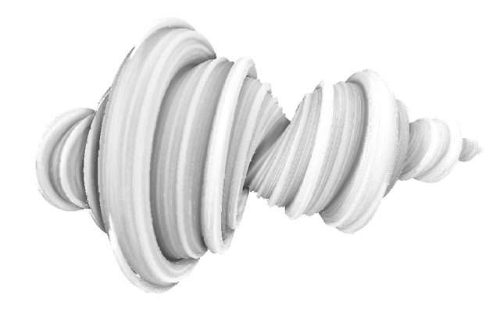
Ambient Occlusion
Image from Iñigo Quílez. http://iquilezles.org/www/articles/ssao/ssao.htm

Slide 5
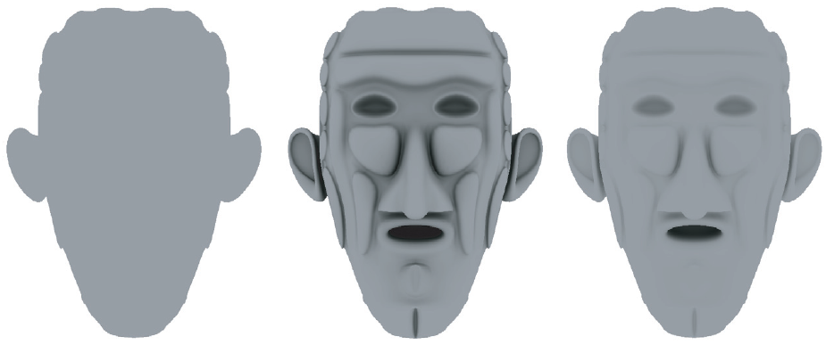
Ambient Occlusion
Evenly lit from all directions
Ambient Occlusion
Global Illumination
Images courtesy of A K Peters, Ltd. http://www.realtimerendering.com/
Notes:
AO is darker than GI because generally it does not account for interreflections.

Slide 6
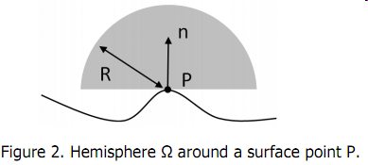
Ambient Occlusion
"the integral of the occlusion contributed from inside a hemisphere of a given radius R, centered at the current surface point P and oriented towards the normal n at P"
Image from Bavoil and Sainz. http://developer.download.nvidia.com/SDK/10.5/direct3d/Source/ScreenSpaceAO/doc/ScreenSpaceAO.pdf

Slide 7
Object Space Ambient Occlusion
AO does not depend on light direction
Precompute AO for static objects using ray casting
How many rays?
How far do they go?
Local objects? Or all objects?

Slide 8
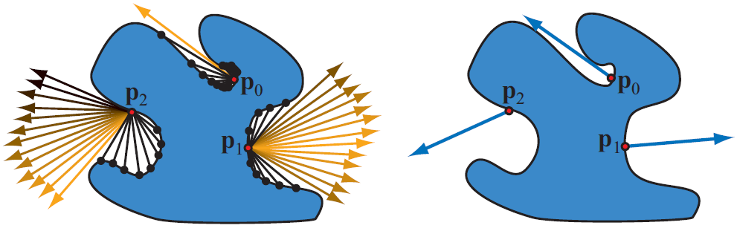
Object Space Ambient Occlusion
Cosine weight rays
or use importance sampling: cosine distribute number of rays
Image courtesy of A K Peters, Ltd. http://www.realtimerendering.com/
Notes:
On the right, the bent normal is cosine-weighted average of unoccluded rays, can be used for direct lighting or looking up into irradiance environment maps.

Slide 9
Object Space Ambient Occlusion
Depends on scene complexity
Stored in textures or vertices
How can we
Support dynamic scenes
Be independent of scene complexity

Slide 10
Screen Space Ambient Occlusion
Apply AO as a post processing effect using a combination of depth, normal, and position buffers
Not physically correct but plausible
Visual quality depends on
Screen resolution
Number of buffers
Number of samples

Slide 11
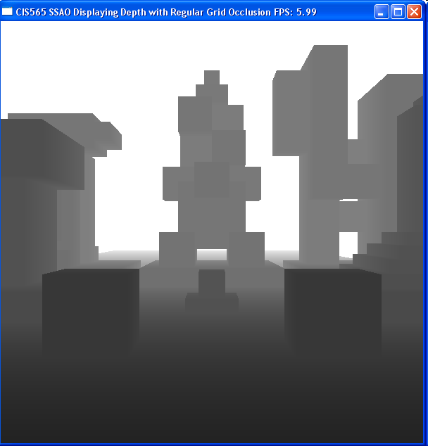
Depth Buffer

Slide 12
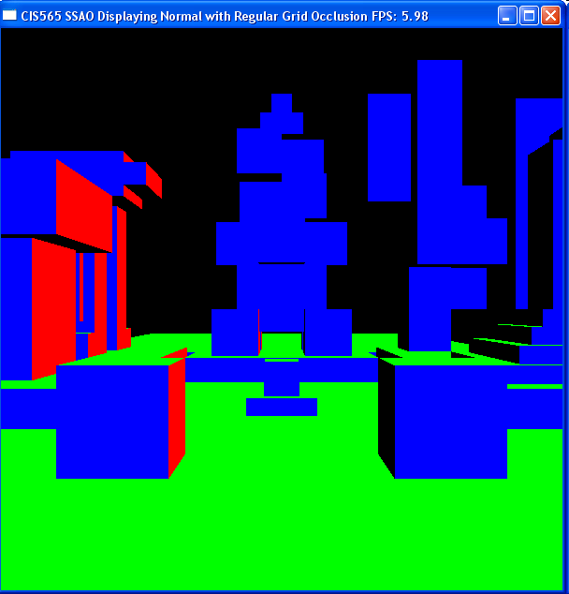
Normal Buffer

Slide 13
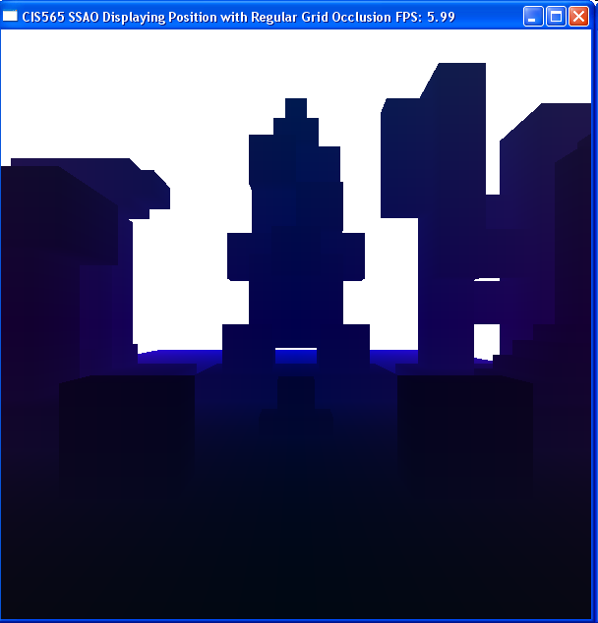
View Space Eye Position Buffer

Slide 14
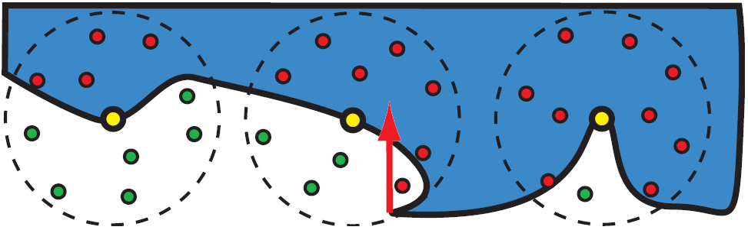
Screen Space Ambient Occlusion
Images courtesy of A K Peters, Ltd. http://www.realtimerendering.com/
Notes:
Crytek - Crysis
Points distributed in a sphere around each fragment. AO is how many samples are in front of depth buffer.
Weight samples based on distance to fragment (similar to offline obsurance factor; not cos weighted)
Physically incorrect, but visually pleasing. Flat areas will have AO since whole sphere is used, not just hemisphere.
How many samples? 200 for quality? 16 for performance?
Convert banding artifacts into high frequency noise by varying sample for each pixel in a 4x4 block. Remove noise with a 4x4 blur pass.

Slide 15
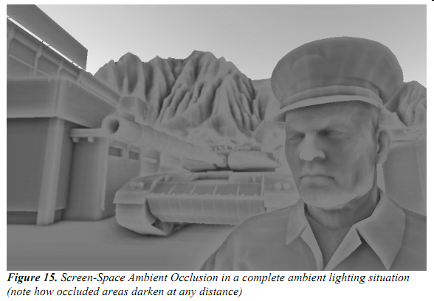
Screen Space Ambient Occlusion
Image from Martin Mittring. http://developer.amd.com/documentation/presentations/legacy/Chapter8-Mittring-Finding_NextGen_CryEngine2.pdf

Slide 16
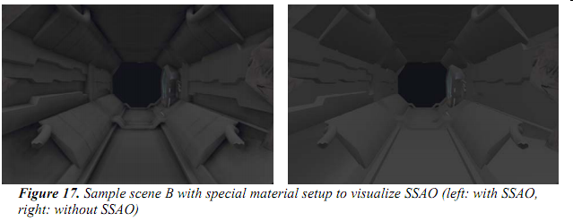
Screen Space Ambient Occlusion
Image from Martin Mittring. http://developer.amd.com/documentation/presentations/legacy/Chapter8-Mittring-Finding_NextGen_CryEngine2.pdf

Slide 17
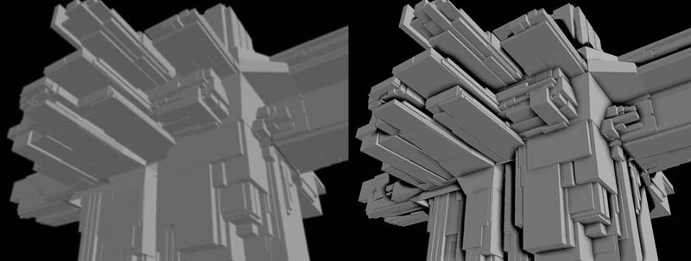
Screen Space Ambient Occlusion
Blur depth buffer
Subtract it from original depth buffer
Scale and clamp image, then subtract from original
Superficially resembles AO but fast
Image from Mike Pan. http://mikepan.com
Notes:
Unsharp mask
[802] in RTR 3rd

