Slide 1
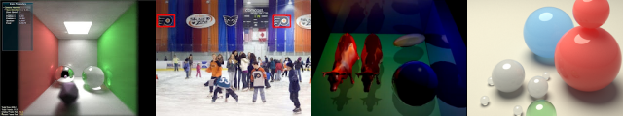

GLSL Sandbox Hackathon
Patrick Cozzi
University of Pennsylvania
CIS 565 - Fall 2012

Slide 2
Reminder
Monday 12/03
Final project midpoint presentations
Seven minutes
Demonstrate working code (videos, images, …)
Post on your blog before class
25% of the project grade. Email your grade to Karl after class

Slide 3
Hackathon
Code something awesome in the GLSL Sandbox in the next five hours
Theme
Two triangles (or even one) is all we need
Ideas
Ray tracing
Ray marching distance fields
Procedural shading with noise, e.g., water

Slide 4
Resources
Starter code
http://cis565-fall-2012.github.com/lectures/11-28-Hackathon/HelloWorld.glsl
Noise functions
http://cis565-fall-2012.github.com/lectures/11-28-Hackathon/Noise.glsl
Ray Marching
Example from Mr. Doob
Reference from Inigo Quilez

Slide 5
GLSL Resources
GLSL Reference
http://www.opengl.org/sdk/docs/manglsl/
OpenGL Insights
Chapter 7 – Procedural Textures in GLSL
The Orange Book
Chapter 11 – Procedural Texture Shaders
Graphics Shaders
Chapter 9 - Noise

Slide 6
Schedule
6pm – Kickoff
9pm – Snacks
Code must be public by 9pm
11pm – Email link to your code to Karl
Practice your demo
11:15pm – Two-minute demos
Followed by prizes

Slide 7
Forking
Browse the GLSL Sandbox gallery for ideas
Fork anything (including other students work)
Credit all third-party code
You must demo the original and your version

Slide 8
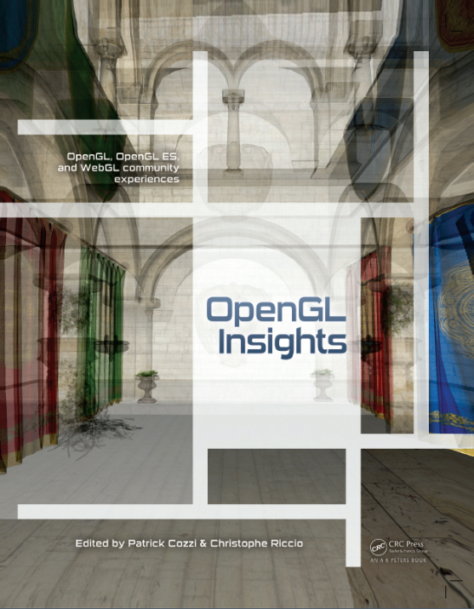
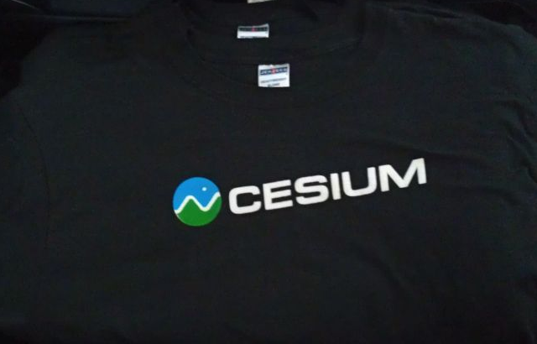
Prizes
1st Place
OpenGL Insights
2nd and 3rd Place
Cesium tee-shirts

Slide 9
Judging
Each student gets 100 points
Assign each project any amount of points
Except for your own
Don’t be cheap and give everyone a zero ☺

