Slide 1

Introduction to CUDA (2 of 2)
Patrick Cozzi
University of Pennsylvania
CIS 565 - Fall 2012

Slide 2
Announcements
Open pull request for Project 0
Project 1 released. Due Sunday 09/30
Not due Tuesday, 09/25
Code on GitHub
Email grade to Karl

Slide 3
Agenda
Built-ins and functions
Synchronizing threads
Scheduling threads
Memory model
Matrix multiply revisited
Atomic functions

Slide 4
Functional Declarations
 | Executed on the: | Only callable from the:
__global__ void KernelFunc() | device | host
__device__ float DeviceFunc() | device | device
__host__ float HostFunc() | host | host
See Appendix B.1 in the NVIDIA CUDA C Programming Guide for more details

Slide 5
Functional Declarations
__global__
Must return void
__device__
Inlined by default
See Appendix B.1 in the NVIDIA CUDA C Programming Guide for more details

Slide 6
Functional Declarations
What do these do?
__global__ __host__ void func()
__device__ __host__ void func()
Notes:
Global + host = not allowed.
Device + host = creates two functions

Slide 7
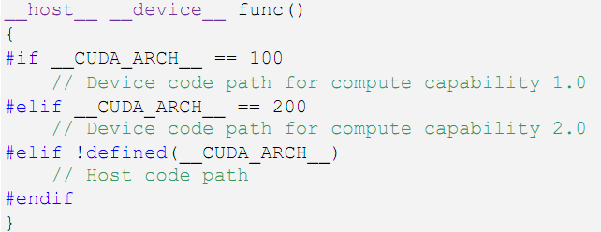
Functional Declarations
What do these do?
__global__ __host__ void func()
__device__ __host__ void func()
Code from http://developer.download.nvidia.com/compute/cuda/3_2_prod/toolkit/docs/CUDA_C_Programming_Guide.pdf
Notes:
Use __CUDA_ARCH__ to know if code is for the host or device.

Slide 8
Functional Declarations
Global and device functions
No recursion (except Fermi)
No static variables
No malloc()
Careful with function calls through pointers
We’ll see similar constraints in GLSL
Notes:
Can’t take the address of a __device__ function in host code.
Can only call __device__ functions through pointers in compute capable 2.x.

Slide 9
Vector Types
char[1–4], uchar[1–4]
short[1–4], ushort[1–4]
int[1–4], uint[1–4]
long[1–4], ulong[1–4]
longlong[1–4], ulonglong[1–4]
float[1–4]
double1, double2

Slide 10
Vector Types
Available in host and device code
Construct with make_<type name>
int2 i2 = make_int2(1, 2);
float4 f4 = make_float4(
1.0f, 2.0f, 3.0f, 4.0f);

Slide 11
Vector Types
Access with .x, .y, .z, and .w
int2 i2 = make_int2(1, 2);
int x = i2.x;
int y = i2.y;
No .r, .g, .b, .a, etc. like GLSL

Slide 12
Math Functions
Double and float overloads
No vector overloads
On the host, functions use the C runtime implementation if available
See Appendix C in the NVIDIA CUDA C Programming Guide for a complete list of math functions
Notes:
On the device, SFU are likely used.

Slide 13
Math Functions
Partial list:
sqrt, rsqrt
exp, log
sin, cos, tan, sincos
asin, acos, atan2
trunc, ceil, floor
See Appendix C in the NVIDIA CUDA C Programming Guide for a complete list of math functions

Slide 14
Math Functions
Intrinsic function
Device only
Faster, but less accurate
Prefixed with __
__exp, __log , __sin , __pow , …
See Appendix C in the NVIDIA CUDA C Programming Guide for a complete list of math functions

Slide 15
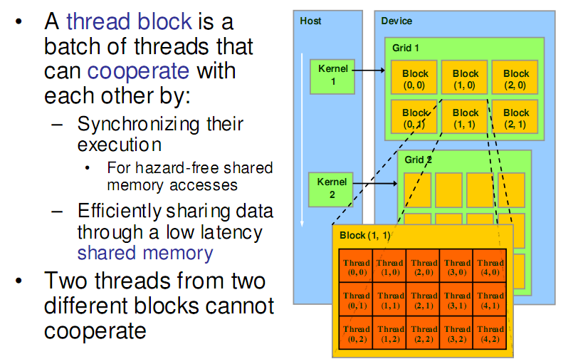
Review: Thread Hierarchies
Image from: http://courses.engr.illinois.edu/ece498/al/textbook/Chapter2-CudaProgrammingModel.pdf

Slide 16
Review: Thread Hierarchies
int threadID = blockIdx.x * blockDim.x + threadIdx.x;
float x = input[threadID];
float y = func(x);
output[threadID] = y;

Slide 17
Review: Thread Hierarchies
int threadID = blockIdx.x * blockDim.x + threadIdx.x;
float x = input[threadID];
float y = func(x);
output[threadID] = y;
Use grid and block position to compute a thread id

Slide 18
Review: Thread Hierarchies
int threadID = blockIdx.x * blockDim.x + threadIdx.x;
float x = input[threadID];
float y = func(x);
output[threadID] = y;
Use thread id to read from input

Slide 19
Review: Thread Hierarchies
int threadID = blockIdx.x * blockDim.x + threadIdx.x;
float x = input[threadID];
float y = func(x);
output[threadID] = y;
Run function on input: data-parallel!

Slide 20
Review: Thread Hierarchies
int threadID = blockIdx.x * blockDim.x + threadIdx.x;
float x = input[threadID];
float y = func(x);
output[threadID] = y;
Use thread id to output result

Slide 21
Thread Synchronization
Threads in a block can synchronize
call __syncthreads to create a barrier
A thread waits at this call until all threads in the block reach it, then all threads continue
Mds[i] = Md[j];
__syncthreads();
func(Mds[i], Mds[i + 1]);

Slide 22
Thread Synchronization
Thread 0
Thread 1
Mds[i] = Md[j];
__syncthreads();
func(Mds[i], Mds[i+1]);
Mds[i] = Md[j];
__syncthreads();
func(Mds[i], Mds[i+1]);
Thread 2
Thread 3
Mds[i] = Md[j];
__syncthreads();
func(Mds[i], Mds[i+1]);
Mds[i] = Md[j];
__syncthreads();
func(Mds[i], Mds[i+1]);
Time: 0
Notes:
In this example, the warp size is 2. The block size is 4.

Slide 23
Thread Synchronization
Thread 0
Thread 1
Mds[i] = Md[j];
__syncthreads();
func(Mds[i], Mds[i+1]);
Mds[i] = Md[j];
__syncthreads();
func(Mds[i], Mds[i+1]);
Thread 2
Thread 3
Mds[i] = Md[j];
__syncthreads();
func(Mds[i], Mds[i+1]);
Mds[i] = Md[j];
__syncthreads();
func(Mds[i], Mds[i+1]);
Time: 1

Slide 24
Thread Synchronization
Thread 0
Thread 1
Mds[i] = Md[j];
__syncthreads();
func(Mds[i], Mds[i+1]);
Mds[i] = Md[j];
__syncthreads();
func(Mds[i], Mds[i+1]);
Thread 2
Thread 3
Mds[i] = Md[j];
__syncthreads();
func(Mds[i], Mds[i+1]);
Mds[i] = Md[j];
__syncthreads();
func(Mds[i], Mds[i+1]);
Threads 0 and 1 are blocked at barrier
Time: 1

Slide 25
Thread Synchronization
Thread 0
Thread 1
Mds[i] = Md[j];
__syncthreads();
func(Mds[i], Mds[i+1]);
Mds[i] = Md[j];
__syncthreads();
func(Mds[i], Mds[i+1]);
Thread 2
Thread 3
Mds[i] = Md[j];
__syncthreads();
func(Mds[i], Mds[i+1]);
Mds[i] = Md[j];
__syncthreads();
func(Mds[i], Mds[i+1]);
Time: 2

Slide 26
Thread Synchronization
Thread 0
Thread 1
Mds[i] = Md[j];
__syncthreads();
func(Mds[i], Mds[i+1]);
Mds[i] = Md[j];
__syncthreads();
func(Mds[i], Mds[i+1]);
Thread 2
Thread 3
Mds[i] = Md[j];
__syncthreads();
func(Mds[i], Mds[i+1]);
Mds[i] = Md[j];
__syncthreads();
func(Mds[i], Mds[i+1]);
Time: 3

Slide 27
Thread Synchronization
Thread 0
Thread 1
Mds[i] = Md[j];
__syncthreads();
func(Mds[i], Mds[i+1]);
Mds[i] = Md[j];
__syncthreads();
func(Mds[i], Mds[i+1]);
Thread 2
Thread 3
Mds[i] = Md[j];
__syncthreads();
func(Mds[i], Mds[i+1]);
Mds[i] = Md[j];
__syncthreads();
func(Mds[i], Mds[i+1]);
All threads in block have reached barrier, any thread can continue
Time: 3

Slide 28
Thread Synchronization
Thread 0
Thread 1
Mds[i] = Md[j];
__syncthreads();
func(Mds[i], Mds[i+1]);
Mds[i] = Md[j];
__syncthreads();
func(Mds[i], Mds[i+1]);
Thread 2
Thread 3
Mds[i] = Md[j];
__syncthreads();
func(Mds[i], Mds[i+1]);
Mds[i] = Md[j];
__syncthreads();
func(Mds[i], Mds[i+1]);
Time: 4

Slide 29
Thread Synchronization
Thread 0
Thread 1
Mds[i] = Md[j];
__syncthreads();
func(Mds[i], Mds[i+1]);
Mds[i] = Md[j];
__syncthreads();
func(Mds[i], Mds[i+1]);
Thread 2
Thread 3
Mds[i] = Md[j];
__syncthreads();
func(Mds[i], Mds[i+1]);
Mds[i] = Md[j];
__syncthreads();
func(Mds[i], Mds[i+1]);
Time: 5

Slide 30
Thread Synchronization
Why is it important that execution time be similar among threads?
Why does it only synchronize within a block?
Notes:
Similar execution time – load balance
Synchronize within a block – runtime can schedule threads in any order

Slide 31
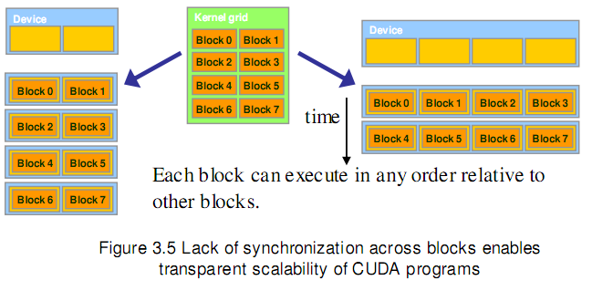
Thread Synchronization
Image from http://courses.engr.illinois.edu/ece498/al/textbook/Chapter3-CudaThreadingModel.pdf

Slide 32
Thread Synchronization
Can __syncthreads() cause a thread to hang?

Slide 33
Thread Synchronization
if (someFunc())
{
__syncthreads();
}
// ...

Slide 34
Thread Synchronization
if (someFunc())
{
__syncthreads();
}
else
{
__syncthreads();
}

Slide 35
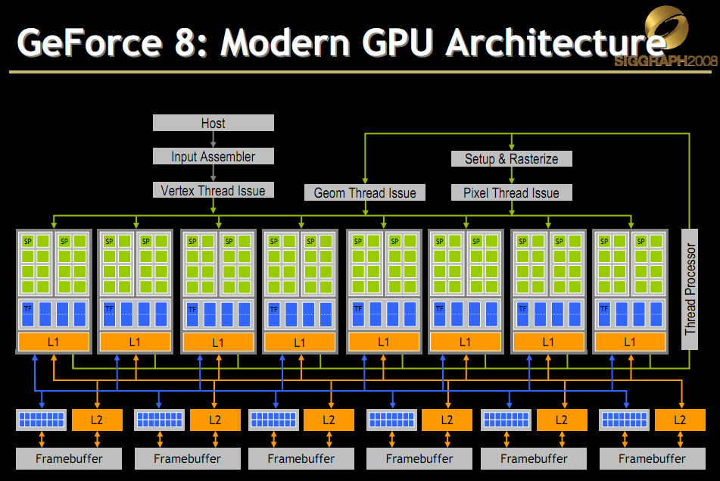
Scheduling Threads
Slide from David Luebke: http://s08.idav.ucdavis.edu/luebke-nvidia-gpu-architecture.pdf
Notes:
G80 – 16 SMs, each with 8 SP.

Slide 36

Scheduling Threads

Slide 37
Scheduling Threads
Streaming Processing (SP)

Slide 38
Scheduling Threads
Streaming Multi-Processor (SM)

Slide 39
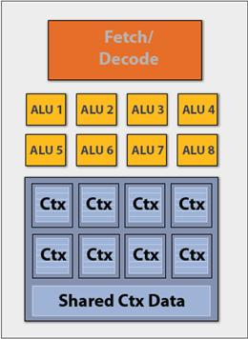
Scheduling Threads
Look familiar?

Slide 40
Scheduling Threads
G80
16 SMs
Each with 8 SPs
128 total SPs
Each SM hosts up to 768 threads
Up to 12,288 threads in flight
Slide from David Luebke: http://s08.idav.ucdavis.edu/luebke-nvidia-gpu-architecture.pdf
Notes:
16 SMs * 768 threads = 12,288 threads in flight

Slide 41
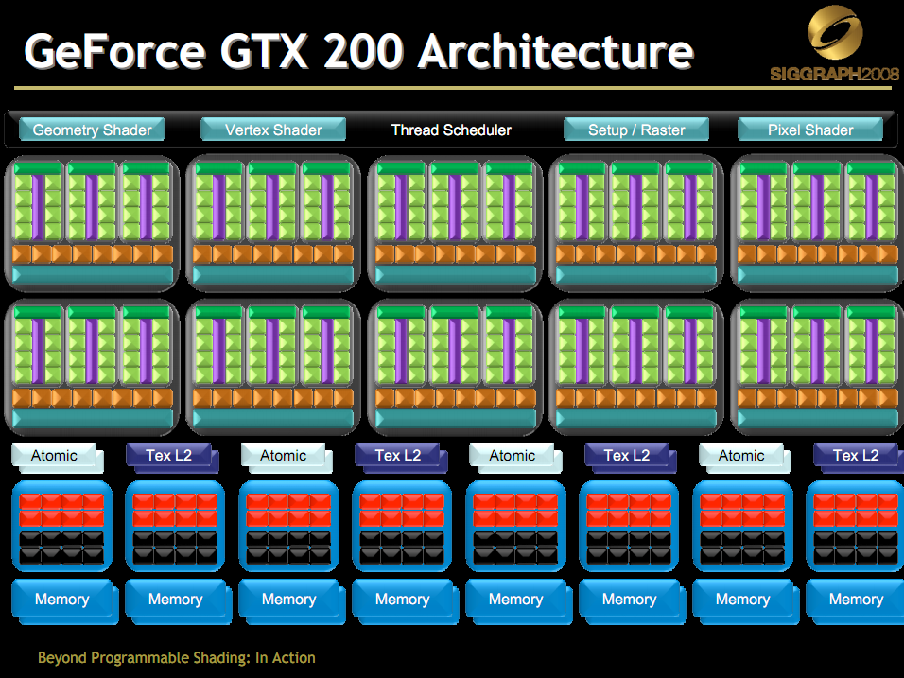
Scheduling Threads
GT200
30 SMs
Each with 8 SPs
240 total SPs
Each SM hosts up to
8 blocks, or
1024 threads
In flight, up to
240 blocks, or
30,720 threads
Slide from David Luebke: http://s08.idav.ucdavis.edu/luebke-nvidia-gpu-architecture.pdf
Notes:
30 SMs * 1024 threads = 30,720 threads in flight

Slide 42
Scheduling Threads
Warp – threads from a block
G80 / GT200 – 32 threads
Run on the same SM
Unit of thread scheduling
Consecutive threadIdx values
An implementation detail – in theory
warpSize

Slide 43
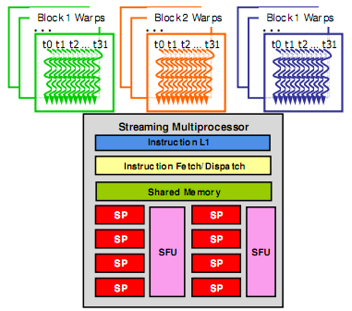
Scheduling Threads
Warps for three blocks scheduled on the same SM.
Image from: http://courses.engr.illinois.edu/ece498/al/textbook/Chapter3-CudaThreadingModel.pdf
Notes:
A warp from any block assigned to the SM can be selected for execution based on priority.

Slide 44
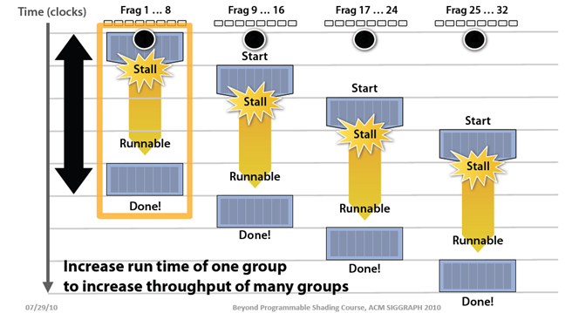
Scheduling Threads
Remember this:
Image from: http://bps10.idav.ucdavis.edu/talks/03-fatahalian_gpuArchTeraflop_BPS_SIGGRAPH2010.pdf

Slide 45
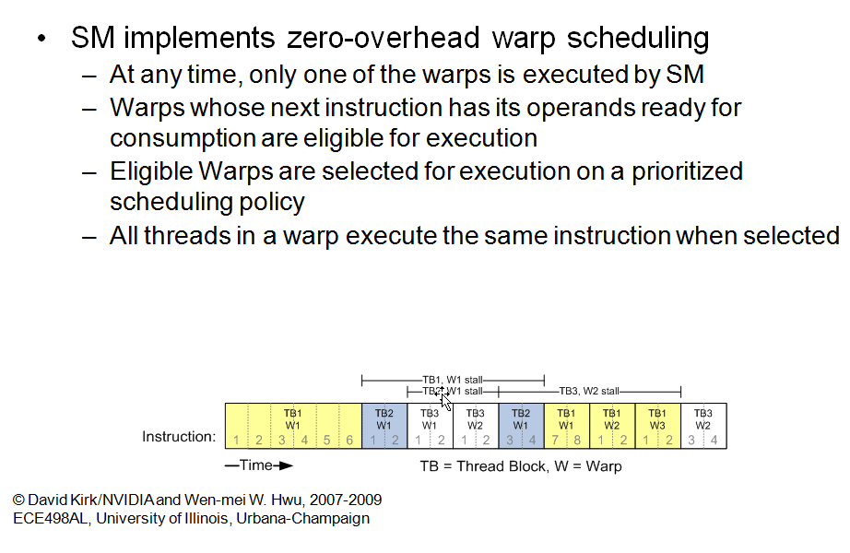
Scheduling Threads
Slide from: http://courses.engr.illinois.edu/ece498/al/Syllabus.html

Slide 46
Scheduling Threads
What happens if branches in a warp diverge?

Slide 47
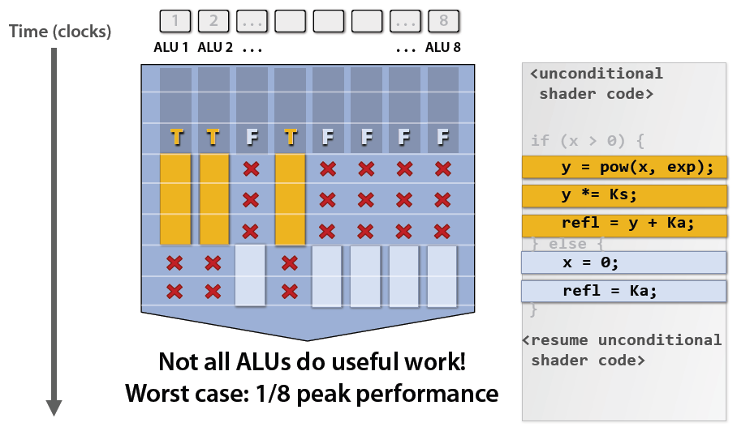
Scheduling Threads
Remember this:
Image from: http://bps10.idav.ucdavis.edu/talks/03-fatahalian_gpuArchTeraflop_BPS_SIGGRAPH2010.pdf

Slide 48
Scheduling Threads
If 3 blocks are assigned to an SM and each block has 256 threads, how many warps are there?
A SM on GT200 can host up to 1024 threads, how many warps is that?
Notes:
(3 * 256) / 32 = 24 warps
1024 / 32 = 32 warps

Slide 49
Scheduling Threads
32 threads per warp but 8 SPs per SM. What gives?
Notes:
G80
More on dispatching:
GT200: http://www.realworldtech.com/page.cfm?ArticleID=RWT090808195242&p=8
Fermi: http://www.realworldtech.com/page.cfm?ArticleID=RWT093009110932&p=5

Slide 50
Scheduling Threads
32 threads per warp but 8 SPs per SM. What gives?
When an SM schedules a warp:
Its instruction is ready
8 threads enter the SPs on the 1st cycle
8 more on the 2nd, 3rd, and 4th cycles
Therefore, 4 cycles are required to dispatch a warp

Slide 51
Scheduling Threads
Question
A kernel has
1 global memory read (200 cycles)
4 non-dependent multiples/adds
How many warps are required to hide the memory latency?

Slide 52
Scheduling Threads
Solution
Each warp has 4 multiples/adds
16 cycles
We need to cover 200 cycles
200 / 16 = 12.5
ceil(12.5) = 13
13 warps are required
Notes:
Our book says 14 in Section 6.4 (Data Prefetching) on Page 113, but I believe it is a typo.

Slide 53
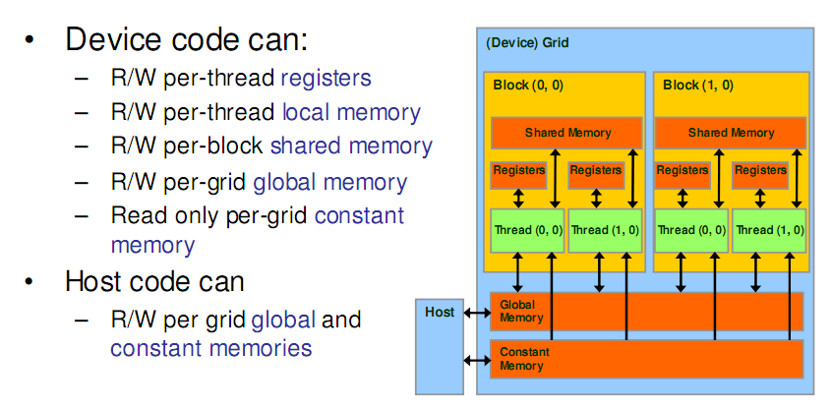
Memory Model
Recall:
Image from: http://courses.engr.illinois.edu/ece498/al/textbook/Chapter2-CudaProgrammingModel.pdf

Slide 54
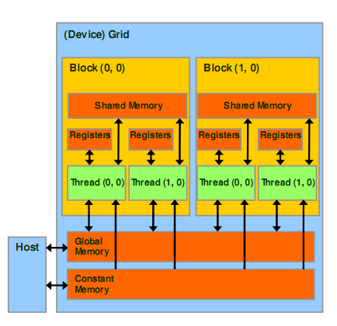
Memory Model
Registers
Per thread
Fast, on-chip, read/write access
Increasing the number of registers used by a kernel has what affect?
Notes:
Potentially decrease the number of threads (well, blocks) available to that SM for scheduling.

Slide 55
Memory Model
Registers - G80
Per SM
Up to 768 threads
8K registers
How many registers per thread?

Slide 56
Memory Model
Registers - G80
8K / 768 = 10 registers per thread
Exceeding limit reduces threads by the block
Example: Each thread uses 11 registers, and each block has 256 threads
How many threads can a SM host?
How many warps can a SM host?
What does having less warps mean?
Notes:
Host 512 threads (2 blocks instead of 3)
Host 512 / 32 = 16 warps
Instead of 768 threads and 24 warps

Slide 57
Memory Model
Local Memory
Stored in global memory
Copy per thread
Used for automatic arrays
Unless all accessed with only constant indices

Slide 58
Memory Model
Shared Memory
Per block
Fast, on-chip, read/write access
Full speed random access

Slide 59
Memory Model
Shared Memory – G80
Per SM
Up to 8 blocks
16 KB
How many KB per block
Notes:
2 KB per block

Slide 60
Memory Model
Shared Memory – G80
16 KB / 8 = 2 KB per block
Example
If each block uses 5 KB, how many blocks can a SM host?
Notes:
16 KB / 5 KB = 3 blocks per SM

Slide 61
Memory Model
Global Memory
Long latency (100s cycles)
Off-chip, read/write access
Random access causes performance hit
Host can read/write
GT200
150 GB/s
Up to 4 GB
G80 – 86.4 GB/s

Slide 62
Memory Model
Constant Memory
Short latency, high bandwidth, read only access when all threads access the same location
Stored in global memory but cached
Host can read/write
Up to 64 KB

Slide 63
Memory Model
Variable Declaration | Memory | Scope | Lifetime
Automatic variables other than arrays | register | thread | kernel
Automatic array variables | local | thread | kernel
__shared__ int sharedVar; | shared | block | kernel
__device__ int globalVar; | global | grid | application
__constant__ int constantVar; | constant | grid | application
See Appendix B.2 in the NVIDIA CUDA C Programming Guide for more details

Slide 64
Memory Model
Global and constant variables
Host can access with
cudaGetSymbolAddress()
cudaGetSymbolSize()
cudaMemcpyToSymbol()
cudaMemcpyFromSymbol()
Constants must be declared outside of a function body
Notes:
__constant__ float constData[256];
float data[256];
cudaMemcpyToSymbol(constData, data, sizeof(data));
cudaMemcpyFromSymbol(data, constData, sizeof(data))

Slide 65
Let’s revisit matrix multiple

Slide 66
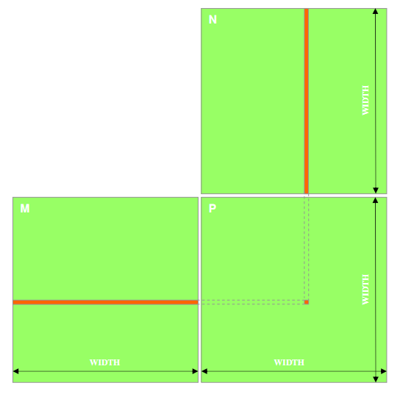
Matrix Multiply: CPU Implementation
void MatrixMulOnHost(float* M, float* N, float* P, int width)‏
{
for (int i = 0; i < width; ++i)‏
for (int j = 0; j < width; ++j)
{
float sum = 0;
for (int k = 0; k < width; ++k)
{
float a = M[i * width + k];
float b = N[k * width + j];
sum += a * b;
}
P[i * width + j] = sum;
}
}
Code from: http://courses.engr.illinois.edu/ece498/al/lectures/lecture3%20cuda%20threads%20spring%202010.ppt

Slide 67
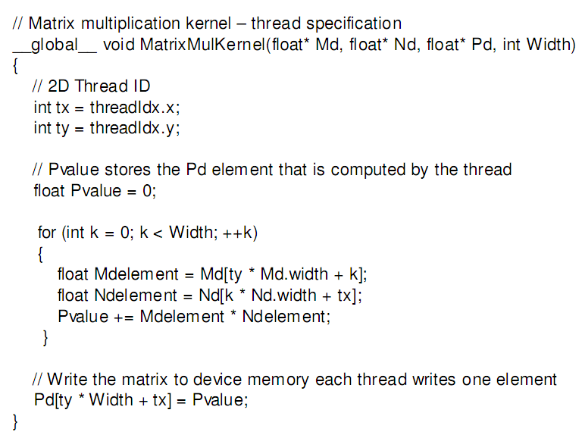
Matrix Multiply: CUDA Kernel
Accessing a matrix, so using a 2D block
Code from: http://courses.engr.illinois.edu/ece498/al/textbook/Chapter2-CudaProgrammingModel.pdf

Slide 68
Matrix Multiply: CUDA Kernel
Each kernel computes one output
Code from: http://courses.engr.illinois.edu/ece498/al/textbook/Chapter2-CudaProgrammingModel.pdf

Slide 69
Matrix Multiply: CUDA Kernel
Where did the two outer for loops in the CPU implementation go?
Code from: http://courses.engr.illinois.edu/ece498/al/textbook/Chapter2-CudaProgrammingModel.pdf

Slide 70
Matrix Multiply: CUDA Kernel
No locks or synchronization, why?
Code from: http://courses.engr.illinois.edu/ece498/al/textbook/Chapter2-CudaProgrammingModel.pdf

Slide 71
Matrix Multiply
Problems
Limited matrix size
Only uses one block
G80 and GT200 – up to 512 threads per block
Lots of global memory access

Slide 72
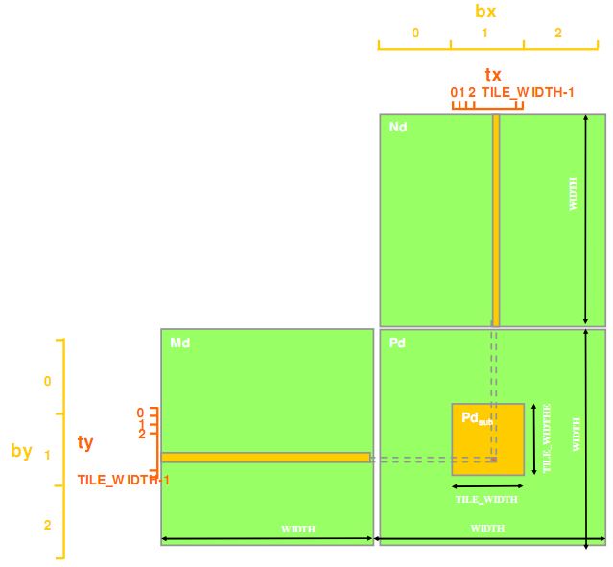
Matrix Multiply
Remove size limitation
Break Pd matrix into tiles
Assign each tile to a block
Use threadIdx and blockIdx for indexing
Image from http://courses.engr.illinois.edu/ece498/al/textbook/Chapter3-CudaThreadingModel.pdf

Slide 73
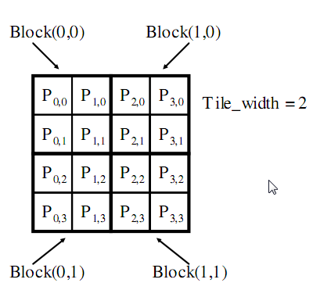
Matrix Multiply
Example
Matrix: 4x4
TILE_WIDTH = 2
Block size: 2x2
Image from http://courses.engr.illinois.edu/ece498/al/textbook/Chapter3-CudaThreadingModel.pdf

Slide 74
Matrix Multiply
Nd_{0,0}
Nd_{1,0}
Example
Matrix: 4x4
TILE_WIDTH = 2
Block size: 2x2
Nd_{0,1}
Nd_{1,1}
Nd_{0,2}
Nd_{1,2}
Nd_{0,3}
Nd_{1,3}
Md_{0,0}
Md_{1,0}
Md_{2,0}
Md_{3,0}
Pd_{0,0}
Pd_{1,0}
Pd_{2,0}
Pd_{3,0}
Md_{0,1}
Md_{1,1}
Md_{2,1}
Md_{3,1}
Pd_{0,1}
Pd_{1,1}
Pd_{2,1}
Pd_{3,1}
Pd_{0,2}
Pd_{1,2}
Pd_{2,2}
Pd_{3,2}
Pd_{0,3}
Pd_{1,3}
Pd_{2,3}
Pd_{3,3}
Image from http://courses.engr.illinois.edu/ece498/al/Syllabus.html

Slide 75
Matrix Multiply
__global__ void MatrixMulKernel(
float* Md, float* Nd, float* Pd, int Width)
{
int Row = blockIdx.y * blockDim.y + threadIdx.y;
int Col = blockIdx.x * blockDim.x + threadIdx.x;
float Pvalue = 0;
for (int k = 0; k < Width; ++k)
Pvalue += Md[Row * Width + k] * Nd[k * Width + Col];
Pd[Row * Width + Col] = Pvalue;
}
Code from http://courses.engr.illinois.edu/ece498/al/Syllabus.html

Slide 76
Matrix Multiply
Calculate the row index of the Pd element and M
__global__ void MatrixMulKernel(
float* Md, float* Nd, float* Pd, int Width)
{
int Row = blockIdx.y * TILE_WIDTH + threadIdx.y;
int Col = blockIdx.x * TILE_WIDTH + threadIdx.x;
float Pvalue = 0;
for (int k = 0; k < Width; ++k)
Pvalue += Md[Row * Width + k] * Nd[k * Width + Col];
Pd[Row * Width + Col] = Pvalue;
}
Code from http://courses.engr.illinois.edu/ece498/al/Syllabus.html

Slide 77
Matrix Multiply
Calculate the column index of Pd and N
__global__ void MatrixMulKernel(
float* Md, float* Nd, float* Pd, int Width)
{
int Row = blockIdx.y * TILE_WIDTH + threadIdx.y;
int Col = blockIdx.x * TILE_WIDTH + threadIdx.x;
float Pvalue = 0;
for (int k = 0; k < Width; ++k)
Pvalue += Md[Row * Width + k] * Nd[k * Width + Col];
Pd[Row * Width + Col] = Pvalue;
}
Code from http://courses.engr.illinois.edu/ece498/al/Syllabus.html

Slide 78
Matrix Multiply
Each thread computes one element of the block sub-matrix
__global__ void MatrixMulKernel(
float* Md, float* Nd, float* Pd, int Width)
{
int Row = blockIdx.y * TILE_WIDTH + threadIdx.y;
int Col = blockIdx.x * TILE_WIDTH + threadIdx.x;
float Pvalue = 0;
for (int k = 0; k < Width; ++k)
Pvalue += Md[Row * Width + k] * Nd[k * Width + Col];
Pd[Row * Width + Col] = Pvalue;
}
Code from http://courses.engr.illinois.edu/ece498/al/Syllabus.html

Slide 79
Matrix Multiply
Invoke kernel:
dim3 dimGrid(Width / TILE_WIDTH, Height / TILE_WIDTH);
dim3 dimBlock(TILE_WIDTH, TILE_WIDTH);
MatrixMulKernel<<<dimGrid, dimBlock>>>(
Md, Nd, Pd, TILE_WIDTH);

Slide 80
What about global memory access?

Slide 81
Matrix Multiply
Limited by global memory bandwidth
G80 peak GFLOPS: 346.5
Require 1386 GB/s to achieve this
G80 memory bandwidth: 86.4 GB/s
Limits code to 21.6 GFLOPS
In practice, code runs at 15 GFLOPS
Must drastically reduce global memory access

Slide 82
Matrix Multiply
N
Each input element is read by Width threads
Use shared memory to reduce global memory bandwidth
WIDTH
M
P
ty
WIDTH
tx
WIDTH
WIDTH
Image from http://courses.engr.illinois.edu/ece498/al/Syllabus.html

Slide 83
Matrix Multiply
bx
0
1
2
tx
0
TILE_WIDTH-1
1
2
Nd
Break kernel into phases
Each phase accumlates Pd using a subset of Md and Nd
Each phase has good data locality
TILE_WIDTH
WIDTH
TILE_WIDTH
Md
Pd
0
0
Pd_{sub}
1
ty
2
WIDTH
by
1
TILE_WIDTHE
TILE_WIDTH-1
TILE_WIDTH
TILE_WIDTH
TILE_WIDTH
2
WIDTH
WIDTH
Image from http://courses.engr.illinois.edu/ece498/al/Syllabus.html

Slide 84
Matrix Multiply
bx
0
1
2
tx
0
TILE_WIDTH-1
1
2
Nd
Each thread
loads one element of Md and Nd in the tile into shared memory
m
TILE_WIDTH
bx
k
WIDTH
TILE_WIDTH
Md
Pd
by
0
m
0
Pd_{sub}
1
k
ty
2
WIDTH
by
1
TILE_WIDTHE
TILE_WIDTH-1
TILE_WIDTH
TILE_WIDTH
TILE_WIDTH
2
WIDTH
WIDTH
Image from http://courses.engr.illinois.edu/ece498/al/Syllabus.html

Slide 85
__global__ void MatrixMulKernel(
float* Md, float* Nd, float* Pd, int Width)
{
__shared__ float Mds[TILE_WIDTH][TILE_WIDTH];
__shared__ float Nds[TILE_WIDTH][TILE_WIDTH];
int bx = blockIdx.x; int by = blockIdx.y;
int tx = threadIdx.x; int ty = threadIdx.y;
int Row = by * TILE_WIDTH + ty;
int Col = bx * TILE_WIDTH + tx;
float Pvalue = 0;
for (int m = 0; m < Width/TILE_WIDTH; ++m) {
Mds[ty][tx] = Md[Row*Width + (m*TILE_WIDTH + tx)];
Nds[ty][tx] = Nd[Col + (m*TILE_WIDTH + ty)*Width];
__syncthreads();
for (int k = 0; k < TILE_WIDTH; ++k)
Pvalue += Mds[ty][k] * Nds[k][tx];
__synchthreads();
}
Pd[Row*Width+Col] = Pvalue;
}
Code from http://courses.engr.illinois.edu/ece498/al/Syllabus.html

Slide 86
__global__ void MatrixMulKernel(
float* Md, float* Nd, float* Pd, int Width)
{
__shared__ float Mds[TILE_WIDTH][TILE_WIDTH];
__shared__ float Nds[TILE_WIDTH][TILE_WIDTH];
int bx = blockIdx.x; int by = blockIdx.y;
int tx = threadIdx.x; int ty = threadIdx.y;
int Row = by * TILE_WIDTH + ty;
int Col = bx * TILE_WIDTH + tx;
float Pvalue = 0;
for (int m = 0; m < Width/TILE_WIDTH; ++m) {
Mds[ty][tx] = Md[Row*Width + (m*TILE_WIDTH + tx)];
Nds[ty][tx] = Nd[Col + (m*TILE_WIDTH + ty)*Width];
__syncthreads();
for (int k = 0; k < TILE_WIDTH; ++k)
Pvalue += Mds[ty][k] * Nds[k][tx];
__synchthreads();
}
Pd[Row*Width+Col] = Pvalue;
}
Shared memory for a
subset of Md and Nd
Code from http://courses.engr.illinois.edu/ece498/al/Syllabus.html

Slide 87
__global__ void MatrixMulKernel(
float* Md, float* Nd, float* Pd, int Width)
{
__shared__ float Mds[TILE_WIDTH][TILE_WIDTH];
__shared__ float Nds[TILE_WIDTH][TILE_WIDTH];
int bx = blockIdx.x; int by = blockIdx.y;
int tx = threadIdx.x; int ty = threadIdx.y;
int Row = by * TILE_WIDTH + ty;
int Col = bx * TILE_WIDTH + tx;
float Pvalue = 0;
for (int m = 0; m < Width/TILE_WIDTH; ++m) {
Mds[ty][tx] = Md[Row*Width + (m*TILE_WIDTH + tx)];
Nds[ty][tx] = Nd[Col + (m*TILE_WIDTH + ty)*Width];
__syncthreads();
for (int k = 0; k < TILE_WIDTH; ++k)
Pvalue += Mds[ty][k] * Nds[k][tx];
__synchthreads();
}
Pd[Row*Width+Col] = Pvalue;
}
Width/TILE_WIDTH
Number of phases
m
Index for current phase
Code from http://courses.engr.illinois.edu/ece498/al/Syllabus.html

Slide 88
__global__ void MatrixMulKernel(
float* Md, float* Nd, float* Pd, int Width)
{
__shared__ float Mds[TILE_WIDTH][TILE_WIDTH];
__shared__ float Nds[TILE_WIDTH][TILE_WIDTH];
int bx = blockIdx.x; int by = blockIdx.y;
int tx = threadIdx.x; int ty = threadIdx.y;
int Row = by * TILE_WIDTH + ty;
int Col = bx * TILE_WIDTH + tx;
float Pvalue = 0;
for (int m = 0; m < Width/TILE_WIDTH; ++m) {
Mds[ty][tx] = Md[Row*Width + (m*TILE_WIDTH + tx)];
Nds[ty][tx] = Nd[Col + (m*TILE_WIDTH + ty)*Width];
__syncthreads();
for (int k = 0; k < TILE_WIDTH; ++k)
Pvalue += Mds[ty][k] * Nds[k][tx];
__synchthreads();
}
Pd[Row*Width+Col] = Pvalue;
}
Bring one element each from Md and Nd into shared memory
Code from http://courses.engr.illinois.edu/ece498/al/Syllabus.html

Slide 89
__global__ void MatrixMulKernel(
float* Md, float* Nd, float* Pd, int Width)
{
__shared__ float Mds[TILE_WIDTH][TILE_WIDTH];
__shared__ float Nds[TILE_WIDTH][TILE_WIDTH];
int bx = blockIdx.x; int by = blockIdx.y;
int tx = threadIdx.x; int ty = threadIdx.y;
int Row = by * TILE_WIDTH + ty;
int Col = bx * TILE_WIDTH + tx;
float Pvalue = 0;
for (int m = 0; m < Width/TILE_WIDTH; ++m) {
Mds[ty][tx] = Md[Row*Width + (m*TILE_WIDTH + tx)];
Nds[ty][tx] = Nd[Col + (m*TILE_WIDTH + ty)*Width];
__syncthreads();
for (int k = 0; k < TILE_WIDTH; ++k)
Pvalue += Mds[ty][k] * Nds[k][tx];
__synchthreads();
}
Pd[Row*Width+Col] = Pvalue;
}
Wait for every thread in the block, i.e., wait for the tile to be in shared memory
Code from http://courses.engr.illinois.edu/ece498/al/Syllabus.html

Slide 90
__global__ void MatrixMulKernel(
float* Md, float* Nd, float* Pd, int Width)
{
__shared__ float Mds[TILE_WIDTH][TILE_WIDTH];
__shared__ float Nds[TILE_WIDTH][TILE_WIDTH];
int bx = blockIdx.x; int by = blockIdx.y;
int tx = threadIdx.x; int ty = threadIdx.y;
int Row = by * TILE_WIDTH + ty;
int Col = bx * TILE_WIDTH + tx;
float Pvalue = 0;
for (int m = 0; m < Width/TILE_WIDTH; ++m) {
Mds[ty][tx] = Md[Row*Width + (m*TILE_WIDTH + tx)];
Nds[ty][tx] = Nd[Col + (m*TILE_WIDTH + ty)*Width];
__syncthreads();
for (int k = 0; k < TILE_WIDTH; ++k)
Pvalue += Mds[ty][k] * Nds[k][tx];
__synchthreads();
}
Pd[Row*Width+Col] = Pvalue;
}
Accumulate subset of dot product
Code from http://courses.engr.illinois.edu/ece498/al/Syllabus.html

Slide 91
__global__ void MatrixMulKernel(
float* Md, float* Nd, float* Pd, int Width)
{
__shared__ float Mds[TILE_WIDTH][TILE_WIDTH];
__shared__ float Nds[TILE_WIDTH][TILE_WIDTH];
int bx = blockIdx.x; int by = blockIdx.y;
int tx = threadIdx.x; int ty = threadIdx.y;
int Row = by * TILE_WIDTH + ty;
int Col = bx * TILE_WIDTH + tx;
float Pvalue = 0;
for (int m = 0; m < Width/TILE_WIDTH; ++m) {
Mds[ty][tx] = Md[Row*Width + (m*TILE_WIDTH + tx)];
Nds[ty][tx] = Nd[Col + (m*TILE_WIDTH + ty)*Width];
__syncthreads();
for (int k = 0; k < TILE_WIDTH; ++k)
Pvalue += Mds[ty][k] * Nds[k][tx];
__synchthreads();
}
Pd[Row*Width+Col] = Pvalue;
}
Why?
Code from http://courses.engr.illinois.edu/ece498/al/Syllabus.html

Slide 92
__global__ void MatrixMulKernel(
float* Md, float* Nd, float* Pd, int Width)
{
__shared__ float Mds[TILE_WIDTH][TILE_WIDTH];
__shared__ float Nds[TILE_WIDTH][TILE_WIDTH];
int bx = blockIdx.x; int by = blockIdx.y;
int tx = threadIdx.x; int ty = threadIdx.y;
int Row = by * TILE_WIDTH + ty;
int Col = bx * TILE_WIDTH + tx;
float Pvalue = 0;
for (int m = 0; m < Width/TILE_WIDTH; ++m) {
Mds[ty][tx] = Md[Row*Width + (m*TILE_WIDTH + tx)];
Nds[ty][tx] = Nd[Col + (m*TILE_WIDTH + ty)*Width];
__syncthreads();
for (int k = 0; k < TILE_WIDTH; ++k)
Pvalue += Mds[ty][k] * Nds[k][tx];
__synchthreads();
}
Pd[Row*Width+Col] = Pvalue;
}
Write final answer to global memory
Code from http://courses.engr.illinois.edu/ece498/al/Syllabus.html

Slide 93
Matrix Multiply
How do you pick TILE_WIDTH?
How can it be too large?

Slide 94
Matrix Multiply
How do you pick TILE_WIDTH?
How can it be too large?
By exceeding the maximum number of threads/block
G80 and GT200 – 512
Fermi – 1024

Slide 95
Matrix Multiply
How do you pick TILE_WIDTH?
How can it be too large?
By exceeding the maximum number of threads/block
G80 and GT200 – 512
Fermi – 1024
By exceeding the shared memory limitations
G80: 16KB per SM and up to 8 blocks per SM
2 KB per block
1 KB for Nds and 1 KB for Mds (16 * 16 * 4)
TILE_WIDTH = 16
A larger TILE_WIDTH will result in less blocks

Slide 96
Matrix Multiply
Shared memory tiling benefits
Reduces global memory access by a factor of TILE_WIDTH
16x16 tiles reduces by a factor of 16
G80
Now global memory supports 345.6 GFLOPS
Close to maximum of 346.5 GFLOPS

Slide 97
First-order Size Considerations in G80
Each thread block should have many threads
TILE_WIDTH of 16 gives 16*16 = 256 threads
There should be many thread blocks
A 1024*1024 Pd gives 64*64 = 4K Thread Blocks
Each thread block perform 2*256 = 512 float loads from global memory for 256 * (2*16) = 8K mul/add operations.
Memory bandwidth no longer a limiting factor
Slide from http://courses.engr.illinois.edu/ece498/al/Syllabus.html

Slide 98
Atomic Functions
What is the value of count if 8 threads execute ++count?
__device__ unsigned int count = 0;
// ...
++count;
Notes:
1 to 8. Maybe 1 if all threads are in the same warp and issued at the same time.

Slide 99
Atomic Functions
Read-modify-write atomic operation
Guaranteed no interference from other threads
No guarantee on order
Shared or global memory
Requires compute capability 1.1 (> G80)
See G.1 in the NVIDIA CUDA C Programming Guide for full compute capability requirements

Slide 100
Atomic Functions
What is the value of count if 8 threads execute atomicAdd below?
__device__ unsigned int count = 0;
// ...
// atomic ++count
atomicAdd(&count, 1);
Notes:
8 – no race condition

Slide 101
Atomic Functions
How do you implement atomicAdd?
__device__ int atomicAdd(
int *address, int val);

Slide 102
Atomic Functions
How do you implement atomicAdd?
__device__ int atomicAdd(
int *address, int val)
{ // Made up keyword:
__lock (address) {
*address += val;
}
}

Slide 103
Atomic Functions
How do you implement atomicAdd without locking?

Slide 104
Atomic Functions
How do you implement atomicAdd without locking?
What if you were given an atomic compare and swap?
int atomicCAS(int *address, int compare, int val);
Notes:
There is a PTX instruction for CAS and other atomics. http://developer.download.nvidia.com/compute/DevZone/docs/html/C/doc/ptx_isa_3.0.pdf.

Slide 105
Atomic Functions
atomicCAS pseudo implementation
int atomicCAS(int *address,
int compare, int val)
{ // Made up keyword
__lock(address) {
int old = *address;
*address = (old == compare) ? val : old;
return old;
}
}

Slide 106
Atomic Functions
atomicCAS pseudo implementation
int atomicCAS(int *address,
int compare, int val)
{ // Made up keyword
__lock(address) {
int old = *address;
*address = (old == compare) ? val : old;
return old;
}
}

Slide 107
Atomic Functions
atomicCAS pseudo implementation
int atomicCAS(int *address,
int compare, int val)
{ // Made up keyword
__lock(address) {
int old = *address;
*address = (old == compare) ? val : old;
return old;
}
}

Slide 108
Atomic Functions
Example:
*addr = 1;
atomicCAS(addr, 1, 2);
atomicCAS(addr, 1, 3);
atomicCAS(addr, 2, 3);

Slide 109
Atomic Functions
Example:
*addr = 1;
atomicCAS(addr, 1, 2);
atomicCAS(addr, 1, 3);
atomicCAS(addr, 2, 3);
// returns 1
// *addr = 2

Slide 110
Atomic Functions
Example:
*addr = 1;
atomicCAS(addr, 1, 2);
atomicCAS(addr, 1, 3);
atomicCAS(addr, 2, 3);
// returns 2
// *addr = 2

Slide 111
Atomic Functions
Example:
*addr = 1;
atomicCAS(addr, 1, 2);
atomicCAS(addr, 1, 3);
atomicCAS(addr, 2, 3);
// returns 2
// *addr = 3

Slide 112
Atomic Functions
Again, how do you implement atomicAdd given atomicCAS?
__device__ int atomicAdd(
int *address, int val);

Slide 113
Atomic Functions
__device__ int atomicAdd(int *address, int val)
{
int old = *address, assumed;
do {
assumed = old;
old = atomicCAS(address,
assumed, val + assumed);
} while (assumed != old);
return old;
}

Slide 114
Atomic Functions
__device__ int atomicAdd(int *address, int val)
{
int old = *address, assumed;
do {
assumed = old;
old = atomicCAS(address,
assumed, val + assumed);
} while (assumed != old);
return old;
}
Read original value at *address.

Slide 115
Atomic Functions
__device__ int atomicAdd(int *address, int val)
{
int old = *address, assumed;
do {
assumed = old;
old = atomicCAS(address,
assumed, val + assumed);
} while (assumed != old);
return old;
}
If the value at *address didn’t change, increment it.

Slide 116
Atomic Functions
__device__ int atomicAdd(int *address, int val)
{
int old = *address, assumed;
do {
assumed = old;
old = atomicCAS(address,
assumed, assumed + val);
} while (assumed != old);
return old;
}
Otherwise, loop until atomicCAS succeeds.
The value of *address after this function returns is not necessarily the original value of *address + val, why?

Slide 117
Atomic Functions
Lots of atomics:
// Arithmetic // Bitwise
atomicAdd() atomicAnd()
atomicSub() atomicOr()
atomicExch() atomicXor()
atomicMin()
atomicMax()
atomicAdd()
atomicDec()
atomicCAS()
See B.10 in the NVIDIA CUDA C Programming Guide

Slide 118
Atomic Functions
How can threads from different blocks work together?
Use atomics sparingly. Why?
Notes:
Work together: use atomics, __syncthreads() only works within a thread block.
Sparingly: kills parallelism.

