Slide 1
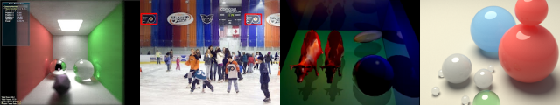
GPU Programming and Architecture: Course Overview
Patrick Cozzi
University of Pennsylvania
CIS 565 - Fall 2012

Slide 2
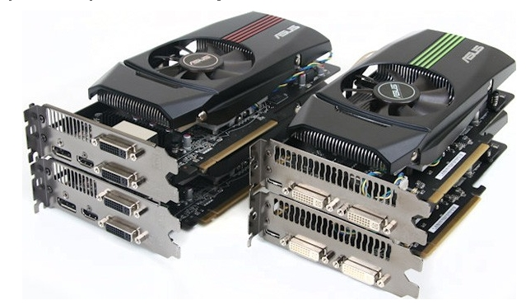
Lectures
Monday and Wednesday
6-7:30pm
Moore 212
Lectures are recorded
Attendance is required for guest lectures
Image from http://pinoytutorial.com/techtorial/geforce-gtx-580-vs-amd-radeon-hd-6870-review-and-comparison-conclusion/
Notes:
Even though the lectures are recorded, come to class for the same reason that you shouldn’t work from home. Will you ever be promoted? Are you surrounding yourself by the best people you can find?

Slide 3






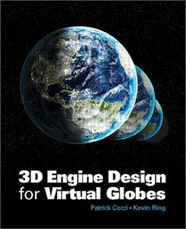

Instructor
Patrick Cozzi
If you are curious, see http://www.seas.upenn.edu/~pcozzi/
Notes:
Cesium demo - http://cesium.agi.com/

Slide 4
Instructor
Email
pjcozzi+cis565@gmail.com
Office Hours
After class
Generally, I’m here as long as you’re here
Notes:
I am not:
Professor Cozzi.
Dr. Cozzi.
Mr. Cozzi.
Sir.

Slide 5

Teaching Assistant
Karl Li: yiningli@seas.upenn.edu
Office Hours
SIG Lab
Tuesday, TBA
Friday, TBA
If you are curious, see http://www.yiningkarlli.com/
Notes:
Last semester’s project - http://gpupathtracer.blogspot.com/

Slide 6

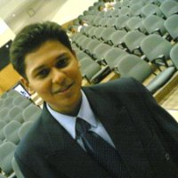
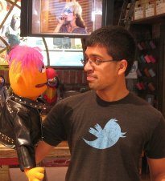


CIS 565 Hall of Fame
Jon
McCaffrey
Krishnan
Ramachandran
Varun
Sampath
Sean
Lilley
Ian
Lilley
Are you next?
Notes:
Jon: System Design Engineer, NVIDIA (Android performance)
Krishnan: Character Simulations TD, Blue Sky Studios
Varun: NVIDIA (video bios)
Sean: AMD (internship working on shadows)
Ian: AGI (internship working on materials)
Students whose futures were significantly influenced, e.g., jobs, etc., by CIS 565. Not based on grades.
Many more students that either I didn’t teach or have not heard from. (I didn’t teach Jon, but he was a TA)

Slide 7
Prerequisites
Passion for computer graphics
CIS 460/560. Preferably received an A
Strong C or C++
Also useful: CIS 371 or CIS 501
Notes:
I don’t officially check prerequisites; the first few projects will.

Slide 8
Course Website
http://www.seas.upenn.edu/~cis565/
Schedule, reading, slides, audio, projects, etc.

Slide 9

Piazza
https://piazza.com/upenn/fall2012/cis565/
Be active; let’s build a course community
Notes:
Default to ask publically for the benefit of the entire class.
You’ll be involved in many communities throughout your career, let’s start now.
Previously used a Google Group. We’ll see how this goes…

Slide 10

GitHub
Used for course materials, projects, and the final project
Create an account:
https://github.com/signup/free
Join our GitHub organization:
https://github.com/CIS565-Fall-2012
Who is new to source control?
Notes:
Everyone needs to learn how to use source control. Learn best practices now while in school. Also better for collaboration and backups.

Slide 11

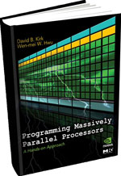
Recommended Books
Real-Time Rendering
2008, Tomas Akenine-Möller, Eric Haines, and Naty Hoffman
OpenGL Insights
2012, Patrick Cozzi and Christophe Riccio, Editors
Readings handed out in class
Programming Massively Parallel Processors
2010, David Kirk and Wen-mei Hwu
Old draft: http://courses.engr.illinois.edu/ece498/al/Syllabus.html
Notes:
See the dates on these books? This course is bleeding-edge!
If you get only one book, get Real-Time Rendering.
The best people I know read a lot.

Slide 12
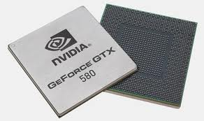
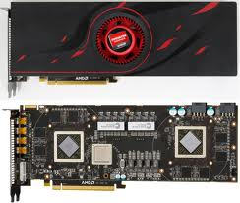
Course Contents
GPU – Graphics Processing Unit
Is it still just for graphics?
Images from http://www.ngohq.com/news/18784-nvidia-launches-geforce-gtx-580-a.html and http://gs7.blogspot.com/2011/09/amd-radeon-hd-6990-worlds-fastest.html
Notes:
The game industry is now larger than the movie industry. The demand for realistic graphics has driven innovation.

Slide 13
Course Contents
Start with GPU architecture
GPU Architecture
Not to scale
Notes:
Focus GPU memory model and threading.
Differences, and now similarities, between GPU and CPU.

Slide 14

Course Contents
CUDA programming model for GPU Compute
CUDA
GPU Architecture
Not to scale
Notes:
Knowing GPU architecture is key to programming with CUDA.
Compute examples: image processing, computer vision, financial analysis, collision detection, path planning, etc.

Slide 15
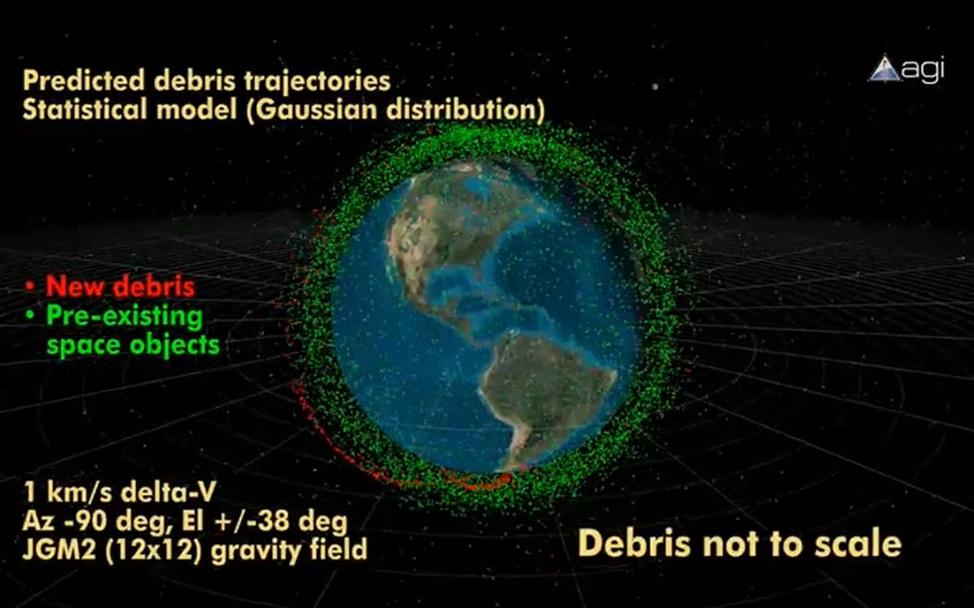
Course Contents
GPU Compute example: conjunction analysis
http://www.youtube.com/watch?v=dtT3pTh_q-8

Slide 16
Course Contents
Parallel algorithms that form building blocks
Parallel Algorithms
CUDA
GPU Architecture
Not to scale
Notes:
Parallel reduction, scan (prefix sums), sorting, and more.

Slide 17
Course Contents
Parallel Algorithms example: Scan
Given:
Compute:
In parallel!
3
1
7
0
4
1
6
3
0
3
4
11
11
15
16
22

Slide 18
Course Contents
Historical and modern graphics pipeline
Parallel Algorithms
CUDA
Graphics Pipeline
GPU Architecture
Not to scale
Notes:
History of rasterization pipeline.
What the current generation pipeline looks like. Where is it going?

Slide 19


Course Contents
WebGL
Parallel Algorithms
CUDA
OpenGL / WebGL
Graphics Pipeline
GPU Architecture
Not to scale

Slide 20
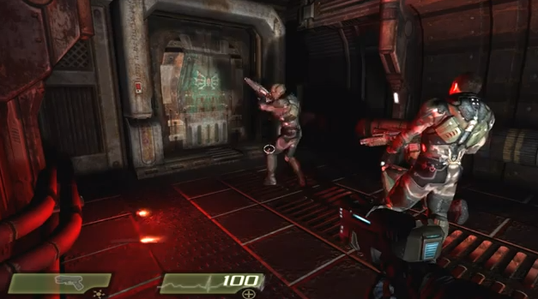
Turbulenz
http://www.youtube.com/watch?v=AJg_BmY9-8o
Notes:
http://www.shader.org/webglcamp/slides/s2_4.pdf
Quake 4 assets
1694 assets – compression and caching
353 lights, 346 particle systems – culling with portals and bounding-box trees
55 shading techniques, 451 materials – sort by technique and material
“huge number of dynamic lights and shadows, high quality animated skinned characters, particle systems with multiple stages, 2D GUIs and animations mapped onto 3D objects, and a great variety of materials and shading effects.”
“portal-based scene manager.”

Slide 21
Course Contents
Real-Time Rendering
Real-Time Rendering
Parallel Algorithms
CUDA
OpenGL / WebGL
Graphics Pipeline
GPU Architecture
Not to scale

Slide 22
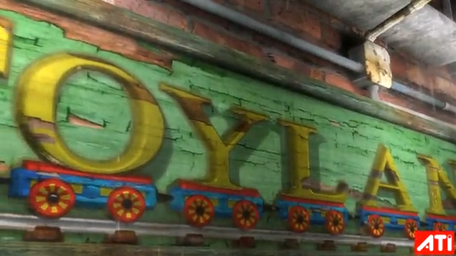
AMD Toyshop Demo
http://www.youtube.com/watch?v=LtxvpS5AYHQ
Notes:
http://developer.amd.com/media/gpu_assets/ToyShop-Eurographics_AnimationFestival.pdf
From 2006 (pre unified shader architecture, wow) – Radeon X1800 at 26-29 fps
Parallax Occlusion Mapping – self-shadows, perspective-correct: bricks, wood letters, sidewalks
28 MB vertex/index. 156 MB for (compressed) textures. 54 MB for framebuffers. Total 240 MB.
500 different shaders.
250 draw calls for 200-500K polygons and 0-22K particles
Post-processing effects for glow, blurry reflections, and rain
Water simulation on GPU using Euler integration (only SM 2.0!)

Slide 23
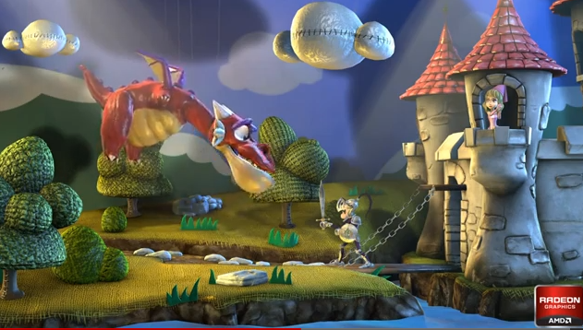
AMD Leo Demo
http://www.youtube.com/watch?v=zYweEn6DFcU
Notes:
http://developer.amd.com/Resources/documentation/samples/demos/pages/AMDRadeonHD7900SeriesGraphicsReal-TimeDemos.aspx
Also see - http://www.youtube.com/watch?v=s2y7e3Zm1xc
Complex materials AND many lights AND many light models.
Use compute to cull lights per tile. Forward shade per tile only with affecting lights.
One bounce global illumination effects by spawning virtual point light sources where light strikes a surface.
Multiple BRDF equations, realistic use of index of refraction, absorption based on wavelength for metals, etc.

Slide 24
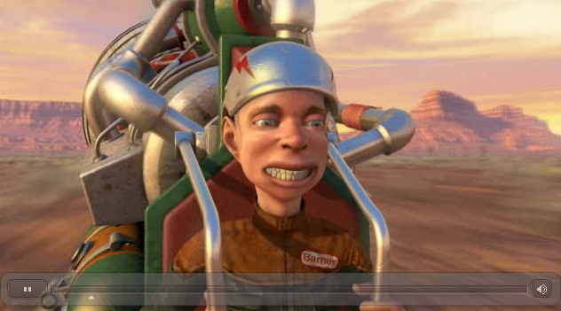
GPU Compute + Rendering
http://www.nvidia.com/object/GTX_400_games_demos.html
Notes:
Smoke - fluid simulation
Compute particles - bridge 1,000,000 particles
Terrain - Tessellation shader

Slide 25
Course Contents
Mobile
Mobile
Real-Time Rendering
Parallel Algorithms
CUDA
OpenGL / WebGL
Graphics Pipeline
GPU Architecture
Not to scale
Notes:
And hopefully console architectures too…

Slide 26
Course Contents
Performance!
Mobile
Real-Time Rendering
Parallel Algorithms
CUDA
OpenGL / WebGL
Graphics Pipeline
GPU Architecture
To scale!
Notes:
GPUs are about doing data-parallel problems quickly!
Walk clock performance. Not theoretical.

Slide 27
Grading
Projects 60%
Final Project 40%
Final 0%
Notes:
Quest for knowledge vs. question for grades.
Some outstanding students don’t have great grades. Most students will great grades do well outside of school.
This is a pragmatic course about creating outstanding GPU/graphics developers. I don’t care if you can pass a test. No midterm. Mostly no written homework

Slide 28
Projects
Intense. Usually one week.
Significantly more work than previous semesters.
Notes:
Rebrand homework as projects. Change culture. No one wants to do homework.

Slide 29
Projects
Each project has
Coding
Pick x of n, e.g., 3 of 5, plus open-ended parts
Written performance analysis
A blog post with screenshots and a video/demo
Random in-class demos. Show, don’t tell.
Notes:
Replacing student presentations with in-class demos: live or video, not sure yet.
Blog is for practicing writing and building your portfolio. Post as often as you want.
Everyone needs to learn how to talk in front of a group and sell themselves. The demo will be the class following the due date.

Slide 30
Projects
One or two projects will be replaced with four-hour hackathons
Class will be canceled that day
Notes:
Good for intensity.
Most likely topic with be ray marching distance functions.

Slide 31
Projects
Due anytime on the due date
Submitted using GitHub
Late Policy
1 second to 1 week late: 50% deduction

Slide 32
Projects
Grade yourself. Seriously
We reserve 30% of the grade as a sanity check
Notes:
Build self-awareness. We focus on feedback, not grades.

Slide 33
Projects
Can be done as open source
Build your code portfolio
Want to use private repos? Get a free edu account
https://github.com/edu

Slide 34

On Interviews…
“Send me your code and then we’ll talk”
- Christophe Riccio

Slide 35
Intensity
Effort
Effort
Time
Time
Student
Pro boxer
Due date
Fight night
Notes:
What can we learn from boxing?
Not to scale; ignore integrating to see the area of the region under the curve.
Actually, we can learn a lot more from boxing: continuous feedback, intensity, etc.
Avoid burning out or making mistakes at the very end. Avoid unforeseen problems. “Early and often.”
I suggest to move the peek even sooner. Hit it hard right away. Line up your effort with office hours, so you can get help early and late.

Slide 36
Academic Integrity
http://www.upenn.edu/academicintegrity/
An academic integrity violation will result in the student receiving an F in this course
Get approval for all code you didn’t write yourself with the TA in advance
Notes:
Example: for a depth-of-view project, it is OK to use a third-party library to load models, but it is not OK to use a depth-of-view fragment shader found in google.
Copying from another student is not OK. If two students have the same exact code, and it is wrong…
Be ready to explain any part of your code.
Violating academic integrity is bad for you, your peers, and your university. It literally steals time away from making the course better for everyone.

Slide 37
GPU Requirements
Most projects require an NVIDIA GeForce 8 series or higher
Update your drivers:
http://www.nvidia.com/Download/index.aspx
What GPU do I have?
What OpenGL/OpenCL/CUDA version:
http://www.ozone3d.net/gpu_caps_viewer/

Slide 38
GPU Requirements
Lab Resources
Moore 100b - NVIDIA GeForce 9800s
SIG Lab - Most systems have at least NVIDIA GeForce 8800s. Two systems have a GeForce 480, three have Fermi Quadros, one has a Fermi Tesla, and one has an AMD card
Contact Karl

Slide 39
CPU and GPU Trends
FLOPS – FLoating-point OPerations per Second
GFLOPS - One billion (10⁹) FLOPS
TFLOPS – 1,000 GFLOPS
Notes:
FLOPS are not a perfect measurement because of memory access, instruction mix, branches, etc. Peak FLOPS are idealistic, but not often reached in practice.

Slide 40
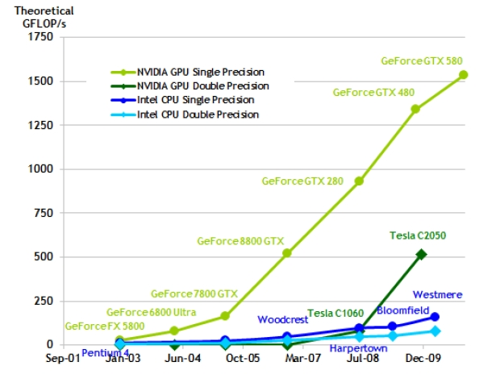
CPU and GPU Trends
Chart from: http://proteneer.com/blog/?p=263
Notes:
Moore’s Law – the number of transistors on a chip will double about every two year
High FLOP per watt
High FLOP per dollar
High FLOP per mm

Slide 41
CPU and GPU Trends
Compute
Intel Core i7 – 4 cores – 100 GFLOP
NVIDIA GTX280 – 240 cores – 1 TFLOP
Memory Bandwidth
System Memory – 60 GB/s
NVIDIA GT200 – 150 GB/s
Install Base
Over 200 million NVIDIA G80s shipped

Slide 42
Class Exercise
Graphics Pipeline

Slide 43
Reminders
Piazza
Signup: https://piazza.com/upenn/fall2012/cis565/
GitHub
Create an account: https://github.com/signup/free
Change it to an edu account: https://github.com/edu
Join our organization: https://github.com/CIS565-Fall-2012
No class Wednesday, 09/12

