Slide 1
Getting CUDA
Current version:
https://developer.nvidia.com/cuda-downloads
Legacy Versions
https://developer.nvidia.com/cuda-toolkit-archive
Use version 4.0 to be compatible with the Moore 100 computers
Version 5.0+ can be used, but it takes a little effort.
In version 5.0+ NVIDIA removed cutil*.h files from the sdk.
They now use helper*.h files located in “CUDA Samples\v5.X\C\common\inc”
Some adjustments to the code base are required for compatibility.

Slide 2
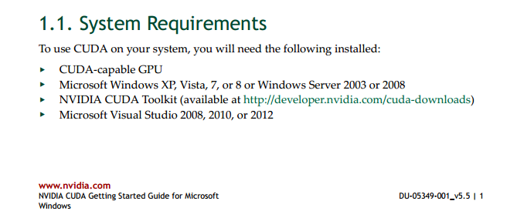
Getting CUDA

Slide 3
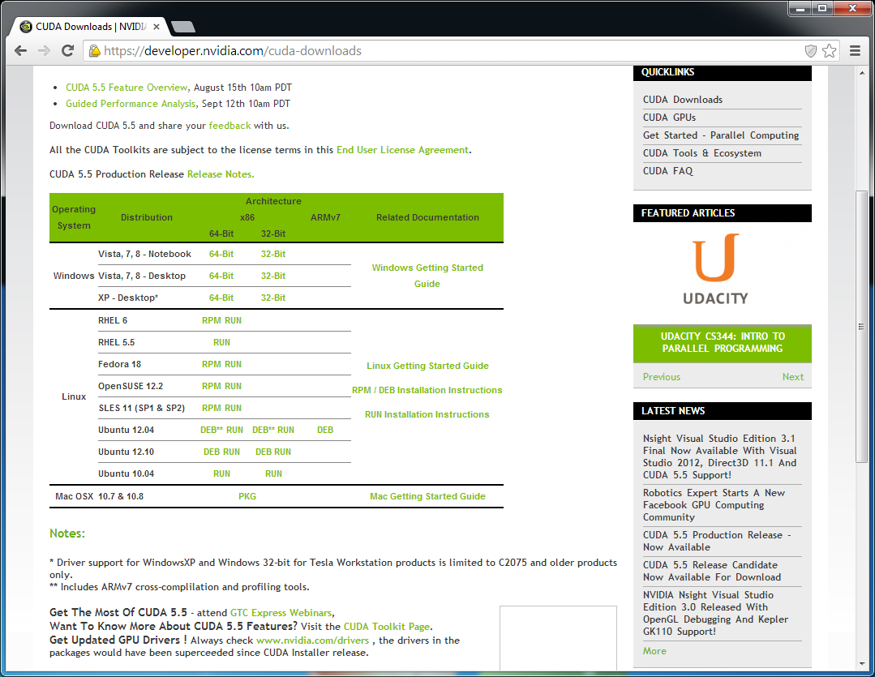
Getting CUDA

Slide 4
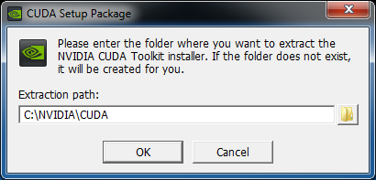
Installing CUDA
Notes:
This is where the samples and docs go

Slide 5
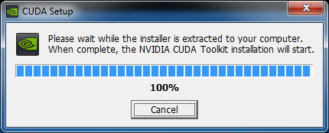
Installing CUDA

Slide 6
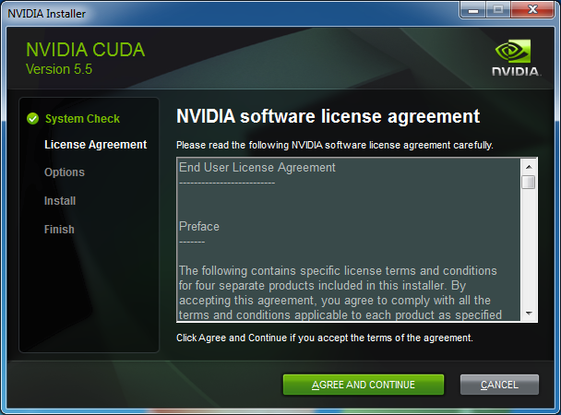
Installing CUDA

Slide 7
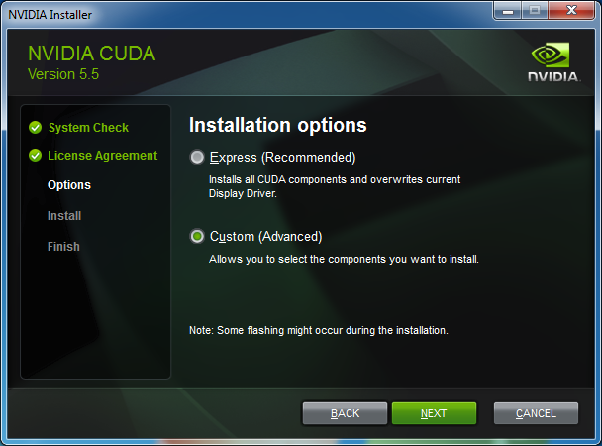
Installing CUDA

Slide 8
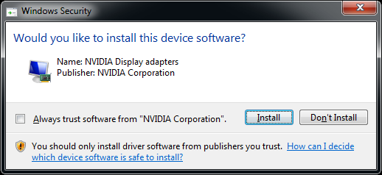
Installing CUDA

Slide 9
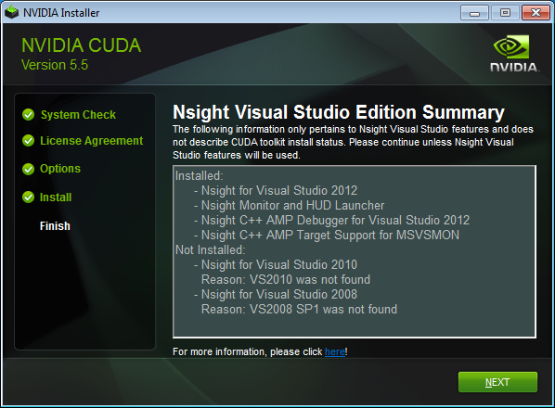
Installing CUDA

Slide 10
Getting GIT
I use msysgit (http://msysgit.github.io/)
You are free to use any git client that can interface with github.

Slide 11
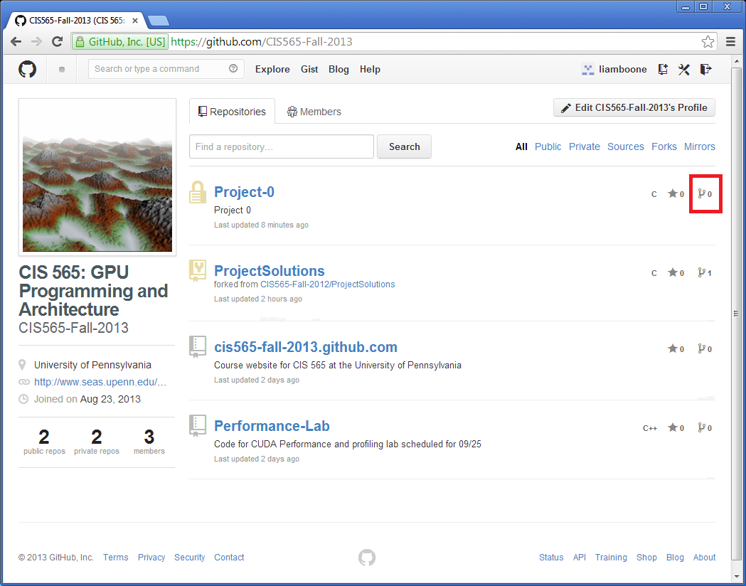
Forking the Project

Slide 12
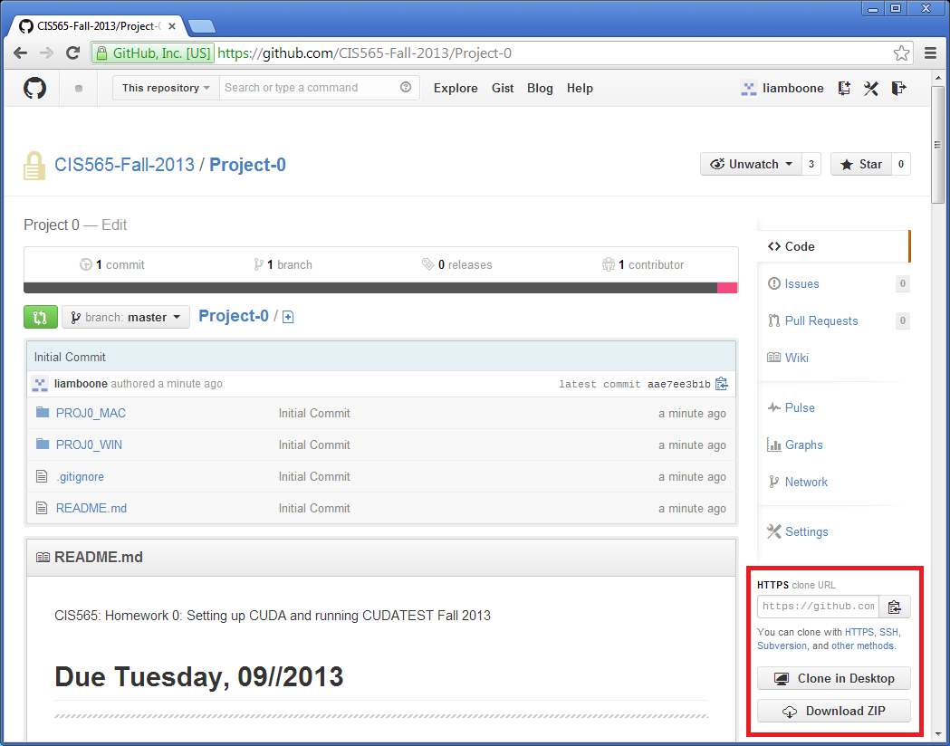
Cloning from Github

Slide 13
Using the CLI
Sample Workflow:
git clone https://github.com/CIS565-Fall-2013/Project-0.git
[Make your edits]
git commit -a -m “Made my edits!”
git push

Slide 14
Places to Look (VS)
Project
Properties
C/C++
General
CUDA C/C++
Common
Linker
General
The Readme

Slide 15
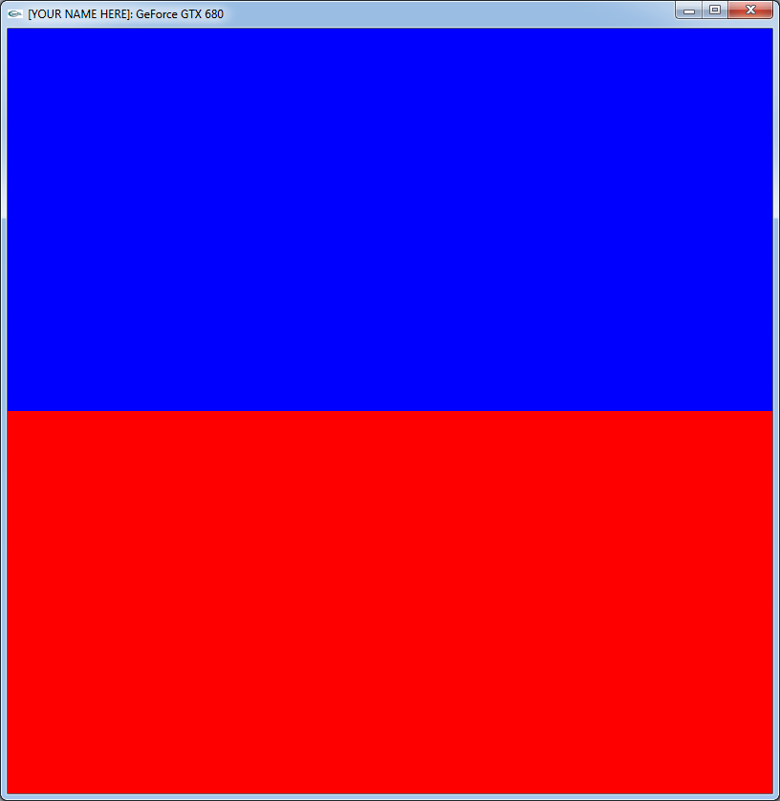
Output

Slide 16
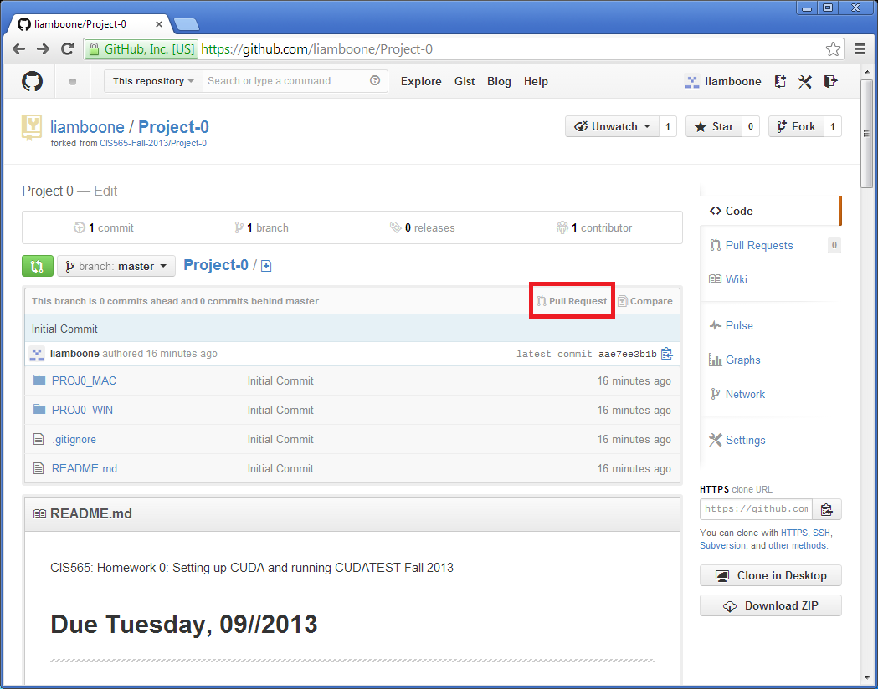
Opening a Pull Request

Slide 17
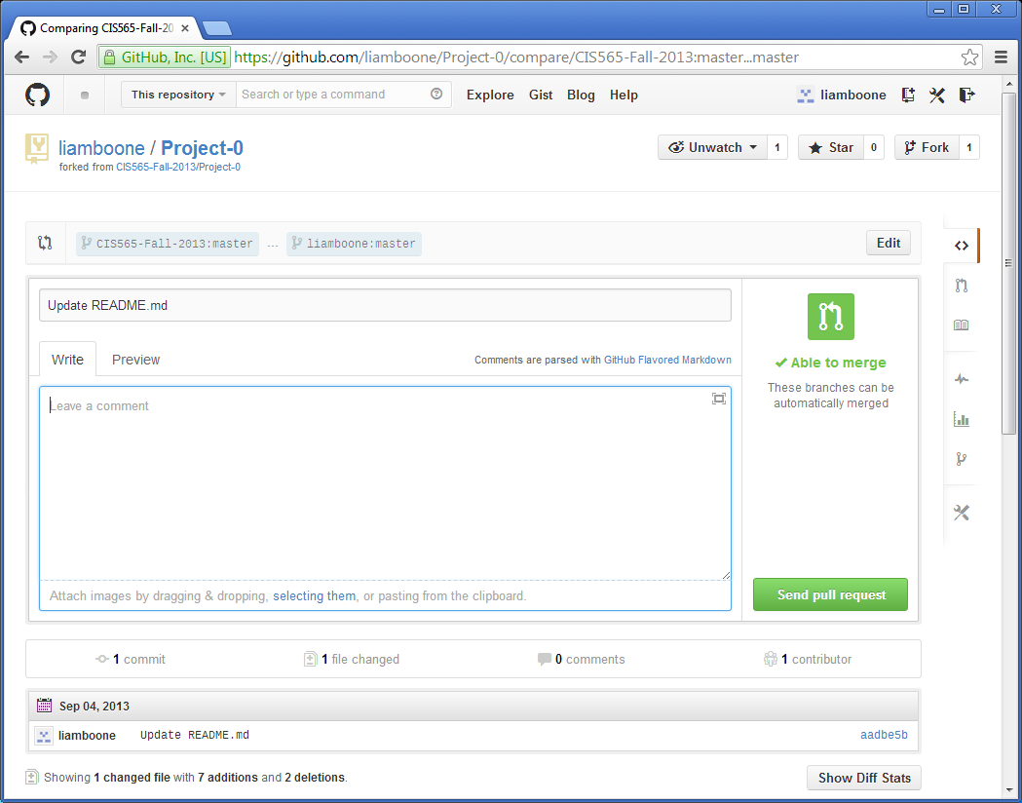
Opening a Pull Request

