Slide 1

Simple Simulation
Liam Boone
University of Pennsylvania
CIS 565 - Fall 2013

Slide 2


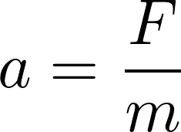
Basics – Euler Integration
Update Positions based on Velocities
Update Velocities based on Accelerations
Update Accelerations based on Forces

Slide 3
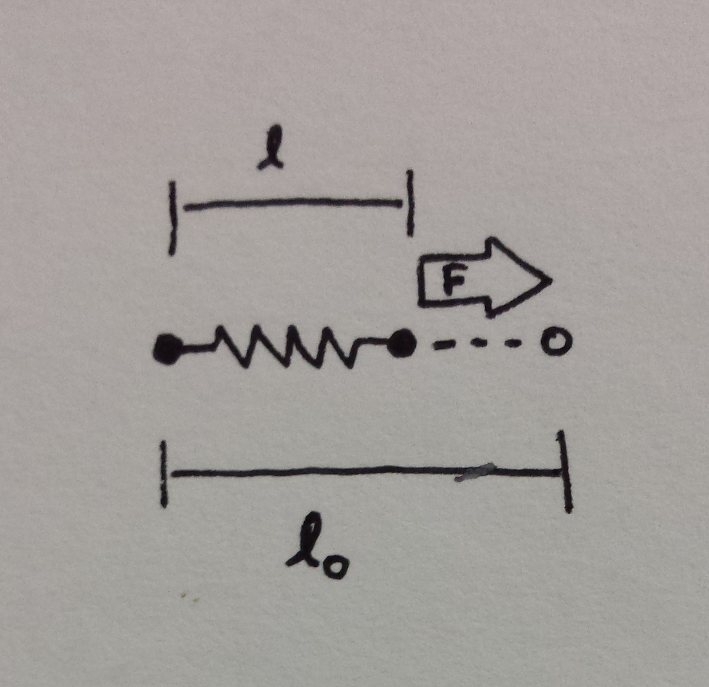

Hooke's Law
k – The stiffness constant
  Larger values give stiffer springs
  Require finer time steps
Easily adaptable to 3D.
  Force exerted along the vector between two end points

Slide 4
Cloth
Model cloth as a grid point masses connected by springs
Compute the forces acting on each point and integrate to achieve motion

Slide 5
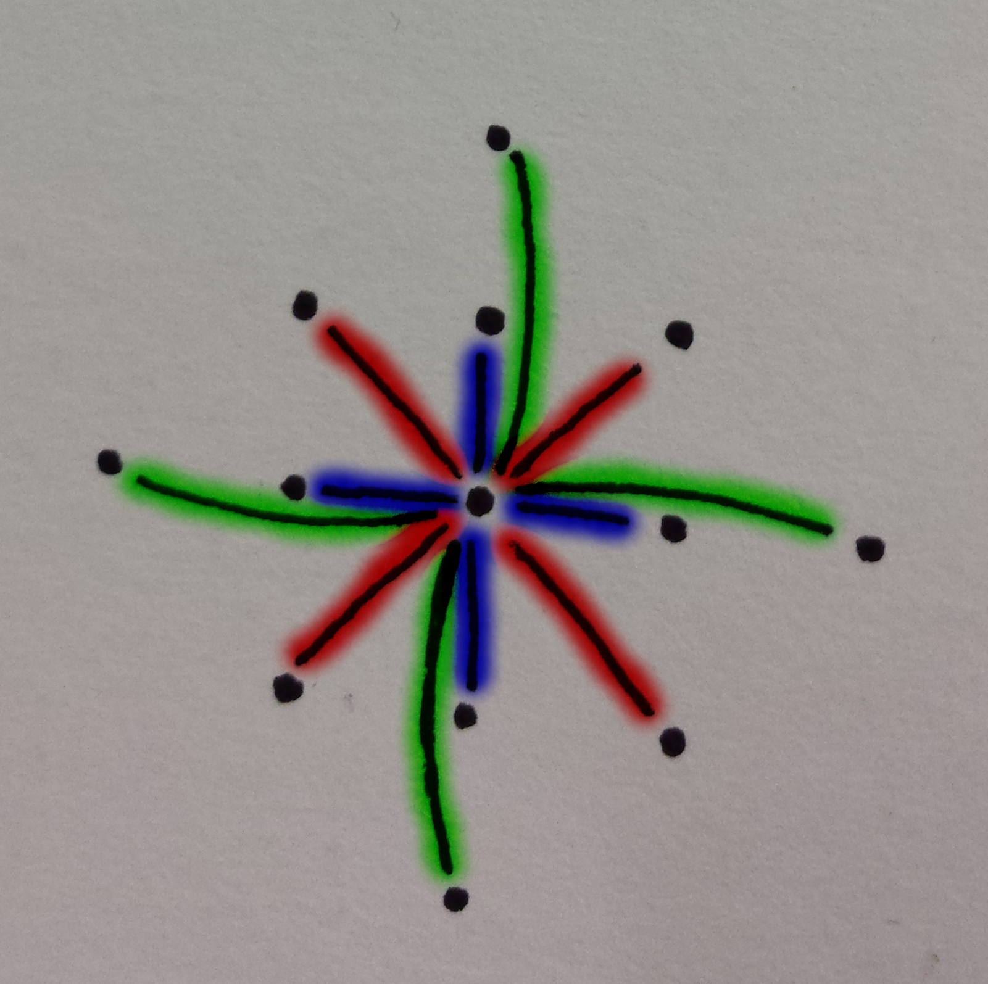
Cloth
Three types of springs
  Structure
  Shear
  Bend
Each have their own k values

Slide 6
Flocking
Each particle represents a “boid”
Motion controlled by three steering forces:
  Alignment
  Separation
  Cohesion
Most of the images in the following slides are taken from Chris Reynolds excellent website:http://www.red3d.com/cwr/boids/

Slide 7
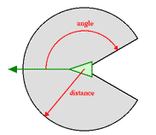
Neighborhood
Any given boid can only “see” other boids in a small area around it
Area determined by two parameters
  Distance
  Field of view

Slide 8
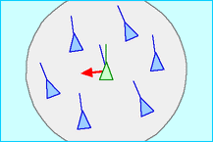
Alignment
Force applied to steer towards the mean direction of the group
This force keeps everyone going in roughly the same direction

Slide 9
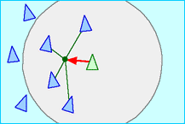
Cohesion
Force applied to steer towards the mean location of the group
This force keeps flocks from spreading out too much

Slide 10
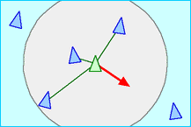
Separation
Force applied to steer away from collisions
Without this force every boid would end up in the same place

Slide 11
Motion
Represent velocity as heading and speed
  Polar coordinates
  Speed can remain constant
Compute each force for each boid
Sum the forces and integrate

