Slide 1






OpenGL and WebGL
Patrick Cozzi
University of Pennsylvania
CIS 565 - Fall 2013

Slide 2
Announcements
LinkedIn Group
Academic Integrity
Project 4 demos next Wednesday

Slide 3
Announcements
Projects
4. Due tomorrow
5. Released Friday. Due Thursday 11/07
6. Released Friday 11/08. Due Friday 11/15
Hackathon
Monday 11/11
Final Project
Kickoff Wednesday 11/13
Pitches on Monday 11/18

Slide 4

OpenGL
Is a C-based API
Is cross platform
Is run by the ARB: Architecture Review Board
Hides the device driver details
OpenGL vs. Direct3D

Slide 5
OpenGL
We are core profile
No fixed function vertex and fragment shading
No legacy API calls:
glBegin()
glRotatef()
glTexEnvf()
AlphaFunc()
…
Recall the fixed function light map
Why was the alpha test remove?

Slide 6
OpenGL
Software stack:
Application
OpenGL API
Device Driver
GPU

Slide 7
OpenGL
Major objects:
Shader Programs
Shader Objects
Array Buffers
Framebuffers
Element Buffers
Textures
Pixel Buffers
Renderbuffers
Fixed Function State
We are not covering everything. Just surveying the most relevant parts for writing GLSL shaders
Notes:
Array buffers = vertex buffers
Element buffers = index buffers

Slide 8
Shaders
Shader object: an individual vertex, fragment, etc. shader
Are provided shader source code as a string
Are compiled
Shader program: Multiple shader objects linked together

Slide 9
Shader Objects
Compile a shader object:
const char *source = // ...
GLint sourceLength = // ...
GLuint v = glCreateShader(GL_VERTEX_SHADER);
glShaderSource(v, 1, &source, &sourceLength);
glCompileShader(v);
GLint compiled;
glGetShaderiv(v, GL_COMPILE_STATUS, &compiled);
// success: compiled == GL_TRUE
// ...
glDeleteShader(v);
Notes:
Just like compiling an OpenCL kernel.

Slide 10
Shader Objects
Compile a shader object:
OpenGL functions start with gl. Why? How would you design this in C++?
const char *source = // ...
GLint sourceLength = // ...
GLuint v = glCreateShader(GL_VERTEX_SHADER);
glShaderSource(v, 1, &source, &sourceLength);
glCompileShader(v);
GLint compiled;
glGetShaderiv(v, GL_COMPILE_STATUS, &compiled);
// success: compiled == GL_TRUE
// ...
glDeleteShader(v);
v is an opaque object
What is it under the hood?
How would you design this in C++?
Notes:
Is it a pointer? Is it an index into an array? Is it a key into a map?

Slide 11
Shader Objects
Compile a shader object:
Provide the shader’s
source code
const char *source = // ...
GLint sourceLength = // ...
GLuint v = glCreateShader(GL_VERTEX_SHADER);
glShaderSource(v, 1, &source, &sourceLength);
glCompileShader(v);
GLint compiled;
glGetShaderiv(v, GL_COMPILE_STATUS, &compiled);
// success: compiled == GL_TRUE
// ...
glDeleteShader(v);
Where should the
source come from?
Why can we pass more than one string?

Slide 12
Shader Objects
Compile a shader object:
const char *source = // ...
GLint sourceLength = // ...
GLuint v = glCreateShader(GL_VERTEX_SHADER);
glShaderSource(v, 1, &source, &sourceLength);
glCompileShader(v);
GLint compiled;
glGetShaderiv(v, GL_COMPILE_STATUS, &compiled);
// success: compiled == GL_TRUE
// ...
glDeleteShader(v);
Compile, but what does the driver really do?

Slide 13
Shader Objects
Compile a shader object:
const char *source = // ...
GLint sourceLength = // ...
GLuint v = glCreateShader(GL_VERTEX_SHADER);
glShaderSource(v, 1, &source, &sourceLength);
glCompileShader(v);
GLint compiled;
glGetShaderiv(v, GL_COMPILE_STATUS, &compiled);
// success: compiled == GL_TRUE
// ...
glDeleteShader(v);
Good developers check for error. Again, how would you design this in C++?
Calling glGet* has performance implications. Why?

Slide 14
Shader Objects
Compile a shader object:
const char *source = // ...
GLint sourceLength = // ...
GLuint v = glCreateShader(GL_VERTEX_SHADER);
glShaderSource(v, 1, &source, &sourceLength);
glCompileShader(v);
GLint compiled;
glGetShaderiv(v, GL_COMPILE_STATUS, &compiled);
// success: compiled == GL_TRUE
// ...
glDeleteShader(v);
Good developers also cleanup resources

Slide 15
Shader Programs
Link a shader program:
GLuint v = glCreateShader(GL_VERTEX_SHADER);
GLuint f = glCreateShader(GL_FRAGMENT_SHADER);
// ...
GLuint p = glCreateProgram();
glAttachShader(p, v);
glAttachShader(p, f);
glLinkProgram(p);
GLint linked;
glGetShaderiv(p, GL_LINK_STATUS, &linked);
// success: linked == GL_TRUE
// ...
glDeleteProgram(v);

Slide 16
Shader Programs
Link a shader program:
A program needs a vertex and fragment shader
GLuint v = glCreateShader(GL_VERTEX_SHADER);
GLuint f = glCreateShader(GL_FRAGMENT_SHADER);
// ...
GLuint p = glCreateProgram();
glAttachShader(p, v);
glAttachShader(p, f);
glLinkProgram(p);
GLint linked;
glGetShaderiv(p, GL_LINK_STATUS, &linked);
// success: linked == GL_TRUE
// ...
glDeleteProgram(v);
Notes:
Moden desktop OpenGL has even more stages.
In old desktop OpenGL, we could mix fixed and programmable vertex/fragment shading.

Slide 17
Shader Programs
Link a shader program:
GLuint v = glCreateShader(GL_VERTEX_SHADER);
GLuint f = glCreateShader(GL_FRAGMENT_SHADER);
// ...
GLuint p = glCreateProgram();
glAttachShader(p, v);
glAttachShader(p, f);
glLinkProgram(p);
GLint linked;
glGetShaderiv(p, GL_LINK_STATUS, &linked);
// success: linked == GL_TRUE
// ...
glDeleteProgram(v);

Slide 18
Shader Programs
Link a shader program:
GLuint v = glCreateShader(GL_VERTEX_SHADER);
GLuint f = glCreateShader(GL_FRAGMENT_SHADER);
// ...
GLuint p = glCreateProgram();
glAttachShader(p, v);
glAttachShader(p, f);
glLinkProgram(p);
GLint linked;
glGetShaderiv(p, GL_LINK_STATUS, &linked);
// success: linked == GL_TRUE
// ...
glDeleteProgram(v);
Be a good developer again

Slide 19
Using Shader Programs
GLuint p = glCreateProgram();
// ...
glUseProgram(p);
glDraw*(); // * because there are lots of draw functions
Part of the current state
How do you draw different objects with different shaders?
What is the cost of using multiple shaders?
How do we reduce the cost?
Hint: write more CPU code – really.

Slide 20
Uniforms
GLuint p = glCreateProgram();
// ...
glLinkProgram(p);
GLuint m = glGetUniformLocation(p, “u_modelViewMatrix”);
GLuint l = glGetUniformLocation(p, “u_lightMap”);
glUseProgram(p);
mat4 matrix = // ...
glUniformMatrix4fv(m, 1, GL_FALSE, &matrix[0][0]);
glUniform1i(l, 0);

Slide 21
Uniforms
Each active uniform has an integer index location.
GLuint p = glCreateProgram();
// ...
glLinkProgram(p);
GLuint m = glGetUniformLocation(p, “u_modelViewMatrix”);
GLuint l = glGetUniformLocation(p, “u_lightMap”);
glUseProgram(p);
mat4 matrix = // ...
glUniformMatrix4fv(m, 1, GL_FALSE, &matrix[0][0]);
glUniform1i(l, 0);

Slide 22
Uniforms
GLuint p = glCreateProgram();
// ...
glLinkProgram(p);
GLuint m = glGetUniformLocation(p, “u_modelViewMatrix”);
GLuint l = glGetUniformLocation(p, “u_lightMap”);
glUseProgram(p);
mat4 matrix = // ...
glUniformMatrix4fv(m, 1, GL_FALSE, &matrix[0][0]);
glUniform1i(l, 0);
mat4 is part of the C++ GLM library
GLM: http://www.g-truc.net/project-0016.html#menu

Slide 23
Uniforms
GLuint p = glCreateProgram();
// ...
glLinkProgram(p);
GLuint m = glGetUniformLocation(p, “u_modelViewMatrix”);
GLuint l = glGetUniformLocation(p, “u_lightMap”);
glUseProgram(p);
mat4 matrix = // ...
glUniformMatrix4fv(m, 1, GL_FALSE, &matrix[0][0]);
glUniform1i(l, 0);
glUniform* for all sorts of datatypes
Uniforms can be changed as often as needed, but are constant during a draw call
Not transposing the matrix

Slide 24
Uniforms
GLuint p = glCreateProgram();
// ...
glLinkProgram(p);
GLuint m = glGetUniformLocation(p, “u_modelViewMatrix”);
GLuint l = glGetUniformLocation(p, “u_lightMap”);
glUseProgram(p);
mat4 matrix = // ...
glUniformMatrix4fv(m, 1, GL_FALSE, &matrix[0][0]);
glUniform1i(l, 0);
Why not glUniform*(p, …)?

Slide 25





WebGL
The web has text, images, and video
What is the next media-type?
We want to support
Windows, Linux, Mac
Desktop and mobile

Slide 26
Bring 3D to the Masses
Put it in on a webpage
Does not require a plugin or install
Does not require administrator rights
Make it run on most GPUs

Slide 27
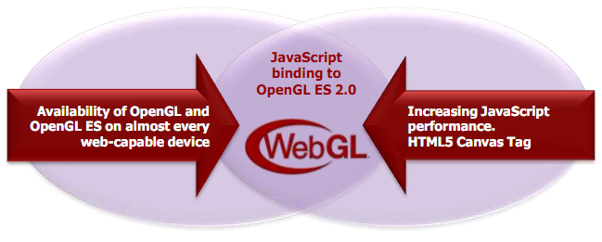
WebGL
OpenGL ES 2.0 for JavaScript
Seriously, JavaScript
Image from http://www.khronos.org/assets/uploads/developers/library/2011-siggraph-mobile/Khronos-and-the-Mobile-Ecosystem_Aug-11.pdf

Slide 28
WebGL
Includes
Vertex shaders
Fragment shaders
Vertex buffers
Textures
Framebuffers
Render states
…
Does not include
Geometry shaders
Tessellation shaders
Vertex Array Objects
Multiple render targets
Floating-point textures
Compressed textures
FS depth writes
…
See http://www.khronos.org/registry/webgl/specs/latest/

Slide 29
WebGL
If you know OpenGL, you already know WebGL
If you know C++, the real learning curve is JavaScript

Slide 30
WebGL Alternatives?
Flash
Silverlight
Java Applets
Unity

Slide 31
WebGL
Creating a context is easy:
// HTML:
<canvas id="glCanvas" width="1024" height="768"></canvas>
// JavaScript:
var gl = document.getElementById("glCanvas").getContext("experimental-webgl");
Notes:
Try “webgl”, then “experimental-webgl”

Slide 32
WebGL
The rest is similar to desktop OpenGL:
// ...
gl.bindBuffer(/* ... */);
gl.vertexAttribPointer(/* ... */);
gl.useProgram(/* ... */);
gl.drawArrays(/* ... */);
Checkout http://learningwebgl.com/

Slide 33
WebGL
Create an animation loop:
(function tick(){
// ... GL calls to draw scene
window.requestAnimationFrame(tick);
})();
You want this to work cross-browser. See http://paulirish.com/2011/requestanimationframe-for-smart-animating/

Slide 34
WebGL Performance
Performance can be very good. Why?

Slide 35
WebGL Performance
Performance can be very good. Why?
The GPU is still doing the rendering
Batch!
Draw multiple objects with one draw call
Sort by texture
Push work into shaders
Push work into web workers
See http://www.youtube.com/watch?v=rfQ8rKGTVlg

Slide 36
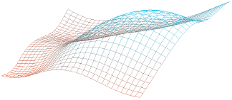
WebGL Performance
 | 32x32 | 64x64 | 128x128
C++ | 1.9 ms | 6.25 ms | 58.82 ms
Chrome 18 | 27.77 ms | 111.11 ms | 454.54 ms
x slowdown | 14.62 | 17.78 | 7.73
CPU-intensive
 | 32x32 | 64x64 | 128x128
C++ | 3.33 ms | 9.43 ms | 37.03 ms
Chrome 18 | 12.82 ms | 22.72 ms | 41.66 ms
x slowdown | 3.85 | 2.41 | 1.13
GPU-intensive (256 draws per frame)
Image from http://openglinsights.com/
Notes:
A 32x32 grid evenly spaced in the xy plane; each point's z component is determined by a 3D noise function given the xy position and the current time.

Slide 37
WebGL and other APIs
Take advantage of other web APIs:
HTML5 <video>
2D <canvas>
CSS transforms
Composite UI elements
Web workers
Typed Arrays

Slide 38
HTML5 on Mobile
Touch events
Geolocation
Device orientation and motion
The future of HTML5 and WebGL on mobile is very promising
Notes:
Touch events: http://www.html5rocks.com/en/mobile/touch.html
Geolocation: http://diveintohtml5.org/geolocation.html
Orientation and motion: http://www.html5rocks.com/en/tutorials/device/orientation/

Slide 39
WebGL support is good, and it is getting better…

Slide 40

WebGL Stats
October 2013
Notes:
http://webglstats.com/

Slide 41



WebGL Support
Desktop:
Android:
iOS:
Notes:
Desktop:
---------
Opera is built on Chromium now.
Safari – Mac OSX only and needs a switch to turn it on.
IE – third-party plugins
Android:
---------
Cesium works pretty well on Android, but not everything is tested.
Performance depends on the device. Great on Nexus 4 and 10 and Samsung Galaxy S3. Qualcomm Adreno has great performance as do most new devices. Tegra 3 performance is OK.
Chrome is the stock browser in Nexus.

Slide 42
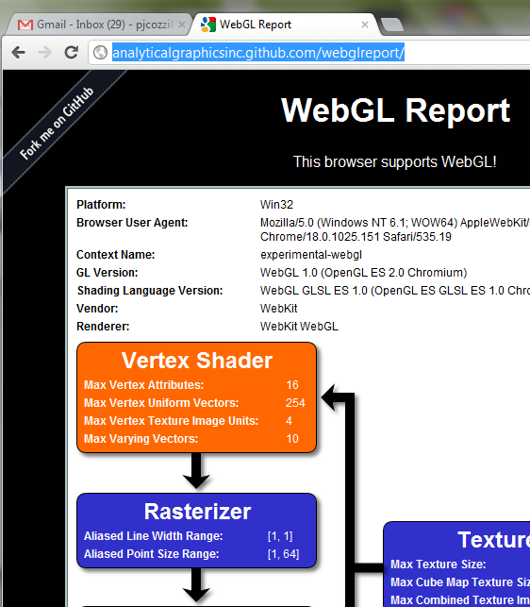
WebGL on Your System
http://www.webglreport.com

Slide 43
Desktop WebGL Support
Windows
No OpenGL driver installed? Old driver?
Only 35% of Windows XP machines have GL 2 drivers
Buggy driver?
No problem:
ANGLE – Almost Native Graphics Layer Engine
OpenGL ES 2.0
Direct3D 9
See http://code.google.com/p/angleproject/
Notes:
ANGLE
Implements GL ES API over D3D 9
Translates GLSL ES to HLSL

Slide 44
WebCL
OpenCL bindings for JavaScript are coming.
N-Body Simulation
http://www.youtube.com/watch?v=F7YSQxz3j7o
http://www.khronos.org/webcl/
Prototypes for Firefox and WebKit are available
Notes:
Calculates the positions and velocities of N particles and animates them
For 1024 particles, WebCL gets 20~40x faster simulation time on Mac

Slide 45
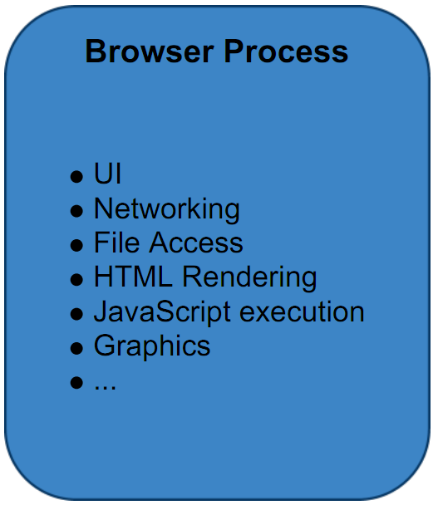
Browser Architecture
Single Process
See http://www.khronos.org/assets/uploads/developers/library/2010_siggraph_bof_webgl/WebGL-BOF-2-WebGL-in-Chrome_SIGGRAPH-Jul29.pdf

Slide 46
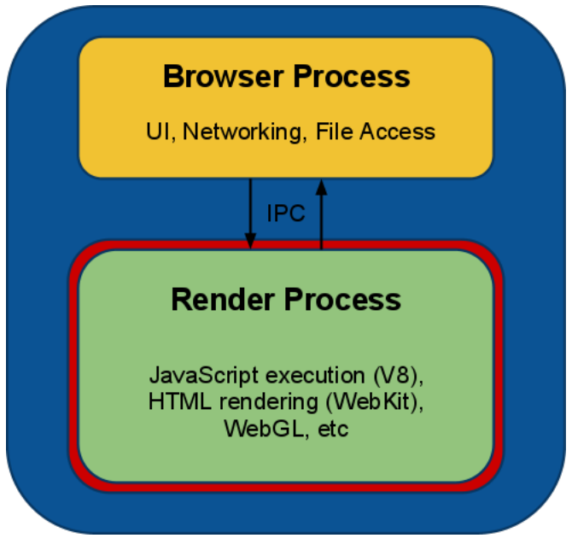
Browser Architecture
Chrome’s Multi-process
See http://www.khronos.org/assets/uploads/developers/library/2010_siggraph_bof_webgl/WebGL-BOF-2-WebGL-in-Chrome_SIGGRAPH-Jul29.pdf

Slide 47
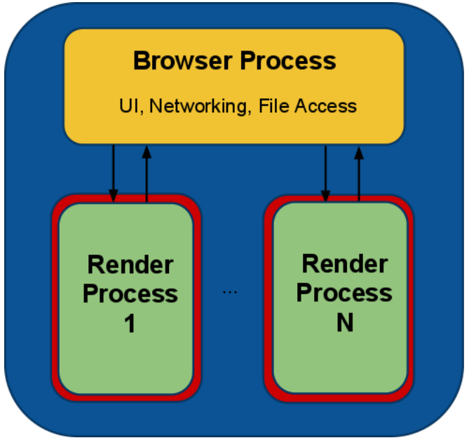
Browser Architecture
Chrome’s Multi-process
See http://www.khronos.org/assets/uploads/developers/library/2010_siggraph_bof_webgl/WebGL-BOF-2-WebGL-in-Chrome_SIGGRAPH-Jul29.pdf
Notes:
Each tab is in a separate process – security – one tab can’t crash other tabs.

Slide 48
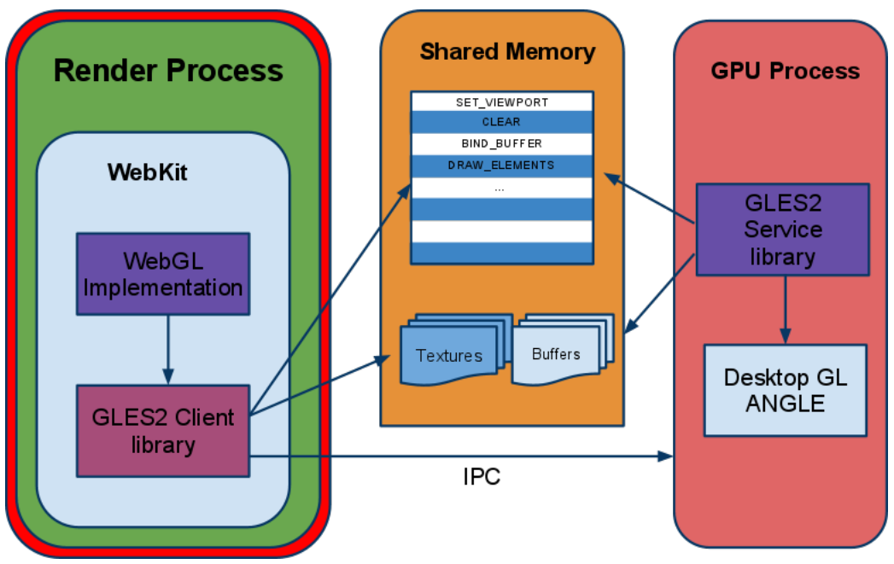
Browser Architecture
Chrome’s Multi-process
See http://www.khronos.org/assets/uploads/developers/library/2010_siggraph_bof_webgl/WebGL-BOF-2-WebGL-in-Chrome_SIGGRAPH-Jul29.pdf
Notes:
Other browsers also use a multi-process architecture in one form or another

Slide 49
Questions
In a multi-process is gl.Get* slow? Why?
What about security?
Notes:
Has to synchronize processes.

Slide 50
Cross-Origin Resource Sharing
Images can’t always be used as texture sources. Why?

Slide 51
Cross-Origin Resource Sharing
Same domain is OK:
var img = new Image();
img.onload = function() {
gl.texImage2D(/* ... */, img);
};
img.src = "image.png";

Slide 52
Cross-Origin Resource Sharing
Another domain requires CORS if supported:
var img = new Image();
img.onload = function() {
gl.texImage2D(/* ... */, img);
};
img.crossOrigin = "anonymous";
img.src =
"http://another-domain.com/image.png";

Slide 53
Cross-Origin Resource Sharing
Not all servers support CORS:
www.your-domain.com
www.another-domain.com
html/js/css
files
Images files
used for textures
Browser

Slide 54
Cross-Origin Resource Sharing
Use a proxy server:
www.another-domain.com
Images files
used for textures
www.your-domain.com
“proxy.php?http://another-domain.com/image.png"
html/js/css
files
Images files
used for textures
Browser
See http://resources.esri.com/help/9.3/arcgisserver/apis/javascript/arcgis/help/jshelp/ags_proxy.htm

Slide 55
Denial of Service Attacks
Long draw calls
Complicated shaders
Big vertex buffers
Solutions
Kill long draw calls
Forbid further rendering
Lots of WebGL security info: http://learningwebgl.com/blog/?p=3890
Notes:
Long draw calls were also used in early GPGPU days. These calls were killed by some operating systems (I think Windows Vista killed draw calls longer than two seconds).

Slide 56
WebGL Libraries
Three.js: https://github.com/mrdoob/three.js/
Cesium: http://cesium.agi.com/
Many more: http://www.khronos.org/webgl/wiki/User_Contributions

Slide 57
WebGL Resources
WebGL Camps: http://www.webglcamp.com
Learning WebGL: http://learningwebgl.com

Slide 58
The Joys of JavaScript
Skip the next 30 slides if you already know JavaScript

Slide 59
JavaScript is weakly typed…

Slide 60
JavaScript Type System
short, int, float, double. Who needs them?
var n = 1;
Notes:
All numbers are 64-bit IEEE floating-point.

Slide 61
JavaScript Type System
JavaScript has numbers, strings, and booleans:
var n = 1;
var s = “WebGL”;
var b = true;
Notes:
All numbers are 64-bit IEEE floating-point.

Slide 62
JavaScript Type System
This compiles:
var n = 1;
var s = “WebGL”;
var b = true;
var sum = n + s + b;
Notes:
Output is “1WebGLtrue”

Slide 63
JavaScript is a functional language…

Slide 64
JavaScript Functions
Looks familiar:
Functions are first-class objects, so…
function add(x, y) {
return x + y;
}
var sum = add(1, 2);

Slide 65
JavaScript Functions
Functions are objects:
var add = function(x, y) {
return x + y;
};
var sum = add(1, 2);

Slide 66
JavaScript Functions
Pass functions to functions:
var add = function // ...
function execute(op, x, y) {
return op(x, y);
}
var sum = execute(add, 1, 2);

Slide 67
JavaScript Anonymous Functions
Why name functions?
function execute(op, x, y) // ...
var sum = execute(function(x, y) {
return x + y;
}, 1, 2);
Notes:
Anonymous functions are also in C#, etc.

Slide 68
JavaScript Closures
Why limit scope?
var z = 3;
var sum = execute(function(x, y) {
return x + y + z;
}, 1, 2);
Notes:
Anonymous functions are also in C#, etc.

Slide 69
JavaScript is a dynamic language…

Slide 70
JavaScript Object Literals
Who needs struct? Create objects on the fly:
var position = {
x : 1.0,
y : 2.0
};

Slide 71
JavaScript Object Literals
Why not add fields on the fly too?
var position = {
x : 1.0,
y : 2.0
};
position.z = 3.0;

Slide 72
JavaScript Object Literals
Who needs class?

Slide 73
JavaScript Object Literals
Who needs class? Create functions too:
var position = {
x : 1.0,
y : 2.0,
min : function() {
return Math.min(this.x, this.y);
}
};

Slide 74
JavaScript Object Literals
Why not change min()?
position.z = 3.0;
position.min = function() {
return Math.min(this.x, this.y,
this.z);
};

Slide 75
JavaScript Object Literals
Useful for passing to functions. Why?

Slide 76
JavaScript Object Literals
Useful for passing to functions. Why?
What do these arguments mean?
pick(322, 40, 5, 4);

Slide 77
JavaScript Object Literals
Useful for passing to functions. Why?
What do these arguments mean?
pick({
x : 322,
y : 40,
width : 5,
height : 4
});
Notes:
Self-documenting code.
Also, you can pass arguments in any order.

Slide 78
JavaScript does object-oriented…
Notes:
But there are no classes

Slide 79
JavaScript Constructor Functions
function Vector(x, y) {
this.x = x;
this.y = y;
}
var v = new Vector(1, 2);
Notes:
Constructor functions start with a capital letter by convention.

Slide 80
JavaScript Constructor Functions
Objects can have functions:
function Vector(x, y) {
this.x = x;
this.y = y;
this.min = function() {
return Math.min(this.x, this.y);
};
}
Notes:
Constructor functions start with a capital letter by convention.

Slide 81
JavaScript Constructor Functions
Objects have prototypes:
function Vector(x, y) {
this.x = x;
this.y = y;
}
Vector.prototype.min = function() {
return Math.min(this.x, this.y);
};
Notes:
Prototype functions can’t access closures in the constructor function.

Slide 82
JavaScript Polymorphism
No need for virtual functions
function draw(model) {
model.setRenderState();
model.render();
}
Notes:
“Duck typing”
Kind of like C# templates.

Slide 83
JavaScript Polymorphism
No need for virtual functions
var level = {
setRenderState : function() // ...
render : function() // ...
};
draw(level); // Just works
Notes:
“Duck typing”
Kind of like C# templates.

Slide 84
JavaScript Build Pipeline
Different than C++
Goal: fast downloads
Common:
Alternative: fine-grain modules
How do you deploy shaders?
.js
files
Concatenate
One
.js file
Minify
“Compressed”
.js file
See http://www.julienlecomte.net/blog/2007/09/16/
Notes:
Example minified javascript, and then beautifying it with http://jsbeautifier.org/
Shader source can be put into HTML script tags, into separate glsl files downloaded with XMLHttpRequest, or put into JavaScript literals as part of the build process.

Slide 85
JavaScript Advice
Use JSHint
Have excellent test coverage
Use the Chrome and Firefox debuggers

Slide 86



JavaScript Resources
I promise I do not work for O'Reilly or Yahoo

