Slide 1

CUDA Odds and Ends
Patrick Cozzi
University of Pennsylvania
CIS 565 - Fall 2013

Slide 2
Course News
Working on getting NVIDIA Nsight in Moore 100B
Project 3: Simulation
Released tomorrow
Due Tuesday 10/15. After fall break
After fall break
Project 2 demos
Rasterization

Slide 3
Course News
Make great README.md files
More words isn’t always better
GPU-related jobs
IBM Research
AccelerEyes

Slide 4
Agenda
Performance
Data Prefetching
Loop Unrolling
Thread Granularity
Atomic functions

Slide 5
Data Prefetching
Independent instructions between a global memory read and its use can hide memory latency
float m = Md[i];
float f = a * b + c * d;
float f2 = m * f;

Slide 6
Data Prefetching
Independent instructions between a global memory read and its use can hide memory latency
float m = Md[i];
float f = a * b + c * d;
float f2 = m * f;
Read global memory

Slide 7
Data Prefetching
Independent instructions between a global memory read and its use can hide memory latency
float m = Md[i];
float f = a * b + c * d;
float f2 = m * f;
Execute instructions that are not dependent on memory read

Slide 8
Data Prefetching
Independent instructions between a global memory read and its use can hide memory latency
float m = Md[i];
float f = a * b + c * d;
float f2 = m * f;
Use global memory after the above line from enough warps hide the memory latency

Slide 9
Data Prefetching
Prefetching data from global memory can effectively increase the number of independent instructions between global memory read and use

Slide 10
Data Prefetching
Recall tiled matrix multiply:
for (/* ... */)
{
// Load current tile into shared memory
__syncthreads();
// Accumulate dot product
__syncthreads();
}

Slide 11
Data Prefetching
Tiled matrix multiply with prefetch:
// Load first tile into registers
for (/* ... */)
{
// Deposit registers into shared memory
__syncthreads();
// Load next tile into registers
// Accumulate dot product
__syncthreads();
}
Notes:
Compared to not prefetching, this requires two extra registers per thread.
For the final iteration, the next tile does not need to be loaded.
The first edition of our book says data prefetching also requires twice the amount of shared memory in this case, but I don’t think that is true (last paragraph of Section 6.4 on Page 115).

Slide 12
Data Prefetching
Tiled matrix multiply with prefetch:
// Load first tile into registers
for (/* ... */)
{
// Deposit registers into shared memory
__syncthreads();
// Load next tile into registers
// Accumulate dot product
__syncthreads();
}

Slide 13
Data Prefetching
Tiled matrix multiply with prefetch:
// Load first tile into registers
for (/* ... */)
{
// Deposit registers into shared memory
__syncthreads();
// Load next tile into registers
// Accumulate dot product
__syncthreads();
}
Prefetch for next iteration of the loop

Slide 14
Data Prefetching
Tiled matrix multiply with prefetch:
// Load first tile into registers
for (/* ... */)
{
// Deposit registers into shared memory
__syncthreads();
// Load next tile into registers
// Accumulate dot product
__syncthreads();
}
These instructions executed by enough threads will hide the memory latency of the prefetch

Slide 15
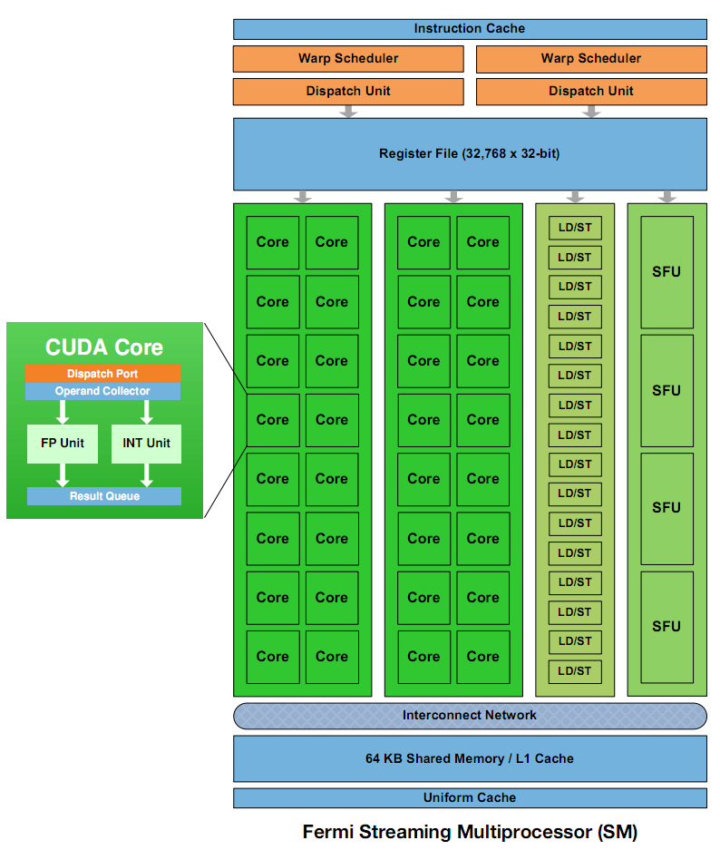
Instruction Mix
Special Function Units (SFUs)
Use to compute __sinf(), __expf()
Only 4, each can execute 1 instruction per clock
Image: NVIDIA Fermi Whitepaper
Notes:
2 SFUs per SM on G80

Slide 16
Loop Unrolling
for (int k = 0; k < BLOCK_SIZE; ++k)
{
Pvalue += Ms[ty][k] * Ns[k][tx];
}
Instructions per iteration
One floating-point multiply
One floating-point add
What else?

Slide 17
Loop Unrolling
for (int k = 0; k < BLOCK_SIZE; ++k)
{
Pvalue += Ms[ty][k] * Ns[k][tx];
}
Other instructions per iteration
Update loop counter

Slide 18
Loop Unrolling
for (int k = 0; k < BLOCK_SIZE; ++k)
{
Pvalue += Ms[ty][k] * Ns[k][tx];
}
Other instructions per iteration
Update loop counter
Branch

Slide 19
Loop Unrolling
for (int k = 0; k < BLOCK_SIZE; ++k)
{
Pvalue += Ms[ty][k] * Ns[k][tx];
}
Other instructions per iteration
Update loop counter
Branch
Address arithmetic

Slide 20
Loop Unrolling
for (int k = 0; k < BLOCK_SIZE; ++k)
{
Pvalue += Ms[ty][k] * Ns[k][tx];
}
Instruction Mix
2 floating-point arithmetic instructions
1 loop branch instruction
2 address arithmetic instructions
1 loop counter increment instruction

Slide 21
Loop Unrolling
Only 1/3 are floating-point calculations
But I want my full theoretical 1 TFLOP (Fermi)
Consider loop unrolling
Image: NVIDIA Fermi Whitepaper

Slide 22
Loop Unrolling
Pvalue +=
Ms[ty][0] * Ns[0][tx] +
Ms[ty][1] * Ns[1][tx] +
...
Ms[ty][15] * Ns[15][tx]; // BLOCK_SIZE = 16
No more loop
No loop count update
No branch
Constant indices – no address arithmetic instructions
Notes:
Compilers are getting better at unrolling, but many programmers still do it by hand.

Slide 23
Loop Unrolling
Automatically:
#pragma unroll BLOCK_SIZE
for (int k = 0; k < BLOCK_SIZE; ++k)
{
Pvalue += Ms[ty][k] * Ns[k][tx];
}
Disadvantages to unrolling?
Notes:
Disadvantages include instruction cache misses and increased register usage. Manually unrolling avoids the disadvantages of predication (which itself is only used for a few-instruction branch).

Slide 24
Thread Granularity
How much work should one thread do?
Parallel Reduction
Reduce two elements?
Matrix multiply
Compute one element of Pd?

Slide 25
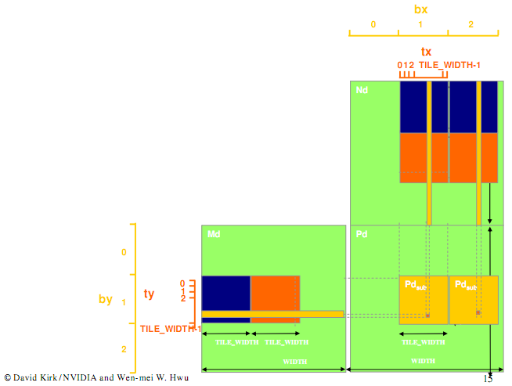
Thread Granularity
Matrix Multiple
Image from http://courses.engr.illinois.edu/ece498/al/textbook/Chapter5-CudaPerformance.pdf

Slide 26
Thread Granularity
Matrix Multiple
Both elements of Pd require the same row of Md
Image from http://courses.engr.illinois.edu/ece498/al/textbook/Chapter5-CudaPerformance.pdf

Slide 27
Thread Granularity
Matrix Multiple
Compute both Pd elements in the same thread
Reduces global memory access by ¼
Increases number of independent instructions
What is the benefit?
New kernel uses more registers and shared memory
What does that imply?

Slide 28
Atomic Functions
What is the value of count if 8 threads execute ++count?
__device__ unsigned int count = 0;
// ...
++count;
Notes:
1 to 8. Maybe 1 if all threads are in the same warp and issued at the same time.

Slide 29
Atomic Functions
Read-modify-write atomic operation
Guaranteed no interference from other threads
No guarantee on order
Shared or global memory
Requires compute capability 1.1 (> G80)
See G.1 in the NVIDIA CUDA C Programming Guide for full compute capability requirements

Slide 30
Atomic Functions
What is the value of count if 8 threads execute atomicAdd below?
__device__ unsigned int count = 0;
// ...
// atomic ++count
atomicAdd(&count, 1);
Notes:
8 – no race condition

Slide 31
Atomic Functions
How do you implement atomicAdd?
__device__ int atomicAdd(
int *address, int val);

Slide 32
Atomic Functions
How do you implement atomicAdd?
__device__ int atomicAdd(
int *address, int val)
{ // Made up keyword:
__lock (address) {
*address += val;
}
}

Slide 33
Atomic Functions
How do you implement atomicAdd without locking?

Slide 34
Atomic Functions
How do you implement atomicAdd without locking?
What if you were given an atomic compare and swap?
int atomicCAS(int *address, int compare, int val);
Notes:
There is a PTX instruction for CAS and other atomics. http://developer.download.nvidia.com/compute/DevZone/docs/html/C/doc/ptx_isa_3.0.pdf.

Slide 35
Atomic Functions
atomicCAS pseudo implementation
int atomicCAS(int *address,
int compare, int val)
{ // Made up keyword
__lock(address) {
int old = *address;
if (*address == compare) {*address = val; }
return old;
}
}

Slide 36
Atomic Functions
Example:
*addr = 1;
atomicCAS(addr, 1, 2);
atomicCAS(addr, 1, 3);
atomicCAS(addr, 2, 3);

Slide 37
Atomic Functions
Example:
*addr = 1;
atomicCAS(addr, 1, 2);
atomicCAS(addr, 1, 3);
atomicCAS(addr, 2, 3);
// returns 1
// *addr = 2

Slide 38
Atomic Functions
Example:
*addr = 1;
atomicCAS(addr, 1, 2);
atomicCAS(addr, 1, 3);
atomicCAS(addr, 2, 3);
// returns 2
// *addr = 2

Slide 39
Atomic Functions
Example:
*addr = 1;
atomicCAS(addr, 1, 2);
atomicCAS(addr, 1, 3);
atomicCAS(addr, 2, 3);
// returns 2
// *addr = 3

Slide 40
Atomic Functions
Again, how do you implement atomicAdd given atomicCAS?
__device__ int atomicAdd(
int *address, int val);

Slide 41
Atomic Functions
__device__ int atomicAdd(int *address, int val)
{
int old = *address, assumed;
do {
assumed = old;
old = atomicCAS(address,
assumed, val + assumed);
} while (assumed != old);
return old;
}

Slide 42
Atomic Functions
__device__ int atomicAdd(int *address, int val)
{
int old = *address, assumed;
do {
assumed = old;
old = atomicCAS(address,
assumed, val + assumed);
} while (assumed != old);
return old;
}
Read original value at *address.

Slide 43
Atomic Functions
__device__ int atomicAdd(int *address, int val)
{
int old = *address, assumed;
do {
assumed = old;
old = atomicCAS(address,
assumed, val + assumed);
} while (assumed != old);
return old;
}
If the value at *address didn’t change, increment it.

Slide 44
Atomic Functions
__device__ int atomicAdd(int *address, int val)
{
int old = *address, assumed;
do {
assumed = old;
old = atomicCAS(address,
assumed, assumed + val);
} while (assumed != old);
return old;
}
Otherwise, loop until atomicCAS succeeds.
The value of *address after this function returns is not necessarily the original value of *address + val, why?

Slide 45
Atomic Functions
Lots of atomics:
// Arithmetic // Bitwise
atomicAdd() atomicAnd()
atomicSub() atomicOr()
atomicExch() atomicXor()
atomicMin()
atomicMax()
atomicAdd()
atomicDec()
atomicCAS()
See B.10 in the NVIDIA CUDA C Programming Guide

Slide 46
Atomic Functions
How can threads from different blocks work together?
Use atomics sparingly. Why?
Notes:
Work together: use atomics, __syncthreads() only works within a thread block.
Sparingly: kills parallelism.

