Slide 1
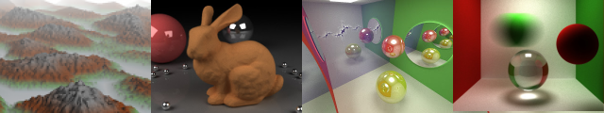
glTF and rest3d
Patrick Cozzi
University of Pennsylvania
CIS 565 - Fall 2013

Slide 2
Agenda
Asset Formats
Tool, interchange, and runtime formats
glTF
Content Pipeline
rest3d
Notes:
TODO: next semster
* OpenGEX
* Expand rest3d

Slide 3
Asset Formats

Slide 4



Native Modeling Tool Formats
Examples
.blend
.ma / .mb
.lxo
Notes:
Get data in/out modeling tool without losing any information. Like a .bmp file compared to a .jpg (for runtime).
Sometimes there is an SDK to read/write these files.
Sometimes the format is published.
.ma – ASCII
.mb – binary
Blender logo - http://www.blender.org/about/logo/
May logo - http://en.wikipedia.org/wiki/Autodesk_Maya
Modo logo - http://en.wikipedia.org/wiki/Modo_(software)

Slide 5

Interchange Formats
.fbx
.obj
…
…
Notes:
COLLADA is an open-standard from Khronos. Open-source OpenCOLLADA and COLLADA DOM read/write COLLADA file.
FBX is proprietary and owned by Autodesk. Autodesk has an SDK to read/write FBX. FBX can be binary or ASCII. There is an unofficial spec.
OBJ is originally from Wavefront. It is geometry only, so doesn’t include animations, skins, physics, etc.
COLLADA logo - http://www.khronos.org/legal/trademarks/#collada

Slide 6
Interchange Formats
.fbx
.obj
?
?
Engine
(Runtime)
Notes:
Interchange formats can move assets between tools, but what about between tools and the runtime engine?

Slide 7
Interchange Formats
Target tools, not the GPU, OpenGL, or Direct3D
Example: COLLADA
XML + image files
One index per attribute, not vertex
Unsigned int indices
Transform stack per node
Polygons and splines
Common profile materials
Doesn’t specify image file format
Lots of flexibility and indirection in animations and skins
Notes:
Interchange formats are generally verbose and slow to load for runtime use.
Interchange formats need to go through many conversion steps before a graphics API. This doesn’t belong in a runtime; it belongs in the content pipeline.
Common profile materials – need to generate shaders to render. However, some engines will want to do this to match their g-buffer format for deferred shading, for example.
Keyframe animation supports several different splines. Great for interchange, but a runtime usually only needs one or two.

Slide 8
Runtime Format
Optimized for use in an engine
Tool
format
Content Pipeline
Runtime
format
Engine
Interchange format
Notes:
Again, .bmp vs. .jpg example.
The content pipeline runs offline, perhaps as part of the build process. It does not ship with the game.

Slide 9
Engines
Engines are more than the runtime
Example:
“Engine”
Runtime
C++
Ships with the game
“Tools”
Editor
C#
Pipeline
C++
Used by developers, artists, etc.
Notes:
“Engine” is often used when we mean just the “runtime.”
“Pipeline”, “Content Pipeline”, “Asset Pipeline”, …

Slide 10


Engine Examples
Unity (November 2013)
Runtime: ~500K lines of code
Tools: ~500K
Frostbite (November 2013)
Engine + Pipeline: 1.7M
Editor: 1.1M
Notes:
About half of an engine is the tools: content pipeline, editor, etc.
Also an additional ~250K of unit tests in Unity
Unity stats - http://aras-p.info/blog/2013/11/08/some-unity-codebase-stats/
Frostbite stats - https://twitter.com/FrostbiteEngine/status/398199738589515776
Unity logo - http://unity3d.com/company/public-relations/brand
Frostbite logo - http://en.wikipedia.org/wiki/Frostbite_(game_engine)

Slide 11
glTF

Slide 12




glTF
“the runtime asset format for WebGL, OpenGL ES, and OpenGL”
jpg, mp3, mpeg, … what about 3D?
Open standard
Not ratified yet
Notes:
Story about how I got involved in glTF - http://blog.virtualglobebook.com/2013/03/how-i-got-involved-in-gltf-and-khronos.html
Also see “glTF: Designing an Open-Standard Runtime Asset Format” in GPU Pro 5.
Logos from http://www.khronos.org/legal/trademarks/

Slide 13
glTF Goals
Easy and efficient to render
.json
Node hierarchy, materials, lights, cameras
.bin
Geometry: vertices and indices
Animation: key-frames
Skins: inverse-bind matrices
.glsl
Shaders
.png, .jpg, …
Textures
Notes:
Why JSON - cross-platform, compact, readable, allows validation, and minifies and compresses well
Geometry, animation, and skins are binary, unlike, COLLADA, for example, which uses XML
Binary data is little endian
Binary blobs - allow efficient creation of GL buffers and textures since they require no additional parsing, except perhaps decompression
Shaders can be in .json or separate .glsl files
Can have any number of .bin files
Flexible for a wide array of applications.

Slide 14
glTF Goals
Balanced Feature Set
Extensible
<
<
Notes:
glTF has more features than a graphics API, like a node hierarchy, animation, and skins, but less features than an interchange format, like physics and spline representations.
Extensible – extra properties – forwards compatible
Logos from http://www.khronos.org/legal/trademarks/

Slide 15
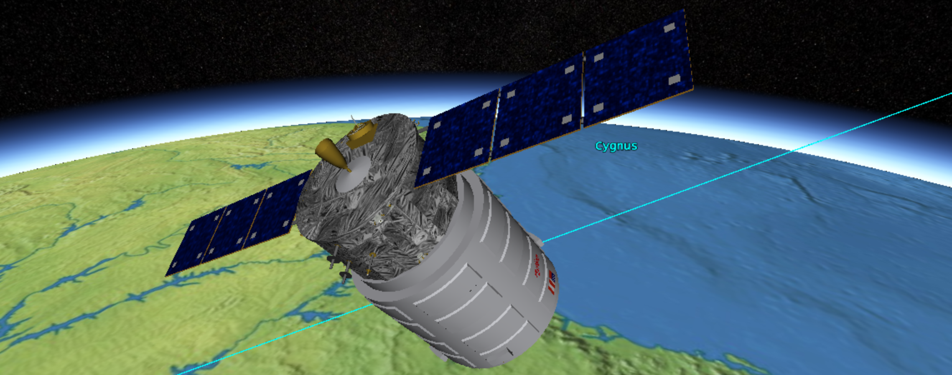
glTF Goals
Code, Not Just Spec
Content Pipeline is key to adoption
Three.js is key to adoption
Implementations are needed for a sane spec
Notes:
We developed 4 renderers. Sometimes multiple times each.

Slide 16

glTF Goals
Community
Grassroots and transparency
https://github.com/KhronosGroup/glTF

Slide 17
glTF Goals
WebGL, OpenGL ES, and OpenGL
Initial adoption - WebGL
Notes:
Established engines like Unity and C4 already have a runtime format. WebGL engines are still emerging.

Slide 18
glTF Schema
scene
*
glTF duck
example
node
*
1
1
*
camera
mesh
light
animation
*
*
*
accessor
material
skin
*
1
1
*
bufferView
technique
texture
1
1
1
1
buffer
program
image
sampler
2
shader
Notes:
Bottom-up:
Geometry
buffer – binary blob. Can be combination of geometry, animation, and skins
bufferView – subset of buffer with target info (ARRAY_BUFFER, ELEMENT_BUFFER, animation/skin)
accessor – subset of bufferView with type info, e.g., float-point. Similar to a call to glVertexAttribPointer
For example, a bufferView may be all vertices in the asset (think glBufferData), where as an accessor may be an individual attribute for a mesh (think glVertexAttribPointer)
mesh – (composed of primitives, not shown) – corresponds to glDrawElements
node – one or more meshes, plus transform, plus children
Material
image – Image file
sampler – texture filter and wrap modes, think glTexParameter
texture – think glTexImage2D
shader – GLSL shader source
program – think glCompileShader and glLinkProgram
technique – parameter inputs (attributes + uniforms) + pass – program + render state
Material – an instance of a technique. Overrides parameter inputs
Animation
animation accesses keyframes from accessor
animation targets node (transforms), material/technique parameters, and camera/light
Skin
skin accesses inverse-bind matrices from accessor
node references skins. skins reference nodes - https://github.com/KhronosGroup/glTF/issues/193

Slide 19
Content Pipeline

Slide 20
Content Pipeline
Optimize and package assets for use with the engine
Several areas
Geometry
Animation and skins
Texture
Shaders
Notes:
Usually not all hand coded, but instead a combination of many tools from different third-parties, e.g., texture compression, mesh compression, vertex cache optimize, etc.

Slide 21
Content Pipeline
Cleanup redundancies created by artist/exporters
Remove unused nodes, meshes, materials, techniques, etc.
Remove unused vertices. Remove duplicate vertices
Remove duplicate materials and techniques
Combine primitives with the same material and vertex format
Notes:
SketchUp story with one triangle per primitive.

Slide 22
Content Pipeline: Geometry
Triangulation
Polygons Triangles
Higher-order surfaces
Notes:
Also, triangle strips/fans to triangles.
For polygons, this only adds indices so the payload increase is not that bad.
Ear clipping. Accelerate with spatial data structure.
Randomized algorithm. Select random cut. Split polygon if it doesn’t intersect any edges.

Slide 23
Content Pipeline: Geometry
Deindex
One index per attribute one index per vertex
positions
position indices: [0, 1, 2, 0, 2, 3]
normals
normal indices: [0, 0, 0, 0, 0, 0]
positions
normals
indices: [0, 1, 2, 0, 2, 3]
Notes:
Deindexing reduces the about of index data but can increase the amount of vertex data. A single set of indices is required for glDrawElements and friends.
Example here is one side of a box. It is 2 triangles with one normal. Deindexing requires duplicating the normals.
This example:
Before:
Vertex data: 16 + 4 = 20
Index data: 12 +12 = 24
Total: 44
After:
Vertex data: 16 + 16 = 32
Index data: 12
Total: 46
If most attributes are unique (not shared by multiple vertices), deindexing can decrease the size.
* See “Indexing Multiple Vertex Arrays” in OpenGL Insights. Chapter 26.

Slide 24
Content Pipeline: Geometry
Flatten node hierarchy
Notes:
Node hierarchy or “scene graph.”
Increases the batch size and, therefore, reduces the number of draw calls.
Nodes need the same material (and vertex format, which is implied when they share material).
Transform combined meshes into the same coordinate system. Children have their transform applied when they are combined with their parent.
If a node is targeted by an animation, it’s sub-tree can be combined, but it can’t be combined with its parent.
Texture atlases help nodes have the same material since they share the same texture.
Also reduces the number of meshes and combines buffers as needed.

Slide 25
Content Pipeline: Geometry
Split meshes
So indices fit into unsigned short
vertices ... ...
indices: [0, 1, 2, ..., 64K - 3, 64K - 2, 64K - 1, 3, 4, 5, 64K, 64K + 1, 64K + 2, ...]
vertices ...
indices: [0, 1, 2, ..., 64K - 3, 64K - 2, 64K - 1, 3, 4, 5, ...]
vertices ...
indices: [0, 1, 2, ...]
Notes:
Needs to duplicate some vertices.
Without extensions, this is needed for WebGL 2 and OpenGL ES 2. The unsigned int extension is widely supported, and although it uses more memory and potentially contributes to cache pollution, I have not noticed a performance hit, and it allows for larger batches.

Slide 26
Content Pipeline: Geometry
Compression
Open3DGC (TFAN)
Pre-gzip for web deployment
Easy tricks
Minify JSON, e.g., whitespace
Exclude default values, e.g., identity matrix
Uniform scale instead of non-uniform scale
4x3 matrices instead of 4x4
Quaternions are normalized, only store 3 components
Notes:
Need to consider decompression time along with the payload savings.
Open3DGC – http://kmamou.blogspot.com/2013/07/open-3d-graphics-compression-open3dgc.html
TFAN – fans, quantize, parallelogram predict, O(n) wrt vertices to decompress.
These transform tricks also apply to animation data.
Also see “WebGL Models: End-to-End” in OpenGL Insights (Chapter 30).

Slide 27
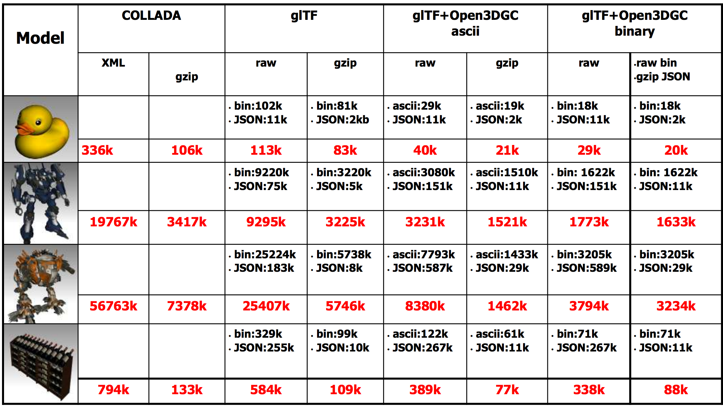
Notes:
Slide from https://www.khronos.org/assets/uploads/developers/library/2013-siggraph-collada-bof/COLLADA-BOF_SIGGRAPH-2013.pdf

Slide 28
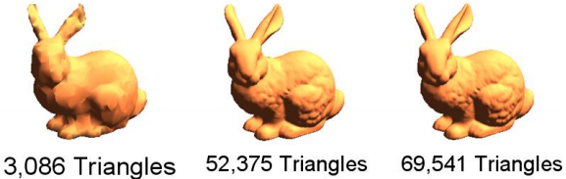
Content Pipeline: Geometry
Generate LODs
Notes:
Vertex clustering from my master’s thesis is shown here.
QEM is most popular.
Many games are not using geometric LOD on their characters.
Many generate different models for different platforms – mobile vs. console vs. desktop.

Slide 29
Content Pipeline: Geometry
Others
Consistent up axis
What’s up? y? z? What’s forward?
Re-order for the pre- and post-vertex-shader caches
Interleave vertex attributes?
Notes:
Vertex cache optimization
* http://home.comcast.net/~tom_forsyth/papers/fast_vert_cache_opt.html
* http://gfx.cs.princeton.edu/pubs/Sander_2007_%3ETR/
Interleaving – see Chapter 3 - http://www.sci.utah.edu/~csilva/papers/thesis/louis-bavoil-ms-thesis.pdf

Slide 30
Content Pipeline: Animation and Skins
Animations
Resample key-frames
Compress like geometry
Skins
Limit joints affecting a vertex
Split meshes
Notes:
Animation:
15 fps may be fine instead of 30 or 60
Control points don’t need to be uniformly sampled, e.g., samples can be removed for linear parts.
Don’t store a channel for scale, for example, if it never changes.
See Section 11.8 in Game Engine Architecture
Skins:
2 joints for an elbow. 3 weights for a hip. Games rarely use more than 4 weights.
Mesh splits are required to keep joint matrices in a uniform array.

Slide 31
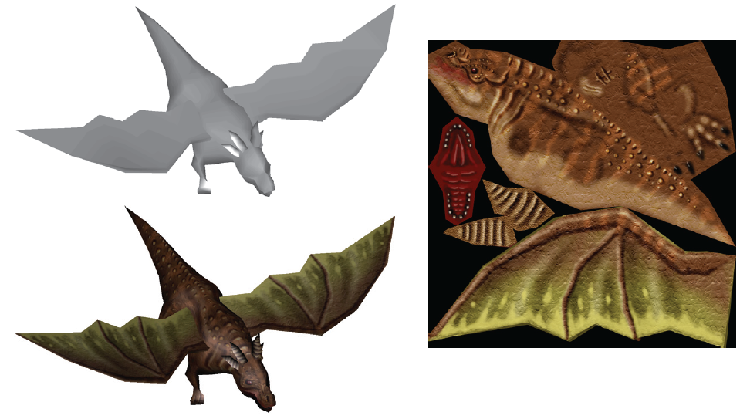
Content Pipeline: Texture
Create texture atlas
Increases batch size. Reduces individual files
Notes:
Care needs to be taken when mipmapping.
Packing a texture atlas is NP hard, see
http://clb.demon.fi/files/RectangleBinPack.pdf
http://clb.demon.fi/projects/even-more-rectangle-bin-packing
http://www.blackpawn.com/texts/lightmaps/
See https://developer.nvidia.com/sites/default/files/akamai/tools/files/Texture_Atlas_Whitepaper.pdf
Image from Real-Time Rendering - http://www.realtimerendering.com/

Slide 32
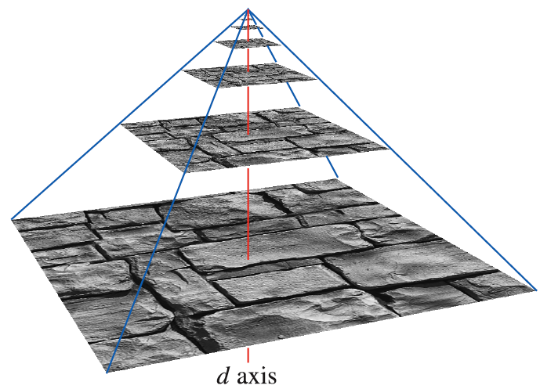
Content Pipeline: Texture
Generate mipmaps
Higher quality than doing it online
Increase size by 1/3
Notes:
glGenerateMipmap may use a low-quality filter and/or be slow.
In addition to visual quality, mipmaps also help the GPU cache since sampling from the mip level has better spatial coherence than sampling from the full texture.
Image from Real-Time Rendering - http://www.realtimerendering.com/

Slide 33
Content Pipeline: Texture
Convert image formats
For example, .bmp to .jpg
Compress images
DXT / S3TC
ETC2
Notes:
Format for modeling: lossless. Format for runtime: can be lossly. In our engine, we would compress satellite imagery except for the leaf nodes.
Often, we convert .tga to .png.
.jpg can have an alpha channel nowadays.
JPEG compression is better than DXT.
DXT – use PCA to fit a line through color space. Lossy. Slow to compress but fast to decompress on-the-fly in hardware. Also higher visual quality if compressing a larger texture, compared to a smaller uncompressed texture. Several versions of DXT, with and without alpha.
ETC2 required in ES 3.0 and GL 4.3. Higher quality than DXT at same bitrate. More flexibility in texture format, e.g., R and RG formats.
Also, ASTC (Adaptive Scalable Texture Compression), but is optional in GL.
“Recent research shows that special-purpose packing methods can compress ETC-files to sizes smaller than JPEG for equal quality, at around 2.2 bpp.”
* See https://www.khronos.org/assets/uploads/developers/library/2012-siggraph-opengl-es-bof/Ericsson-ETC2-SIGGRAPH_Aug12.pdf

Slide 34
Content Pipeline: Shaders
Generate shaders
Common profile -> GLSL
g-buffer formats
Notes:
g-buffer format is engine-specific.

Slide 35
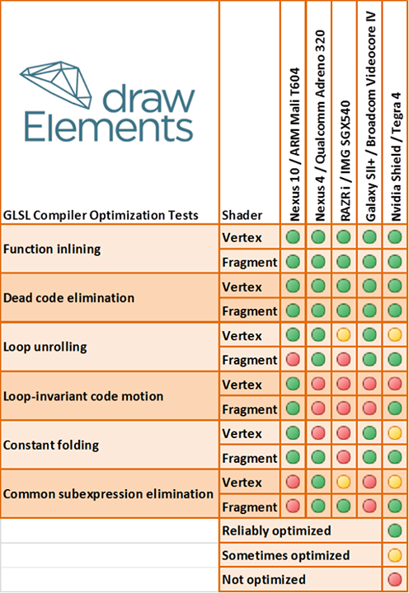
Content Pipeline: Shaders
Optimize shaders
Minify too?
Notes:
Less important if shaders are hand-coded.
Combine uniforms. Replace uniforms with constants if they aren’t targeted for animation (don’t add more materials or techniques though).
Image from https://twitter.com/drawElements/status/391174860161822720/photo/1
Minify or just remove whitespace. Size is nothing compared to textures, geometry, and animations.
See
* https://github.com/KhronosGroup/glTF/issues/34
* https://github.com/KhronosGroup/glTF/issues/36

Slide 36
Content Pipeline
Where is the parallelism?
Notes:
Examples:
* Multiple models can be converted in parallel, obviously
* Polygons can be triangulated in parallel
* Meshes can be deindexed in parallel
* Each image can be compressed/converted in parallel
* Shaders can be optimized and minified while images are compressed/converted

Slide 37
rest3d

Slide 38
rest3d
Content Pipeline meets the cloud
Modeling Tools
Engines
rest3d
Manage and process
Notes:
Not using rest3d, but related demos:
http://sketchfab.com/
http://verold.com/
Return a glTF version specific to the runtime request, e.g., mobile vs. desktop

Slide 39
Closing
glTF properties not covered today
Morph targets
Multipass
Cube maps, mipmaps
Lights, cameras
Themes
Keep the runtime simple
Push work to the Content Pipeline

