Slide 1
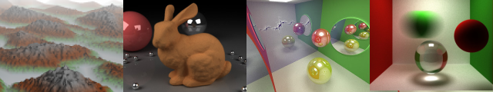
Z-Buffer Optimizations
Patrick Cozzi
University of Pennsylvania
CIS 565 - Fall 2013

Slide 2
Announcements
Student work on course website
Twitter
Eric Haines’ talk

Slide 3
Announcements
Project 4 demos today
Project 5
Due tomorrow
Demos on Monday
Project 6 – Deferred shading
Released Friday. Due next Friday 11/15
Hackathon
Next Saturday 11/16, 6pm-12am, SIG lab

Slide 4

Overview
Hardware: Early-Z
Software: Front-to-Back Sorting
Hardware: Double-Speed Z-Only
Software: Early-Z Pass
Software: Deferred Shading
Hardware: Buffer Compression
Hardware: Fast Clear
Hardware: Z-Cull
Future: Programmable Culling Unit
Notes:
Applies to desktops, not most mobile GPUs

Slide 5
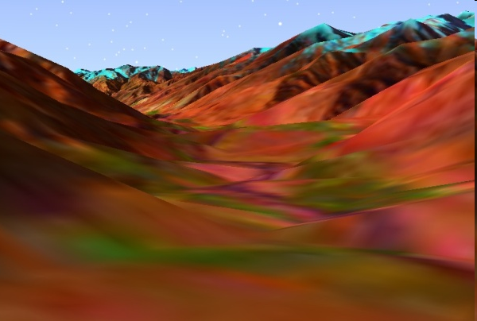

Z-Buffer
Also called Depth Buffer
Fragment vs Pixel
Alternatives: Painter’s, Ray Casting, etc.

Slide 6
Z-Buffer History
“Brute-force approach”
“Ridiculously expensive”
Sutherland, Sproull, and, Schumacker, “A Characterization of Ten Hidden-Surface Algorithms”, 1974
Notes:
Mentioned in appendix. Ed Catmull's thesis came out a few months later.

Slide 7
Z-Buffer Quiz
10 triangles cover a pixel. Rendering these in random order with a Z-buffer, what is the average number of times the pixel’s z-value is written?
See Subtle Tools Slides: erich.realtimerendering.com
Notes:
Memory bandwidth is a killer. Let's think of reads vs. writes
* Always reads depth buffer
* Writes aren't as bad, even for high depth complexity…

Slide 8
Z-Buffer Quiz
1st triangle writes depth
2nd triangle has 1/2 chance of writing depth
3rd triangle has 1/3 chance of writing depth
1 + 1/2 + 1/3 + …+ 1/10 = 2.9289…
See Subtle Tools Slides: erich.realtimerendering.com

Slide 9
Z-Buffer Quiz
Harmonic Series
# Triangles | # Depth Writes
1 | 1
4 | 2.08
11 | 3.02
31 | 4.03
83 | 5
12,367 | 10
See Subtle Tools Slides: erich.realtimerendering.com

Slide 10
Z-Test in the Pipeline
When is the Z-Test?
Fragment
Shader
Z-Test
or
Z-Test
Fragment
Shader

Slide 11
Early-Z
Z-Test
Fragment
Shader
Avoid expensive fragment shaders

Slide 12
Early-Z
Z-Test
Fragment
Shader
Automatically enabled on GeForce (8?) unless¹
Fragment shader discards or write depth
Depth writes and alpha-test² are enabled
Fine-grained as opposed to Z-Cull
ATI: “Top of the Pipe Z Reject”
¹ See NVIDIA GPU Programming Guide for exact details
² Alpha-test is deprecated in GL 3

Slide 13
Front-to-Back Sorting
Utilize Early-Z for opaque objects
Old hardware still has less z-buffer writes
CPU overhead. Need efficient sorting
Bucket Sort
Octree
Conflicts with state sorting¹
1
2
0
1
0 - 0.25
0.25 – 0.5
0.5 – 0.75
0.75 - 1
[1] For example, see http://home.comcast.net/~tom_forsyth/blog.wiki.html#%5B%5BRenderstate%20change%20costs%5D%5D
Notes:
Do this so fragments fail early-z.
Other Software techniques include
Disable depth buffering when it is not needed, e.g. an alpha blended HUD
If using multiple depth buffers, allocate the most render-intensive one first
Octree does’t need explicit sort; the sort can be a lookup into a handful of unique pre-sorted traversals. For a quadtree (2D), render the node that the viewer is in, then adjacent nodes, then last node.

Slide 14
Double Speed Z-Only
GeForce FX and later render at double speed when writing only depth or stencil
Enabled when
Color writes are disabled
Fragment shader discards or write depth
Alpha-test is disabled
See NVIDIA GPU Programming Guide for exact details
Notes:
Perhaps even triple speed – “processes fragment-bound scenes in about 1/3 the time of a regular shading pass on NVIDIA GPUs, which have special fixed-function support for depth-only rendering” from http://casual-effects.blogspot.com/2013/08/z-prepass-considered-irrelevant.html

Slide 15
Early-Z Pass
Software technique to utilize Early-Z and Double Speed Z-Only
Two passes
Render depth only. “Lay down depth”
Double Speed Z-Only
Render with full shaders and no depth
Early-Z (and Z-Cull)
Notes:
Also called “depth prepass”
* 1st pass - double speed Z, and simple shaders since they don’t need to compute the final color, just depth
* 2nd pass - less application CPU overhead, e.g.., culling, etc. already done, just blast through draw calls again (and set state, of course)
Z-prepass doesn't help post-processing passes.
Z-prepass may not be worth it when there are a lot of draw calls and different shaders, and low occlusion - http://casual-effects.blogspot.com/2013/08/z-prepass-considered-irrelevant.html

Slide 16
Early-Z Pass
Optimizations
Depth pass
Coarse sort front-to-back
Only render major occluders
Color pass
Sort by state
Render depth just for non-occluders
Notes:
Front-to-back: reduce depth buffer writes.

Slide 17
Deferred Shading
Similar to Early-Z Pass
1st Pass: Visibility tests
2nd Pass: Shading
Different than Early-Z Pass
Geometry is only transformed once

Slide 18
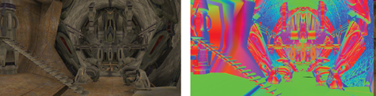

Deferred Shading
1st Pass
Render geometry into G-Buffers:
Diffuse
Normals
Depth
Images from Tabula Rasa. See Resources.

Slide 19
Deferred Shading
2nd Pass
Shading == post processing effects
Render full screen quads that read from G-Buffers
Geometry is no longer needed

Slide 20
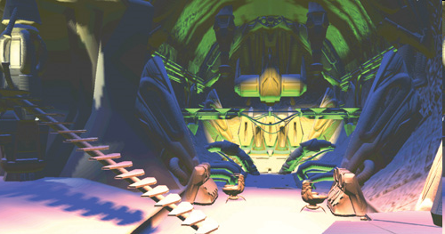
Deferred Shading
Light Accumulation Result
Image from Tabula Rasa. See Resources.

Slide 21
Deferred Shading
Eliminates shading fragments that fail Z-Test
Increases video memory requirement
How does it affect bandwidth?
Notes:
Hurts memory bandwidth * Needs compression
* Decouples material and lighting
* Good for lots of lights, otherwise
* Ubershader
* Multipass, one per light
* If each light needs the same computation, it is written to the g-buffer
* Good for effects: motion blur, depth of field, etc.
* Transparency and AA are hard

Slide 22
Buffer Compression
Reduce depth buffer bandwidth
Generally does not reduce memory usage of actual depth buffer
Same architecture applies to other buffers, e.g. color and stencil

Slide 23
Buffer Compression
Tile Table: Status for nxn tile of depths, e.g. n=8
[state, z_{min}, z_{max}]
state is either compressed, uncompressed, or cleared
0.1
0.5
0.5
0.1
0.5
0.8
0.8
0.5
[uncompressed, 0.1, 0.8]
0.5
0.8
0.8
0.5
0.1
0.5
0.5
0.1

Slide 24
Buffer Compression
Rasterizer
nxn uncompressed z values
[z_{min}, z_{max}]
updated
z-values
Tile
Table
Decompress
Compress
updated z-max
Compressed Z-Buffer

Slide 25
Buffer Compression
Depth Buffer Write
Rasterizer modifies copy of uncompressed tile
Tile is lossless compressed (if possible) and sent to actual depth buffer
Update Tile Table
z_{min} and z_{max}
status: compressed or decompressed
Notes:
RADEON 9500/9700 can achieve up to 24:1 compression rate in extreme cases

Slide 26
Buffer Compression
Depth Buffer Read
Tile Status
Uncompressed: Send tile
Compressed: Decompress and send tile
Cleared: See Fast Clear

Slide 27
Buffer Compression
ATI: Writing depth interferes with compression
Render those objects last
Minimize far/near ratio
Improves Z_{min}, Z_{max} precision

Slide 28
Fast Clear
Doesn’t touch depth buffer
glClear sets state of each tile to cleared
When the rasterizer reads a cleared buffer
A tile filled with GL_DEPTH_CLEAR_VALUE is sent
Depth buffer is not accessed

Slide 29
Fast Clear
Use glClear
Not full screen quads
Not the skybox
No "one frame positive, one frame negative“ trick
Clear stencil together with depth – they are stored in the same buffer
Notes:
* Clear only depth without stencil results in read/modify/write

Slide 30
Z-Cull
Cull blocks of fragments before shading
Coarse-grained as opposed to Early-Z
Also called Hierarchical Z
Notes:
Benefits from front to back rendering and depth pass just like early-z

Slide 31
Z-Cull
Z_{max}-Culling
Rasterizer fetches z_{max} for each tile it processes
Compute z^{triangle}_{min} for a triangle
Culled if z^{triangle}_{min} > z_{max}
z^{triangle}_{min}
Z-Cull
Fragment
Shader
Z^{triangle}_{min} > tile’s z_{max}

Slide 32
Z-Cull
Z_{min}-Culling
Support different depth tests
Avoid depth buffer reads
If triangle is in front of tile, depth tests for each pixel is unnecessary
z^{triangle}_{max}
Z-Cull
Fragment
Shader
Z^{triangle}_{max} < tile’s z_{min}
Notes:
ATI calls Z-Cull “Hierarchical Z” and NVIDIA calls it “Light Memory Architecture.”

Slide 33
Z-Cull
Automatically enabled on GeForce (6?) cards unless
glClear isn’t used
Fragment shader writes depth (or discards?)
Direction of depth test is changed
ATI: avoid = and != depth compares on old cards
ATI: avoid stencil fail and stencil depth fail operations
Less efficient when depth varies a lot within a few pixels
See NVIDIA GPU Programming Guide for exact details

Slide 34
ATI HyperZ
HyperZ =
Early Z +
Z Compression +
Fast Z clear +
Z-Cull
See ATI's Depth-in-depth

Slide 35

Programmable Culling Unit
Cull before fragment shader even if the shader writes depth or discards
Run part of shader over an entire tile to determine lower bound z value
Hasselgren and Akenine-Möller, “PCU: The Programmable Culling Unit,” 2007

Slide 36

Summary
What was once “ridiculously expensive” is now the primary visible surface algorithm for rasterization
Notes:
* Easy to implement in hardware
* Memory density when up
* Costs went down
* What research are we doing that will change?

Slide 37
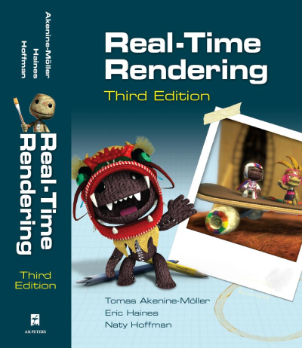
Resources
Sections 7.9.2 and 18.3
www.realtimerendering.com

Slide 38

Resources
GeForce 8 Guide: sections 3.4.9, 3.6, and 4.8
GeForce 7 Guide: section 3.6
developer.nvidia.com/object/gpu_programming_guide.html

Slide 39

Resources
Depth In-depth
http://developer.amd.com/media/gpu_assets/Depth_in-depth.pdf

Slide 40

Resources
ATI Radeon HyperZ Technology
Steve Morein
http://www.graphicshardware.org/previous/www_2000/presentations/ATIHot3D.pdf

Slide 41

Resources
Performance Optimization Techniques for ATI Graphics Hardware with DirectX® 9.0
Guennadi Riguer
Sections 6.5 and 8
http://ati.amd.com/developer/dx9/ATI-DX9_Optimization.pdf

Slide 42
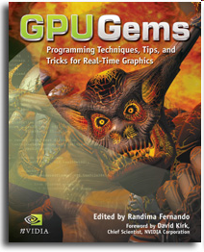
Resources
Chapter 28: Graphics Pipeline Performance
developer.nvidia.com/object/gpu_gems_home.html

Slide 43

Resources
Chapter 19: Deferred Shading in Tabula Rasa
developer.nvidia.com/object/gpu-gems-3.html

