Slide 1
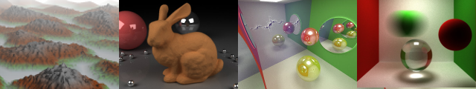
Final Project Ideas
Patrick Cozzi
University of Pennsylvania
CIS 565 - Fall 2013

Slide 2
How to Find Ideas
Previous final projects, books, conference courses, and recent papers:
https://docs.google.com/document/d/1Dh-YBDXoVPlxJMRX_vZ2BCuqvRDx89WsS3j0D_bXIFE/edit?usp=sharing

Slide 3
Guidelines
Teams of two
Open-ended
2-3x more work than hardest project
Pitch Alpha Presentation Final Presentation Paper
Code
Notes:
Teams of 1 or 3 considered in extreme cases
Any topic – any language, APIs, platform
2-3x more work per person on the team
Use to say 75-100 hours
Pitch – like funding a startup, responding to a grant, convincing your boss
Presentations – different than demos in class in that you can prepare better for them
Paper – experience writing beyond your README.md
Focus on code the whole time

Slide 4
Guidelines
Full Details
https://docs.google.com/document/d/1I2j43Jnv3xTKLJHJEKxTLRi6rs-DUhUYisRRqDKpbSs/edit?usp=sharing

Slide 5
Selected Project Ideas

Slide 6
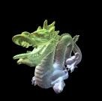

Alternative Rendering Pipelines
Voxel Pipeline
Point Pipeline
Notes:
3D point data: http://kos.informatik.uni-osnabrueck.de/3Dscans/

Slide 7
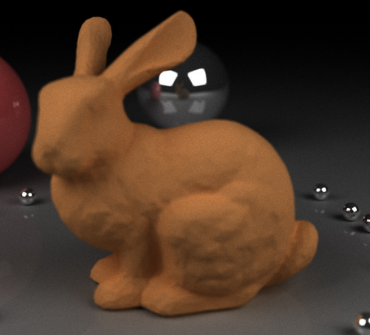
High-Quality Server-Side Rendering
Client-side WebGL
On mouse pause, server-side:
GPU path tracer, or
GPU Photon mapping
Image from http://www.colorseffectscode.com/Projects/FinalProject.html
Notes:
Low-res geometry, cheap shaders client-side. Server-side full geometry and shaders.

Slide 8

Distributed Rendering
In general, where is the client/server split?
All server, compress and stream
Create g-buffer server-side, light accumulate client-side
Temporal coherence
Image from http://shield.nvidia.com/
Notes:
Temporal coherence – what can we compute server-side and use for many frames?

Slide 9

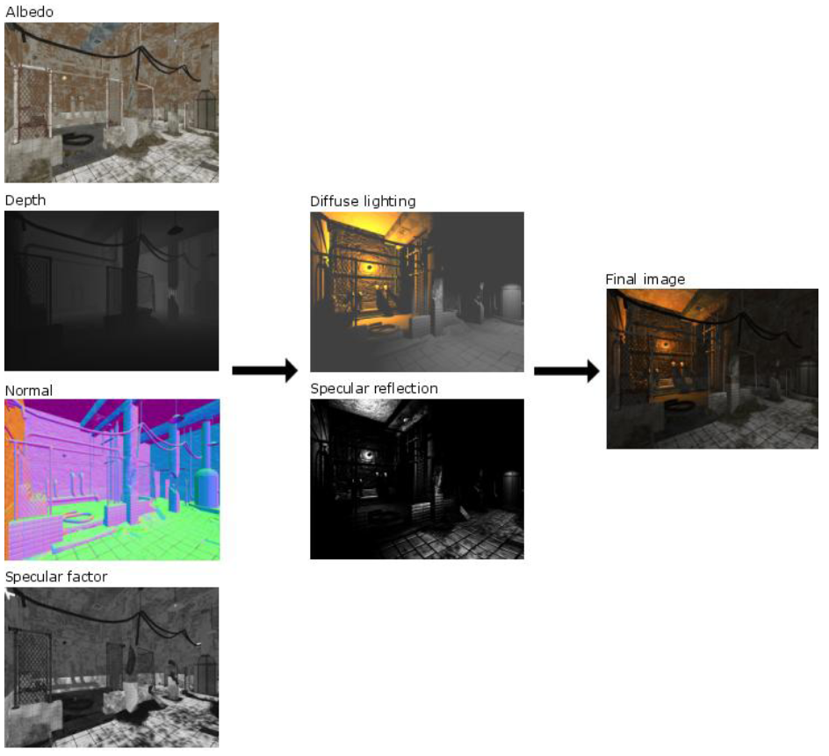
WebGL Deferred Shading
Develop one of the first WebGL deferred shaders with and without MRT. How does it compare to a forward shader with the same effects?
Image from http://www.leadwerks.com/files/Deferred_Rendering_in_Leadwerks_Engine.pdf
Notes:
Multiple g-buffer passes are needed without MRT.
How does it scale with number of light sources?
What compression and approximate techniques are most effective?

Slide 10
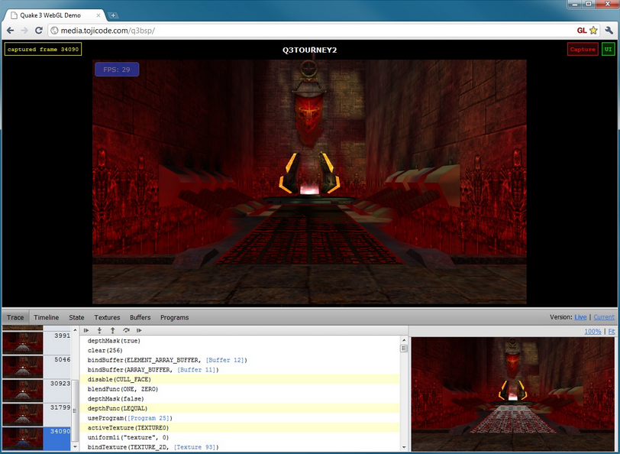
WebGL Profiler
For widespread adoption, WebGL needs world-class developer tools. WebGL Inspection is a good start: http://benvanik.github.com/WebGL-Inspector/.
However, how do we profile our shaders? We want to mouse over a pixel and see the shader hotspots.
Image from http://benvanik.github.com/WebGL-Inspector/
Notes:
OK to limit to just fragment shaders
OK to group pixels into regions of pixels
Perhaps we modify the shader over several runs to determine the hotspots. Perhaps this is done automatically or with user-provided markup.

Slide 11
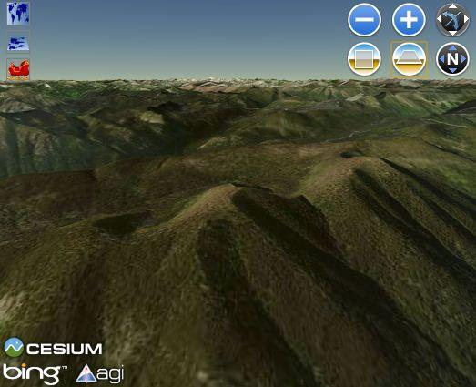
Precompute AO for terrain
Each vertex in parallel
Each ray in parallel
Consider local area only

Slide 12
HLSL to GLSL
Big industry need to one shading language
http://aras-p.info/blog/2012/10/01/cross-platform-shaders-in-2012/
“A non-crappy implementation of a library like this would almost certainly land you a job at Unity and I guess many other places.”

Slide 13
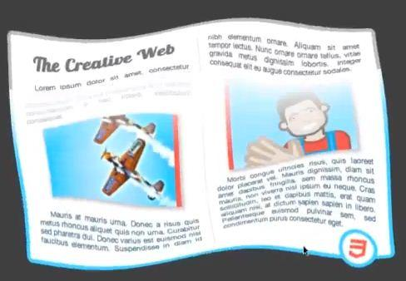
CSS Shaders
GLSL vertex and fragment meets CSS
http://www.youtube.com/watch?v=NZRqnohI3m4

Slide 14
WebCL
Rasterization pipeline
Path tracer
Photon mapping
…

Slide 15
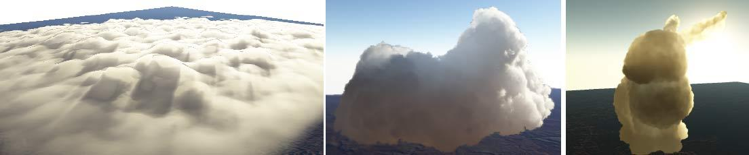
Volumetric Clouds
Render volumetric clouds with light scattering via GPU ray casting.
Great chapter in Game Engine Gems 2
Also see http://vterrain.org/Atmosphere/Clouds/
Image from http://vterrain.org/Atmosphere/Clouds/

Slide 16
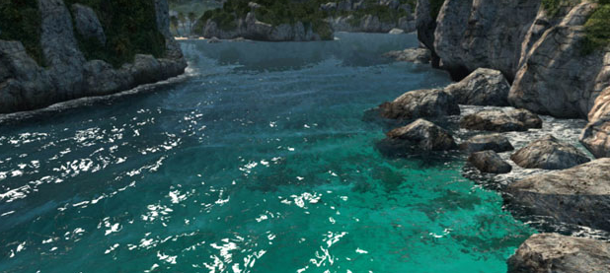
Water
http://www.fxguide.com/featured/assassins-creed-iii-the-tech-behind-or-beneath-the-action/

Slide 17
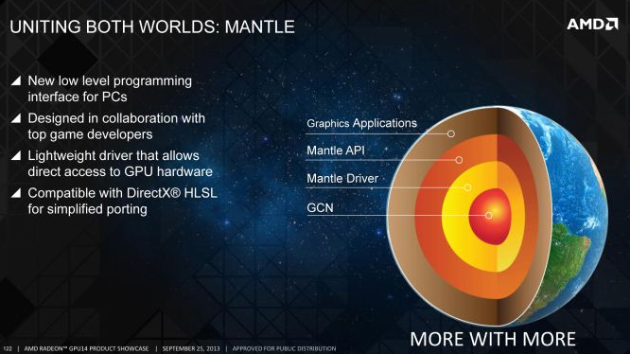
AMD Mantle
http://www.anandtech.com/show/7371/understanding-amds-mantle-a-lowlevel-graphics-api-for-gcn
Notes:
Lower draw call overhead. What are good use cases?
Compare with OpenGL performance

Slide 18
Next Steps
Sign up for a timeslot
https://docs.google.com/spreadsheet/ccc?key=0AoowFPtY81iUdE96X0Y5NC1KdkhlZDl5bFNoV1pRM0E&usp=sharing

