Slide 1
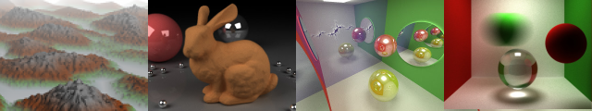
Hackathon
Patrick Cozzi
University of Pennsylvania
CIS 565 - Fall 2013

Slide 2
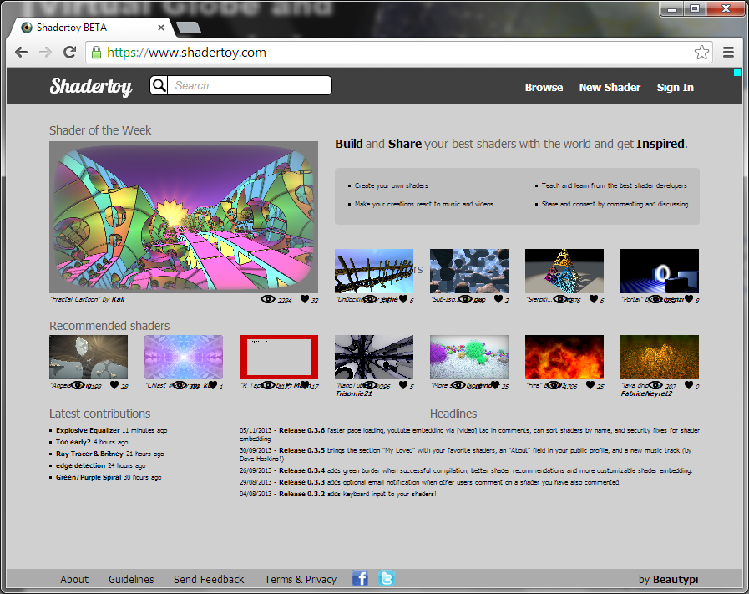

Hackathon
6pm-midnight. 11/16. SIG lab.
Code something visually-stunning in six hours

Slide 3
Teams
Teams of two
Code comment at the top of your shader
Names of each member and links to your githubs
Link to course website – http://seas.upenn.edu/~cis565/

Slide 4
Why?
Demo reel / code portfolio
Fun high-energy
Fame
Free food
Win prizes
Notes:
Twitter frame

Slide 5

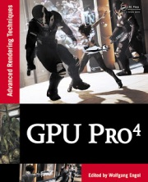

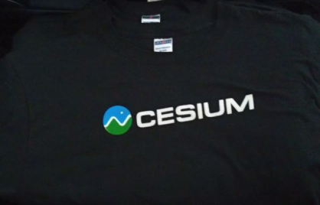

Prizes
1st Place
OpenGL Insights
GPU Pro 4
2nd Place
Cesium t-shirts
Notes:
Each student gets 100 points
Assign each project any amount of points
Except for your own
Don’t be cheap and give everyone a zero

Slide 6
Ray marching with distance fields
Two triangles (or one)
No explicit scene geometry
Ray cast in the fragment shader
Take big steps along ray
Distance field function returns the minimum distance to a surface from a point
See Rendering Worlds with Two Triangles with raytracing on the GPU in 4096 bytes
(slides 23-29 in particular)
Notes:
Also ray march heightfields, volumes, etc.

Slide 7
Ray marching with distance fields
See Rendering Worlds with Two Triangles with raytracing on the GPU in 4096 bytes
(slides 23-29 in particular)
Distance field functions
See modeling with distance functions
CSG operations
Displacements

Slide 8
How to Prepare
Find a teammate
Create a Shadertoy account
Browse Shadertoy examples
Checkout last year’s results
Read about ray marching

Slide 9
Resources
Ray marching
Rendering Worlds with Two Triangles with raytracing on the GPU in 4096 bytes
modeling with distance functions
All of iq’s articles: http://iquilezles.org/www/index.htm
GLSL Reference
http://www.opengl.org/sdk/docs/manglsl/
Noise functions
http://cis565-fall-2012.github.com/lectures/11-28-Hackathon/Noise.glsl
Notes:
Talk video - http://www.demoscene.tv/page.php?id=172&id_prod=13601&lang=uk&vsmaction=view_prod

