Slide 1

GPU Programming and Architecture: Project 0 Walkthrough
Liam Boone
University of Pennsylvania
CIS 565 - Fall 2013

Slide 2
Getting CUDA
Current version:
https://developer.nvidia.com/cuda-downloads
Legacy Versions
https://developer.nvidia.com/cuda-toolkit-archive
Use version 4.0 to be compatible with the Moore 100 computers
Version 5.0+ can be used, but it takes a little effort.
In version 5.0+ NVIDIA removed cutil*.h files from the sdk.
They now use helper*.h files located in “CUDA Samples\v5.X\C\common\inc”
Some adjustments to the code base are required for compatibility.
Notes:
Lecture are optional, but everyone comes. Students even say they will stay longer because they don’t have class afterwards.
Even though the lectures are not required, come to class for the same reason that you shouldn’t work from home. Will you ever be promoted? Are you surrounding yourself by the best people you can find?

Slide 3
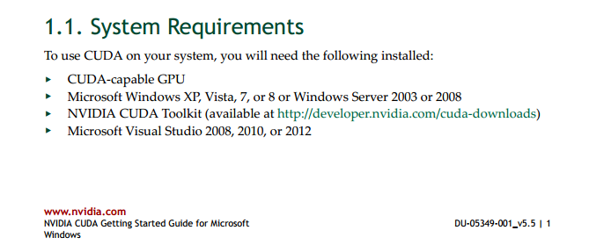
Getting CUDA

Slide 4
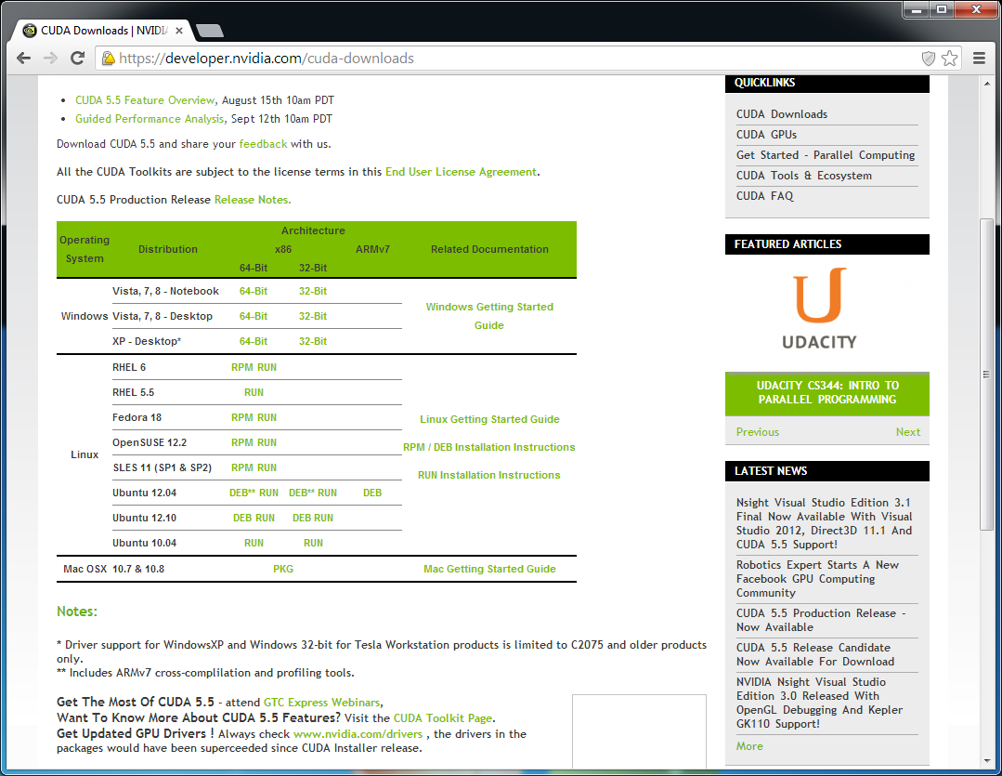
Getting CUDA

Slide 5
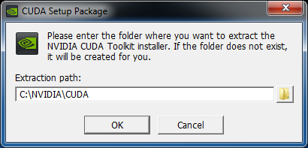
Installing CUDA

Slide 6
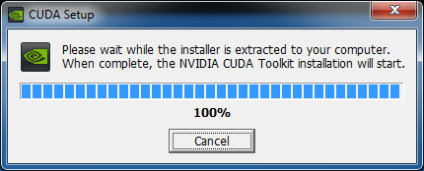
Installing CUDA

Slide 7
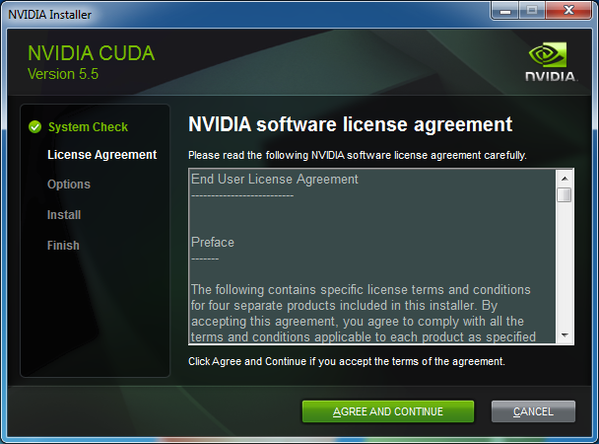
Installing CUDA

Slide 8
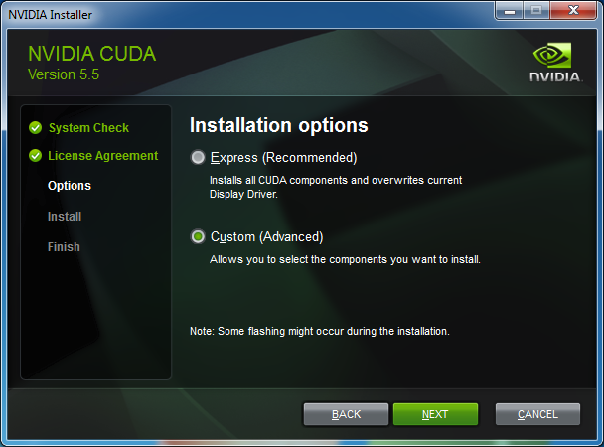
Installing CUDA

Slide 9
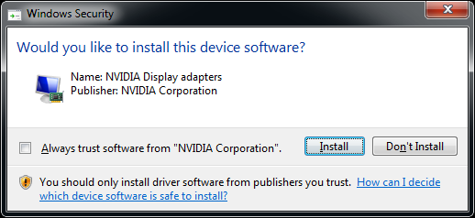
Installing CUDA

Slide 10
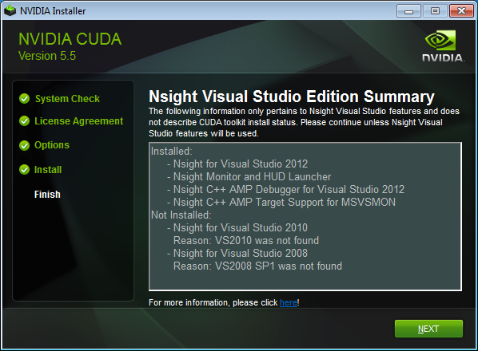
Installing CUDA

Slide 11
Getting Git
I use msysgit (http://msysgit.github.io/)
There is also a portable version that can be used on the Moore 100 computers
You are free to use any git client that can interface with GitHub.

Slide 12
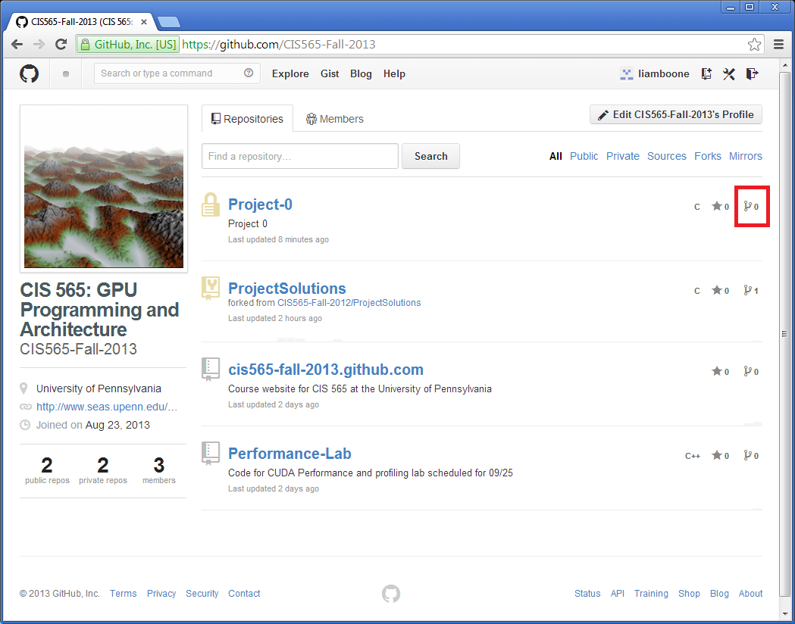
Forking the Project

Slide 13
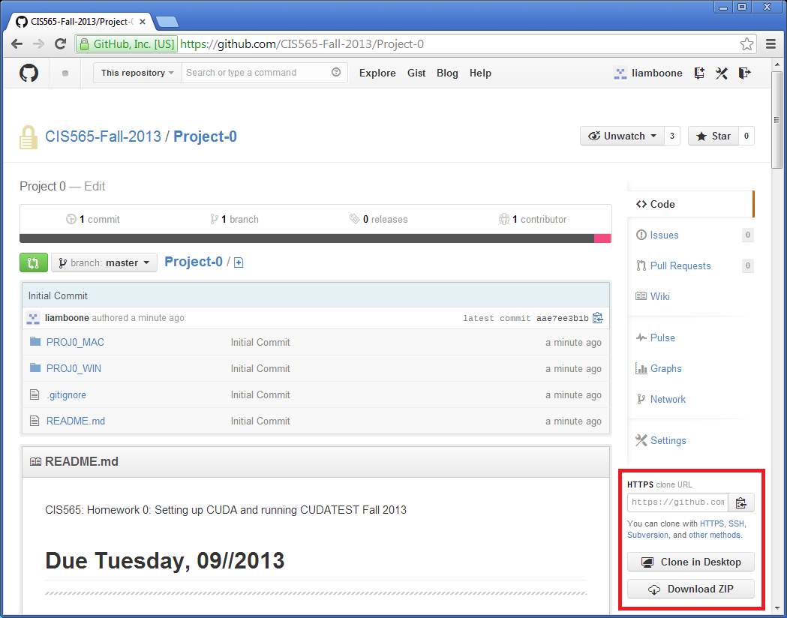
Cloning the Project

Slide 14
Using the CLI
git clone https://github.com/CIS565-Fall-2013/Project-0.git
git commit -a -m “Made my edits!”
git push

Slide 15
Places to Look to Change dependencies (VS)
Project
Properties
C/C++
General
CUDA C/C++
Common
Linker
General

Slide 16
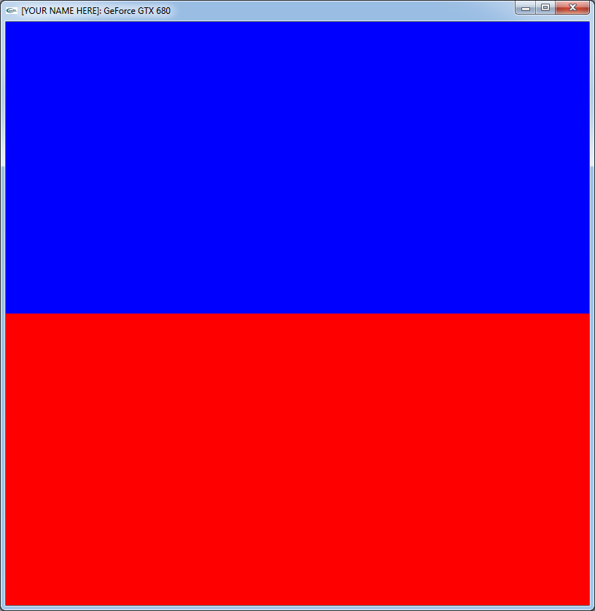
Output

Slide 17
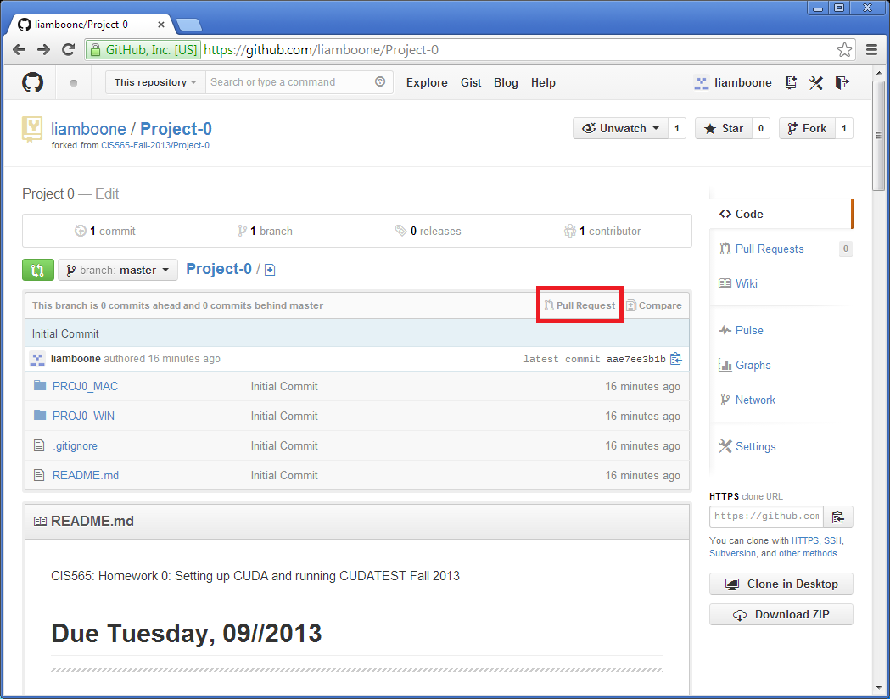
Opening a Pull Request

Slide 18
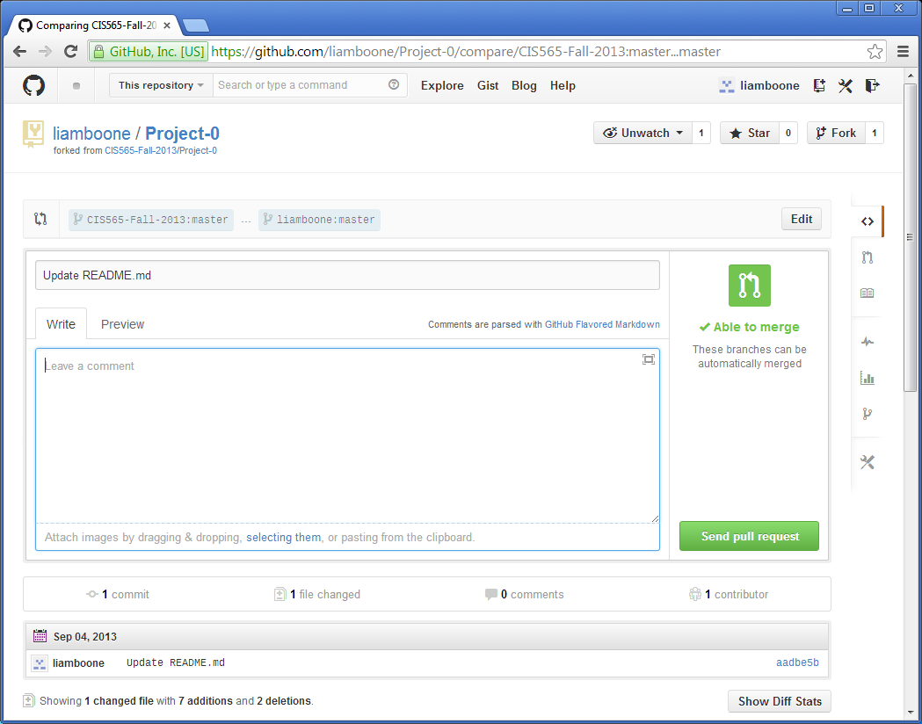
Opening a Pull Request
DO NOT PUT YOUR GRADE HERE

Slide 19
Questions?

