Slide 1
CUDA Profiling and Debugging
Shehzan
ArrayFire

Slide 2
Summary
ArrayFire
GPU Programming and CUDA
Debugging and Profiling using CUDA Tools
Memory Coalescing
Shared Memory and Bank Conflicts
Transpose
Reduction
Notes:
A lot of the programming concepts have been covered in theory. Today we will see how to find these places and apply optimizations

Slide 3

ArrayFire
Awesomely Fast GPU Library
CUDA, OpenCL
Write once. Run anywhere
Going Open Source!
www.accelereyes.com
Notes:
Releasing on Sept 30
First OpenCL library

Slide 4
ArrayFire
High-level GPU Library
Features
Scalar and vector math
Matrix ops
Linear algebra & data analysis
Image and signal processing
Graphics
Integrate with your CUDA/OpenCL code
Windows, Linux and Mac
www.accelereyes.com
Notes:
Releasing on Sept 30
First OpenCL library

Slide 5
ArrayFire
What do I do?
Currently working on getting open-source ready
95% time coding
5% Settlers of Catan
Go-to guy for Windows
www.accelereyes.com
Notes:
Releasing on Sept 30
First OpenCL library

Slide 6
CUDA
Overview
Notes:
Quick overview
Most of it covered by Patrick

Slide 7
What is CUDA
Compute Unified Device Architecture
The Architecture
Expose GPU computing for general purpose
CUDA C/C++
Extensions to the C/C++ language to enable heterogeneous programming
APIs to manage devices and memory

Slide 8
Debugging and Profiling
NVIDIA Nsight Visual Studio Edition

Slide 9
Debugging
Host side
Visual Studio Debugger, gdb
Device side
Nsight, cuda-gdb (linux)

Slide 10
CUDA Tools
Debugging : Nsight / CUDA GDB
Profiling : NV Visual Profiler, Nsight
Runtime : CUDA Occupancy Calculator

Slide 11
CUDA GDB (Linux)
CUDA-GDB
An extension of GDB
Allows you to debug on actual hardware
Can debug CPU and GPU code
Compile using the -g and the -G flags
Includes debug info
nvcc -g -G foo.cu -o foo
Usage of cuda-gdb is similar to gdb
For more information, shoot me an email!

Slide 12
Debugging Coordinates
Software Coordinates
Thread
Block
Kernel
Hardware Coordinates
Lane (thread)
Warp
SM
Device
Notes:
Lane is a thread executing on a device
Warp is a set of 32 currently active threads

Slide 13
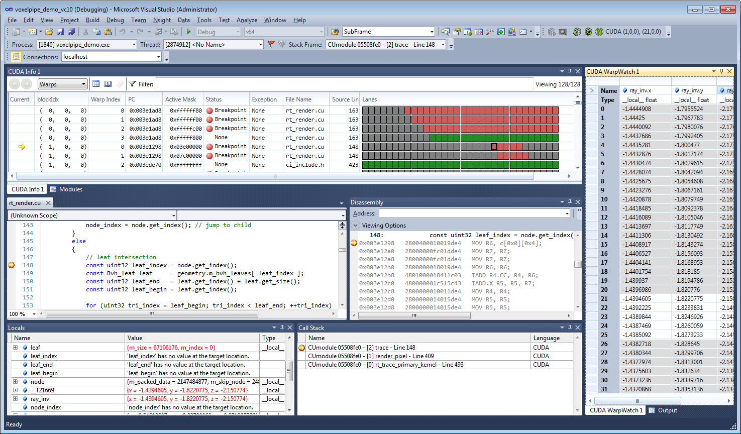
NVIDIA Nsight VSE

Slide 14
NVIDIA Nsight VSE
Comprehensive debugging and profiling tool
Contents:
GPU Debugger
Graphics Inspector
System Profiling
More information than you know what to do with
NVIDIA Nsight Visual Studio Documentation
Notes:
We will be demoing only debugger today.
Graphics debugging is awesome.

Slide 15
NVIDIA Nsight VSE
GPU Debugging
CUDA Debugger
CUDA Memcheck
CUDA Profiling
Trace

Slide 16
Enable Nsight Debugging
Turn on Debug Info
Project->Properties->CUDA C/C++->
Generate GPU Debug Info
Generate Host Debug Info
Best to run at highest compute available

Slide 17
NVIDIA Nsight VSE
Demo
Credits:
Vector Add - CUDA Samples
Resize – ArrayFire Source Code
Nsight Fluids GL Tutorial – NVIDIA
https://developer.nvidia.com/nsight-visual-studio-edition-videos
Notes:
Demos to run:
CUDA Samples -> Simple -> Matrix Mul
Show debug info, debug focus, cuda info, warp watch
Profiling application
Generating trace
ogl_samples -> gl-420-texture-cube
Unwrapping texture
Viewing and debugging glsl
Show --line-info parameter

Slide 18
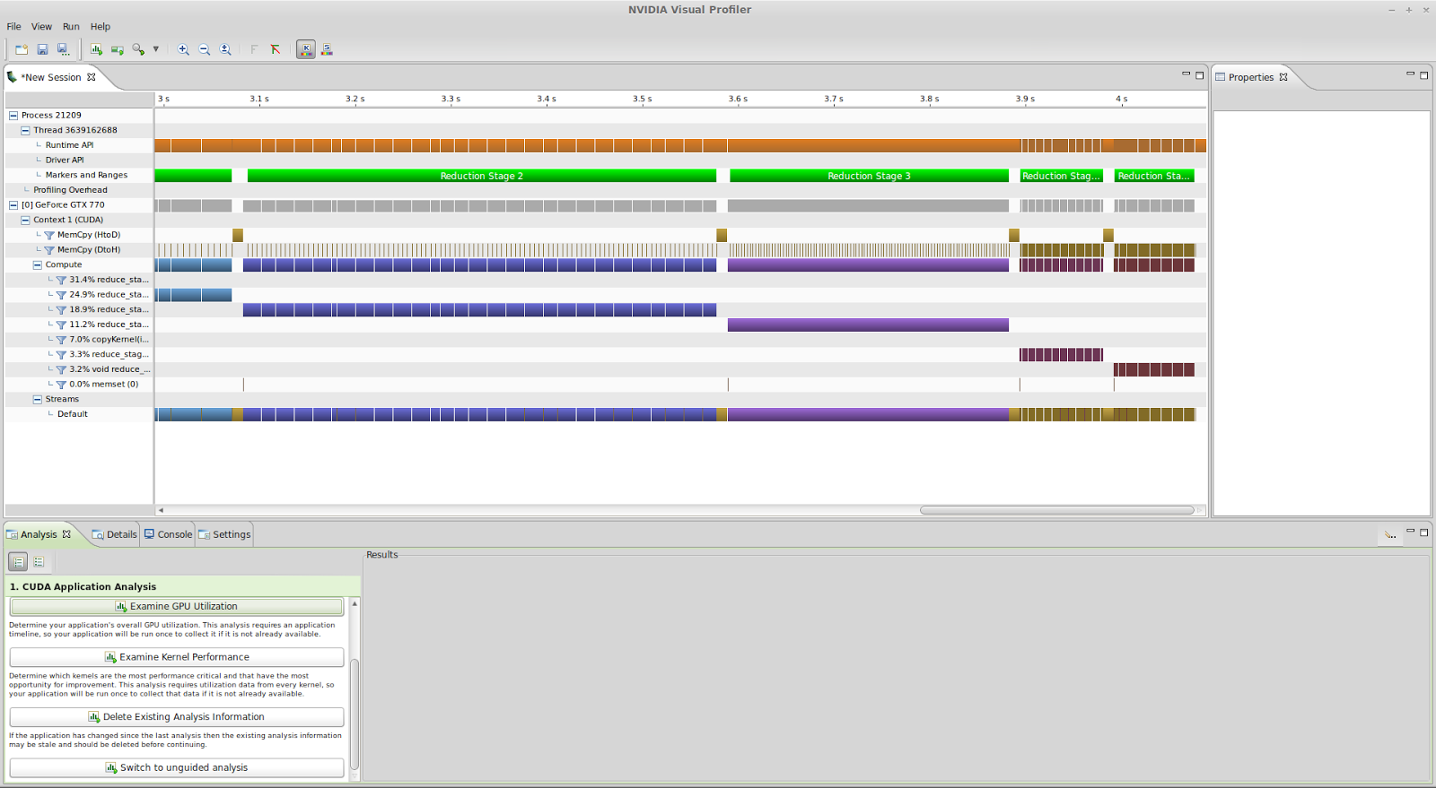
NVIDIA Visual Profiler

Slide 19
NVIDIA Visual Profiler
Standalone application with CUDA Toolkit
Visualize performance
Timeline
Power, clock, thermal profiling
Concurrent profiling
NV Tools Extensions API
nvprof - command line tool
http://docs.nvidia.com/cuda/profiler-users-guide/index.html#visual-profiler
Notes:
Thermal profiling with CUDA 5.5
Kernels of one cuda version will not execute with NVVP of another version
Concurrent profiling - For dynamic parallelism

Slide 20
NVIDIA Visual Profiler
Demo
Notes:
800 Contacts comparison - Before and after split
Path tracer - Run 5 or 10 frames
Further use in transpose and reduction

Slide 21
Memory Coalescing
Super awesome speed up

Slide 22
Memory Coalescing
Coalesce access to global memory
Most important performance consideration
Loads and stores by threads of a warp can be combined into as low as one instruction
The concurrent accesses of the threads of a warp will coalesce into a number of transactions equal to the number of cache lines necessary to service all of the threads
Notes:
Threads in a warp are continuous. They execute the same command at the same time.
So why not have them access the same are of the memory. This is memory coalescing and works really fast
Basically says continuous/concurrent memory access is better

Slide 23
Coalescence
A warp requests 32 aligned, 4-byte words
32 threads requesting 1 float each (continuous in memory)
Address fall within 1 L1 cache-line
Warp needs 128 bytes
128 bytes move across the bus on a miss
Bus utilization: 100%
addresses from a warp
...
L1
...
L2
0
32
64
96
128
160
192
224
256
288
320
352
384
416
448
Memory addresses
Notes:
A warp has 32 threads
They execute command to fetch 4-byte words ie. ints or floats in sequential order
[i] = [j]
[i+1] = [j+1]

Slide 24
Coalescence
A warp requests 32 aligned, 4-byte words
32 threads requesting 1 float each (continuous in memory)
Not sequentially indexed
Address fall within 1 L1 cache-line
Warp needs 128 bytes
128 bytes move across the bus on a miss
Bus utilization: 100%
addresses from a warp
...
L1
...
L2
0
32
64
96
128
160
192
224
256
288
320
352
384
416
448
Memory addresses
Notes:
A warp has 32 threads
They execute command to fetch 4-byte words ie. ints or floats in non-sequential order
[i+y] = [j+x]
However, this does not affect performance negatively since we are not using excess memory space.

Slide 25
Coalescence
A warp requests 32 aligned, 4-byte words
32 threads requesting 1 float each (not all continuous in memory)
Address fall within 2 L1 cache-line
Warp needs 128 bytes
256 bytes move across the bus on a miss
Bus utilization: 50%
addresses from a warp
...
L1
...
L2
0
32
64
96
128
160
192
224
256
288
320
352
384
416
448
Memory addresses
Notes:
A warp has 32 threads
They execute command to fetch 4-byte words ie. ints or floats in sequential order of say alternating elements
This means 256 bytes are fetched although only 128 bytes are accessed.
Why are 256 bytes fecthed? because we are using caches. So continuous data is copied from global to cache and then to threads
[i] = [j]
[i+1] = [j+2]
[i+2] = [j+4]

Slide 26
Coalescence (Non-cached)
A warp requests 32 aligned, 4-byte words
32 threads requesting 1 float each (not all continuous in memory)
Address fall within 5 L2 cache-line
Warp needs 128 bytes
160 bytes move across the bus on a miss
Bus utilization: 80%
addresses from a warp
...
L1
L2
0
32
64
96
128
160
192
224
256
288
320
352
384
416
448
Memory addresses
Notes:
A warp has 32 threads
They execute command to fetch 4-byte words ie. ints or floats in sequential order of say alternating elements
This means 160 bytes are fetched although only 128 bytes are accessed.
Why are 160 bytes fecthed? because we are not using caches. So continuous data is copied from global to cache and then to threads
If we were using cache, then 2 L1 blocks would have been occupied which would need 256 bytes to move across the bus.

Slide 27
Coalescence
A warp requests 1 4-byte word
All 32 threads requesting 1 float value
Address falls within 1 L1 cache-line
Warp needs 4 bytes
128 bytes move across the bus on a miss
Bus utilization: 3.125%
addresses from a warp
L1
...
L2
0
32
64
96
128
160
192
224
256
288
320
352
384
416
448
Memory addresses
Notes:
Even though 1 element is access by all threads, the entire memory block needs to be copied
128 bytes in case of L1 and 32 in case of L2

Slide 28
Coalescence (Non-cachED)
A warp requests 1 4-byte words
All 32 threads requesting 1 float value
Address fall within 1 L2 cache-line
Warp needs 4 bytes
32 bytes move across the bus on a miss
Bus utilization: 12.5%
addresses from a warp
L1
L2
0
32
64
96
128
160
192
224
256
288
320
352
384
416
448
Memory addresses
Notes:
Even though 1 element is access by all threads, the entire memory block needs to be copied
128 bytes in case of L1 and 32 in case of L2

Slide 29
Coalescence
A warp requests 32 scattered 4-byte words
Randomly stored in memory
Address fall within N L1 cache-line
Warp needs 128 bytes
N * 128 bytes move across the bus on a miss
Bus utilization: 128 / (N * 128)
addresses from a warp
...
L1
...
L2
0
32
64
96
128
160
192
224
256
288
320
352
384
416
448
Memory addresses
Notes:
Generalization of cases discussed

Slide 30
Coalescence (Non-cached)
A warp requests 32 scattered 4-byte words
Randomly stored in memory
Address fall within N L1 cache-line
Warp needs 128 bytes
N * 32 bytes move across the bus on a miss
Bus utilization: 128 / (N*32)
addresses from a warp
...
L1
L2
0
32
64
96
128
160
192
224
256
288
320
352
384
416
448
Memory addresses

Slide 31
Shared
Memory

Slide 32
Shared Memory
Acts as a user-controlled cache
Declared using the __shared__ qualifier
Accessible from all threads in the block
Lifetime of the block
Allocate statically or at kernel launch.
__shared__ float myVariable[32];
// ... or specify at launch:
extern __shared__ float myVar[];
myKernel<<<blocks, threads, shared_bytes>>>(parameters);

Slide 33
Shared Memory
Inter-thread communication within a block
Cache data to reduce redundant global memory access
Improve global memory access patterns
Divided into 32 32-bit banks
Can be accessed simultaneously
Requests to the same bank are serialized
Notes:
Total shared memory per block depends on GPU, but most have 48K

Slide 34
Shared Memory
Will revisit….
Notes:
Total shared memory per block depends on GPU, but most have 48K

Slide 35
Matrix Transpose
Get 90% Bandwidth
Notes:
Take a paper and write down how much of a speed up you can get over CPU

Slide 36
Matrix Transpose
Inherently parallel
Each element independent of another
Simple to implement
1 | 2 | 3 | 4
5 | 6 | 7 | 8
9 | 10 | 11 | 12
13 | 14 | 15 | 16
1 | 5 | 9 | 13
2 | 6 | 10 | 14
3 | 7 | 11 | 15
4 | 8 | 12 | 16

Slide 37
Matrix Transpose [CPU Transpose]
for(int i = 0; i < rows; i++)
for(int j = 0; j < cols; j++)
transpose[i][j] = matrix[j][i]
Easy
O(n2)
Slow!!!!!!

Slide 38
Matrix Transpose
[Naive GPU Transpose]
GPU Transpose
Launch 1 thread per element
Compute index
Compute transposed index
Copy data to transpose matrix
O(1) using Parallel compute
Essentially one memcpy from global-to-global
It should be fast, shouldn’t it?

Slide 39
Matrix Transpose [Naive GPU Transpose]
__global__
void matrixTranspose(float *_a, float *_b) {
int i = blockIdx.y * blockDim.y + threadIdx.y; // row
int j = blockIdx.x * blockDim.x + threadIdx.x; // col
int index_in = i*cols+j; // (i, j) from matrix A
int index_out = j*rows+i; // transposed index
b[index_out] = a[index_in];
}
2 | 3 | 4
5 | 5 | 8
-2 | 3 | 4
6 | 4 | -1
6 | 6 | 3
2 | 5 | -2 | 6 | 6
3 | 5 | 3 | 4 | 6
4 | 8 | 4 | -1 | 3
_b[ . . . . . .]
_a[ . . . . . .]

Slide 40
Matrix Transpose [Naive GPU Transpose]
Problems?

Slide 41
GMEM Access Pattern in NT
READ - Coalesced memory access
Good!
_a
2 | 3 | 4 | 5 | 5 | 8 | -2 | 3 | 4 | 6 | 4 | -1 | 6 | 6 | 3
_b
2 | 5 | -2 | 6 | 6 | 3 | 5 | 3 | 4 | 6 | 4 | 8 | 4 | -1 | 3
WRITE - Uncoalesced memory access
Bad!
Notes:
Kept this diagram from using earlier
Each element also represents a thread

Slide 42
Matrix Transpose [Naive GPU Transpose]
Problems?
Non-coalesced memory
Improvements?

Slide 43
Matrix Transpose
[Naive GPU Transpose]
Problems?
Non-coalesced memory
Improvements?
Use shared memory
Use coalesced memory access

Slide 44
Matrix Transpose [GPU Transpose]
Use Shared Memory
Allows temporary storage of data
Use coalesced memory access to global memory
Walkthrough
Compute input index (same as in naive transpose)
Copy data to shared memory
Compute output index
Remember, coalesced memory access
Hint, transpose only in shared memory
Copy data from shared memory to output
Notes:
Lets flip it in shared memory
Use __syncthreads

Slide 45
Memory Access Pattern for SMT
2 | 3 | 4 | 5
…
8 | 3 | 5 | 3
…
1 | 0 | 5 | 9
…
1 | 9 | 8 | 4
SHARED
2 | 3 | 4 | 5
8 | 3 | 5 | 3
1 | 0 | 5 | 9
1 | 9 | 8 | 4
__syncthreads();
re-indexing
2 | 8 | 1 | 1
3 | 3 | 0 | 9
4 | 5 | 5 | 8
5 | 3 | 9 | 4
MEMORY
2 | 8 | 1 | 1
…
3 | 3 | 0 | 9
…
4 | 5 | 5 | 8
…
5 | 3 | 9 | 4

Slide 46
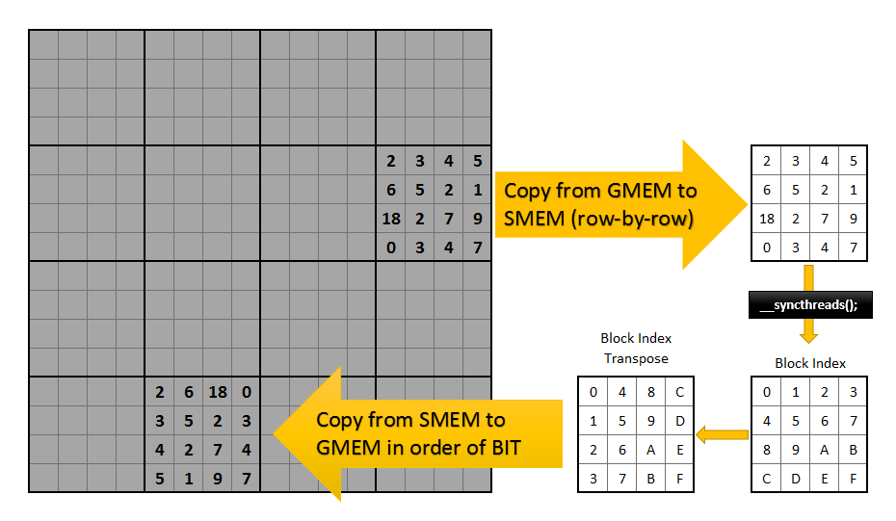
Shared Memory Transpose

Slide 47
Transpose: Shared Memory
__global__
void matrixTransposeShared(const float *_a, float *_b){ __shared__ float mat[BLOCK_SIZE_X][BLOCK_SIZE_Y];
int bx = blockIdx.x * BLOCK_SIZE_X;
int by = blockIdx.y * BLOCK_SIZE_Y;
int i = by + threadIdx.y; int j = bx + threadIdx.x; //input
int ti = bx + threadIdx.y; int tj = by + threadIdx.x; //output
if(i < rows && j < cols)
mat[threadIdx.x][threadIdx.y] = a[i * cols + j];
__syncthreads(); //Wait for all data to be copied
if(tj < cols && ti < rows)
b[ti * rows + tj] = mat[threadIdx.y][threadIdx.x];
}

Slide 48
Matrix Transpose [GPU Transpose]
Problem?

Slide 49
Matrix Transpose [GPU Transpose]
Problem?
Why are we not even close to max bandwidth?
Hint, think “banks”
Solution?

Slide 50
Matrix Transpose [GPU Transpose]
Problem?
Why are we not even close to max bandwidth?
Hint, think “banks”
Solution?
Remove bank conflicts

Slide 51
Bank Conflicts

Slide 52
Banks
Shared Memory is organized into 32 banks
Consecutive shared memory locations fall on different banks
0
1
2
3
4
30
31
32
33
34
35
36
62
63
Warp
...
__shared__ float tile[64];
...
Bank 1
Bank 2
Bank 3
Bank 4
Bank 5
Bank 30
Bank 31

Slide 53
Banks
Warp
...
Access to different banks by
a warp executes in parallel.
0
1
2
3
4
30
31
32
33
34
35
36
62
63
__shared__ float tile[64];
int tidx = threadidx.x;
float foo = tile[tidx] - 3;
...
Bank 1
Bank 2
Bank 3
Bank 4
Bank 5
Bank 30
Bank 31

Slide 54
Banks
Warp
...
Access to the same element
in a bank is also executed
in parallel.
0
1
2
3
4
30
31
32
33
34
35
36
62
63
__shared__ float tile[64];
int tidx = threadidx.x;
int bar = tile[tidx - tidx % 2];
...
Bank 1
Bank 2
Bank 3
Bank 4
Bank 5
Bank 30
Bank 31

Slide 55
Banks
Warp
...
Access to the different elements in a bank is executed serially.
“2 way bank conflict”
0
1
2
3
4
30
31
32
33
34
35
36
62
63
__shared__ float tile[64];
int tidx = threadidx.x;
tmp = tile[tidx + tidx % 2*31];
...
Bank 1
Bank 2
Bank 3
Bank 4
Bank 5
Bank 30
Bank 31
Notes:
Threads want alternate elements which means 2 threads want elements from the same bank

Slide 56
Banks
Warp
...
Access to the different elements in a bank is also executed serially.
32 way bank conflict
0
1
2
3
4
30
31
32
33
34
35
36
62
63
_b[index_out] = tile[tx][ty];
...
Bank 1
Bank 2
Bank 3
Bank 4
Bank 5
Bank 30
Bank 31
Notes:
All threads want memory from the same bank

Slide 57
Transpose: Shared Memory
__global__
void matrixTransposeShared(const float *_a, float *_b) {
__shared__ float mat[BLOCK_SIZE_X][BLOCK_SIZE_Y];
int bx = blockIdx.x * BLOCK_SIZE_X;
int by = blockIdx.y * BLOCK_SIZE_Y;
int i = by + threadIdx.y;
int j = bx + threadIdx.x; //input
int ti = bx + threadIdx.y;
int tj = by + threadIdx.x; //output
if(i < rows && j < cols)
mat[threadIdx.x][threadIdx.y] = a[i * cols + j];
__syncthreads(); //Wait for all data to be copied
if(tj < cols && ti < rows)
b[ti * rows + tj] = mat[threadIdx.y][threadIdx.x];
}
Represents row of the “bank”
Represents bank number or “col”
Same for all threads in the warp
Notes:
If we look at this code, we notice that threadIdx.x is used as the second index.
We can safely assume that for all threads in the warp, threadIdx.y will be same (because of block size)
Hence, threadIdx.y, which represents the same bank in shared memory, is same for all threads in the warp.
Hence a 32-way bank conflict.

Slide 58
Shared Memory Transpose

Slide 59
Transpose
No Bank conflicts
Thread 31
Add Unused column
Thread 0

Slide 60
Transpose
32-way Bank conflict!!
Add Unused column
Thread 0
Thread 31

Slide 61
Banks
Warp
...
Resolving bank conflict
Elements per row = 32
Shared Mem per row = 33
1 empty element per memory row
This is what avoid bank conflicts
Tile[0][0] = 0 = 0 -> Bank 0
Tile[1][0] = 0 + 33 = 33 -> Bank 1
Tile[2][0] = 0 + 33 + 33 = 66-> Bank 2
Tile[n][0] = 0 + n * 33 -> Bank n
__shared__ float tile[BLOCKSIZE][BLOCKSIZE+1];
_b[index_out] = tile[tx][ty];
0
1
2
3
4
30
31
32
33
34
35
36
62
63
...
Bank 1
Bank 2
Bank 3
Bank 4
Bank 5
Bank 30
Bank 31

Slide 62
Transpose: Shared Memory
No Bank Conflicts
__global__
void matrixTransposeShared(const float *_a, float *_b) {
__shared__ float mat[BLOCK_SIZE_X][BLOCK_SIZE_Y + 1];
//Rest is same as shared memory version
}

Slide 63
Matrix Transpose [GPU Transpose]
Very very close to production ready!
More ways to improve?
More work per thread - Do more than one element
Loop unrolling

Slide 64
Transpose: Loop Unrolled
More work per thread:
Threads should be kept light
But they should also be saturated
Give them more operations
Loop unrolling
Allocate operation in a way that loops can be unrolled by the compiler for faster execution
Warp scheduling
Kernels can execute 2 instructions simultaneously as long as they are independent

Slide 65
Transpose: Loop Unrolled
Use same number of blocks, shared memory
Reduce threads per block by factor (side)
Block Size X = 4
Block Size Y = 4
Threads/Block = 16
Total blocks = 2
Shared mem = 4 x 4
Block Size X = 4 -> TILE
Block Size Y = 1 -> SIDE
Threads/Block = 4
Total blocks = 2
Shared mem = TILE x TILE
Notes:
Using same number of blocks but using less threads per block.
This means less warps to execute
Note: not all GPUs may see a performance benefit

Slide 66
Transpose: Loop Unrolled
Walkthrough
Host:
Same number of blocks
Compute new threads per block
Device:
Allocate same shared memory
Compute input indices similar to before
Copy data to shared memory using loop (k)
Unrolled index: add k to y
Compute output indices similar to before
Copy data from shared memory into global memory
Unrolled index: add k to y

Slide 67
Transpose: Loop Unrolled
const int TILE = 32; const int SIDE = 8;
__global__ void matrixTransposeUnrolled(const float *_a, float *_b)
{
__shared__ float mat[TILE][TILE + 1];
int x = blockIdx.x * TILE + threadIdx.x;
int y = blockIdx.y * TILE + threadIdx.y;
#pragma unroll
for(int k = 0; k < TILE ; k += SIDE) {
if(x < rows && y + k < cols)
mat[threadIdx.y + k][threadIdx.x] = a[((y + k) * rows) + x];
}
__syncthreads();
x = blockIdx.y * TILE + threadIdx.x;
y = blockIdx.x * TILE + threadIdx.y;
#pragma unroll
for(int k = 0; k < TILE; k += SIDE) {
if(x < cols && y + k < rows)
b[(y + k) * cols + x] = mat[threadIdx.x][threadIdx.y + k];
}
}

Slide 68
Performance for 4k x 4k Matrix Transpose (K40c)
 | Time (ms) | Bandwidth (GB/s) | Step Speedup | Speed Up vs CPU
CPU (Core i7 4770) | 153.6 | 0.873
Naive Transpose | 1.078 | 124.46 | 142.48 | 142.48
Coalesced Memory | 0.998 | 134.48 | 1.080 | 153.90
Bank Conflicts | 0.994 | 134.92 | 1.004 | 154.52
Loop Unrolling | 0.772 | 173.72 | 1.287 | 198.96

Slide 69
Transpose
Let’s review your predictions!

Slide 70
CUDA Tips and Tricks
Don’t launch 1024 threads per block
Prefer 256
Avoid branching
Use templates where possible
Avoid syncthreads and global memory usage
Consider memory access patterns
Atomics on global memory is a sin
Awesome CUDA Programming Guide
Too many arguments?
Use structures.
Use Nsight
Highly advance:
__mul24, __umul24. Faster than * operation
__shfl, rintf, __sin etc

Slide 71
CIS 565 How to make the most out of it
Do all the extra credit possible, the grade really doesn't matter.
Psst. Do extra credit after submitting (can help in final proj.)
Practice speaking about your assignments.
It really really helps in your interview and job.
Final projects - break the bank on this one.
This is your calling card in software programming

Slide 72
CIS 565 How to make the most out of it
Write excellent blogs.
Ask Patrick/3rd person to review them.
Helps in reviewers understand your work/challenges better
Live by Git (thanks Patrick!).
Use local repos for other classes.
Look at Gitlab – Github like interface hosted privately
See CUDA Samples (they are really good!)
Share you knowledge
Stackoverflow, open source contributions, forums etc.

Slide 73
Job Advice
Do side projects, extra work - driven by motivation!
Open Source contributions = Bonus Points
Learn to write makefile
Good practice: try converting projects to Linux
Its really not hard
Programs run faster on linux
Demonstrates flexibitly to work environment
Maintain a coding style
Doesn’t matter what style – Consistency is key
Recommended reading: (C++) http://google-styleguide.googlecode.com/svn/trunk/cppguide.html
Other languages: Google Style Guide

Slide 74
Job Advice
Contribute to open source projects, take part actively in forums.
Having an accepted contribution may mean more to development-centered companies than research.
Forums get you noticed. Coders have high respect for people who share knowledge.
Do not settle for a job/role you do not want
Its a burden you will not enjoy
Don’t go after the money
Be ready to forget everything you did in school

Slide 75
Job Advice
2 Questions to ask in every single interview:
“How can I contribute to benefit you?”
“How will I benefit working for you?” -> Yes, be pricey.
Only two thing matters:
Can we enjoy working with you
Will you enjoy working with us
Every other metric can be wrapped in those 2 points

Slide 76
ArrayFIRE THE BEST ARE ALWAYS WELCOME HERE
We are hiring!
Apply at: http://arrayfire.theresumator.com/apply/
Email me: shehzan@arrayfire.com
or visit: www.arrayfire.com
https://github.com/arrayfire
Twitter: @shehzanm @arrayfire

Slide 77
Acknowledgements
NVIDIA Documentation and website
ArrayFire
UPenn CIS 565 - Patrick Cozzi

Slide 78
Resources
CUDA Documentation: http://docs.nvidia.com/cuda/index.html
GTC On-Demand: http://on-demand-gtc.gputechconf.com/gtcnew/on-demand-gtc.php
CUDA Getting Started Windows: http://docs.nvidia.com/cuda/cuda-getting-started-guide-for-microsoft-windows/index.html
Google Style Guide C++: http://google-styleguide.googlecode.com/svn/trunk/cppguide.html
Demos and tutorials:
http://on-demand.gputechconf.com/gtc/2013/presentations/S3478-Debugging-CUDA-Kernel-Code.pdf
https://developer.nvidia.com/content/efficient-matrix-transpose-cuda-cc
http://developer.download.nvidia.com/compute/cuda/1.1-Beta/x86_website/projects/reduction/doc/reduction.pdf

Slide 79
Reduction

Slide 80
Reduce
Algorithm to apply a reduction operation on a set of elements to get a result.
Example:
SUM(10, 13, 9, 14) = 10+13+9+14 = 46
MAX(10, 13, 9, 14) = 14
Notes:
Reduction: Any sequence of the same binary operation
Again, lets write your speedup on CPU
Hint: reduction is not as simple as transpose so don’t expect a similar speed up

Slide 81
Serial Reduce
Loop through all elements
Number of steps: N - 1
Serial Code:
int sum = array[0];
for(i=1;i<n;i++) {
sum += array[i];
}
10
13
+
9
+
14
Number of Steps : 4-1 = 3
+
46

Slide 82
Parallel reduce
Operations can be applied for Parallel reduce
Binary
example: a*b, a+b, a&b, a|b
not binary: !(a), (a)!
Associative
example: a*b, a+b, a&b, a|b
non associative: a/b, ab
Example:
Reduce[(10,13,9,14) +]
10
13
9
14
+
+
+
Number of steps: log₂ 4 = 2
46
Notes:
Most parallel reductions use a binary tree structure

Slide 83
Parallel Reduce on GPU
Parallel reduce is applied to a part of the whole array in each block.
Multiple blocks help in:
Maximizing Occupancy by keeping SMs busy.
Processing very large arrays.
Parallel reduce is not arithmetic intensive, it takes only 1 Flop per thread(1 add) so it is completely memory bandwidth bounded.

Slide 84




Parallel Reduce on GPU
Need a way to communicate partial results between blocks
Global sync is not practical due to the overhead of sync across so many cores
Solution: Call the reduce kernel recursively to reduce the results from previous reduce.
Level 0:
8 Blocks
Level 1:
1 Block

Slide 85
Serial reduce vs
Parallel reduce
Serial Reduce:
Each iteration is dependant on the previous iteration.
Number of steps taken is n-1.
Runtime complexity is O(n)
Parallel Reduce:
Has smaller number steps log 2n.
Faster than a serial implementation.
Runtime complexity : O(log n)

Slide 86
Method 1: Interleaved Addressing
14 | 15 | 64 | 12 | 87 | 67 | 54 | 75 | 40 | 19 | 5 | 23 | 48 | 56 | 25 | 52
Step 1
0
2
4
6
8
10
12
14
29 | 15 | 76 | 12 | 154 | 67 | 129 | 75 | 59 | 19 | 28 | 23 | 104 | 56 | 77 | 52
Step 2
0
4
8
12
105 | 15 | 76 | 12 | 283 | 67 | 129 | 75 | 87 | 19 | 28 | 23 | 181 | 56 | 77 | 52
0
8
Step 3
388 | 15 | 76 | 12 | 154 | 67 | 129 | 75 | 268 | 19 | 28 | 23 | 104 | 56 | 77 | 52
Step 4
0
656 | 15 | 76 | 12 | 154 | 67 | 129 | 75 | 59 | 19 | 28 | 23 | 104 | 56 | 77 | 52
Notes:
Add 2 consecutive elements
After required steps, the element 0 will have the result

Slide 87
Method 1:
Interleaved Addressing
__global__ void reduce_stage0(int* d_idata, int* d_odata, int n) {
//Dynamic allocation of shared memory - See kernel call in host code
extern __shared__ int smem[];
//Calculate index
int idx = blockIdx.x * blockDim.x + threadIdx.x;
//Copy input data to shared memory
if(idx < n) smem[threadIdx.x] = d_idata[idx];
__syncthreads();
//Reduce within block
for(int c = 1; c < blockDim.x; c *= 2) {
if(threadIdx.x % (2*c) == 0)
smem[threadIdx.x] += smem[threadIdx.x + c];
__syncthreads();
} //Copy result of reduction to global memory
if(threadIdx.x == 0)
d_odata[blockIdx.x] = smem[0];
}
Notes:
Walkthrough:
Compute index
Copy data to shared memory
Reduce interleaved in shared memory
Copy result to global

Slide 88
Performance for 32M elements (GTX 770)
 | Time (ms) | Bandwidth (GB/s) | Step Speedup | Speed Up vs CPU
CPU | 8.8 | 15.25
Stage 0 | 7.90 | 16.98 | 1.11 | 1.11

Slide 89
Method 1:
Interleaved Addressing
Problem?

Slide 90
Method 1:
Interleaved Addressing
Problem?
Interleaved addressing
Divergent warps
Solution?

Slide 91
Method 1:
Interleaved Addressing
Problem?
Interleaved addressing
Divergent warps
Solution?
Non-divergent branches

Slide 92
Warps
Divergence

Slide 93
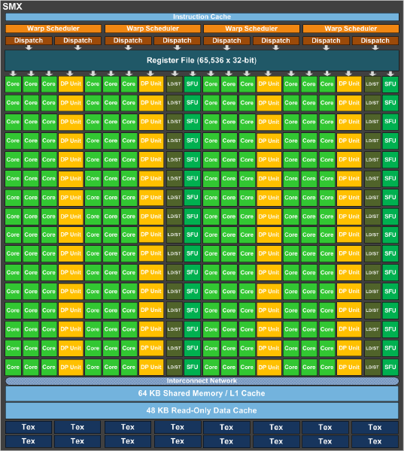
Warp
A thread block is broken down to 32-thread warps
Warps are executed physically in a SM(X)
Total number of warps in a block: ceil(T/Wsize)
Up to 64 Warps/SM
Up to 1024
Threads
32 threads each

Slide 94
Warp
Each thread in a warp execute one common instruction at a time
Warps with diverging threads execute each branch serially
if (threadIdx.x < 4) { x++; }else{ x--; }
Notes:
Lets say warp size is 8
The warp is executing 3 commands instead of 2 (If statement is also a command)

Slide 95
Warp
Each thread in a warp execute one common instruction at a time
Warps with diverging threads execute each branch serially
if (threadIdx.x < 4) { x++; }else{ x--; }

Slide 96
Warp
Each thread in a warp execute one common instruction at a time
Warps with diverging threads execute each branch serially
if (threadIdx.x < 4) { x++; }else{ x--; }

Slide 97
Warp
Each thread in a warp execute one common instruction at a time
Warps with diverging threads execute each branch serially
if (threadIdx.x < WARP_SIZE ) { x++; }else{ x--; }

Slide 98
Warp
Each thread in a warp execute one common instruction at a time
Warps with diverging threads execute each branch serially
if (threadIdx.x < WARP_SIZE ) { x++; }else{ x--; }
Notes:
Warp executes only 2 commands

Slide 99
Warps - Take aways
Try to make threads per blocks to be a multiple of a warp (32)
incomplete warps disable unused cores (waste)
128-256 threads per blocks is a good starting point
Try to have all threads in warp execute in lock step
divergent warps will use time to compute all paths as if they were in serial order

Slide 100
...back to reductions

Slide 101
Method 2: Interleaved addressing with non divergent branch
s=2
tid = 0
tid=256
tid=3
tid=53
Problem: Thread Divergence
thread 3 and 53 are idle
if (tid % (2*s) == 0) sdata[tid] += sdata[tid+s];
Solution: Replace with non divergent branch
uses half the number of threads as before
int index = 2 * s * tid;
if (index < blockDim.x) {
sdata[index] += sdata[index + s]; } __syncthreads();
Notes:
Previous version:
for(int c = 1; c < blockDim.x; c *= 2) { if(threadIdx.x % (2*c) == 0) smem[threadIdx.x] += smem[threadIdx.x + c]; __syncthreads(); }
New Version:
for(int c = 1; c < blockDim.x; c *= 2) { int index = 2 * c * threadIdx.x; if(index < blockDim.x) smem[index] += smem[index + c]; __syncthreads(); }

Slide 102
Performance for 32M elements (GTX 770)
 | Time (ms) | Bandwidth (GB/s) | Step Speedup | Speed Up vs CPU
CPU | 8.8 | 15.25
Stage 0 | 7.90 | 16.98 | 1.11 | 1.11
Stage 1 | 6.26 | 21.45 | 1.26 | 1.41

Slide 103
Method 2
Problem:
Bank conflict
Each thread accesses adjacent memory locations resulting in shared memory bank conflict.
Threads in a Warp
t0 | t1 | t2 | t3 | t4 | t5
Bank
0 | 1 | 2 | 3 | 4 | 5 | 6 | 7 | 8 | 9 | 10 | 11
Solution:
Resolve bank conflicts.

Slide 104
Method 3:
Removing Bank Conflicts
14 | 15 | 64 | 12 | 87 | 67 | 54 | 75 | 40 | 19 | 5 | 23 | 48 | 56 | 25 | 52
0
1
2
Step 1
3
4
5
6
7
54 | 34 | 69 | 35 | 135 | 123 | 79 | 127 | 59 | 19 | 28 | 23 | 104 | 56 | 77 | 52
Final Step 4
656 | 319 | 148 | 162 | 135 | 123 | 79 | 127 | 59 | 19 | 28 | 23 | 104 | 56 | 77 | 52
Notes:
Instead of adding adjacent elements, add elements in adjacent blocks

Slide 105
Method 3 :
Sequential reduction
Replace the interleaved addressing in for loop of Method 2
for(unsigned int s=blockDim.x/2; s>0; s>>=1) {
if (tid < s) { sdata[tid] += sdata[tid + s];
}
__syncthreads();
}
With reversed loop thread id based indexing in Method 3
for(unsigned int s=1; s < blockDim.x; s *= 2) {
int index = 2 * s * tid;
if (index < blockDim.x) { sdata[index] += sdata[index + s]; } __syncthreads();
}
Notes:
S>>=1 is s = s / 2

Slide 106
Performance for 32M elements (GTX 770)
 | Time (ms) | Bandwidth (GB/s) | Step Speedup | Speed Up vs CPU
CPU | 8.8 | 15.25
Stage 0 | 7.90 | 16.98 | 1.11 | 1.11
Stage 1 | 6.26 | 21.45 | 1.26 | 1.41
Stage 2 | 4.70 | 28.54 | 1.33 | 1.87

Slide 107
Method 3:
Sequential Reduction
Problem:
In the first iteration itself half of the threads in each block are wasted, only half of them perform the reduction
Solution:
Reduce the number of threads to half in each block.
Make each thread read 2 elements to the shared memory.
Perform first reduction during first read.
Notes:
Half the warps are not doing anything because of the adding increment condition S >> =1

Slide 108
Method 4: Add on Load
(Multiple Elements/Thread)
Until now each thread loaded one element to the shared memory.
// each thread loads one element from global to shared mem unsigned int tid = threadIdx.x; unsigned int i = blockIdx.x*blockDim.x + threadIdx.x; sdata[tid] = g_idata[i];
__syncthreads();
Half the number of threads. Make each thread read in two values from global memory, perform reduction and write result to shared memory
// reading from global memory, writing to shared memory
unsigned int tid = threadIdx.x;
unsigned int i = blockIdx.x * blockDim.x * 2 + threadIdx.x; sdata[tid] = g_idata[i] + g_idata[i+blockDim.x];
__syncthreads();

Slide 109
Performance for 32M elements (GTX 770)
 | Time (ms) | Bandwidth (GB/s) | Step Speedup | Speed Up vs CPU
CPU | 8.8 | 15.25
Stage 0 | 7.90 | 16.98 | 1.11 | 1.11
Stage 1 | 6.26 | 21.45 | 1.26 | 1.41
Stage 2 | 4.70 | 28.54 | 1.33 | 1.87
Stage 3 (2 elements / thread) | 2.84 | 47.22 | 1.65 | 3.10

Slide 110
Method X :
Multiple adds / thread
Replace single add with a loop.
Use a counter TILE to define the number to adds per thread
defining TILE as global constant will allow loop unrolling
preferable set TILE as power of 2
Notes:
Substitute 2 adds per load by TILE adds per load.
Similar to loops in transpose

Slide 111
Method X :
Multiple adds / thread
//in global space
const int TILE = 4;
//in kernel
extern __shared__ int smem[];
int idx = blockIdx.x * blockDim.x * TILE + threadIdx.x;
int tid = threadIdx.x;
if(idx < n) {
smem[tid] = 0;
for(int c = 0; c < TILE; c++) { //can use #pragma unroll here
if(idx + c * blockDim.x < n)
smem[tid] += d_idata[idx + c * blockDim.x];
}
}
__syncthreads();

Slide 112
Method 5 :
Last Warp Unroll
Write a device function “warpReduce” to be called by all threads with threadIdx.x < 32
__device__ void warpReduce(volatile int* sdata, int tid) {
sdata[tid] += sdata[tid + 32];
sdata[tid] += sdata[tid + 16];
sdata[tid] += sdata[tid + 8];
sdata[tid] += sdata[tid + 4];
sdata[tid] += sdata[tid + 2];
sdata[tid] += sdata[tid + 1];
}
Observe that volatile is used to declare sdata, so that the compiler doesn't reorder stores to it and induce incorrect behavior.
Notes:
Explicitly unroll last warp
Allows compiler to make more optimizations

Slide 113
Method 5 :
Last Warp Unroll
Rewrite inner loop as:
for (unsigned int s=blockDim.x/2; s>32; s>>=1) {
if (tid < s) sdata[tid] += sdata[tid + s];
__syncthreads();
}
if (tid < 32) warpReduce(sdata, tid);

Slide 114
Performance for 32M elements (GTX 770)
 | Time (ms) | Bandwidth (GB/s) | Step Speedup | Speed Up vs CPU
CPU | 8.8 | 15.25
Stage 0 | 7.90 | 16.98 | 1.11 | 1.11
Stage 1 | 6.26 | 21.45 | 1.26 | 1.41
Stage 2 | 4.70 | 28.54 | 1.33 | 1.87
Stage 3 (2 elements / thread) | 2.84 | 47.22 | 1.65 | 3.10
Stage 4 (32 elements / thread) | 0.91 | 147.89 | 3.13 | 9.70

Slide 115
Method 6 :
Complete Unroll
Problem:
Now we come down to inner for loop lowering the performance.
Solution:
Unroll the for loop entirely.
Possible only if the block size is known beforehand.
Block size in GPU limited to 512 or 1024 threads.
Also make block sizes power of 2 (preferably multiples of 32).

Slide 116
Method 6 :
Complete Unroll
But block sizes is not known at compile time.
Solution :
Use Templates
CUDA supports C++ template parameters on device and host functions
Specify block size as a function template parameter:
template <unsigned int blockSize>
__global__ void reduce4(int *g_idata, int *g_odata)

Slide 117
Method 6 :
Complete Unroll
Loop Unroll:
if (blockSize >= 1024) { if (tid < 512) { sdata[tid] += sdata[tid + 512]; } __syncthreads(); }
if (blockSize >= 512) {
if (tid < 256) { sdata[tid] += sdata[tid + 256]; } __syncthreads(); }
if (blockSize >= 256) {
if (tid < 128) { sdata[tid] += sdata[tid + 128]; } __syncthreads(); }
if (blockSize >= 128) { if (tid < 64) { sdata[tid] += sdata[tid + 64]; } __syncthreads(); }
if (tid< 32) warpReduce<blockSize>(sdata, tid.x);
The block size is known at compile time, so all the code in red is evaluated at compile time.
In the main host code add :
// number of threads in the block = 256
reduce<256><<< dimGrid, dimBlock, smemSize >>>(d_idata, d_odata);

Slide 118
Method 6 :
Complete Unroll
Also template the device warpReduce function
//Using templates, blockSize will be defined at compile time
template <unsigned int blockSize>
__device__ void warpReduce(volatile int* sdata, int tid) {
sdata[tid] += sdata[tid + 32];
sdata[tid] += sdata[tid + 16];
sdata[tid] += sdata[tid + 8];
sdata[tid] += sdata[tid + 4];
sdata[tid] += sdata[tid + 2];
sdata[tid] += sdata[tid + 1];
}

Slide 119
Performance for 32M elements (GTX 770)
 | Time (ms) | Bandwidth (GB/s) | Step Speedup | Speed Up vs CPU
CPU (Intel Core i7 4770K) | 8.8 | 15.25
Stage 0 | 7.90 | 16.98 | 1.11 | 1.11
Stage 1 | 6.26 | 21.45 | 1.26 | 1.41
Stage 2 | 4.70 | 28.54 | 1.33 | 1.87
Stage 3 (2 elements / thread) | 2.84 | 47.22 | 1.65 | 3.10
Stage 4 (32 elements / thread) | 0.91 | 147.89 | 3.13 | 9.70
Stage 5 (32 elements / thread) | 0.87 | 154.18 | 1.04 | 10.11

Slide 120
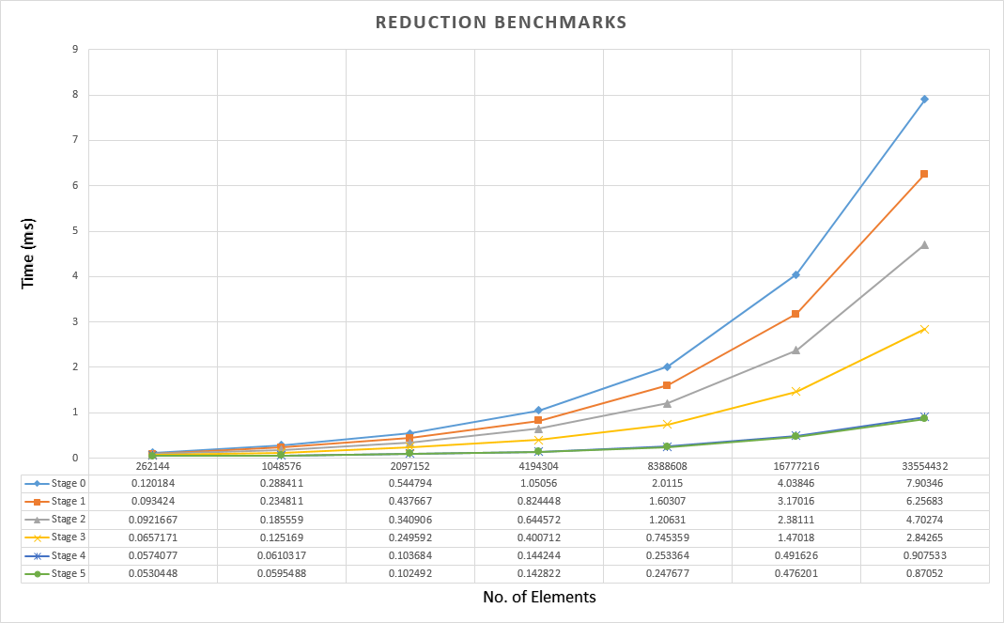
Performance Comparison

Slide 121
Overview of Basics
kernel: C/C++ function which executes on the device
thread: lightweight thread that runs on the device
block: collection of threads
grid: collection of all blocks launched
Notes:
Rubix cube

Slide 122
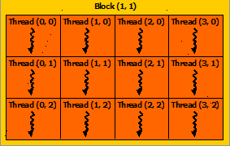
Parallel Execution
Blocks are a group of threads
Each block has a unique ID which is accessed by the blockIdx variable
Threads in the same block share a very fast local memory called shared memory
Organized in a 1D, 2D, or 3D grid
You can have a maximum of 2048M x 64K x 64K grid of blocks
Each block executes on an SM in unspecified order
Notes:
Built in variables
Use CUDA device query (look in samples) or GPU caps viewer so see your specs

Slide 123
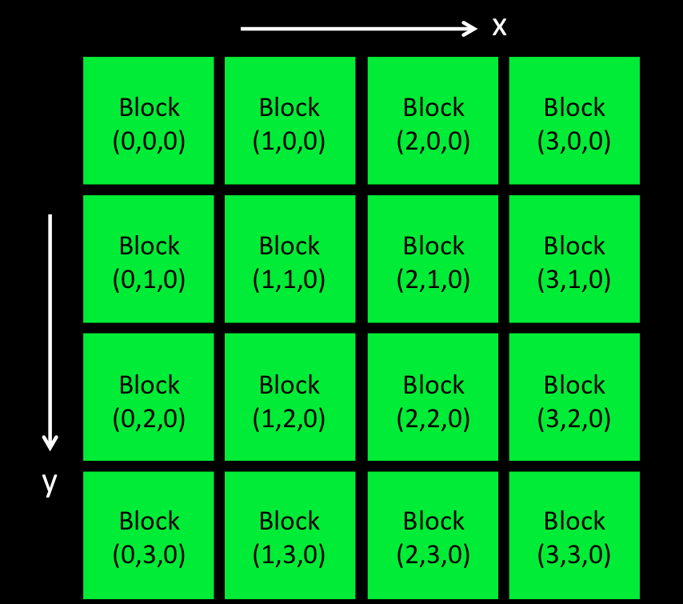
Grid: 1D/2D/3D Collection of Blocks
blockIdx.x
blockIdx.y
blockIdx.z
(3, 2, 0)
x y z
Notes:
Think in terms of dimensions rather than row and column

Slide 124
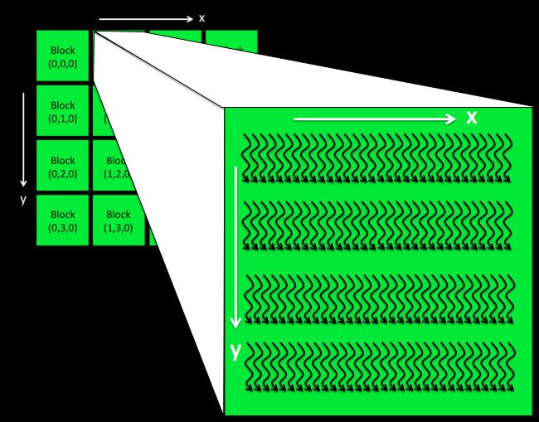
Block: 1D/2D/3D Collection of Threads
CUDA
threads
arranged
in a
32 x 4 x 1 pattern inside each Block
Notes:
This is a sample arrangement.
A block could have 1024 linear threads or 32x32 2D threads or any other acceptable form of arrangement

Slide 125
Basic Control Flow
1. Allocate memory on the device
2. Copy data from host memory to device memory
3. Launch: kernel<<<..>>>
4. Retrieve results from GPU memory to CPU memory

Slide 126
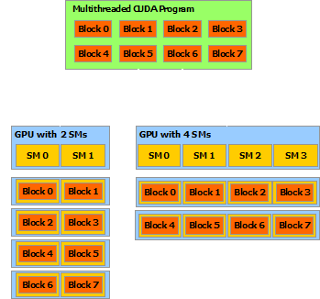
Parallel Execution
Execution Path
The same CUDA program gets its thread blocks distributed automatically across any given SM architecture.

Slide 127
Memory Hierarchy
global, local, shared

Slide 128
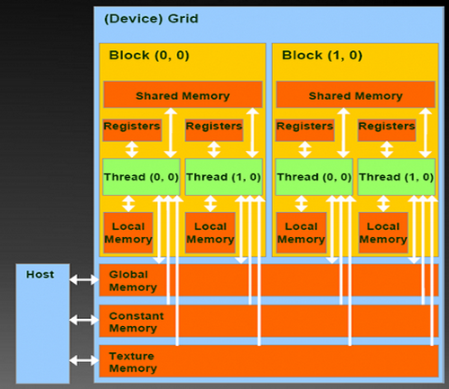
Memory Hierarchy

Slide 129
Memory Hierarchy
Global Memory
Created using cudaMalloc
Available to all threads
__global__ void add(int* a, int* b, int* c) { int id = blockIdx.x*blockDim.x
+ threadIdx.x;
c[id] = a[id] + b[id]; }

Slide 130
Memory Hierarchy
Local Memory
Stored in registers (very fast)
Thread local
__global__ void add(int* a, int* b, int* c) { int id = blockIdx.x*blockDim.x
+ threadIdx.x;
c[id] = a[id] + b[id]; }

Slide 131
Memory Hierarchy
Shared Memory
Located on the GPU's SM
User managed
Fast (like registers)
Accessible by all threads in the block
__global__ void add(int* a, int* b, int* c) { __shared__ int aValues[BLOCK_SIZE];
__shared__ int bValues[BLOCK_SIZE];
int id = threadIdx.x;
int globalId = blockIdx.x * BLOCK_SIZE + threadIdx.x;
aValues[id] = a[globalId];
bValues[id] = b[globalId]; c[id] = aValues[id] + bValues[id]; }

Slide 132
Running CUDA-GDB (Linux)
Debugging requires pausing the GPU
If the desktop manager is running on the GPU then it will become unusable.
Single GPU debugging
Stop the desktop manager
On Linux: sudo service gdm stop
On Mac OS X you can log in with the >console user name
Multi-GPU debugging
In Linux the driver excludes GPUs used by X11
On Mac OS X you can set which device to expose to cuda-gdb by setting the CUDA_VISIBLE_DEVICES environment variable
Notes:
cuda-gdb requires 2 gpus to debug. X11 system does not allow gpu debugging access.
Alternatives are to use ssh or use CLI mode with no X system

