Slide 1

CUDA Performance
Patrick Cozzi
University of Pennsylvania
CIS 565 - Fall 2015

Slide 2
Acknowledgements
Some slides from Varun Sampath

Slide 3
Agenda
Parallel Reduction Revisited
Warp Partitioning
Memory Coalescing
Bank Conflicts
Dynamic Partitioning of SM Resources
Data Prefetching
Instruction Mix
Loop Unrolling
Thread Granularity

Slide 4
Efficient data-
parallel algorithms
+
Optimizations based
on GPU Architecture
=
Maximum
Performance

Slide 5
Parallel Reduction
Recall Parallel Reduction (sum)
0
1
2
3
4
5
6
7

Slide 6
Parallel Reduction
0
1
2
3
4
5
6
7
1
5
9
13

Slide 7
Parallel Reduction
0
1
2
3
4
5
6
7
1
5
9
13
6
22

Slide 8
Parallel Reduction
0
1
2
3
4
5
6
7
1
5
9
13
6
22
28

Slide 9
__shared__ float partialSum[];
// ... load into shared memory
unsigned int t = threadIdx.x;
for (unsigned int stride = 1;
stride < blockDim.x;
stride *= 2)
{
__syncthreads();
if (t % (2 * stride) == 0)
partialSum[t] +=
partialSum[t + stride];
}
Code from http://courses.engr.illinois.edu/ece498/al/Syllabus.html

Slide 10
__shared__ float partialSum[];
// ... load into shared memory
unsigned int t = threadIdx.x;
for (unsigned int stride = 1;
stride < blockDim.x;
stride *= 2)
{
__syncthreads();
if (t % (2 * stride) == 0)
partialSum[t] +=
partialSum[t + stride];
}
Computing the sum for the elements in shared memory
Code from http://courses.engr.illinois.edu/ece498/al/Syllabus.html

Slide 11
__shared__ float partialSum[];
// ... load into shared memory
unsigned int t = threadIdx.x;
for (unsigned int stride = 1;
stride < blockDim.x;
stride *= 2)
{
__syncthreads();
if (t % (2 * stride) == 0)
partialSum[t] +=
partialSum[t + stride];
}
Stride:
1, 2, 4, …
Code from http://courses.engr.illinois.edu/ece498/al/Syllabus.html

Slide 12
__shared__ float partialSum[];
// ... load into shared memory
unsigned int t = threadIdx.x;
for (unsigned int stride = 1;
stride < blockDim.x;
stride *= 2)
{
__syncthreads();
if (t % (2 * stride) == 0)
partialSum[t] +=
partialSum[t + stride];
}
Why?
Code from http://courses.engr.illinois.edu/ece498/al/Syllabus.html

Slide 13
__shared__ float partialSum[];
// ... load into shared memory
unsigned int t = threadIdx.x;
for (unsigned int stride = 1;
stride < blockDim.x;
stride *= 2)
{
__syncthreads();
if (t % (2 * stride) == 0)
partialSum[t] +=
partialSum[t + stride];
}
Compute sum in same shared memory
As stride increases, what do more threads do?
Code from http://courses.engr.illinois.edu/ece498/al/Syllabus.html

Slide 14
Parallel Reduction
Thread
0
Thread
1
Thread
2
Thread
3
Thread
4
Thread
5
Thread
6
Thread
7
0
1
2
3
4
5
6
7
1
5
9
13
6
22
28

Slide 15
Parallel Reduction
Thread
0
Thread
1
Thread
2
Thread
3
Thread
4
Thread
5
Thread
6
Thread
7
0
1
2
3
4
5
6
7
1
5
9
13
6
22
28
1st pass: threads 1, 3, 5, and 7 don’t do anything
Really only need n/2 threads for n elements

Slide 16
Parallel Reduction
Thread
0
Thread
1
Thread
2
Thread
3
Thread
4
Thread
5
Thread
6
Thread
7
0
1
2
3
4
5
6
7
1
5
9
13
6
22
28
2nd pass: threads 2 and 6 also don’t do anything

Slide 17
Parallel Reduction
Thread
0
Thread
1
Thread
2
Thread
3
Thread
4
Thread
5
Thread
6
Thread
7
0
1
2
3
4
5
6
7
1
5
9
13
6
22
28
3rd pass: thread 4 also doesn’t do anything

Slide 18
Parallel Reduction
Thread
0
Thread
1
Thread
2
Thread
3
Thread
4
Thread
5
Thread
6
Thread
7
0
1
2
3
4
5
6
7
1
5
9
13
6
22
28
In general, number of required threads cuts in half after each pass

Slide 19
Parallel Reduction
What if we tweaked the implementation?

Slide 20
Parallel Reduction
0
1
2
3
4
5
6
7

Slide 21
Parallel Reduction
0
1
2
3
4
5
6
7
4
6
8
10

Slide 22
Parallel Reduction
0
1
2
3
4
5
6
7
4
6
8
10
12
16

Slide 23
Parallel Reduction
0
1
2
3
4
5
6
7
4
6
8
10
12
16
28

Slide 24
__shared__ float partialSum[]
// ... load into shared memory
unsigned int t = threadIdx.x;
for(unsigned int stride = blockDim.x / 2;
stride > 0;
stride /= 2)
{
__syncthreads();
if (t < stride)
partialSum[t] +=
partialSum[t + stride];
}
stride: …, 4, 2, 1
Code from http://courses.engr.illinois.edu/ece498/al/Syllabus.html

Slide 25
__shared__ float partialSum[]
// ... load into shared memory
unsigned int t = threadIdx.x;
for(unsigned int stride = blockDim.x / 2;
stride > 0;
stride /= 2)
{
__syncthreads();
if (t < stride)
partialSum[t] +=
partialSum[t + stride];
}
Code from http://courses.engr.illinois.edu/ece498/al/Syllabus.html

Slide 26
Parallel Reduction
Thread
0
Thread
1
Thread
2
Thread
3
Thread
4
Thread
5
Thread
6
Thread
7
0
1
2
3
4
5
6
7
4
6
8
10
12
16
28

Slide 27
Parallel Reduction
Thread
0
Thread
1
Thread
2
Thread
3
Thread
4
Thread
5
Thread
6
Thread
7
0
1
2
3
4
5
6
7
4
6
8
10
12
16
28
1st pass: threads 4, 5, 6, and 7 don’t do anything
Really only need n/2 threads for n elements

Slide 28
Parallel Reduction
Thread
0
Thread
1
Thread
2
Thread
3
Thread
4
Thread
5
Thread
6
Thread
7
0
1
2
3
4
5
6
7
4
6
8
10
12
16
28
2nd pass: threads 2 and 3 also don’t do anything

Slide 29
Parallel Reduction
Thread
0
Thread
1
Thread
2
Thread
3
Thread
4
Thread
5
Thread
6
Thread
7
0
1
2
3
4
5
6
7
4
6
8
10
12
16
28
3rd pass: thread 1 also doesn’t do anything

Slide 30
Parallel Reduction
What is the difference?
0 1 2 3 4 5 6 7
0 1 2 3 4 5 6 7
stride = 1, 2, 4, …
stride = 4, 2, 1, …

Slide 31
Parallel Reduction
What is the difference?
if (t % (2 * stride) == 0)
partialSum[t] +=
partialSum[t + stride];
if (t < stride)
partialSum[t] +=
partialSum[t + stride];
stride = 1, 2, 4, …
stride = 4, 2, 1, …

Slide 32
Warp Partitioning
Warp Partitioning: how threads from a block are divided into warps
Knowledge of warp partitioning can be used to:
Minimize divergent branches
Retire warps early

Slide 33
Warp Partitioning
Partition based on consecutive increasing threadIdx

Slide 34
Warp Partitioning
1D Block
threadIdx.x between 0 and 512 (G80/GT200)
Warp n
Starts with thread 32n
Ends with thread 32(n + 1) – 1
Last warp is padded if block size is not a multiple of 32
Warp 0
Warp 1
Warp 2
Warp 3
0…31
32...63
64...95
96...127
…

Slide 35
Warp Partitioning
2D Block
Increasing threadIdx means
Increasing threadIdx.x
Starting with row threadIdx.y == 0

Slide 36
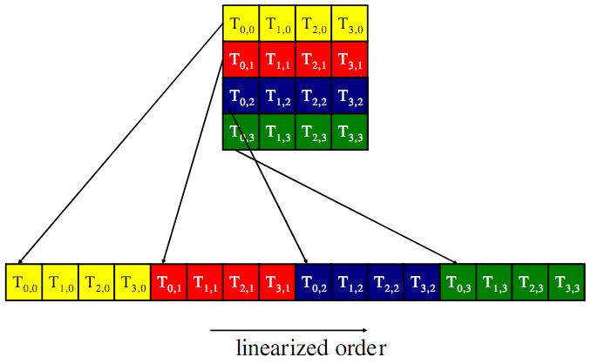
Warp Partitioning
2D Block
Image from http://courses.engr.illinois.edu/ece498/al/textbook/Chapter5-CudaPerformance.pdf

Slide 37
Warp Partitioning
3D Block
Start with threadIdx.z == 0
Partition as a 2D block
Increase threadIdx.z and repeat

Slide 38
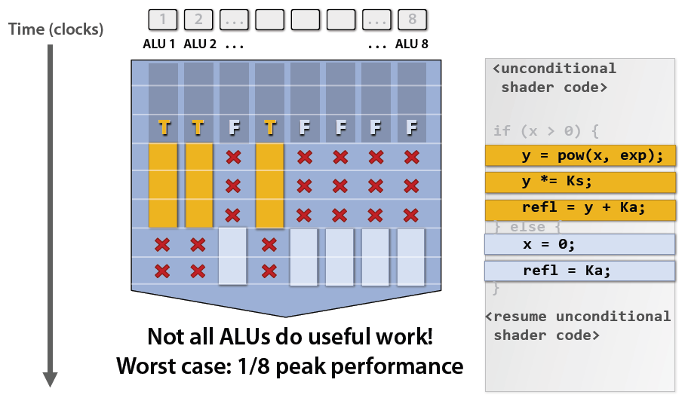
Warp Partitioning
Divergent branches are within a warp!
Image from: http://bps10.idav.ucdavis.edu/talks/03-fatahalian_gpuArchTeraflop_BPS_SIGGRAPH2010.pdf

Slide 39
Warp Partitioning
For warpSize == 32, does any warp have a divergent branch with this code:
if (threadIdx.x > 15)
{
// ...
}
Notes:
Yes, warp 0

Slide 40
Warp Partitioning
For any warpSize > 1, does any warp have a divergent branch with this code:
if (threadIdx.x > warpSize - 1)
{
// ...
}
Notes:
No, but this “if (threadIdx.x > warpSize)” would diverge in Warp 1.
When branch granularity is a whole multiple of warp size; all threads in any given warp follow the same path.

Slide 41
Warp Partitioning
Given knowledge of warp partitioning, which parallel reduction is better?
if (t % (2 * stride) == 0)
partialSum[t] +=
partialSum[t + stride];
if (t < stride)
partialSum[t] +=
partialSum[t + stride];
stride = 1, 2, 4, …
stride = 4, 2, 1, …

Slide 42
Warp Partitioning
Pretend warpSize == 2
Warp
0
Warp
1
Warp
2
Warp
3
Warp
0
Warp
1
Warp
2
Warp
3
stride = 1, 2, 4, …
stride = 4, 2, 1, …

Slide 43
Warp Partitioning
1st Pass
Warp
0
Warp
1
Warp
2
Warp
3
Warp
0
Warp
1
Warp
2
Warp
3
4
divergent
branches
0
divergent
branches
stride = 1, 2, 4, …
stride = 4, 2, 1, …

Slide 44
Warp Partitioning
2nd Pass
Warp
0
Warp
1
Warp
2
Warp
3
Warp
0
Warp
1
Warp
2
Warp
3
2
divergent
branches
0
divergent
branches
stride = 1, 2, 4, …
stride = 4, 2, 1, …

Slide 45
Warp Partitioning
2nd Pass
Warp
0
Warp
1
Warp
2
Warp
3
Warp
0
Warp
1
Warp
2
Warp
3
1
divergent
branch
1
divergent
branch
stride = 1, 2, 4, …
stride = 4, 2, 1, …

Slide 46
Warp Partitioning
2nd Pass
Warp
0
Warp
1
Warp
2
Warp
3
Warp
0
Warp
1
Warp
2
Warp
3
1
divergent
branch
1
divergent
branch
stride = 1, 2, 4, …
stride = 4, 2, 1, …
Still diverge when number of elements left is <= warpSize

Slide 47
Warp Partitioning
Good partitioning also allows warps to be retired early.
Better hardware utilization
if (t % (2 * stride) == 0)
partialSum[t] +=
partialSum[t + stride];
if (t < stride)
partialSum[t] +=
partialSum[t + stride];
stride = 1, 2, 4, …
stride = 4, 2, 1, …

Slide 48
Warp Partitioning
Parallel Reduction
Warp
0
Warp
1
Warp
2
Warp
3
Warp
0
Warp
1
Warp
2
Warp
3
stride = 1, 2, 4, …
stride = 4, 2, 1, …

Slide 49
Warp Partitioning
1st Pass
Warp
0
Warp
1
Warp
2
Warp
3
Warp
0
Warp
1
Warp
2
Warp
3
0
warps
retired
2
warps
retired
stride = 1, 2, 4, …
stride = 4, 2, 1, …

Slide 50
Warp Partitioning
1st Pass
Warp
0
Warp
1
Warp
2
Warp
3
Warp
0
Warp
1
Warp
2
Warp
3
stride = 1, 2, 4, …
stride = 4, 2, 1, …

Slide 51
Warp Partitioning
2nd Pass
Warp
0
Warp
1
Warp
2
Warp
3
Warp
0
Warp
1
Warp
2
Warp
3
2
warps
retired
1
warp
retired
stride = 1, 2, 4, …
stride = 4, 2, 1, …

Slide 52
Warp Partitioning
2nd Pass
Warp
0
Warp
1
Warp
2
Warp
3
Warp
0
Warp
1
Warp
2
Warp
3
stride = 1, 2, 4, …
stride = 4, 2, 1, …

Slide 53
Memory Coalescing
Given a matrix stored row-major in global memory, what is a thread’s desirable access pattern?
M_{0,0}
M_{1,0}
M_{2,0}
M_{3,0}
M_{0,1}
M_{1,1}
M_{2,1}
M_{3,1}
M_{0,2}
M_{1,2}
M_{2,2}
M_{3,2}
M
M_{0,3}
M_{1,3}
M_{2,3}
M_{3,3}
M_{0,0}
M_{1,0}
M_{2,0}
M_{3,0}
M_{0,1}
M_{1,1}
M_{2,1}
M_{3,1}
M_{0,2}
M_{1,2}
M_{2,2}
M_{3,2}
M_{0,3}
M_{1,3}
M_{2,3}
M_{3,3}
Image from: http://bps10.idav.ucdavis.edu/talks/03-fatahalian_gpuArchTeraflop_BPS_SIGGRAPH2010.pdf

Slide 54
Memory Coalescing
Given a matrix stored row-major in global memory, what is a thread’s desirable access pattern?
Thread
0
Thread
1
Md
Nd
Thread 0
H
T
D
I
Thread 1
W
WIDTH
a) column after column?
b) row after row?
Image from: http://courses.engr.illinois.edu/ece498/al/textbook/Chapter5-CudaPerformance.pdf

Slide 55
Memory Coalescing
Given a matrix stored row-major in global memory, what is a thread’s desirable access pattern?
a) column after column
Individual threads read increasing, consecutive memory address
b) row after row
Adjacent threads read increasing, consecutive memory addresses

Slide 56
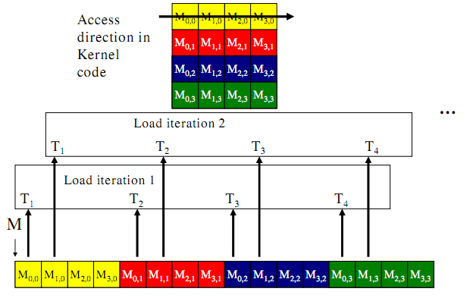
Memory Coalescing
a) column after column
Image from: http://courses.engr.illinois.edu/ece498/al/textbook/Chapter5-CudaPerformance.pdf

Slide 57
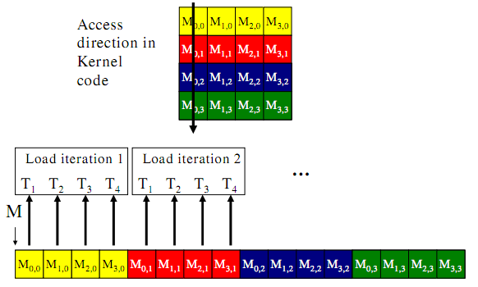
Memory Coalescing
b) row after row
Image from: http://courses.engr.illinois.edu/ece498/al/textbook/Chapter5-CudaPerformance.pdf

Slide 58
Memory Coalescing
Global memory bandwidth (DRAM)
G80 – 86.4 GB/s
GT200 – 150 GB/s
Achieve peak bandwidth by requesting large, consecutive locations from DRAM
Accessing random location results in much lower bandwidth

Slide 59
Memory Coalescing
Memory coalescing – rearrange access patterns to improve performance
Useful today but will be less useful with large on-chip caches

Slide 60
Memory Coalescing
The GPU coalesces consecutive reads in a half-warp into a single read
Strategy: read global memory in a coalesce-able fashion into shared memory
Then access shared memory randomly at maximum bandwidth
Ignoring bank conflicts…
See Appendix G in the NVIDIA CUDA C Programming Guide for coalescing alignment requirements
Notes:
Because each thread executes the same instruction

Slide 61
Bank Conflicts
Shared Memory
Sometimes called a parallel data cache
Multiple threads can access shared memory at the same time
Memory is divided into banks
Bank 0
Bank 1
Bank 2
Bank 3
Bank 4
Bank 5
Bank 6
Bank 7
Bank 15
Image from http://courses.engr.illinois.edu/ece498/al/Syllabus.html
Notes:
Divided into banks to achieve high bandwidth
G80 – 2 cycles to shared memory. 1 cycle to register.

Slide 62
Bank Conflicts
Banks
Each bank can service one address per two cycles
Per-bank bandwidth: 32-bits per two (shader clock) cycles
Successive 32-bit words are assigned to successive banks
Bank 0
Bank 1
Bank 2
Bank 3
Bank 4
Bank 5
Bank 6
Bank 7
Bank 15
Image from http://courses.engr.illinois.edu/ece498/al/Syllabus.html

Slide 63
Bank Conflicts
Bank Conflict: Two simultaneous accesses to the same bank, but not the same address
Serialized
G80-GT200: 16 banks, with 8 SPs concurrently executing
Fermi: 32 banks, with 16 SPs concurrently executing
Bank 0
Bank 1
Bank 2
Bank 3
Bank 4
Bank 5
Bank 6
Bank 7
Bank 15
Image from http://courses.engr.illinois.edu/ece498/al/Syllabus.html
Notes:
* 16 threads in a half-warp
Bank conflicts only occur within a half warp for G80, but within a full warp for Fermi

Slide 64
Bank Conflicts
Bank Conflicts?
Linear addressing stride == 1
Bank Conflicts?
Random 1:1 Permutation
Thread 0
Bank 0
Thread 0
Bank 0
Thread 1
Bank 1
Thread 1
Bank 1
Thread 2
Bank 2
Thread 2
Bank 2
Thread 3
Bank 3
Thread 3
Bank 3
Thread 4
Bank 4
Thread 4
Bank 4
Thread 5
Bank 5
Thread 5
Bank 5
Thread 6
Bank 6
Thread 6
Bank 6
Thread 7
Bank 7
Thread 7
Bank 7
Thread 15
Bank 15
Thread 15
Bank 15
Image from http://courses.engr.illinois.edu/ece498/al/Syllabus.html
Notes:
Neither of these have bank conflicts

Slide 65
Bank Conflicts
Bank Conflicts?
Linear addressing stride == 2
Bank Conflicts?
Linear addressing stride == 8
Thread 0
Bank 0
Thread 0
x8
Bank 0
Thread 1
Bank 1
Thread 1
Bank 1
Thread 2
Bank 2
Thread 2
Bank 2
Thread 3
Bank 3
Thread 3
Thread 4
Bank 4
Thread 4
Bank 5
Thread 5
Bank 7
Bank 6
Thread 6
Bank 8
Bank 7
Thread 7
Bank 9
Thread 8
x8
Thread 9
Thread 10
Thread 11
Bank 15
Thread 15
Bank 15
Image from http://courses.engr.illinois.edu/ece498/al/Syllabus.html
Notes:
Left: 2-degree bank conflict
Right: 8-degree bank conflict

Slide 66
Bank Conflicts
Fast Path 1 (G80)
All threads in a half-warp access different banks
Thread 0
Bank 0
Thread 1
Bank 1
Thread 2
Bank 2
Thread 3
Bank 3
Thread 4
Bank 4
Thread 5
Bank 5
Thread 6
Bank 6
Thread 7
Bank 7
Thread 15
Bank 15
Image from http://courses.engr.illinois.edu/ece498/al/Syllabus.html

Slide 67
Bank Conflicts
Fast Path 2 (G80)
All threads in a half-warp access the same address
Same
address
Thread 0
Bank 0
Thread 1
Bank 1
Thread 2
Bank 2
Thread 3
Bank 3
Thread 4
Bank 4
Thread 5
Bank 5
Thread 6
Bank 6
Thread 7
Bank 7
Thread 15
Bank 15
Image from http://courses.engr.illinois.edu/ece498/al/Syllabus.html

Slide 68
Bank Conflicts
Slow Path (G80)
Multiple threads in a half-warp access the same bank
Access is serialized
What is the cost?
Thread 0
Bank 0
Thread 1
Bank 1
Thread 2
Bank 2
Thread 3
Bank 3
Thread 4
Bank 4
Bank 5
Bank 6
Bank 7
Thread 8
Thread 9
Thread 10
Thread 11
Bank 15
Image from http://courses.engr.illinois.edu/ece498/al/Syllabus.html
Notes:
Cost: maximum number of simultaneous accesses to a single bank.
A degree-n bank conflict requires n times as many cycles to process as an access with no conflict.

Slide 69
Bank Conflicts
__shared__ float shared[256];
// ...
float f = shared[index + s * threadIdx.x];
For what values of s is this conflict free?
Hint: The G80 has 16 banks
Notes:
“In this case, threads tid and tid+n access the same bank whenever s*n is a multiple of the number of banks (i.e. 32) or, equivalently, whenever n is a multiple of 32/d where d is the greatest common divisor of 32 and s. As a consequence, there will be no bank conflict only if the warp size (i.e. 32) is less than or equal to 32/d., that is only if d is equal to 1, i.e. s is odd. “ – CUDA Programming Guide

Slide 70
Bank Conflicts
__shared__ float shared[256];
// ...
float f = shared[index + s * threadIdx.x];
s=1
s=3
Thread 0
Bank 0
Thread 0
Bank 0
Thread 1
Bank 1
Thread 1
Bank 1
Thread 2
Bank 2
Thread 2
Bank 2
Thread 3
Bank 3
Thread 3
Bank 3
Thread 4
Bank 4
Thread 4
Bank 4
Thread 5
Bank 5
Thread 5
Bank 5
Thread 6
Bank 6
Thread 6
Bank 6
Thread 7
Bank 7
Thread 7
Bank 7
Thread 15
Bank 15
Thread 15
Bank 15
Image from http://courses.engr.illinois.edu/ece498/al/Syllabus.html
Notes:
When s shares no common factors with the number of banks. s must be odd.
Another simple fix: __shared__ float tile[TILE_DIM][TILE_DIM+1]; // pad with one extra column → optimizing matrix transpose with CUDA source

Slide 71
Bank Conflicts
Without using a profiler, how can we tell what kind of speedup we can expect by removing bank conflicts?
What happens if more than one thread in a warp writes to the same shared memory address (non-atomic instruction)?
Notes:
* Change all shared memory reads to the same value: broadcast.
change shared memory reads to threadIdx.x: no conflicts.
* Only one thread per half-warp performs a write and which thread performs the final write is undefined

Slide 72
SM Resource Partitioning
Recall a SM dynamically partitions resources:
Thread block slots
Thread slots
Registers
Shared memory
SM

Slide 73
SM Resource Partitioning
Recall a SM dynamically partitions resources:
G80 Limits
Thread block slots
8
Thread slots
768
Registers
8K registers / 32K memory
Shared memory
16K
SM

Slide 74
SM Resource Partitioning
We can have
8 blocks of 96 threads
4 blocks of 192 threads
But not 8 blocks of 192 threads
G80 Limits
Thread block slots
8
Thread slots
768
Registers
8K registers / 32K memory
Shared memory
16K
SM

Slide 75
SM Resource Partitioning
We can have (assuming 256 thread blocks)
768 threads (3 blocks) using 10 registers each
512 threads (2 blocks) using 11 registers each
G80 Limits
Thread block slots
8
Thread slots
768
Registers
8K registers / 32K memory
Shared memory
16K
SM

Slide 76
SM Resource Partitioning
We can have (assuming 256 thread blocks)
768 threads (3 blocks) using 10 registers each
512 threads (2 blocks) using 11 registers each
More registers decreases thread-level parallelism
Can it ever increase performance?
G80 Limits
Thread block slots
8
Thread slots
768
Registers
8K registers / 32K memory
Shared memory
16K
SM
Notes:
If adding registers can be used to hide global memory access by sticking enough non-dependent multiple/adds between the memory read and its use, it can actually improve performance.

Slide 77
SM Resource Partitioning
Performance Cliff: Increasing resource usage leads to a dramatic reduction in parallelism
For example, increasing the number of registers, unless doing so hides latency of global memory access

Slide 78
Data Prefetching
Independent instructions between a global memory read and its use can hide memory latency
float m = Md[i];
float f = a * b + c * d;
float f2 = m * f;

Slide 79
Data Prefetching
Independent instructions between a global memory read and its use can hide memory latency
float m = Md[i];
float f = a * b + c * d;
float f2 = m * f;
Read global memory

Slide 80
Data Prefetching
Independent instructions between a global memory read and its use can hide memory latency
float m = Md[i];
float f = a * b + c * d;
float f2 = m * f;
Execute instructions that are not dependent on memory read

Slide 81
Data Prefetching
Independent instructions between a global memory read and its use can hide memory latency
float m = Md[i];
float f = a * b + c * d;
float f2 = m * f;
Use global memory after the above line from enough warps hide the memory latency

Slide 82
Data Prefetching
Prefetching data from global memory can effectively increase the number of independent instructions between global memory read and use

Slide 83
Data Prefetching
Recall tiled matrix multiply:
for (/* ... */)
{
// Load current tile into shared memory
__syncthreads();
// Accumulate dot product
__syncthreads();
}

Slide 84
Data Prefetching
Tiled matrix multiply with prefetch:
// Load first tile into registers
for (/* ... */)
{
// Deposit registers into shared memory
__syncthreads();
// Load next tile into registers
// Accumulate dot product
__syncthreads();
}
Notes:
Compared to not prefetching, this requires two extra registers per thread.
For the final iteration, the next tile does not need to be loaded.
Our book says data prefetching also requires twice the amount of shared memory in this case, but I don’t think that is true (last paragraph of Section 6.4 on Page 115).

Slide 85
Data Prefetching
Tiled matrix multiply with prefetch:
// Load first tile into registers
for (/* ... */)
{
// Deposit registers into shared memory
__syncthreads();
// Load next tile into registers
// Accumulate dot product
__syncthreads();
}

Slide 86
Data Prefetching
Tiled matrix multiply with prefetch:
// Load first tile into registers
for (/* ... */)
{
// Deposit registers into shared memory
__syncthreads();
// Load next tile into registers
// Accumulate dot product
__syncthreads();
}
Prefetch for next iteration of the loop

Slide 87
Data Prefetching
Tiled matrix multiply with prefetch:
// Load first tile into registers
for (/* ... */)
{
// Deposit registers into shared memory
__syncthreads();
// Load next tile into registers
// Accumulate dot product
__syncthreads();
}
These instructions executed by enough threads will hide the memory latency of the prefetch

Slide 88
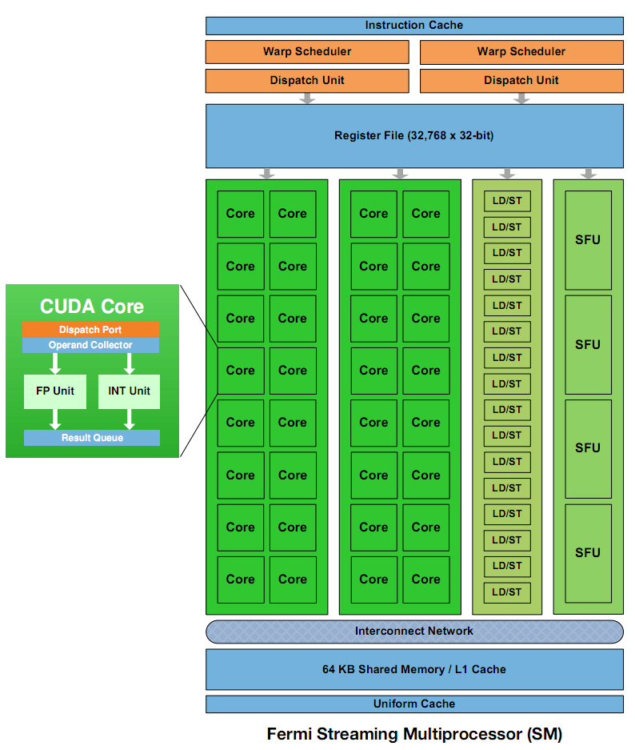
Instruction Mix
Special Function Units (SFUs)
Use to compute __sinf(), __expf()
Only 4, each can execute 1 instruction per clock
Image: NVIDIA Fermi Whitepaper
Notes:
2 SFUs per SM on G80

Slide 89
Loop Unrolling
for (int k = 0; k < BLOCK_SIZE; ++k)
{
Pvalue += Ms[ty][k] * Ns[k][tx];
}
Instructions per iteration
One floating-point multiply
One floating-point add
What else?

Slide 90
Loop Unrolling
for (int k = 0; k < BLOCK_SIZE; ++k)
{
Pvalue += Ms[ty][k] * Ns[k][tx];
}
Other instructions per iteration
Update loop counter

Slide 91
Loop Unrolling
for (int k = 0; k < BLOCK_SIZE; ++k)
{
Pvalue += Ms[ty][k] * Ns[k][tx];
}
Other instructions per iteration
Update loop counter
Branch

Slide 92
Loop Unrolling
for (int k = 0; k < BLOCK_SIZE; ++k)
{
Pvalue += Ms[ty][k] * Ns[k][tx];
}
Other instructions per iteration
Update loop counter
Branch
Address arithmetic

Slide 93
Loop Unrolling
for (int k = 0; k < BLOCK_SIZE; ++k)
{
Pvalue += Ms[ty][k] * Ns[k][tx];
}
Instruction Mix
2 floating-point arithmetic instructions
1 loop branch instruction
2 address arithmetic instructions
1 loop counter increment instruction

Slide 94
Loop Unrolling
Only 1/3 are floating-point calculations
But I want my full theoretical 1 TFLOP (Fermi)
Consider loop unrolling
Image: NVIDIA Fermi Whitepaper

Slide 95
Loop Unrolling
Pvalue +=
Ms[ty][0] * Ns[0][tx] +
Ms[ty][1] * Ns[1][tx] +
...
Ms[ty][15] * Ns[15][tx]; // BLOCK_SIZE = 16
No more loop
No loop count update
No branch
Constant indices – no address arithmetic instructions
Notes:
Compilers are getting better at unrolling, but many programmers still do it by hand.

Slide 96
Loop Unrolling
Automatically:
#pragma unroll BLOCK_SIZE
for (int k = 0; k < BLOCK_SIZE; ++k)
{
Pvalue += Ms[ty][k] * Ns[k][tx];
}
Disadvantages to unrolling?
Notes:
Disadvantages include instruction cache misses and increased register usage. Manually unrolling avoids the disadvantages of predication (which itself is only used for a few-instruction branch).

Slide 97
Thread Granularity
How much work should one thread do?
Parallel Reduction
Reduce two elements?
Matrix multiply
Compute one element of Pd?

Slide 98
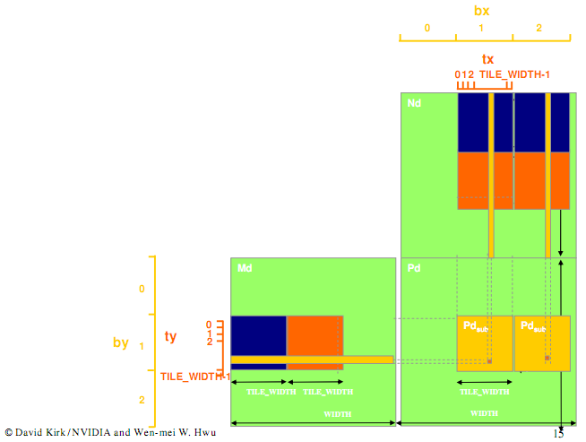
Thread Granularity
Matrix Multiple
Image from http://courses.engr.illinois.edu/ece498/al/textbook/Chapter5-CudaPerformance.pdf

Slide 99
Thread Granularity
Matrix Multiple
Both elements of Pd require the same row of Md
Image from http://courses.engr.illinois.edu/ece498/al/textbook/Chapter5-CudaPerformance.pdf

Slide 100
Thread Granularity
Matrix Multiple
Compute both Pd elements in the same thread
Reduces global memory access by ¼
Increases number of independent instructions
What is the benefit?
New kernel uses more registers and shared memory
What does that imply?

