Slide 1
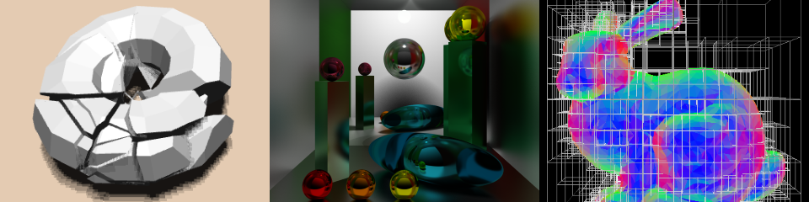
Mobile Graphics
Patrick Cozzi
University of Pennsylvania
CIS 565 - Fall 2015

Slide 2
Agenda
Mobile GPUs
Tile-Based Rendering
Motivation
Implementation
Implications on optimizing our code

Slide 3
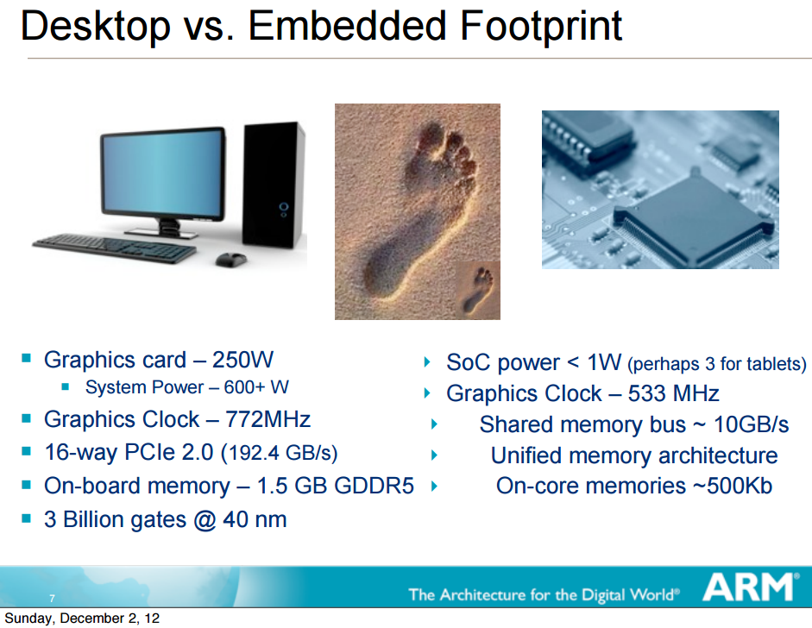
Slide by Dave Shreiner

Slide 4
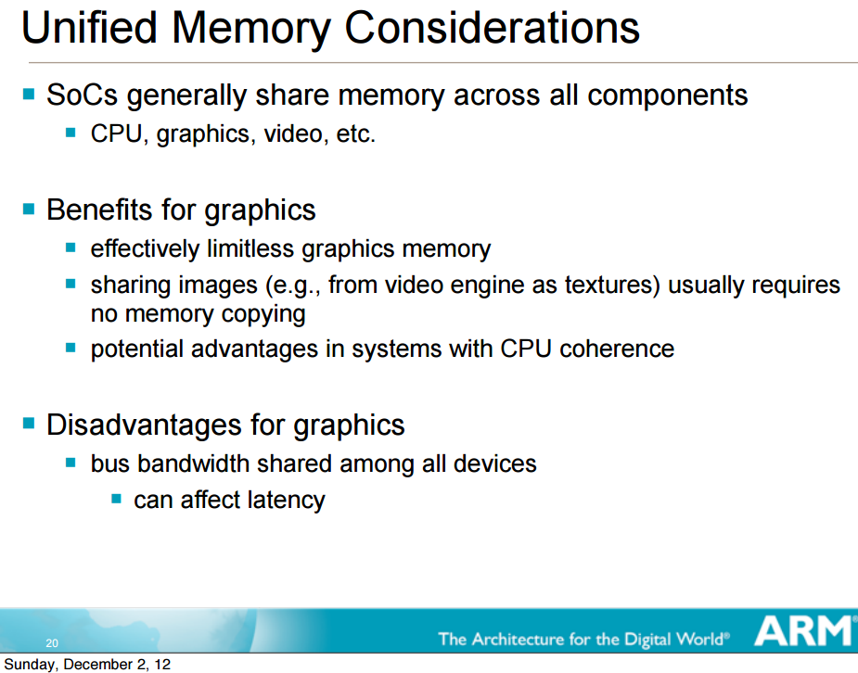
Slide by Dave Shreiner

Slide 5
Memory Bandwidth
For 32-bit color, 4 bytes per pixel are needed for display
How many bytes were transferred?

Slide 6
Memory Bandwidth
For 32-bit color, 4 bytes per pixel are needed for display
How many bytes were transferred?
12 bytes?
Read/write depth and stencil
Write color

Slide 7
Memory Bandwidth
For 32-bit color, 4 bytes per pixel are needed for display
How many bytes were transferred?
12 bytes?
Read/write depth and stencil
Write color
What about:
Textures
Overdraw
Blending
Multisampling
Notes:
Over 100 bytes is common.

Slide 8
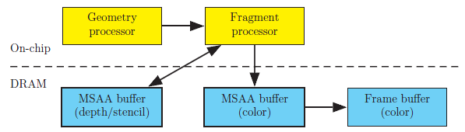
Immediate Mode Rendering
Immediate Mode Rendering (IMR) specifies triangles to be drawn in a current state
Image from http://www.openglinsights.com/

Slide 9

Immediate Mode Rendering
IMRs can result in overdraw
Image from http://www.openglinsights.com/
Notes:
Results in unnecessary shading and depth buffer writes

Slide 10

Immediate Mode Rendering
Sort front to back to minimize overdraw
Image from http://www.openglinsights.com/
Notes:
Uses early-z. View-dependent. Needs to be done per frame for dynamic scenes. Translucent objects still need to be rendered back to front.

Slide 11
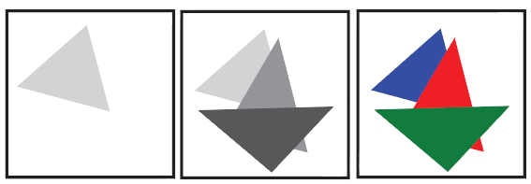
Immediate Mode Rendering
Depth pre-pass to minimize overdraw
Image from http://www.openglinsights.com/
Notes:
Have to transform vertices twice, but CPU overhead can be low on the second pass. Depth only pass can use double-speed z-only.

Slide 12
Tile-Based Rendering
Bandwidth uses a significant amount of power consumption
Mobile graphics want to maximum battery life. How?
Minimize accessing the framebuffer in global memory
Notes:
Reducing bandwidth helps power consumption and performance!
Compression helps, but it is not enough.
OpenGL spec says triangles are rendered in order; however, we can reorder and parallelize things under the hood.

Slide 13
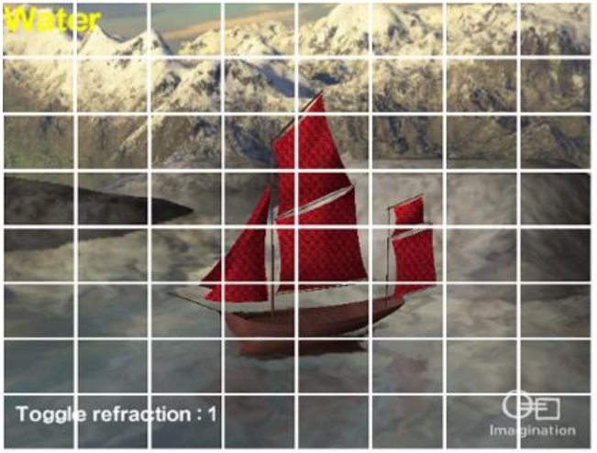
Tile-Based Rendering
Break framebuffer up into tiles, e.g., 16x16 pixels
Image from http://www.imgtec.com/powervr/insider/docs/PowerVR%20Series5%20Graphics.SGX%20architecture%20guide%20for%20developers.1.0.8.External.pdf

Slide 14
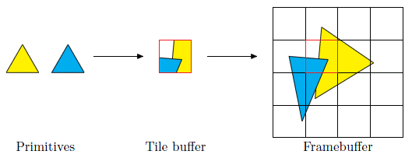
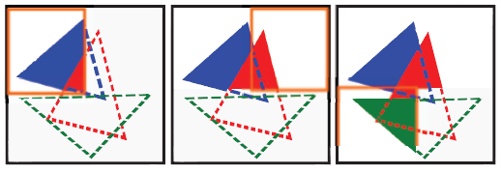
Tile-Based Rendering
Render one tile at a time using all primitives that overlap a tile
Images from http://www.openglinsights.com/

Slide 15
Tile-Based Rendering
A tile is stored on-chip in the tile buffer
All depth/stencil/color access is on-chip
After the tile is rendered, color is written to global memory
How does this affect vertex processing?
Notes:
Sounds like using shared memory in CUDA, right?
Doesn't have to write overdrawn pixels, depth/stencil, etc. to global memory.
Depth/stencil testing and blending are done on chip.

Slide 16
Tile-Based Rendering
Avoid transforming all vertices in the scene per-tile by storing
gl_Position and vertex shader varyings
Fragment shader and uniforms
Fixed function state, e.g., depth test, etc.
in a spatial data structure call the frame data (or polygon lists or parameter buffer)
Notes:
Frame data is also called polygon lists (ARM) and the parameter buffer (Imagination Technologies).

Slide 17
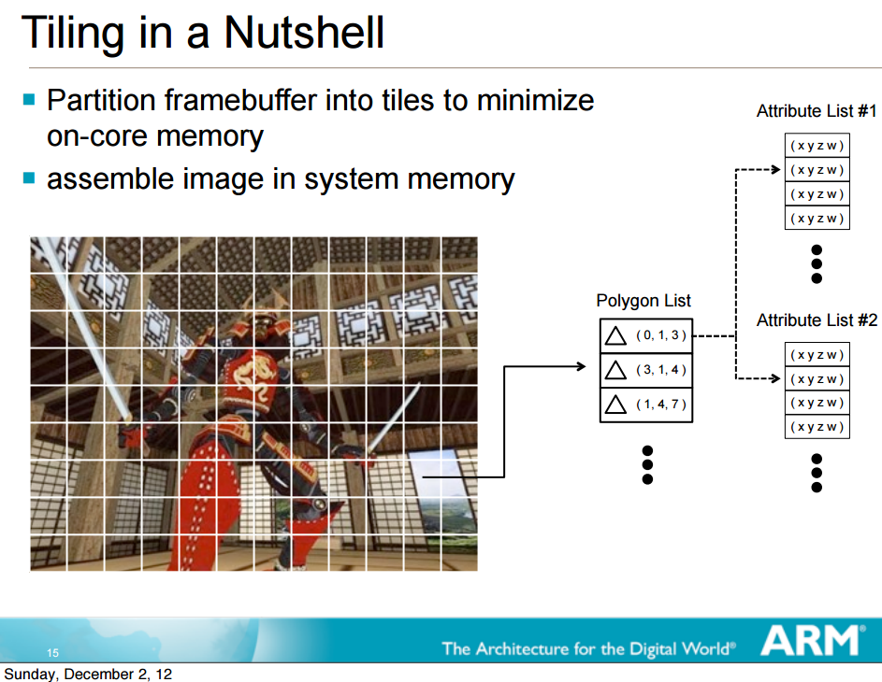
Slide by Dave Shreiner

Slide 18
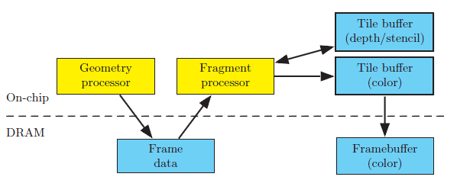
Tile-Based Rendering
Image from http://www.openglinsights.com/

Slide 19
What’s the Difference?
IMR
Tile-Based
Image from http://www.openglinsights.com/
Notes:
Much less global memory access since a tile is only written to global memory once, and only color is written. However, frame data is now in global memory. As long as there is not too many posted-clipped triangles, the extra global memory access introduced by frame data is much less than the access saved using tiling.

Slide 20
Framebuffer Clears
glClear is cheap and clears frame data
Don’t skip it
Clear everything, e.g., all buffers, no scissor test, etc.
Even better, use EXT_discard_framebuffer:
const GLenum attachments[3] = { COLOR_EXT, DEPTH_EXT, STENCIL_EXT };
glDiscardFramebufferEXT(GL_FRAMEBUFFER, 3, attachments);
Notes:
Old school optimizations use to draw the sky box first, etc. to avoid glClear. Don’t do that.

Slide 21
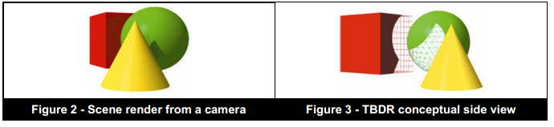
Tile-Based Deferred Rendering
On PowerVR, only fragments that contribute to the scene are shaded:
Called Tile-Based Deferred Rendering (TBDR)
Image from http://www.imgtec.com/powervr/insider/docs/PowerVR%20Series5%20Graphics.SGX%20architecture%20guide%20for%20developers.1.0.8.External.pdf
Notes:
A tile has access to the frame data spatial data structure, and can therefore sort front-to-back unlike IMR.
The image on the right is a view from the left of the camera.
I suspect, in theory, they can do OIT with the frame data too.

Slide 22
Tile-Based Deferred Rendering
How does sorting front-to-back and depth prepass affect TBDR?
Image from http://www.openglinsights.com/
Notes:
No longer useful; wasted CPU time

Slide 23
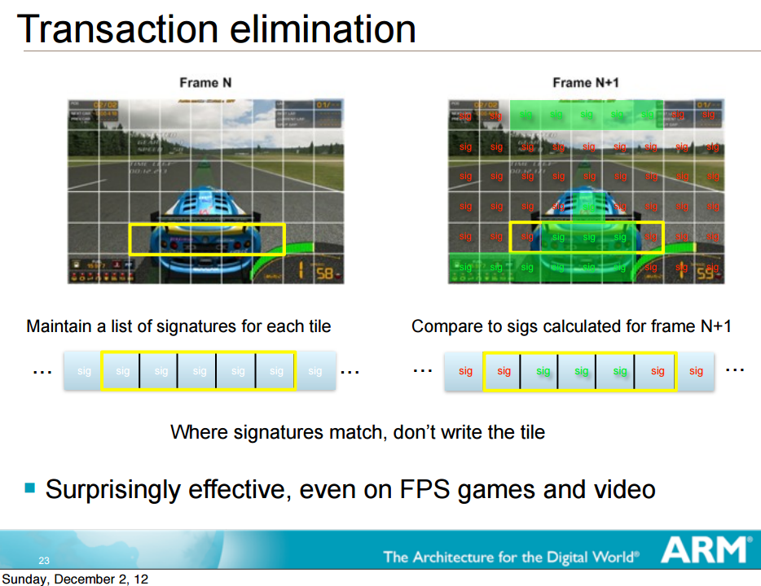
Slide by Dave Shreiner
Notes:
Video: https://www.youtube.com/watch?v=4pDADEhka_g
Roughly 1.5% overhead from computing and comparing the CRCs.
64-bit CRC. Collisions possible.
More info: http://www.anandtech.com/show/8234/arms-mali-midgard-architecture-explored/7

