Slide 1
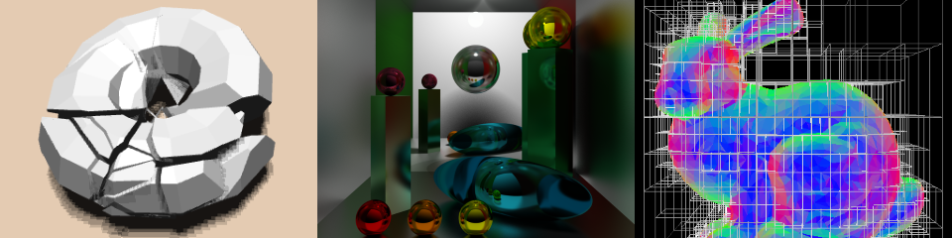
README.md Tips
Patrick Cozzi
University of Pennsylvania
CIS 565 - Fall 2015

Slide 2
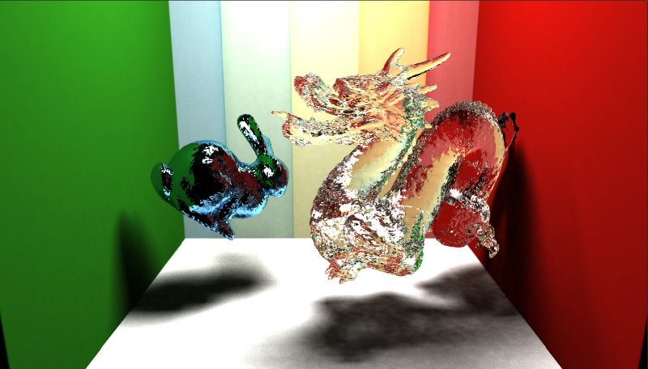
README Tips
Provide context and contact info
Have a representative image
Accelerated Stochastic Progressive Photon Mapping on the GPU by Ishaan Singh, Yingting Xiao, and Xiaoyan Zhu (Fall 2013)
Notes:
The README.md file in the root directory is displayed when we visit a GitHub repo. We encourage students to make this as compelling as possible to showcase their work.
Screenshot: Accelerated Stochastic Progressive Photon Mapping on the GPU by Ishaan Singh, Yingting Xiao, and Xiaoyan Zhu, https://github.com/ishaan13/PhotonMapper

Slide 3
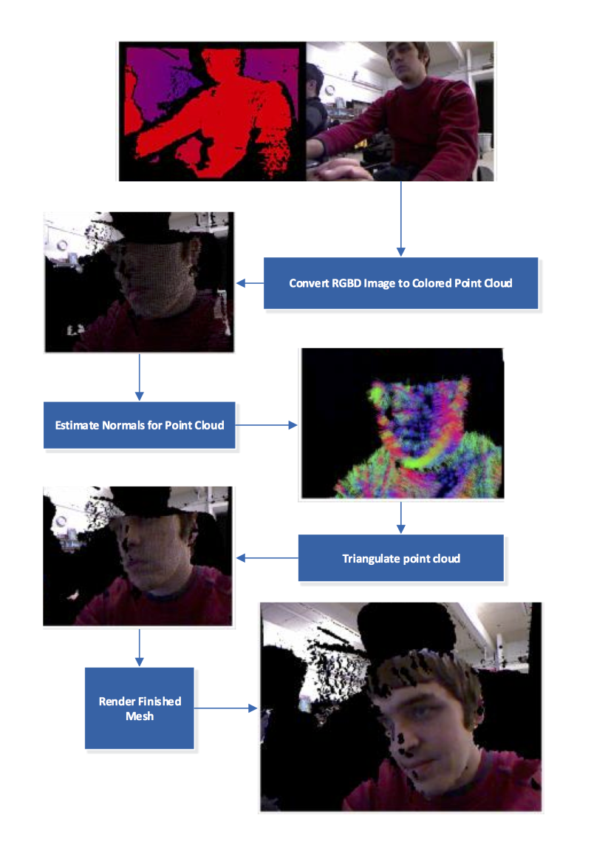
README Tips
Use screenshots with captions to walk through features
Surface Mesh Reconstruction from RGBD by Collin Boots and Dalton Banks (Fall 2013)
Notes:
Screenshot: Surface Mesh Reconstruction from RGBD by Collin Boots and Dalton Banks, https://github.com/cboots/RGBD-to-Mesh

Slide 4
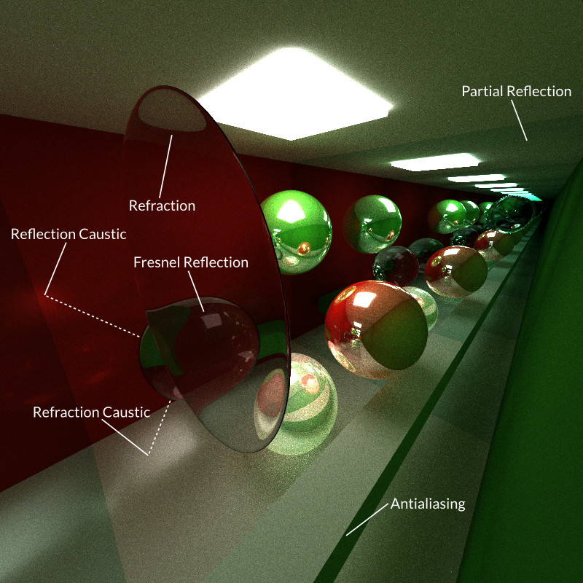
README Tips
Annotate
GPU Path Tracer by Kai Ninomiya (Fall 2014)
Notes:
Screenshot: GPU path tracer by Kai Ninomiya, https://github.com/kainino0x/Project3-Pathtracer

Slide 5
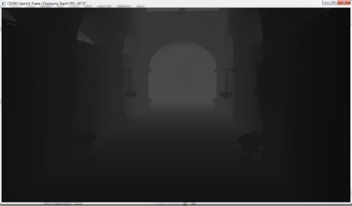
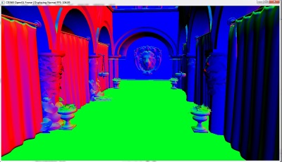
README Tips
Debug screenshots
Deferred Shader by Cheng-Tso Lin (Fall 2013)
Notes:
Screenshot: Deferred Shader by Cheng-Tso Lin, https://github.com/otaku690/GLSLDeferredShading

Slide 6
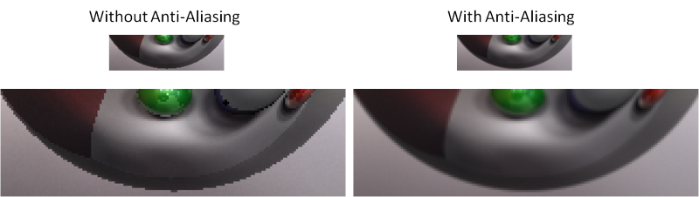
README Tips
Side-by-side comparisons
GPU Path Tracer by Wei-Chien Tu (Fall 2014)
Notes:
Screenshot: GPU Path Tracer by Wei-Chien Tu, https://github.com/foxking0416/Project3-Pathtracer

Slide 7
README Tips
Bloopers
Videos
Demos
Performance analysis
Build instructions
Focus on what is unique

Slide 8
Read the Guide!
How to make an attractive GitHub repo:
https://github.com/pjcozzi/Articles/tree/master/CIS565/GitHubRepo

