Slide 1
Interactive k-D Tree GPU Raytracing
Daniel Reiter Horn, Jeremy Sugerman,
Mike Houston and Pat Hanrahan

Slide 2
Architectural trends
Processors are becoming more parallel
  SMP
  Stream Processors (Cell)
  Threaded Processors (Niagra)
  GPUs
To raytrace quickly in the future
  We must understand how architectural tradeoffs affect raytracing performance

Slide 3
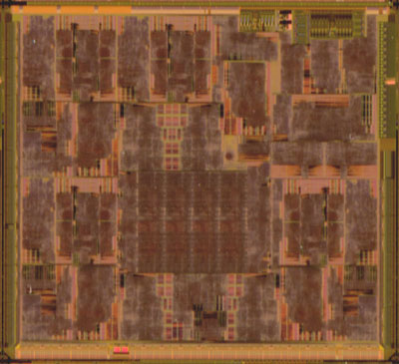
A Modern GPU: ATI X1900XT
360 GFLOPS peak
40 GB/s cache bandwidth
28 GB/s streaming bandwidth

Slide 4
ATI X1900XT architecture
1000’s of threads
  Each does not communicate with any other
  Each has 512 bytes of scratch space
    Exposed as 32 16-byte registers
  Groups of ~48 threads in lockstep
    Same program counter

Slide 5
ATI X1900XT architecture
Execute one thread until stall, then switch to next thread
T1
T2
T3
T4
.
.
.
STALL
Mem
access
STALL
STALL
STALL
STALL
STALL
Whenever a memory fetch occurs
  active thread group put on queue
  inactive thread group resumes for more math

Slide 6
Evolving a GPU to raytrace
Get all GPU features
  Rasterizer
  Fast
    Texturing
    Shading
Plus a raytracer

Slide 7
Current state of GPU raytracing
Foley et al. slower than CPU
  Performance only 30% of a CPU
  Limited by memory bandwidth
    More math units won’t improve raytracer
  Hard to store a stack in 512 bytes
    Invented KD-Restart to compensate

Slide 8
GPU Improvements
Allows us to apply modern CPU raytracing techniques to GPU raytracers
Looping
  Entire intersection as a single pass
Longer supported programs
  Ray packets of size 4 (matching SIMD width)
Access to hardware assembly language
  Hand-tune inner loop

Slide 9
Contribution
Port to ATI x1900
Exploiting new architectural features
Short stack
Result: 4.75 x faster than CPU on untextured scene

Slide 10
KD-Tree
tmin
X
Z
B
X
Y
C
D
Y
Z
A
A
B
C
D
tmax

Slide 11
KD-Tree Traversal
X
Z
B
X
Y
C
D
Y
Z
A
A
B
C
D
A
Stack:
Z

Slide 12
KD-Restart
X
Z
B
Standard traversal
  Omit stack operations
  Proceed to 1st leaf
If no intersection
  Advance (tmin,tmax)
  Restart from root
Proceed to next leaf
Y
C
D
A

Slide 13

Eliminating Cost of KD-Restart
Only 512b storage space, no room for stack
Save last 3 elements pushed
  Call this a short stack
When pushing a full short stack
  Discard oldest element
When popping an empty short stack
  Fall back to restart
  Rare

Slide 14
KD-Restart with short stack (size 1)
X
Z
B
X
Y
C
D
Y
Z
A
A
B
C
D
A
Stack:
Z
A

Slide 15
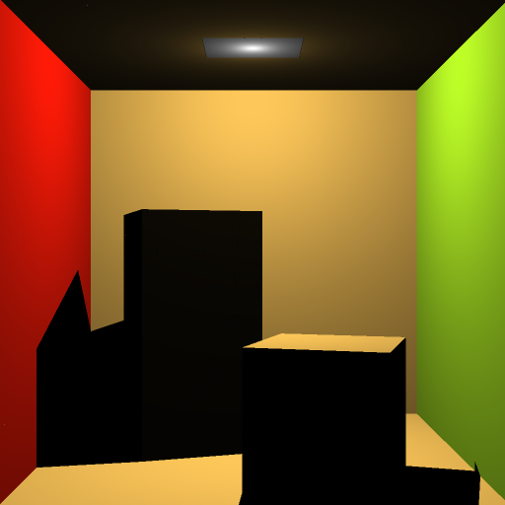
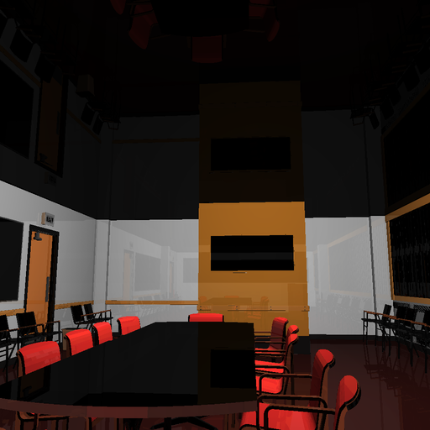
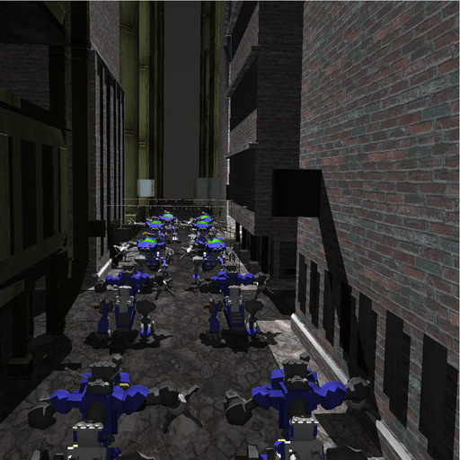
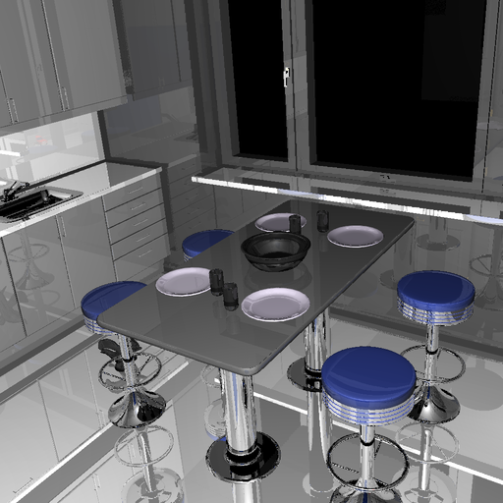
Scenes
Cornell Box
32 triangles
Conference Room
282,801 triangles
BART Robots
71,708 triangles
BART Kitchen
110,561 triangles

Slide 16
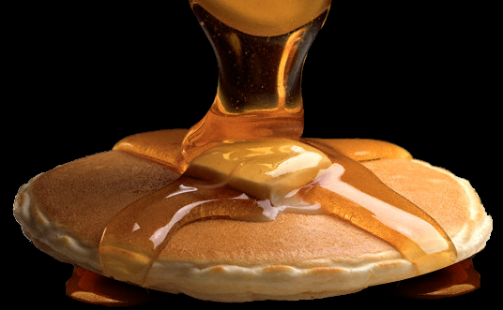
How tall a short stack do we need?
Vanilla KD-Restart visits 166% more nodes than standard k-D tree traversal on Robots scene
Short stack size 1 visits only 25% extra nodes
  Storage needed is
    36 bytes for packets
    12 bytes for single ray
Short stack size 3 visits only 3% extra nodes
  Storage needed is
    108 bytes for packets
    36 bytes for single ray

Slide 17
Demonstration

Slide 18
Performance of Intersection
 | Cornell Box | Kitchen | Robots
KD-Restart | 38.3 | 8.6 | 7.7
+Packets | 88.8 | 12.5 | 14.7
+Short Stack | 91.3 | 16.3 | 17.9
Millions of rays per second

Slide 19
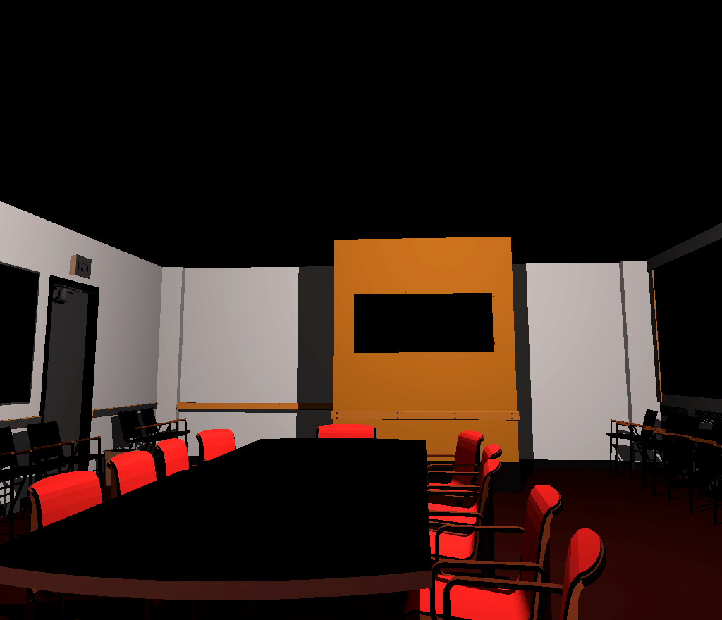
End-to-end performance
frames per second
 | AMD 2.4GHz | ATI X1900 | CELL
frames second | 3.0 | 14.2 | 20.0
¹
¹
- We rasterize first hits
- And texturing is cheap! (diffuse texture doesn’t alter framerate)
¹Source: Ray Tracing on the Cell processor, Benthin et al., 2006]

Slide 20
Analysis
Dual GPU can outperform a Cell processor
  But both have comparable FLOPS
    Each GPU should be on par
  We run at 40-60% of GPU’s peak instruction issue rate
    Why?

Slide 21
Why do we run at 40-60% peak?
Memory bandwidth or latency?
  No: Turned memory clock to 2/3: minimal effect
KD-Restarts?
  No: 3-tall short-stack is enough
Execution incoherence?
  Yes: 48 threads must be at the same program counter
  Tested with a dummy kernel thaat fetched no data and did no math, but followed the same execution path as our raytracer: same timing

Slide 22
Raytracing rate vs # bounces
Kitchen Scene
single
packets

Slide 23
Conclusion
KD-Tree traversal with shortstack
  Allows efficient GPU kd-tree
    Small, bounded state per ray
    Only visits 3% more nodes than a full stack
Raytracer is compute bound
  No longer memory bound
Also SIMD bound
  Running at 40-60% peak
  Can only use more ALU’s if they are not SIMD

Slide 24
Acknowledgements
Tim Foley
Ian Buck, Mark Segal, Derek Gerstmann
Department of Energy
Rambus Graduate Fellowship
ATI Fellowship Program
Intel Fellowship Program

Slide 25
Questions?
Feel free to ask questions!
  Source Available at http://graphics.stanford.edu/papers/i3dkdtree
danielrh@graphics.stanford.edu

Slide 26
Relative Speedup
Relative speedup over previous GPU raytracer.

