Slide 1

Maximizing Parallelism in the Construction of BVHs, Octrees, and k-d Trees
Tero Karras
NVIDIA Research
Notes:
Thanks for the introduction. My name is Tero Karras, and I’m going to talk about (X) trees.

Slide 2
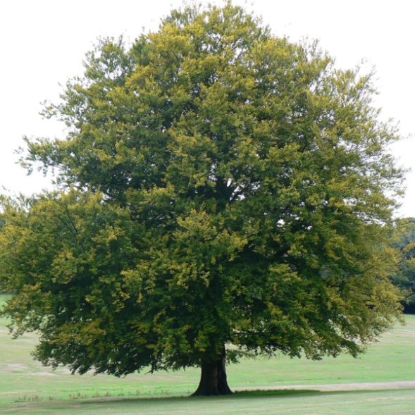
Trees
Notes:
You know, they are used a lot in graphics… (X) (to accelerate things like)

Slide 3
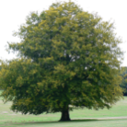






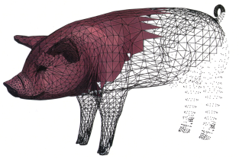
Trees
Better
Faster
✓
Ageia
Collision detection
Pharr & Humphreys
Path tracing
NVIDIA
NVIDIA
Real-time ray tracing
Particle simulation
Amenta et al.
Crassin et al.
Uchida
Surface reconstruction
Voxel-based
global illumination
Photon mapping
Notes:
… to accelerate things like (X) path tracing, (X) real-time ray tracing, (X) collision detection, (X) photon mapping, (X) voxel GI, (X) and so on. The requirements for tree construction vary a lot (X). Generally, you can either build (X) high-quality trees, or you can build them (X) really fast.
(X) In offline image synthesis, you’ll be spending a considerable amount of time querying the same tree over and over for high-quality sampling, so you want a lovingly crafted tree to make this as fast as possible. The construction is often done on the CPU using the greedy surface area heuristic, but a number of other methods exist as well.
(X) In the other extreme, you have real-time physics and illumination, where the time you can spend on one frame is very limited. In many cases, you need a new tree every frame, and the number of queries is fairly low, so you want to maximize the construction speed. This is well-suited for the GPU, and many fast methods have been introduced recently. Our work focuses on (X) this domain of applications as well. (X) --- (The main problem with the fastest)

Slide 4
Outline
Fastest existing methods are sequential
Parallelize within each hierarchy level
But not between levels
Notes:
The main problem with the fastest existing GPU-based methods is that they are all essentially sequential. They do have parallelism within each level in the hierarchy, but they still have to process the levels one by one and synchronize in between. (X) (Current GPUs already require tens of)

Slide 5
Outline
Fastest existing methods are sequential
Parallelize within each hierarchy level
But not between levels
Lack of parallelism
Small workloads bottlenecked by top levels
Sub-linear scaling of performance
Notes:
Current GPUs already require tens of thousands of threads to run at full speed, and we can expect future GPUs to be even more demanding. This is problematic at the top levels of the tree, because there simply isn’t enough work to fully employ all the cores. So, the existing methods tend to require large workloads, and they do not scale well when the number of cores is increased. (X) (Our goal is to construct the entire hierarchy)

Slide 6
Outline
Novel way to build the entire tree in parallel
Two algorithmic “building blocks”
Fast, scalable
Notes:
Our goal is to construct the entire hierarchy in parallel, so that all levels are processed in one go. This avoids under-utilization, and makes the performance scale linearly with the size of the GPU. To make this possible, we present two new algorithms, which we will discuss (X) in the context of … (bounding volume hierarchies)

Slide 7
Outline
Novel way to build the entire tree in parallel
Two algorithmic “building blocks”
Fast, scalable
Main focus: BVHs
Point-based octrees and k-d trees also covered in the paper
Notes:
... bounding volume hierarchies. Our paper also applies the same ideas to point-based octrees and k-d trees, but we’ll skip the details here to keep things simple. (X) --- (So, as most of you know)

Slide 8
Bounding volume hierarchy
Notes:
So, as most of you know, a bounding volume hierarchy is used for indexing a bunch of 3D primitives (X) like triangles. The primitives are grouped into nodes, (X) and each node stores a bounding volume that fully contains the underlying primitives – axis-aligned bounding box is the most common choice. The grouping is repeated (X) hierarchically, so the (X) root node covers the entire scene. (X) (To find the primitives intersecting)

Slide 9
Bounding volume hierarchy
?
Notes:
To find the primitives intersecting a given shape – say, in collision detection – you start from the (X) root, and descend the tree recursively (X). When you reach a node whose bounding volume does not intersect the query, you can (X) cull the entire subtree. (X) Repeating this, you (X) finally reach individual primitives, which you can then (X) check against the query. (X) --- (Lauterbach and others)

Slide 10
LBVH - Lauterbach et al. [2009]
Assign Morton codes
Sort primitives
Generate hierarchy
Fit bounding boxes
p
px = 0.
1
0
1
0
py = 0.
0
1
1
1
pz = 0.
1
1
0
0
Notes:
Lauterbach and others were the first to present a fast method for constructing so-called linear BVHs, which was later improved by Pantaleoni and Luebke, as well as Garanzha and others. Our work is based on the same basic idea.
(X) The first step is to assign a Morton code for each (X) primitive. This is done by finding the (X) centroid point of its bounding box and looking at its (X) bit representation, relative to the scene bounding box. The idea is to (X) expand the bits... (of each coordinate)

Slide 11
LBVH - Lauterbach et al. [2009]
Assign Morton codes
Sort primitives
Generate hierarchy
Fit bounding boxes
p
1
0
px = 0.
1
1
0
0
1
0
py = 0.
0
1
1
0
1
1
1
1
1
1
0
0
pz = 0.
1
1
0
0
Notes:
... of each coordinate, and then (X) interleave them... (to form a single bit string)

Slide 12
LBVH - Lauterbach et al. [2009]
Assign Morton codes
Sort primitives
Generate hierarchy
Fit bounding boxes
p
px = 0.
1
0
1
0
py = 0.
code =
1
0
1
0
1
1
1
1
0
0
1
0
pz = 0.
1
1
0
0
Notes:
... to form a single bit string. In practice, this is very fast, and usually takes less than 5% of the execution time. (X) (The second step is to)

Slide 13
LBVH - Lauterbach et al. [2009]
Assign Morton codes
Sort primitives
Generate hierarchy
Fit bounding boxes
Notes:
The second step is to sort the (X) primitives according to their Morton codes. This orders them along a (X) space-filling curve, so that primitives close to each other in 3D are likely to end up nearby in the sorted sequence. In practice, this can be performed efficiently using the fast radix sort by Merrill and Grimshaw. (X) (The third step is to)

Slide 14
LBVH - Lauterbach et al. [2009]
Assign Morton codes
Sort primitives
Generate hierarchy
Fit bounding boxes
Notes:
The third step is to generate a node hierarchy by partitioning the primitives. Our observation is that this is actually equivalent to constructing a radix tree, defined over the set of Morton codes. (X) (So, a radix tree)

Slide 15
Binary radix tree
0
1
2
3
4
5
6
7
00001
00010
00100
00101
10011
11000
11001
11110
Notes:
So, a radix tree, which is also called a Patricia tree, is a well-known data structure used for indexing string data. The input is a set of (X) keys, which are arbitrary (X) strings. In our case, these are the sorted Morton codes.
The (X) root covers the full range of keys, and (X) partitions them according to their (X) first differing bit. In this case, the difference occurs between keys (X) 3 and 4. The range is split in (X) two, and each half is handled by a child node. (X) (X) (We repeat the same thing)

Slide 16
Binary radix tree
00
0
0
1
2
3
4
5
6
7
00001
00010
00100
00101
10011
11000
11001
11110
Notes:
We repeat the same thing for the left child. The (X) first bit of the keys is (X) equal, the (X) second bit is (X) also equal, but the (X) third bit (X) differs. The common prefix is stored in the node, and the range is again (X) split in two. (X) (X) (The left child again)

Slide 17
Binary radix tree
00
000
0
00
0
1
2
3
4
5
6
7
00001
00010
00100
00101
10011
11000
11001
11110
Notes:
The left child again (X) looks at the bits, and finds that the fourth bit differs. Splitting the range now gives us two individual keys, so we (X) use them as leaf nodes. (X) (X) (Doing this for the rest of the tree)

Slide 18
Binary radix tree
00
1
11
000
0010
1100
0
1
2
3
4
5
6
7
00001
00010
00100
00101
10011
11000
11001
11110
Notes:
Doing this for the rest of the tree, we essentially get a hierarchical representation of the common prefixes between the keys. As with any binary tree, a tree with (X) n keys... (will always have exactly)

Slide 19
Binary radix tree
00
1
n-1
11
000
0010
1100
0
1
2
3
4
5
6
7
00001
00010
00100
00101
10011
11000
11001
11110
n
Notes:
... will always have exactly (X) n-1 internal nodes. (X) --- (Let’s look at the prefixes more closely)

Slide 20
Longest common prefix
00
1
11
000
0010
1100
0
1
2
3
4
5
6
7
00001
00010
00100
00101
10011
11000
11001
11110
Notes:
Let’s look at the prefixes more closely, using (X) these two nodes as an example. (X) (So, to identify the prefix of the right-hand node)

Slide 21
Longest common prefix
δ(5,6) = 4
5
6
00
δ(5,6) = 4
11000
11001
4
1100
4
0
1
2
3
4
5
6
7
00001
00010
00100
00101
10011
11000
11001
11110
Notes:
So, to identify the prefix of the (X) right-hand node, we compare keys (X) 5 and 6. These keys have (X) 4 bits in common, and differ at the 5th bit. We denote the number of common bits with (X) delta, which we can compute for any pair of keys. This directly tells us (X) the length of the prefix in our node. (X) --- (Doing the same thing for the left-hand node)

Slide 22
Longest common prefix
δ(0,3) = 2
δ(0,3) = 2
δ(0,3) = ?
0
3
2
00
00001
00101
δ(5,6) = 4
2
1100
4
0
1
2
3
4
5
6
7
00001
00010
✓
00100
00101
10011
11000
11001
11110
Notes:
Doing the same thing for the left-hand node, we compare keys (X) 0 and 3, and see that they have 2 bits in common. The (X) length of the prefix is thus 2, and it’s shared by (X) all the underlying keys. Even though we only compared keys 0 and 3, we know for sure that (X) the ones in between must also share the same prefix because the keys are sorted. (X) --- (The fastest algorithm for generating the hierarchy)

Slide 23
Garanzha et al. [2011]
Level 0
0
1 node
Level 1
1
2
2 nodes
Level 2
4
5
3
3 nodes
Level 3
6
1 node
0
1
2
3
4
5
6
7
00001
00010
00100
00101
10011
11000
11001
11110
Notes:
The fastest algorithm for generating the hierarchy was introduced by Garanzha and others. (X) The idea is to process one hierarchy level at a time, starting from the top. (X) Each node performs a binary search over its keys to find the (X) differing bit, and then allocates its (X) child nodes using an atomic counter. (X) The children are then processed in the (X) next round, and they again find the (X) differing bit and allocate (X) their children. (X) Note that the order of allocations is non-deterministic, so the numbering may vary from one run to the next.
Repeating this, (X) we end up doing 4 rounds in total. Each round has to wait for the previous one, which is wasteful since we don’t have enough work to fill the GPU. In the first round, for example, we are waiting for a single thread while the rest of the GPU remains idle. In practice, it will take around 10 to 15 rounds before we can even hope to reach full utilization. (X) (To do better than this)

Slide 24
Our method
?
0
1
2
3
4
5
6
7
00001
00010
00100
00101
10011
11000
11001
11110
Notes:
To do better than this, we need to avoid synchronization. (X) We know that there are n-1 internal nodes in total, and we’d like to (X) process them all in parallel. But the (X) problem is that we just have a bunch of nodes, and we know nothing about them. How can you build something if you don’t know anything about it? (X) (Well, we have to make it so)

Slide 25
Our method
Define a numbering scheme for the nodes
Gain some knowledge of their identity
Establish a connection with the keys
Notes:
Well, we have to make it so that we know something. Our idea is to define a specific numbering scheme for the internal nodes that we can exploit to find out about their identity. Specifically, we have to be able to tell which keys they cover, so there must be some kind of a connection between node indices and key indices. (X) (Based on our numbering scheme)

Slide 26
Our method
Define a numbering scheme for the nodes
Gain some knowledge of their identity
Establish a connection with the keys
Find the children of a given node
Only look at node index and nearby keys
Notes:
Based on our numbering scheme, we can then formulate an algorithm to identify the children of any given node. To do this, we only need the index and the nearby keys, nothing else. (X) (Constructing the tree is then)

Slide 27
Our method
Define a numbering scheme for the nodes
Gain some knowledge of their identity
Establish a connection with the keys
Find the children of a given node
Only look at node index and nearby keys
Do this for all nodes in parallel
Notes:
Constructing the tree is then a matter of doing this for all nodes. We simply process each node in parallel, which is easy since there are no dependencies. (X) --- (So, let’s first look at the numbering scheme)

Slide 28
Numbering scheme
0
3
4
0
1
2
3
4
5
6
7
00001
00010
00100
00101
10011
11000
11001
11110
Notes:
So, let’s first look at the numbering scheme. For clarity, we’ll indicate the covered keys using a (X) horizontal bar. For the (X) root, we will always use index (X) 0. The root is (X) split between indices (X) 3 and 4, and our rule is that we also use these same indices for the (X) child nodes. (X) (We apply the same rule)

Slide 29
Numbering scheme
0
3
4
5
0
1
2
3
4
5
6
7
00001
00010
00100
00101
10011
11000
11001
11110
Notes:
We apply the same rule for (X) other nodes as well. This node is (X) split between keys (X) 4 and 5. Key 4 is already used as the left child anyway, so we’ll just assign index 5 to the (X) right child. (X) We can fill in the remaining indices in the same fashion. (X) (Interestingly, this never results)

Slide 30
Numbering scheme
0
0
3
3
4
4
1
1
2
2
5
5
6
6
0
1
2
3
4
5
6
7
00001
00010
00100
00101
10011
11000
11001
11110
Notes:
Interestingly, this never results in duplicates or gaps. The indices run conveniently from 0 to 6, so we can use them directly to address the nodes in memory. The numbering scheme has other desirable properties as well – let’s (X) tweak the figure a bit by aligning each node horizontally with a key of the same index.
The first property is that the index of every node always matches either its (X) first (X) key… (or its (X) last (X) key)

Slide 31
Numbering scheme
0
3
4
1
2
5
6
0
1
2
3
4
5
6
7
00001
00010
00100
00101
10011
11000
11001
11110
Notes:
… or its (X) last (X) key. (X) The second property is that (X) sibling nodes are always located at neighboring indices. (X) (X) (X) (X) (X) --- (Now, let’s look at how we can use these properties)

Slide 32
Algorithm
0
3
4
1
2
5
6
0
1
2
3
4
5
6
7
00001
00010
00100
00101
10011
11000
11001
11110
Notes:
Now, let’s look at how we can use these properties to find the children of a (X) given node. (X) (We are only given an index and the keys)

Slide 33
Algorithm
?
δ(2,3) = 4
✓
δ(2,3) = 4
δ(3,4) = 0
2
3
3
3
4
00100
00101
00101
10011
0
1
2
3
4
5
6
7
00001
00010
00100
00101
10011
11000
11001
11110
Notes:
We are only given an index and the keys. Because of our numbering, we know that the node covers at least the (X) key with the same index, and that the range of keys (X) extends into either direction from it. When we consider the (X) neighboring keys, we know that one of them must belong to the same node, while the other one belongs to a sibling node.
(X) Let’s compare key 3 against each neighbor. (X) It has 4 bits in common with key 2, (X) and 0 bits in common with key 4. It turns out that we just need to pick the larger number (X), so our range must extend to the (X) left in this case. The reason is that the keys in our node will always have more bits in common with each other than they do with any key from the sibling.
(X) Now that we know which way the range goes, let’s figure out how (X) far it goes. (At this point, we know that the range contains)

Slide 34
Algorithm
δ(1,3) = 2
✓
δ(3,4) = 0
δ(0,3) = 2
δ(2,3) = 4
?
3
3
4
00101
10011
0
1
2
3
4
5
6
7
00001
00010
00100
00101
10011
11000
11001
11110
Notes:
At this point, we know that the range contains at least keys 2 and 3. Let’s see if it also contains (X) key 1. Keys 1 and 3 (X) have 2 bits in common, which is more than our reference of 0 bits, so (X) we can extend the range. We do the same for (X) key 0, which also (X) has 2 bits in common. (X) In this case, we run out of keys and cannot extend the range any further. We have thus found out that the node covers precisely (X) keys 0 thru 3.
Now that we know the range, we can start looking for where to split it. (X) (Let’s proceed by finding out)

Slide 35
Algorithm
δ(0,3) = 2
3
?
✗
δ(2,3) = 4
✓
δ(1,3) = 2
0
1
2
3
4
5
6
7
00001
00010
00100
00101
10011
11000
11001
11110
Notes:
Let’s proceed by finding out which keys belong to the right child. We know that at least (X) key 3 does, so let’s try (X) key 2 next.
Since the keys in the parent node have 2 bits in common, the keys we’re looking for will have to share at least 3 bits. Key 2 has (X) 4 bits in common with key 3, so we (X) can include it in the right child. (X) Key 1, however, has (X) only 2 bits in common, so it must belong to the (X) left child. We thus (X) split the range between keys 1 and 2. (X) (Next, we look at how many keys)

Slide 36
Algorithm
δ(0,3) = 2
3
1
2
2
2
0
1
2
3
4
5
6
7
00001
00010
00100
00101
10011
11000
11001
11110
Notes:
Next, we look at how many keys each child covers to find out whether it’s an internal node or a leaf. The left child covers (X) 2, so it has to be an internal node, and our numbering scheme readily tells us which (X) index it should have. The (X) same is true for the (X) right child as well.
So, given just the number 3, we were able to figure out that the children of node 3 are nodes 1 and 2. (X) --- (To summarize, our algorithm consists)

Slide 37
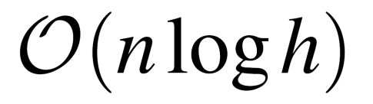
Algorithm
For each node i=0..n-2 in parallel:
Determine direction of the range
Expand the range as far as possible
Find where to split the range
Identify children
Binary search
Notes:
To summarize, our algorithm consists of 4 steps that are executed for all nodes in parallel. For each node, we first determine which way its range extends, and then expand the range as far as possible. We then find where to split the range, and finally use the resulting sub-ranges to identify the child nodes.
(X) In practice, steps 2 and 3 can be implemented very efficiently using binary search. The details can be found in the paper, along with pseudocode. It can be shown that the time complexity for the entire tree is (X) n log h, where n is the number of keys and h is the height of the tree. (X) --- (However, there’s a slight difficulty)

Slide 38
Duplicate keys
The algorithm only works with unique keys
Duplicates are common in practice
Notes:
However, there’s a slight difficulty. Our algorithm doesn’t really work if there are duplicate keys, which quite common in practice. (X) (Luckily, the problem can be avoided)

Slide 39
Duplicate keys
The algorithm only works with unique keys
Duplicates are common in practice
Trick: Augment each key with its index
Distinguishes between duplicates
Keys are still in lexicographical order
Notes:
Luckily, the problem can be avoided using a simple trick: we augment each key with a binary representation of its index. Since each key has a different index, this guarantees that the augmented keys are unique, and also remain in sorted order. (X) (In practice, there’s no need)

Slide 40
Duplicate keys
The algorithm only works with unique keys
Duplicates are common in practice
Trick: Augment each key with its index
Distinguishes between duplicates
Keys are still in lexicographical order
Tie-break when evaluating δ(i,j)
Notes:
In practice, there’s no need to actually store the augmented keys. It’s enough to use this as a tie-breaking rule when evaluating delta. (X) --- (So, that covers the hierarchy generation part)

Slide 41
LBVH
Assign Morton codes
Sort primitives
Generate hierarchy
Fit bounding boxes
Notes:
So, that covers the hierarchy generation part. (X) In the last part, we need to assign a bounding box for each node so that it contains all the underlying primitives. (X) --- (The previous method by Lauterbach and others)

Slide 42
Lauterbach et al. [2009]
Notes:
The previous method by Lauterbach and others exploits the fact that their hierarchy was generated in a breadth-first order. They (X) first assign a bounding box for each (X) leaf node, and then proceed to the (X) next level. Each internal node simply calculates the (X) union of the bounding boxes of its children. The same thing is (X) repeated for each level in a bottom-up manner, and the nodes on each level are processed in parallel. (X) --- (Unfortunately, this approach doesn’t work for us)

Slide 43
Our method
Need a different approach
How many levels are there?
Which nodes are located on a given level?
Notes:
Unfortunately, this approach doesn’t work for us since our node layout is different. We only know the relationships between nodes, but we don’t know which level our nodes are located on. (X) (Instead, we take a different approach)

Slide 44
Our method
Need a different approach
How many levels are there?
Which nodes are located on a given level?
Traverse paths in the tree in parallel
Start from leaves, advance toward the root
Terminate threads using per-node atomic flags
Notes:
Instead, we take a different approach where we traverse paths from the leaf nodes to the root in parallel. To do this, we need to store a parent pointer for each node, which we can record during the hierarchy generation phase. To avoid duplicate work, we use an atomic flag per node to terminate threads as early as possible. (X) (So, the flags are initialized)

Slide 45
Our method
✗
✗
✗
✓
✓
✗
✗
✗
✓
✓
✓
✗
✓
Notes:
So, the flags are initialized to (X) false in the beginning, and we launch one thread for each (X) leaf node to assign their bounding boxes. The threads execute in a non-deterministic order, but let’s say the (X) second one finishes first. It (X) follows the parent pointer, and checks the flag atomically. Since the flag is false, the thread (X) sets it to true and then (X) terminates.
Suppose the (X) first thread finishes next. It again (X) follows the parent pointer, and sees that the flag is true. This indicates that both children of the node have been processed, and the thread is free to (X) continue. The same thing (X) happens with the remaining threads. Some of them terminate, and some of them get a (X) permission to proceed. In the end, each node gets processed by exactly one thread. (X) --- (To evaluate performance)

Slide 46
Results
Evaluate performance on GTX 480 (Fermi)
CUDA, 30-bit Morton codes
Notes:
To evaluate performance, we implemented our approach on NVIDIA Fermi using CUDA. (X) (We compare our timings against)

Slide 47
Results
Evaluate performance on GTX 480 (Fermi)
CUDA, 30-bit Morton codes
Compare against Garanzha et al. [2011]
Identical tree (top-level SAH splits disabled)
Notes:
We compare our timings against the method by Garanzha and others, in which we have disabled the top-level SAH splits to get comparable results. (X) (We also compare the scalability)

Slide 48
Results
Evaluate performance on GTX 480 (Fermi)
CUDA, 30-bit Morton codes
Compare against Garanzha et al. [2011]
Identical tree (top-level SAH splits disabled)
Simulate large GPUs
N times as many cores
N times the memory bandwidth
Notes:
We also compare the scalability of the methods by simulating larger GPUs with N times as many cores, and N times the memory bandwidth. (X) --- (Here are the results for a relatively small test scene)

Slide 49

Results
Fairy Forest
174K triangles
milliseconds
1 × cores
2 ×
4 ×
Our method
Garanzha et al.
Notes:
Here are the results for a relatively small test scene. Our method is on the left, and the comparison method is on the right. We show the execution time of each processing step in milliseconds for (X) 1, 2, and 4 times as many cores as in GTX 480. (X) The first two steps are the same for both methods. They evaluate the Morton codes, which is very cheap, and then sort them. In theory, the sorting should scale linearly with scene size and the number of cores, but in practice, the… (X) (overheads start to dominate on small scenes)

Slide 50
Results
Fairy Forest
174K triangles
milliseconds
12.5 ×
33.6 ×
1.7 ×
1.3 ×
1.1 ×
2.4 ×
Our method
Garanzha et al.
Notes:
… overheads start to dominate on small scenes. The time required to (X) generate the hierarchy is substantially lower with our method. The difference is especially high on large GPUs, where the comparison method suffers from under-utilization the most. The (X) bounding box calculation is roughly the same for both methods, although our approach scales slightly better. (X) --- (For comparison, here’s the same plot)

Slide 51
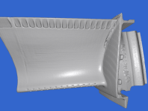
Results
Turbine Blade
1.77M triangles
milliseconds
3.7 ×
7.0 ×
0.8 ×
1.0 ×
Our method
Garanzha et al.
Notes:
For comparison, here’s the same plot for a larger scene with roughly 10 times as many triangles. The comparison method is now able to utilize the GPU a lot better, (X) but our method still wins by a large margin. The (X) bounding box calculation is again almost the same, but our method suffers slightly from the additional bookkeeping in this case. (X) --- (This plot shows the total execution time)

Slide 52

Results
Stanford Dragon
871K triangles
milliseconds
milliseconds
AABB
Build
Sort
Morton
Our method
Garanzha et al.
Notes:
This plot shows the total execution time of the comparison method as a function of the GPU size. (X) The execution is clearly dominated by the hierarchy generation, which hardly improves even with 8 times as many cores. (X) Our method essentially removes this bottleneck, and the execution time is now dominated by sorting. (X) --- (So, that’s it.)

Slide 53
Acknowledgements
Timo Aila
Samuli Laine
David Luebke
Jacopo Pantaleoni
Jaakko Lehtinen
For helpful suggestions and proofreading.
Notes:
So, that’s it. Finally, I would like to thank my colleagues at NVIDIA Research for useful advice and proofreading. (X) --- (Thank you)

Slide 54


Thank You
Questions
Notes:
Thank you.

Slide 55
Backup slides

Slide 56
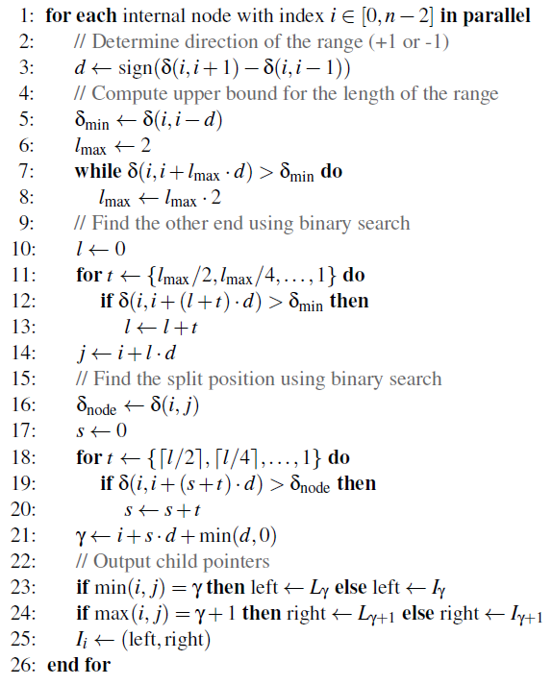
Pseudocode

Slide 57
Results
 |  |  | Common |  | Build |  | AABB
 | Scene | Cores | Eval | Sort | Our | Prev | Our | Prev
 | Fairy Forest (174K tris) | 1x | 0.05 | 0.56 | 0.15 | 1.88 | 0.23 | 0.29
 |  | 2x | 0.03 | 0.33 | 0.09 | 1.75 | 0.13 | 0.22
 |  | 4x | 0.02 | 0.30 | 0.05 | 1.68 | 0.08 | 0.19
 | Conference Room (283K tris) | 1x | 0.08 | 0.78 | 0.24 | 1.93 | 0.35 | 0.38
 |  | 2x | 0.04 | 0.51 | 0.13 | 1.72 | 0.19 | 0.26
 |  | 4x | 0.03 | 0.31 | 0.08 | 1.58 | 0.12 | 0.20
 | Stanford Dragon (871K tris) | 1x | 0.22 | 1.67 | 0.65 | 3.14 | 1.10 | 1.03
 |  | 2x | 0.12 | 1.09 | 0.34 | 2.38 | 0.57 | 0.60
 |  | 4x | 0.06 | 0.64 | 0.18 | 1.97 | 0.30 | 0.38
 | Turbine Blade (1.77M tris) | 1x | 0.45 | 2.73 | 1.28 | 4.73 | 2.10 | 1.77
 |  | 2x | 0.23 | 1.63 | 0.65 | 3.19 | 1.07 | 0.96
 |  | 4x | 0.12 | 1.08 | 0.34 | 2.37 | 0.56 | 0.55

Slide 58
Algorithm
0
3
4
1
2
5
6
0
1
2
3
4
5
6
7
00001
00010
00100
00101
10011
11000
11001
11110

Slide 59
Algorithm
δ(1,2) = 2
?
δ(2,3) = 4
✓
δ(2,3) = 4
1
2
2
3
00010
00100
2
00100
00101
0
1
2
3
4
5
6
7
00001
00010
00100
00101
10011
11000
11001
11110

Slide 60
Algorithm
δ(1,2) = 2
✗
δ(2,3) = 4
δ(2,4) = 0
1
2
?
00010
00100
2
0
1
2
3
4
5
6
7
00001
00010
00100
00101
10011
11000
11001
11110

Slide 61
Algorithm
δ(2,3) = 4
2
?
✗
δ(2,3) = 4
0
1
2
3
4
5
6
7
00001
00010
00100
00101
10011
11000
11001
11110

Slide 62
Algorithm
δ(2,3) = 4
2
1
1
0
1
2
3
4
5
6
7
00001
00010
00100
00101
10011
11000
11001
11110

