Slide 1

DirectX Raytracing (DXR)

Slide 2
DirectX
Graphics API
Used to build a rendering pipeline
CPU code: builds (resource binding) the pipeline and runs it
GPU code: contains logic for how the pipeline should run

Slide 3
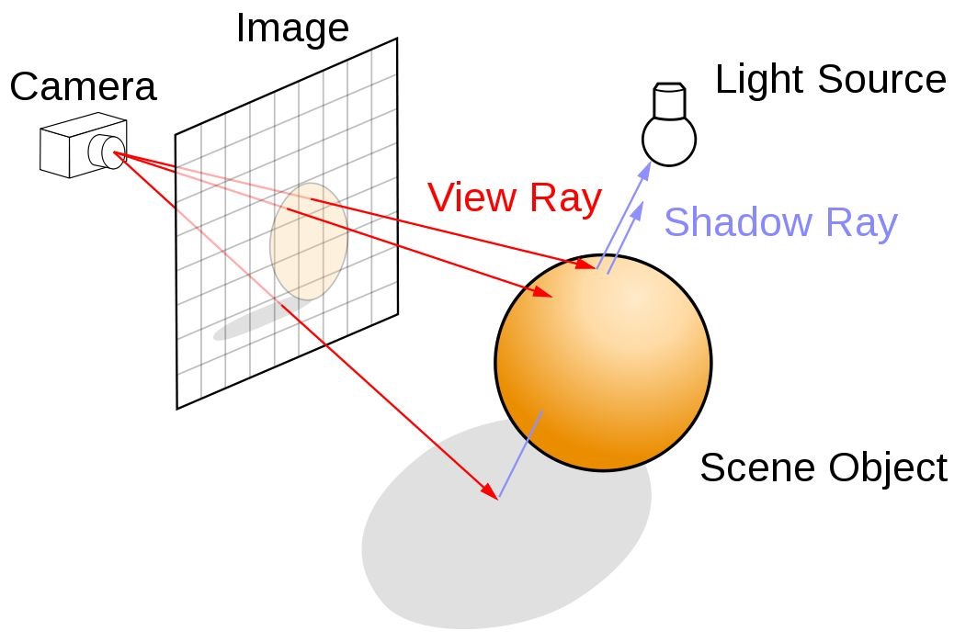
Raytracing

Slide 4
Raytracing vs. Pathtracing
Raytracing is:
Deterministic
Only 1 pass over the scene
Light sources are usually not Objects (i.e assumed to be point light sources)
After a ray hits an objects, we trace the ray directly towards the light
Pathtracing is:
Probabilistic
Multiple passes over the scene (iterations)
Light sources usually have dimensions (e.g boxes, spheres)
A ray must somehow hit a light source at some point

Slide 5
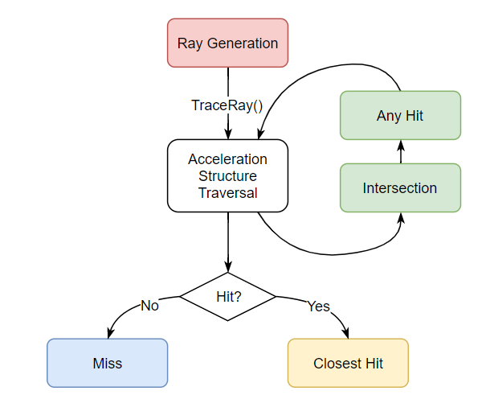
DirectX + Raytracing = DirectX Raytracing (DXR)

Slide 6
Ray types
primary (radiance) ray generated from the camera
shadow ray just in case the ray hits a geometry on its way to the light source
reflection ray in case the material of the object is reflective
Reflection logic = Radiance logic. We just have to know when to fire off this ray → effectively only need two TraceRay() functions

Slide 7
Radiance vs Shadow rays
Aside from TraceRay() calls, where else do we need to distinguish between these two?
Miss shaders:
These define what happens when a ray misses
E.g Shadow ray misses → ???

Slide 8
What are we raytracing?
Procedural Geometry
Axis-Aligned Bounding Box
Type of Procedural
Box, Spheres, Metaballs
Logic that defines bounds/behavior of Procedural
Plane
2 Triangles
Question: where do we need to distinguish between these two in the GPU code?

Slide 9
Remember this guy?
Intersection shader defines the point of intersection and the normal vector at that point?
Why do we need normals?
Why do we need the intersection point?
We use this to distinguish between sphere intersection, triangle intersection, box intersection, etc..

Slide 10
ClosestHit shader
We defined:
How to trace a ray
What happens when we hit something
What happens when we miss something
Where is the coloring?
ClosestHit shader

Slide 11
Where do these rays even come from?
RayGen shader
For each pixel (X,Y):
Convert center of pixel to Normalized Device Coordinates (Xd, Yd)
(0.0) → (-1,-1)
(height, width) -> (1,1)
(0,0) is Top Left in pixels, (-1,1) is Top Left for DirectX
Convert (Xd, Yd) to world-coordinates (Xw, Yw)
Screen to world projection matrix = inverse world projection matrix
Perspective divide
What happens to z?
Ray = (CameraX, CameraY) + t * (Xw, Yw)

Slide 12
How did this even get to the GPU?
CPU code builds the pipeline
Binds resources
Compiles shaders
Links resources to shaders
Prepares geometry to be raytraced
Patiently waits for the GPU to build this in a synchronized fashion
Problems with Raytracing on the GPU:
ALL RESOURCES MUST BE CORRECTLY DEFINED FOR RAYTRACING TO HAPPEN
→ Debugging is extremely hard
PIX: https://devblogs.microsoft.com/pix/directx-raytracing/

Slide 13
CPU code: Scene Data
Scene data = camera, lights, materials, matrices
Metadata necessary for rendering
Does NOT include geometry data
Generally will be available as Global data (Global root signature) or Local function parameters (Local root signature)
How do we tell the GPU about them?
GpuUploadBuffer → allocates a ComittedResource (CR)
CR: allocates virtual addr range on the GPU, a heap on the CPU that fits the data, then maps them.
ConstantBuffer → struct
StructuredBuffer → array of structs

Slide 14
CPU code: Root Signatures
Cool, the GPU knows where to read the data.
But does it know what it is used for? → Root Signatures!
Root Signatures = set of Views (called descriptors) over the resources
ConstantBufferView (CBV) → constant data like matrices, lights, etc..
ShaderResourceView (SRV) → repetitive data that is usually read only (geometry data)
UnifromAccessView (UAV) → repetitive data that is usually r/w (render targets)
Step 1 is to see how many of these you need and then map them to GPU registers
Example: render target is a UAV that you will bind to register 0 of the UAVs
Example: scene constant data is a CBV that you will bind to register 0 of the CBVs
Step 2 is to actually fill in the descriptor

Slide 15
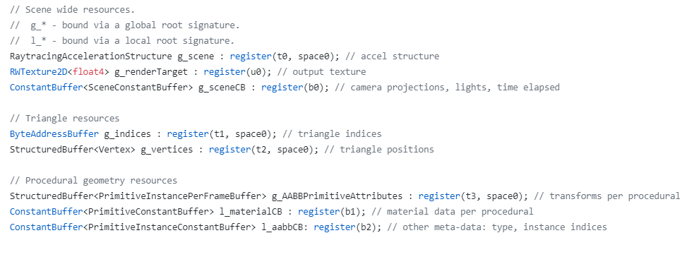
What this means on the GPU

Slide 16
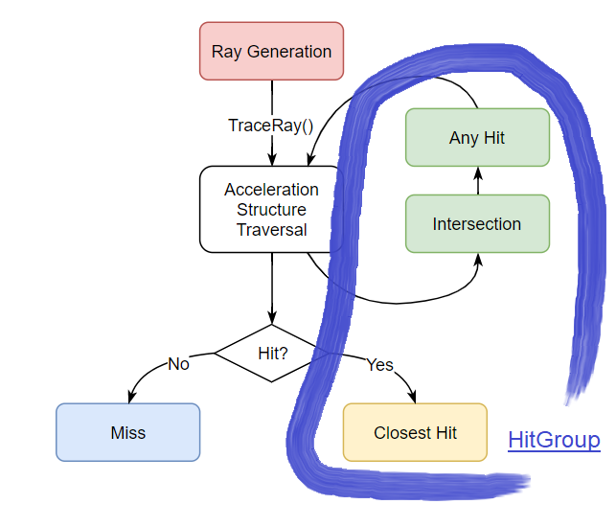
CPU Code: HitGroups
Tells the GPU the names of the functions that comprise a hit group.
We call them SubObjects, there are other subobjects too (DXIL library)
This is where we also *link* a local root signature to a hit group!

Slide 17
CPU Code: Raytracing Pipeline State Object (RTPSO)
A parent object that holds most “non-geometry” data
DXIL library of compiled shaders
Hit groups
Shader config
Payload size, barycentric attributes size
Local root signatures + associations
Global root signature
Pipeline config
Max recursion depth

Slide 18
CPU Code: Geometry data (Triangles)
Triangles:
Vertices + Indices
E.g for plane:
4 vertices = {4 positions, 4 normals}
Indices: 2 triangles, so 6 indices each
Allocating an upload buffer so data lives on GPU
CommittedResource, GPU virtual address of data
Creating a View over the resource → generally SRV
Descriptor that tells the GPU how the data is formatted

Slide 19
CPU Code: Geometry data (Procedurals)
Procedural Geometry = AABB:
Literally a box that bounds the geometry
Min (X,Y,Z)
Max (X,Y,Z)
Defined in local space
Allocating an upload buffer so data lives on GPU
CommittedResource, GPU virtual address of data
Do we need a view over the data? No because it’s simple enough that DXR decided to delegate the logic to AccelerationStructures

Slide 20
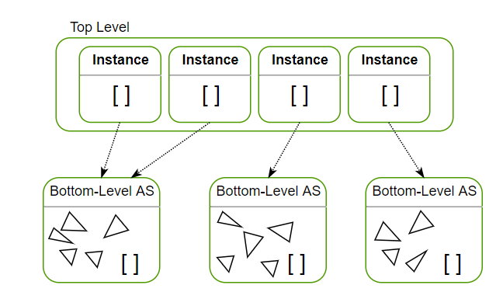
CPU Code: Acceleration Structures
KD-Tree, BVH
Yes you will build your own
No that’s a joke, it’s too hard → DXR provides an API for this
Hierarchical:
Top-Level → Bottom-Level *instances*
Instance = {Bottom-Level, Transform}
Non-unique instances
Bottom-Level → Geometry
Unique

Slide 21
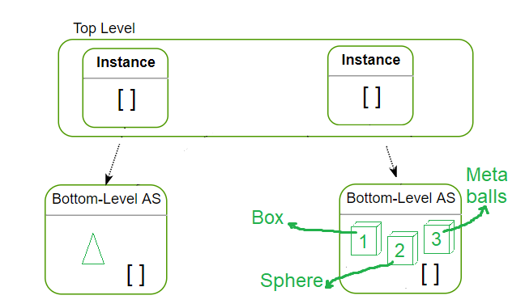
Our Acceleration Structure

Slide 22
How to describe this monstrosity?
Bottom-up approach
(1) Geometry descriptors
Triangles: Where is the data? How much data? Size of element? Indices?
AABB: How many AABBs per Geometry (usually 1), some extra flags
(2) Bottom Level AS
Inputs = Geometry descriptors
Ask GPU to predict the space it needs to build each one (scratch space)
Allocate that much space
(3) Bottom Level Instances
Actual AS + Transform + Some other data (InstanceContributionHitGroupIndex)
Allocate space for each
(4) Top Level AS
Inputs = Bottom Level AS + Instances

Slide 23
CPU Code: Shader Tables
Shader Table = GpuUploadBuffer
GPU indexes into it to run unique shaders depending on the geometry
https://microsoft.github.io/DirectX-Specs/d3d/Raytracing.html#shader-tables
Table = Records = {Shader ID, LocalRootArguments}
rayGenShaderTable.push_back(ShaderRecord(rayGenShaderID, shaderRecordSize, nullptr, 0));
How to get IDs:
Ask RTPSO
How to get LocalRootArguments
You already built them!

Slide 24
CPU Code: DispatchRays()
We have our data..
We have descriptors..
Now we need to link all of this together and tell the GPU to start working
CommandList: set of GPU methods that are executed serially
Example: SetComputeRootSignature(globalRootSignaturePtr)
Example: sceneConstantData.CopyToGpu(), then SetComputeRootConstantBufferView(slot in the global root sig, ptr to data)
Other things:
Ptr to acceleration structures
Ptr to vertex data
Ptr to shader tables
Viewport settings (i.e number of threads)

Slide 25
GPU Code: Raygen/TraceRay/Miss/ClosestHit
All of this was explained at the start of the presentation
Raygen is entry point
Generates a ray object per pixel
Calls TraceRay
What type of ray?
Collects colors of these rays into the render target
Miss shaders → what happens when nothing is hit
CloestHit → out of all the intersections, which one was the closest → color it
TraceRay
Per generated ray
Define a payload (color, recursion depth, basically the stuff that persists between shader calls)

Slide 26
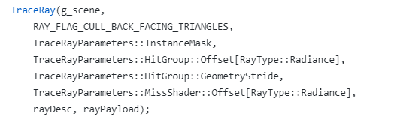

Slide 27
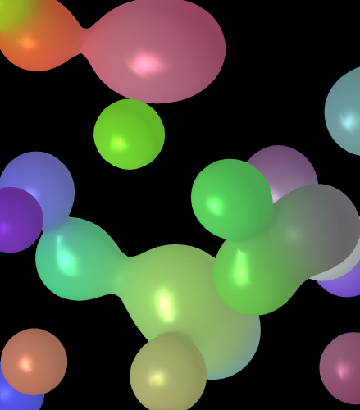
Intersection Shader: Metaballs

Slide 28
How do we even define a blob?!
If you’ve taken an ENM physics class, this might make some sense
Each blob is a sphere with “rendering” potential
At its core, the potential is strong
At its bounds, the potential is zero
Outside, still zero
In between: some falloff → people use a quantic falloff function (polynomial of degree 5)
Ok, still doesn’t explain how we shade points…

Slide 29

Core Idea: Threshold rendering
Potential of all of these points is combined, becomes stronger
How about we compute the total potential of a point, and if it is higher than some threshold, we render it!
Consequence: if threshold is low, we will get very thing metaballs
BUT HOW DO WE EVEN FIND THIS POINT? → Raymarching

Slide 30
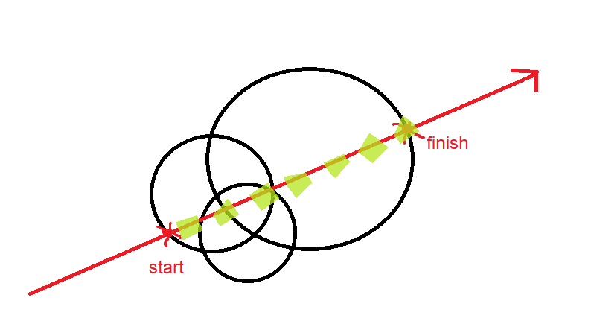
Raymarching Metaballs
Start at the closest intersection
End at farthest intersection
Test points in between using some fixed step size
Compute potential
If high enough → decide to render
How about normals?

Slide 31
Questions?

