Slide 1
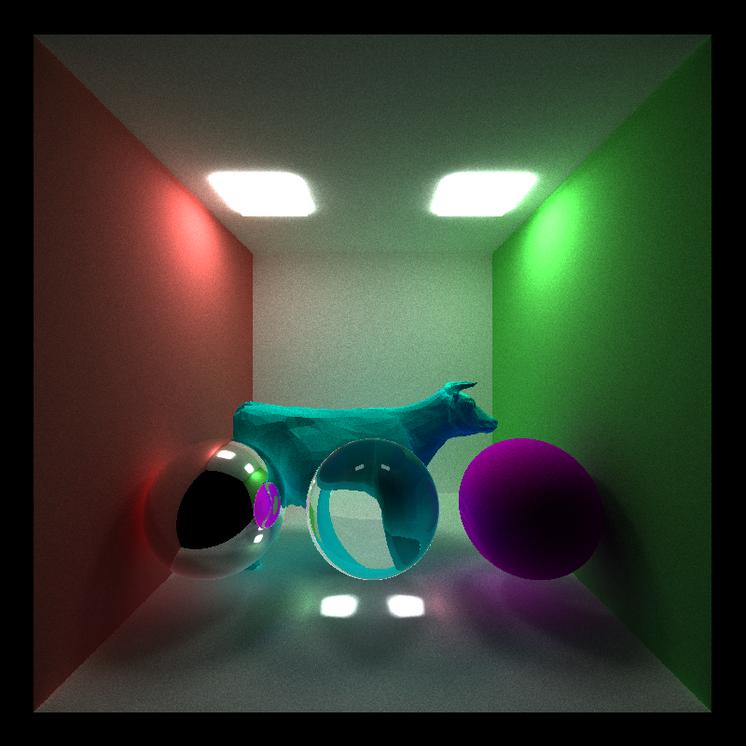
Fresnel
mesh loading
refraction
octree
ideal diffuse
reflection
global illumination
But wait, there’s more!
Stream compaction, material sorting, and first-bounce caching

