Slide 1
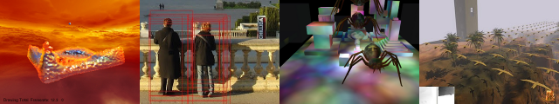
GPU Programming and Architecture: Course Overview
Patrick Cozzi
University of Pennsylvania
CIS 565 - Spring 2012

Slide 2
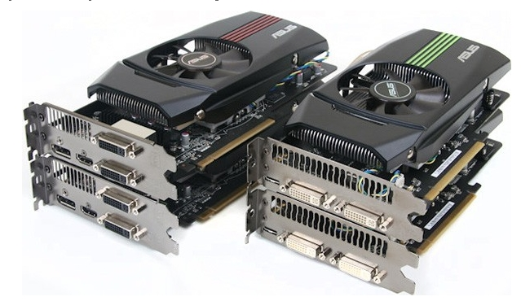
Lectures
Monday and Wednesday
9-10:30am
Moore 212
Lectures will be recorded
Image from http://pinoytutorial.com/techtorial/geforce-gtx-580-vs-amd-radeon-hd-6870-review-and-comparison-conclusion/
Notes:
Even though the lectures are recorded, come to class for the same reason that you shouldn’t work from home. Will you ever be promoted? Are you surrounding yourself by the best people you can find?

Slide 3








Instructor
Patrick Cozzi: pjcozzi@siggraph.org
If you are curious, see http://www.seas.upenn.edu/~pcozzi/
Notes:
I am not:
Professor Cozzi.
Dr. Cozzi.
Mr. Cozzi.
Sir.

Slide 4
Instructor
Include “[CIS565]” in email subject line
Office Hours
  SIG Lab
  Monday and Wednesday, 10:30-11:00am
Just see me after class

Slide 5


Teaching Assistant
Varun Sampath: vsampath@seas.upenn.edu
Office Hours
  SIG Lab
  Tuesday, 5-6pm
  Thursday, 3-4pm
Starting at NVIDIA this summer
If you are curious, see http://vsampath.com/

Slide 6


CIS 565 Hall of Fame
Jon
McCaffrey
Krishnan
Ramachandran
Varun
Sampath
Are you next?
Notes:
Jon: System Design Engineer, NVIDIA (Android performance)
Krishnan: Character Simulations TD, Blue Sky Studios
Varun: NVIDIA (video bios)
Students whose futures were significantly influenced, e.g., jobs, etc., by CIS 565. Not based on grades.
Many more students that either I didn’t teach or have not heard from. (I didn’t teach Jon, but he was a TA)

Slide 7
Course Website
http://www.seas.upenn.edu/~cis565/
Schedule, reading, slides, audio, homework, etc.

Slide 8
Google Group
cis565-s2012@googlegroups.com
Signup:
    http://groups.google.com/group/cis565-s2012
Be active; let’s build a course community

Slide 9

GitHub
Used for course materials, homeworks, and the final project
Create an account:
  https://github.com/signup/free
Join our GitHub organization:
  https://github.com/CIS565-Spring-2012
Who is new to source control?
Notes:
Everyone needs to learn how to use source control. Learn best practices now while in school. Also better for collaboration and backups.

Slide 10
Prerequisites
CIS 460/560
CIS 371 or CIS 501
Strong C or C++
Notes:
We review both computer architecture and graphics. Graphics students can do well. Non-graphics students also get A’s.
Avoid graphics student: “what’s a cycle?”

Slide 11
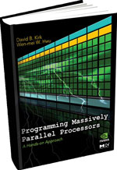
Books
Programming Massively Parallel Processors
2010, David Kirk and Wen-mei Hwu
Old draft: http://courses.engr.illinois.edu/ece498/al/Syllabus.html
OpenGL Insights
2012, Patrick Cozzi and Christophe Riccio, Editors
Selected readings handed out in class
Notes:
See the dates on these books? This course is bleeding-edge!

Slide 12
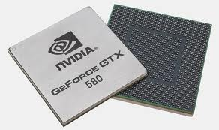
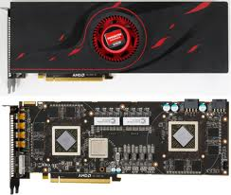
Course Contents
GPU – Graphics Processing Unit
Is it still just for graphics?
Images from http://www.ngohq.com/news/18784-nvidia-launches-geforce-gtx-580-a.html and http://gs7.blogspot.com/2011/09/amd-radeon-hd-6990-worlds-fastest.html
Notes:
The game industry is now larger than the movie industry. The demand for realistic graphics has driven innovation.

Slide 13
Course Contents
New: Start with GPU architecture
GPU Architecture
Not to scale
Notes:
Focus GPU memory model and threading.
Differences, and now similarities, between GPU and CPU.

Slide 14

Course Contents
CUDA programming model for GPU Compute
CUDA
GPU Architecture
Not to scale
Notes:
Knowing GPU architecture is keep to programming with CUDA.
Image processing, computer vision, financial analysis, collision detection, path planning, etc.

Slide 15
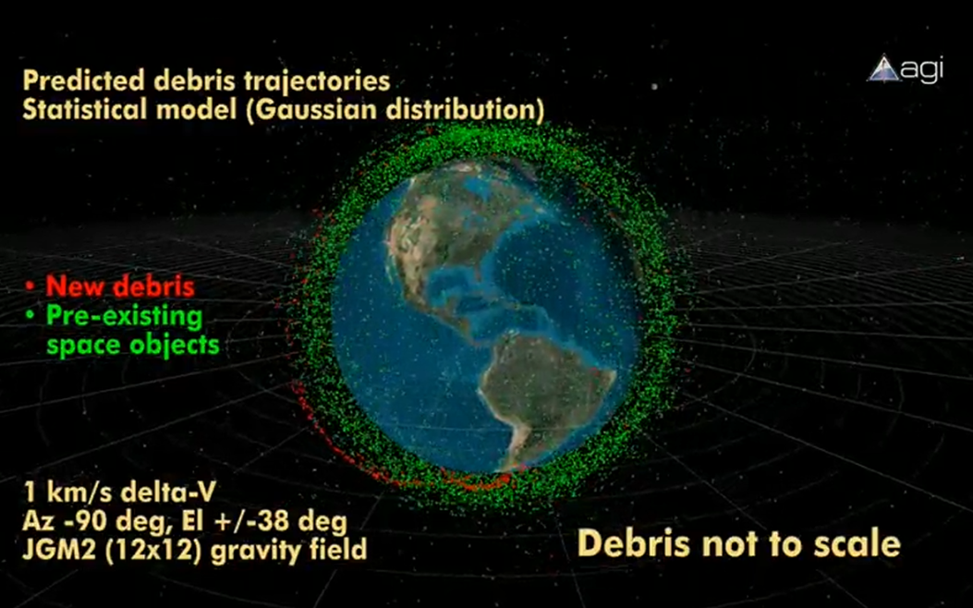
Course Contents
GPU Compute example: conjunction analysis
http://www.youtube.com/watch?v=dtT3pTh_q-8

Slide 16
Course Contents
Parallel algorithms that form building blocks
Parallel Algorithms
CUDA
GPU Architecture
Not to scale
Notes:
Parallel reduction, scan (prefix sums), sorting, and more.

Slide 17
Course Contents
Parallel Algorithms example: Scan
  Given:
  Compute:
  In parallel!
3
1
7
0
4
1
6
3
0
3
4
11
11
15
16
22

Slide 18
Course Contents
Historical and modern graphics pipeline
Parallel Algorithms
CUDA
Graphics Pipeline
GPU Architecture
Not to scale
Notes:
History of rasterization pipeline.
What the current generation pipeline looks like. Where is it going?

Slide 19


Course Contents
New: WebGL
Parallel Algorithms
CUDA
OpenGL / WebGL
Graphics Pipeline
GPU Architecture
Not to scale

Slide 20
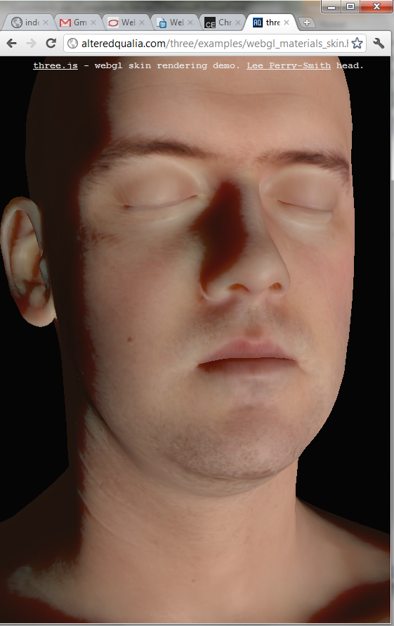
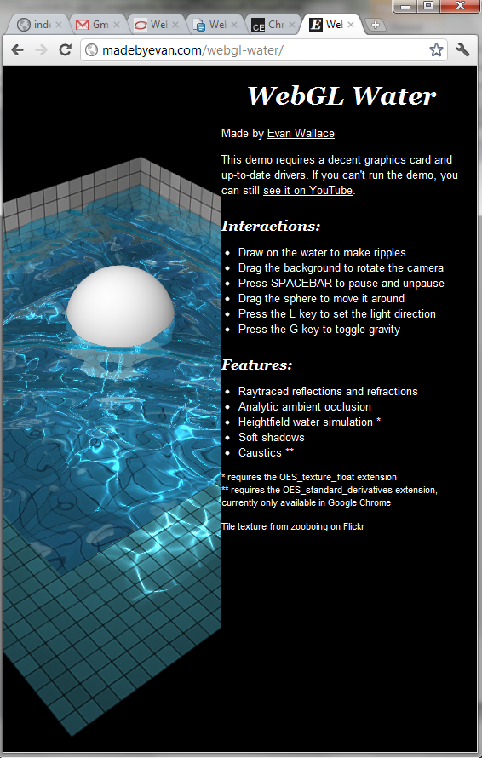
Course Contents
WebGL Demos
WebGL Skin
http://alteredqualia.com/three/examples/webgl_materials_skin.html
WebGL Water
http://madebyevan.com/webgl-water/
Notes:
Skin uses subsurface scattering approximated by four blur layers. See http://alteredqualia.com/three/examples/js/ShaderSkin.js.
Water heightfield is simulated using a floating-point texture; the caustics are rendered using GLSL derivative functions.

Slide 21
Course Contents
Real-Time Rendering
Real-Time Rendering
Parallel Algorithms
CUDA
OpenGL / WebGL
Graphics Pipeline
GPU Architecture
Not to scale

Slide 22

Course Contents
Real-Time Rendering
http://www.geforce.com/Hardware/GPUs/geforce-gtx-590/videos
Notes:
Image-based reflections
Subsurface scattering
Deferred rendering

Slide 23

Course Contents
GPU Compute + Real-Time Rendering
http://www.nvidia.com/object/GTX_400_games_demos.html
Notes:
Smoke - fluid simulation
Compute particles - bridge 1,000,000 particles
Terrain - Tessellation shader

Slide 24
Course Contents
New: Mobile
Mobile
Real-Time Rendering
Parallel Algorithms
CUDA
OpenGL / WebGL
Graphics Pipeline
GPU Architecture
Not to scale

Slide 25
Course Contents
Performance!
Mobile
Real-Time Rendering
Parallel Algorithms
CUDA
OpenGL / WebGL
Graphics Pipeline
GPU Architecture
To scale!
Notes:
GPUs are about doing data-parallel problems quickly!
Walk clock performance. Not theoretical.

Slide 26
Course Contents
Student Presentations. Examples:
Topics are up to you
Order-Independent Translucency
Volume Rendering
Financial Analysis
Computer Vision
Fluid Simulation
…
Architecture, Compute, Rendering, etc.
Notes:
We teach the foundations. Students presentations dive into specific problem domains. I am not an expert in all problem domains.
Improve presentation skills in a low-risk environment.

Slide 27
Grading
Homeworks (5) 40%
Student Presentation 10%
Final Project 40%
Final 10%
Notes:
Quest for knowledge vs. question for grades.
Some outstanding students don’t have great grades. Most students will great grades do well outside of school.

Slide 28
Homework Submission
Push your submission to GitHub by midnight on the due date
Bonus Days:
  Five per person
  Homework only; not for presentation or project
Notes:
Bonus days cover interviewing, conflicts with other courses, etc.

Slide 29
Homework Submission
Late Policy:
  One second to one week late: 50% deduction
  More than one week late: no credit

Slide 30
Homework Submission
Effort
Effort
Time
Time
Student
Pro boxer
Due date
Fight night
Notes:
What can we learn from boxing?
Not to scale; ignore integrating to see the area of the region under the curve.
Actually, we can learn a lot more from boxing: continuous feedback, intensity, etc.
Avoid burning out or making mistakes at the very end. Avoid unforeseen problems. “Early and often.”

Slide 31
Academic Integrity
http://www.upenn.edu/academicintegrity/

Slide 32
GPU Requirements
Homework and the project require an NVIDIA GeForce 8 series or higher
Update your drivers:
  http://www.nvidia.com/Download/index.aspx
What GPU do I have?
What OpenGL/OpenCL/CUDA version:
  http://www.ozone3d.net/gpu_caps_viewer/

Slide 33
GPU Requirements
Lab Resources
  Moore 100b - NVIDIA GeForce 9800s
  SIG Lab - Most machines have at least NVIDIA GeForce 8800s. Two machines have a GeForce 480, and one machine has a Fermi Tesla card
Contact Varun

Slide 34
CPU and GPU Trends
FLOPS – FLoating-point OPerations per Second
GFLOPS - One billion (10⁹) FLOPS
TFLOPS – 1,000 GFLOPS
Notes:
FLOPS are not a perfect measurement because of memory access, instruction mix, branches, etc. Peak FLOPS are idealistic, but not often reached in practice.

Slide 35
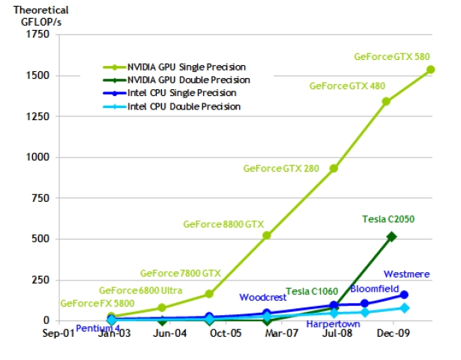
CPU and GPU Trends
Chart from: http://proteneer.com/blog/?p=263
Notes:
Moore’s Law – the number of transistors on a chip will double about every two year
High FLOP per watt
High FLOP per dollar
High FLOP per mm

Slide 36
CPU and GPU Trends
Compute
  Intel Core i7 – 4 cores – 100 GFLOP
  NVIDIA GTX280 – 240 cores – 1 TFLOP
Memory Bandwidth
  System Memory – 60 GB/s
  NVIDIA GT200 – 150 GB/s
Install Base
  Over 200 million NVIDIA G80s shipped

Slide 37
Class Exercise
Parallel sorting

Slide 38
Reminders
Include “[CIS565]” in email subject line.
Signup for our google group:
  http://groups.google.com/group/cis565-s2012
Join our GitHub organization:
  Signup: https://github.com/signup/free
  Organization: https://github.com/CIS565-Spring-2012
No class or office hours Monday, 01/16.

