Slide 1
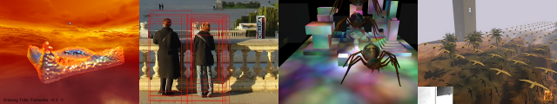





WebGL
Patrick Cozzi
University of Pennsylvania
CIS 565 - Spring 2012

Slide 2
Announcements
Homework 5 due Monday, 04/16
In-class quiz Wednesday, 04/18
Final on Tuesday, 05/01
6-8pm
David Rittenhouse Lab A7
Networking event immediately following
Final project presentation/demo

Slide 3
WebGL for Web Developers
The web has
Text
Images
Video
What is the next media-type?
Notes:
3D is the next media type.

Slide 4





WebGL for Graphics Developers
We want to support
Windows, Linux, Mac
Desktop and mobile
How?

Slide 5
Bring 3D to the Masses
Put it in on a webpage
Does not require a plugin or install
Does not require administrator rights
Make it run on most GPUs

Slide 6
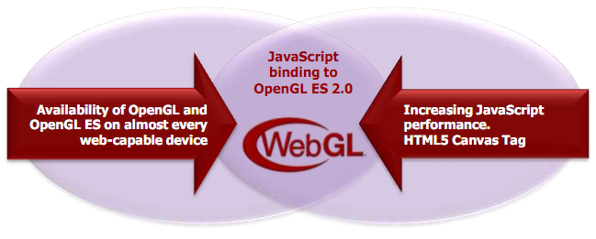
WebGL
OpenGL ES 2.0 for JavaScript
Seriously, JavaScript
Image from http://www.khronos.org/assets/uploads/developers/library/2011-siggraph-mobile/Khronos-and-the-Mobile-Ecosystem_Aug-11.pdf

Slide 7
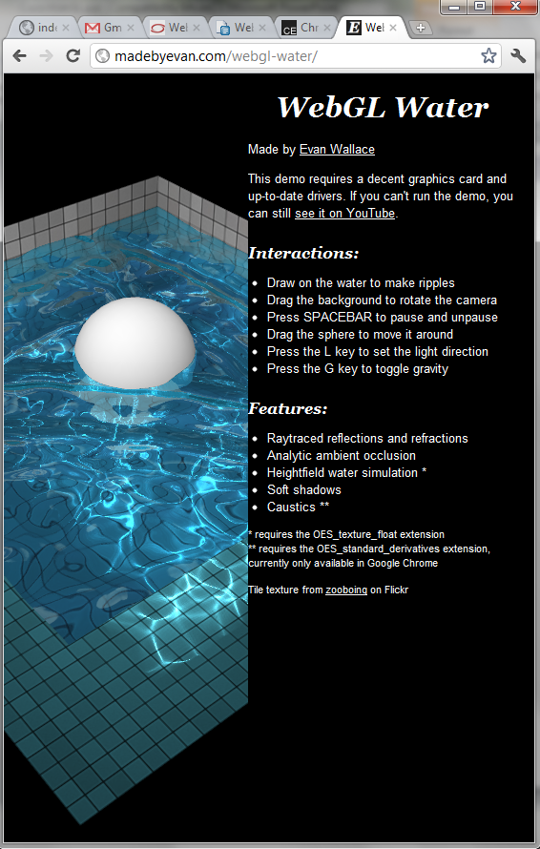
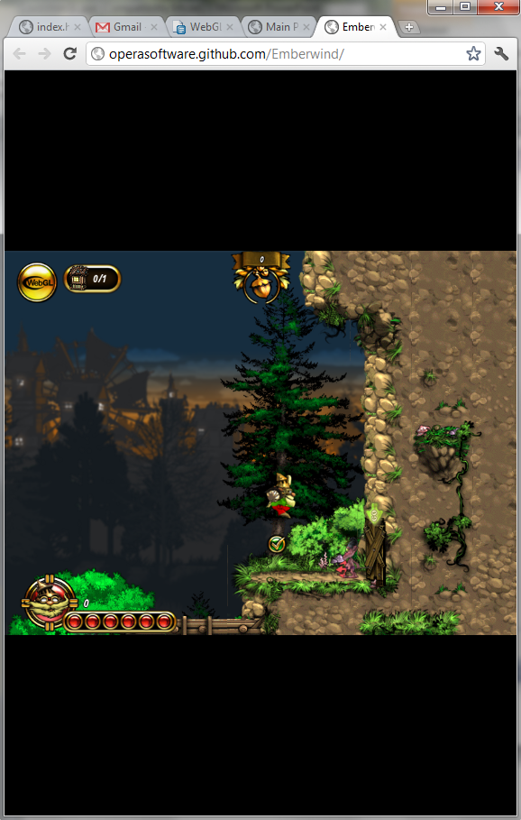
Demos
WebGL Water
http://madebyevan.com/webgl-water/
EmberWind
http://operasoftware.github.com/Emberwind/

Slide 8
WebGL
Includes
Vertex shaders
Fragment shaders
Vertex buffers
Textures
Framebuffers
Render states
…
Does not include
Geometry shaders
Tessellation shaders
Vertex Array Objects
Multiple render targets
Floating-point textures
Compressed textures
FS depth writes
…
See http://www.khronos.org/registry/webgl/specs/latest/

Slide 9
WebGL
If you know OpenGL, you already know WebGL
If you know C++, the real learning curve is JavaScript

Slide 10
WebGL Alternatives?
Flash
Silverlight
Java Applets
Unity

Slide 11
WebGL
Creating a context is easy:
// HTML:
<canvas id="glCanvas" width="1024" height="768"></canvas>
// JavaScript:
var gl = document.getElementById("glCanvas").getContext("experimental-webgl");
Notes:
Try “webgl”, then “experimental-webgl”

Slide 12
WebGL
The rest is similar to desktop OpenGL:
// ...
gl.bindBuffer(/* ... */);
gl.vertexAttribPointer(/* ... */);
gl.useProgram(/* ... */);
gl.drawArrays(/* ... */);
Checkout http://learningwebgl.com/

Slide 13
WebGL
Create an animation loop:
(function tick(){
// ... GL calls to draw scene
window.requestAnimationFrame(tick);
})();
You want this to work cross-browser. See http://paulirish.com/2011/requestanimationframe-for-smart-animating/

Slide 14
WebGL Performance
Performance can be very good. Why?

Slide 15
WebGL Performance
Performance can be very good. Why?
The GPU is still doing the rendering
Batch!
Draw multiple objects with one draw call
Sort by texture
Push work into shaders
See http://www.youtube.com/watch?v=rfQ8rKGTVlg

Slide 16
WebGL and other APIs
Take advantage of other web APIs:
HTML5 <video>
2D <canvas>
CSS transforms
Composite UI elements
Web workers
Typed Arrays

Slide 17
WebGL support is good, and it is getting better…

Slide 18



Desktop WebGL Support
In April, 2012
- 3rd Party Plugins available
See http://www.khronos.org/webgl/wiki/Getting_a_WebGL_Implementation

Slide 19
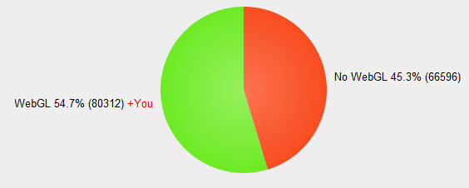
WebGL Stats
In April, 2012
See http://webglstats.com/

Slide 20
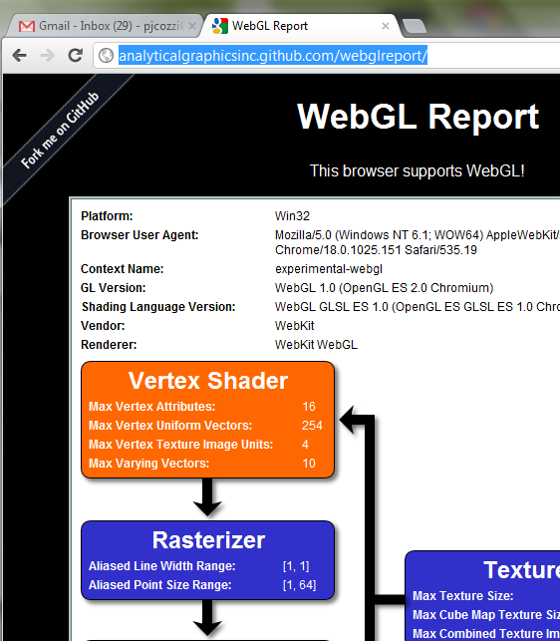
WebGL Support on your System
http://analyticalgraphicsinc.github.com/webglreport/
Disclosure: My awesome intern wrote this

Slide 21
Desktop WebGL Support
Windows
No OpenGL driver installed? Old driver?
Only 35% of Windows XP machines have GL 2 drivers
Buggy driver?
No problem:
ANGLE – Almost Native Graphics Layer Engine
OpenGL ES 2.0
Direct3D 9
See http://code.google.com/p/angleproject/
Notes:
ANGLE
Implements GL ES API over D3D 9
Translates GLSL ES to HLSL

Slide 22



Mobile WebGL Support
In April, 2012
Firefox Mobile – “Fennec”
Performance improvements possibly this this year
Opera Mobile
Stock Browser
Demo at SIGGRAPH 2011. NVIDIA is working on it.
Notes:
Chrome to get WebGL support soon

Slide 23

Mobile WebGL Support
In April, 2012
In iOS 5 for iAd developers
See http://news.cnet.com/8301-30685_3-20071902-264/apple-signs-up-for-webgl-graphics-in-iads/

Slide 24
HTML5 on Mobile
Touch events
Test with http://www.snappymaria.com/misc/TouchEventTest_v2.html
Geolocation
Device orientation and motion
The future of HTML5 and WebGL on mobile is very promising
Notes:
Touch events: http://www.html5rocks.com/en/mobile/touch.html
Geolocation: http://diveintohtml5.org/geolocation.html
Orientation and motion: http://www.html5rocks.com/en/tutorials/device/orientation/

Slide 25
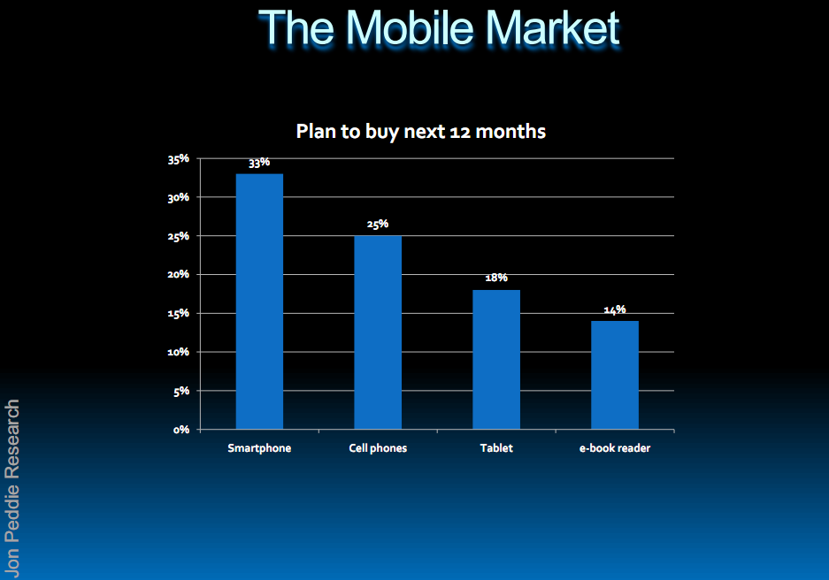
By the way, mobile is really important:
See http://www.khronos.org/assets/uploads/developers/library/2011-siggraph-mobile/OpenGL-ES-and-Mobile-Trends_Aug-11.pdf

Slide 26
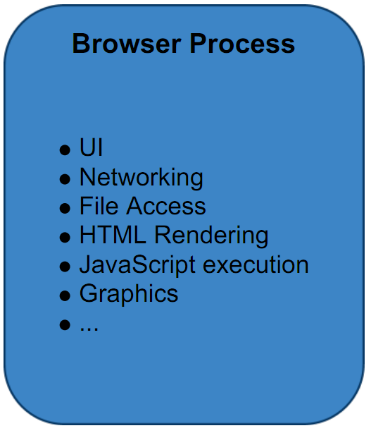
Browser Architecture
Single Process
See http://www.khronos.org/assets/uploads/developers/library/2010_siggraph_bof_webgl/WebGL-BOF-2-WebGL-in-Chrome_SIGGRAPH-Jul29.pdf

Slide 27
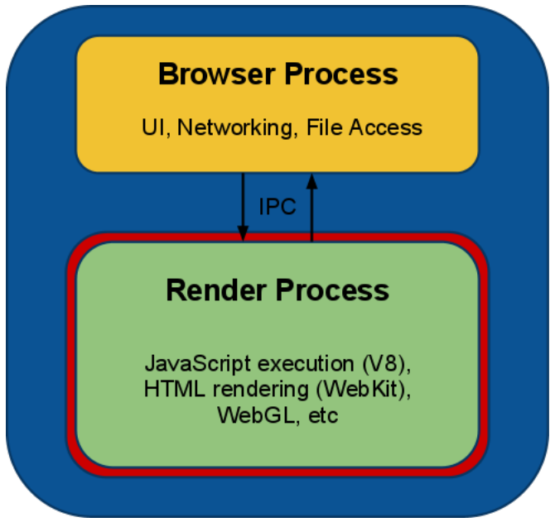
Browser Architecture
Chrome’s Multi-process
See http://www.khronos.org/assets/uploads/developers/library/2010_siggraph_bof_webgl/WebGL-BOF-2-WebGL-in-Chrome_SIGGRAPH-Jul29.pdf

Slide 28
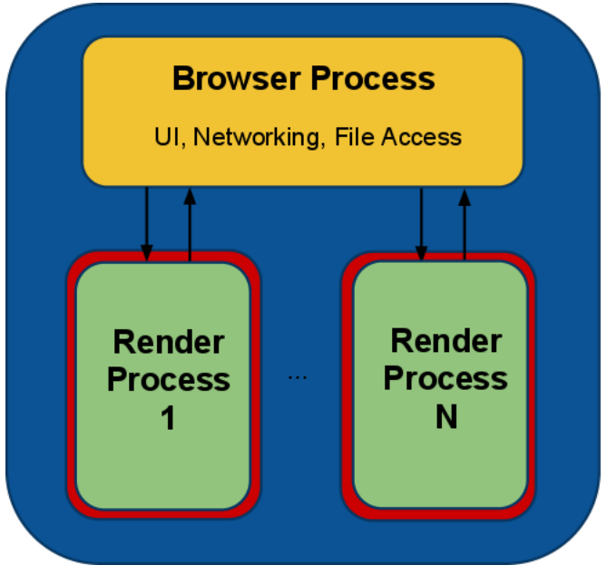
Browser Architecture
Chrome’s Multi-process
See http://www.khronos.org/assets/uploads/developers/library/2010_siggraph_bof_webgl/WebGL-BOF-2-WebGL-in-Chrome_SIGGRAPH-Jul29.pdf
Notes:
Each tab is in a separate process – security – one tab can’t crash other tabs.

Slide 29
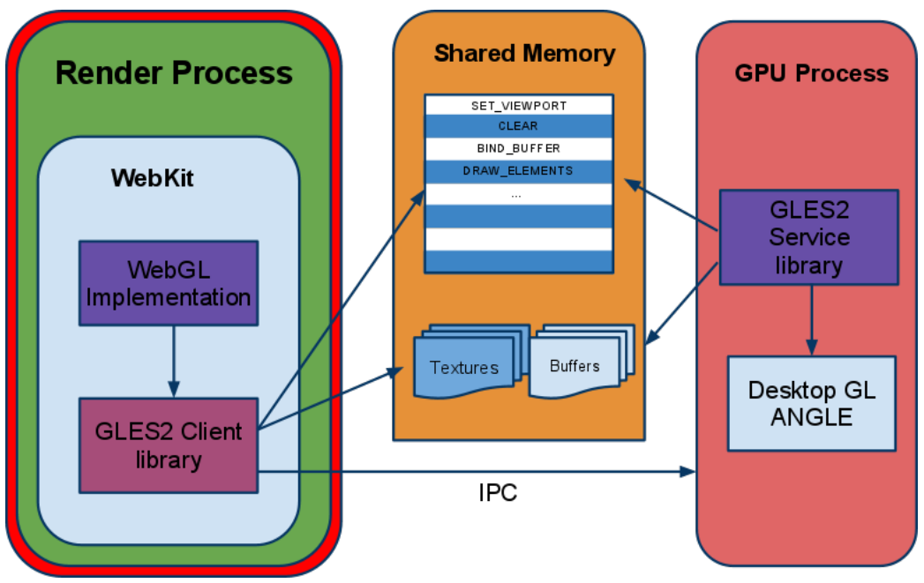
Browser Architecture
Chrome’s Multi-process
See http://www.khronos.org/assets/uploads/developers/library/2010_siggraph_bof_webgl/WebGL-BOF-2-WebGL-in-Chrome_SIGGRAPH-Jul29.pdf
Notes:
Other browsers also use a multi-process architecture in one form or another

Slide 30
Questions
In a multi-process is gl.Get* slow? Why?
What about security?
Notes:
Has to synchronize processes.

Slide 31
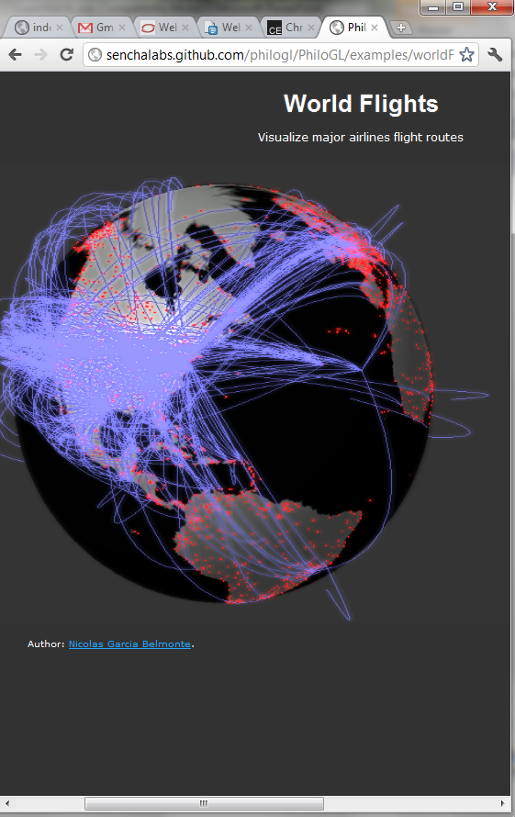
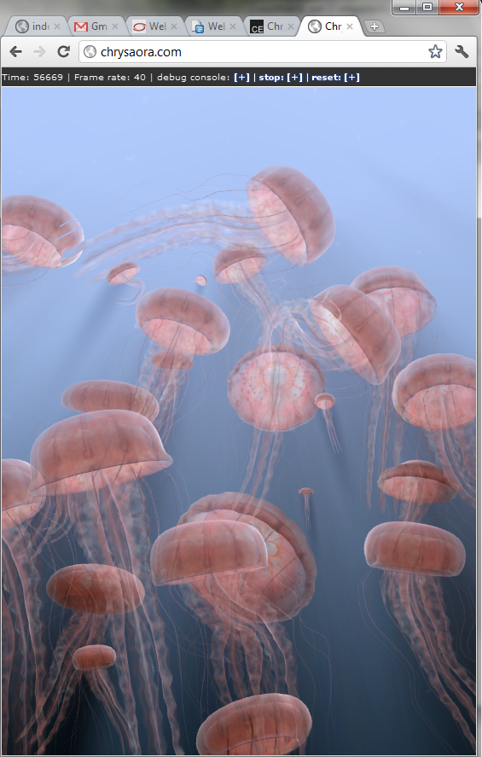
Demos
World Flights
http://senchalabs.github.com/philogl/PhiloGL/examples/worldFlights/
WebGL Jellyfish
http://chrysaora.com/

Slide 32
WebGL Libraries
Three.js: https://github.com/mrdoob/three.js/
SceneJS: http://scenejs.org/
PhiloGL: http://senchalabs.github.com/philogl/
SpiderGL: http://spidergl.org/
Many more: http://www.khronos.org/webgl/wiki/User_Contributions

Slide 33
WebGL Resources
WebGL Camps: http://www.webglcamp.com
Learning WebGL: http://learningwebgl.com

Slide 34



JavaScript Resources
I promise I do not work for O'Reilly or Yahoo

Slide 35
By the way, WebCL is coming
http://www.khronos.org/webcl/
Prototypes for Firefox and WebKit are available
Interactive WebCL kernel editor:
http://webcl.nokiaresearch.com/kerneltoy/

