Slide 1
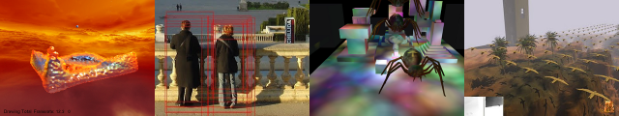
Parallel Algorithms
Patrick Cozzi
University of Pennsylvania
CIS 565 - Spring 2012

Slide 2
Announcements
Presentation topics due 02/07
Homework 2 due 02/13

Slide 3
Agenda
Finish atomic functions from Monday
Parallel Algorithms
  Parallel Reduction
  Scan
  Stream Compression
  Summed Area Tables

Slide 4
Parallel Reduction
Given an array of numbers, design a parallel algorithm to find the sum.
Consider:
  Arithmetic intensity: compute to memory access ratio

Slide 5
Parallel Reduction
Given an array of numbers, design a parallel algorithm to find:
  The sum
  The maximum value
  The product of values
  The average value
How different are these algorithms?
Notes:
They are all a general class of algorithms called a parallel reduction, each with a different operation.

Slide 6
Parallel Reduction
Reduction: An operation that computes a single result from a set of data
Examples:
  Minimum/maximum value
  Average, sum, product, etc.
Parallel Reduction: Do it in parallel. Obviously
Notes:
Min/max value useful for tone mapping

Slide 7
Parallel Reduction
Example. Find the sum:
0
1
2
3
4
5
6
7

Slide 8
Parallel Reduction
0
1
2
3
4
5
6
7
1
5
9
13

Slide 9
Parallel Reduction
0
1
2
3
4
5
6
7
1
5
9
13
6
22

Slide 10
Parallel Reduction
0
1
2
3
4
5
6
7
1
5
9
13
6
22
28

Slide 11
Parallel Reduction
Similar to brackets for a basketball tournament
log(n) passes for n elements

Slide 12
All-Prefix-Sums
All-Prefix-Sums
  Input
    Array of n elements:
    Binary associate operator:
    Identity: I
  Outputs the array:
Images from http://http.developer.nvidia.com/GPUGems3/gpugems3_ch39.html

Slide 13
All-Prefix-Sums
Example
  If is addition, the array
    [3 1 7 0 4 1 6 3]
  is transformed to
    [0 3 4 11 11 15 16 22]
Seems sequential, but there is an efficient parallel solution

Slide 14
Scan
Scan: all-prefix-sums operation on an array of data
Exclusive Scan: Element j of the result does not include element j of the input:
    In: [3 1 7 0 4 1 6 3]
    Out: [0 3 4 11 11 15 16 22]
Inclusive Scan (Prescan): All elements including j are summed
    In: [3 1 7 0 4 1 6 3]
    Out: [3 4 11 11 15 16 22 25]

Slide 15
Scan
How do you generate an exclusive scan from an inclusive scan?
    Input: [3 1 7 0 4 1 6 3]
    Inclusive: [3 4 11 11 15 16 22 25]
    Exclusive: [0 3 4 11 11 15 16 22]
      // Shift right, insert identity
How do you go in the opposite direction?
Notes:
Shift left, then exclusive[j – 1] = exclusive[j – 2] + input[j – 1]

Slide 16
Scan
Use cases
  Stream compaction
  Summed-area tables for variable width image processing
  Radix sort
  …

Slide 17
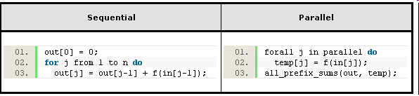
Scan
Used to convert certain sequential computation into equivalent parallel computation
Image from http://http.developer.nvidia.com/GPUGems3/gpugems3_ch39.html

Slide 18
Scan
Design a parallel algorithm for exclusive scan
  In: [3 1 7 0 4 1 6 3]
  Out: [0 3 4 11 11 15 16 22]
Consider:
  Total number of additions

Slide 19

Scan
Sequential Scan: single thread, trivial
n adds for an array of length n
Work complexity: O(n)
How many adds will our parallel version have?
Image from http://http.developer.nvidia.com/GPUGems3/gpugems3_ch39.html

Slide 20
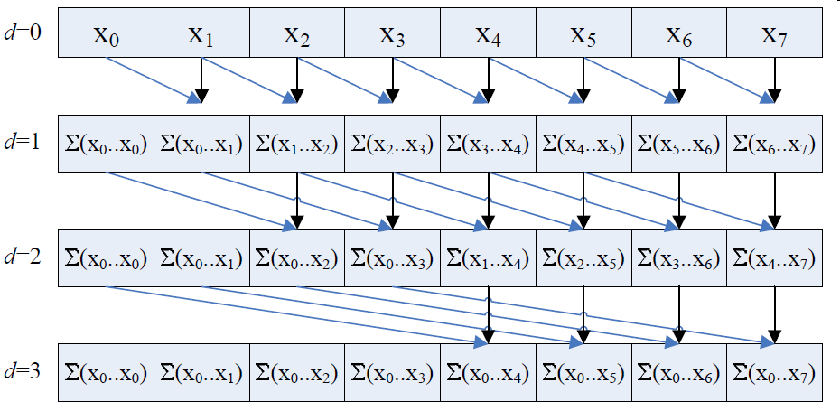
Scan
Naive Parallel Scan
for d = 1 to log₂n
for all k in parallel
if (k >= 2^{d-1})
x[k] = x[k – 2^{d-1}] + x[k];
Is this exclusive or inclusive?
Each thread
  Writes one sum
  Reads two values
Image from http://developer.download.nvidia.com/compute/cuda/1_1/Website/projects/scan/doc/scan.pdf
Notes:
Inclusive. output[0] is not identity. output[length – 1] includes input[length – 1]

Slide 21
Scan
Naive Parallel Scan: Input
0
1
2
3
4
5
6
7

Slide 22
Scan
Naive Parallel Scan: d = 1, 2^{d-1} = 1
0
1
2
3
4
5
6
7
0
for d = 1 to log₂n
for all k in parallel
if (k >= 2^{d-1})
x[k] = x[k – 2^{d-1}] + x[k];

Slide 23
Scan
Naive Parallel Scan: d = 1, 2^{d-1} = 1
0
1
2
3
4
5
6
7
0
1
for d = 1 to log₂n
for all k in parallel
if (k >= 2^{d-1})
x[k] = x[k – 2^{d-1}] + x[k];

Slide 24
Scan
Naive Parallel Scan: d = 1, 2^{d-1} = 1
0
1
2
3
4
5
6
7
0
1
3
for d = 1 to log₂n
for all k in parallel
if (k >= 2^{d-1})
x[k] = x[k – 2^{d-1}] + x[k];

Slide 25
Scan
Naive Parallel Scan: d = 1, 2^{d-1} = 1
0
1
2
3
4
5
6
7
0
1
3
5
for d = 1 to log₂n
for all k in parallel
if (k >= 2^{d-1})
x[k] = x[k – 2^{d-1}] + x[k];

Slide 26
Scan
Naive Parallel Scan: d = 1, 2^{d-1} = 1
0
1
2
3
4
5
6
7
0
1
3
5
7
for d = 1 to log₂n
for all k in parallel
if (k >= 2^{d-1})
x[k] = x[k – 2^{d-1}] + x[k];

Slide 27
Scan
Naive Parallel Scan: d = 1, 2^{d-1} = 1
0
1
2
3
4
5
6
7
0
1
3
5
7
9
for d = 1 to log₂n
for all k in parallel
if (k >= 2^{d-1})
x[k] = x[k – 2^{d-1}] + x[k];

Slide 28
Scan
Naive Parallel Scan: d = 1, 2^{d-1} = 1
0
1
2
3
4
5
6
7
0
1
3
5
7
9
11
for d = 1 to log₂n
for all k in parallel
if (k >= 2^{d-1})
x[k] = x[k – 2^{d-1}] + x[k];

Slide 29
Scan
Naive Parallel Scan: d = 1, 2^{d-1} = 1
0
1
2
3
4
5
6
7
0
1
3
5
7
9
11
13
for d = 1 to log₂n
for all k in parallel
if (k >= 2^{d-1})
x[k] = x[k – 2^{d-1}] + x[k];

Slide 30
Scan
Naive Parallel Scan: d = 1, 2^{d-1} = 1
0
1
2
3
4
5
6
7
Recall, it runs in parallel!
for d = 1 to log₂n
for all k in parallel
if (k >= 2^{d-1})
x[k] = x[k – 2^{d-1}] + x[k];

Slide 31
Scan
Naive Parallel Scan: d = 1, 2^{d-1} = 1
0
1
2
3
4
5
6
7
0
1
3
5
7
9
11
13
Recall, it runs in parallel!
for d = 1 to log₂n
for all k in parallel
if (k >= 2^{d-1})
x[k] = x[k – 2^{d-1}] + x[k];

Slide 32
Scan
Naive Parallel Scan: d = 2, 2^{d-1} = 2
0
1
2
3
4
5
6
7
0
1
3
5
7
9
11
13
after d = 1
for d = 1 to log₂n
for all k in parallel
if (k >= 2^{d-1})
x[k] = x[k – 2^{d-1}] + x[k];

Slide 33
Scan
Naive Parallel Scan: d = 2, 2^{d-1} = 2
0
1
2
3
4
5
6
7
0
1
3
5
7
9
11
13
after d = 1
22
for d = 1 to log₂n
for all k in parallel
if (k >= 2^{d-1})
x[k] = x[k – 2^{d-1}] + x[k];
Consider only k = 7

Slide 34
Scan
Naive Parallel Scan: d = 2, 2^{d-1} = 2
0
1
2
3
4
5
6
7
0
1
3
5
7
9
11
13
after d = 1
0
1
3
6
10
14
18
22
after d = 2
for d = 1 to log₂n
for all k in parallel
if (k >= 2^{d-1})
x[k] = x[k – 2^{d-1}] + x[k];

Slide 35
Scan
Naive Parallel Scan: d = 3, 2^{d-1} = 4
0
1
2
3
4
5
6
7
0
1
3
5
7
9
11
13
after d = 1
0
1
3
6
10
14
18
22
after d = 2
for d = 1 to log₂n
for all k in parallel
if (k >= 2^{d-1})
x[k] = x[k – 2^{d-1}] + x[k];

Slide 36
Scan
Naive Parallel Scan: d = 3, 2^{d-1} = 4
0
1
2
3
4
5
6
7
0
1
3
5
7
9
11
13
after d = 1
0
1
3
6
10
14
18
22
after d = 2
28
for d = 1 to log₂n
for all k in parallel
if (k >= 2^{d-1})
x[k] = x[k – 2^{d-1}] + x[k];
Consider only k = 7

Slide 37
Scan
Naive Parallel Scan: Final
0
1
2
3
4
5
6
7
0
1
3
5
7
9
11
13
0
1
3
6
10
14
18
22
0
1
3
6
10
15
21
28

Slide 38
Scan
Naive Parallel Scan
  What is naive about this algorithm?
    What was the work complexity for sequential scan?
    What is the work complexity for this?
Notes:
Work complexity: O(n log2 n)

Slide 39
Stream Compaction
Stream Compaction
  Given an array of elements
    Create a new array with elements that meet a certain criteria, e.g. non null
    Preserve order
a
b
c
d
e
f
g
h

Slide 40
Stream Compaction
Stream Compaction
  Given an array of elements
    Create a new array with elements that meet a certain criteria, e.g. non null
    Preserve order
a
b
c
d
e
f
g
h
a
c
d
g

Slide 41
Stream Compaction
Stream Compaction
  Used in collision detection, sparse matrix compression, etc.
  Can reduce bandwidth from GPU to CPU
a
b
c
d
e
f
g
h
a
c
d
g

Slide 42
Stream Compaction
Stream Compaction
  Step 1: Compute temporary array containing
    1 if corresponding element meets criteria
    0 if element does not meet criteria
a
b
c
d
e
f
g
h

Slide 43
Stream Compaction
Stream Compaction
  Step 1: Compute temporary array
a
b
c
d
e
f
g
h
1

Slide 44
Stream Compaction
Stream Compaction
  Step 1: Compute temporary array
a
b
c
d
e
f
g
h
1
0

Slide 45
Stream Compaction
Stream Compaction
  Step 1: Compute temporary array
a
b
c
d
e
f
g
h
1
0
1

Slide 46
Stream Compaction
Stream Compaction
  Step 1: Compute temporary array
a
b
c
d
e
f
g
h
1
0
1
1

Slide 47
Stream Compaction
Stream Compaction
  Step 1: Compute temporary array
a
b
c
d
e
f
g
h
1
0
1
1
0

Slide 48
Stream Compaction
Stream Compaction
  Step 1: Compute temporary array
a
b
c
d
e
f
g
h
1
0
1
1
0
0

Slide 49
Stream Compaction
Stream Compaction
  Step 1: Compute temporary array
a
b
c
d
e
f
g
h
1
0
1
1
0
0
1

Slide 50
Stream Compaction
Stream Compaction
  Step 1: Compute temporary array
a
b
c
d
e
f
g
h
1
0
1
1
0
0
1
0

Slide 51
Stream Compaction
Stream Compaction
  Step 1: Compute temporary array
a
b
c
d
e
f
g
h
It runs in parallel!

Slide 52
Stream Compaction
Stream Compaction
  Step 1: Compute temporary array
a
b
c
d
e
f
g
h
1
0
1
1
0
0
1
0
It runs in parallel!

Slide 53
Stream Compaction
Stream Compaction
  Step 2: Run exclusive scan on temporary array
a
b
c
d
e
f
g
h
1
0
1
1
0
0
1
0
Scan result:

Slide 54
Stream Compaction
Stream Compaction
  Step 2: Run exclusive scan on temporary array
  Scan runs in parallel
  What can we do with the results?
a
b
c
d
e
f
g
h
1
0
1
1
0
0
1
0
Scan result:
0
1
1
2
3
3
3
4

Slide 55
Stream Compaction
Stream Compaction
  Step 3: Scatter
    Result of scan is index into final array
    Only write an element if temporary array has a 1

Slide 56
Stream Compaction
Stream Compaction
  Step 3: Scatter
a
b
c
d
e
f
g
h
1
0
1
1
0
0
1
0
Scan result:
0
1
1
2
3
3
3
4
Final array:
0
1
2
3

Slide 57
Stream Compaction
Stream Compaction
  Step 3: Scatter
a
b
c
d
e
f
g
h
1
0
1
1
0
0
1
0
Scan result:
0
1
1
2
3
3
3
4
Final array:
a
0
1
2
3

Slide 58
Stream Compaction
Stream Compaction
  Step 3: Scatter
a
b
c
d
e
f
g
h
1
0
1
1
0
0
1
0
Scan result:
0
1
1
2
3
3
3
4
Final array:
a
c
0
1
2
3

Slide 59
Stream Compaction
Stream Compaction
  Step 3: Scatter
a
b
c
d
e
f
g
h
1
0
1
1
0
0
1
0
Scan result:
0
1
1
2
3
3
3
4
Final array:
a
c
d
0
1
2
3

Slide 60
Stream Compaction
Stream Compaction
  Step 3: Scatter
a
b
c
d
e
f
g
h
1
0
1
1
0
0
1
0
Scan result:
0
1
1
2
3
3
3
4
Final array:
a
c
d
g
0
1
2
3

Slide 61
Stream Compaction
Stream Compaction
  Step 3: Scatter
a
b
c
d
e
f
g
h
1
0
1
1
0
0
1
0
Scan result:
0
1
1
2
3
3
3
4
Final array:
0
1
2
3
Scatter runs in parallel!

Slide 62
Stream Compaction
Stream Compaction
  Step 3: Scatter
a
b
c
d
e
f
g
h
1
0
1
1
0
0
1
0
Scan result:
0
1
1
2
3
3
3
4
Final array:
a
c
d
g
0
1
2
3
Scatter runs in parallel!

Slide 63
Summed Area Table
Summed Area Table (SAT): 2D table where each element stores the sum of all elements in an input image between the lower left corner and the entry location.

Slide 64
Summed Area Table
Example:
Input image
SAT
2
1
0
0
4
9
12
14
0
1
2
0
2
6
9
11
1
2
1
0
2
5
6
8
1
1
0
2
1
2
2
4
(1 + 1 + 0) + (1 + 2 + 1) + (0 + 1 + 2) = 9

Slide 65

Summed Area Table
Benefit
  Used to perform different width filters at every pixel in the image in constant time per pixel
  Just sample four pixels in SAT:
Image from http://http.developer.nvidia.com/GPUGems3/gpugems3_ch39.html
Notes:
w and h are the width and height of the filter kernel

Slide 66
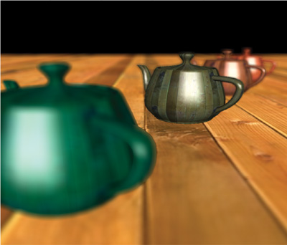
Summed Area Table
Uses
  Glossy environment reflections and refractions
  Approximate depth of field
Image from http://http.developer.nvidia.com/GPUGems3/gpugems3_ch39.html
Notes:
Objects far from the focal length are blurry, while objects at the focal length are in focus.

Slide 67
Summed Area Table
Input image
SAT
2
1
0
0
0
1
2
0
1
2
1
0
1
1
0
2

Slide 68
Summed Area Table
Input image
SAT
2
1
0
0
0
1
2
0
1
2
1
0
1
1
0
2
1

Slide 69
Summed Area Table
Input image
SAT
2
1
0
0
0
1
2
0
1
2
1
0
1
1
0
2
1
2

Slide 70
Summed Area Table
Input image
SAT
2
1
0
0
0
1
2
0
1
2
1
0
1
1
0
2
1
2
2

Slide 71
Summed Area Table
Input image
SAT
2
1
0
0
0
1
2
0
1
2
1
0
1
1
0
2
1
2
2
4

Slide 72
Summed Area Table
Input image
SAT
2
1
0
0
0
1
2
0
1
2
1
0
2
1
1
0
2
1
2
2
4

Slide 73
Summed Area Table
Input image
SAT
2
1
0
0
0
1
2
0
1
2
1
0
2
5
1
1
0
2
1
2
2
4

Slide 74
Summed Area Table
…

Slide 75
Summed Area Table
Input image
SAT
2
1
0
0
4
9
0
1
2
0
2
6
9
11
1
2
1
0
2
5
6
8
1
1
0
2
1
2
2
4

Slide 76
Summed Area Table
Input image
SAT
2
1
0
0
4
9
12
0
1
2
0
2
6
9
11
1
2
1
0
2
5
6
8
1
1
0
2
1
2
2
4

Slide 77
Summed Area Table
Input image
SAT
2
1
0
0
4
9
12
14
0
1
2
0
2
6
9
11
1
2
1
0
2
5
6
8
1
1
0
2
1
2
2
4

Slide 78
Summed Area Table
How would implement
this on the GPU?

Slide 79
Summed Area Table
How would compute a
SAT on the GPU using
inclusive scan?

Slide 80
Summed Area Table
Step 1 of 2:
Input image
Partial SAT
2
1
0
0
2
3
3
3
0
1
2
0
0
1
3
3
1
2
1
0
1
3
4
4
1
1
0
2
1
2
2
4
One inclusive scan for each row

Slide 81
Summed Area Table
Step 2 of 2:
Partial SAT
Final SAT
2
3
3
3
4
9
12
14
0
1
3
3
2
6
9
11
1
3
4
4
2
5
6
8
1
2
2
4
1
2
2
4
One inclusive scan for each
column, bottom to top

Slide 82
Summary
Parallel reductions and scan are building blocks for many algorithms
An understanding of parallel programming and GPU architecture yields efficient GPU implementations

