Slide 1
Modern GPU Architectures
Varun Sampath
University of Pennsylvania
CIS 565 - Spring 2012

Slide 2
Agenda/GPU Decoder Ring
Fermi / GF100 / GeForce GTX 480
“Fermi Refined” / GF110 / GeForce GTX 580
“Little Fermi” / GF104 / GeForce GTX 460
Cypress / Evergreen / RV870 / Radeon HD 5870
Cayman / Northern Islands / Radeon HD 6970
Tahiti / Southern Islands / GCN / Radeon HD 7970
Kepler / GK104 / GeForce GTX 680
Future
Project Denver
Heterogeneous System Architecture
Notes:
Note: will not be talking about new graphics features of these cards (tessellation, partially resident textures, etc.)

Slide 3
From G80/GT200 to Fermi
GPU Compute becomes a driver for innovation
Unified address space
Control flow advancements
Arithmetic performance
Atomics performance
Caching
ECC (is this seriously a graphics card?)
Concurrent kernel execution & fast context switching

Slide 4
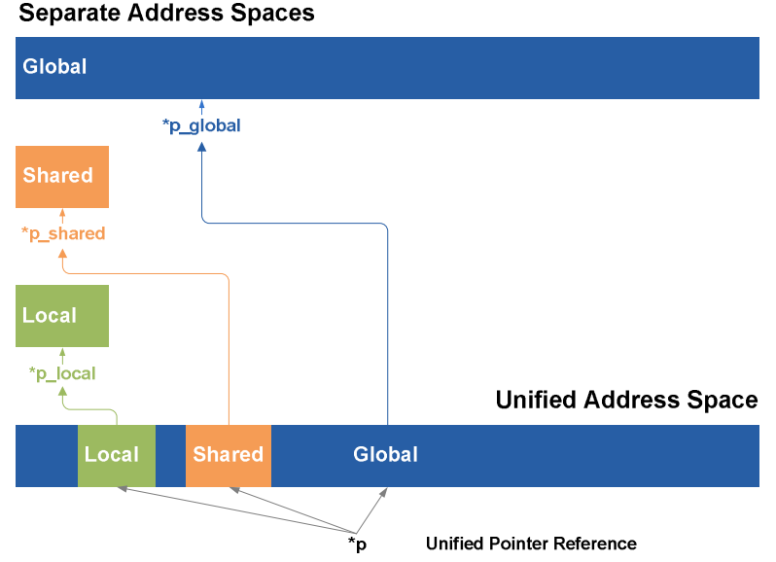
Unified Address Space
PTX 2.0 ISA supports 64-bit virtual addressing (40-bit in Fermi)
CUDA 4.0+: Address space shared with CPU
Advantages?
Image from NVIDIA

Slide 5
Unified Address Space
cudaMemcpy(d_buf, h_buf, sizeof(h_buf), cudaMemcpyDefault)
Runtime manages where buffers live
Enables copies between different devices (not only GPUs) via DMA
Called GPUDirect
Useful for HPC clusters
Pointers for global and shared memory are equivalent

Slide 6
Control Flow Advancements
Predicated instructions
avoid branching stalls (no branch predictor)
Indirect function calls: call{.uni} fptr, flist;
What does this enable support for?
Notes:
.uni suffix guarantees call is not divergent

Slide 7
Control Flow Advancements
Predicated instructions
avoid branching stalls (no branch predictor)
Indirect function calls: call{.uni} fptr, flist;
What does this enable support for?
Function pointers
Virtual functions
Exception handling
Fermi gains support for recursion

Slide 8
Arithmetic
Improved support for IEEE 754-2008 floating point standards
Double precision performance at half-speed
Native 32-bit integer arithmetic
Does any of this help for graphics code?

Slide 9
Cache Hierarchy
64KB L1 cache per SM
Split into 16KB and 48KB pieces
Developer chooses whether shared memory or cache gets larger space
768KB L2 cache per GPU
Makes atomics really fast. Why?
128B cache line
Loosens memory coalescing constraints

Slide 10
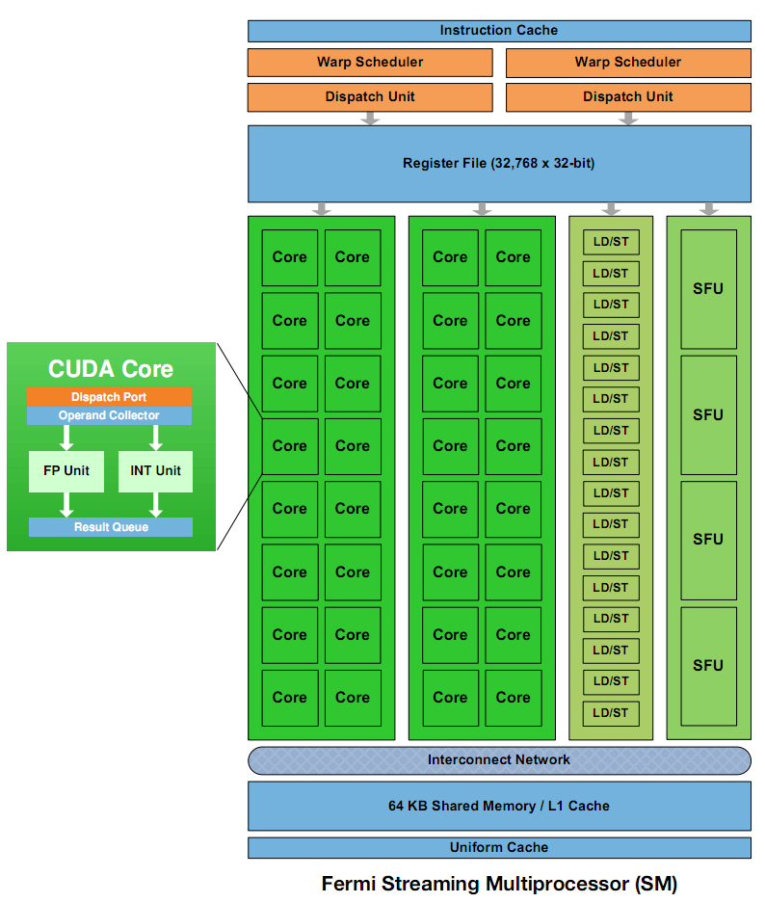
The Fermi SM
Dual warp schedulers – why?
Two banks of 16 CUDA cores, 16 LD/ST units, 4 SFU units
A warp can now complete as quickly as 2 cycles
Image from NVIDIA
Notes:
2 SFUs per SM on G80

Slide 11
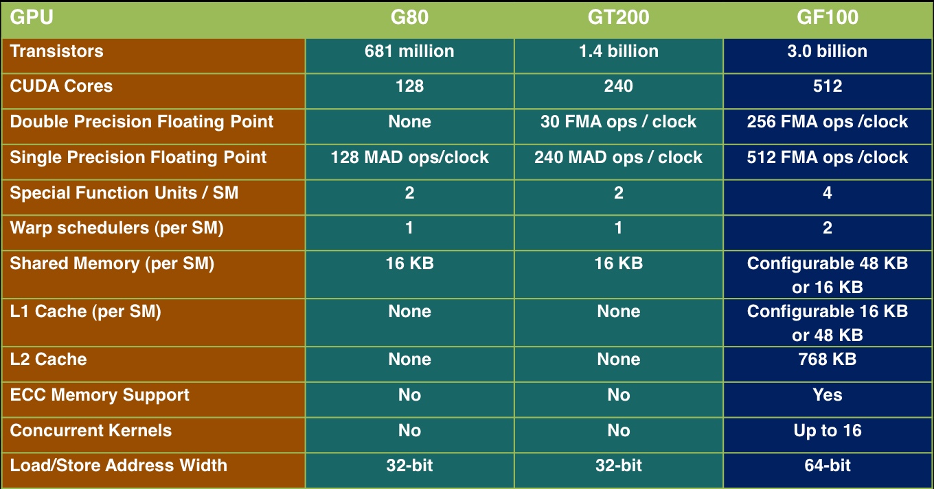
The Stats
Image from Stanford CS193g
Notes:
Moore’s Law is beautiful isn’t it?

Slide 12
The Review in March 2010
Compute performance unbelievable, gaming performance on the other hand…
“The GTX 480… it’s hotter, it’s noisier, and it’s more power hungry, all for 10-15% more performance.” – AnandTech (article titled “6 months late, was it worth the wait?”)
Massive 550mm² die
Only 14/16 SMs could be enabled (480/512 cores)

Slide 13
“Fermi Refined” – GTX 580
All 32-core SMs enabled
Clocks ~10% higher
Transistor mix enables lower power consumption

Slide 14
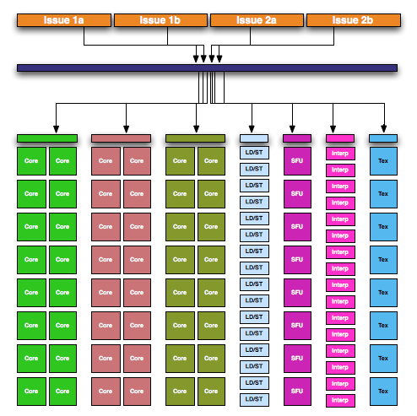
“Little Fermi” – GTX 460
Smaller memory bus (256-bit vs 384-bit)
Much lower transistor count (1.95B)
Superscalar execution: one scheduler dual-issues
Reduce overhead per core?
Image from AnandTech
Notes:
Greatly improve

Slide 15
A 2010 Comparison
NVIDIA GeForce GTX 480
ATI Radeon HD 5870
480 cores
177.4 GB/s memory bandwidth
1.34 TFLOPS single precision
3 billion transistors
1600 cores
153.6 GB/s memory bandwidth
2.72 TFLOPS single precision
2.15 billion transistors
Over double the FLOPS for less transistors! What is going on here?

Slide 16
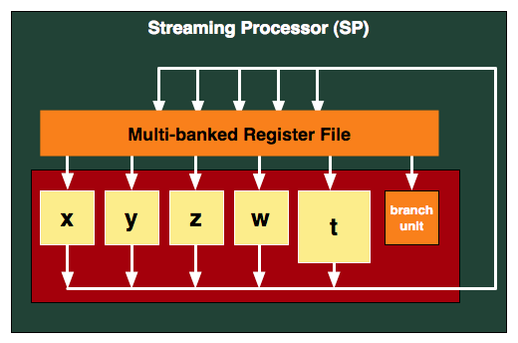
VLIW Architecture
Very-Long-Instruction-Word
Each instruction clause contains up to 5 instructions for the ALUs to execute in parallel
+ Save on scheduling and interconnect (clause “packing” done by compiler)
- Utilization
Image from AnandTech

Slide 17
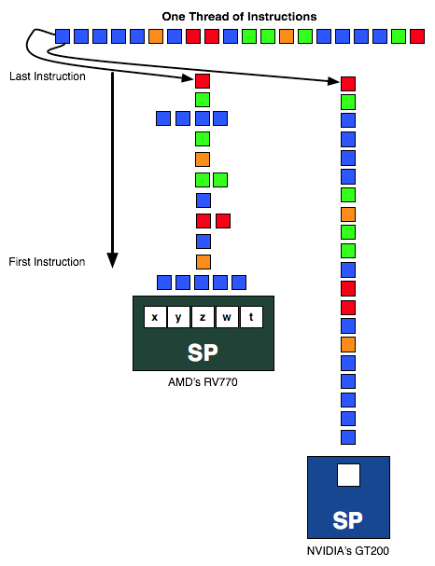
Execution Comparison
Image from AnandTech

Slide 18
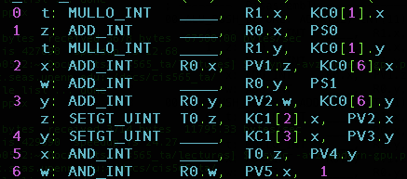
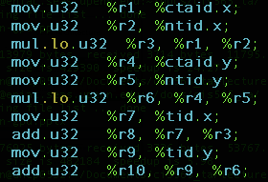
Assembly Example
AMD VLIW IL
NVIDIA PTX

Slide 19
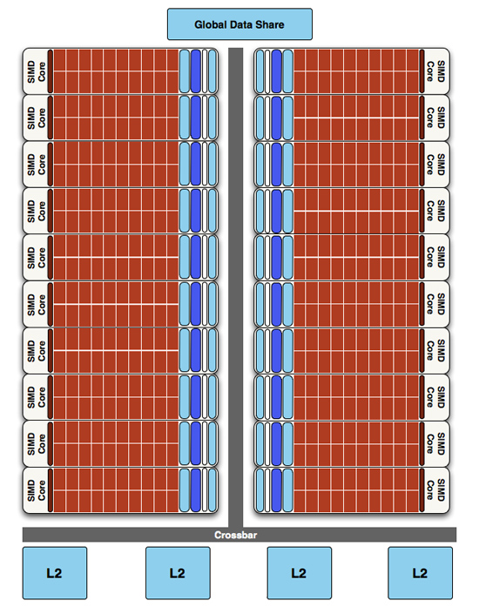
The Rest of Cypress
16 Streaming Processors packed into SIMD Core/compute unit (CU)
Execute a “wavefront” (a 64-thread warp) over 4 cycles
20 CUs * 16 SPs * 5 ALUs = 1600 ALUs
Image from AnandTech

Slide 20
Performance Notes
VLIW architecture relies on instruction-level parallelism
Excels at heavy floating-point workloads with low register dependencies
Shaders?
Memory hierarchy not as aggressive as Fermi
Read-only texture caches
Can’t feed all of the ALUs in an SP in parallel
Fewer registers per ALU
Lower LDS capacity and bandwidth per ALU
Notes:
Seen 2 TFLOP SGEMM implementation
Can only service two LDS loads per cycle for an SP.

Slide 23
Optimizing for AMD Architectures
Many of the ideas are the same – the constants & names just change
Staggered Offsets (Partition camping)
Local Data Share (shared memory) bank conflicts
Memory coalescing
Mapped and pinned memory
NDRange (grid) and work-group (block)sizing
Loop Unrolling
Big change: be aware of VLIW utilization
Consult the OpenCL Programming Guide

Slide 24
AMD’s Cayman Architecture – A Shift
AMD found average VLIW utilization in games was 3.4/5
Shift to VLIW4 architecture
Increased SIMD core count at expense of VLIW width
Found in Radeon HD 6970 and 6950

Slide 25
Paradigm Shift – Graphics Core Next
Switch to SIMD-based instruction set architecture (no VLIW)
16-wide SIMD units executing a wavefront
4 SIMD units + 1 scalar unit per compute unit
Hardware scheduling
Memory hierarchy improvements
Read/write L1 & L2 caches, larger LDS
Programming goodies
Unified address space, exceptions, functions, recursion, fast context switching
Sound Familiar?

Slide 26
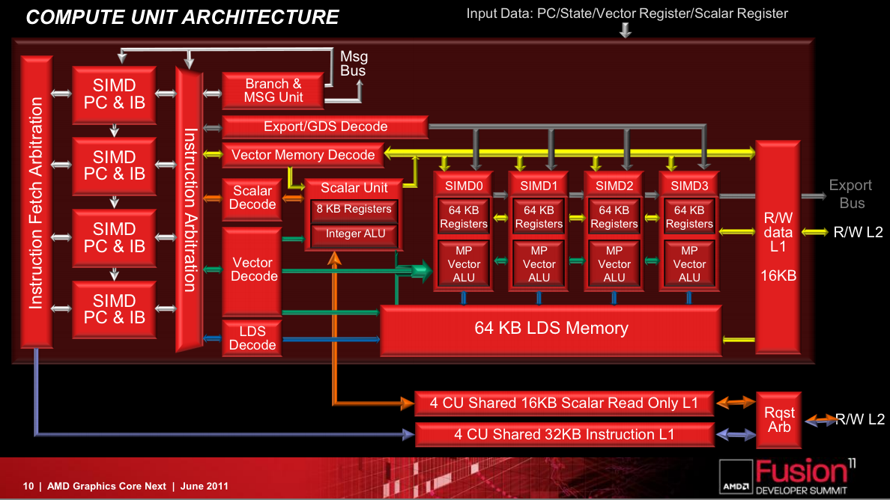
Radeon HD 7970: 32 CUs * 4 SIMDs/CU * 16 ALUs/SIMD = 2048 ALUs
Image from AMD

Slide 27
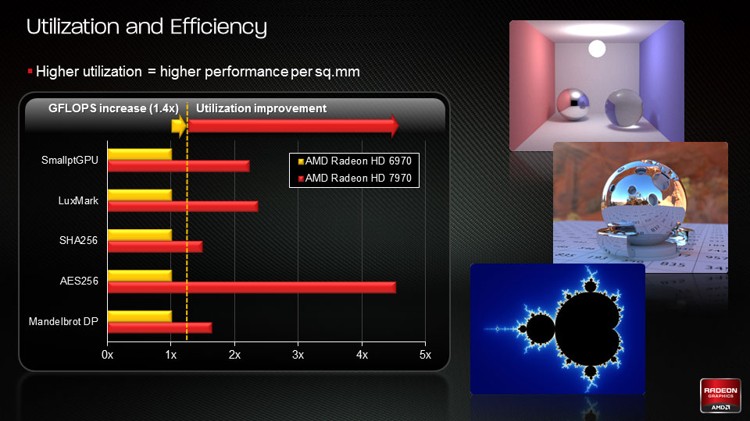
Image from AMD

Slide 28
NVIDIA’s Kepler
NVIDIA GeForce GTX 680
NVIDIA GeForce GTX 580
1536 SPs
28nm process
192.2 GB/s memory bandwidth
195W TDP
1/24 double performance
3.5 billion transistors
512 SPs
40nm process
192.4 GB/s memory bandwidth
244W TDP
1/8 double performance
3 billion transistors
A focus on efficiency
Transistor scaling not enough to account for massive core count increase or power consumption
Kepler die size 56% of GF110’s

Slide 29
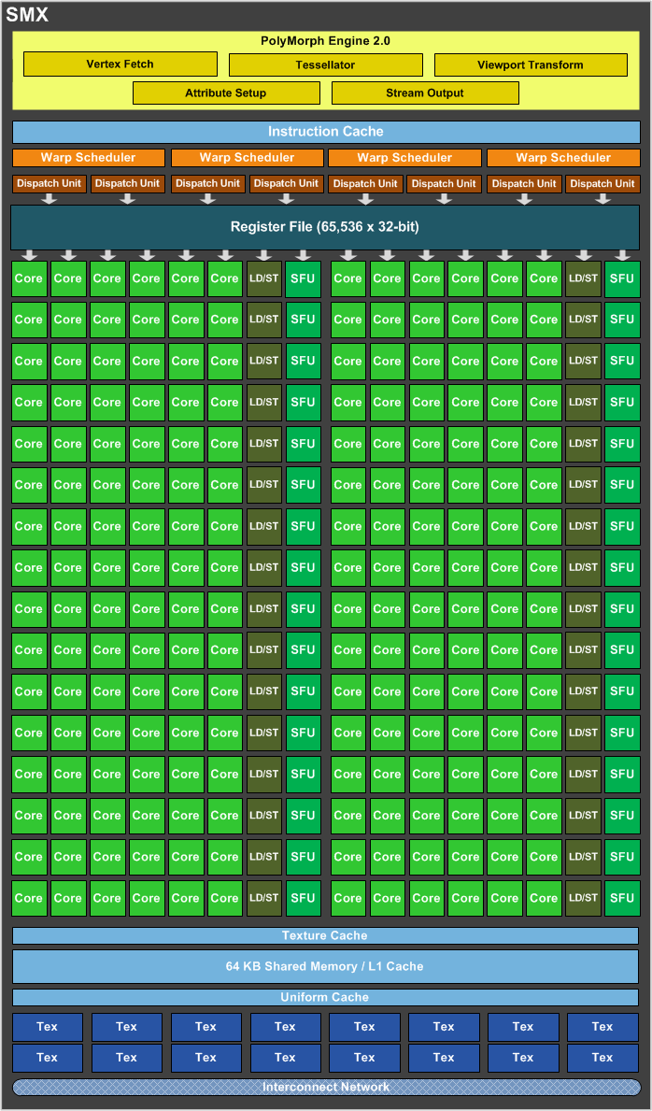
Kepler’s Extended SM (SMX)
Removal of shader clock means warp executes in 1 GPU clock cycle
Need 32 SPs per clock
Kepler then doubles resources again of GF104 SM
96 SPs, 32 LD/ST, 32 SFUs
New FP64 block
Note: from Fermi, register file size has only doubled and shared memory/L1 size is the same
Image from AnandTech
Notes:
Also big changes to Kepler’s scheduler, but we’ll leave this out

Slide 30
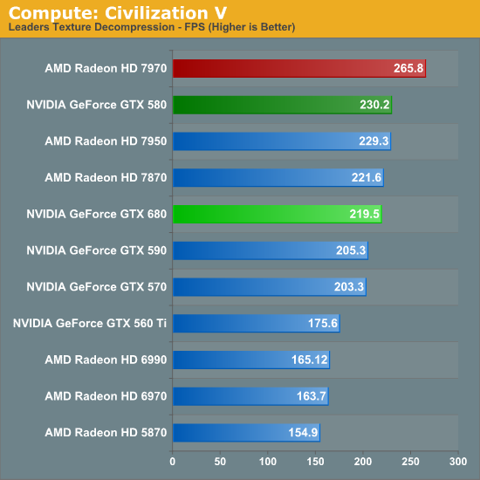
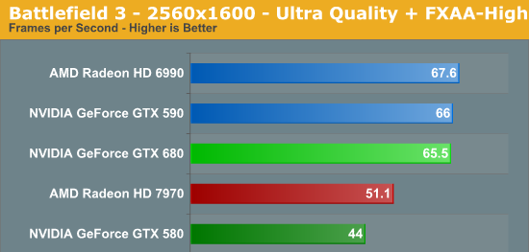
Performance
GTX 680 may be compute regression but gaming leap
“Big Kepler” expected to remedy gap
Double performance necessary
Images from AnandTech

Slide 31
Future: Integration
Hardware benefits from merging CPU & GPU
Mobile (smartphone / laptop): lower energy consumption, area consumption
Desktop / HPC: higher density, interconnect bandwidth
Software benefits
Mapped pointers, unified addressing, consistency rules, programming languages point toward GPU as vector co-processor

Slide 32
The Contenders
AMD – Heterogeneous System Architecture
Virtual ISA, make use of CPU or GPU transparent
Enabled by Fusion APUs, blending x86 and AMD GPUs
NVIDIA – Project Denver
Desktop-class ARM processor effort
Target server/HPC market?
Intel
Larrabee Intel MIC

Slide 33
References
NVIDIA Fermi Compute Architecture Whitepaper. Link
Schroeder, Tim C. “Peer-to-Peer & Unified Virtual Addressing” CUDA Webinar. Slides
AnandTech Review of the GTX 460. Link
AnandTech Review of the Radeon HD 5870. Link
AnandTech Review of the GTX 680. Link
AMD OpenCL Programming Guide (v 1.3f). Link

Slide 34
Bibliography
Beyond3D’s Fermi GPU and Architecture Analysis. Link
RWT’s article on Fermi. Link
AMD Financial Analyst Day Presentations. Link

