Slide 1
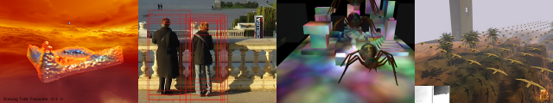
Mobile Graphics
Patrick Cozzi
University of Pennsylvania
CIS 565 - Spring 2012

Slide 2
Announcements
Homework 5
Due today
In-class quiz this Wednesday
Monday, 04/23
No class
Wednesday, 04/25
Project presentations, 9am-12pm, 307 Towne
Post code, paper, and video on blog beforehand
One-on-one demos to follow presentations

Slide 3
Agenda
Tile-Based Rendering
Motivation
Implementation
Implications on optimizing our code

Slide 4
Memory Bandwidth
For 32-bit color, 4 bytes per pixel are needed for display
How many bytes were transferred?

Slide 5
Memory Bandwidth
For 32-bit color, 4 bytes per pixel are needed for display
How many bytes were transferred?
12 bytes?
Read/write depth and stencil
Write color

Slide 6
Memory Bandwidth
For 32-bit color, 4 bytes per pixel are needed for display
How many bytes were transferred?
12 bytes?
Read/write depth and stencil
Write color
What about:
Textures
Overdraw
Blending
Multisampling
Notes:
Over 100 bytes is common.

Slide 7
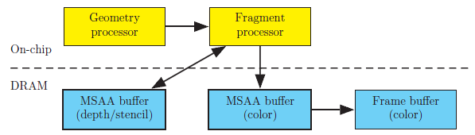
Immediate Mode Rendering
Immediate Mode Rendering (IMR) specifies triangles to be drawn in a current state
Image from http://www.openglinsights.com/

Slide 8

Immediate Mode Rendering
IMRs can result in overdraw
Image from http://www.openglinsights.com/
Notes:
Results in unnecessary shading and depth buffer writes

Slide 9

Immediate Mode Rendering
Sort front to back to minimize overdraw
Image from http://www.openglinsights.com/
Notes:
Uses early-z. View-dependent. Needs to be done per frame for dynamic scenes. Translucent objects still need to be rendered back to front.

Slide 10
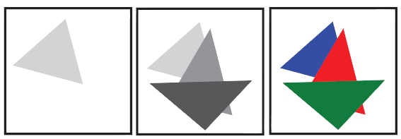
Immediate Mode Rendering
Depth pre-pass to minimize overdraw
Image from http://www.openglinsights.com/
Notes:
Have to transform vertices twice, but CPU overhead can be low on the second pass. Depth only pass can use double-speed z-only.

Slide 11
Tile-Based Rendering
Bandwidth uses a significant amount of power consumption
Mobile graphics want to maximum battery life. How?
Minimize accessing the framebuffer in global memory
Notes:
Reducing bandwidth helps power consumption and performance!
Compression helps, but it is not enough.
OpenGL spec says triangles are rendered in order; however, we can reorder and parallelize things under the hood.

Slide 12
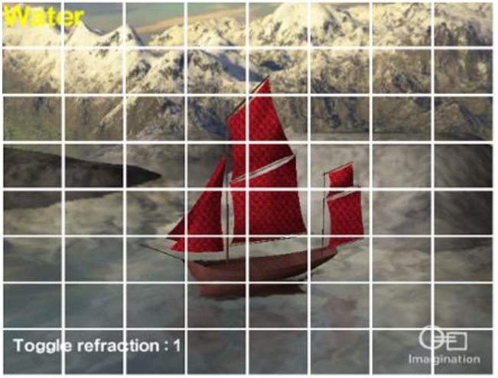
Tile-Based Rendering
Break framebuffer up into tiles, e.g., 16x16 pixels
Image from http://www.imgtec.com/powervr/insider/docs/PowerVR%20Series5%20Graphics.SGX%20architecture%20guide%20for%20developers.1.0.8.External.pdf

Slide 13
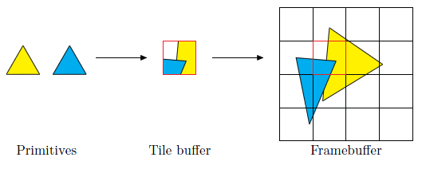
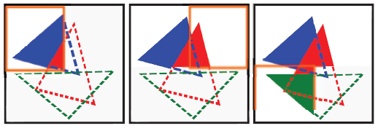
Tile-Based Rendering
Render one tile at a time using all primitives that overlap a tile
Images from http://www.openglinsights.com/

Slide 14
Tile-Based Rendering
A tile is stored on-chip in the tile buffer
All depth/stencil/color access is on-chip
After the tile is rendered, color is written to global memory
How does this affect vertex processing?
Notes:
Sounds like using shared memory in CUDA, right?
Doesn't have to write overdrawn pixels, depth/stencil, etc. to global memory.
Depth/stencil testing and blending are done on chip.

Slide 15
Tile-Based Rendering
Avoid transforming all vertices in the scene per-tile by storing
gl_Position and vertex shader varyings
Fragment shader and uniforms
Fixed function state, e.g., depth test, etc.
in a spatial data structure call the frame data
Notes:
Frame data is also called polygon lists (ARM) and the parameter buffer (Imagination Technologies).

Slide 16
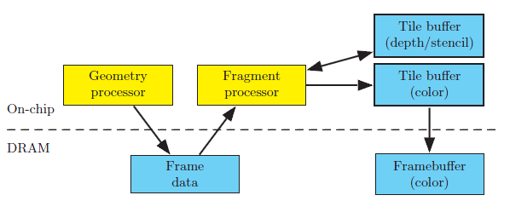
Tile-Based Rendering
Image from http://www.openglinsights.com/

Slide 17
What’s the Difference?
IMR
Tile-Based
Image from http://www.openglinsights.com/
Notes:
Much less global memory access since a tile is only written to global memory once, and only color is written. However, frame data is now in global memory. As long as there is not too many posted-clipped triangles, the extra global memory access introduced by frame data is much less than the access saved using tiling.

Slide 18
Framebuffer Clears
glClear is cheap and clears frame data
Don’t skip it
Clear everything, e.g., all buffers, no scissor test, etc.
Even better, use EXT_discard_framebuffer:
const GLenum attachments[3] = { COLOR_EXT, DEPTH_EXT, STENCIL_EXT };
glDiscardFramebufferEXT(GL_FRAMEBUFFER, 3, attachments);
Notes:
Old school optimizations use to draw the sky box first, etc. to avoid glClear. Don’t do that.

Slide 19
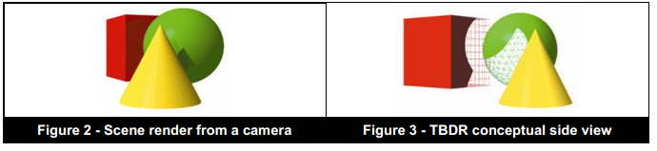
Tile-Based Deferred Rendering
On PowerVR, only fragments that contribute to the scene are shaded:
Called Tile-Based Deferred Rendering (TBDR)
Image from http://www.imgtec.com/powervr/insider/docs/PowerVR%20Series5%20Graphics.SGX%20architecture%20guide%20for%20developers.1.0.8.External.pdf
Notes:
A tile has access to the frame data spatial data structure, and can therefore sort front-to-back unlike IMR.
The image on the right is a view from the left of the camera.
I suspect, in theory, they can do OIT with the frame data too.

Slide 20
Tile-Based Deferred Rendering
How does sorting front-to-back and depth prepass affect TBDR?
Image from http://www.openglinsights.com/
Notes:
No longer useful; wasted CPU time

