Slide 1
CPU Architecture Overview
Varun Sampath
CIS 565 Spring 2012

Slide 2
Objectives
Performance tricks of a modern CPU
Pipelining
Branch Prediction
Superscalar
Out-of-Order (OoO) Execution
Memory Hierarchy
Vector Operations
SMT
Multicore

Slide 3
What is a CPU anyways?
Execute instructions
Now so much more
Interface to main memory (DRAM)
I/O functionality
Composed of transistors
Notes:
Code in HLL is compiled to assembly, machine code executed.
Becoming more of an SoC.

Slide 4
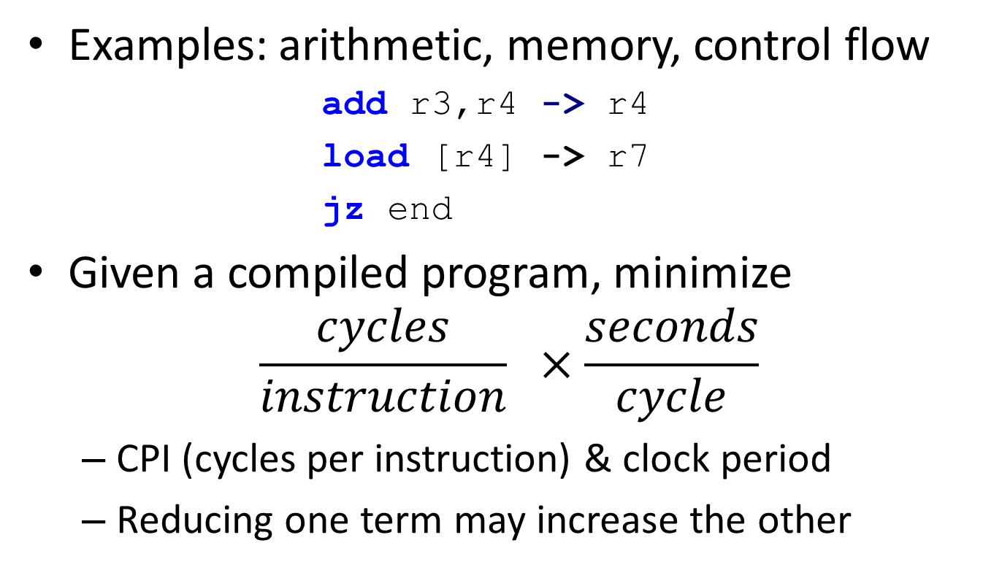
Instructions
Examples: arithmetic, memory, control flow
add r3,r4 -> r4
load [r4] -> r7
jz end
Given a compiled program, minimize
$$\frac{cycles}{instruction} ×\frac{seconds}{cycle}$$
CPI (cycles per instruction) & clock period
Reducing one term may increase the other

Slide 5
Desktop Programs
Lightly threaded
Lots of branches
Lots of memory accesses
 | vim | ls
Conditional branches | 13.6% | 12.5%
Memory accesses | 45.7% | 45.7%
Vector instructions | 1.1% | 0.2%
Profiled with psrun on ENIAC
Notes:
Software likes “serial,” hardware likes “parallel.”
Branch prediction accuracy
96.7% - vim
98.9% - ls

Slide 6
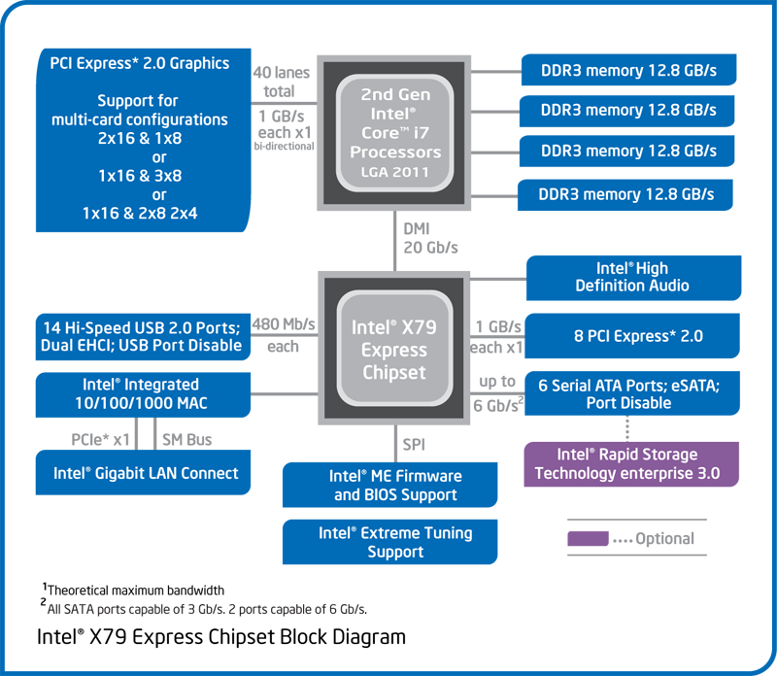
Source: intel.com
Notes:
CPU has connections to external I/O (PCIE) and memory (DDR3).
I/O hub for everything else.

Slide 7
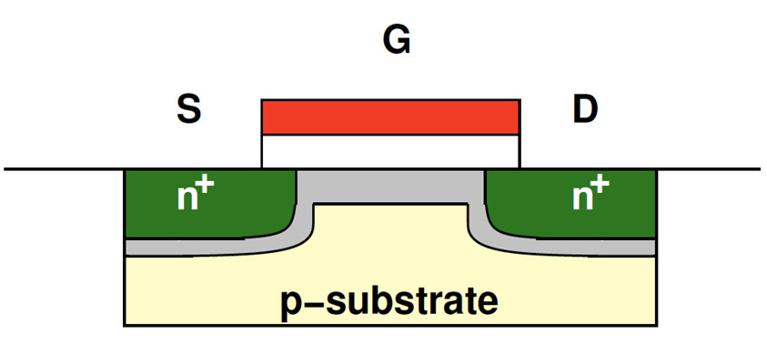
What is a Transistor?
Approximation: a voltage-controlled switch
Typical channel lengths (for 2012): 22-32nm
Channel
Image: Penn ESE370
Notes:
Use transistors to build boolean logic gates, use gates to build more complicated logic (ALUs, muxes, memory).

Slide 8
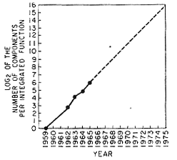
Moore’s Law
“The complexity for minimum component costs has increased at a rate of roughly a factor of two per year”
Self-fulfilling prophecy
What do we do with our transistor budget?
Source: intel.com
Notes:
In other words, our transistor density is doubling extremely quickly. How do we take advantage? Hardware enjoys parallelism (board example) but software does not. Have to design to accelerate the common cases. MCCF.

Slide 9
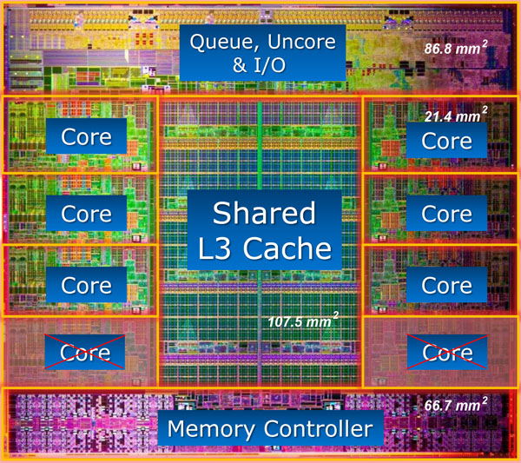
Intel Core i7 3960X (Codename Sandy Bridge-E) – 2.27B transistors, Total Size 435mm²
^{Source: www.lostcircuits.com}
Notes:
Current top of the line desktop Intel CPU.
Only about 2cm x 2cm.
Delve into how a core is built.

Slide 10
A Simple CPU Core
+
4
PC
Register
File
I$
D$
s1
s2
d
control
Image: Penn CIS501
Notes:
Datapath requires Control. Example of add instruction on board.
Obtain an instruction indexed by PC.
Setup control and read operands from register file.
Execute instruction.
Access data memory if need be.
Write back to registers.

Slide 11
A Simple CPU Core
+
4
PC
Register
File
I$
D$
s1
s2
d
control
Fetch → Decode → Execute → Memory → Writeback
Image: Penn CIS501
Notes:
Clocked. All of these steps occur in one clock period.
Clock period bound by datapath delay.
Bad utilization.

Slide 12
Pipelining
+
4
Register
File
PC
Insn
Mem
Data
Mem
s1
s2
d
T_{insn-mem}
T_{regfile}
T_{ALU}
T_{data-mem}
T_{regfile}
T_{singlecycle}
Image: Penn CIS501

Slide 13
Pipelining
Capitalize on instruction-level parallelism (ILP)
+ Significantly reduced clock period
– Slight latency & area increase (pipeline latches)
? Dependent instructions
? Branches
Alleged Pipeline Lengths:
Core 2: 14 stages
Pentium 4 (Prescott): > 20 stages
Sandy Bridge: in between
Notes:
Remember the performance equation. Pipelining allows much higher clock speeds
Pipeline length source: Agner Fog’s Microarchitecture Guide

Slide 14
Bypassing
IR
Register
File
A
B
IR
O
B
IR
O
D
IR
Data
Mem
a
s1
s2
d
d
S
X
F/D
D/X
X/M
M/W
nop
stall
add R1,R7 → R2
sub R2,R3 → R7
Image: Penn CIS501
Notes:
Dependent instructions: add is dependent on result of sub. Use bypass network to get R7’s value from next stage.

Slide 15
Stalls
IR
Register
File
A
B
IR
O
B
IR
O
D
IR
Data
Mem
a
s1
s2
d
d
S
X
F/D
D/X
X/M
M/W
nop
stall
add R1,R7 → R2
load [R3] → R7
Image: Penn CIS501
Notes:
Picked the worst case example. No way to bypass R7 from load, so need to stall pipeline before add can execute. There are some remedies we will discuss later (OOOE).

Slide 16
Branches
IR
Register
File
A
B
IR
O
B
IR
O
D
IR
Data
Mem
a
s1
s2
d
d
S
X
F/D
D/X
X/M
M/W
nop
???
???
jeq loop
Image: Penn CIS501
Notes:
We don’t know what instructions will execute after the branch until the branch is executed. We could either stall until it is, or “speculate” and flush on a misprediction.

Slide 17
Branch Prediction
Guess what instruction comes next
Based off branch history
Example: two-level predictor with global history
Maintain history table of all outcomes for M successive branches
Compare with past N results (history register)
Sandy Bridge employs 32-bit history register
Notes:
Avoid stall cost by speculating what might be executed. Could use board example to illustrate 2-bit two-level/correlated predictor

Slide 18
Branch Prediction
+ Modern predictors > 90% accuracy
Raise performance and energy efficiency (why?)
– Area increase
– Potential fetch stage latency increase
Notes:
96.7% accurate on vim example
Flushing a pipeline means a waste of all executed instructions. Area increase potentially even greater for tournament predictors.

Slide 19
Another option: Predication
Replace branches with conditional instructions
; if (r1==0) r3=r2
cmoveq r1, r2 -> r3
+ Avoids branch predictor
Avoids area penalty, misprediction penalty
– Avoids branch predictor
Introduces unnecessary nop if predictable branch
GPUs also use predication
Notes:
Keep in mind most branches are predictable. Branch performance is a big factor when writing code for GPUs.

Slide 20
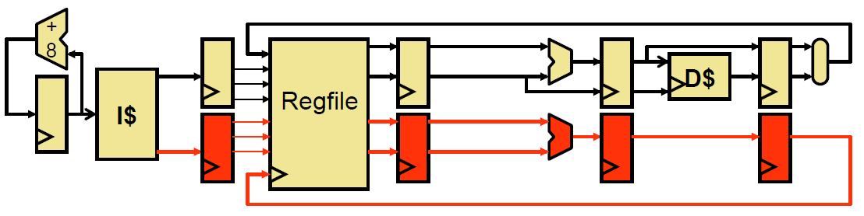
Improving IPC
IPC (instructions/cycle) bottlenecked at 1 instruction / clock
Superscalar – increase pipeline width
Image: Penn CIS371
Notes:
Duplicate pipeline registers, execution resources, ports

Slide 21
Superscalar
+ Peak IPC now at N (for N-way superscalar)
Branching and scheduling impede this
Need some more tricks to get closer to peak (next)
– Area increase
Doubling execution resources
Bypass network grows at N²
Need more register & memory bandwidth

Slide 22
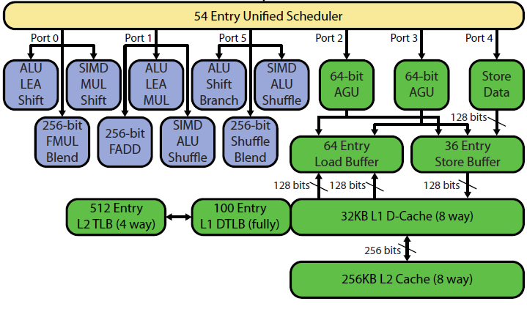
Superscalar in Sandy Bridge
Image © David Kanter, RWT
Notes:
Sandy Bridge can issue up to 6 ops and retire 4 ops per cycle.

Slide 23
Scheduling
Consider instructions:
xor r1,r2 -> r3
add r3,r4 -> r4
sub r5,r2 -> r3
addi r3,1 -> r1
xor and add are dependent (Read-After-Write, RAW)
sub and addi are dependent (RAW)
xor and sub are not (Write-After-Write, WAW)

Slide 24
Register Renaming
How about this instead:
xor p1,p2 -> p6
add p6,p4 -> p7
sub p5,p2 -> p8
addi p8,1 -> p9
xor and sub can now execute in parallel

Slide 25
Out-of-Order Execution
Reordering instructions to maximize throughput
Fetch → Decode → Rename → Dispatch → Issue → Register-Read → Execute → Memory → Writeback → Commit
Reorder Buffer (ROB)
Keeps track of status for in-flight instructions
Physical Register File (PRF)
Issue Queue/Scheduler
Chooses next instruction(s) to execute
Notes:
New pipeline. 3 Principal data structures.

Slide 26
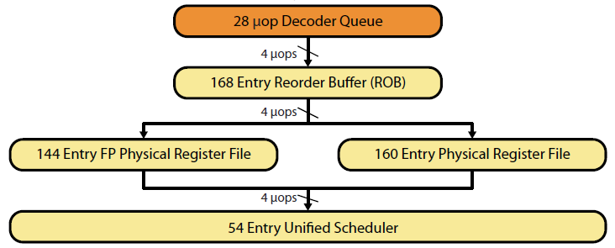
OoO in Sandy Bridge
Image © David Kanter, RWT
Notes:
Unified could mean both shared with FP & integer, and also shared dynamically between threads

Slide 27
Out-of-Order Execution
+ Brings IPC much closer to ideal
– Area increase
– Energy increase
Modern Desktop/Mobile In-order CPUs
Intel Atom
ARM Cortex-A8 (Apple A4, TI OMAP 3)
Qualcomm Scorpion
Modern Desktop/Mobile OoO CPUs
Intel Pentium Pro and onwards
ARM Cortex-A9 (Apple A5, NV Tegra 2/3, TI OMAP 4)
Qualcomm Krait
Notes:
IPC boost useful for both instruction ordering and cache miss losses.
Jump to OoO can be done in conjunction with a process shrink to mitigate area and energy increases (A8→A9 was 65→40nm transition)
http://ieeexplore.ieee.org/stamp/stamp.jsp?tp=&arnumber=694769 says 14+% of energy budget goes to OoO for Pentium Pro

Slide 28
Memory Hierarchy
Memory: the larger it gets, the slower it gets
Rough numbers:
 | Latency | Bandwidth | Size
SRAM (L1, L2, L3) | 1-2ns | 200GBps | 1-20MB
DRAM (memory) | 70ns | 20GBps | 1-20GB
Flash (disk) | 70-90µs | 200MBps | 100-1000GB
HDD (disk) | 10ms | 1-150MBps | 500-3000GB
SRAM & DRAM latency, and DRAM bandwidth for Sandy Bridge from Lostcircuits
Flash and HDD latencies from AnandTech
Flash and HDD bandwidth from AnandTech Bench
SRAM bandwidth guesstimated.

Slide 29
Caching
Keep data you need close
Exploit:
Temporal locality
Chunk just used likely to be used again soon
Spatial locality
Next chunk to use is likely close to previous

Slide 30
Cache Hierarchy
Hardware-managed
L1 Instruction/Data caches
L2 unified cache
L3 unified cache
Software-managed
Main memory
Disk
I$
D$
L2
Larger
Faster
L3
Main Memory
Disk
(not to scale)
Notes:
LRU-esque eviction algorithms used for caches. Could be inclusive, exclusive, or neither. OS manages virtual memory.

Slide 31
Intel Core i7 3960X – 15MB L3 (25% of die). 4-channel Memory Controller, 51.2GB/s total
^{Source: www.lostcircuits.com}
Notes:
Look at caches – 24.7% of die is L3 cache – 15MB
32KB I$ and 32KB D$
256KB L2 per core
Memory controller – 15% of die; 4 channels, each supporting DDR3-1600 → 12.8GB/s

Slide 32
Some Memory Hierarchy Design Choices
Banking
Avoid multi-porting
Coherency
Memory Controller
Multiple channels for bandwidth
Notes:
Compulsory – never seen it before; Capacity – would have gotten it if cache was bigger; Conflict – aliased block kicked it out
Banking – cache has multiple banks, access multiple banks in parallel; stall on same bank access
Coherency – does the cache have the latest data? x86 has a consistency model, but not all architectures do.

Slide 33
Parallelism in the CPU
Covered Instruction-Level (ILP) extraction
Superscalar
Out-of-order
Data-Level Parallelism (DLP)
Vectors
Thread-Level Parallelism (TLP)
Simultaneous Multithreading (SMT)
Multicore

Slide 34
Vectors Motivation
for (int i = 0; i < N; i++)
A[i] = B[i] + C[i];
Notes:
How do we make this go fast?

Slide 35
CPU Data-level Parallelism
Single Instruction Multiple Data (SIMD)
Let’s make the execution unit (ALU) really wide
Let’s make the registers really wide too
for (int i = 0; i < N; i+= 4) {
// in parallel
A[i] = B[i] + C[i];
A[i+1] = B[i+1] + C[i+1];
A[i+2] = B[i+2] + C[i+2];
A[i+3] = B[i+3] + C[i+3];
}

Slide 36
Vector Operations in x86
SSE2
4-wide packed float and packed integer instructions
Intel Pentium 4 onwards
AMD Athlon 64 onwards
AVX
8-wide packed float and packed integer instructions
Intel Sandy Bridge
AMD Bulldozer
Notes:
Sandy Bridge can issue 2 AVX ops per cycle

Slide 37
Thread-Level Parallelism
Thread Composition
Instruction streams
Private PC, registers, stack
Shared globals, heap
Created and destroyed by programmer
Scheduled by programmer or by OS

Slide 38
Simultaneous Multithreading
Instructions can be issued from multiple threads
Requires partitioning of ROB, other buffers
+ Minimal hardware duplication
+ More scheduling freedom for OoO
– Cache and execution resource contention can reduce single-threaded performance
Notes:
Register state, return stack buffer, and large page ITLB only replicated stuff: http://www.anandtech.com/show/2594/8

Slide 39
Multicore
Replicate full pipeline
Sandy Bridge-E: 6 cores
+ Full cores, no resource sharing other than last-level cache
+ Easier way to take advantage of Moore’s Law
– Utilization

Slide 40
Locks, Coherence, and Consistency
Problem: multiple threads reading/writing to same data
A solution: Locks
Implement with test-and-set, load-link/store-conditional instructions
Problem: Who has the correct data?
A solution: cache coherency protocol
Problem: What is the correct data?
A solution: memory consistency model
Notes:
Locks: very slow. Transactional memory is a hope to avoid them.
Caching causes coherency issues. Coherency protocols make sure correct data is given, minimizing bus traffic.
The reordering of loads and stores by OoO processors make multiple interpretations possible for different threads. Consistency models limit how they can be reordered.

Slide 41
Conclusions
CPU optimized for sequential programming
Pipelines, branch prediction, superscalar, OoO
Reduce execution time with high clock speeds and high utilization
Slow memory is a constant problem
Parallelism
Sandy Bridge-E great for 6-12 active threads
How about 12,000?
Notes:
A lot of effort put into improving IPC, and avoiding memory latencies. Attacking throughput is an entirely different game.

Slide 42
References
Milo Martin, Penn CIS501 Fall 2011 http://www.seas.upenn.edu/~cis501
David Kanter, “Intel's Sandy Bridge Microarchitecture.” 9/25/10. http://www.realworldtech.com/page.cfm?ArticleID=RWT091810191937
Agner Fog, “The microarchitecture of Intel, AMD and VIA CPUs.” 6/8/2011. http://www.agner.org/optimize/microarchitecture.pdf

Slide 43
Bibliography
Classic Jon Stokes’ articles introducing basic CPU architecture, pipelining (1, 2), and Moore’s Law
CMOV discussion on Mozilla mailing list
Herb Sutter, “The Free Lunch Is Over: A Fundamental Turn Toward Concurrency in Software.” link

