Slide 1

OpenGL Buffer Transfers
Patrick Cozzi
University of Pennsylvania
CIS 565 - Spring 2012

Slide 2



Drawing
It doesn’t matter if we’re using:
Efficiently transferring data between the CPU and GPU is critical for performance.

Slide 3
How many vertices per second do we need?

Slide 4
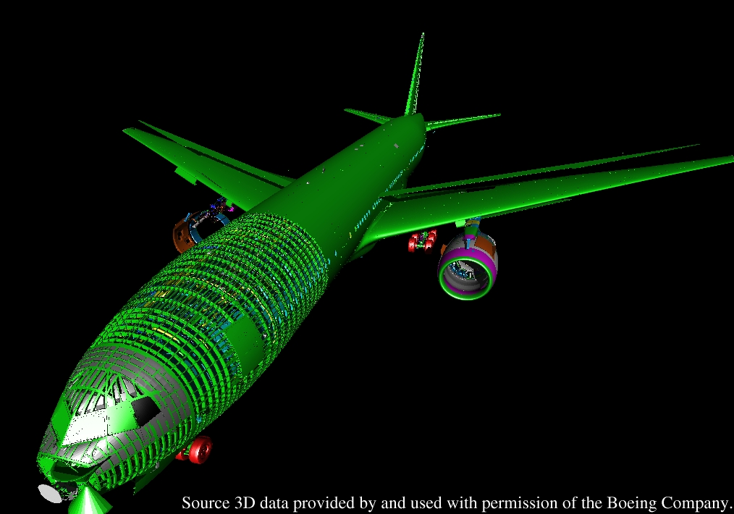
Drawing
Boeing 777 model: ~350 million polygons
Image from http://graphics.cs.uni-sb.de/MassiveRT/boeing777.html

Slide 5
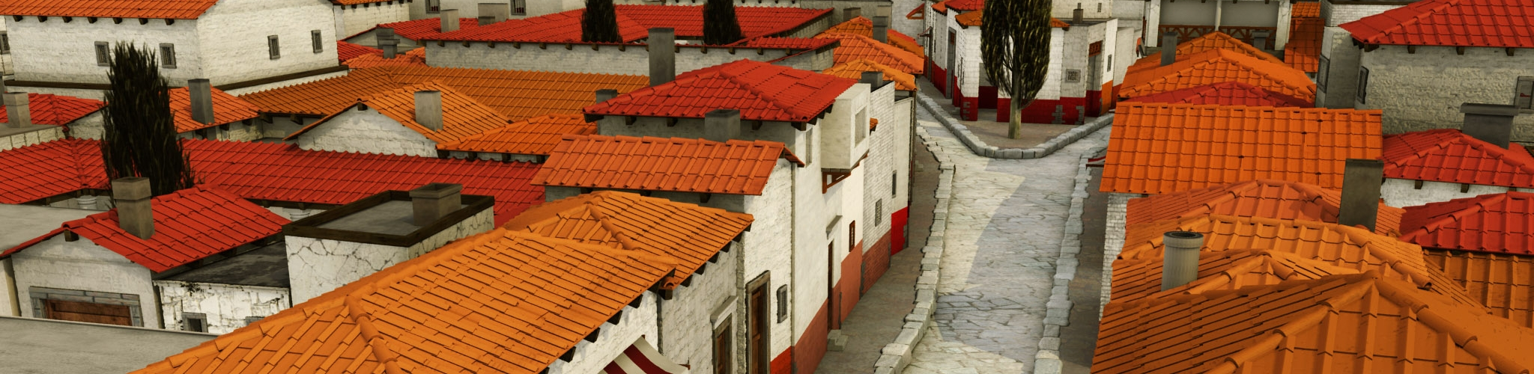
Drawing
Procedurally generated model of Pompeii: ~1.4 billion polygons
Image from http://www.vision.ee.ethz.ch/~pmueller/wiki/CityEngine/Documents

Slide 6
Buffer Objects
Array buffers – store vertex attributes
Element buffers – store indices
Stored in driver-controlled memory, not an array in our application
Provide hints to the driver about how we will use the buffer

Slide 7
Buffer Objects
GLuint vbo;
GLfloat* vertices = new GLfloat[3 * numberOfVertices];
glGenBuffers(1, &vbo);
glBindBuffer(GL_ARRAY_BUFFER_ARB, vbo);
glBufferData(GL_ARRAY_BUFFER_ARB, numberOfBytes, vertices, GL_STATIC_DRAW_ARB);
// Also check out glBufferSubData
delete [] vertices;
glDeleteBuffers(1, &vbo);

Slide 8
Buffer Objects
GLuint vbo;
GLfloat* vertices = new GLfloat[3 * numberOfVertices];
glGenBuffers(1, &vbo);
glBindBuffer(GL_ARRAY_BUFFER_ARB, vbo);
glBufferData(GL_ARRAY_BUFFER_ARB, numberOfBytes, vertices, GL_STATIC_DRAW_ARB);
// Also check out glBufferSubData
delete [] vertices;
glDeleteBuffers(1, &vbo);

Slide 9
Buffer Objects
GLuint vbo;
GLfloat* vertices = new GLfloat[3 * numberOfVertices];
glGenBuffers(1, &vbo);
glBindBuffer(GL_ARRAY_BUFFER_ARB, vbo);
glBufferData(GL_ARRAY_BUFFER_ARB, numberOfBytes, vertices, GL_STATIC_DRAW_ARB);
// Also check out glBufferSubData
delete [] vertices;
glDeleteBuffers(1, &vbo);

Slide 10
Buffer Objects
GLuint vbo;
GLfloat* vertices = new GLfloat[3 * numberOfVertices];
glGenBuffers(1, &vbo);
glBindBuffer(GL_ARRAY_BUFFER_ARB, vbo);
glBufferData(GL_ARRAY_BUFFER_ARB, numberOfBytes, vertices, GL_STATIC_DRAW_ARB);
// Also check out glBufferSubData
delete [] vertices;
glDeleteBuffers(1, &vbo);
Copy from application to driver-controlled memory. GL_STATIC_DRAW should imply video memory.

Slide 11
Buffer Objects
GLuint vbo;
GLfloat* vertices = new GLfloat[3 * numberOfVertices];
glGenBuffers(1, &vbo);
glBindBuffer(GL_ARRAY_BUFFER_ARB, vbo);
glBufferData(GL_ARRAY_BUFFER_ARB, numberOfBytes, vertices, GL_STATIC_DRAW_ARB);
// Also check out glBufferSubData
delete [] vertices;
glDeleteBuffers(1, &vbo);
Does glBufferData block?
Does glBufferSubData block?

Slide 12
Buffer Objects
Usage Hint
Static: 1-to-n update-to-draw ratio
Dynamic: n-to-m update to draw (n < m)
Stream: 1-to-1 update to draw
It’s a hint. Do drivers take it into consideration?
GL_ARB_debug_output tells us where the buffer is stored

Slide 13
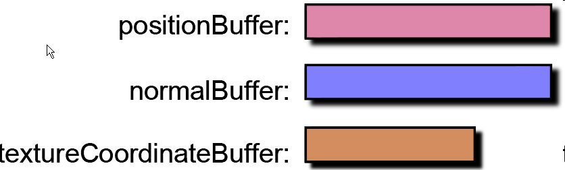
Layouts
Separate Buffers
Non-interleaved Buffer
Interleaved Buffer
Images from www.virtualglobebook.com

Slide 14
Layout Tradeoffs
Separate Buffers
Flexibility, e.g.:
Combination of static and dynamic buffers
Multiple objects share the same buffer
Non-interleaved Buffer
How is the memory coherence?
Interleaved Buffer
Faster for static buffers
Proportional to the number of attributes
Hybrid?

Slide 15
Vertex Throughput Tips
Optimize for the Vertex Cache
Use smaller vertices
Use less precision, e.g., half instead of float
Pack, then unpack in vertex shader
Derive attributes or components from other attributes
How many components do you need to store a normal?

Slide 16
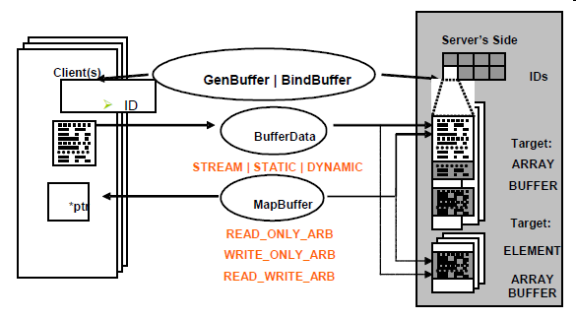
Buffer Objects
Map a pointer to driver-controlled memory
Also map just a subset of the buffer
Image from http://developer.nvidia.com/object/using_VBOs.html

Slide 17
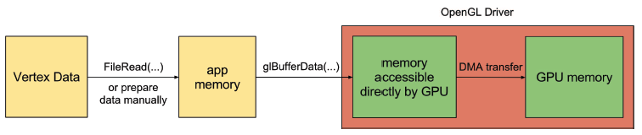
DMA
DMA – Direct Memory Access
Asynchronously transfer buffer between CPU and GPU
Asynchronous with respect to the CPU, not always the GPU
How many copies are made?
Image from http://www.openglinsights.com/
Notes:
Not all GPUs/drivers can transfer and render at the same time. Recent Quadro cards and transfer textures and render at the same time using two separate threads.
Depending on the usage hint, the data might not leave pinned memory.

Slide 18
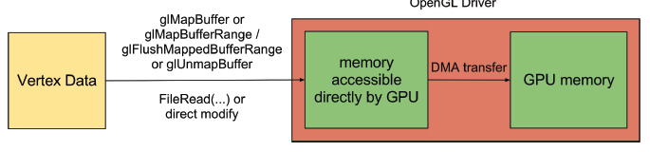
Buffer Mapping
Use glMapBuffer, glUnmapBuffer, and friends to save a copy
Pointer returned by glMapBuffer is valid until glUnmapBuffer is called.
Image from http://developer.nvidia.com/object/using_VBOs.html
Notes:
Since the pointer is valid until glUnmapBuffer is called, it can be accessed in a worker thread.

Slide 19
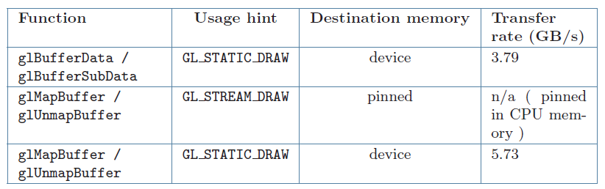
Buffer Mapping
Image from http://developer.nvidia.com/object/using_VBOs.html
Notes:
Intel Core i5 760 and an NVIDIA GeForce GTX 470 with PCI-e 2.0

Slide 20
Buffer Mapping
Use glMapBufferRange to map a subset of a buffer. Why?

Slide 21
Buffer Mapping
Use glMapBufferRange to map a subset of a buffer. Why?
Only upload the portion of a buffer that changed
Manual double buffering – use one half for updating and the other for rendering

Slide 22
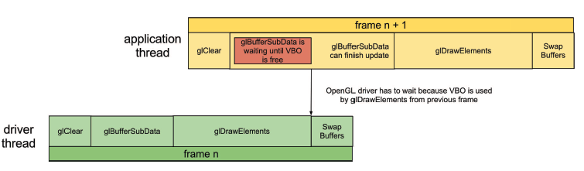
Implicit Synchronization
Command queue
Rendering may occur a frame or two later
Helps hide latency
However implicit synchronization can occur:
Image from http://developer.nvidia.com/object/using_VBOs.html

Slide 23
Implicit Synchronization
Avoiding implicit synchronization
Round-robin
Orphan
Manual synchronization

Slide 24
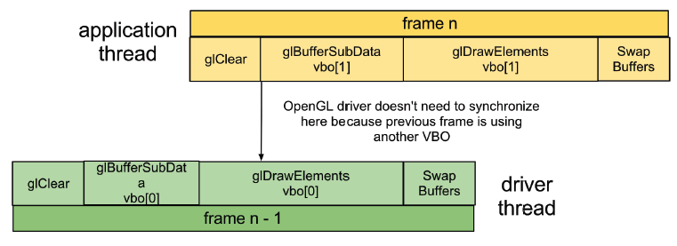
Implicit Synchronization
Round-robin
Image from http://developer.nvidia.com/object/using_VBOs.html

Slide 25
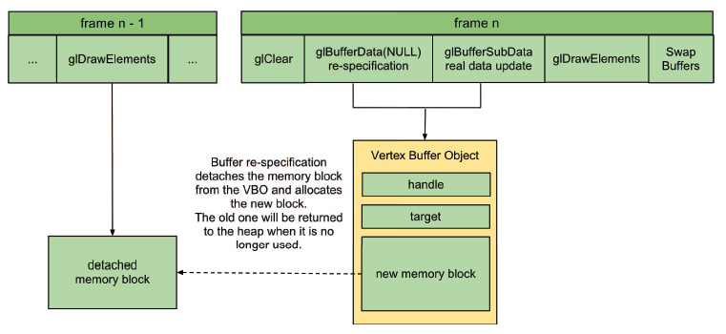
Implicit Synchronization
Orphan – round robin inside the driver?
Image from http://developer.nvidia.com/object/using_VBOs.html
Notes:
Inconsistent performance across vendors. NVIDIA appears to still synchronize. Not recommended.

Slide 26
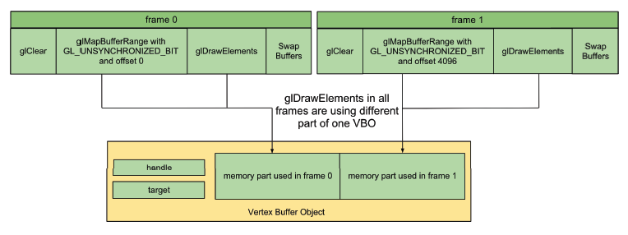
Implicit Synchronization
Use glMapBufferRange with GL_MAP_UNSYNCHRONIZED_BIT
Manually sync with glClientWaitSync
Image from http://developer.nvidia.com/object/using_VBOs.html

Slide 27
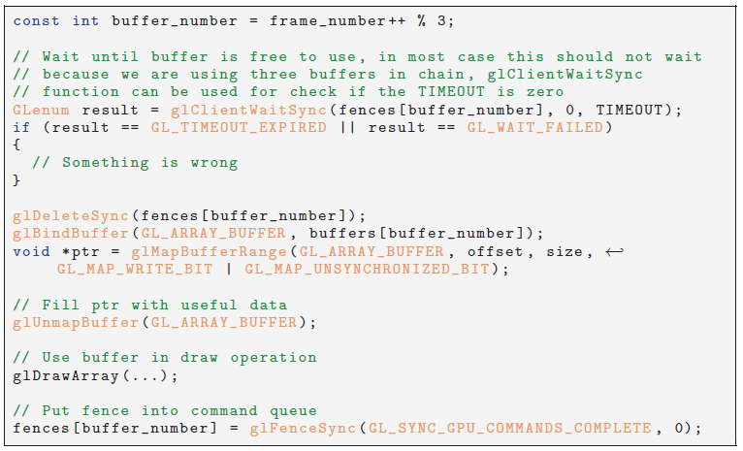
Implicit Synchronization
Image from http://developer.nvidia.com/object/using_VBOs.html

Slide 28
Other Buffer Objects
Pixel Buffers
Texture Buffers
Uniform Buffers
These are not in OpenGL ES 2.

