Slide 1
TODO
RTR 18.3
http://www.google.com/url?sa=t&rct=j&q=&esrc=s&source=web&cd=4&ved=0CD0QFjAD&url=http%3A%2F%2Fbps11.idav.ucdavis.edu%2Ftalks%2F05-schedulingGraphicsPipelineWithNotes-BPS2011-raganKelley.pdf&ei=JH9BT-OIBqL00gGB9-3GBw&usg=AFQjCNEJxX_IvZ8eMZZTZZLXXDLhSYGF1g
http://www.cs.cmu.edu/afs/cs.cmu.edu/academic/class/15869-f11/www/

Slide 2
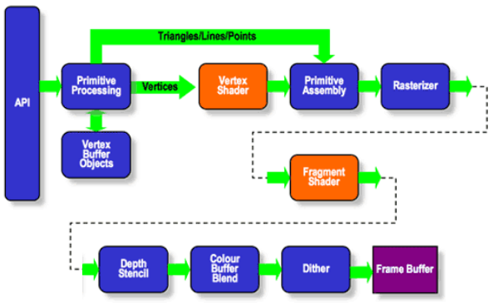
OpenGL ES 2.0 Pipeline
Image from http://www.khronos.org/assets/uploads/developers/library/2011-devcon5-santa-clara/DevCon5-WebGL-WebCL-and-Beyond_Dec11.pdf

Slide 3
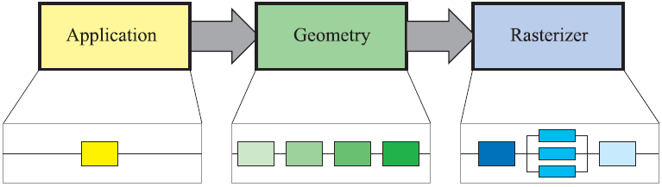
Why GPUs?
Pipeline Parallel
Parallelism across stages
Examples: washer/dryer, ski lift, assembly line
Image from http://www.realtimerendering.com/

Slide 4
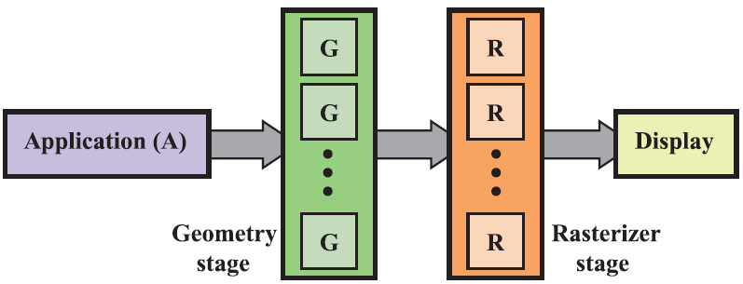
Why GPUs?
Data-parallel
Parallelism within stages
Image from http://www.realtimerendering.com/

Slide 5
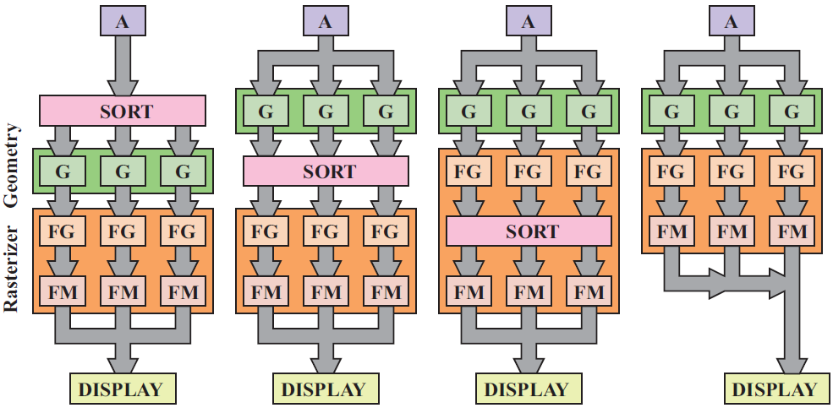
Why GPUs?
Data-parallel
How do we schedule the pipeline?
Image from http://www.realtimerendering.com/

Slide 6
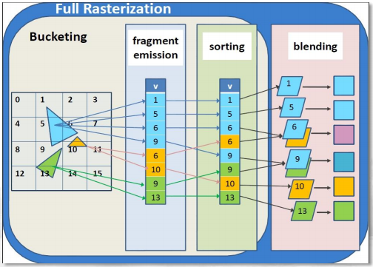
Rasterization
Image from http://bps11.idav.ucdavis.edu/talks/08-gpuSoftwareRasterLaineAndPantaleoni-BPS2011.pdf

Slide 7
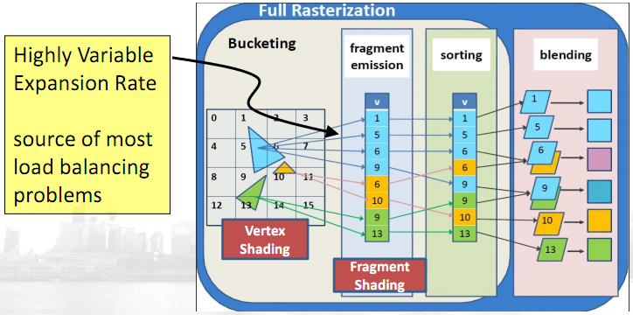
Rasterization
Image from http://bps11.idav.ucdavis.edu/talks/08-gpuSoftwareRasterLaineAndPantaleoni-BPS2011.pdf

