Slide 1
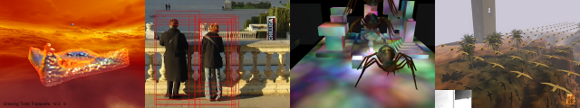
Introduction to GLSL
Patrick Cozzi
University of Pennsylvania
CIS 565 - Spring 2012

Slide 2
Announcements
Initial project blog post due today
Email a link to cis565-s2012@googlegroups.com
Homework 4 will be released 03/19

Slide 3
Course Contents
Mobile
Real-Time Rendering
Parallel Algorithms
CUDA
OpenGL / WebGL
Graphics Pipeline
GPU Architecture

Slide 4
Agenda
Fixed vs. Programmable Pipeline Example
GLSL

Slide 5
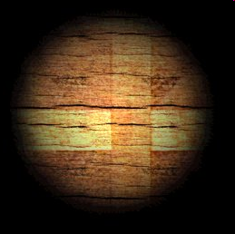
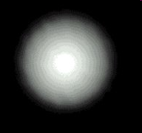
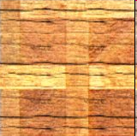
Light Map
x
=
Precomputed light
Surface color
“lit” surface
Multiple two textures component-wise
Images from: http://zanir.wz.cz/?p=56&lang=en

Slide 6
Light Map: Fixed Function
GLuint lightMap;
GLuint surfaceMap;
// ...
glEnable(GL_TEXTURE_2D);
glActiveTexture(GL_TEXTURE0);
glBindTexture(GL_TEXTURE_2D, lightMap);
glTexEnvf(GL_TEXTURE_ENV, GL_TEXTURE_ENV_MODE, GL_MODULATE);
glActiveTexture(GL_TEXTURE1);
glBindTexture(GL_TEXTURE_2D, surfaceMap);
glTexEnvf(GL_TEXTURE_ENV, GL_TEXTURE_ENV_MODE, GL_MODULATE);
glDraw*(...);
Tell fixed function we are
using texture mapping
Tell fixed function how to combine textures

Slide 7
Light Map: Fixed Function
In general, the fixed function
is configurable
is limited
leads to a bloated API
Is a pain to use
Isn’t as cool as writing shaders
True – but not a valid answer on the homework/exam

Slide 8
Light Map: Programmable
Write a fragment shader:
uniform sampler2D lightMap;
uniform sampler2D surfaceMap;
varying vec2 fs_txCoord;
void main(void)
{
float intensity = texture2D(lightMap, fs_txCoord).r;
vec3 color = texture2D(surfaceMap, fs_txCoord).rgb;
gl_FragColor = vec4(intensity * color, 1.0);
}
Textures (input)
Per-fragment input
one channel intensity
Three channel color
modulate
Notes:
In GL ES and WebGL, replace:
“varying” with “attribute”
“texture” with “texture2D”
“out_Color” with “gl_FragColor.” Remove “out vec3 out_Color;”

Slide 9
Light Map: Programmable
Recall the fixed function light map:
GLuint lightMap;
GLuint surfaceMap;
// ...
glEnable(GL_TEXTURE_2D);
glActiveTexture(GL_TEXTURE0);
glBindTexture(GL_TEXTURE_2D, lightMap);
glTexEnvf(GL_TEXTURE_ENV, GL_TEXTURE_ENV_MODE, GL_MODULATE);
glActiveTexture(GL_TEXTURE1);
glBindTexture(GL_TEXTURE_2D, surfaceMap);
glTexEnvf(GL_TEXTURE_ENV, GL_TEXTURE_ENV_MODE, GL_MODULATE);
glDraw*(...);

Slide 10
Light Map: Programmable
GLuint lightMap;
GLuint surfaceMap;
GLuint program;
// ...
glActiveTexture(GL_TEXTURE0);
glBindTexture(GL_TEXTURE_2D, lightMap);
glActiveTexture(GL_TEXTURE1);
glBindTexture(GL_TEXTURE_2D, surfaceMap);
glUseProgram(program); // Later: pass uniform variables
glDraw*(...);

Slide 11
Programmable Shading
In general:
Write a shader: a small program that runs on the GPU
Tell OpenGL to execute your shader
Write less CPU code / API calls
Forget that the equivalent fixed function API ever existed

Slide 12

Programmable Shading
In general:
Say no to drugs
too, please.
Fixed function shading
Programmable shading
Image from: http://upgifting.com/tmnt-pizza-poster

Slide 13
Programmable Shading
Software engineering question:
If different GPUs have different levels of shader support, what capabilities do we target?

Slide 14
Shader Execution Model
For any shader type:
Uniform (constant) input
Shader
Streaming input
Output
Streaming input and output examples: vertices, primitives, fragments, …
Uniform input examples: matrices, textures, time, …

Slide 15
Shader Execution Model
Shaders run in parallel on the GPU
Uniform (constant) input
Shader
Shader
Streaming input
Output
Shader
Shader

Slide 16
Shader Execution Model
Each shader
Shares the same read-only uniform inputs
Has different read-only input from a stream
Writes it own output
Has no side effects*
Executes independently without communicating with other shaders*
Uniform (constant) input
Shader
Streaming input
Shader
Output
Shader
Shader
* Except in OpenGL 4.2+

Slide 17
Shader Execution Model
Parallelism is implicit
Calling glDraw* invokes a parallel processor – the GPU
The driver/hardware takes care of scheduling and synchronizing
Users write parallel applications without even knowing it!

Slide 18
Shaders in the Pipeline
Vertex Assembly
Classic OpenGL 2 / OpenGL ES 2 / WebGL / Direct3D 9 Pipeline
Newer pipelines also have programmable geometry and tessellation shaders
Vertex Shader
Primitive Assembly
Rasterizer
Fragment Shader
Per-Fragment Tests
Blend
Framebuffer

Slide 19
Vertex Shaders in the Pipeline
A simple vertex shader:
The same model-view transform is used for each vertex in a particular glDraw* call.
uniform mat4 u_modelViewProjection;
attribute vec4 position;
void main(void)
{
gl_Position = u_modelViewProjection * vec4(position, 1.0);
}
Each vertex shader executes in a different thread with a different position.
4x4 matrix times a 4-element vector; transform from model to clip coordinates.
gl_Position is the GLSL built-in vertex shader position output. We must write to it.

Slide 20
Vertex Shaders in the Pipeline
A vertex shader with two input attributes:
uniform mat4 u_modelViewProjection;
attribute vec3 position;
attribute vec3 color;
varying vec3 fs_color;
void main(void)
{
fs_color = color;
gl_Position = u_modelViewProjection * vec4(position, 1.0);
}
Each vertex shader executes in a different thread with a different position and color.
This vertex shader outputs a vec3 color in addition to gl_Position.

Slide 21
Fragment Shaders in the Pipeline
Recall:
Input
Fragment position in screen space: gl_FragCoord.xy
Fragment depth: gl_FragCoord.z
Interpolated vertex shader outputs
Uniforms
Output
Fragment color
Optional: fragment depth: gl_FragDepth*
Optional: multiple “colors” to multiple textures*
discard
Can’t change gl_FragCoord.xy. Why?
* When supported

Slide 22

Fragment Shaders in the Pipeline
A simple fragment shader:
void main(void)
{
gl_FragColor = vec3(1.0, 0.0, 0.0, 1.0);
}
Each fragment shader executes in a different thread and outputs the color for a different fragment.
Result:
Shade solid red.

Slide 23
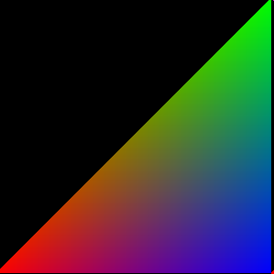
Fragment Shaders in the Pipeline
A slightly less simple fragment shader:
varying vec3 fs_color;
void main(void)
{
gl_FragColor = fs_color;
}
Fragment shader input from vertex shader output after rasterization.
Pass color through.
Result:
How?

Slide 24
GLSL Syntax
GLSL is like C without
pointers
recursion
dynamic memory allocation
GLSL is like C with
Built-in vector, matrix, and sampler types
Constructors
A great math library
Language features allow us to write concise, efficient shaders.

Slide 25

GLSL Syntax
My advice: If you know C, just do it.
Image from: http://nouvellemode.wordpress.com/2009/11/25/just-do-it/

Slide 26
GLSL Syntax
GLSL has a preprocessor
#ifdef FAST_EXACT_METHOD
FastExact();
#else
SlowApproximate();
#endif
#line 0
// ... many others
All shaders have main()
void main(void)
{
}

Slide 27
GLSL Syntax: Vectors
Scalar types: float, int, uint, and bool
Vectors are also built-in types:
vec2, vec3, and vec4
Also ivec*, uvec*, and bvec*
Access components three ways:
.x, .y, .z, .w
.r, .g, .b, .a
.s, .t, .p, .q
Position or direction
Color
Texture coordinate

Slide 28
GLSL Syntax: Vectors
Vectors have constructors
vec3 xyz = vec3(1.0, 2.0, 3.0);
vec3 xyz = vec3(1.0); // [1.0, 1.0, 1.0]
vec3 xyz = vec3(vec2(1.0, 2.0), 3.0);

Slide 29
GLSL Syntax: Swizzling
Swizzle: select or rearrange components
vec4 c = vec4(0.5, 1.0, 0.8, 1.0);
vec3 rgb = c.rgb; // [0.5, 1.0, 0.8]
vec3 bgr = c.bgr; // [0.8, 1.0, 0.5]
vec3 rrr = c.rrr; // [0.5, 0.5, 0.5]
c.a = 0.5; // [0.5, 1.0, 0.8, 0.5]
c.rb = 0.0; // [0.0, 1.0, 0.0, 0.5]
float g = rgb[1]; // 0.5, indexing, not swizzling
Try it – you’ll love it.

Slide 30
GLSL Syntax: Matrices
Matrices are built-in types:
Square: mat2, mat3, and mat4
Rectangular: matmxn. m columns, n rows
Stored column major.

Slide 31
GLSL Syntax: Matrices
Matrix Constructors
mat3 i = mat3(1.0); // 3x3 identity matrix
mat2 m = mat2(1.0, 2.0, // [1.0 3.0]
3.0, 4.0); // [2.0 4.0]
Accessing Elements
Treat matrix as array of column vectors
float f = m[column][row];
float x = m[0].x; // x component of first column
vec2 yz = m[1].yz; // yz components of second column
Can swizzle too!

Slide 32
GLSL Syntax: Vectors and Matrices
Matrix and vector operations are easy and fast:
vec3 xyz = // ...
vec3 v0 = 2.0 * xyz; // scale
vec3 v1 = v0 + xyz; // component-wise
vec3 v2 = v0 * xyz; // component-wise
mat3 m = // ...
mat3 v = // ...
mat3 mv = v * m; // matrix * matrix
mat3 xyz2 = mv * xyz; // matrix * vector
mat3 xyz3 = xyz * mv; // vector * matrix

Slide 33
GLSL Syntax: attribute / varying / uniform
Recall:
uniform: shader input constant across glDraw*
uniform mat4 u_modelViewProjection;
attribute vec3 position;
attribute vec3 color;
varying vec3 fs_color;
void main(void)
{
fs_color = color;
gl_Position = u_modelViewProjection * vec4(position, 1.0);
}
attribute: shader input varies per vertex attribute
varying: shader output
Notes:
Modern desktop GL uses in/out

Slide 34
GLSL Syntax: Samplers
Opaque types for accessing textures
uniform sampler2D diffuseMap; // 2D texture
vec3 color = texture2D(diffuseMap, vec2(0.5, 0.5)).rgb;
// Also samplerCube.

Slide 35
GLSL Syntax: Samplers
Opaque types for accessing textures
uniform sampler2D diffuseMap; // 2D texture
vec3 color = texture2D(diffuseMap, vec2(0.5, 0.5)).rgb;
// Also samplerCube.
Samplers must be uniforms

Slide 36
GLSL Syntax: Samplers
Opaque types for accessing textures
uniform sampler2D diffuseMap; // 2D texture
vec3 color = texture2D(diffuseMap, vec2(0.5, 0.5)).rgb;
// Also samplerCube.
texture() returns a vec4; extract the components you need
2D texture uses 2D texture coordinates for lookup

Slide 37
GLSL Syntax: Samplers
Textures
Usually, but not always:
Textures are square, e.g., 256x256
Dimensions are a power of two
Coordinates are usually normalized, i.e., in the range [0, 1]
Texel: a pixel in a texture
texture2D() does filtering using fixed function hardware

Slide 38
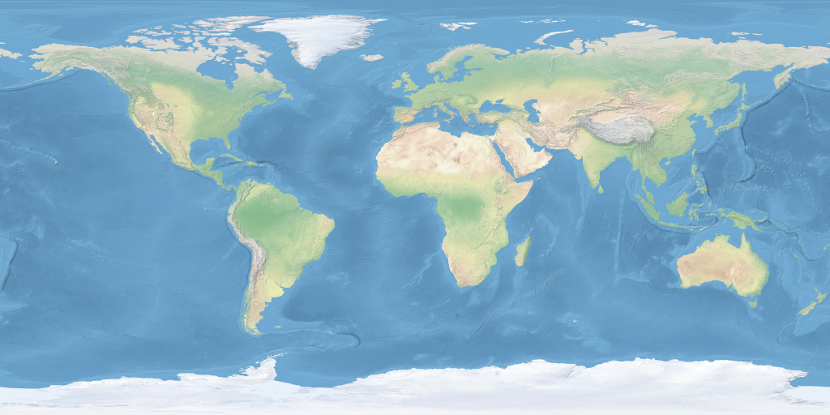
GLSL Syntax: Samplers
t
(1, 1)
s
(0, 0)
Images from: http://www.naturalearthdata.com/

Slide 39
GLSL Built-in Functions
Selected Trigonometry Functions
float s = sin(theta);
float c = cos(theta);
float t = tan(theta);
float as = asin(theta);
// ...
vec3 angles = vec3(/* ... */);
vec3 vs = sin(angles);
Works on vectors component-wise.

Slide 40
GLSL Built-in Functions
Exponential Functions
float xToTheY = pow(x, y);
float eToTheX = exp(x);
float twoToTheX = exp2(x);
float l = log(x); // ln
float l2 = log2(x); // log2
float s = sqrt(x);
float is = inversesqrt(x);
One GPU instruction!
Notes:
CUDA Guide says inversesqrt is 16 clock cycles for 32 thread warp – 4x the cost of other instructions.

Slide 41
GLSL Built-in Functions
Selected Common Functions
float ax = abs(x); // absolute value
float sx = sign(x); // -1.0, 0.0, 1.0
float m0 = min(x, y); // minimum value
float m1 = max(x, y); // maximum value
float c = clamp(x, 0.0, 1.0);
// many others: floor(), ceil(),
// step(), smoothstep(), ...

Slide 42
GLSL Built-in Functions
Rewrite with one function call
float minimum = // ...
float maximum = // ...
float x = // ...
float f = min(max(x, minimum), maximum);
Notes:
float f= clamp(x, minimum, maximum);

Slide 43
GLSL Built-in Functions
Rewrite this without the if statement
float x = // ...
float f;
if (x > 0.0)
{
f = 2.0;
}
else
{
f = -2.0;
}
Notes:
For x != 0:
float f = 2.0 * sign(x);

Slide 44
GLSL Built-in Functions
Rewrite this without the if statement
float root1 = // ...
float root2 = // ...
if (root1 < root2)
{
return vec3(0.0, 0.0, root1);
}
else
{
return vec3(0.0, 0.0, root2);
}
Notes:
return vec3(0.0, 0.0, min(root1, root2));

Slide 45
GLSL Built-in Functions
Rewrite this without the if statement
bool b = // ...
vec3 color;
if (b)
{
color = vec3(1.0, 0.0, 0.0);
}
else
{
color = vec3(0.0, 1.0, 0.0);
}
Hint: no built-in functions required for this one.
Notes:
vec3 color = vec3(b, !b, 0.0);

Slide 46
GLSL Built-in Functions
Selected Geometric Functions
vec3 l = // ...
vec3 n = // ...
vec3 p = // ...
vec3 q = // ...
float f = length(l); // vector length
float d = distance(p, q); // distance between points
float d2 = dot(l, n); // dot product
vec3 v2 = cross(l, n); // cross product
vec3 v3 = normalize(l); // normalize
vec3 v3 = reflect(l, n); // reflect
// also: faceforward() and refract()

Slide 47


GLSL Built-in Functions
reflect(-l, n)
Given l and n, find r. Angle in equals angle out
n
l
r
Notes:
Observe: 2(dot(n, l)) = l + r, therefore r = 2(dot(n, l)) – l
Also refect()

Slide 48
GLSL Built-in Functions
Rewrite without length.
vec3 p = // ...
vec3 q = // ...
vec3 v = length(p – q);
Notes:
vec3 v =distance(p, q);

Slide 49
GLSL Built-in Functions
What is wrong with this code?
vec3 n = // ...
normalize(n);
Notes:
Normalize returns a new vector

Slide 50
GLSL Built-in Functions
Selected Vector Relational Functions
vec3 p = vec3(1.0, 2.0, 3.0);
vec3 q = vec3(3.0, 2.0, 1.0);
bvec3 b = equal(p, q); // (false, true, false)
bvec3 b2 = lessThan(p, q); // (true, false, false)
bvec3 b3 = greaterThan(p, q); // (false, false, true)
bvec3 b4 = any(b); // true
bvec3 b5 = all(b); // false

Slide 51
GLSL Built-in Functions
Rewrite this in one line of code
bool foo(vec3 p, vec3 q)
{
if (p.x < q.x)
{
return true;
}
else if (p.y < q.y)
{
return true;
}
else if (p.z < q.z)
{
return true;
}
return false;
}
Notes:
return any(lessThan(p, q));

Slide 52
GLSL Syntax and Built-in Functions
We didn’t cover:
Arrays
Structs
Function calls
const
if / while / for
dFdX, dFdy, fwidth
…
Notes:
Screen space partial derivatives impact fragment shading scheduling. More later.

Slide 53
GLSL Resources
OpenGL ES/GLSL Quick Reference Card
http://www.khronos.org/opengles/sdk/2.0/docs/reference_cards/OpenGL-ES-2_0-Reference-card.pdf
GLSL Man Pages
http://www.opengl.org/sdk/docs/manglsl/
NShader: Visual Studio GLSL syntax highlighting
http://nshader.codeplex.com/

