Slide 1
GPU Computing Tools
Varun Sampath
University of Pennsylvania
CIS 565 - Spring 2012

Slide 2
Agenda
CUDA Toolchain
APIs
Language bindings
Libraries
Visual Profiler
Parallel Nsight
OpenCL
C++ AMP

Slide 3
CUDA Documentation
http://developer.nvidia.com/nvidia-gpu-computing-documentation
CUDA C Programming Guide
CUDA C Best Practices Guide
CUDA API Reference Manual
Occupancy Calculator
Much more

Slide 4
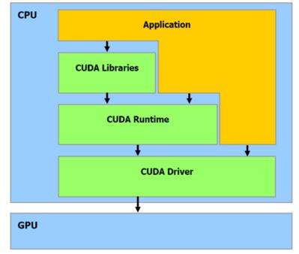
CUDA Organization
Host code: two layers
Runtime API
cudart dynamic library
cuda_runtime_api.h (C)
cuda_runtime.h (C++)
Driver API
nvcuda dynamic library
cuda.h
Device code
Kernel → PTX (parallel thread eXecution)
Image from Stack Overflow

Slide 5
CUDA API Comparison
CUDA Runtime API
CUDA Driver API
// create CUDA device & context
cudaSetDevice( 0 ); // pick first device
kernel_naive_copy<<<cnBlocks, cnBlockSize>>> (i_data, o_data, rows, cols);
cuInit(0);
cuDeviceGet(&hContext, 0); // pick first device
cuCtxCreate(&hContext, 0, hDevice));
cuModuleLoad(&hModule, “copy_kernel.cubin”);
cuModuleGetFunction(&hFunction, hModule, “kernel_naive_copy");
…
cuLaunchGrid(cuFunction, cnBlocks, 1);
Differences?
Code from CUDA Best Practices Guide 4.0
Notes:
Can pass in cubin or even PTX for PTX-JIT compiling. PTX itself is JIT compiled anyways. Code not necessarily important, but idea of treating code as input to another device is important.
Advantages of Driver API:
More device context control
No C extensions in host code
Advantages of Runtime API
Much simpler to use
Easier to link against
Don’t need to distribute .cubin or .ptx files
Don’t need to explicitly manage contexts
Some libraries link only against runtime API (CUBLAS, CUFFT)

Slide 6
Some CUDA Language Bindings
Note: the following are not supported by NVIDIA
PyCUDA (Python)
Developed by Andreas Klöckner
Built on top of CUDA Driver API
Also: PyOpenCL
JCuda (Java)
MATLAB
Parallel Computing Toolbox
AccelerEyes Jacket

Slide 7
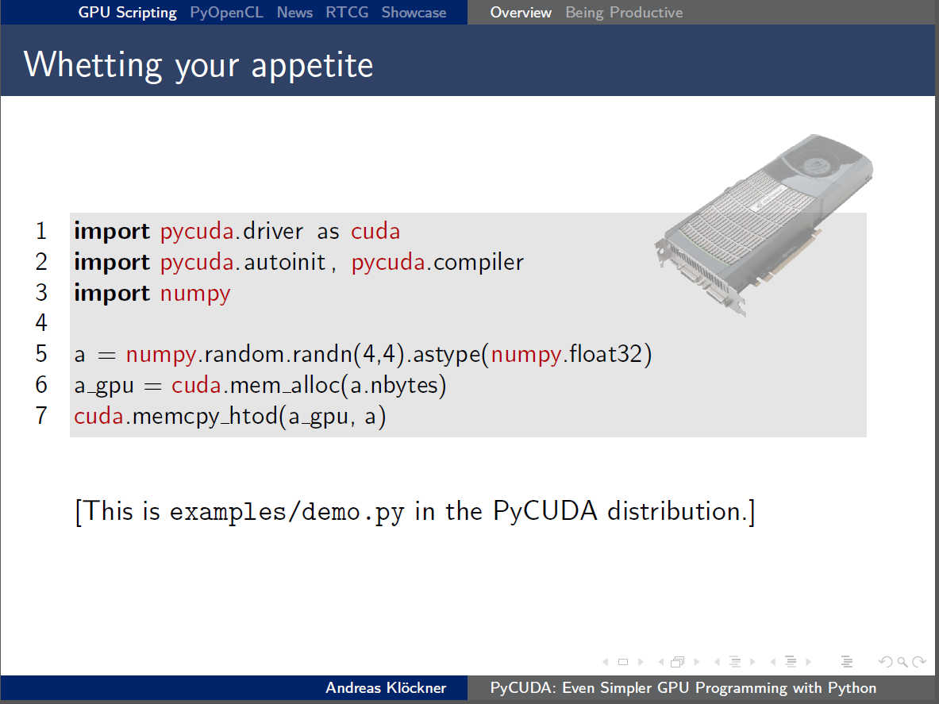
Slides URL

Slide 8
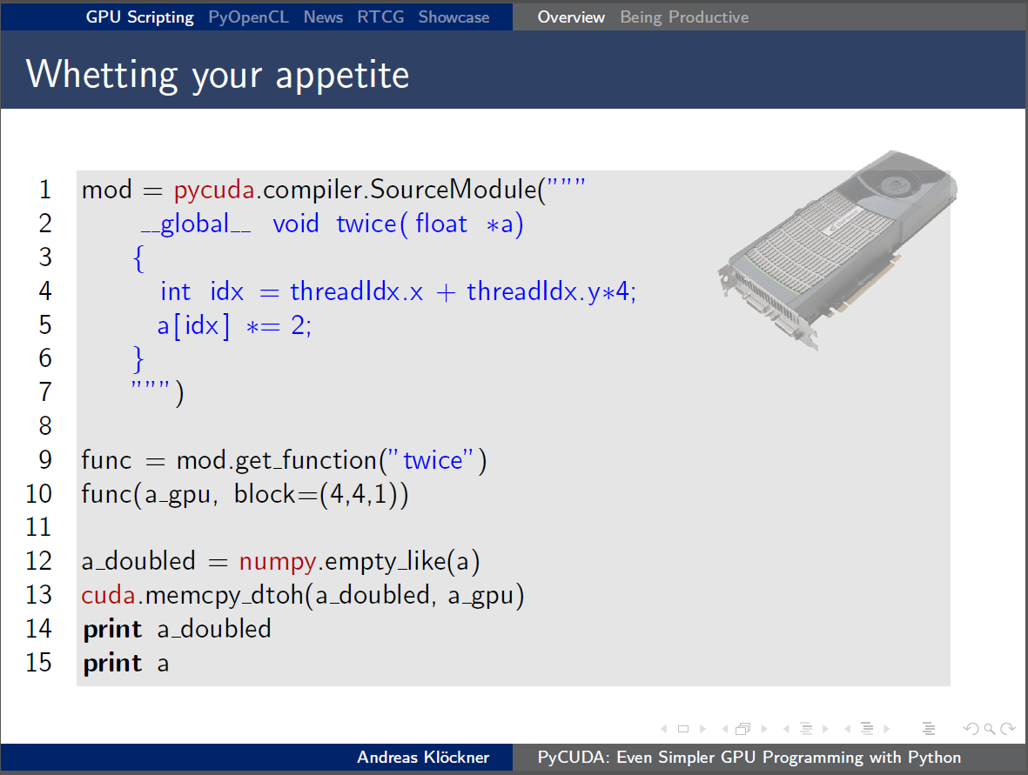
Slides URL

Slide 9
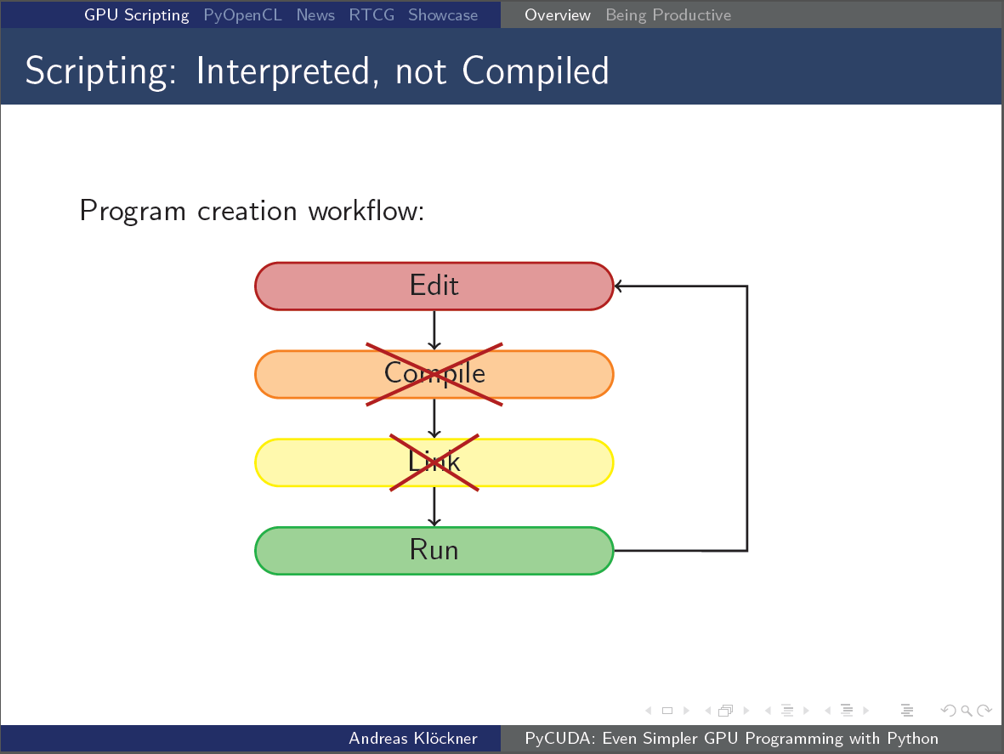
Slides URL

Slide 10
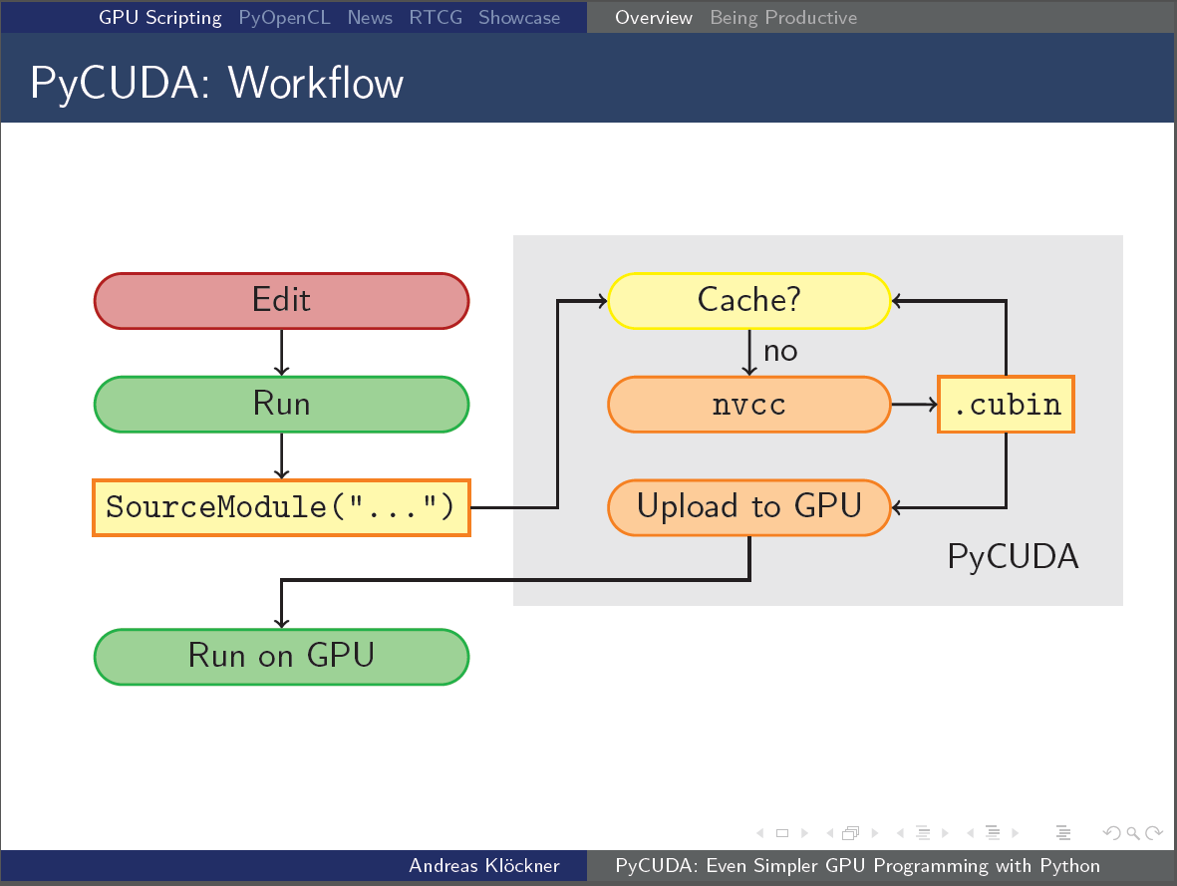
How can not-compiling help?
Slides URL
Notes:
Run-time Code Generation. We can generate, and potentially optimize, GPU code at runtime.

Slide 11
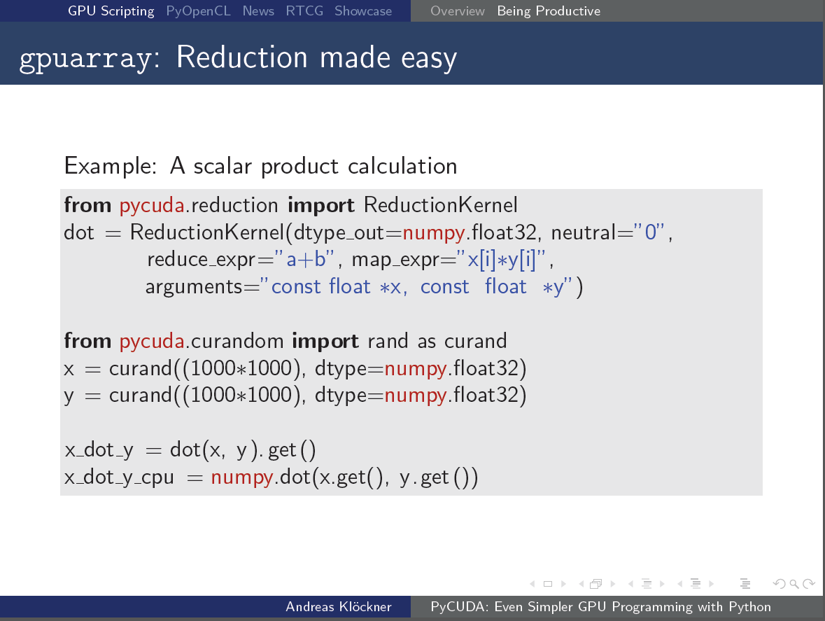
What does this code do?
Slides URL

Slide 12
MATLAB Parallel Computing Toolbox
A = gpuArray(rand(2^16,1)); % copy to GPU
B = fft (A); % run FFT (overloaded function)
C = gather(B); % copy back to host
Only differences between this and CPU code are gpuArray()and gather()
Can also use arrayfun()or your own CUDA kernel
Any performance problems with this approach?
Code from MathWorks
Notes:
Implementation of algorithms are pure black boxes. Limited variables we can control. Jacket claims much better performance and efficiency.

Slide 13
CUDA Libraries
Productivity
Thrust
Performance
cuBLAS
cuFFT
Plenty more

Slide 14
Prelude: C++ Templates Primer
template <typename T>
T sum(const T a, const T b) {
return a + b;
}
int main() {
cout << sum<int>(1, 2) << endl;
cout << sum<float>(1.21, 2.43) << endl;
return 0;
}
Make functions and classes generic
Evaluate at compile-time
Standard Template Library (STL)
Algorithms, iterators, containers
Reference: MIT OCW

Slide 15
Thrust - “Code at the speed of light”
Developed by Jared Hoberock and Nathan Bell of NVIDIA Research
Objectives
Programmer productivity
Leverage parallel primitives
Encourage generic programming
E.g. one reduction to rule them all
High performance
With minimal programmer effort
Interoperability
Integrates with CUDA C/C++ code
Objectives from Intro to Thrust Slides

Slide 16
Thrust - Example
#include <thrust/host_vector.h>
#include <thrust/device_vector.h>
#include <thrust/generate.h>
#include <thrust/sort.h>
#include <thrust/copy.h>
#include <cstdlib>
int main(void)
{
// generate 16M random numbers on the host
thrust::host_vector<int> h_vec(1 << 24);
thrust::generate(h_vec.begin(), h_vec.end(), rand);
// transfer data to the device
thrust::device_vector<int> d_vec = h_vec;
// sort data on the device
thrust::sort(d_vec.begin(), d_vec.end());
// transfer data back to host
thrust::copy(d_vec.begin(), d_vec.end(), h_vec.begin());
return 0;
}
Code from GPU Computing Gems

Slide 17
Thrust Design
Based off STL ideas
Algorithms, iterators, containers
Generic through C++ templates
Built on top of CUDA Runtime API
Ships with CUDA 4.0+
Four fundamental parallel algorithms
for_each
reduce
scan
sort
Notes:
Nearly everything is built off of these 4 algorithms.

Slide 18
Thrust-CUDA C Interoperability
size_t N = 1024;
// raw pointer to device memory
int* raw ptr;
cudaMalloc(&raw_ptr, N*sizeof(int));
// wrap raw pointer with a device ptr
device_ptr<int> dev_ptr = device_pointer_cast(raw_ptr);
// use device ptr in Thrust algorithms
sort(dev_ptr, dev_ptr + N);
// access device memory through device ptr
dev_ptr[0] = 1;
// free memory
cudaFree(raw ptr);
Code from GPU Computing Gems
Notes:
Functions to convert between raw pointers and device_pointer objects

Slide 19
Thrust with User-Defined Functions
struct saxpy_functor {
const float a;
saxpy_functor(float a) : a( a) {}
__host__ __device__
float operator()(float x, float y){ return a*x+y; }
};
void saxpy(float a, device vector<float>& x, device vector<float>& y) {
// setup functor
saxpy_functor func(a);
// call transform
transform(x.begin(), x.end(), y.begin(), y.begin(), func);
}
Code from GPU Computing Gems
Notes:
Transform is based off for_each. Transform’s unary function could probably be inlined too, and it’s all nicely generic. Because of namespaces, we don’t have to worry about conflicts with STL.

Slide 20
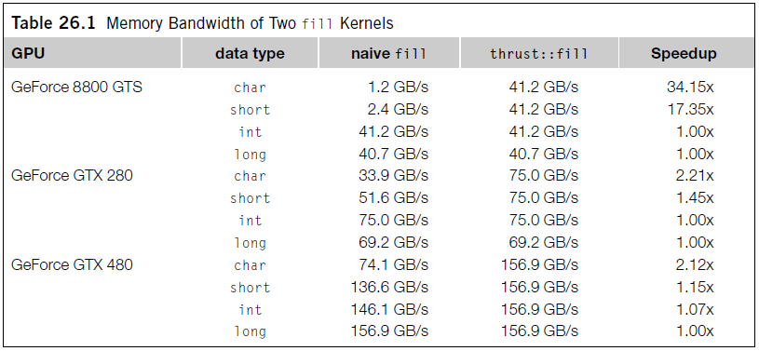
Thrust Performance
Templates allow inlining and type analysis
How could knowing types improve global memory performance?
Image from GPU Computing Gems
Notes:
“Global memory instructions support reading or writing words of size equal to 1, 2, 4, 8, or 16 bytes. Any access (via a variable or a pointer) to data residing in global memory compiles to a single global memory instruction if and only if the size of the data type is 1, 2, 4, 8, or 16 bytes and the data is naturally aligned (i.e. its address is a multiple of that size).
If this size and alignment requirement is not fulfilled, the access compiles to multiple instructions with interleaved access patterns that prevent these instructions from fully coalescing. It is therefore recommended to use types that meet this requirement for data that resides in global memory.” -- CUDA Programming Guide

Slide 21
Thrust Toy-box
Kernel fusion with transform_iterator and permutation_iterator
Conversion between arrays of structs (AoS) and structure of arrays (SoA) with zip_iterator
Implicit ranges

Slide 22
Thrust Kernel Fusion
struct square {
__host__ __device__
float operator()(float x) const { return x*x; }
};
float snrm2_slow(const thrust::device_vector<float>& x) {
// without fusion
device_vector<float> temp(x.size());
transform(x.begin(), x.end(), temp.begin(), square());
return sqrt( reduce(temp.begin(), temp.end()) );
}
float snrm2_fast(const thrust::device_vector<float>& x) {
// with fusion
return sqrt( transform_reduce(x.begin(), x.end(), square(), 0.0f, plus<float>());
}
Code from GPU Computing Gems
Notes:
SNRM2 – computes Euclidean norm of a float vector
Applying function composition to reduce memory bandwidth abuse.

Slide 23
Thrust SoA ↔AoS Conversion
struct rotate_tuple
{
__host__ __device__
tuple<float,float,float> operator()(tuple<float,float,float>& t){
float x = get<0>(t); float y = get<1>(t);
float z = get<2>(t);
float rx = 0.36f*x + 0.48f*y + -0.80f*z;
float ry =-0.80f*x + 0.60f*y + 0.00f*z;
float rz = 0.48f*x + 0.64f*y + 0.60f*z;
return make_tuple(rx, ry, rz);
}};
…
device_vector<float> x(N), y(N), z(N);
transform(make_zip_iterator(make_tuple(x.begin(), y.begin(), z.begin())),
make_zip_iterator(make_tuple(x.end(), y.end(), z.end())),
make_zip_iterator(make_tuple(x.begin(), y.begin(), z.begin())),
rotate_tuple());
Code from GPU Computing Gems
Notes:
SNRM2 – computes Euclidean norm of a float vector
Use zip iterators to combine “structure of arrays” to tuples so that it can be easily passed to transform “array of structures” style functor.

Slide 24
CUDA Specialized Libraries
NVIDIA cuBLAS
Basic Linear Algebra Subprograms (BLAS)
NVIDIA cuFFT
Compute Fast Fourier Transforms
NVIDIA NPP
Image and Signal Processing
See more: http://developer.nvidia.com/gpu-accelerated-libraries

Slide 25
CUDA Profiling and Debugging
Visual Profiler
Parallel Nsight
cuda-gdb

Slide 26
Visual Profiler
Graphical profiling application
Collects performance counter data and makes recommendations
Global memory throughput
IPC
Active warps/cycle
Cache hit rate
Register counts
Bank conflicts
Branch divergence
Many more (Full list in Visual Profiler User Guide)
Notes:
Just about every performance topic we’ve covered can be profiled.

Slide 27
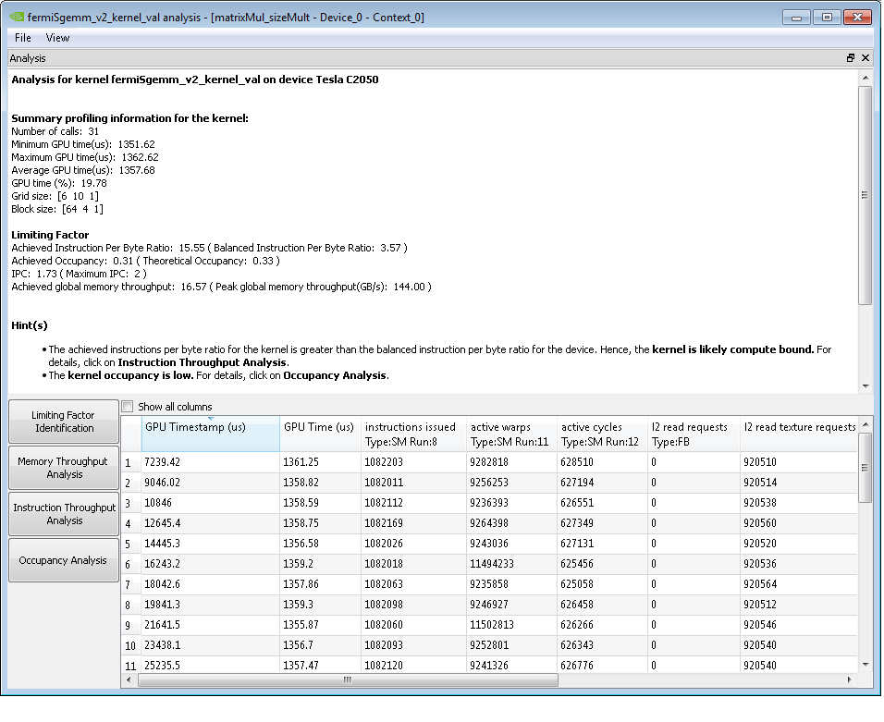
Notes:
Note the Hints that it gives.

Slide 28
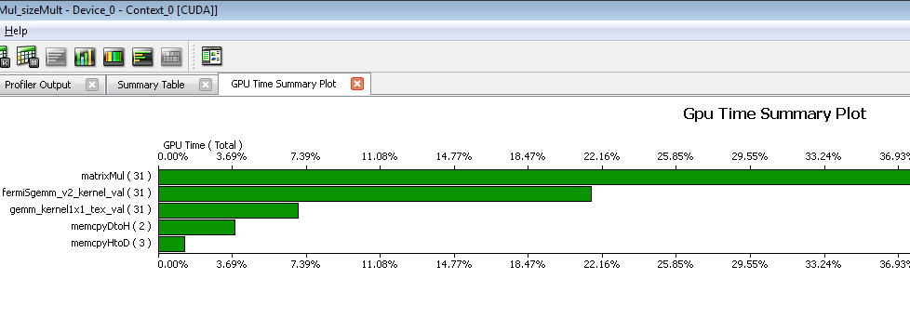
Visual Profiler
Does plots too!

Slide 29
Parallel Nsight
Motivation
Why didn’t breakpoints in Visual Studio work for debugging CUDA?

Slide 30
Parallel Nsight
Debugger and Profiler for:
CUDA
OpenCL
Direct3D Shaders
Integrated into Visual Studio 2008/2010
Caveat: requires extra GPU for display while debugging
Supports NVIDIA Optimus

Slide 31
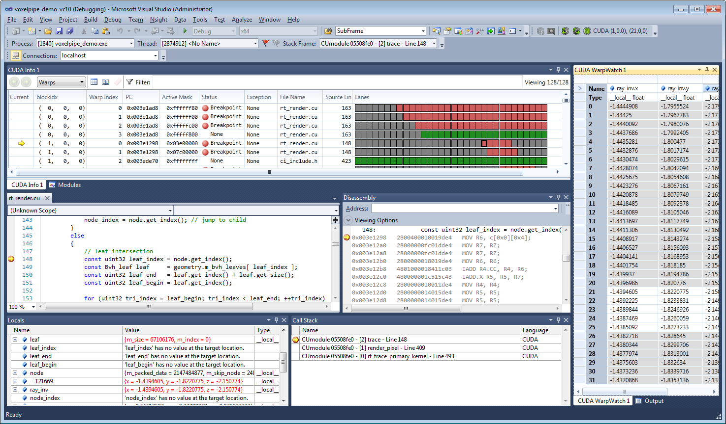
Parallel Nsight, showing breakpoints for different warps, disassembled kernel code, local variables, call stack, and register values per warp
Image from NVIDIA

Slide 32
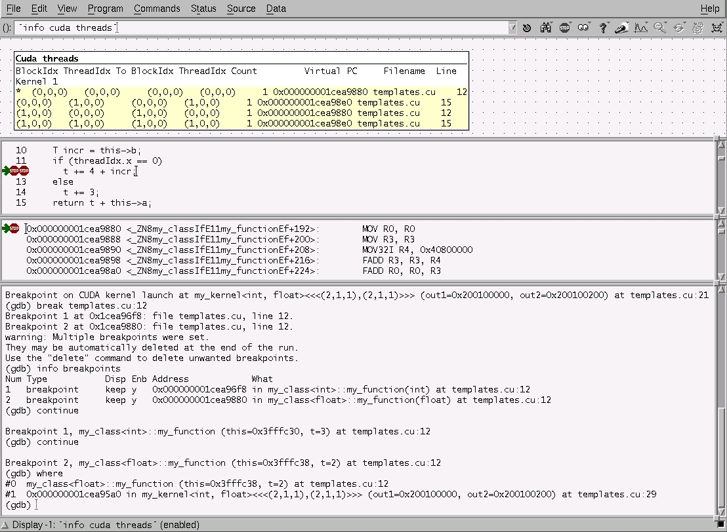
CUDA-GDB: No *nix User Left Behind
Image from NVIDIA

Slide 33

OpenCL
Image from the Khronos Group

Slide 34
OpenCL
Initially developed by Apple with help from AMD, IBM, Intel, and NVIDIA (Wikipedia)
Specification defined by the Khronos Group

Slide 35
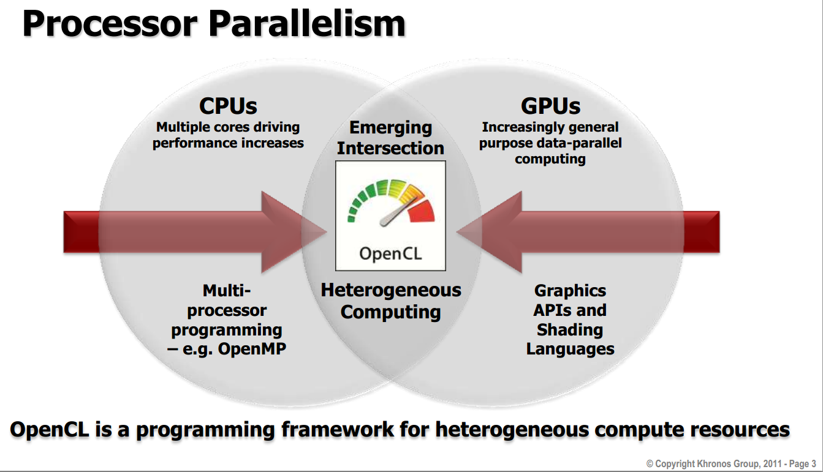
Slide from the Khronos Group

Slide 36
OpenCL Goals
Parallel Compute Framework for GPUs
And CPUs
And FPGAs
And potentially more
Some compliant runtimes
AMD APP SDK (for AMD CPUs, GPUs, and APUs)
Intel OpenCL SDK (for Intel CPUs)
NVIDIA OpenCL Runtime (for NVIDIA GPUs)
Do we want CPUs and GPUs executing the same kernels though?

Slide 37
OpenCL Host Code
size_t szLocalWorkSize[2];
size_t szGlobalWorkSize[2];
szLocalWorkSize[0] = 8;
szLocalWorkSize[1] = 8;
szGlobalWorkSize[0] = cols;
szGlobalWorkSize[1] = rows;
// setup parameter values
copyCode = oclLoadProgSource(“copy_kernel.cl", "", &copyLen);
hCopyProg = clCreateProgramWithSource(t->hContext,1, (const char **)&copyCode, &copyLen, &errcode_ret);
clBuildProgram(hCopyProg, 0, NULL, NULL, NULL, NULL);
// create kernel
t->hCopyKernel = clCreateKernel(hCopyProg, "kernel_naive_copy", &errcode_ret);
clSetKernelArg(t->hCopyKernel, 0, sizeof(cl_mem), (void*)&dev_i_data);
clSetKernelArg(t->hCopyKernel, 1, sizeof(cl_mem), (void*)&dev_o_data);
clSetKernelArg(t->hCopyKernel, 2, sizeof(cl_int), (void*)&rows);
clSetKernelArg(t->hCopyKernel, 3, sizeof(cl_int), (void*)&cols);
clEnqueueNDRangeKernel(t->hCmdQueue, t->hCopyKernel, 2, NULL, szGlobalWorkSize, szLocalWorkSize, 0, NULL, NULL);

Slide 38
OpenCL Host Code
size_t szLocalWorkSize[2];
size_t szGlobalWorkSize[2];
szLocalWorkSize[0] = 8;
szLocalWorkSize[1] = 8;
szGlobalWorkSize[0] = cols;
szGlobalWorkSize[1] = rows;
// setup parameter values
copyCode = oclLoadProgSource(“copy_kernel.cl", "", &copyLen);
hCopyProg = clCreateProgramWithSource(t->hContext,1, (const char **)&copyCode, &copyLen, &errcode_ret);
clBuildProgram(hCopyProg, 0, NULL, NULL, NULL, NULL);
// create kernel
t->hCopyKernel = clCreateKernel(hCopyProg, "kernel_naive_copy", &errcode_ret);
clSetKernelArg(t->hCopyKernel, 0, sizeof(cl_mem), (void*)&dev_i_data);
clSetKernelArg(t->hCopyKernel, 1, sizeof(cl_mem), (void*)&dev_o_data);
clSetKernelArg(t->hCopyKernel, 2, sizeof(cl_int), (void*)&rows);
clSetKernelArg(t->hCopyKernel, 3, sizeof(cl_int), (void*)&cols);
clEnqueueNDRangeKernel(t->hCmdQueue, t->hCopyKernel, 2, NULL, szGlobalWorkSize, szLocalWorkSize, 0, NULL, NULL);
← What are these for?
Look Familiar?

Slide 39
OpenCL Device Code
__kernel void kernel_naive_copy(
__global const float4 * i_data,
__global float4 * o_data,
int rows, int cols)
{
uint x = get_global_id(0);
uint y = get_global_id(1);
o_data[y*rows + x] = i_data[y*rows + x];
}
See some similarities?

Slide 40
OpenCL Code
Very similar to CUDA Driver API and CUDA C
NVIDIA has a short guide outlining syntax differences
C-based API
C++ wrappers and bindings to other languages (e.g. PyOpenCL) available

Slide 41
OpenCL or CUDA?
Which should I choose?

Slide 42
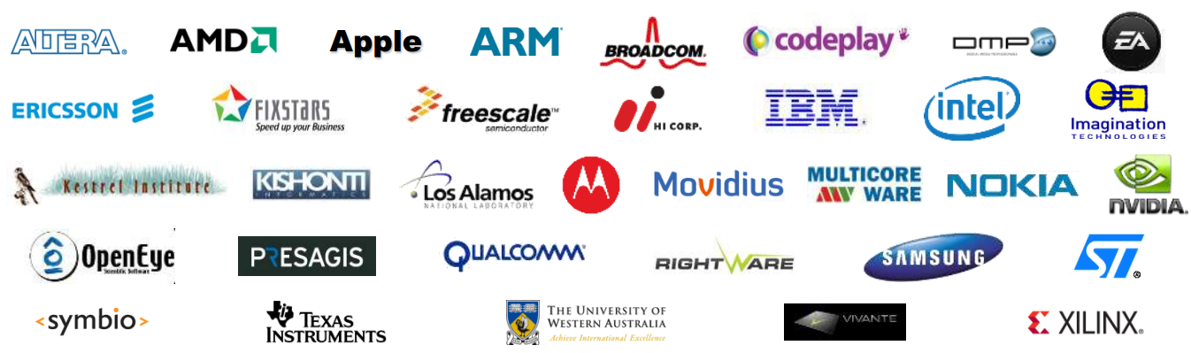
Compatibility
CUDA runs only on NVIDIA GPUs
Not necessarily true…
OpenCL is supported by a lot of vendors
Image from the Khronos Group

Slide 43
Doesn’t everyone just want an NVIDIA GPU?
Notes:
My results are not peer-reviewed, and the benchmarking had quite a few flaws. Nevertheless, point is valid that there is a chance an AMD GPU may be more well-suited to your application.

Slide 44
Performance Comparison on NVIDIA GPUs
[This was done with the CUDA 3.2 Toolkit. CUDA 4.1 brought a new LLVM compiler to CUDA (OpenCL compiler was already LLVM-based)]

Slide 45
Programming Framework Comparison
CUDA 4.0 brought a lot of advancements
Unified address space
C++ new/delete, virtual functions on device
GPUDirect peer-to-peer GPU communication
OpenCL does not have these features
And 18-month release cadence is slower than NVIDIA’s

Slide 46
Libraries & Mindshare
CUDA has a larger ecosystem
Thrust is a particularly important library
Will OpenCL catch up?
Growing in other ways
OpenCL Embedded Profiles
WebCL

Slide 47
C++ AMP

Slide 48
C++ AMP (Accelerated Massive Parallelism)
Announced by Microsoft in June 2011
Targeting “heterogeneous parallel computing”
Multicore CPUs
GPUs
Cloud Infrastructure-as-a-Service (IaaS)

Slide 49
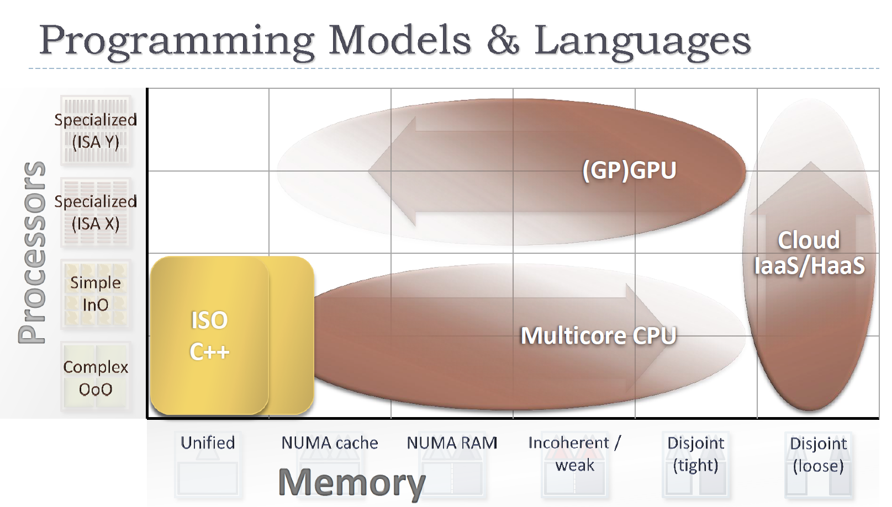
Slide from Herb Sutter’s AMD Fusion Keynote

Slide 50
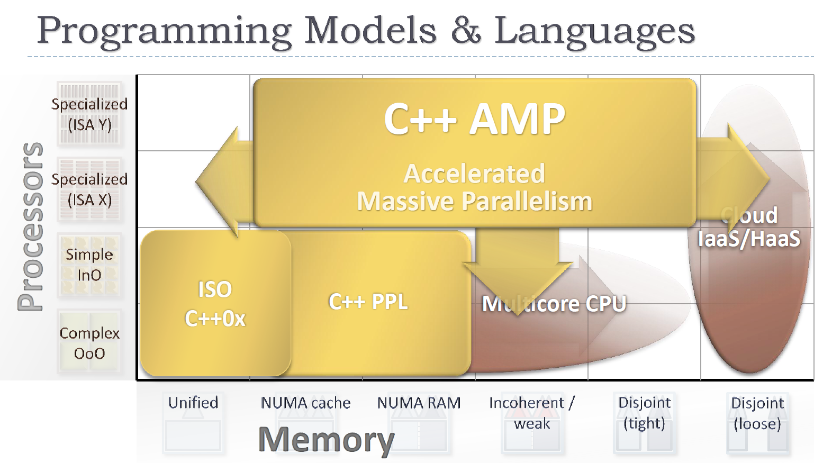
Slide from Herb Sutter’s AMD Fusion Keynote

Slide 51
C++ AMP Matrix Multiply
void MatrixMult( float* C, const vector<float>& A, const vector<float>& B,
int M, int N, int W )
{
array_view<const float,2> a(M,W,A), b(W,N,B);
array_view<writeonly<float>,2> c(M,N,C);
parallel_for_each( c.grid, [=](index<2> idx) restrict(direct3d) {
float sum = 0;
for(int i = 0; i < a.x; i++)
sum += a(idx.y, i) * b(i, idx.x);
c[idx] = sum;
} );
}

Slide 52
C++ AMP Matrix Multiply
void MatrixMult( float* C, const vector<float>& A, const vector<float>& B,
int M, int N, int W )
{
array_view<const float,2> a(M,W,A), b(W,N,B);
array_view<writeonly<float>,2> c(M,N,C);
parallel_for_each( c.grid, [=](index<2> idx) restrict(direct3d) {
float sum = 0;
for(int i = 0; i < a.x; i++)
sum += a(idx.y, i) * b(i, idx.x);
c[idx] = sum;
} );
}
array_view: abstraction for accessing data (like an “iterator range”)
Lambda expressions: like functors of thrust but with less syntactic overhead
restrict: ensure only language capabilities supported by device are used

Slide 53
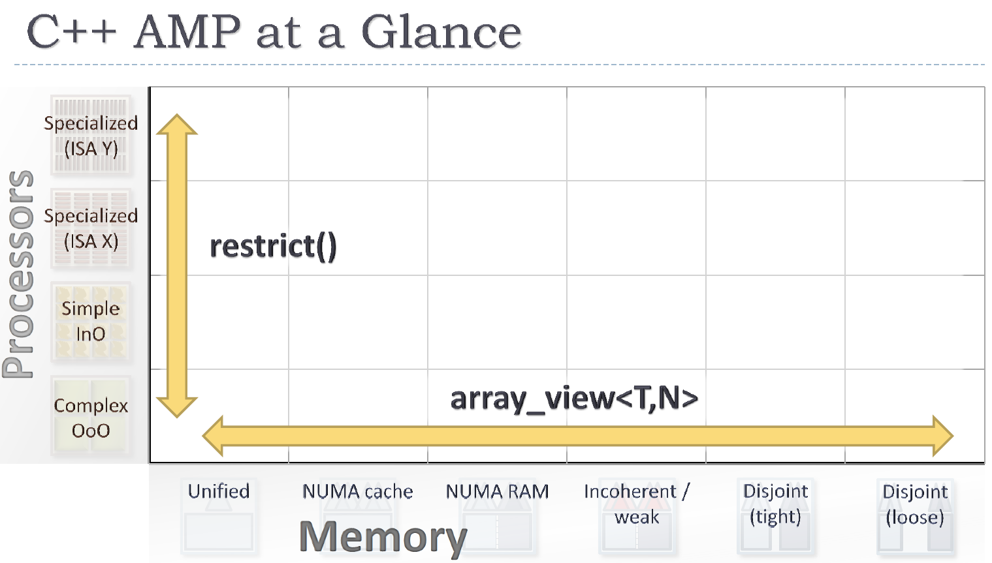
Slide from Herb Sutter’s AMD Fusion Keynote

Slide 54
C++ AMP
Only 1 new keyword added to C++
All other functionality in classes and functions
Released as open specification 2 weeks ago
Debugging and Profiling included in Visual Studio 11

Slide 55
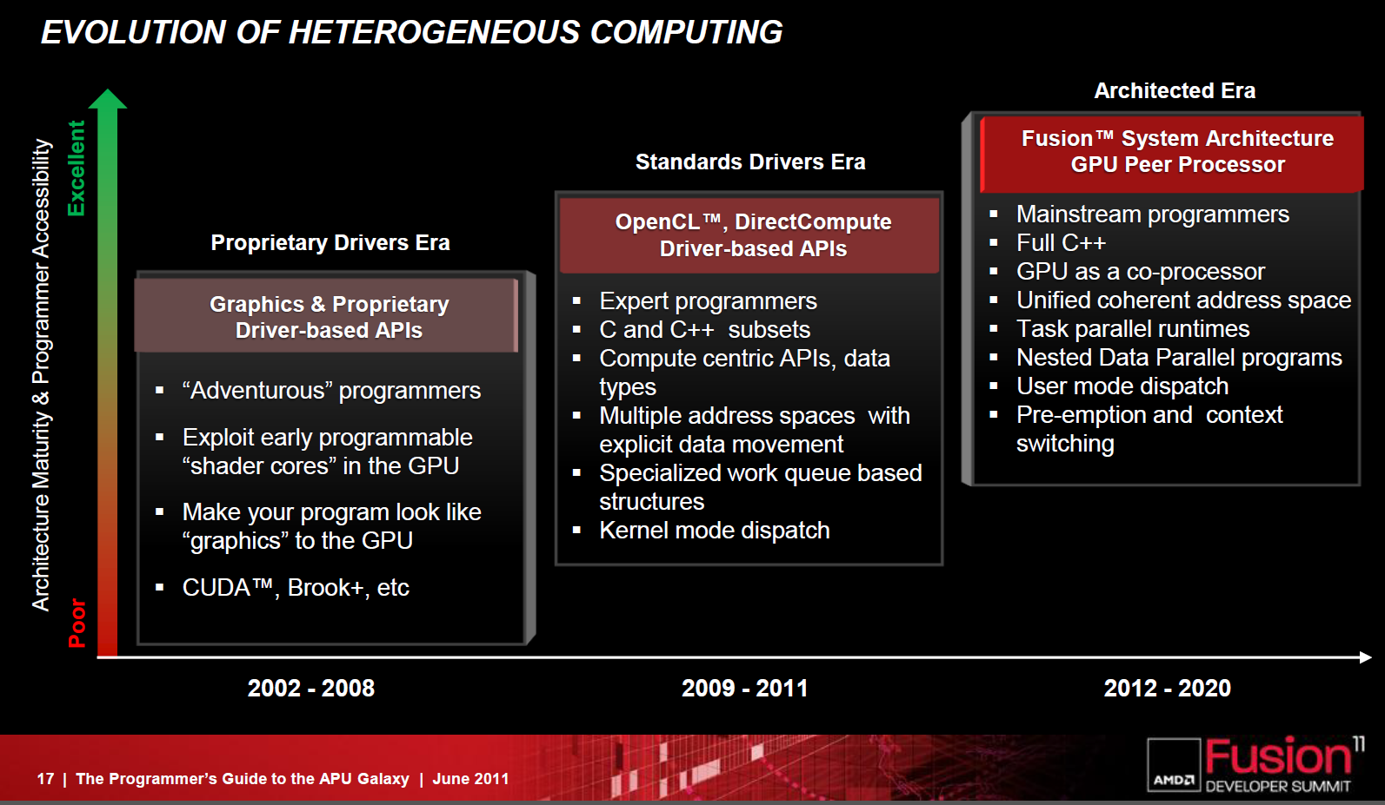
Conclusion: What do you think?
Slide from Herb Sutter’s AMD Fusion Keynote

Slide 56
References
Bell, Nathan and Hoberock, Jared. “Thrust: A Productivity-Oriented Library for CUDA.” GPU Computing Gems: Jade Edition. Link
Klöckner, Andreas. “PyCUDA: Even Simpler
GPU Programming with Python.” Slides
Reese, Jill and Zaranek, Sarah. “GPU Programming in MATLAB.” Link
Rosenberg, Ofer. “OpenCL Overview.” Slides
Sutter, Herb. “Heterogeneous Parallelism at Microsoft.” Link

Slide 57
Bibliography
Klöckner, et al. “PyCUDA and PyOpenCL: A Scripting-Based Approach to GPU Run-Time Code Generation.” arXiv
Moth, Daniel. “Blazing-fast code using GPUs and more, with C++ AMP.” Link

