Slide 1

Introduction to CUDA (1 of 2)
Patrick Cozzi
University of Pennsylvania
CIS 565 - Spring 2012

Slide 2

Announcements
IBM Almaden
Readings listed on our website
Clone your git repository
Image from http://www.almaden.ibm.com/

Slide 3
Acknowledgements
Many slides are from David Kirk and Wen-mei Hwu’s UIUC course:
    http://courses.engr.illinois.edu/ece498/al/

Slide 4
Agenda
Parallelism Review
GPU Architecture Review
CUDA

Slide 5

Parallelism Review
Pipeline Parallel
  Pipelined processors
  Graphics pipeline
Notes:
Pipeline parallel – split a task, e.g., an assembly instruction, into multiple subtasks, e.g., stages, and execute subtasks from different tasks in parallel in a pipeline fashion.

Slide 6
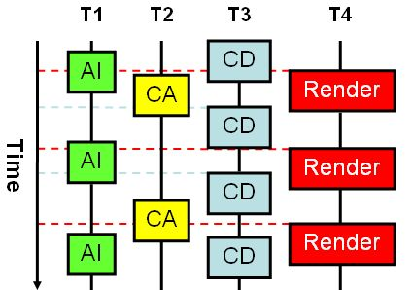
Parallelism Review
Task Parallel
  Spell checker
  Game engines
  Virtual globes
Image from: http://www.gamasutra.com/view/feature/2463/threading_3d_game_engine_basics.php
Notes:
Task parallel – largely independent tasks running in parallel that occasionally synchronize. This is coarse-grain parallelism compared to data-parallel.
Think traditional CPU multithreading.
AI – Artificial Intelligence. CA – Character animation. CD – Collision detection.

Slide 7
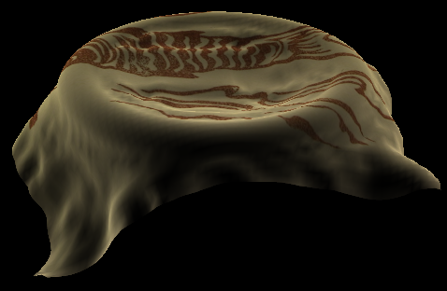
Parallelism Review
Data Parallel
  Cloth simulation
  Particle system
  Matrix multiply
Image from: https://plus.google.com/u/0/photos/100838748547881402137/albums/5407605084626995217/5581900335460078306
Notes:
Data Parallel – The same program running on multiple data (SPMD).
Cloth is modeled with a mass-spring-damper system obeying Hook’s Law. The force on each mass is computed independently at each time step.
Each particle in a particle system has forces like gravity and wind. Integrating from f = ma to position can be done independently at each time step.
Can an application have more than one type of parallelism?

Slide 8
Matrix Multiply Reminder
Vectors
Dot products
Row major or column major?
Dot product per output element

Slide 9
GPU Architecture Review
GPUs are:
  Parallel
  Multithreaded
  Many-core
GPUs have:
  Tremendous computational horsepower
  High memory bandwidth

Slide 10
GPU Architecture Review
GPUs are specialized for
  Compute-intensive, highly parallel computation
  Graphics!
Transistors are devoted to:
  Processing
  Not:
    Data caching
    Flow control

Slide 11
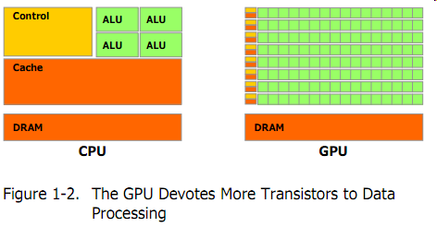
GPU Architecture Review
Transistor Usage
Image from: http://developer.download.nvidia.com/compute/cuda/3_2_prod/toolkit/docs/CUDA_C_Programming_Guide.pdf

Slide 12
Let’s program this thing!

Slide 13
GPU Computing History
2001/2002 – researchers see GPU as data-parallel coprocessor
  The GPGPU field is born
2007 – NVIDIA releases CUDA
  CUDA – Compute Uniform Device Architecture
  GPGPU shifts to GPU Computing
2008 – Khronos releases OpenCL specification

Slide 14
CUDA Abstractions
A hierarchy of thread groups
Shared memories
Barrier synchronization

Slide 15
CUDA Terminology
Host – typically the CPU
  Code written in ANSI C
Device – typically the GPU (data-parallel)
  Code written in extended ANSI C
Host and device have separate memories
CUDA Program
  Contains both host and device code

Slide 16
CUDA Terminology
Kernel – data-parallel function
  Invoking a kernel creates lightweight threads on the device
    Threads are generated and scheduled with hardware
Similar to a shader in OpenGL?

Slide 17
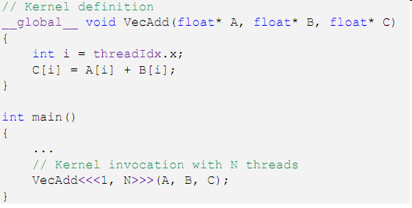
CUDA Kernels
Executed N times in parallel by N different CUDA threads
Thread ID
Declaration
Specifier
Execution
Configuration
Notes:
threadIdx is a 3-component vector

Slide 18
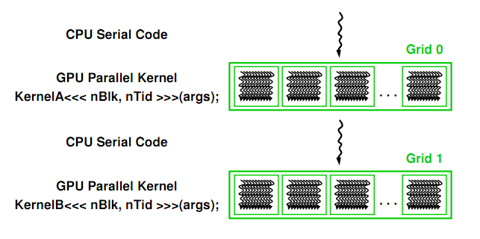
CUDA Program Execution
Image from: http://courses.engr.illinois.edu/ece498/al/textbook/Chapter2-CudaProgrammingModel.pdf

Slide 19
Thread Hierarchies
Grid – one or more thread blocks
  1D or 2D
Block – array of threads
  1D, 2D, or 3D
  Each block in a grid has the same number of threads
  Each thread in a block can
    Synchronize
    Access shared memory

Slide 20
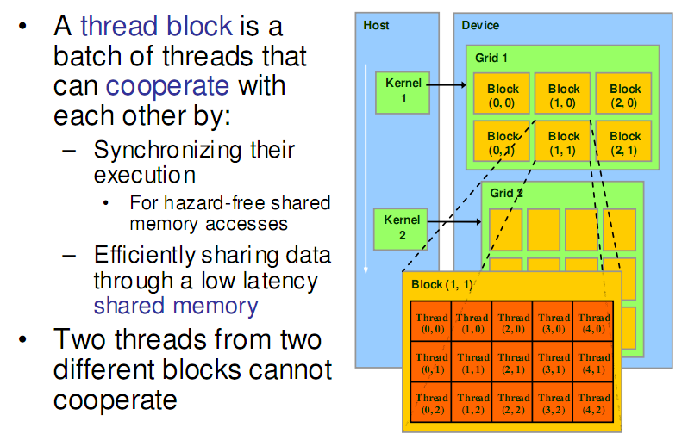
Thread Hierarchies
Image from: http://courses.engr.illinois.edu/ece498/al/textbook/Chapter2-CudaProgrammingModel.pdf

Slide 21
Thread Hierarchies
Block – 1D, 2D, or 3D
  Example: Index into vector, matrix, volume

Slide 22
Thread Hierarchies
Thread ID: Scalar thread identifier
Thread Index: threadIdx
1D: Thread ID == Thread Index
2D with size (D_{x}, D_{y})
  Thread ID of index (x, y) == x + y D_{y}
3D with size (D_{x}, D_{y,} D_{z})
  Thread ID of index (x, y, z) == x + y D_{y} + z D_{x} D_{y}

Slide 23
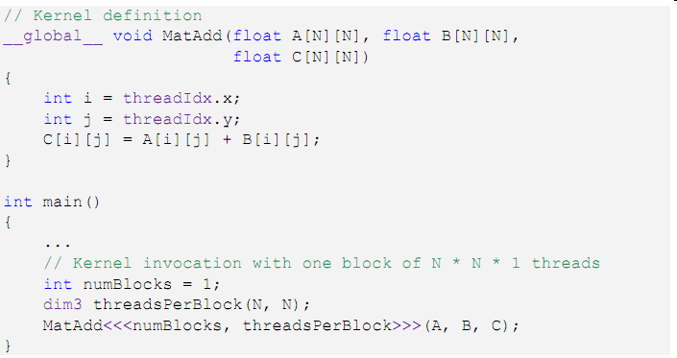
Thread Hierarchies
2D Index
1 Thread Block
2D Block

Slide 24
Thread Hierarchies
Thread Block
  Group of threads
    G80 and GT200: Up to 512 threads
    Fermi: Up to 1024 threads
  Reside on same processor core
  Share memory of that core

Slide 25
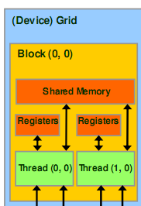
Thread Hierarchies
Thread Block
  Group of threads
    G80 and GT200: Up to 512 threads
    Fermi: Up to 1024 threads
  Reside on same processor core
  Share memory of that core
Image from: http://courses.engr.illinois.edu/ece498/al/textbook/Chapter2-CudaProgrammingModel.pdf

Slide 26
Thread Hierarchies
Block Index: blockIdx
Dimension: blockDim
  1D or 2D

Slide 27
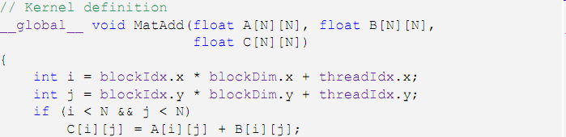
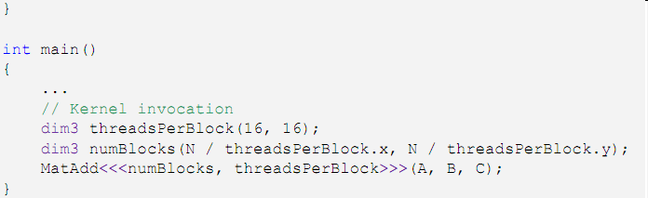
Thread Hierarchies
16x16
Threads per block
2D Thread Block

Slide 28
Thread Hierarchies
Example: N = 32
  16x16 threads per block (independent of N)
    threadIdx ([0, 15], [0, 15])
  2x2 thread blocks in grid
    blockIdx ([0, 1], [0, 1])
    blockDim = 16
i = [0, 1] * 16 + [0, 15]

Slide 29
Thread Hierarchies
Thread blocks execute independently
  In any order: parallel or series
  Scheduled in any order by any number of cores
    Allows code to scale with core count

Slide 30
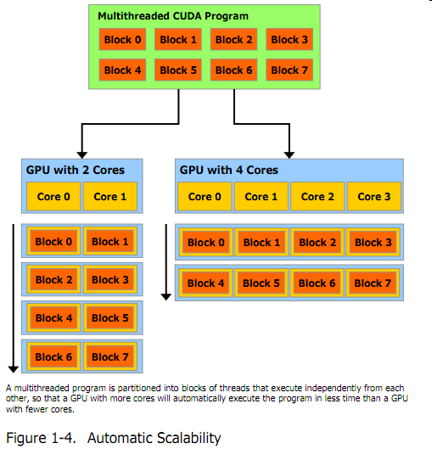
Thread Hierarchies
Image from: http://developer.download.nvidia.com/compute/cuda/3_2_prod/toolkit/docs/CUDA_C_Programming_Guide.pdf
Notes:
Scheduled by the CUDA runtime

Slide 31
Thread Hierarchies
Threads in a block
  Share (limited) low-latency memory
  Synchronize execution
    To coordinate memory accesses
    __syncThreads()
      Barrier – threads in block wait until all threads reach this
      Lightweight
Image from: http://courses.engr.illinois.edu/ece498/al/textbook/Chapter2-CudaProgrammingModel.pdf

Slide 32
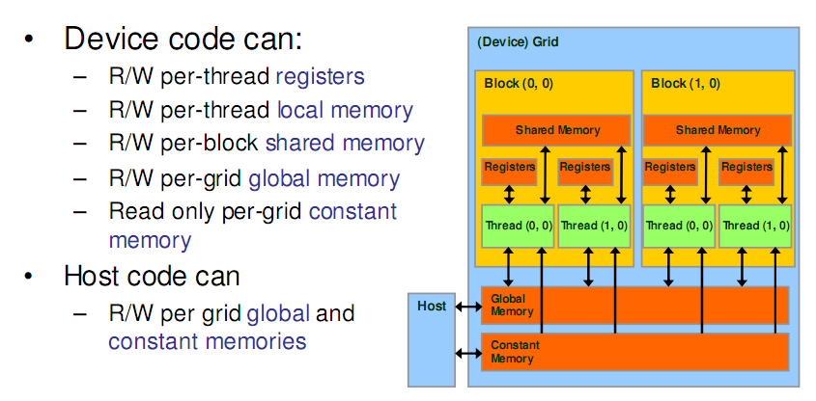
CUDA Memory Transfers
Image from: http://courses.engr.illinois.edu/ece498/al/textbook/Chapter2-CudaProgrammingModel.pdf

Slide 33
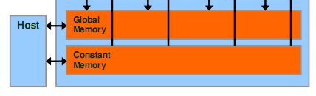
CUDA Memory Transfers
Host can transfer to/from device
  Global memory
  Constant memory
Image from: http://courses.engr.illinois.edu/ece498/al/textbook/Chapter2-CudaProgrammingModel.pdf

Slide 34
CUDA Memory Transfers
cudaMalloc()
  Allocate global memory on device
cudaFree()
  Frees memory
Image from: http://courses.engr.illinois.edu/ece498/al/textbook/Chapter2-CudaProgrammingModel.pdf

Slide 35
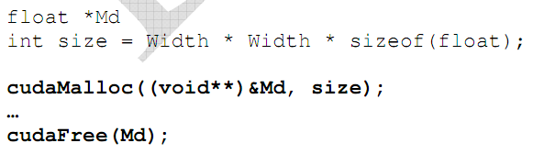
CUDA Memory Transfers
Code from: http://courses.engr.illinois.edu/ece498/al/textbook/Chapter2-CudaProgrammingModel.pdf

Slide 36
CUDA Memory Transfers
Pointer to device memory
Code from: http://courses.engr.illinois.edu/ece498/al/textbook/Chapter2-CudaProgrammingModel.pdf

Slide 37
CUDA Memory Transfers
Size in bytes
Code from: http://courses.engr.illinois.edu/ece498/al/textbook/Chapter2-CudaProgrammingModel.pdf

Slide 38
CUDA Memory Transfers
cudaMemcpy()
  Memory transfer
    Host to host
    Host to device
    Device to host
    Device to device
Host
Device
Global Memory
Similar to buffer objects in OpenGL

Slide 39
CUDA Memory Transfers
cudaMemcpy()
  Memory transfer
    Host to host
    Host to device
    Device to host
    Device to device
Host
Device
Global Memory

Slide 40
CUDA Memory Transfers
cudaMemcpy()
  Memory transfer
    Host to host
    Host to device
    Device to host
    Device to device
Host
Device
Global Memory

Slide 41
CUDA Memory Transfers
cudaMemcpy()
  Memory transfer
    Host to host
    Host to device
    Device to host
    Device to device
Host
Device
Global Memory

Slide 42
CUDA Memory Transfers
cudaMemcpy()
  Memory transfer
    Host to host
    Host to device
    Device to host
    Device to device
Host
Device
Global Memory

Slide 43
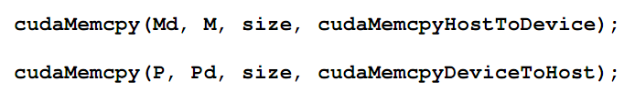
CUDA Memory Transfers
Host to device
Host
Device
Global Memory
Code from: http://courses.engr.illinois.edu/ece498/al/textbook/Chapter2-CudaProgrammingModel.pdf

Slide 44
CUDA Memory Transfers
Destination (device)
Source (host)
Host
Device
Global Memory
Code from: http://courses.engr.illinois.edu/ece498/al/textbook/Chapter2-CudaProgrammingModel.pdf

Slide 45
CUDA Memory Transfers
Host
Device
Global Memory
Code from: http://courses.engr.illinois.edu/ece498/al/textbook/Chapter2-CudaProgrammingModel.pdf

Slide 46
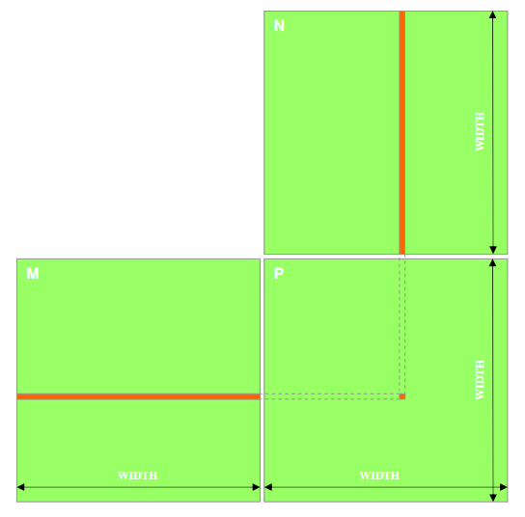
Matrix Multiply
P = M * N
Assume M and N are square for simplicity
Image from: http://courses.engr.illinois.edu/ece498/al/textbook/Chapter2-CudaProgrammingModel.pdf

Slide 47
Matrix Multiply
1,000 x 1,000 matrix
  1,000,000 dot products
    Each 1,000 multiples and 1,000 adds

Slide 48
Matrix Multiply: CPU Implementation
void MatrixMulOnHost(float* M, float* N, float* P, int width)‏
{
for (int i = 0; i < width; ++i)‏
for (int j = 0; j < width; ++j)
{
float sum = 0;
for (int k = 0; k < width; ++k)
{
float a = M[i * width + k];
float b = N[k * width + j];
sum += a * b;
}
P[i * width + j] = sum;
}
}
Code from: http://courses.engr.illinois.edu/ece498/al/lectures/lecture3%20cuda%20threads%20spring%202010.ppt

Slide 49
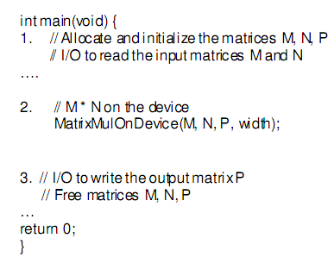
Matrix Multiply: CUDA Skeleton
Code from: http://courses.engr.illinois.edu/ece498/al/textbook/Chapter2-CudaProgrammingModel.pdf

Slide 50
Matrix Multiply: CUDA Skeleton
Code from: http://courses.engr.illinois.edu/ece498/al/textbook/Chapter2-CudaProgrammingModel.pdf

Slide 51
Matrix Multiply: CUDA Skeleton
Code from: http://courses.engr.illinois.edu/ece498/al/textbook/Chapter2-CudaProgrammingModel.pdf

Slide 52
Matrix Multiply
Step 1
  Add CUDA memory transfers to the skeleton

Slide 53
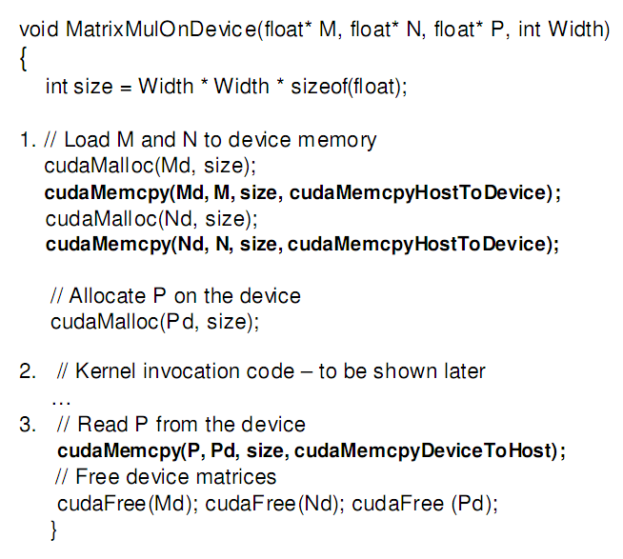
Matrix Multiply: Data Transfer
Allocate input
Code from: http://courses.engr.illinois.edu/ece498/al/textbook/Chapter2-CudaProgrammingModel.pdf

Slide 54
Matrix Multiply: Data Transfer
Allocate output
Code from: http://courses.engr.illinois.edu/ece498/al/textbook/Chapter2-CudaProgrammingModel.pdf

Slide 55
Matrix Multiply: Data Transfer
Code from: http://courses.engr.illinois.edu/ece498/al/textbook/Chapter2-CudaProgrammingModel.pdf

Slide 56
Matrix Multiply: Data Transfer
Read back from device
Code from: http://courses.engr.illinois.edu/ece498/al/textbook/Chapter2-CudaProgrammingModel.pdf

Slide 57
Matrix Multiply: Data Transfer
Similar to GPGPU with GLSL.
Code from: http://courses.engr.illinois.edu/ece498/al/textbook/Chapter2-CudaProgrammingModel.pdf

Slide 58
Matrix Multiply
Step 2
  Implement the kernel in CUDA C

Slide 59
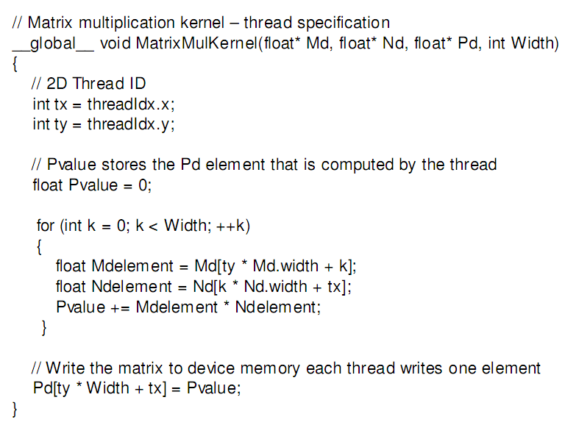
Matrix Multiply: CUDA Kernel
Accessing a matrix, so using a 2D block
Code from: http://courses.engr.illinois.edu/ece498/al/textbook/Chapter2-CudaProgrammingModel.pdf

Slide 60
Matrix Multiply: CUDA Kernel
Each kernel computes one output
Code from: http://courses.engr.illinois.edu/ece498/al/textbook/Chapter2-CudaProgrammingModel.pdf

Slide 61
Matrix Multiply: CUDA Kernel
Where did the two outer for loops in the CPU implementation go?
Code from: http://courses.engr.illinois.edu/ece498/al/textbook/Chapter2-CudaProgrammingModel.pdf

Slide 62
Matrix Multiply: CUDA Kernel
No locks or synchronization, why?
Code from: http://courses.engr.illinois.edu/ece498/al/textbook/Chapter2-CudaProgrammingModel.pdf

Slide 63
Matrix Multiply
Step 3
  Invoke the kernel in CUDA C

Slide 64
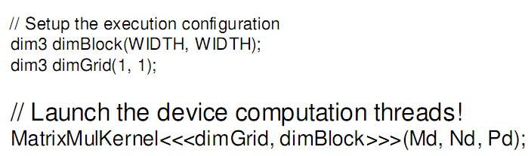
Matrix Multiply: Invoke Kernel
One block with width by width threads
Code from: http://courses.engr.illinois.edu/ece498/al/textbook/Chapter2-CudaProgrammingModel.pdf

Slide 65







Matrix Multiply
Nd
Grid 1
One Block of threads compute matrix Pd
  Each thread computes one element of Pd
Each thread
  Loads a row of matrix Md
  Loads a column of matrix Nd
  Perform one multiply and addition for each pair of Md and Nd elements
  Compute to off-chip memory access ratio close to 1:1 (not very high)‏
Size of matrix limited by the number of threads allowed in a thread block
Block 1
Thread
(2, 2)‏
48
WIDTH
Md
Pd
© David Kirk/NVIDIA and Wen-mei W. Hwu, 2007-2009
ECE 498AL Spring 2010, University of Illinois, Urbana-Champaign
Slide from: http://courses.engr.illinois.edu/ece498/al/lectures/lecture2%20cuda%20spring%2009.ppt

Slide 66
Matrix Multiply
What is the major performance problem with our implementation?
What is the major limitation?

