Slide 1
CUDA Performance Considerations (2 of 2)
Varun Sampath
Original Slides by Patrick Cozzi
University of Pennsylvania
CIS 565 - Spring 2012

Slide 2
Agenda
Instruction Optimizations
Mixed Instruction Types
Loop Unrolling
Thread Granularity
Memory Optimizations
Shared Memory Bank Conflicts
Partition Camping
Pinned Memory
Streams

Slide 3
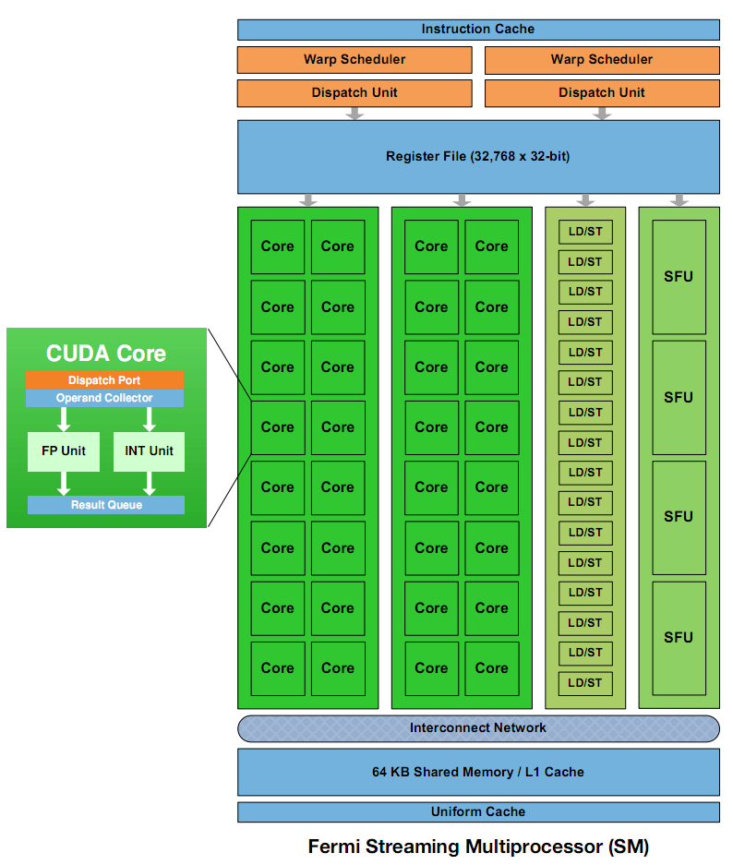
Mixed Instructions
Special Function Units (SFUs)
Use to compute __sinf(), __expf()
Only 4, each can execute 1 instruction per clock
Image: NVIDIA Fermi Whitepaper
Notes:
2 SFUs per SM on G80

Slide 4
Loop Unrolling
for (int k = 0; k < BLOCK_SIZE; ++k)
{
Pvalue += Ms[ty][k] * Ns[k][tx];
}
Instructions per iteration
One floating-point multiply
One floating-point add
What else?

Slide 5
Loop Unrolling
for (int k = 0; k < BLOCK_SIZE; ++k)
{
Pvalue += Ms[ty][k] * Ns[k][tx];
}
Other instructions per iteration
Update loop counter

Slide 6
Loop Unrolling
for (int k = 0; k < BLOCK_SIZE; ++k)
{
Pvalue += Ms[ty][k] * Ns[k][tx];
}
Other instructions per iteration
Update loop counter
Branch

Slide 7
Loop Unrolling
for (int k = 0; k < BLOCK_SIZE; ++k)
{
Pvalue += Ms[ty][k] * Ns[k][tx];
}
Other instructions per iteration
Update loop counter
Branch
Address arithmetic

Slide 8
Loop Unrolling
for (int k = 0; k < BLOCK_SIZE; ++k)
{
Pvalue += Ms[ty][k] * Ns[k][tx];
}
Instruction Mix
2 floating-point arithmetic instructions
1 loop branch instruction
2 address arithmetic instructions
1 loop counter increment instruction

Slide 9
Loop Unrolling
Only 1/3 are floating-point calculations
But I want my full theoretical 1 TFLOP (Fermi)
Consider loop unrolling
Image: NVIDIA Fermi Whitepaper

Slide 10
Loop Unrolling
Pvalue +=
Ms[ty][0] * Ns[0][tx] +
Ms[ty][1] * Ns[1][tx] +
...
Ms[ty][15] * Ns[15][tx]; // BLOCK_SIZE = 16
No more loop
No loop count update
No branch
Constant indices – no address arithmetic instructions
Notes:
Compilers are getting better at unrolling, but many programmers still do it by hand.

Slide 11
Loop Unrolling
Automatically:
#pragma unroll BLOCK_SIZE
for (int k = 0; k < BLOCK_SIZE; ++k)
{
Pvalue += Ms[ty][k] * Ns[k][tx];
}
Under the hood: Predication
Disadvantages to unrolling?
Notes:
Disadvantages include instruction cache misses and increased register usage. Manually unrolling avoids the disadvantages of predication (which itself is only used for a few-instruction branch).

Slide 12
Aside: Loop Counters
for (i = 0; i < n; ++i)
{
out[i] = in[offset + stride*i];
}
Should i be signed or unsigned?
Notes:
Undefined behavior in C can lead to some compiler optimizations. In this case, strength reduction can be used on stride*i because the compiler can do what it wants to if the multiplication overflows. Unsigned i would prevent this.

Slide 13
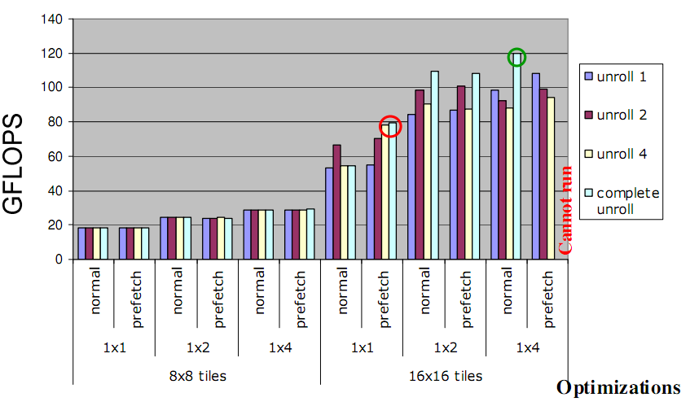
Loop Unrolling Performance
Image from http://courses.engr.illinois.edu/ece498/al/textbook/Chapter5-CudaPerformance.pdf
Notes:
The 1x1 versus 1x2 versus 1x4 is number of blocks merged, due to increased thread granularity. Next subject.

Slide 14
Thread Granularity
How much work should one thread do?
Parallel Reduction
Reduce two elements?
Matrix multiply
Compute one element of Pd?
Notes:
Adding some sequential-ness to our parallel implementations can actually improve performance.

Slide 15
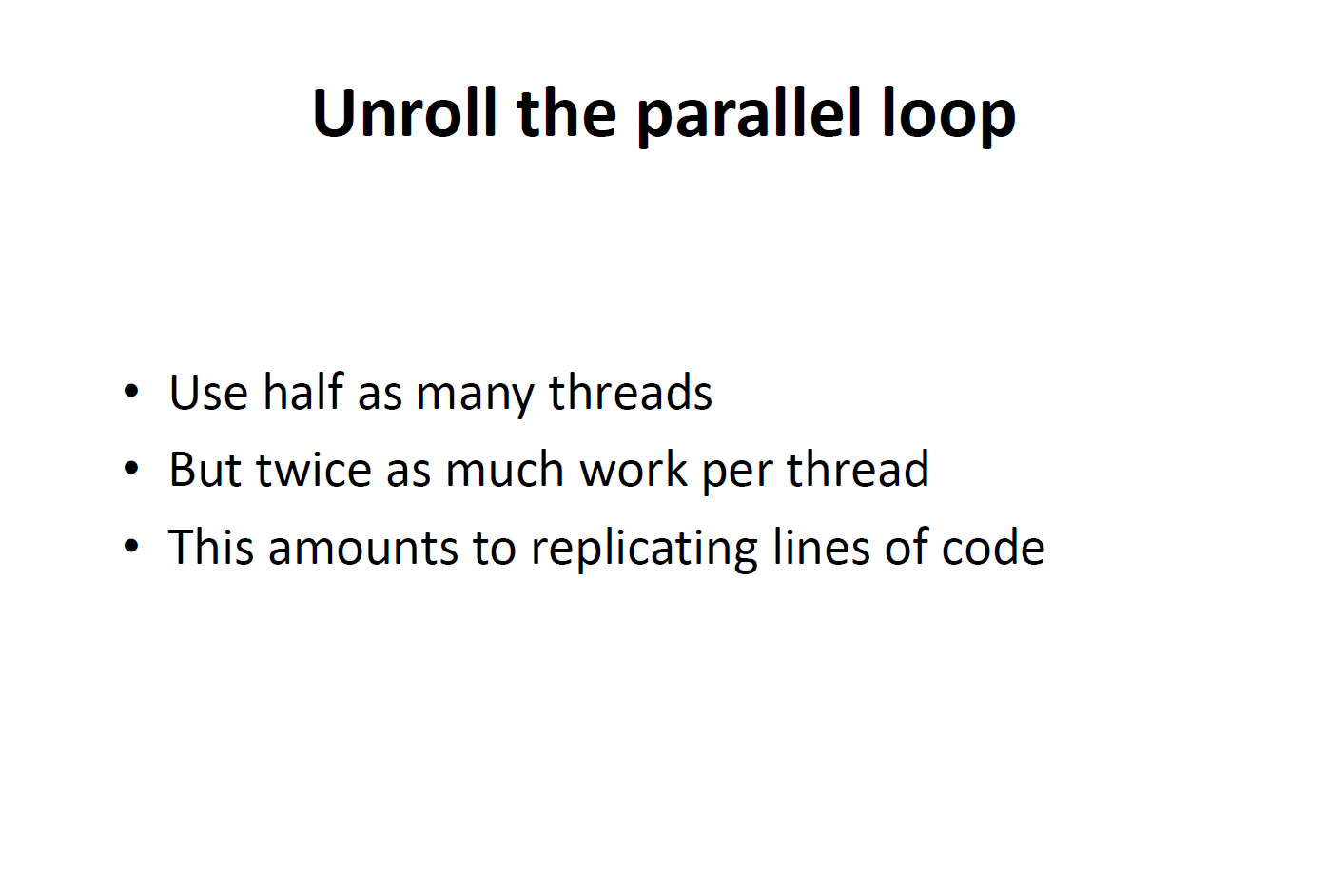
Slide from Vasily Volkov’s talk at SC11
Notes:
Unroll the parallel loop is the important concept.

Slide 16
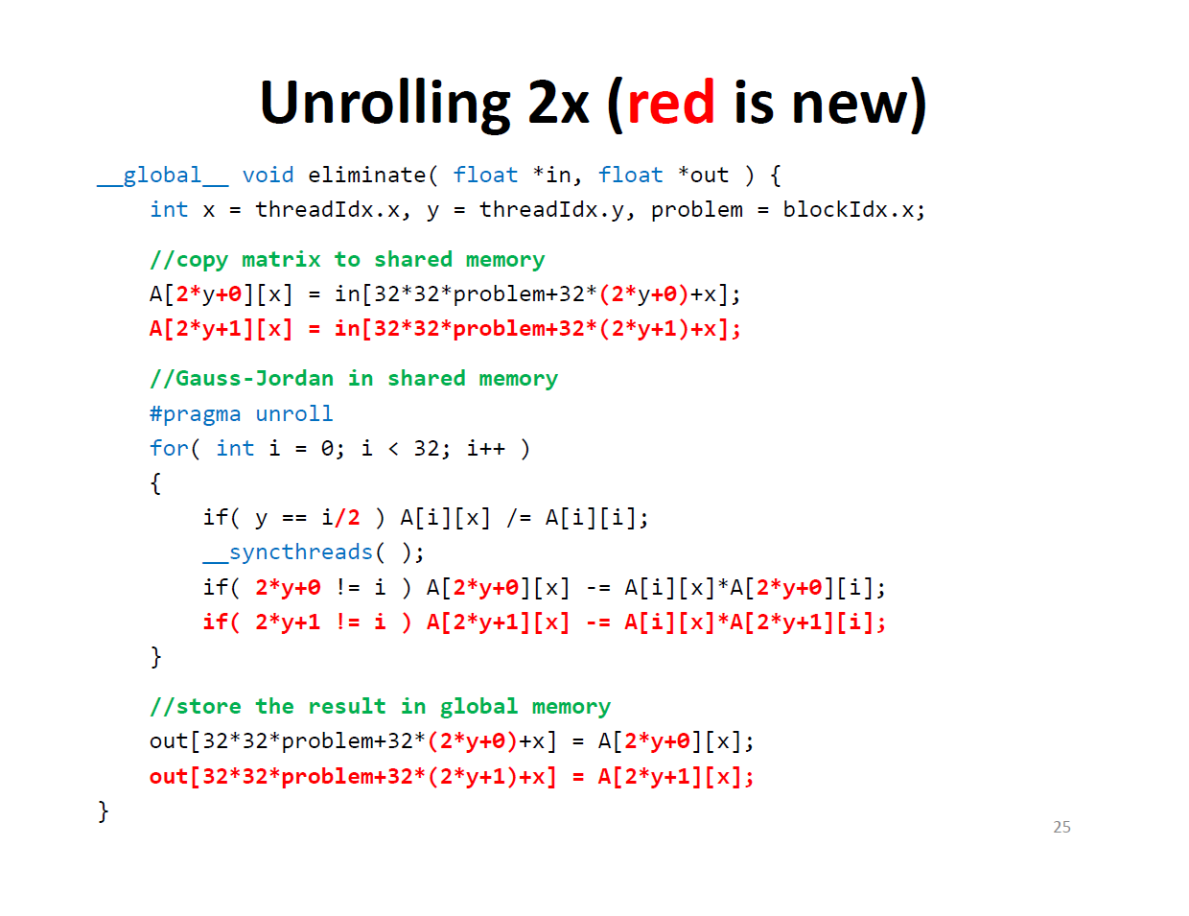
Slide from Vasily Volkov’s talk at SC11

Slide 17
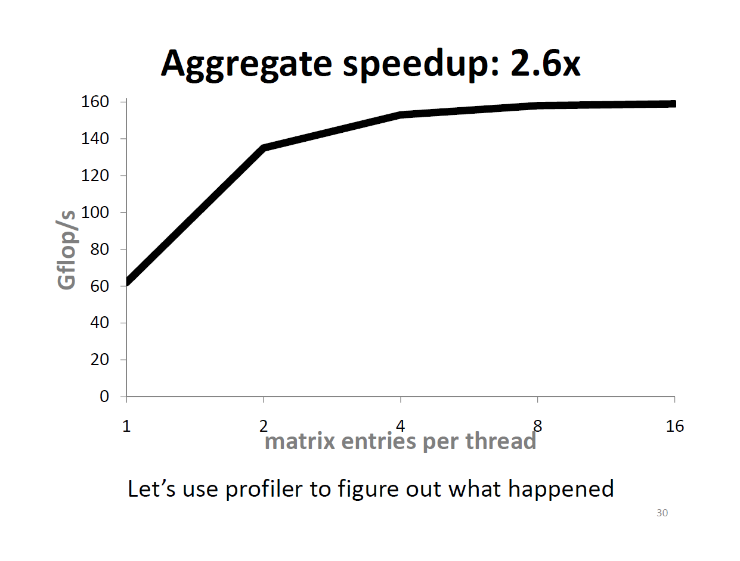
Slide from Vasily Volkov’s talk at SC11

Slide 18
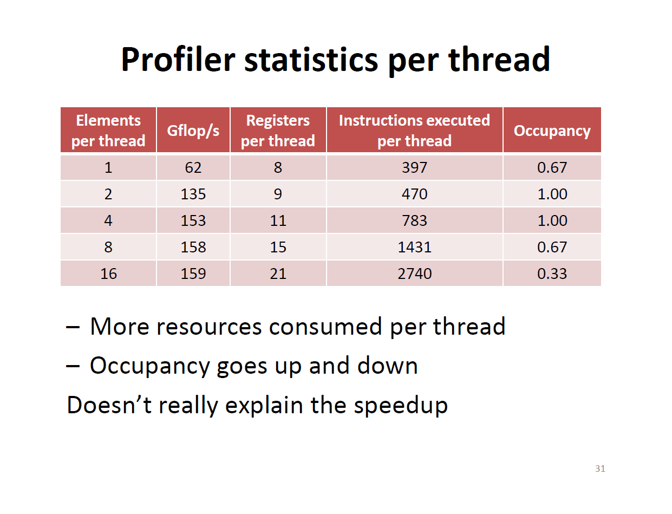
Slide from Vasily Volkov’s talk at SC11

Slide 19
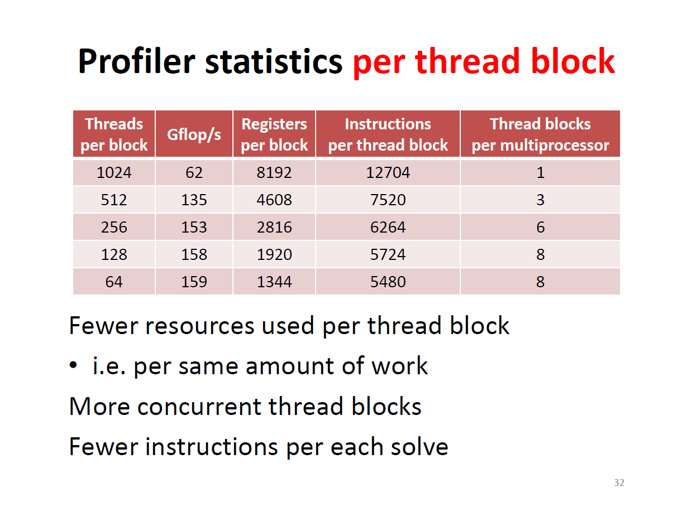
Slide from Vasily Volkov’s talk at SC11

Slide 20
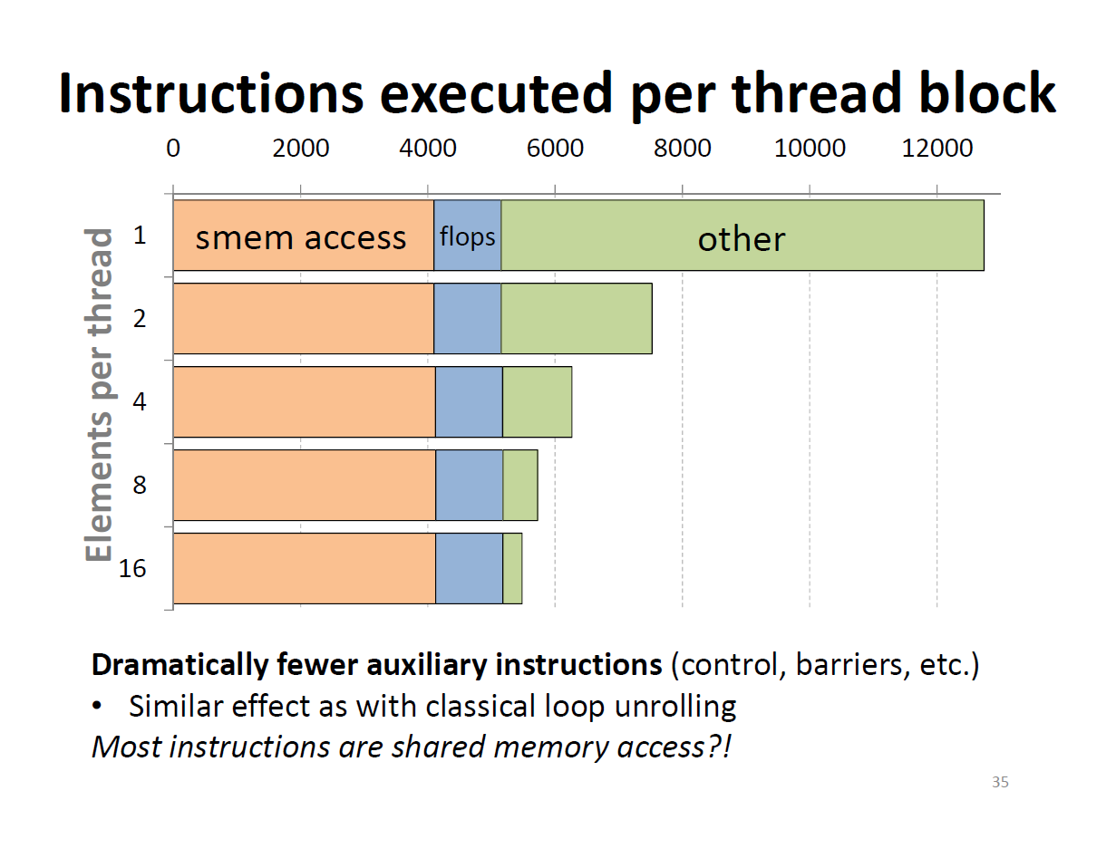
Slide from Vasily Volkov’s talk at SC11
Notes:
Also, more concurrent thread blocks get executed. Memory bound, not compute bound.

Slide 21
All about Tradeoffs
Thread count
Block count
Register count
Shared memory size
Instruction size
Notes:
Occupancy isn’t everything.

Slide 22
Shared Memory
Fast pool of on-chip memory
Allocated per block
Note: runs at base clock instead of shader clock
G80 Limits
Shared memory access patterns can affect performance. Why?
Thread block slots
8
Thread slots
768
Registers
8K registers
Shared memory
16K
SM
Notes:
Base clock source: http://www.beyond3d.com/content/reviews/55/7 and Vasily Volkov

Slide 23
Bank Conflicts
Shared Memory
Sometimes called a parallel data cache
Multiple threads can access shared memory at the same time
Memory is divided into banks (Why?)
Bank 0
Bank 1
Bank 2
Bank 3
Bank 4
Bank 5
Bank 6
Bank 7
Bank 15
Image from http://courses.engr.illinois.edu/ece498/al/Syllabus.html

Slide 24
Bank Conflicts
Banks
Each bank can service one address per two cycles
Per-bank bandwidth: 32-bits per two (shader clock) cycles
Successive 32-bit words are assigned to successive banks
Bank 0
Bank 1
Bank 2
Bank 3
Bank 4
Bank 5
Bank 6
Bank 7
Bank 15
Image from http://courses.engr.illinois.edu/ece498/al/Syllabus.html

Slide 25
Bank Conflicts
Bank Conflict: Two simultaneous accesses to the same bank, but not the same address
Serialized
G80-GT200: 16 banks, with 8 SPs concurrently executing
Fermi: 32 banks, with 16 SPs concurrently executing
What does this mean for conflicts?
Bank 0
Bank 1
Bank 2
Bank 3
Bank 4
Bank 5
Bank 6
Bank 7
Bank 15
Image from http://courses.engr.illinois.edu/ece498/al/Syllabus.html
Notes:
* 16 threads in a half-warp
Bank conflicts only occur within a half warp for G80, but within a full warp for Fermi

Slide 26
Bank Conflicts
Bank Conflicts?
Linear addressing stride == 1
Bank Conflicts?
Random 1:1 Permutation
Thread 0
Bank 0
Thread 0
Bank 0
Thread 1
Bank 1
Thread 1
Bank 1
Thread 2
Bank 2
Thread 2
Bank 2
Thread 3
Bank 3
Thread 3
Bank 3
Thread 4
Bank 4
Thread 4
Bank 4
Thread 5
Bank 5
Thread 5
Bank 5
Thread 6
Bank 6
Thread 6
Bank 6
Thread 7
Bank 7
Thread 7
Bank 7
Thread 15
Bank 15
Thread 15
Bank 15
Image from http://courses.engr.illinois.edu/ece498/al/Syllabus.html
Notes:
Neither of these have bank conflicts

Slide 27
Bank Conflicts
Bank Conflicts?
Linear addressing stride == 2
Bank Conflicts?
Linear addressing stride == 8
Thread 0
Bank 0
Thread 0
x8
Bank 0
Thread 1
Bank 1
Thread 1
Bank 1
Thread 2
Bank 2
Thread 2
Bank 2
Thread 3
Bank 3
Thread 3
Thread 4
Bank 4
Thread 4
Bank 5
Thread 5
Bank 7
Bank 6
Thread 6
Bank 8
Bank 7
Thread 7
Bank 9
Thread 8
x8
Thread 9
Thread 10
Thread 11
Bank 15
Thread 15
Bank 15
Image from http://courses.engr.illinois.edu/ece498/al/Syllabus.html
Notes:
Left: 2-degree bank conflict
Right: 2-degree bank conflict

Slide 28
Bank Conflicts
Fast Path 1 (G80)
All threads in a half-warp access different banks
Thread 0
Bank 0
Thread 1
Bank 1
Thread 2
Bank 2
Thread 3
Bank 3
Thread 4
Bank 4
Thread 5
Bank 5
Thread 6
Bank 6
Thread 7
Bank 7
Thread 15
Bank 15
Image from http://courses.engr.illinois.edu/ece498/al/Syllabus.html

Slide 29
Bank Conflicts
Fast Path 2 (G80)
All threads in a half-warp access the same address
Same
address
Thread 0
Bank 0
Thread 1
Bank 1
Thread 2
Bank 2
Thread 3
Bank 3
Thread 4
Bank 4
Thread 5
Bank 5
Thread 6
Bank 6
Thread 7
Bank 7
Thread 15
Bank 15
Image from http://courses.engr.illinois.edu/ece498/al/Syllabus.html

Slide 30
Bank Conflicts
Slow Path (G80)
Multiple threads in a half-warp access the same bank
Access is serialized
What is the cost?
Thread 0
Bank 0
Thread 1
Bank 1
Thread 2
Bank 2
Thread 3
Bank 3
Thread 4
Bank 4
Bank 5
Bank 6
Bank 7
Thread 8
Thread 9
Thread 10
Thread 11
Bank 15
Image from http://courses.engr.illinois.edu/ece498/al/Syllabus.html
Notes:
Cost: maximum number of simultaneous accesses to a single bank.
A degree-n bank conflict requires n times as many cycles to process as an access with no conflict.

Slide 31
Bank Conflicts
__shared__ float shared[256];
// ...
float f = shared[index + s * threadIdx.x];
For what values of s is this conflict free?
Hint: The G80 has 16 banks
Notes:
“In this case, threads tid and tid+n access the same bank whenever s*n is a multiple of the number of banks (i.e. 32) or, equivalently, whenever n is a multiple of 32/d where d is the greatest common divisor of 32 and s. As a consequence, there will be no bank conflict only if the warp size (i.e. 32) is less than or equal to 32/d., that is only if d is equal to 1, i.e. s is odd. “ – CUDA Programming Guide

Slide 32
Bank Conflicts
__shared__ float shared[256];
// ...
float f = shared[index + s * threadIdx.x];
s=1
s=3
Thread 0
Bank 0
Thread 0
Bank 0
Thread 1
Bank 1
Thread 1
Bank 1
Thread 2
Bank 2
Thread 2
Bank 2
Thread 3
Bank 3
Thread 3
Bank 3
Thread 4
Bank 4
Thread 4
Bank 4
Thread 5
Bank 5
Thread 5
Bank 5
Thread 6
Bank 6
Thread 6
Bank 6
Thread 7
Bank 7
Thread 7
Bank 7
Thread 15
Bank 15
Thread 15
Bank 15
Image from http://courses.engr.illinois.edu/ece498/al/Syllabus.html
Notes:
When s shares no common factors with the number of banks. s must be odd.
Another simple fix: __shared__ float tile[TILE_DIM][TILE_DIM+1]; // pad with one extra column → optimizing matrix transpose with CUDA source

Slide 33
Bank Conflicts
Without using a profiler, how can we tell what kind of speedup we can expect by removing bank conflicts?
What happens if more than one thread in a warp writes to the same shared memory address (non-atomic instruction)?
Notes:
* Change all shared memory reads to the same value: broadcast.
change shared memory reads to threadIdx.x: no conflicts.
* Only one thread per half-warp performs a write and which thread performs the final write is undefined

Slide 34
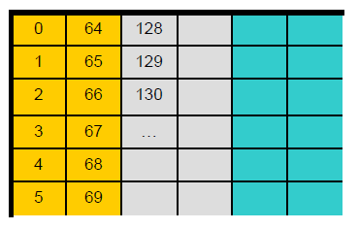
Partition Camping
“Bank conflicts” of global memory
Global memory divided into 6 (G80) or 8 (GT200) 256-byte partitions
The 1 million KBps question: How do active half-warps in your kernel access memory?
Image: [Reutsch & Micikevicius, 2010]
Notes:
Get it? Get it?

Slide 35
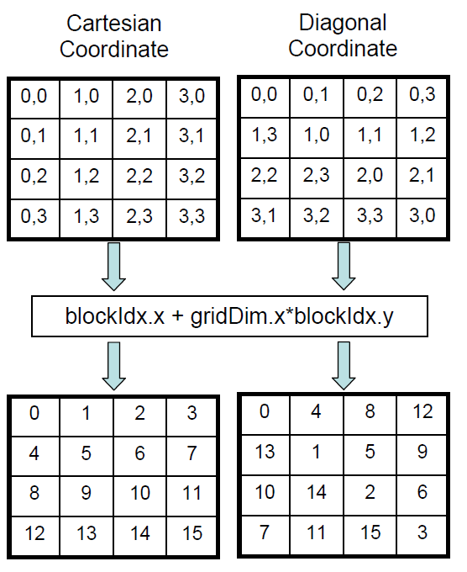
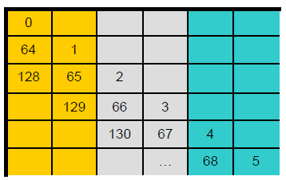
Fixing Partition Camping
Diagonalize block indices
blockIdx_y=blockIdx.x;
blockIdx_x= (blockIdx.x+blockIdx.y)%gridDim.x;
Output:
Not a problem in Fermi (How?)
Image: [Reutsch & Micikevicius, 2010]
Notes:
Fermi’s addresses are hashed.

Slide 36
Page-Locked Host Memory
Page-locked Memory
Host memory that is essentially removed from virtual memory
Also called Pinned Memory

Slide 37
Page-Locked Host Memory
Benefits
Overlap kernel execution and data transfers
Time
Normally:
Data Transfer
Kernel Execution
Paged-locked:
Data Transfer
Kernel Execution
See G.1 in the NVIDIA CUDA C Programming Guide for full compute capability requirements

Slide 38
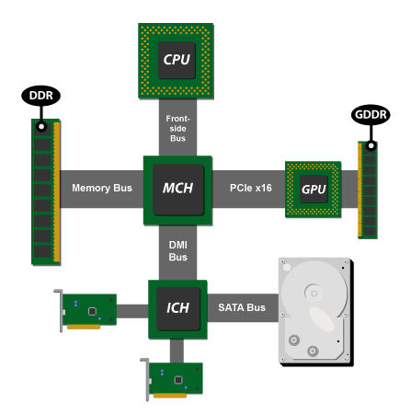
Page-Locked Host Memory
Benefits
Increased memory bandwidth for systems with a front-side bus
Up to ~2x throughput
Image from http://arstechnica.com/hardware/news/2009/10/day-of-nvidia-chipset-reckoning-arrives.ars

Slide 39
Page-Locked Host Memory
Benefits
Option: Write-Combining Memory
Disables page-locked memory’s default caching
Allocate with cudaHostAllocWriteCombined to
Avoid polluting L1 and L2 caches
Avoid snooping transfers across PCIe
Improve transfer performance up to 40% - in theory
Reading from write-combining memory is slow!
Only write to it from the host

Slide 40
Page-Locked Host Memory
Benefits
Paged-locked host memory can be mapped into the address space of the device on some systems
What systems allow this?
What does this eliminate?
What applications does this enable?
Call cudaGetDeviceProperties() and check canMapHostMemory
Notes:
Hybrid CPU/GPU, mobile?, consoles
Eliminates the need to copy to and from host memory.
Enables applications where the memory transfer (bus bandwidth) was the bottleneck such as simple image processing.

Slide 41
Page-Locked Host Memory
Usage:
cudaHostAlloc() / cudaMallocHost()
cudaHostFree()
cudaMemcpyAsync()
See 3.2.5 in the NVIDIA CUDA C Programming Guide
Notes:
HostAlloc() allows flags, MallocHost() does not

Slide 42
Page-Locked Host Memory
What’s the catch?
Page-locked memory is scarce
Allocations will start failing before allocation of in pageable memory
Reduces amount of physical memory available to the OS for paging
Allocating too much will hurt overall system performance

Slide 43
Streams
Stream: Sequence of commands that execute in order
Streams may execute their commands out-of-order or concurrently with respect to other streams
Stream A
Stream B
Command 0
Command 0
Command 1
Command 1
Command 2
Command 2

Slide 44
Streams
Is this a possible order?
Stream A
Stream B
Time
Command 0
Command 0
Command 0
Command 1
Command 1
Command 1
Command 2
Command 2
Command 2
Command 0
Command 1
Command 2
Notes:
Yes, synchronous in order

Slide 45
Streams
Is this a possible order?
Stream A
Stream B
Time
Command 0
Command 0
Command 0
Command 1
Command 1
Command 1
Command 2
Command 2
Command 2
Command 0
Command 1
Command 2
Notes:
Yes, synchronous in order

Slide 46
Streams
Is this a possible order?
Stream A
Stream B
Time
Command 0
Command 0
Command 0
Command 1
Command 1
Command 0
Command 2
Command 2
Command 1
Command 1
Command 2
Command 2
Notes:
Yes, interleaved

Slide 47
Streams
Is this a possible order?
Stream A
Stream B
Time
Command 0
Command 0
Command 0
Command 1
Command 1
Command 0
Command 2
Command 2
Command 2
Command 2
Command 1
Command 1
Notes:
No, out of order within a stream

Slide 48
Streams
Is this a possible order?
Stream A
Stream B
Time
Command 0
Command 0
Command 0
Command 0
Command 1
Command 1
Command 1
Command 1
Command 2
Command 2
Command 2
Command 2
Notes:
Yes, concurrent in order

Slide 49
Streams
In CUDA, what commands go in a stream?
Kernel launches
Host device memory transfers

Slide 50
Streams
Code Example
Create two streams
Each stream:
Copy page-locked memory to device
Launch kernel
Copy memory back to host
Destroy streams

Slide 51
Stream Example (Step 1 of 3)
cudaStream_t stream[2];
for (int i = 0; i < 2; ++i)
{
cudaStreamCreate(&stream[i]);
}
float *hostPtr;
cudaMallocHost(&hostPtr, 2 * size);

Slide 52
Stream Example (Step 1 of 3)
cudaStream_t stream[2];
for (int i = 0; i < 2; ++i)
{
cudaStreamCreate(&stream[i]);
}
float *hostPtr;
cudaMallocHost(&hostPtr, 2 * size);
Create two streams

Slide 53
Stream Example (Step 1 of 3)
cudaStream_t stream[2];
for (int i = 0; i < 2; ++i)
{
cudaStreamCreate(&stream[i]);
}
float *hostPtr;
cudaMallocHost(&hostPtr, 2 * size);
Allocate two buffers in page-locked memory
Notes:
Page-locked memory is required for streams to overlap

Slide 54
Stream Example (Step 2 of 3)
for (int i = 0; i < 2; ++i)
{
cudaMemcpyAsync(/* ... */,
cudaMemcpyHostToDevice, stream[i]);
kernel<<<100, 512, 0, stream[i]>>>
(/* ... */);
cudaMemcpyAsync(/* ... */,
cudaMemcpyDeviceToHost, stream[i]);
}

Slide 55
Stream Example (Step 2 of 3)
for (int i = 0; i < 2; ++i)
{
cudaMemcpyAsync(/* ... */,
cudaMemcpyHostToDevice, stream[i]);
kernel<<<100, 512, 0, stream[i]>>>
(/* ... */);
cudaMemcpyAsync(/* ... */,
cudaMemcpyDeviceToHost, stream[i]);
}
Commands are assigned to, and executed by streams

Slide 56
Stream Example (Step 3 of 3)
for (int i = 0; i < 2; ++i)
{
// Blocks until commands complete
cudaStreamDestroy(stream[i]);
}

Slide 57
Streams
Assume compute capabilities:
Overlap of data transfer and kernel execution
Concurrent kernel execution
Concurrent data transfer
How can the streams overlap?
See F.1 in the NVIDIA CUDA C Programming Guide for more on compute capabilities

Slide 58
Streams
Can we have more overlap than this?
Time
Stream A
Stream B
Host device memory
Kernel execution
Host device memory
Device to host memory
Kernel execution
Device to host memory

Slide 59
Streams
Can we have this?
Time
Stream A
Stream B
Host device memory
Kernel execution
Host device memory
Kernel execution
Device to host memory
Device to host memory
Notes:
Only Fermi supports concurrent kernel execution.

Slide 60
Streams
Can we have this?
Stream A
Time
Host device memory
Stream B
Kernel execution
Dependent on kernel completion
Host device memory
Device to host memory
Kernel execution
Blocked until kernel from Stream A completes
Device to host memory

Slide 61
Streams
Performance Advice
Issue all independent commands before dependent ones
Delay synchronization (implicit or explicit) as long as possible

Slide 62
Streams
Rewrite this to allow concurrent kernel execution
for (int i = 0; i < 2; ++i)
{
cudaMemcpyAsync(/* ... */, stream[i]);
kernel<<< /*... */ stream[i]>>>();
cudaMemcpyAsync(/* ... */, stream[i]);
}

Slide 63
Streams
for (int i = 0; i < 2; ++i) // to device
cudaMemcpyAsync(/* ... */, stream[i]);
for (int i = 0; i < 2; ++i)
kernel<<< /*... */ stream[i]>>>();
for (int i = 0; i < 2; ++i) // to host
cudaMemcpyAsync(/* ... */, stream[i]);
Notes:
The copy from device to host that is dependent a kernel execution is now issued after both kernel launches

Slide 64
Streams
Explicit Synchronization
cudaThreadSynchronize()
Blocks until commands in all streams finish
cudaStreamSynchronize()
Blocks until commands in a stream finish
See 3.2.5.5.3 in the NVIDIA CUDA C Programming Guide for more synchronization functions

Slide 65
References
CUDA C Best Practices Guide, version 4.1
CUDA C Programming Guide, version 4.1
Reutsch, Greg and Micikevicius, Paulius. “Optimizing Matrix Transpose in CUDA.” June 2010.
Volkov, Vasily. “Unrolling parallel loops.” November 14, 2011. Slides

Slide 66
Bibliography
Optimal Parallel Reduction Proof with Brent’s Theorem
Vasily Volkov. “Better Performance at Lower Occupancy.” Slides
Mark Harris. “Optimizing Parallel Reduction in CUDA.” Slides

