Slide 1

CUDA Performance Considerations
(1 of 2)
Patrick Cozzi
University of Pennsylvania
CIS 565 - Spring 2012

Slide 2
Agenda
Parallel Reduction Revisited
Warp Partitioning
Memory Coalescing
Dynamic Partitioning of SM Resources
Data Prefetching

Slide 3
Efficient data-
parallel algorithms
+
Optimizations based
on GPU Architecture
=
Maximum
Performance

Slide 4
Parallel Reduction
Recall Parallel Reduction (sum)
0
1
2
3
4
5
6
7

Slide 5
Parallel Reduction
0
1
2
3
4
5
6
7
1
5
9
13

Slide 6
Parallel Reduction
0
1
2
3
4
5
6
7
1
5
9
13
6
22

Slide 7
Parallel Reduction
0
1
2
3
4
5
6
7
1
5
9
13
6
22
28

Slide 8
Parallel Reduction
Similar to brackets for a basketball tournament
log(n) passes for n elements
How would you implement this in CUDA?

Slide 9
  __shared__ float partialSum[];
  // ... load into shared memory
  unsigned int t = threadIdx.x;
  for (unsigned int stride = 1;
  stride < blockDim.x;
  stride *= 2)
  {
  __syncthreads();
  if (t % (2 * stride) == 0)
  partialSum[t] +=
  partialSum[t + stride];
  }
Code from http://courses.engr.illinois.edu/ece498/al/Syllabus.html

Slide 10
  __shared__ float partialSum[];
  // ... load into shared memory
  unsigned int t = threadIdx.x;
  for (unsigned int stride = 1;
  stride < blockDim.x;
  stride *= 2)
  {
  __syncthreads();
  if (t % (2 * stride) == 0)
  partialSum[t] +=
  partialSum[t + stride];
  }
Computing the sum for the elements in shared memory
Code from http://courses.engr.illinois.edu/ece498/al/Syllabus.html

Slide 11
  __shared__ float partialSum[];
  // ... load into shared memory
  unsigned int t = threadIdx.x;
  for (unsigned int stride = 1;
  stride < blockDim.x;
  stride *= 2)
  {
  __syncthreads();
  if (t % (2 * stride) == 0)
  partialSum[t] +=
  partialSum[t + stride];
  }
Stride:
  1, 2, 4, …
Code from http://courses.engr.illinois.edu/ece498/al/Syllabus.html

Slide 12
  __shared__ float partialSum[];
  // ... load into shared memory
  unsigned int t = threadIdx.x;
  for (unsigned int stride = 1;
  stride < blockDim.x;
  stride *= 2)
  {
  __syncthreads();
  if (t % (2 * stride) == 0)
  partialSum[t] +=
  partialSum[t + stride];
  }
Why?
Code from http://courses.engr.illinois.edu/ece498/al/Syllabus.html

Slide 13
  __shared__ float partialSum[];
  // ... load into shared memory
  unsigned int t = threadIdx.x;
  for (unsigned int stride = 1;
  stride < blockDim.x;
  stride *= 2)
  {
  __syncthreads();
  if (t % (2 * stride) == 0)
  partialSum[t] +=
  partialSum[t + stride];
  }
Compute sum in same shared memory
As stride increases, what do more threads do?
Code from http://courses.engr.illinois.edu/ece498/al/Syllabus.html

Slide 14
Parallel Reduction
Thread
0
Thread
1
Thread
2
Thread
3
Thread
4
Thread
5
Thread
6
Thread
7
0
1
2
3
4
5
6
7
1
5
9
13
6
22
28

Slide 15
Parallel Reduction
Thread
0
Thread
1
Thread
2
Thread
3
Thread
4
Thread
5
Thread
6
Thread
7
0
1
2
3
4
5
6
7
1
5
9
13
6
22
28
1st pass: threads 1, 3, 5, and 7 don’t do anything
  Really only need n/2 threads for n elements

Slide 16
Parallel Reduction
Thread
0
Thread
1
Thread
2
Thread
3
Thread
4
Thread
5
Thread
6
Thread
7
0
1
2
3
4
5
6
7
1
5
9
13
6
22
28
2nd pass: threads 2 and 6 also don’t do anything

Slide 17
Parallel Reduction
Thread
0
Thread
1
Thread
2
Thread
3
Thread
4
Thread
5
Thread
6
Thread
7
0
1
2
3
4
5
6
7
1
5
9
13
6
22
28
3rd pass: thread 4 also doesn’t do anything

Slide 18
Parallel Reduction
Thread
0
Thread
1
Thread
2
Thread
3
Thread
4
Thread
5
Thread
6
Thread
7
0
1
2
3
4
5
6
7
1
5
9
13
6
22
28
In general, number of required threads cuts in half after each pass

Slide 19
Parallel Reduction
What if we tweaked the implementation?

Slide 20
Parallel Reduction
0
1
2
3
4
5
6
7

Slide 21
Parallel Reduction
0
1
2
3
4
5
6
7
4
6
8
10

Slide 22
Parallel Reduction
0
1
2
3
4
5
6
7
4
6
8
10
12
16

Slide 23
Parallel Reduction
0
1
2
3
4
5
6
7
4
6
8
10
12
16
28

Slide 24
  __shared__ float partialSum[]
  // ... load into shared memory
  unsigned int t = threadIdx.x;
  for(unsigned int stride = blockDim.x / 2;
  stride > 0;
  stride /= 2)
  {
  __syncthreads();
  if (t < stride)
  partialSum[t] +=
  partialSum[t + stride];
  }
stride: …, 4, 2, 1
Code from http://courses.engr.illinois.edu/ece498/al/Syllabus.html

Slide 25
  __shared__ float partialSum[]
  // ... load into shared memory
  unsigned int t = threadIdx.x;
  for(unsigned int stride = blockDim.x / 2;
  stride > 0;
  stride /= 2)
  {
  __syncthreads();
  if (t < stride)
  partialSum[t] +=
  partialSum[t + stride];
  }
Code from http://courses.engr.illinois.edu/ece498/al/Syllabus.html

Slide 26
Parallel Reduction
Thread
0
Thread
1
Thread
2
Thread
3
Thread
4
Thread
5
Thread
6
Thread
7
0
1
2
3
4
5
6
7
4
6
8
10
12
16
28

Slide 27
Parallel Reduction
Thread
0
Thread
1
Thread
2
Thread
3
Thread
4
Thread
5
Thread
6
Thread
7
0
1
2
3
4
5
6
7
4
6
8
10
12
16
28
1st pass: threads 4, 5, 6, and 7 don’t do anything
  Really only need n/2 threads for n elements

Slide 28
Parallel Reduction
Thread
0
Thread
1
Thread
2
Thread
3
Thread
4
Thread
5
Thread
6
Thread
7
0
1
2
3
4
5
6
7
4
6
8
10
12
16
28
2nd pass: threads 2 and 3 also don’t do anything

Slide 29
Parallel Reduction
Thread
0
Thread
1
Thread
2
Thread
3
Thread
4
Thread
5
Thread
6
Thread
7
0
1
2
3
4
5
6
7
4
6
8
10
12
16
28
3rd pass: thread 1 also doesn’t do anything

Slide 30
Parallel Reduction
What is the difference?
0 1 2 3 4 5 6 7
0 1 2 3 4 5 6 7
stride = 1, 2, 4, …
stride = 4, 2, 1, …

Slide 31
Parallel Reduction
What is the difference?
if (t % (2 * stride) == 0)
partialSum[t] +=
partialSum[t + stride];
if (t < stride)
partialSum[t] +=
partialSum[t + stride];
stride = 1, 2, 4, …
stride = 4, 2, 1, …

Slide 32
Warp Partitioning
Warp Partitioning: how threads from a block are divided into warps
Knowledge of warp partitioning can be used to:
  Minimize divergent branches
  Retire warps early

Slide 33
Understand warp partitioning make your code run faster

Slide 34
Warp Partitioning
Partition based on consecutive increasing threadIdx

Slide 35
Warp Partitioning
1D Block
  threadIdx.x between 0 and 512 (G80/GT200)
  Warp n
    Starts with thread 32n
    Ends with thread 32(n + 1) – 1
  Last warp is padded if block size is not a multiple of 32
Warp 0
Warp 1
Warp 2
Warp 3
0…31
32...63
64...95
96...127
…

Slide 36
Warp Partitioning
2D Block
  Increasing threadIdx means
    Increasing threadIdx.x
    Starting with row threadIdx.y == 0

Slide 37
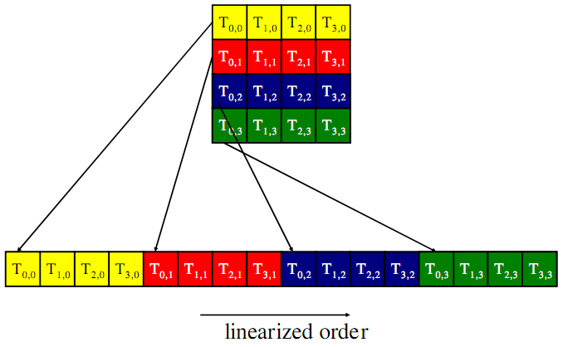
Warp Partitioning
2D Block
Image from http://courses.engr.illinois.edu/ece498/al/textbook/Chapter5-CudaPerformance.pdf

Slide 38
Warp Partitioning
3D Block
  Start with threadIdx.z == 0
  Partition as a 2D block
  Increase threadIdx.z and repeat

Slide 39
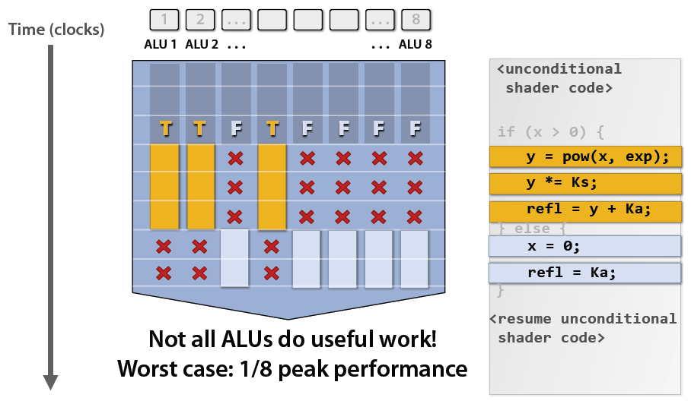
Warp Partitioning
Divergent branches are within a warp!
Image from: http://bps10.idav.ucdavis.edu/talks/03-fatahalian_gpuArchTeraflop_BPS_SIGGRAPH2010.pdf

Slide 40
Warp Partitioning
For warpSize == 32, does any warp have a divergent branch with this code:
if (threadIdx.x > 15)
{
// ...
}
Notes:
Yes, warp 0

Slide 41
Warp Partitioning
For any warpSize, does any warp have a divergent branch with this code:
if (threadIdx.x > warpSize)
{
// ...
}
Notes:
Branch granularity is a whole multiple of warp size; all threads in any given warp follow the same path

Slide 42
Warp Partitioning
Given knowledge of warp partitioning, which parallel reduction is better?
if (t % (2 * stride) == 0)
partialSum[t] +=
partialSum[t + stride];
if (t < stride)
partialSum[t] +=
partialSum[t + stride];
stride = 1, 2, 4, …
stride = 4, 2, 1, …

Slide 43
Warp Partitioning
Pretend warpSize == 2
Warp
0
Warp
1
Warp
2
Warp
3
Warp
0
Warp
1
Warp
2
Warp
3
stride = 1, 2, 4, …
stride = 4, 2, 1, …

Slide 44
Warp Partitioning
1st Pass
Warp
0
Warp
1
Warp
2
Warp
3
Warp
0
Warp
1
Warp
2
Warp
3
4
divergent
branches
0
divergent
branches
stride = 1, 2, 4, …
stride = 4, 2, 1, …

Slide 45
Warp Partitioning
2nd Pass
Warp
0
Warp
1
Warp
2
Warp
3
Warp
0
Warp
1
Warp
2
Warp
3
2
divergent
branches
0
divergent
branches
stride = 1, 2, 4, …
stride = 4, 2, 1, …

Slide 46
Warp Partitioning
2nd Pass
Warp
0
Warp
1
Warp
2
Warp
3
Warp
0
Warp
1
Warp
2
Warp
3
1
divergent
branch
1
divergent
branch
stride = 1, 2, 4, …
stride = 4, 2, 1, …

Slide 47
Warp Partitioning
2nd Pass
Warp
0
Warp
1
Warp
2
Warp
3
Warp
0
Warp
1
Warp
2
Warp
3
1
divergent
branch
1
divergent
branch
stride = 1, 2, 4, …
stride = 4, 2, 1, …
Still diverge when number of elements left is <= warpSize

Slide 48
Warp Partitioning
Good partitioning also allows warps to be retired early.
  Better hardware utilization
if (t % (2 * stride) == 0)
partialSum[t] +=
partialSum[t + stride];
if (t < stride)
partialSum[t] +=
partialSum[t + stride];
stride = 1, 2, 4, …
stride = 4, 2, 1, …

Slide 49
Warp Partitioning
Parallel Reduction
Warp
0
Warp
1
Warp
2
Warp
3
Warp
0
Warp
1
Warp
2
Warp
3
stride = 1, 2, 4, …
stride = 4, 2, 1, …

Slide 50
Warp Partitioning
1st Pass
Warp
0
Warp
1
Warp
2
Warp
3
Warp
0
Warp
1
Warp
2
Warp
3
0
warps
retired
2
warps
retired
stride = 1, 2, 4, …
stride = 4, 2, 1, …

Slide 51
Warp Partitioning
1st Pass
Warp
0
Warp
1
Warp
2
Warp
3
Warp
0
Warp
1
Warp
2
Warp
3
stride = 1, 2, 4, …
stride = 4, 2, 1, …

Slide 52
Warp Partitioning
2nd Pass
Warp
0
Warp
1
Warp
2
Warp
3
Warp
0
Warp
1
Warp
2
Warp
3
2
warps
retired
1
warp
retired
stride = 1, 2, 4, …
stride = 4, 2, 1, …

Slide 53
Warp Partitioning
2nd Pass
Warp
0
Warp
1
Warp
2
Warp
3
Warp
0
Warp
1
Warp
2
Warp
3
stride = 1, 2, 4, …
stride = 4, 2, 1, …

Slide 54
Memory Coalescing
Given a matrix stored row-major in global memory, what is a thread’s desirable access pattern?
M_{0,0}
M_{1,0}
M_{2,0}
M_{3,0}
M_{0,1}
M_{1,1}
M_{2,1}
M_{3,1}
M_{0,2}
M_{1,2}
M_{2,2}
M_{3,2}
M
M_{0,3}
M_{1,3}
M_{2,3}
M_{3,3}
M_{0,0}
M_{1,0}
M_{2,0}
M_{3,0}
M_{0,1}
M_{1,1}
M_{2,1}
M_{3,1}
M_{0,2}
M_{1,2}
M_{2,2}
M_{3,2}
M_{0,3}
M_{1,3}
M_{2,3}
M_{3,3}
Image from: http://bps10.idav.ucdavis.edu/talks/03-fatahalian_gpuArchTeraflop_BPS_SIGGRAPH2010.pdf

Slide 55
Memory Coalescing
Given a matrix stored row-major in global memory, what is a thread’s desirable access pattern?
Thread
0
Thread
1
Md
Nd
Thread 0
H
T
D
I
Thread 1
W
WIDTH
a) column after column?
b) row after row?
Image from: http://courses.engr.illinois.edu/ece498/al/textbook/Chapter5-CudaPerformance.pdf

Slide 56
Memory Coalescing
Given a matrix stored row-major in global memory, what is a thread’s desirable access pattern?
  a) column after column
    Individual threads read increasing, consecutive memory address
  b) row after row
    Adjacent threads read increasing, consecutive memory addresses

Slide 57
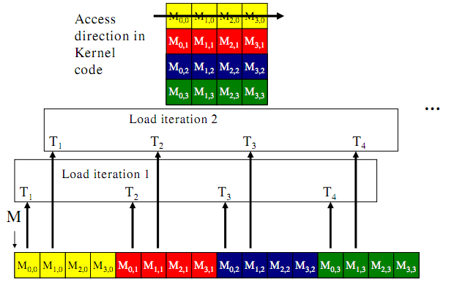
Memory Coalescing
a) column after column
Image from: http://courses.engr.illinois.edu/ece498/al/textbook/Chapter5-CudaPerformance.pdf

Slide 58
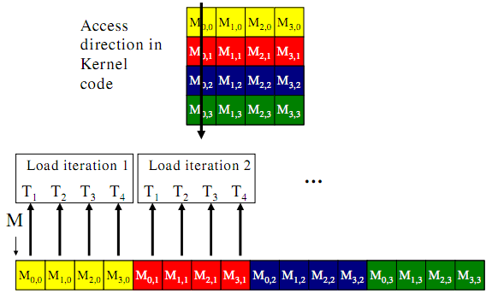
Memory Coalescing
b) row after row
Image from: http://courses.engr.illinois.edu/ece498/al/textbook/Chapter5-CudaPerformance.pdf

Slide 59
Memory Coalescing
Recall warp partitioning; if these threads are in the same warp, global memory addresses are increasing and consecutive across warps.
Image from: http://courses.engr.illinois.edu/ece498/al/textbook/Chapter5-CudaPerformance.pdf

Slide 60
Memory Coalescing
Global memory bandwidth (DRAM)
  G80 – 86.4 GB/s
  GT200 – 150 GB/s
Achieve peak bandwidth by requesting large, consecutive locations from DRAM
  Accessing random location results in much lower bandwidth

Slide 61
Memory Coalescing
Memory coalescing – rearrange access patterns to improve performance
Useful today but will be less useful with large on-chip caches

Slide 62
Memory Coalescing
The GPU coalesce consecutive reads in a half-warp into a single read
Strategy: read global memory in a coalesce-able fashion into shared memory
  Then access shared memory randomly at maximum bandwidth
    Ignoring bank conflicts – next lecture
See Appendix G in the NVIDIA CUDA C Programming Guide for coalescing alignment requirements
Notes:
Because each thread executes the same instruction

Slide 63
SM Resource Partitioning
Recall a SM dynamically partitions resources:
Thread block slots
Thread slots
Registers
Shared memory
SM

Slide 64
SM Resource Partitioning
Recall a SM dynamically partitions resources:
G80 Limits
Thread block slots
8
Thread slots
768
Registers
8K registers / 32K memory
Shared memory
16K
SM

Slide 65
SM Resource Partitioning
We can have
  8 blocks of 96 threads
  4 blocks of 192 threads
  But not 8 blocks of 192 threads
G80 Limits
Thread block slots
8
Thread slots
768
Registers
8K registers / 32K memory
Shared memory
16K
SM

Slide 66
SM Resource Partitioning
We can have (assuming 256 thread blocks)
  768 threads (3 blocks) using 10 registers each
  512 threads (2 blocks) using 11 registers each
G80 Limits
Thread block slots
8
Thread slots
768
Registers
8K registers / 32K memory
Shared memory
16K
SM

Slide 67
SM Resource Partitioning
We can have (assuming 256 thread blocks)
  768 threads (3 blocks) using 10 registers each
  512 threads (2 blocks) using 11 registers each
More registers decreases thread-level parallelism
  Can it ever increase performance?
G80 Limits
Thread block slots
8
Thread slots
768
Registers
8K registers / 32K memory
Shared memory
16K
SM
Notes:
If adding registers can be used to hide global memory access by sticking enough non-dependent multiple/adds between the memory read and its use, it can actually improve performance.

Slide 68
SM Resource Partitioning
Performance Cliff: Increasing resource usage leads to a dramatic reduction in parallelism
  For example, increasing the number of registers, unless doing so hides latency of global memory access

Slide 69
SM Resource Partitioning
CUDA Occupancy Calculator
  http://developer.download.nvidia.com/compute/cuda/CUDA_Occupancy_calculator.xls

Slide 70
Data Prefetching
Independent instructions between a global memory read and its use can hide memory latency
float m = Md[i];
float f = a * b + c * d;
float f2 = m * f;

Slide 71
Data Prefetching
Independent instructions between a global memory read and its use can hide memory latency
float m = Md[i];
float f = a * b + c * d;
float f2 = m * f;
Read global memory

Slide 72
Data Prefetching
Independent instructions between a global memory read and its use can hide memory latency
float m = Md[i];
float f = a * b + c * d;
float f2 = m * f;
Execute instructions that are not dependent on memory read

Slide 73
Data Prefetching
Independent instructions between a global memory read and its use can hide memory latency
float m = Md[i];
float f = a * b + c * d;
float f2 = m * f;
Use global memory after the above line from enough warps hide the memory latency

Slide 74
Data Prefetching
Prefetching data from global memory can effectively increase the number of independent instructions between global memory read and use

Slide 75
Data Prefetching
Recall tiled matrix multiply:
for (/* ... */)
{
// Load current tile into shared memory
__syncthreads();
// Accumulate dot product
__syncthreads();
}

Slide 76
Data Prefetching
Tiled matrix multiply with prefect:
// Load first tile into registers
for (/* ... */)
{
// Deposit registers into shared memory
__syncthreads();
// Load next tile into registers
// Accumulate dot product
__syncthreads();
}

Slide 77
Data Prefetching
Tiled matrix multiply with prefetch:
// Load first tile into registers
for (/* ... */)
{
// Deposit registers into shared memory
__syncthreads();
// Load next tile into registers
// Accumulate dot product
__syncthreads();
}

Slide 78
Data Prefetching
Tiled matrix multiply with prefetch:
// Load first tile into registers
for (/* ... */)
{
// Deposit registers into shared memory
__syncthreads();
// Load next tile into registers
// Accumulate dot product
__syncthreads();
}
Prefetch for next iteration of the loop

Slide 79
Data Prefetching
Tiled matrix multiply with prefetch:
// Load first tile into registers
for (/* ... */)
{
// Deposit registers into shared memory
__syncthreads();
// Load next tile into registers
// Accumulate dot product
__syncthreads();
}
These instructions executed by enough threads will hide the memory latency of the prefetch

