Slide 1
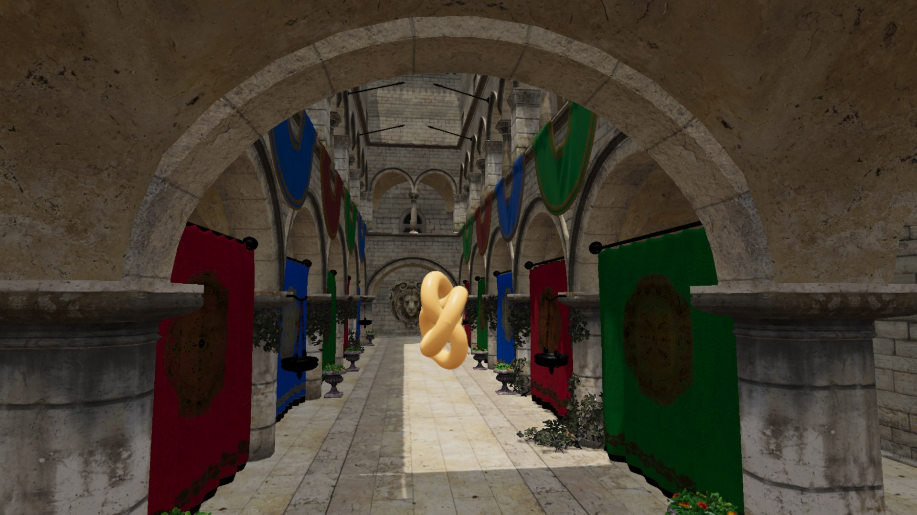
WebFGSR (Frame Generation & Super Resolution)
Milestone 1 · November 11, 2026
Hangyu Zhang, Weike Qian, Yikai Li
CIS 5650 GPU Programming and Architecture, Fall 2026
One frame rendered at 960×540 and reconstructed to 1920×1080
Notes:
About 15 seconds. We are WebFGSR: super resolution and frame generation for the web, built on Mob-FGSR from SIGGRAPH 2024. Milestone 1 was super resolution. The image on the right is already an output: Babylon.js rendered a quarter of these pixels and our WebGPU port reconstructed the rest.

Slide 2
What we are building, and why
Why
Goal
web engines we found that generate frames; DLSS, FSR, XeSS and MetalFX are native-only SDKs
Super resolution and frame generation for the web. Babylon.js renders fewer pixels and fewer frames; our WebGPU compute passes, ported from Mob-FGSR [1], rebuild the rest.
0
2.3 ms
Mob-FGSR’s SR + frame generation on a phone GPU (540p → 1080p), with no neural network
Super resolution · Milestone 1, done
Render a quarter of the pixels; rebuild 1080p from jittered 540p frames.
Frame generation · Milestone 2, next
Render every other frame; generate the one in between.
[1] Mob-FGSR: Frame Generation and Super Resolution for Mobile Real-Time Rendering. SIGGRAPH 2024.
Notes:
About 40 seconds. A quick reminder of what WebFGSR is. PC and console games get DLSS, FSR, XeSS or MetalFX: they render fewer pixels and fewer frames and reconstruct the rest. A web page can't call any of those SDKs, and we found no web engine that generates frames. It matters because cost grows with resolution: in our own Babylon.js Sponza with 1024 lights, 4K takes 3.5 times the GPU time of 1080p, and 120-hertz screens want twice the frames. So we are porting Mob-FGSR, a lightweight method from SIGGRAPH 2024 that runs on phones without a neural network, to WebGPU: super resolution first, frame generation next.

Slide 3
Milestone 1: super resolution is done
Milestone 1 goal (from the pitch) | Status
Babylon.js inputs: jittered 960×540 color, depth and motion vectors | Done
Mob-FGSR super resolution as WGSL compute shaders, running live in Chrome | Done
Reference capture: identical frames every run, 64 samples per pixel | Done
Initial measurements: PSNR / SSIM over 480 frames, GPU time per pass | Done
Pitch
M1 · Super resolution
M2 · Frame generation
M3 · Quality + speed
Final demo
done
Nov 11 · today
Nov 18
Nov 30
Dec 7
Notes:
About 20 seconds. Milestone 1 was super resolution, and it's done. In the pitch we promised four things for today: inputs from Babylon.js, the super-resolution shaders, a reference capture, and first measurements. All four work. Next: how the pipeline works, what we built, and the results.

Slide 4
How temporal super resolution works
Render a quarter of the pixels, shift the camera by a quarter pixel every frame, and merge each new frame into last frame’s full-resolution result.
BABYLON.JS RENDER PASSES
WGSL COMPUTE PASSES (OURS, PORTED FROM MOB-FGSR)
Render
960×540 color, camera shifted ¼ pixel per frame
G-buffer
linear depth and motion vectors
Reproject
follow motion vectors into last frame’s output
Validate
clamp to neighbour colors; drop history on depth mismatch
Blend
mix in this frame’s samples → 1920×1080
history: last frame’s 1920×1080 output
Notes:
About 40 seconds. The idea: render only a quarter of the pixels, but shift the camera by a quarter pixel every frame, so over four frames every full-resolution pixel gets sampled. Babylon renders the small colour image and a G-buffer with depth and motion vectors. Then our WGSL compute passes take over. Reproject: each output pixel follows its motion vector into last frame's result. Validate: if that old colour is outside the range of its new neighbours, or the depth no longer matches, we drop it. Blend: mix in a bit of the new frame. The output becomes next frame's history.

Slide 5
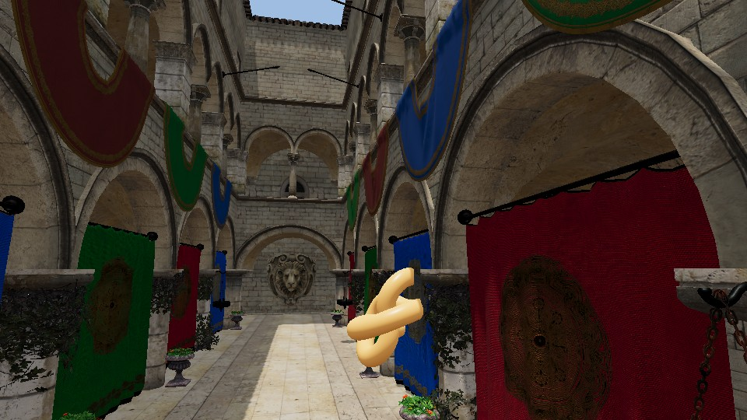
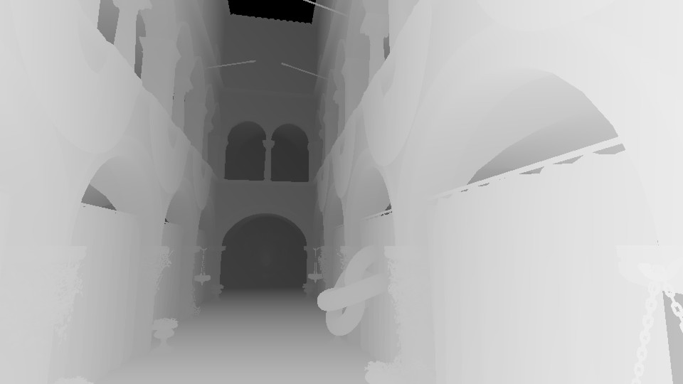


What we built
1
Jittered 540p frames
Frozen camera matrices shift every frame by ¼ pixel, in Mob-FGSR’s 12-step pattern.
Check: flipping the shift costs 3.1 dB.
2
Depth + motion vectors
Our WGSL G-buffer uses un-jittered matrices and covers the moving object and alpha-tested leaves.
(a) Jittered 960×540 color
(b) Linear depth
Check: warping with them cuts reprojection error 5×.
3
SR as compute passes
Mob-FGSR’s dilate and blend-history shaders in WGSL, dispatched with Babylon’s ComputeShader.
Cost: about 0.6 ms of GPU time at 1080p.
4
Capture + metrics
(c) Motion vectors (hue = direction)
(d) Discarded history (red)
Headless Chrome renders identical frames every run, with a 64-sample ground truth.
Check: 61 dB vs a 144-sample reference.
Notes:
About 40 seconds. Concretely, four pieces. One: jittered 540p frames. We freeze Babylon's camera matrices so we control the quarter-pixel shift exactly; flip it on purpose and quality drops by 3 dB, so the convention is right. Two: our own G-buffer pass for depth and motion vectors, including the moving object and the leaves; warping last frame with them cuts the error five times. Three: Mob-FGSR's shaders in WGSL, dispatched through Babylon's ComputeShader. Four: a headless Chrome harness that renders identical frames every run, with a 64-sample ground truth. On the left: colour, depth, motion, and where history gets discarded.

Slide 6
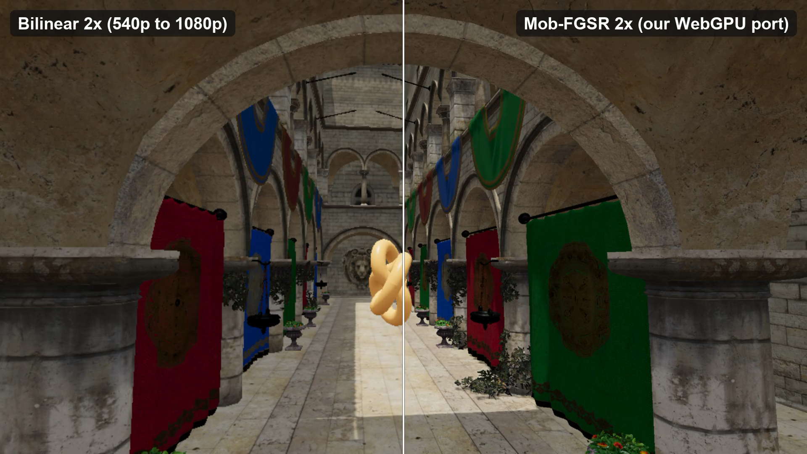
Demo: same 540p input, two upscalers
Left: bilinear upscale of a plain 540p render. Right: our Mob-FGSR port from jittered 540p frames. Watch the chains and curtain edges.
Notes:
About 30 seconds. Same 540p budget on both sides. Left: a plain 540p frame, stretched. Right: our port, jittered and accumulated over time. Watch the chains and the curtain edges: blocky and crawling on the left, smooth on the right. You can run it yourself with npm run dev.

Slide 7
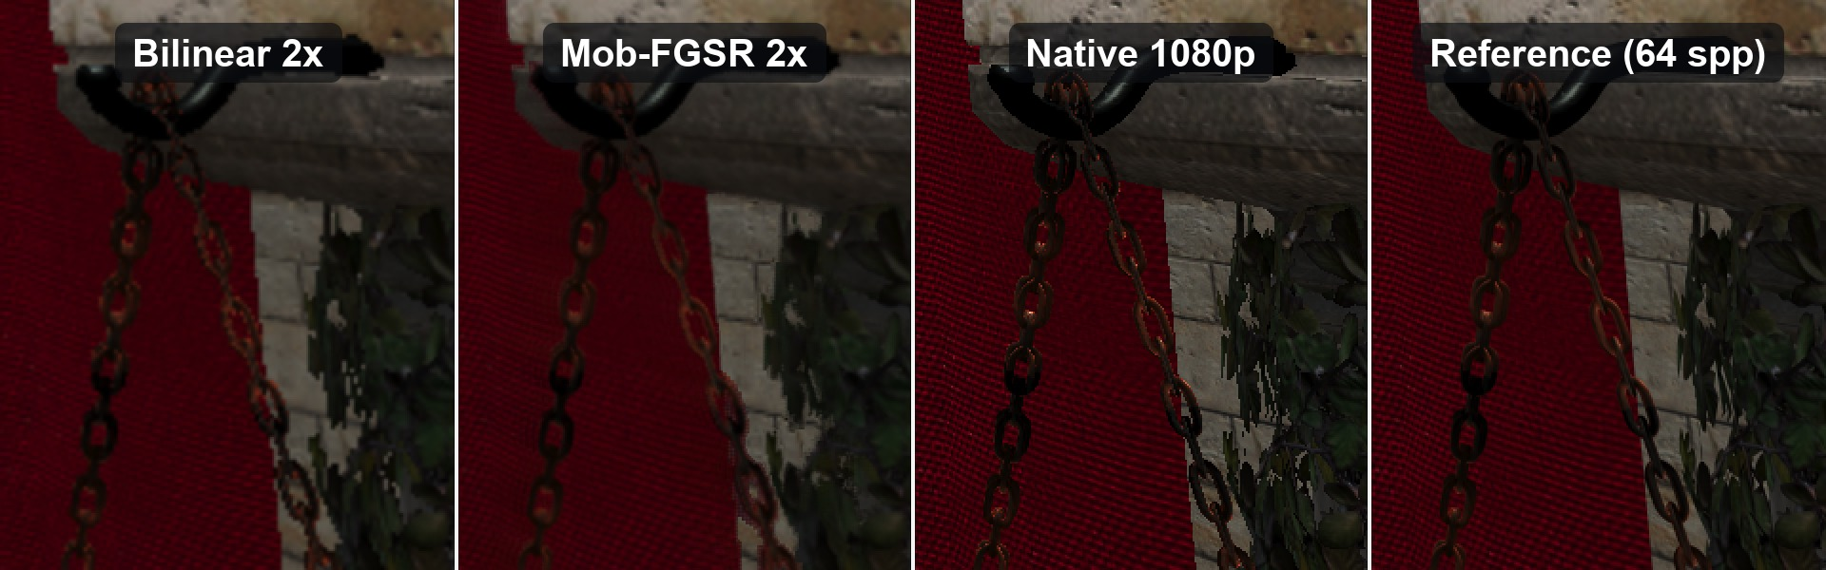
Quality against a 64-sample reference
Frame 150, zoomed: bilinear 2×, Mob-FGSR 2× (ours), native 1080p, 64-sample reference.
Method | PSNR (dB) ↑ | SSIM ↑ | Pixels shaded
Bilinear 2× | 32.9 | 0.882 | 25%
Mob-FGSR 2× (ours) | 34.2 | 0.918 | 25%
Native 1080p | 38.7 | 0.981 | 100%
480 frames (8-second walk at 60 fps) against a 64-sample-per-pixel reference. A texture LOD bias for the 540p pass contributes 0.8 dB.
Notes:
About 35 seconds. A zoom on that chain against a 64-sample ground truth. Bilinear is blocky; ours is smooth and close to the reference; native 1080p has sharper textures but jagged edges. Over all 480 frames we gain 1.3 dB over bilinear, and SSIM goes from 0.88 to 0.92. Native is still ahead, but it shades four times the pixels. Biasing texture sampling toward sharper mip levels in the low-res pass gave 0.8 dB of that.

Slide 8
GPU time per frame
Scene rendering
SR passes (G-buffer, dilate, blend)
2.8×
4K · native
30.0 ms
faster at 4K output: 30.0 → 10.8 ms
4K · ours
10.8 ms
2.3×
faster at 1080p output: 8.7 → 3.7 ms
1080p · native
8.7 ms
1080p · ours
3.7 ms
With only a sun and sky light, native 1080p takes 0.77 ms and ours 1.14 ms: super resolution pays off once shading dominates.
0
10
20
30 ms
GPU time per frame (ms)
Apple M4 Pro, Chrome, WebGPU timestamp queries, 400-frame averages. Sponza with 1024 clustered point lights. “Ours” = half-resolution render + G-buffer + dilate + blend.
Notes:
About 35 seconds. GPU time from timestamp queries, Sponza with 1024 lights. 4K output costs 10.8 ms with super resolution instead of 30, 2.8 times faster, and the SR passes in orange are only 1.7 ms of it. At 1080p it's 3.7 versus 8.7 ms. The caveat: with just a sun and sky light, native is under a millisecond and SR doesn't pay off. It helps when shading is expensive.

Slide 9
Next step: frame generation
Milestone 2 · November 18
Frame N−1
rendered
Midpoint frame
generated
Frame N
rendered
t = N−1
t = N−½
t = N
Generate one frame between every two rendered frames from their motion vectors and depth, so the screen gets twice the frames.
Notes:
About 20 seconds. Our next step is frame generation, due November 18. Between every two rendered frames we generate the midpoint frame from their motion vectors and depth, which doubles the frame rate on screen. Thank you, and we're happy to take questions.

