Slide 1
Introduction
The purpose of the narrative diagram is to provide a high-level overview of each attack path. To that point, each diagram should fit (while maintaining readability) on a single slide.
The Reporting Engine (RE) currently only supports one diagram per narrative - this is intentional. Identify 3-6 key steps to highlight and focus on those within the diagrams.
This process is temporary and will be utilized until a diagram feature is integrated in RE.
See slide #4 for an example of how the diagram should be arranged, including samples of high-level descriptions for each step of the attack path.

Slide 2
Instructions
1. Use the icons in this document to build an attack path diagram on a blank PowerPoint slide. For the purpose of standardization and consistent styling, it is highly recommended to only use the icons in this document. If additional icons are needed, use PowerPoint’s icon library so that the style matches as closely as possible.
2. Do not include a title or any other content on the PowerPoint slide with the diagram. Once the diagram is complete, conduct a thorough review to ensure accuracy. It is recommended to save a copy of the PowerPoint document containing the diagram(s) in case modifications are needed later.
3. Navigate to the slide containing the diagram to be exported and select File > Export.

Slide 3
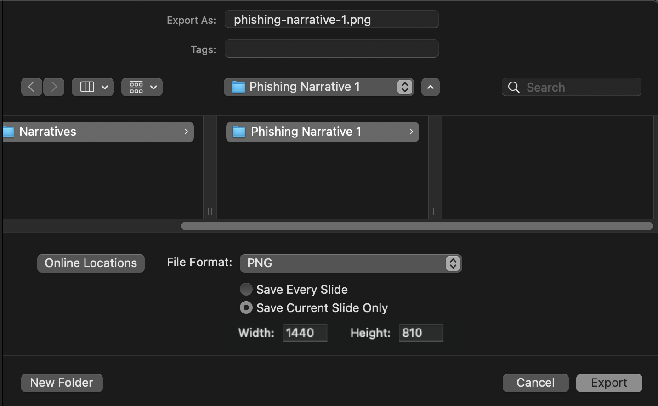
Instructions (cont.)
4. Choose a file location and select PNG from the File Format drop-down. Select the Save Current Slide Only radio button and increase the Width to 1440 (height should auto-adjust), then select the Export button. The image can now be uploaded to the corresponding RE Attack Path screen.

Slide 4




Example
2
The victim user executes the payload linked in the email, giving the adversary control over their workstation
4
With full control over the domain, the adversary can access domain-joined systems, propagate ransomware, exfiltrate sensitive data, and more
1
An adversary sends a phishing email to a low-level user within the organization
3
The adversary identifies and exploits a vulnerable certificate template to obtain Domain Administrator privileges

Slide 5
Icons (Mapping)
#
arrow to link steps
node to number steps

Slide 6




Icons (Endpoints)
phished user workstation
standard workstation
attacker workstation
alternate standard workstation
server(s)
cloud technology
database server

Slide 7






Icons (Objects/Files)
domain
group/users/accounts
user/account
certificate/certificate template
share/folder/files
file/document
phishing/email
code/exploit/malware

Slide 8



Icons (Software/Applications)
application/web application
software/application bug
database software

Slide 9

Icons (Actions)
command execution/shell/exploitation
significant exploitation/domain compromise

Slide 10



Icons (Networking)
wireless technology/weakness
router/wireless device
switch/misc hardware

