Slide 1

IoT Based Smart Irrigation in Arecanut Farms
MCA491P : Major Project
1RV23MC039
HARI KETAN T
Under the Guidance
Of
Internal Guide
Dr. Renuka Prasad B
Associate Professor
Department of MCA
Sponsored By : BSOL
Date : 15-05-2025 Department of MCA, RVCE 1/17

Slide 2
Agenda
Introduction
Literature Survey
Objectives of the Project Work
Proposed Methodology
Training Details
Work Progress
References
2/17

Slide 3
Introduction
Arecanut is a vital commercial crop in India, especially in states like Karnataka, Kerala, and Tamil Nadu, where it supports thousands of small and medium-scale farmers.
Traditional irrigation methods for arecanut farms are mostly manual, leading to water wastage, inconsistent irrigation, and higher labor dependency.
This project aims to build a smart irrigation system that automates and optimizes water usage based on real-time soil and environmental conditions.
The system is designed to promote precision agriculture, improving crop yield while conserving water and reducing human effort.
It uses a rule-based irrigation logic inspired by the Soil Moisture Deficit (SMD) model to determine when and how much to irrigate
3/17

Slide 4
Literature Survey
Sl No | Author (s) & Paper title | Details of Publication | Summary of the Paper
1 | SharathKumar KR, Mohan K, Nirisha, “Arecanut Crop Disease Prediction using IoT and Machine Learning” | Journal of Science; Technology , vol. 5, no. 3, pp. 160–165, May 2020 | This study presents a system that predicts diseases in Arecanut crops by analyzing environmental factors such as temperature, humidity, rainfall, wind flow, and soil moisture using IoT sensors and machine learning algorithms.
2 | Jyothi R, Rachana S, Ranjitha R, Krishna Prasad R, “Smart Irrigation System Based on Iot” | IJAST, vol. 29, no. 3, pp. 5730 - 5737, Mar. 2020. | This paper discusses an automated irrigation system using IoT to manage water efficiently by monitoring soil moisture, light intensity, and temperature.
3 | A. J. Rao, C. Bekal, Y. R. Manoj, R. Rakshitha, N. Poornima, “Automatic Detection of Crop Diseases and Smart Irrigation Using IoT and Image Processing,” | Advances in Communication and Computational Technology, Springer, pp. 343–353, 2021. | This paper combines image processing and IoT to automatically detect plant diseases and control irrigation accordingly. The system supports decision-making for irrigation timing and intensity.
4 | S. Ramya, A. M. Swetha, M. Doraipandian, “IoT Framework for Smart Irrigation Using Machine Learning Technique,” | Journal of Computer Science, vol. 16, no. 3, pp. 355–363, Mar. 2020 | The authors propose an IoT framework enhanced with machine learning for optimized irrigation management. The system uses real-time environmental data and predictions to irrigate Arecanut and similar water-sensitive crops efficiently.
4/17

Slide 5
Literature Survey
Sl No | Author (s) & Paper title | Details of Publication | Summary of the Paper
5 | Raja Muthuramalingam, Reshnuvi Rathnam Velu, Harshini Baskar, Merun Hrithik Vellan Saminathan, “An IoT-Based Smart Irrigation System,” | Engineering Proceedings, vol. 66, no. 1, pp. 13, July 2024. | This study presents an automated irrigation system utilizing an ATMEGA328P microcontroller and hygrometer sensors to monitor soil moisture. The system employs GSM-GPRS for real-time updates, allowing farmers to remotely check and control water supply, enhancing water usage efficiency.
6 | I. Ravi, G. Prabhu, P. S. Shelake, R. Selvarajan, and V. B. . Patel, “IoT enabled soil moisture sensor based irrigation in banana” | Indian Horticulture, vol. 69, no. 6, pp. 17–21, Jan. 2025. | The paper discusses the implementation of IoT-enabled soil moisture sensors for banana cultivation. The system ensures optimal irrigation by monitoring soil moisture levels, which can be adapted for farming to improve water management.
7 | Hema Losini Jayashanker, Nurmiza Othman, “IoT Based Irrigation and Fertigation System for Smart Smallholder Farming Application,” | Emerging Advances in Integrated Technology, vol. 5, no. 1, pp. 16–25, July 2024. | This study presents an IoT-based system integrating irrigation and fertigation for smallholder farms. It monitors soil pH, temperature, and moisture, automating water and nutrient delivery.
5/17

Slide 6
Literature Survey
Sl No | Author (s) & Paper title | Details of Publication | Summary of the Paper
8 | Eddala Chandu, M. K. Shukla, “IoT-Based Smart Irrigation System for Mango Orchard,” | Artificial Intelligence and Machine Learning in Satellite Data Processing and Services, Springer, pp. 61–69, Jan. 2023. | This research presents an IoT-based irrigation system for mango orchards, utilizing weather data and soil moisture sensors to optimize water usage. The methodologies can be adapted for farming to enhance irrigation efficiency.
9 | D. Thakur, Y. Kumar, S. Vijendra, “Smart Irrigation and Intrusions Detection in Agricultural Fields Using IoT,” | Procedia Computer Science, vol. 167, pp. 154–162, 2020. | This study presents an IoT-based system that not only automates irrigation based on soil moisture but also detects intrusions in agricultural fields, enhancing security and resource management for crops.
10 | Manish Vasant Gurao and U. B. Vaidya, “IOT based Smart Irrigation System,” | International Journal of Engineering Research & Technology (IJERT), vol. 11, no. 11, Nov. 2022. | This paper proposes an automated irrigation system that monitors and maintains the desired soil moisture content via automatic watering. It utilizes an Arduino Uno and NodeMCU ESP8266 microcontroller, along with soil moisture sensors and a DHT11 temperature and humidity sensor, to provide real-time monitoring and control of the irrigation process.
6/17

Slide 7
Summary of the literature survey
Most supports the use of IoT to automate irrigation and reduce water waste in crops like Arecanut that need regular and controlled watering.
Almost all surveyed systems use soil moisture sensors to trigger irrigation, validating your sensor-driven approach.
Rule- and threshold-based systems are practical, reliable, and do not require expert calibration.
Use of ESP32 and Raspberry Pi with MQTT follows a successful and widely adopted architecture in smart agriculture.
Automating irrigation helps reduce manual workload and ensures even water distribution both are key to improving Arecanut yield.
7/17

Slide 8
Summary of the literature survey
Sl No | Author (s) & Paper title | Pros | Cons
1 | Arecanut Crop Disease Prediction using IoT and Machine Learning | Directly targets Arecanut crops Uses environmental parameters Adds disease prediction layer | Focus on disease, not irrigation ML adds complexity
2 | Smart Irrigation System Based on IoT | Uses basic IoT hardware Optimizes water usage Simple and adaptable | Generic system No Arecanut-specific insights
3 | Automatic Detection of Crop Diseases and Smart Irrigation Using IoT and Image Processing | Combines disease detection + irrigation Uses real-time decision-making | Image processing requires more power
4 | IoT Framework for Smart Irrigation Using Machine Learning Technique | Uses ML for optimized scheduling Real-time environmental data use | Higher complexity Needs large training data
5 | An IoT-Based Smart Irrigation System | Affordable microcontroller(GSM) Remote monitoring possible | GSM may not work reliably in all areas Limited scalability
8/17

Slide 9
Summary of the literature survey
Sl No | Author (s) & Paper title | Pros | Cons
6 | IoT-enabled Soil Moisture Sensor Based Irrigation in Banana | Crop-specific approach Focus on soil moisture | Designed for banana; Tuning needed for Arecanut No fertigation/prediction
7 | IoT Based Irrigation and Fertigation System for Smallholder Farms | Combines irrigation + nutrients Small-farm focus matches the scope | Additional sensor/hardware cost Complexity increases with fertigation
8 | IoT-Based Smart Irrigation for Mango Orchard | Orchard model suits Arecanut Uses weather + soil data | Mango-specific models Needs weather API integration
9 | Smart Irrigation and Intrusions Detection in Agriculture Using IoT | Adds intrusion detection Improves field security | Security diverts focus from irrigation Extra cost and hardware
10 | IoT based Smart Irrigation System | Uses common modules (NodeMCU, DHT11) Real-time monitoring and control | Basic setup lacks analytics No scheduling or multi-zone control
9/17

Slide 10
Objectives
To develop an IoT-based smart irrigation system
Automate irrigation in arecanut farms using IoT devices to reduce manual work.
Monitor soil moisture and water flow using sensors to ensure proper watering.
Control water flow with a motorized valve based on real-time sensor readings.
Display live data on a web interface to help farmers monitor conditions remotely.
Set irrigation schedules using simple rule-based logic based on crop needs.
10/17

Slide 11
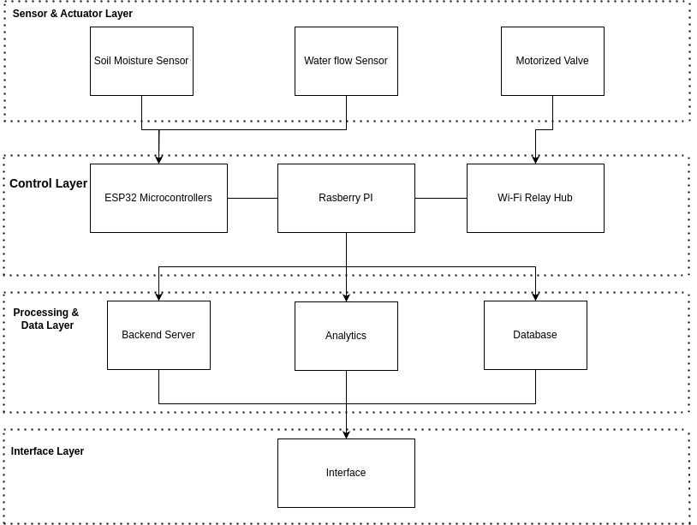
Proposed Methodology
Step 1: Parameter Identification
Step 2: Sensor Integration
Step 3: Microcontroller & Gateway Setup
Step 4: Irrigation Control
Step 5: Backend Development
Step 6: Frontend Interface
Step 7: Analytics & Decision Logic
Block Diagram – IoT-Based Smart Irrigation for Arecanut
11/17

Slide 12
Proposed Methodology
Phase 1
Conduct a literature review of existing smart irrigation systems and identify gaps in arecanut-specific solutions.
Finalize hardware components: ESP32, Capacitive Soil Moisture Sensor, Water Flow Sensor, Raspberry Pi, Motorized Valve, Wi-Fi Relay Hub.
Phase 2
Design and implement PostgreSQL schema for storing sensor logs, irrigation events, and user inputs.
Develop RESTful APIs using Node.js and Express.js to manage sensor data and irrigation control logic.
Use Python to implement irrigation logic based on rule-based thresholds and the Water Requirement Table (factors: soil type, season, plant age).
Phase 3
Program ESP32 for sensor data collection and MQTT publishing.
Configure Raspberry Pi as the gateway for data routing and logic control.
Integrate Wi-Fi Relay Hub for wireless valve control.
Phase 4
Build a responsive frontend using Next.js for live monitoring, historical data display, and manual override.
Visualize trends and irrigation patterns using Python (Pandas, Matplotlib).
Evaluate system efficiency based on water usage, sensor accuracy, and timely irrigation delivery.
Test system performance in a simulated or small-scale farm setup.
12/17

Slide 13
Tools/ Techniques
IoT Devices & Hardware
ESP32 Microcontroller – For sensor data collection, processing, and wireless communication. Capacitive Soil Moisture Sensor – Measures real-time soil moisture levels. Water Flow Sensor – Monitors water flow to track actual irrigation output. Motorized Valve – Controls water supply based on system decisions.
Wi-Fi Relay Hub – Wirelessly switches the motorized valve on/off as instructed by the control system. Raspberry Pi – Acts as a central gateway and processing unit.
Backend Development
Node.js – Handles data processing, API logic, and system control operations. PostgreSQL – Manages structured sensor data and historical records in a reliable database.
Frontend Development
React.js (Next.js) – Builds a responsive, interactive web interface for user monitoring and manual control.
Communication Protocol
MQTT (Mosquitto) – Facilitates lightweight, real-time messaging between IoT devices and the backend.
Data Visusalization
Python (Pandas, Matplotlib) – Used for analyzing trends, generating irrigation insights, and visualizing environmental data.
13/17

Slide 14
Training / Courses Undertaken
1. PostgreSQL (Database Management)
Learning how to design relational databases, write SQL queries, and manage structured data.
Creating Schema design, data normalization, and integration with backend services.
Practicing using PostgreSQL with Node.js for real-time environmental data handling.
2. Node.js (Backend Development)
Understanding asynchronous programming and event-driven architecture for efficient data processing.
Learning to build RESTful APIs, handle MQTT-based sensor data, and manage backend logic.
Practicing with Express.js, middleware, and backend-server integration with PostgreSQL.
3. Next.js (Frontend Development Framework)
Developing React-based development using Next.js for server-side rendering and better performance.
Learning how to build dynamic user interfaces for real-time sensor data visualization and control.
Working with client-server communication, API calls, and deployment-ready web interfaces.
14/17

Slide 15
References
[1] SharathKumar KR, Mohan K, and Nirisha, “Arecanut Crop Disease Prediction using IoT and Machine Learning”, Journal of Science; Technology , vol. 5, no. 3, pp. 160–165, May 2020.
[2] Jyothi R, Rachana S, Ranjitha R, Krishna Prasad R, “Smart Irrigation System Based on Iot”, IJAST, vol. 29, no. 3, pp. 5730 - 5737, Mar. 2020.
[3] A. J. Rao, C. Bekal, Y. R. Manoj, R. Rakshitha, N. Poornima, “Automatic Detection of Crop Diseases and Smart Irrigation Using IoT and Image Processing,” in Advances in Communication and Computational Technology, Springer, pp. 343–353, 2021.
[4] S. Ramya, A. M. Swetha, M. Doraipandian, “IoT Framework for Smart Irrigation Using Machine Learning Technique,” Journal of Computer Science, vol. 16, no. 3, pp. 355–363, Mar. 2020.
[5] Raja Muthuramalingam, Reshnuvi Rathnam Velu, Harshini Baskar, Merun Hrithik Vellan Saminathan, “An IoT-Based Smart Irrigation System,” Engineering Proceedings, vol. 66, no. 1, pp. 13, July 2024.
[6] I. Ravi, G. Prabhu, P. S. Shelake, R. Selvarajan, and V. B. Patel, “IoT enabled soil moisture sensor based irrigation in banana”, Ind. Horticulture, vol. 69, no. 6, pp. 17–21, Jan. 2025
[7] Hema Losini Jayashanker, Nurmiza Othman, “IoT Based Irrigation and Fertigation System for Smart Smallholder Farming Application,” Emerging Advances in Integrated Technology, vol. 5, no. 1, pp. 16–25, July 2024.
[8] Eddala Chandu, M. K. Shukla, “IoT-Based Smart Irrigation System for Mango Orchard,” in Artificial Intelligence and Machine Learning in Satellite Data Processing and Services, Springer, pp. 61–69, Jan. 2023.
[9] D. Thakur, Y. Kumar, S. Vijendra, “Smart Irrigation and Intrusions Detection in Agricultural Fields Using IoT,” Procedia Computer Science, vol. 167, pp. 154–162, 2020.
[10] Manish Vasant Gurao and U. B. Vaidya, “IOT based Smart Irrigation System,” International Journal of Engineering Research & Technology (IJERT), vol. 11, no. 11, Nov. 2022.
15/17

Slide 16
THANK YOU

