Slide 1
Module 10 JSON Persistence
IoT Project Cost Estimator
Notes:
Open the matching Word tutorial after the exercise overview. Source: Module 10 Word tutorial.

Slide 2
What you will build
Save BOM items in a JSON file.
Reload them after restart.
Test storage and view-model decisions.
Notes:
Give students the outcome before they start. Source: Module 10 Word tutorial.

Slide 3
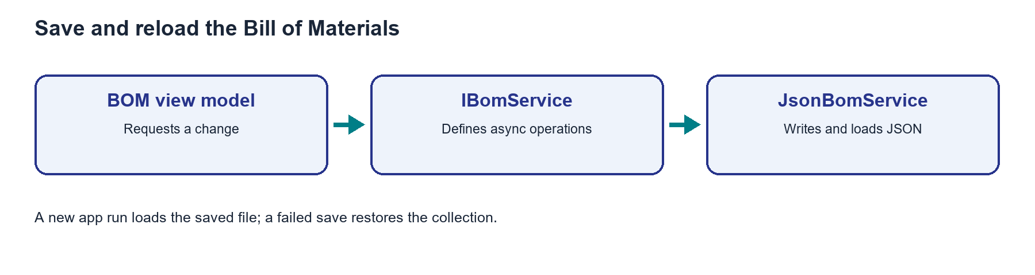
Storage crosses the app process boundary
An in-memory collection ends when the app closes.
A JSON file keeps item values between runs.
Async file methods let the UI await the operation.
Notes:
Explain the framework idea before the first exercise step. MAUI documentation: https://learn.microsoft.com/dotnet/maui/platform-integration/storage/file-system-helpers

Slide 4
From C# to the screen
The service writes in AppDataDirectory.
Load restores items when the BOM page appears.
A failed save must leave the visible list consistent.
Notes:
Ask students to identify the C# object, the XAML control, and the connection between them. Source: Module 10 Word tutorial. MAUI documentation: https://learn.microsoft.com/dotnet/maui/platform-integration/storage/file-system-helpers

Slide 5
Step 1: Async storage
File work can take time.
Task-returning methods keep the UI responsive.
Notes:
Before tutorial Step 1: explain these concepts. Ask students to predict what the change will do. Then open Step 1 in the Word tutorial. Source: Module 10 Word tutorial. Related MAUI documentation: https://learn.microsoft.com/dotnet/maui/platform-integration/storage/file-system-helpers

Slide 6
Step 1: What changed?
All callers await the service.
The app still builds.
Notes:
After tutorial Step 1: run the app or inspect the code. Ask students to explain the observed result. Source: Module 10 Word tutorial.

Slide 7
Step 2: JSON service
JsonBomService writes the item list.
A new service instance loads it.
Notes:
Before tutorial Step 2: explain these concepts. Ask students to predict what the change will do. Then open Step 2 in the Word tutorial. Source: Module 10 Word tutorial. Related MAUI documentation: https://learn.microsoft.com/dotnet/maui/platform-integration/storage/file-system-helpers

Slide 8
Step 2: What changed?
A service instance reloads saved items.
The JSON data has the item values.
Notes:
After tutorial Step 2: run the app or inspect the code. Ask students to explain the observed result. Source: Module 10 Word tutorial.

Slide 9
Step 3: Failed save
A failed write must not leave a false row.
Restore the collection after an error.
Notes:
Before tutorial Step 3: explain these concepts. Ask students to predict what the change will do. Then open Step 3 in the Word tutorial. Source: Module 10 Word tutorial. Related MAUI documentation: https://learn.microsoft.com/dotnet/maui/platform-integration/storage/file-system-helpers

Slide 10
Step 3: What changed?
The visible list matches saved data.
The page shows an error message.
Notes:
After tutorial Step 3: run the app or inspect the code. Ask students to explain the observed result. Source: Module 10 Word tutorial.

Slide 11
Step 4: Page lifecycle
Load when the BOM page appears.
Use FileSystem.AppDataDirectory for the path.
Notes:
Before tutorial Step 4: explain these concepts. Ask students to predict what the change will do. Then open Step 4 in the Word tutorial. Source: Module 10 Word tutorial. Related MAUI documentation: https://learn.microsoft.com/dotnet/maui/platform-integration/storage/file-system-helpers

Slide 12
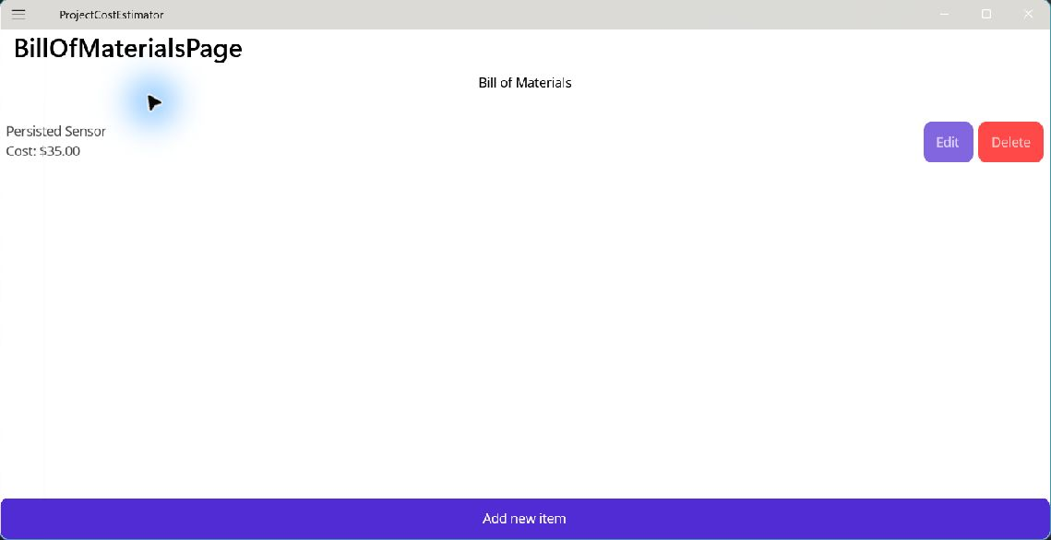
Step 4: What changed?
The saved row appears on return.
An edit survives restart.
Notes:
After tutorial Step 4: run the app or inspect the code. Ask students to explain the observed result. Source: Module 10 Word tutorial.

Slide 13
Step 5: Automated tests
Test storage with a temporary file.
Test decisions with a fake interaction service.
Notes:
Before tutorial Step 5: explain these concepts. Ask students to predict what the change will do. Then open Step 5 in the Word tutorial. Source: Module 10 Word tutorial. Related MAUI documentation: https://learn.microsoft.com/dotnet/maui/platform-integration/storage/file-system-helpers

Slide 14
Step 5: What changed?
Save and reload tests pass.
Cancel and Delete No keep the list.
Notes:
After tutorial Step 5: run the app or inspect the code. Ask students to explain the observed result. Source: Module 10 Word tutorial.

Slide 15
What you can now explain
I can trace a changed item to the JSON file.
I can explain why callers await the service.
I can describe what a failed save does to the list.
Notes:
Use the final tutorial checklist. Ask students to explain the module concept without reading code. Source: Module 10 Word tutorial.

Slide 16
Read more in MAUI documentation
App data and file system
Search Microsoft Learn for this topic.
Try one example in a small test page.
Notes:
Student reading: App data and file system. https://learn.microsoft.com/dotnet/maui/platform-integration/storage/file-system-helpers

