Slide 1
Module 11 MVVM Redo
IoT Project Cost Estimator
Notes:
Open the matching Word tutorial after the exercise overview. Source: Module 11 Word tutorial.

Slide 2
What you will build
Create a new MAUI project.
Build the estimator with MVVM from the start.
Compare your result with the reference.
Notes:
Give students the outcome before they start. Source: Module 11 Word tutorial.

Slide 3
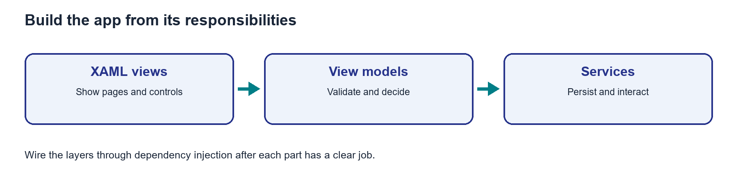
Start with responsibilities, then connect them
The model describes one material item.
View models hold screen state and decisions.
Services provide data and UI operations through interfaces.
Notes:
Explain the framework idea before the first exercise step. MAUI documentation: https://learn.microsoft.com/dotnet/maui/xaml/fundamentals/mvvm

Slide 4
From C# to the screen
Build one working path before adding another.
Register dependencies in MauiProgram.
Bind each page to its view model.
Notes:
Ask students to identify the C# object, the XAML control, and the connection between them. Source: Module 11 Word tutorial. MAUI documentation: https://learn.microsoft.com/dotnet/maui/xaml/fundamentals/mvvm

Slide 5
Step 1: New MAUI project
Create a .NET MAUI App in Visual Studio.
Name it ProjectCostEstimator.
Notes:
Before tutorial Step 1: explain these concepts. Ask students to predict what the change will do. Then open Step 1 in the Word tutorial. Source: Module 11 Word tutorial. Related MAUI documentation: https://learn.microsoft.com/dotnet/maui/xaml/fundamentals/mvvm

Slide 6
Step 1: What changed?
The template app runs on Windows.
Keep the reference closed for now.
Notes:
After tutorial Step 1: run the app or inspect the code. Ask students to explain the observed result. Source: Module 11 Word tutorial.

Slide 7
Step 2: Responsibilities
Views show controls and handle platform UI.
View models own form and list decisions.
Services own storage.
Notes:
Before tutorial Step 2: explain these concepts. Ask students to predict what the change will do. Then open Step 2 in the Word tutorial. Source: Module 11 Word tutorial. Related MAUI documentation: https://learn.microsoft.com/dotnet/maui/xaml/fundamentals/mvvm

Slide 8
Step 2: What changed?
Draw the three layers.
Explain where navigation belongs.
Notes:
After tutorial Step 2: run the app or inspect the code. Ask students to explain the observed result. Source: Module 11 Word tutorial.

Slide 9
Step 3: Model and service
MaterialItem holds item data.
IBomService states storage operations.
Notes:
Before tutorial Step 3: explain these concepts. Ask students to predict what the change will do. Then open Step 3 in the Word tutorial. Source: Module 11 Word tutorial. Related MAUI documentation: https://learn.microsoft.com/dotnet/maui/xaml/fundamentals/mvvm

Slide 10
Step 3: What changed?
A sample item has the right total.
The in-memory service changes the list.
Notes:
After tutorial Step 3: run the app or inspect the code. Ask students to explain the observed result. Source: Module 11 Word tutorial.

Slide 11
Step 5: Editor view model
Generated properties hold form state.
Validation controls Submit.
Notes:
Before tutorial Step 5: explain these concepts. Ask students to predict what the change will do. Then open Step 5 in the Word tutorial. Source: Module 11 Word tutorial. Related MAUI documentation: https://learn.microsoft.com/dotnet/maui/xaml/fundamentals/mvvm

Slide 12
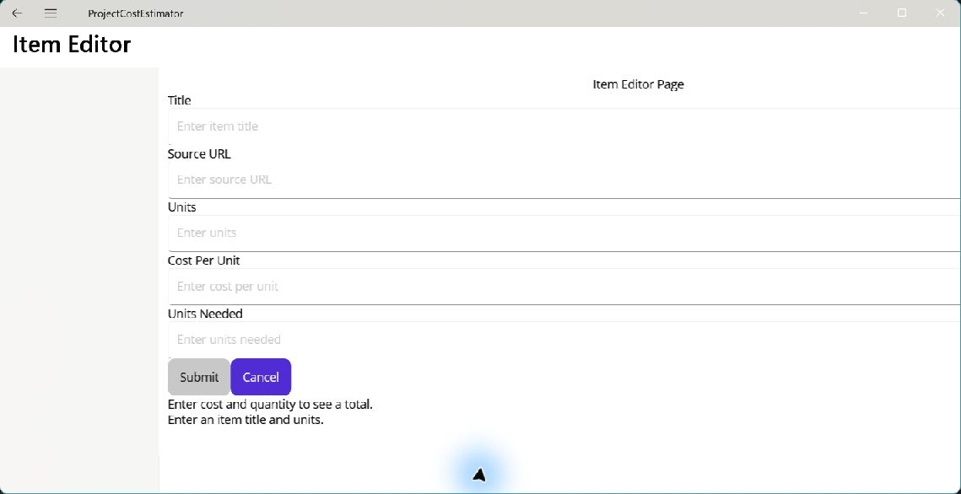
Step 5: What changed?
The page binds to the view model.
Valid values enable Submit.
Notes:
After tutorial Step 5: run the app or inspect the code. Ask students to explain the observed result. Source: Module 11 Word tutorial.

Slide 13
Step 7: BOM view model
Commands own Add, Edit, and Delete decisions.
An interface supplies UI results.
Notes:
Before tutorial Step 7: explain these concepts. Ask students to predict what the change will do. Then open Step 7 in the Word tutorial. Source: Module 11 Word tutorial. Related MAUI documentation: https://learn.microsoft.com/dotnet/maui/xaml/fundamentals/mvvm

Slide 14
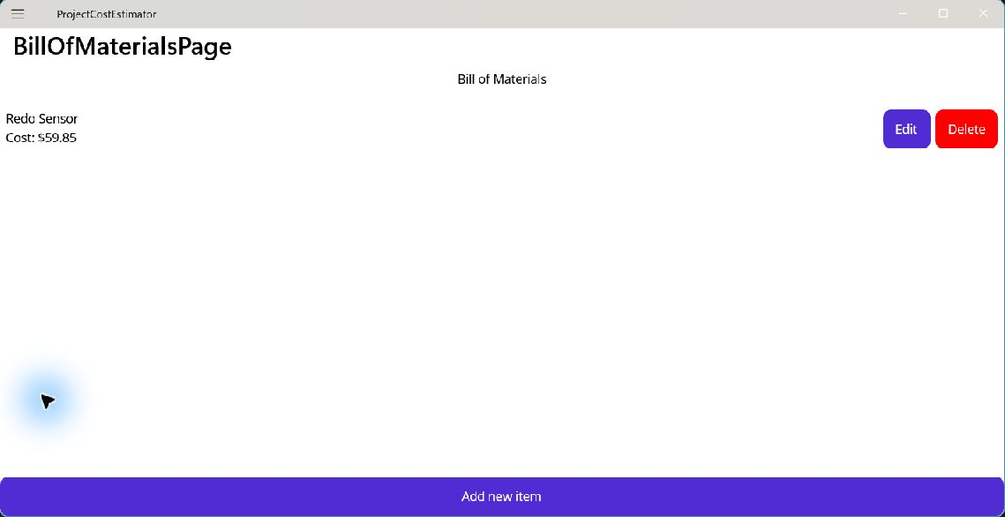
Step 7: What changed?
The BOM shows the changed rows.
Cancel keeps the original row.
Notes:
After tutorial Step 7: run the app or inspect the code. Ask students to explain the observed result. Source: Module 11 Word tutorial.

Slide 15
Step 9: App composition
Register services, view models, and pages.
Shell opens the app destinations.
Notes:
Before tutorial Step 9: explain these concepts. Ask students to predict what the change will do. Then open Step 9 in the Word tutorial. Source: Module 11 Word tutorial. Related MAUI documentation: https://learn.microsoft.com/dotnet/maui/xaml/fundamentals/mvvm

Slide 16
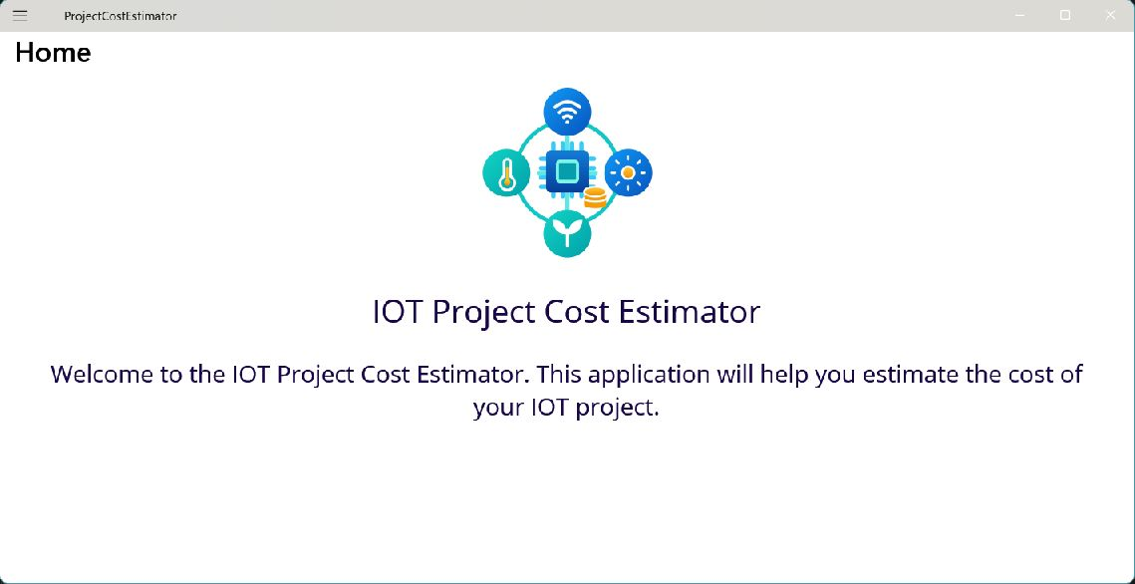
Step 9: What changed?
Home, BOM, and Help open.
The editor opens for Add and Edit.
Notes:
After tutorial Step 9: run the app or inspect the code. Ask students to explain the observed result. Source: Module 11 Word tutorial.

Slide 17
Step 10: JSON persistence
Swap in JsonBomService.
Load items when the BOM page appears.
Notes:
Before tutorial Step 10: explain these concepts. Ask students to predict what the change will do. Then open Step 10 in the Word tutorial. Source: Module 11 Word tutorial. Related MAUI documentation: https://learn.microsoft.com/dotnet/maui/xaml/fundamentals/mvvm

Slide 18
Step 10: What changed?
Items survive restart.
The same BOM workflow still works.
Notes:
After tutorial Step 10: run the app or inspect the code. Ask students to explain the observed result. Source: Module 11 Word tutorial.

Slide 19
Step 11: Test the redo
Test save and reload.
Test decisions with a fake UI service.
Notes:
Before tutorial Step 11: explain these concepts. Ask students to predict what the change will do. Then open Step 11 in the Word tutorial. Source: Module 11 Word tutorial. Related MAUI documentation: https://learn.microsoft.com/dotnet/maui/xaml/fundamentals/mvvm

Slide 20
Step 11: What changed?
Automated tests pass.
Add, Edit, Cancel, and Delete work.
Notes:
After tutorial Step 11: run the app or inspect the code. Ask students to explain the observed result. Source: Module 11 Word tutorial.

Slide 21
What you can now explain
I can build the estimator from a new MAUI project.
I can trace one action through view, view model, and service.
I can test decisions and saved data separately.
Notes:
Use the final tutorial checklist. Ask students to explain the module concept without reading code. Source: Module 11 Word tutorial.

Slide 22
Read more in MAUI documentation
Data binding and MVVM
Search Microsoft Learn for this topic.
Try one example in a small test page.
Notes:
Student reading: Data binding and MVVM. https://learn.microsoft.com/dotnet/maui/xaml/fundamentals/mvvm

