Slide 1
Module 2 Bill of Materials
IoT Project Cost Estimator
Notes:
Open the matching Word tutorial after the exercise overview. Source: Module 2 Word tutorial.

Slide 2
What you will build
Return items from the editor.
Add, edit, and delete BOM rows.
Add Help and Shell destinations.
Notes:
Give students the outcome before they start. Source: Module 2 Word tutorial.

Slide 3
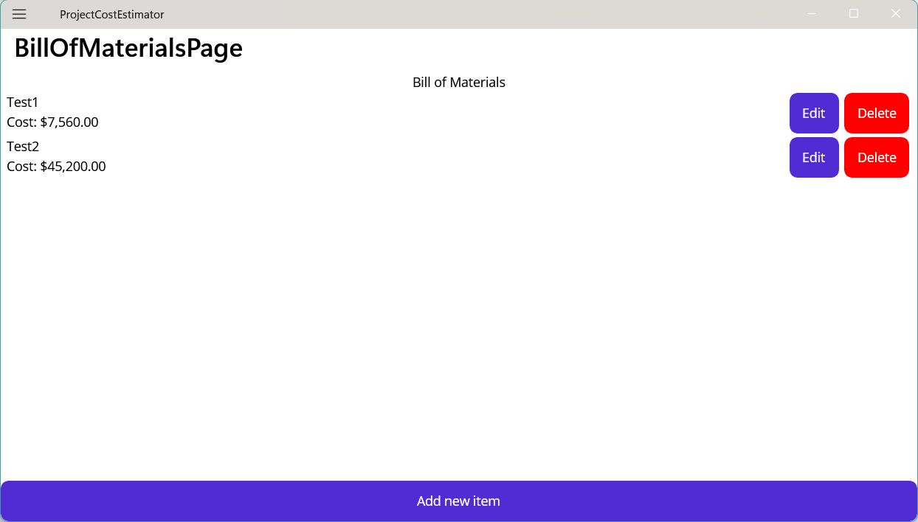
One template, many item rows
CollectionView repeats one DataTemplate for each item.
Inside a row, bindings read that row’s MaterialItem.
The page controls when the list changes.
Notes:
Explain the framework idea before the first exercise step. MAUI documentation: https://learn.microsoft.com/dotnet/maui/user-interface/controls/collectionview/populate-data

Slide 4
From C# to the screen
Add, Edit, and Delete change C# list data.
This module tells the view to refresh after a change.
Later modules make that update automatic.
Notes:
Ask students to identify the C# object, the XAML control, and the connection between them. Source: Module 2 Word tutorial. MAUI documentation: https://learn.microsoft.com/dotnet/maui/user-interface/controls/collectionview/populate-data

Slide 5
Step 2: Return an item
The editor returns a MaterialItem.
Cancel returns without a new item.
Notes:
Before tutorial Step 2: explain these concepts. Ask students to predict what the change will do. Then open Step 2 in the Word tutorial. Source: Module 2 Word tutorial. Related MAUI documentation: https://learn.microsoft.com/dotnet/maui/user-interface/controls/collectionview/populate-data

Slide 6
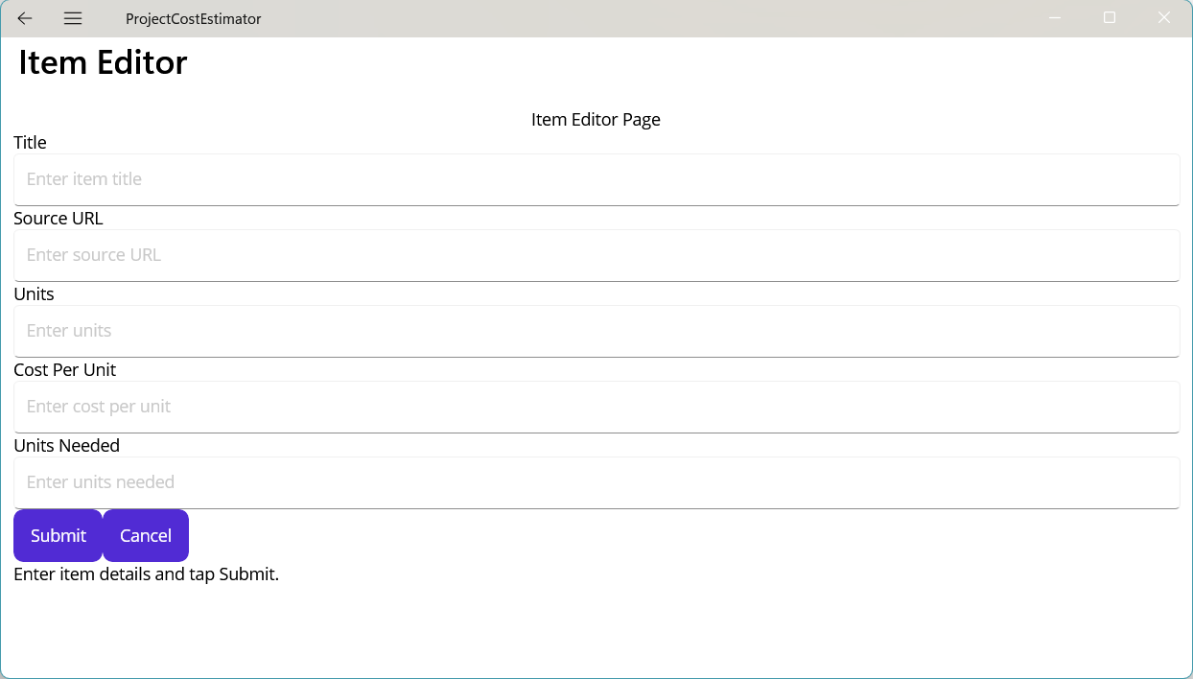
Step 2: What changed?
The page can hold a submitted item.
A new editor starts with empty fields.
Notes:
After tutorial Step 2: run the app or inspect the code. Ask students to explain the observed result. Source: Module 2 Word tutorial.

Slide 7
Step 6: CollectionView rows
CollectionView repeats a row template.
BindingContext supplies each row item.
Notes:
Before tutorial Step 6: explain these concepts. Ask students to predict what the change will do. Then open Step 6 in the Word tutorial. Source: Module 2 Word tutorial. Related MAUI documentation: https://learn.microsoft.com/dotnet/maui/user-interface/controls/collectionview/populate-data

Slide 8
Step 6: What changed?
The BOM shows each sample item.
Each row shows its calculated cost.
Notes:
After tutorial Step 6: run the app or inspect the code. Ask students to explain the observed result. Source: Module 2 Word tutorial.

Slide 9
Step 7: Add and refresh
Add changes the list in memory.
This module refreshes ItemsSource by hand.
Notes:
Before tutorial Step 7: explain these concepts. Ask students to predict what the change will do. Then open Step 7 in the Word tutorial. Source: Module 2 Word tutorial. Related MAUI documentation: https://learn.microsoft.com/dotnet/maui/user-interface/controls/collectionview/populate-data

Slide 10
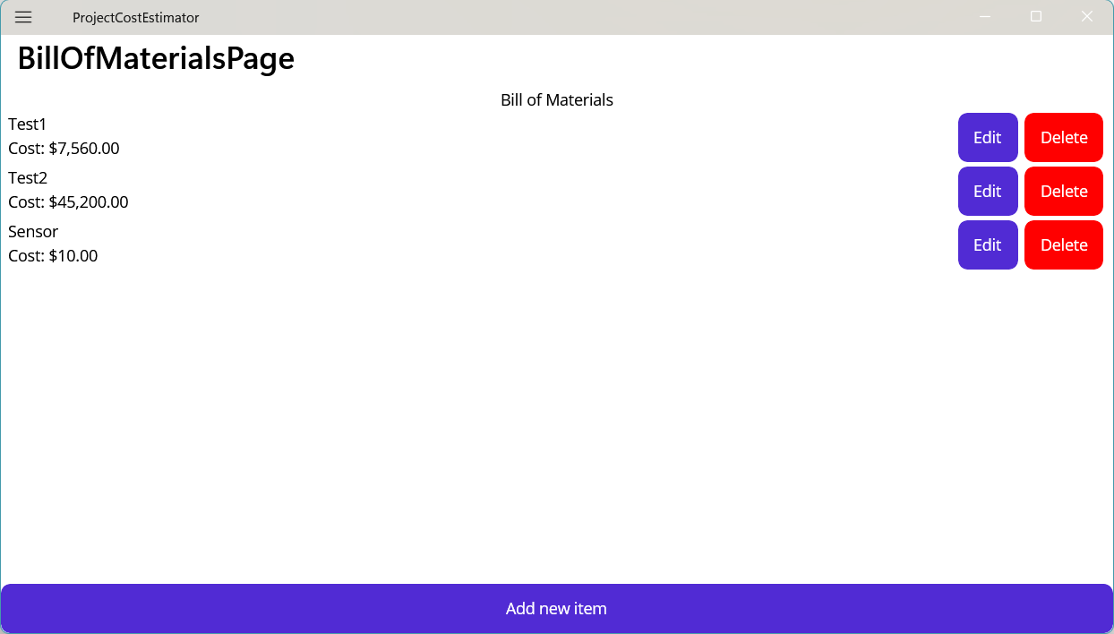
Step 7: What changed?
The new row appears once.
Its total matches the editor result.
Notes:
After tutorial Step 7: run the app or inspect the code. Ask students to explain the observed result. Source: Module 2 Word tutorial.

Slide 11
Step 8: Edit an existing row
Pass the selected item to the editor.
Replace the original only after Submit.
Notes:
Before tutorial Step 8: explain these concepts. Ask students to predict what the change will do. Then open Step 8 in the Word tutorial. Source: Module 2 Word tutorial. Related MAUI documentation: https://learn.microsoft.com/dotnet/maui/user-interface/controls/collectionview/populate-data

Slide 12
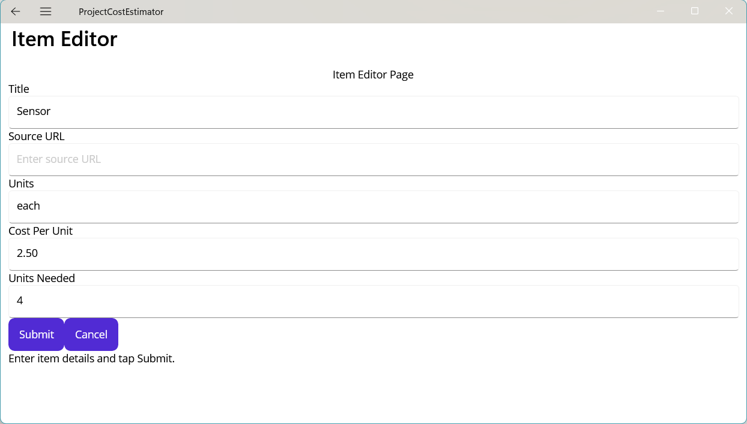
Step 8: What changed?
Edit starts with the row values.
Submit changes the existing row.
Notes:
After tutorial Step 8: run the app or inspect the code. Ask students to explain the observed result. Source: Module 2 Word tutorial.

Slide 13
Step 9: Confirm deletion
Ask before you remove a row.
No keeps the list as it is.
Notes:
Before tutorial Step 9: explain these concepts. Ask students to predict what the change will do. Then open Step 9 in the Word tutorial. Source: Module 2 Word tutorial. Related MAUI documentation: https://learn.microsoft.com/dotnet/maui/user-interface/controls/collectionview/populate-data

Slide 14
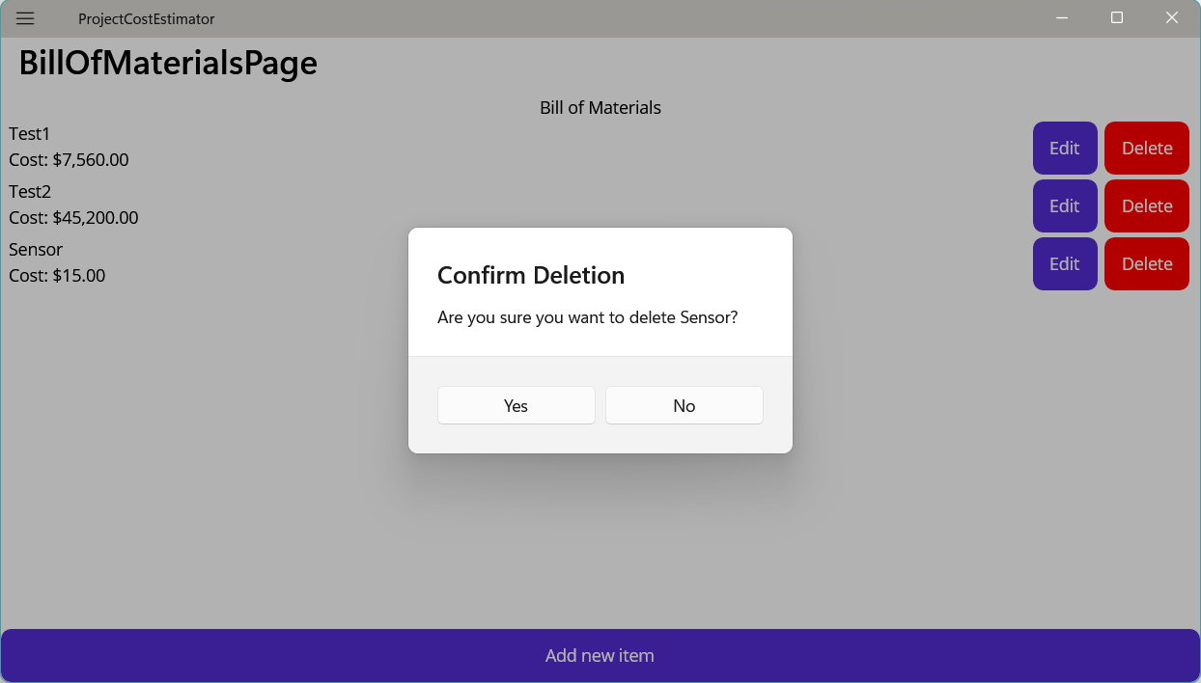
Step 9: What changed?
Yes removes the selected row.
No keeps the selected row.
Notes:
After tutorial Step 9: run the app or inspect the code. Ask students to explain the observed result. Source: Module 2 Word tutorial.

Slide 15
Step 11: Shell destinations
Home, BOM, and Help are top-level pages.
The editor is a temporary page.
Notes:
Before tutorial Step 11: explain these concepts. Ask students to predict what the change will do. Then open Step 11 in the Word tutorial. Source: Module 2 Word tutorial. Related MAUI documentation: https://learn.microsoft.com/dotnet/maui/user-interface/controls/collectionview/populate-data

Slide 16
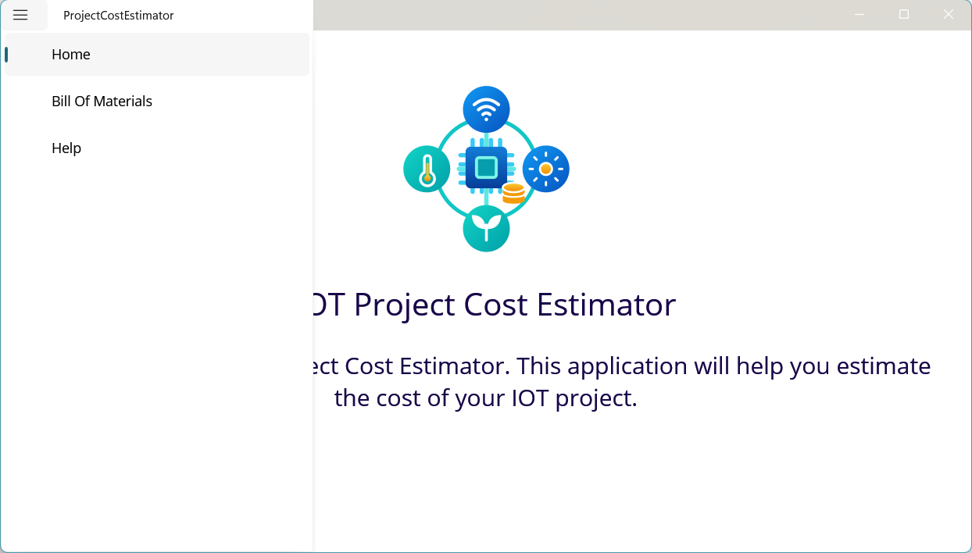
Step 11: What changed?
The Shell menu opens each page.
Back returns from the editor.
Notes:
After tutorial Step 11: run the app or inspect the code. Ask students to explain the observed result. Source: Module 2 Word tutorial.

Slide 17
What you can now explain
I can explain what an ItemsSource contains.
I can trace Add, Edit, and Delete for one row.
I can distinguish a page destination from the editor route.
Notes:
Use the final tutorial checklist. Ask students to explain the module concept without reading code. Source: Module 2 Word tutorial.

Slide 18
Read more in MAUI documentation
CollectionView data
Search Microsoft Learn for this topic.
Try one example in a small test page.
Notes:
Student reading: CollectionView data. https://learn.microsoft.com/dotnet/maui/user-interface/controls/collectionview/populate-data

