Slide 1
Module 5 BOM View Model
IoT Project Cost Estimator
Notes:
Open the matching Word tutorial after the exercise overview. Source: Module 5 Word tutorial.

Slide 2
What you will build
Move list actions into a view model.
Pass the selected row to Edit and Delete.
Keep the current manual refresh.
Notes:
Give students the outcome before they start. Source: Module 5 Word tutorial.

Slide 3
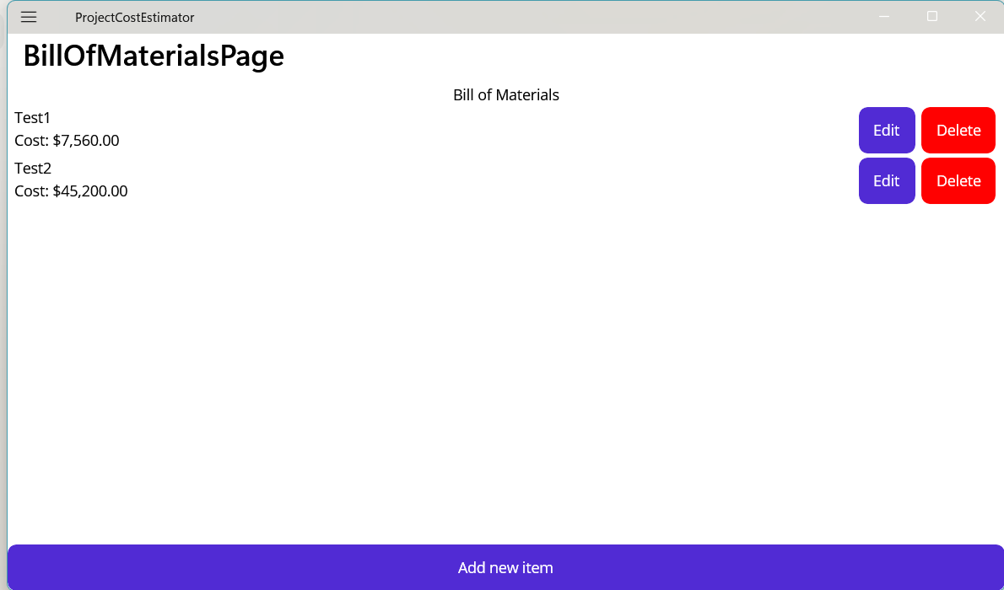
Each row has two useful contexts
The page BindingContext is the BOM view model.
A row template BindingContext is its MaterialItem.
A row button needs both its row item and a page command.
Notes:
Explain the framework idea before the first exercise step. MAUI documentation: https://learn.microsoft.com/dotnet/maui/fundamentals/data-binding/basic-bindings

Slide 4
From C# to the screen
CommandParameter carries the selected MaterialItem.
The command handles the list decision.
The page provides the editor and confirmation UI.
Notes:
Ask students to identify the C# object, the XAML control, and the connection between them. Source: Module 5 Word tutorial. MAUI documentation: https://learn.microsoft.com/dotnet/maui/fundamentals/data-binding/basic-bindings

Slide 5
Step 1: List ownership
The BOM view model owns the item list.
The page binds to its Items property.
Notes:
Before tutorial Step 1: explain these concepts. Ask students to predict what the change will do. Then open Step 1 in the Word tutorial. Source: Module 5 Word tutorial. Related MAUI documentation: https://learn.microsoft.com/dotnet/maui/fundamentals/data-binding/basic-bindings

Slide 6
Step 1: What changed?
The same rows still appear.
The page no longer stores the list.
Notes:
After tutorial Step 1: run the app or inspect the code. Ask students to explain the observed result. Source: Module 5 Word tutorial.

Slide 7
Step 2: Add command
The Add button binds to a command.
The view model requests the editor.
Notes:
Before tutorial Step 2: explain these concepts. Ask students to predict what the change will do. Then open Step 2 in the Word tutorial. Source: Module 5 Word tutorial. Related MAUI documentation: https://learn.microsoft.com/dotnet/maui/fundamentals/data-binding/basic-bindings

Slide 8
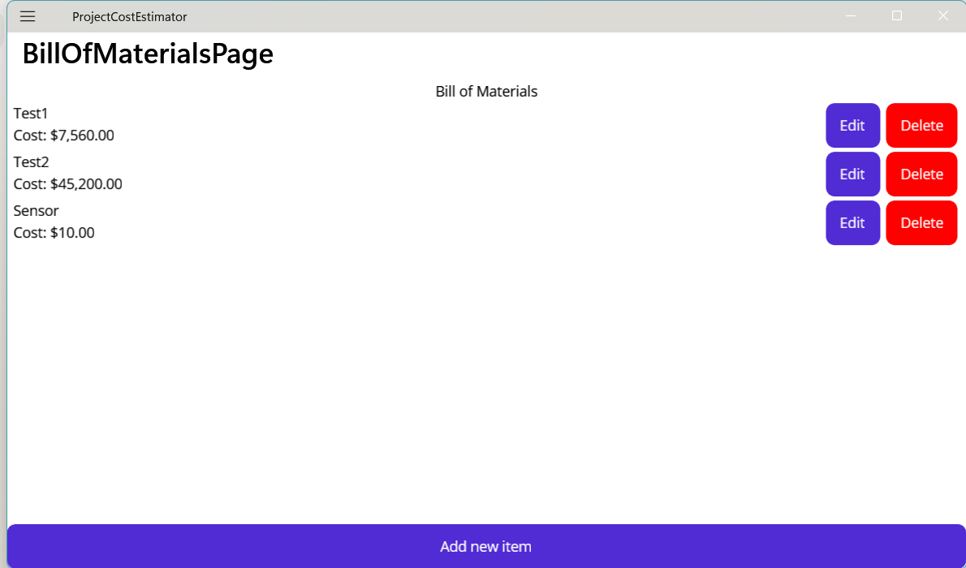
Step 2: What changed?
Add opens a blank editor.
Submit adds the returned item.
Notes:
After tutorial Step 2: run the app or inspect the code. Ask students to explain the observed result. Source: Module 5 Word tutorial.

Slide 9
Step 4: CommandParameter
Each row has its own MaterialItem.
CommandParameter passes that item to Edit.
Notes:
Before tutorial Step 4: explain these concepts. Ask students to predict what the change will do. Then open Step 4 in the Word tutorial. Source: Module 5 Word tutorial. Related MAUI documentation: https://learn.microsoft.com/dotnet/maui/fundamentals/data-binding/basic-bindings

Slide 10
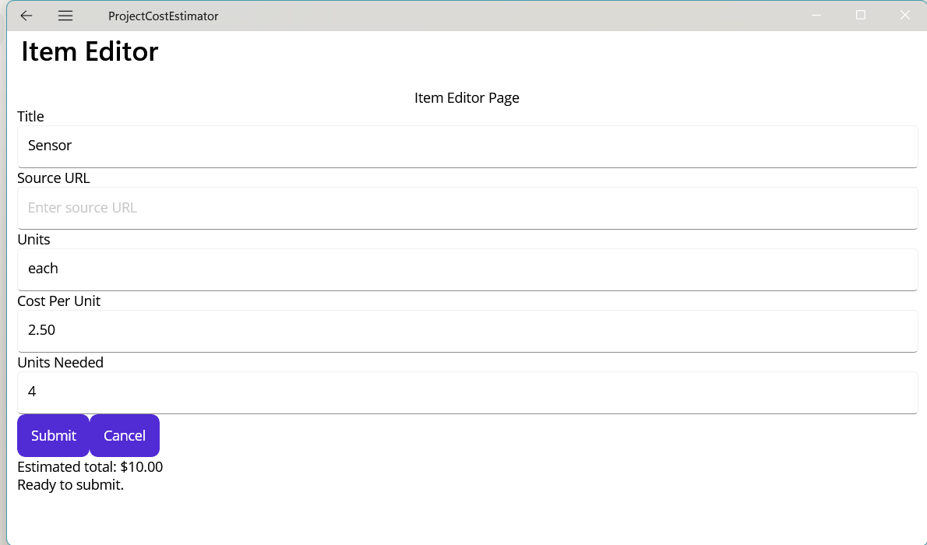
Step 4: What changed?
Edit opens the selected row.
Its values appear in the form.
Notes:
After tutorial Step 4: run the app or inspect the code. Ask students to explain the observed result. Source: Module 5 Word tutorial.

Slide 11
Step 5: Delete command
Delete also receives the row item.
The page still asks for confirmation.
Notes:
Before tutorial Step 5: explain these concepts. Ask students to predict what the change will do. Then open Step 5 in the Word tutorial. Source: Module 5 Word tutorial. Related MAUI documentation: https://learn.microsoft.com/dotnet/maui/fundamentals/data-binding/basic-bindings

Slide 12
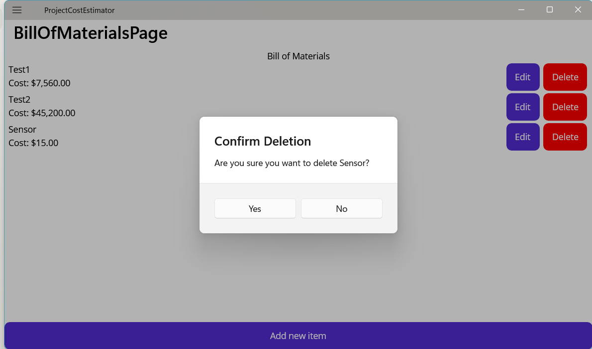
Step 5: What changed?
No keeps the row.
Yes removes the selected row.
Notes:
After tutorial Step 5: run the app or inspect the code. Ask students to explain the observed result. Source: Module 5 Word tutorial.

Slide 13
What you can now explain
I can identify the BindingContext inside a row.
I can trace one Edit command parameter.
I can explain why list refresh is still manual.
Notes:
Use the final tutorial checklist. Ask students to explain the module concept without reading code. Source: Module 5 Word tutorial.

Slide 14
Read more in MAUI documentation
Binding context and CollectionView
Search Microsoft Learn for this topic.
Try one example in a small test page.
Notes:
Student reading: Binding context and CollectionView. https://learn.microsoft.com/dotnet/maui/fundamentals/data-binding/basic-bindings

