Slide 1
Module 6 ObservableCollection
IoT Project Cost Estimator
Notes:
Open the matching Word tutorial after the exercise overview. Source: Module 6 Word tutorial.

Slide 2
What you will build
Replace manual list refresh.
Let the collection report changes.
Check Add, Edit, and Delete.
Notes:
Give students the outcome before they start. Source: Module 6 Word tutorial.

Slide 3
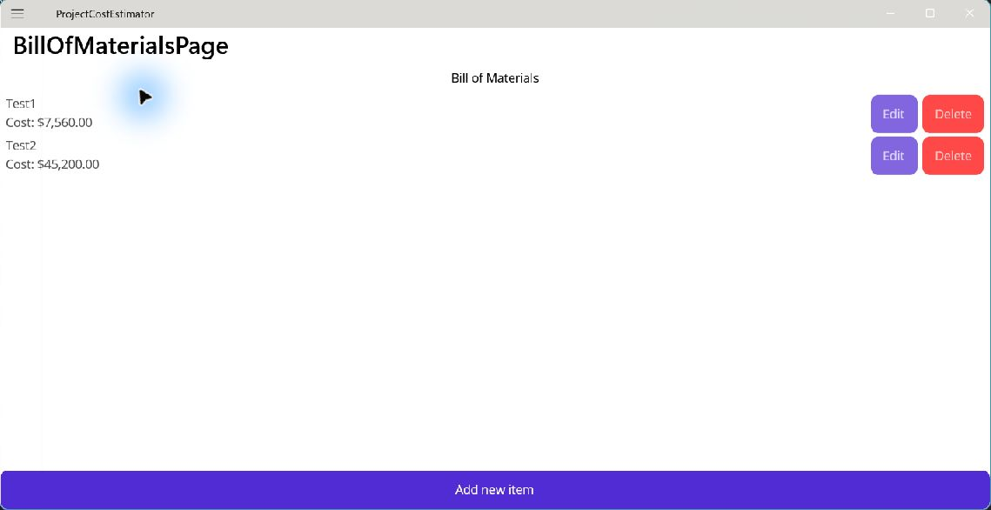
The collection tells the view what changed
List<T> stores items but sends no change event.
ObservableCollection<T> reports Add and Remove.
CollectionView uses those reports to update rows.
Notes:
Explain the framework idea before the first exercise step. MAUI documentation: https://learn.microsoft.com/dotnet/maui/user-interface/controls/collectionview/populate-data

Slide 4
From C# to the screen
A collection change differs from a property change.
Replacing an item reports a row change.
An item’s own properties need their own notifications.
Notes:
Ask students to identify the C# object, the XAML control, and the connection between them. Source: Module 6 Word tutorial. MAUI documentation: https://learn.microsoft.com/dotnet/maui/user-interface/controls/collectionview/populate-data

Slide 5
Step 1: Manual refresh
List changes do not refresh this List by themselves.
The page resets ItemsSource after each change.
Notes:
Before tutorial Step 1: explain these concepts. Ask students to predict what the change will do. Then open Step 1 in the Word tutorial. Source: Module 6 Word tutorial. Related MAUI documentation: https://learn.microsoft.com/dotnet/maui/user-interface/controls/collectionview/populate-data

Slide 6
Step 1: What changed?
Find each manual refresh call.
Explain why the page needs it.
Notes:
After tutorial Step 1: run the app or inspect the code. Ask students to explain the observed result. Source: Module 6 Word tutorial.

Slide 7
Step 2: Collection changes
ObservableCollection reports Add, Replace, and Remove.
CollectionView listens to these reports.
Notes:
Before tutorial Step 2: explain these concepts. Ask students to predict what the change will do. Then open Step 2 in the Word tutorial. Source: Module 6 Word tutorial. Related MAUI documentation: https://learn.microsoft.com/dotnet/maui/user-interface/controls/collectionview/populate-data

Slide 8
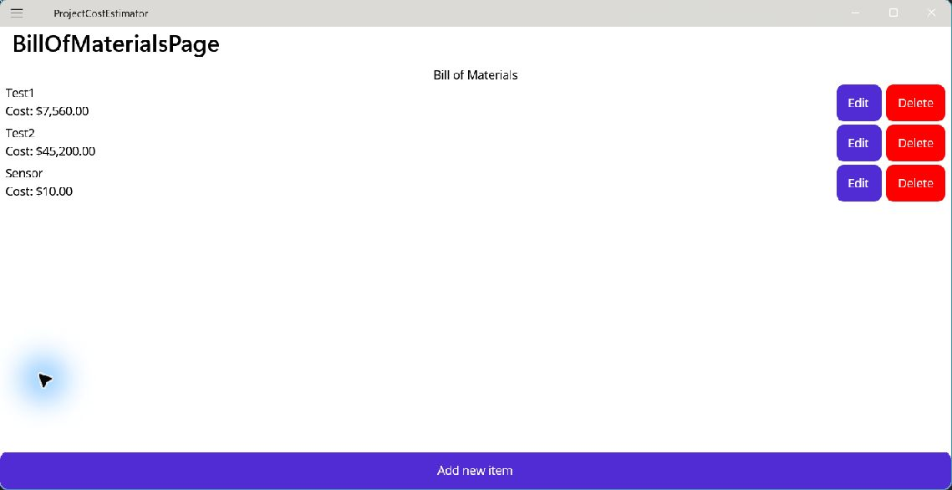
Step 2: What changed?
A new row appears without a reset.
The page still binds to Items.
Notes:
After tutorial Step 2: run the app or inspect the code. Ask students to explain the observed result. Source: Module 6 Word tutorial.

Slide 9
Step 3: Remove the bridge
The collection now reports list changes.
The old page refresh code has no job.
Notes:
Before tutorial Step 3: explain these concepts. Ask students to predict what the change will do. Then open Step 3 in the Word tutorial. Source: Module 6 Word tutorial. Related MAUI documentation: https://learn.microsoft.com/dotnet/maui/user-interface/controls/collectionview/populate-data

Slide 10
Step 3: What changed?
Remove the reset calls.
Add still updates the screen.
Notes:
After tutorial Step 3: run the app or inspect the code. Ask students to explain the observed result. Source: Module 6 Word tutorial.

Slide 11
Step 5: Replace and remove
Edit replaces one item in the collection.
Delete removes one item.
Notes:
Before tutorial Step 5: explain these concepts. Ask students to predict what the change will do. Then open Step 5 in the Word tutorial. Source: Module 6 Word tutorial. Related MAUI documentation: https://learn.microsoft.com/dotnet/maui/user-interface/controls/collectionview/populate-data

Slide 12

Step 5: What changed?
Edit changes one row.
Delete removes one row without a reset.
Notes:
After tutorial Step 5: run the app or inspect the code. Ask students to explain the observed result. Source: Module 6 Word tutorial.

Slide 13
What you can now explain
I can explain why ItemsSource resets were needed.
I can name the changes ObservableCollection reports.
I can check Add, Replace, and Remove on screen.
Notes:
Use the final tutorial checklist. Ask students to explain the module concept without reading code. Source: Module 6 Word tutorial.

Slide 14
Read more in MAUI documentation
CollectionView data updates
Search Microsoft Learn for this topic.
Try one example in a small test page.
Notes:
Student reading: CollectionView data updates. https://learn.microsoft.com/dotnet/maui/user-interface/controls/collectionview/populate-data

